Slide 1
Bluefin tuna larvae in the Gulf of Mexico: an overview of available oceanographic conditions during the past 20 years
Ricardo Domingues
Collaborators: Gustavo Goni, Francis Bringas, John Walter, Barbara Muhling, and David Lindo
Ricardo.Domingues@noaa.gov
AOML-SEFSC discussions, June 24, 2016

Slide 2
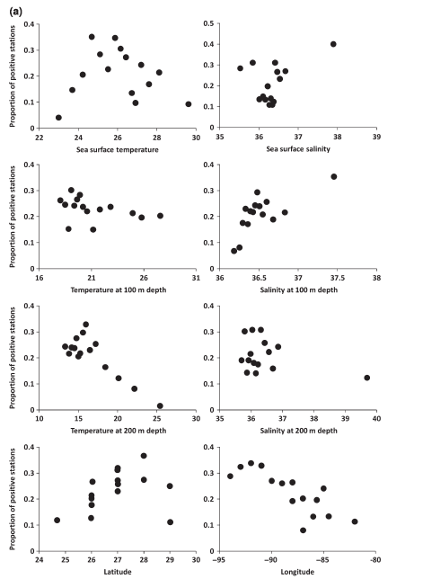
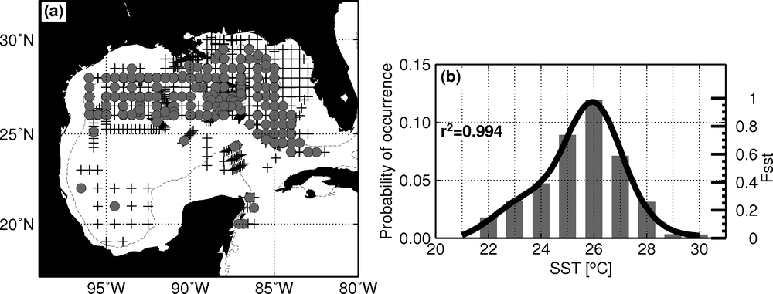
Background
Bluefin tuna (Thunnus thynnus, BFT) spawning in the western North Atlantic has been observed mostly within the Gulf of Mexico during the spring
Muhling et al. (2010, 2011)
BFT larvae are found in the northern GOM mostly during on late-April to late May
Most likely colleted in the SST range 24-28ºC

Slide 3
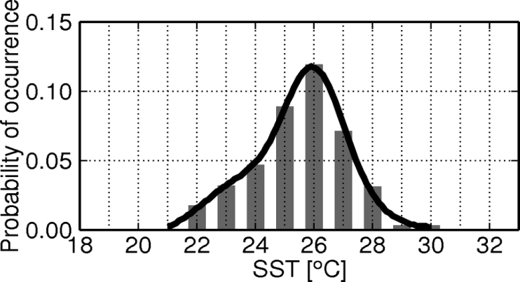
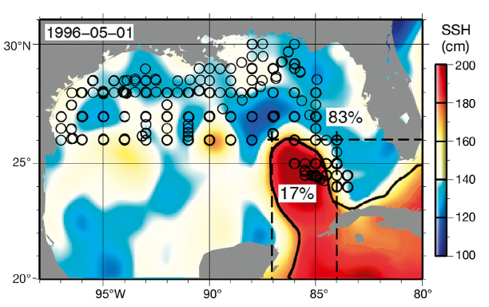
Background
Bluefin tuna (Thunnus thynnus, BFT) spawning in the western North Atlantic has been observed mostly within the Gulf of Mexico during the spring
Muhling et al. (2010, 2011)
BFT larvae are found in the northern GOM mostly during on late-April to late May
Most likely colleted in the SST range 24-28ºC
Lindo et al. (2012)
Identified a relationship between the type of mesoscale feature and the abundance of certain larvae
BFT larvae are more abundant in Anticyclonic boundaries (AB)
Reproduced from Muhling et al. (2011)
Figure 4 from Lindo et al. (2011)

Slide 4
Interannual variability in the GOM
GOM SST:
GOM warming (~0.3ᵒC decade⁻¹) (Good et al. 2007)
Year-to-year variability in the GOM SST linked with El Nino (Enfield and Mayer, 1997)
Modeling studies suggest that cooler SSTs are observed in the northern GOM during winter/spring after a peak of ENSO (Alexander and Scott, 2002)
Long-term variability also linked with changes in the strength of the AMOC (Liu et al., 2012)
Mesoscale features:
Changes in the Loop Current dynamics: the Loop Current has been consistently located more to the north during the past 10 yr (Vukovich, 2012; Lindo-Atichati et al., 2013)

Slide 5
Goals & Objectives
Help improve the understanding on the Bluefin Tuna Stock dynamics and variability
Objectives:
Implement a dimensionless index to monitor the availability of favorable conditions for occurrence of bluefin tuna larvae in the GOM during spring, the BFT_Index
Assess, for the first time, the temporal and spatial variability of favorable environmental conditions for bluefin larvae in the GOM during 1993-2011

Slide 6
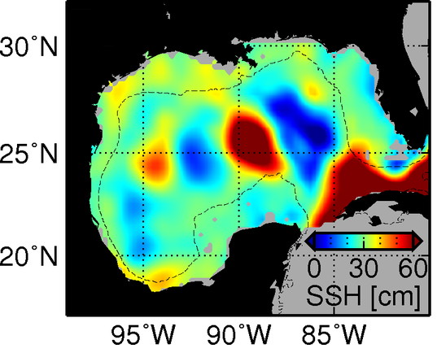
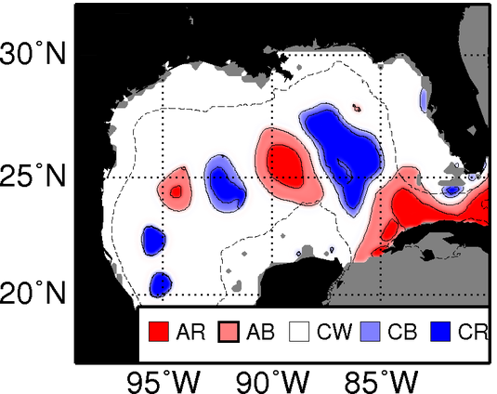
The BFT Index
May 20, 1998
BFT_Index(x,y) = [A1 x Fsst(x,y)] x [A2 x Cmeso(x,y)]
A1=A2=1 (Domingues et al., 2016)

Slide 7
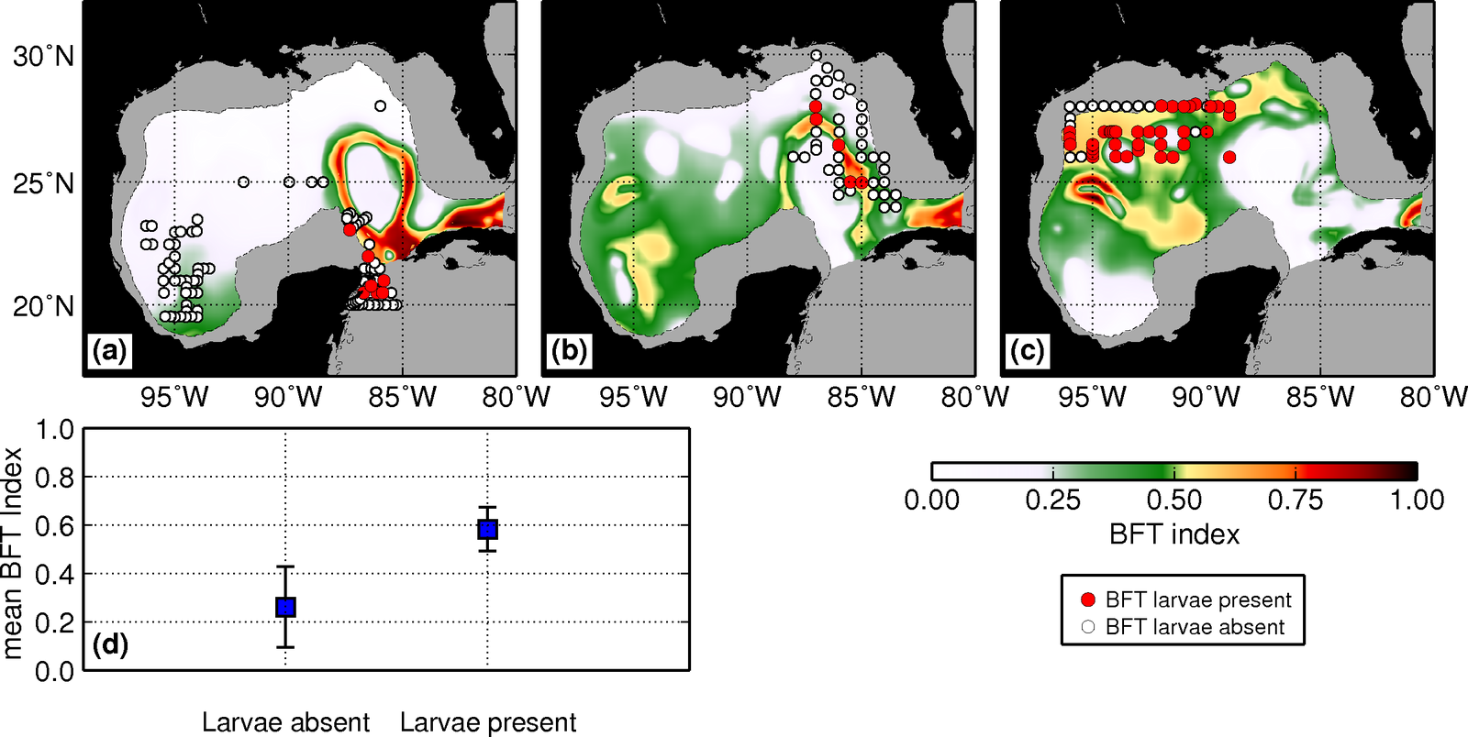
BFT_Index verification

Slide 8
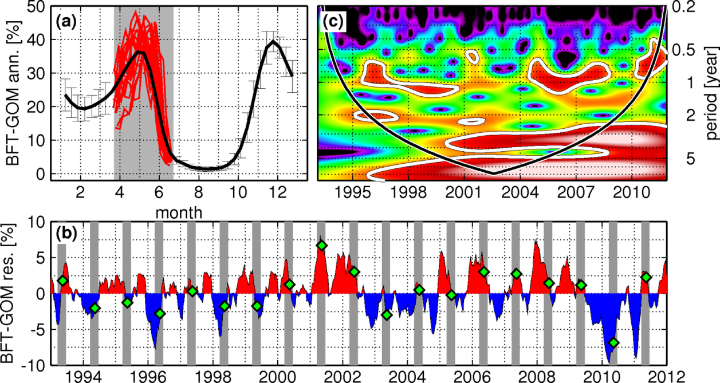
BFT_Index-derived Variability
Time-series of overall availability of favorable conditions for larvae in the GOM

Slide 9
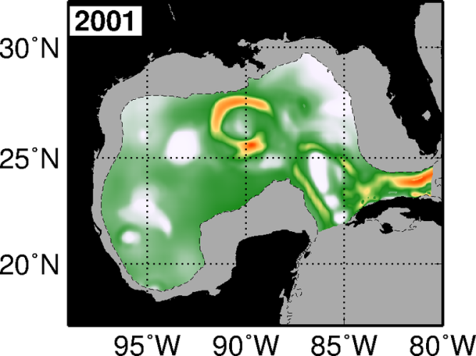
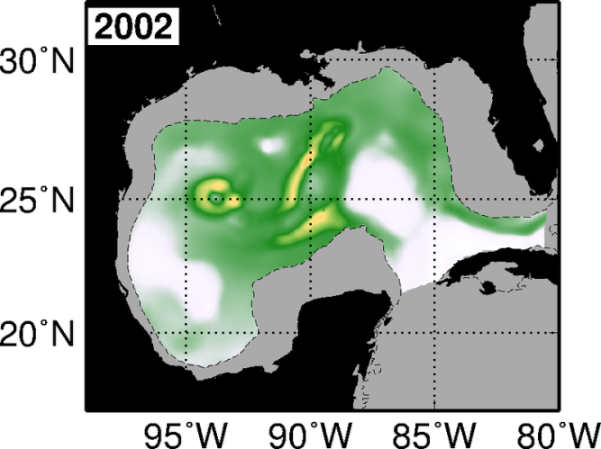
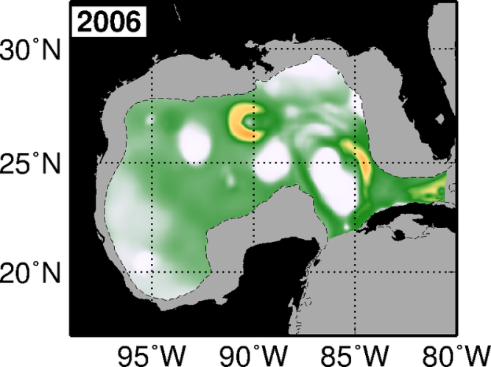
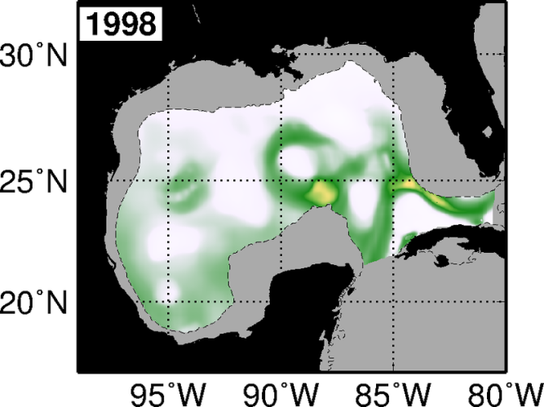
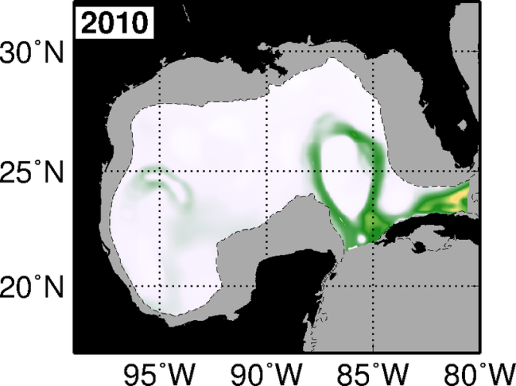
BFT_Index GOM – spring-time extremes
Favorable years
Unfavorable years
Maps of average spring-time BFT_Index provide information on the persistency of favorable conditions on a specific location within the GOM

Slide 10
BFT Index GOM – sources of variability
SST
Positive relationship between BFT_GOMr and SSTr
Y-to-Y variability dominated by SST variability
Lower SST limit for spawning (Masuma et al. 2008) of 24˚C:
Unfavorable Years: April 28 ± 9 days
Favorable Years: April 14 ± 9 days

Slide 11
BFT Index GOM variability
Outside Loop Current Region
Favorable Years: 23 ± 3 % of favorable areas
Unfavorable Years: 16 ± 3 % of favorable areas
Loop Current Region
7 ± 2 % of favorable areas
This is important given that in some years a wide variety of spawning habitat may be available, where as in other years, spawning may be more restricted to the LC. Larvae entrained in the LC may be advected out of the GOM within days -> possibly low survival rates

Slide 12
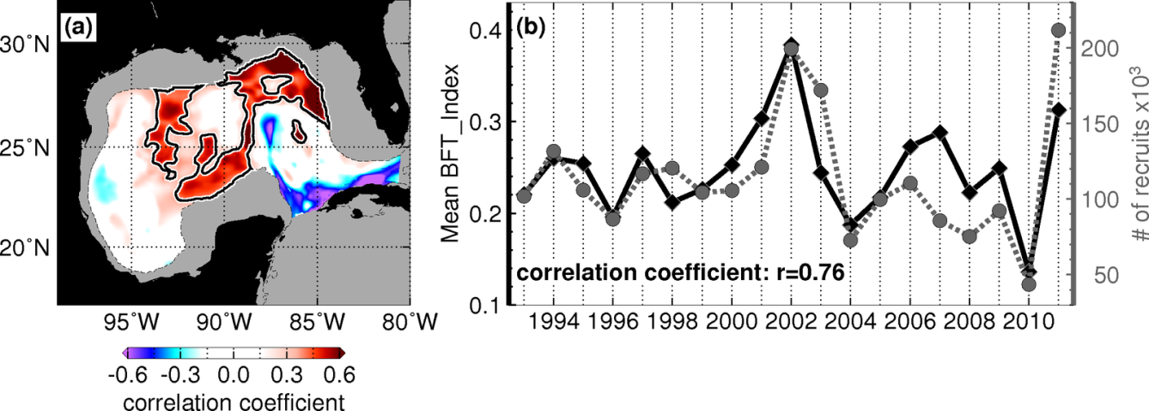
Comparison with Recruitment
BFT Recruitment time-series (ICCAT 2014)
Correlations between:
BFT_Index vs. BFT recruitment time-series
Key areas in the Central/North GOM
LC may act as a “trap” for larvae
BFT_Index explain ~58% of the variance in the recruitment time-series
Estimates of recruitment are obtained from a virtual population analysis that estimated the number of age-1 fish required to produce the observed catches of adults
Time-series of age-0 fish: age-1 estimates were back-calculated using an assumed constant and density-independent natural mortality rate of 0.14 yr-1.

Slide 13
Summary
This study introduced the BFT_Index for tracking favorable conditions for larvae in the GOM
Availability of favorable conditions for BFT larvae during spring exhibits year-to-year variability, which is largely linked with the SST and mesoscale field -> mostly linked to availability of areas outside the Loop-current
Analysis indicate the existence of key areas in the central/north GOM, where favorable conditions may lead to increased recruitment, and also that the LC may act as “trap” for larvae.
Results suggest that environmental conditions during spawning season may drive a relevant component of the recruitment variability.

Slide 14
Real-Time BFT_Index distribution
http://www.aoml.noaa.gov/phod/research/ecosystems/fisheries/bft_maps.php

Slide 15
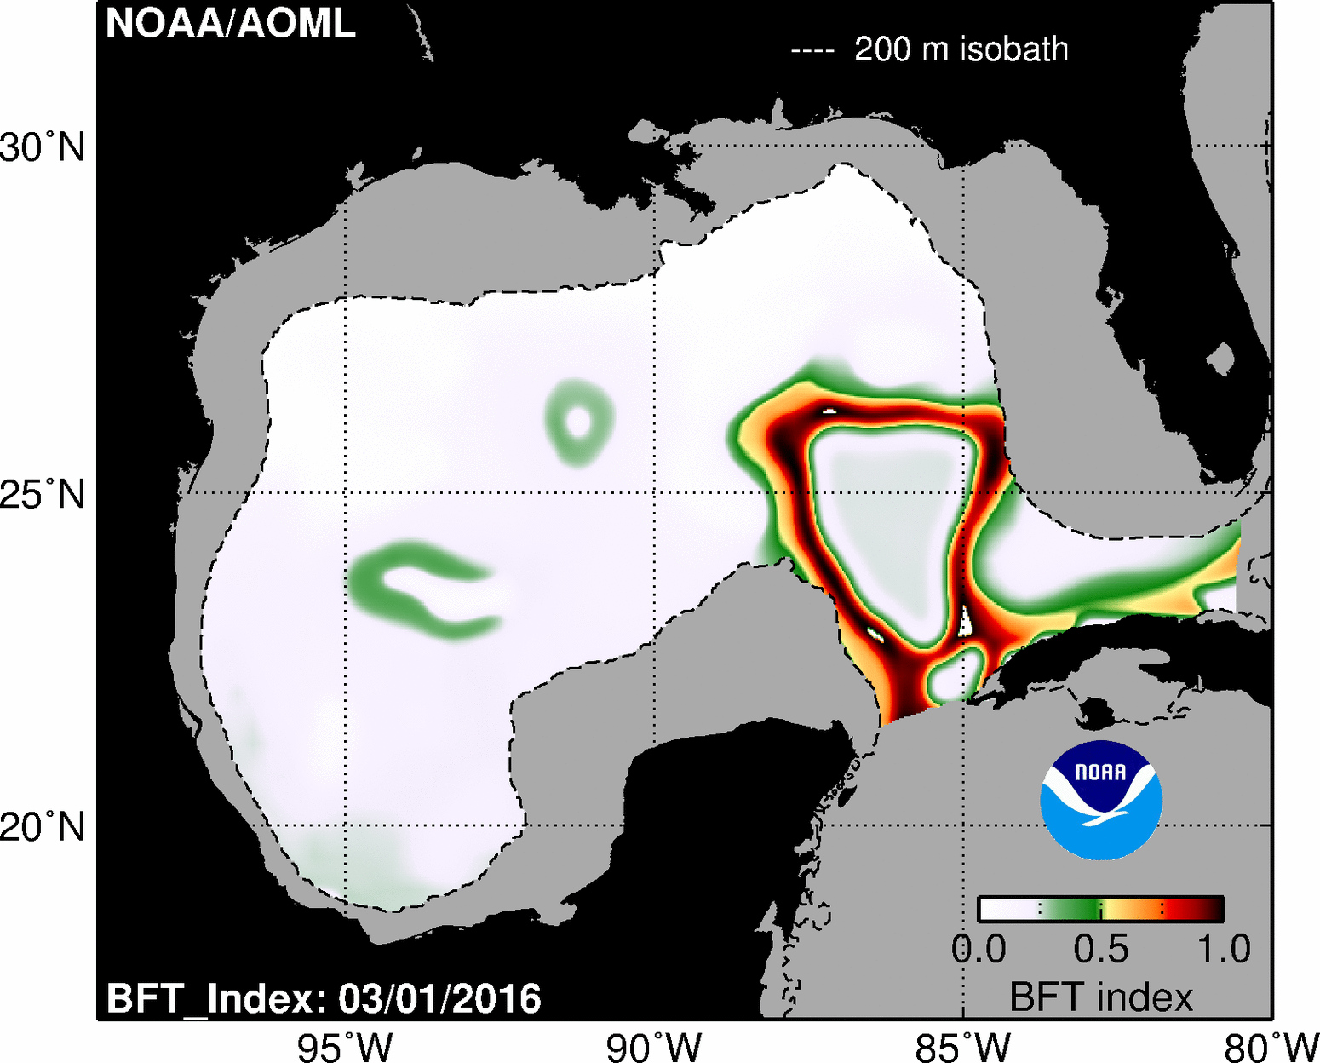
Real-Time BFT_Index distribution
http://www.aoml.noaa.gov/phod/research/ecosystems/fisheries/bft_maps.php
BFT_Index, spring of 2016:

Slide 16
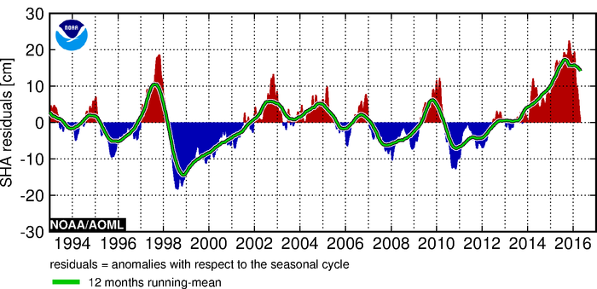
Future Plans
Expand the variability analysis to investigate potential sources of year-to-year variability of favorable conditions for larvae:
Does El Niño plays a role in the BFT stock dynamics?
SHR for Nino 3.4 region
http://www.aoml.noaa.gov/phod/indexes/index.php

Slide 17
Spring-trends during 1993-2011
Weak basin-wide trends (significant at the 60% confidence level only)
Positive in northern GOM
Negative in southern GOM
GOM warming (~0.3ºC decad⁻¹)
(Good et al. 2007; Chollet et al. 2012)
Strong trends (significant at the 95% confidence level)
Patchy distribution
Changes in the mesoscale dynamics
(Alvera-Azcarate et. al., 2008; Lindo et al., 2013)

Slide 18
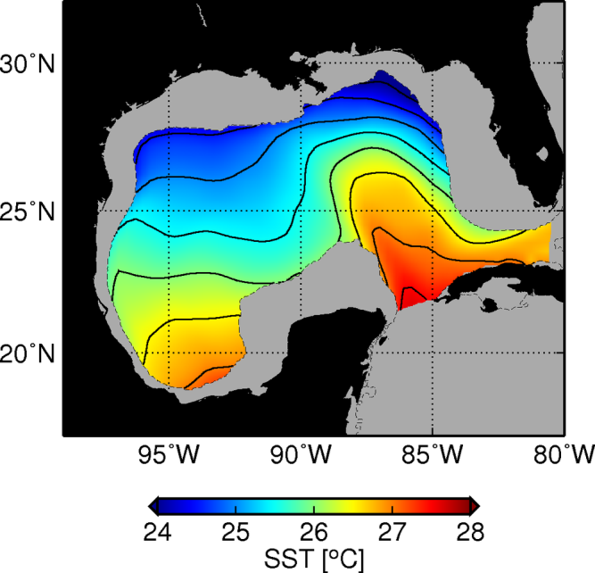
Spring-trends during 1993-2011
Weak trends (significant at the 60% confidence level only)
Positive in northern GOM
Negative in southern GOM
GOM warming (~0.3ºC decade⁻¹)
(Good et al. 2007; Chollet et al. 2012)

Slide 19
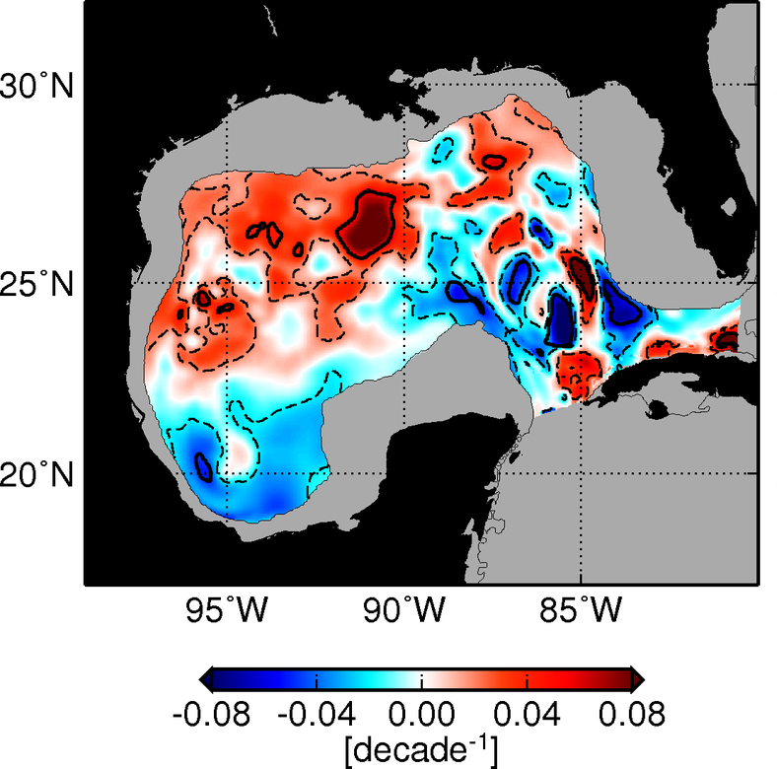
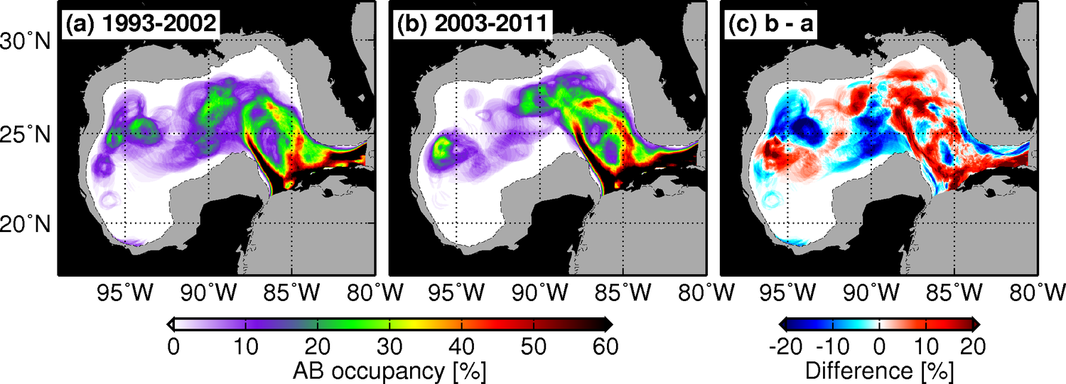
Spring-trends during 1993-2011
Strong trends (significant at the 95% confidence level)
Patchy distribution
Changes in the mesoscale dynamics
(Alvera-Azcarate et. al., 2008; Lindo et al., 2013)

Slide 20
Future Plans
Apply similar approach to other species:
Which ones would be of primary interest?
Apply the BFT_Index to other areas
Mediterranean Sea
Slope Sea

Slide 21
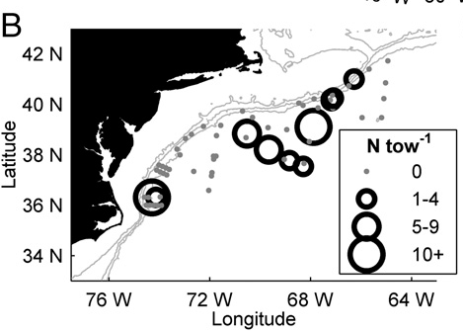
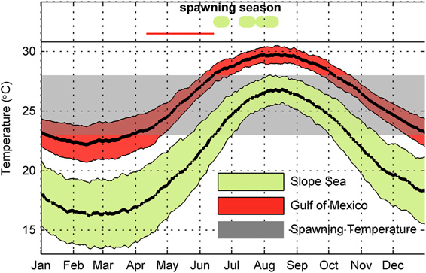
Future Plans
BFT_Index for “Slope-Sea Spawning Season”
Richardson et al. (2016)

