Slide 1
Variability in the Southern Ocean south of Africa: evidence of atmospheric induced variability
Ricardo Domingues^{1,2}, Gustavo Goni²
¹CIMAS – University of Miami
²Physical Oceanography Division, AOML/NOAA
Ricardo.Domingues@noaa.gov
PHOD retreat, March 28-29, 2012

Slide 2
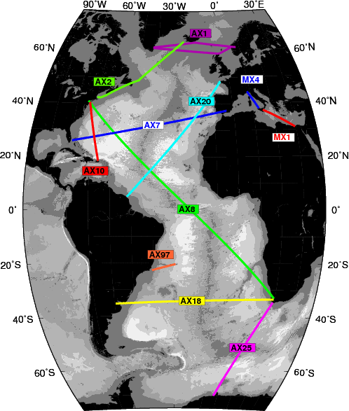
The goal
To evaluate the variability in the Southern Ocean between South Africa and Antarctica and investigate its link with the atmospheric variability
Gille [2002]

Slide 3
The dynamics
Agulhas Current (AGC)
Agulhas Rings (AGR)
Antarctic Circumpolar Current (ACC)
Subantarctic Front – SAF
Antarctic Polar Front – APF
Together account for more than 70% of ACC transport
(Swart et. al. , 2008)
Altimetry-derived gestrophic velocity

Slide 4
Previous work
Southern Ocean
Gille 2002, 2008 – Indicated a consistent warming trend during last decades concentrated within the ACC
Sokolov 2009 – Suggested the S.O. warming as potentially due to a southward shift in the ACC
Sallee et. al 2008 – Observed that the frontal position variability is largely controlled by the atmospheric variability – basically through the Southern Annular Mode (SAM) – but largely regional dependent
XBT transect AX25
Billany et. al 2010 – Demonstrated that frontal motions were not related to the SAM index
Remain to be determined the link between the atmospheric variability and the oceanic

Slide 5
Data and Methods
Atmospheric variabilty
Satellite Winds – CCMP (Atlas et. al [2011], 1993-2010)
SAM index – NOAA-CPC (www.cpc.ncep.noaa.gov)
Oceanic variability
XBT HD along AX25 - 16 transects, starting in 2004
Satellite SST – OISST.v2 (1993-2010)
Satellite altimetry – AVISO (1993-2010)
APF and SAF variability
Transports
Frontal motions

Slide 6
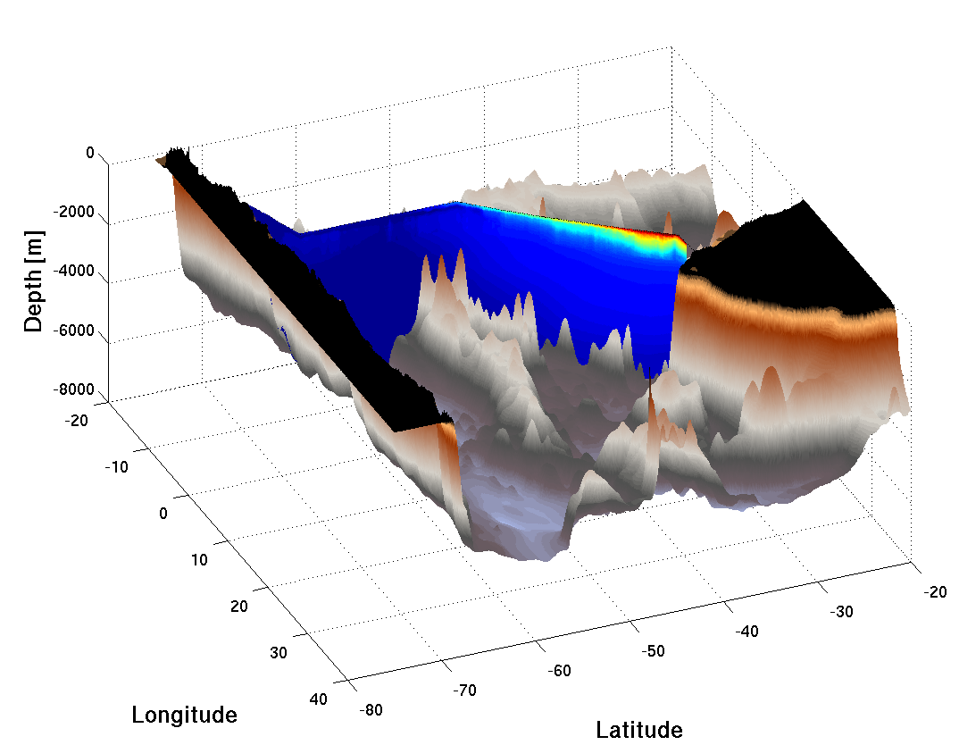
Data and Methods
SAF and APF variability
Frontal transports
Baringer and Garzoli [2007]
Full water column
TS profiles
Cumulative transports
Swart et. al. [2008]
Altimetry-derived
transports (1993-2010)
Frontal position (jet of the current) was defined as the maximum SSH gradient within the known frontal domain
Africa
Antarctica

Slide 7
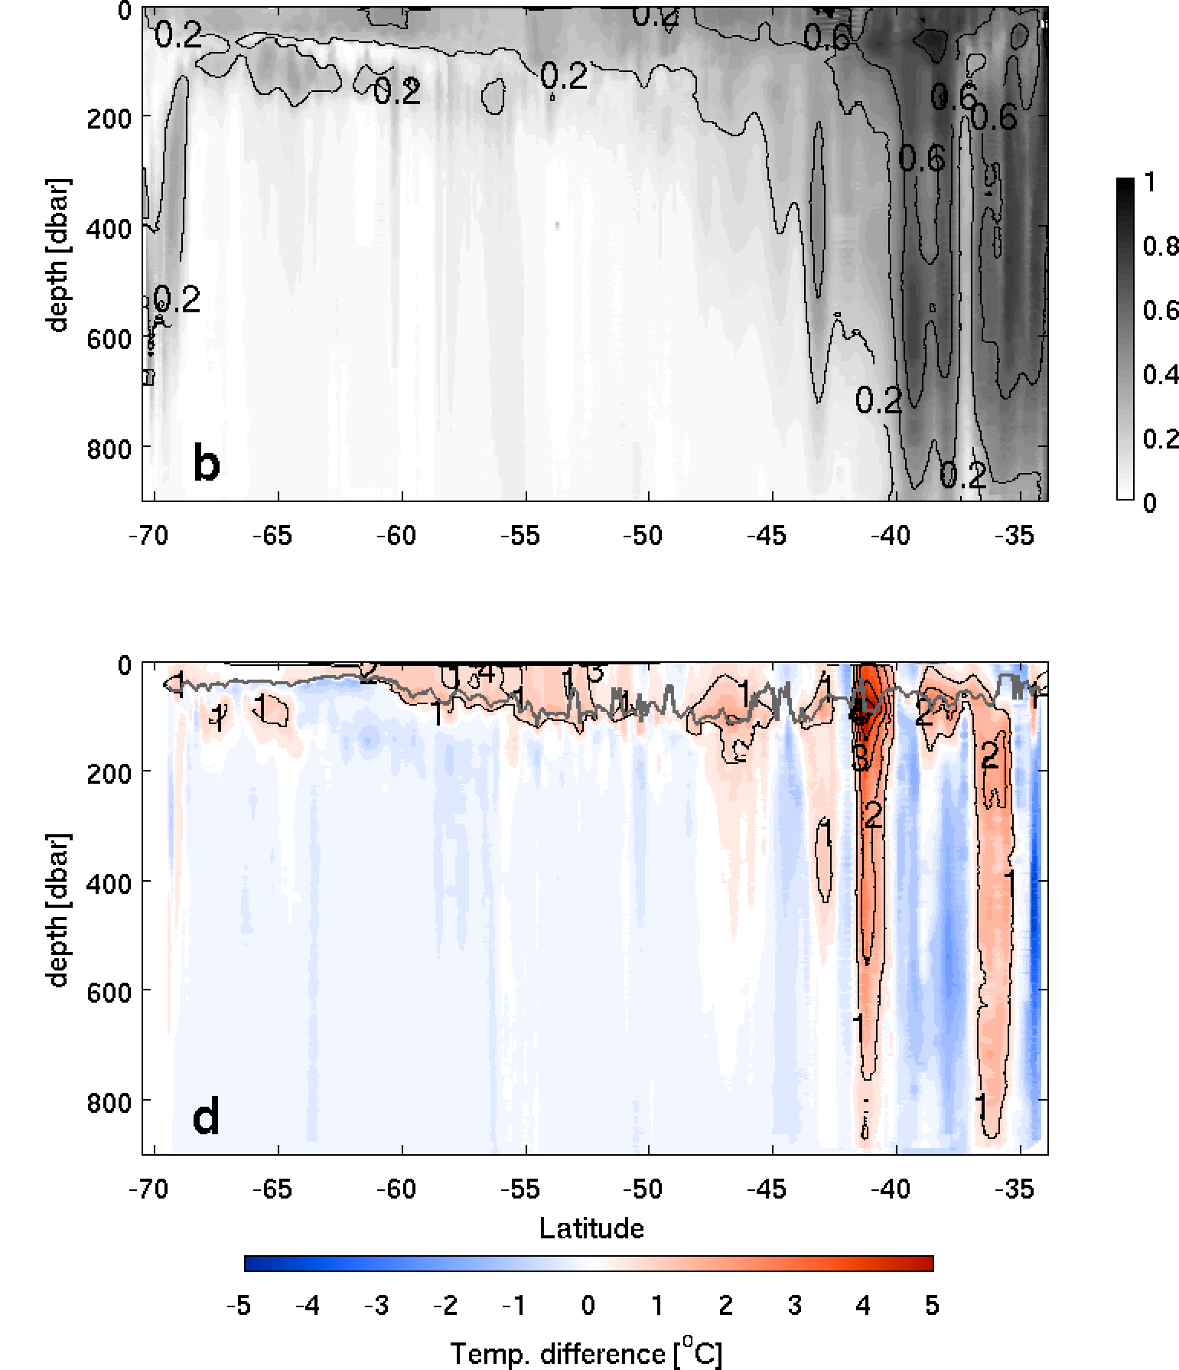
Results
XBT-derived thermal variability
North of 45ºS
Agulhas Rings – up to 5ºC anomalies
Within the ACC
Mixed layer variability – up to 2ºC anomalies
Warm anomalies starting in 2009
Mixed Layer Variability
AGC
AGR
Feb 2010
figure from Domingues et. al. [2012], to be submitted

Slide 8
Results
SST and wind stress time-series along AX25
SST
Wind stress

Slide 9
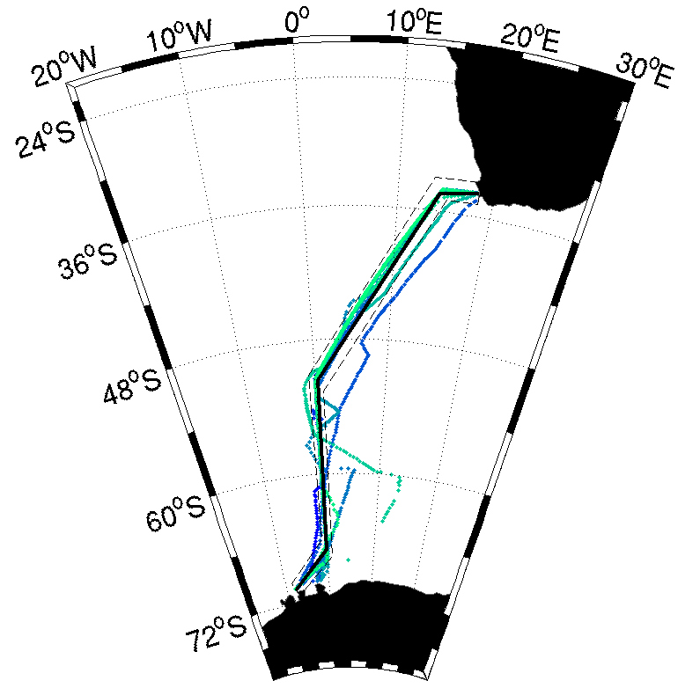
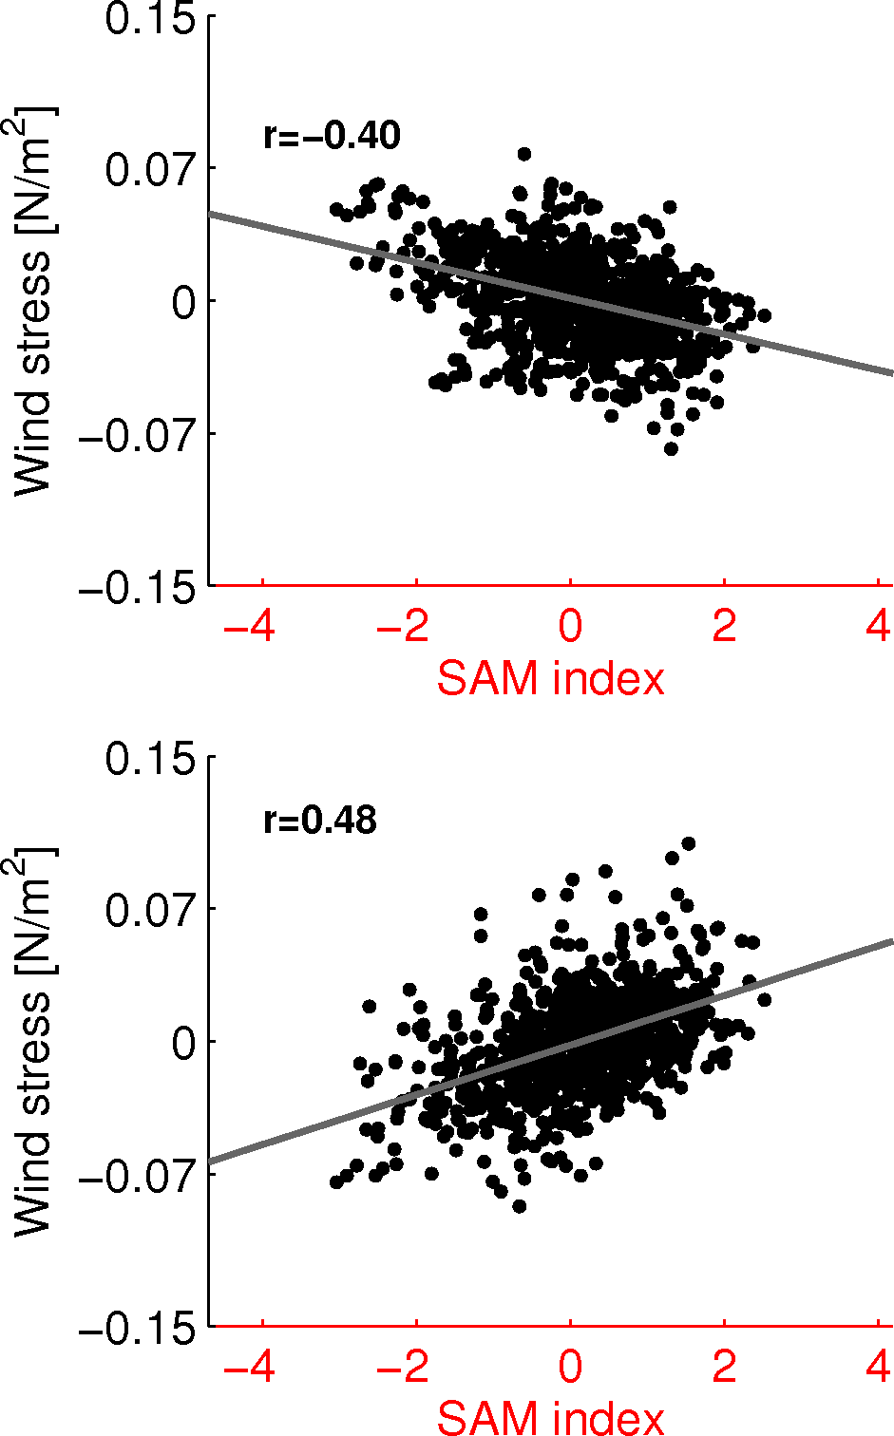
Results
Wind stress variability VS. SAM
35ºS – 45ºS
50ºS – 60ºS
Southward displacement of the westerlies during positive SAM
Ocean response to SAM through Ekman transport anomalies
(Gupta and England 2006)

Slide 10
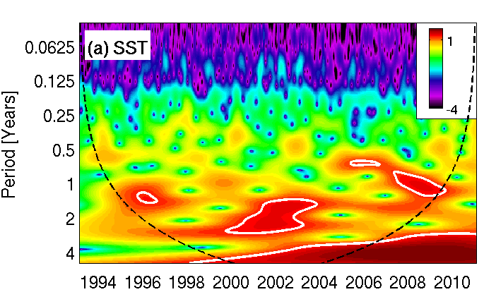
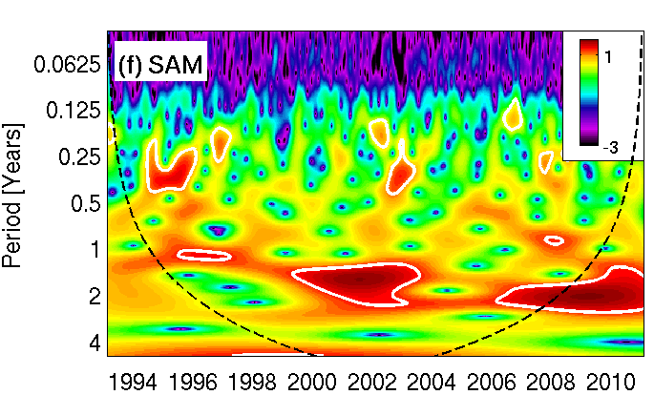
Results
Wavelet transforms
SST - residuals
Mostly interannual variability
Periodicity of ~ 2 years
SAM index
Mostly interannual variability
Periodicity of ~ 2 years
figures from Domingues et. al. [2012], to be submitted

Slide 11
Discussion
Interannual time-scales
Different fronts are exposed to different Ekman regimes
(Sallee et. al. 2008)
Positive SAM
↑ SST within ACC
↓ SAF transport
↑ APF transport
SAF Transp. Vs. wind 45ºS
SAF Transp. Vs. SST
Wind stress [N/m²]
APF Transp. Vs. wind 45ºS
APF Transp. Vs. SST
Wind stress [N/m²]

Slide 12
Discussion
The potential mechanism – Interannual time-scales
Westerlies
Westerlies
Relaxation of $∇$Ƞ
Anomalies + -
X
X
X
X
X
X
X
Intensification of $∇$Ƞ
η
0
Z_{ML}
Depth [m]
W_{ek}
APF
SAF
-H
-60 -55 -50 -45 -40
Latitude
X
Easterlies
Westerlies
η = dynamic height

Slide 13
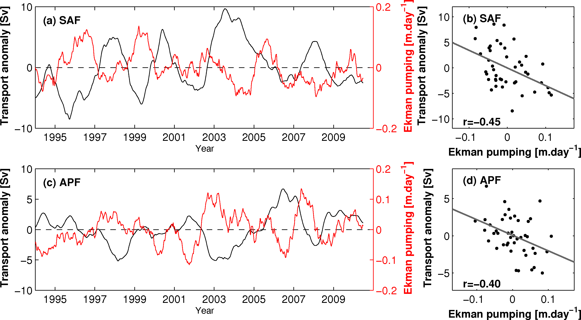
Discussion
Ekman suction velocities
w_{ek}$=\frac{1}{ρ}\frac{dMy}{dy}, and My=\int_{x1}^{x2}{\left(−\frac{τx}{f}\right)dx}$

Slide 14
Summary
Link between atmospheric variability and the oceanic variability south of Africa
SAM-induced wind stress anomalies relate with:
Warmer mixed layer within ACC
Lower SAF transport through relaxation of the dynamic height gradient
Higher APF transport through intensification of the dynamic height gradient
Consistent with observed warming within the ACC
SAM has a consistent positive trend over last decades
Manuscript “Variability in the Southern Ocean between South Africa and Antarctica during 1993-2010” ready to be submitted

