Slide 1
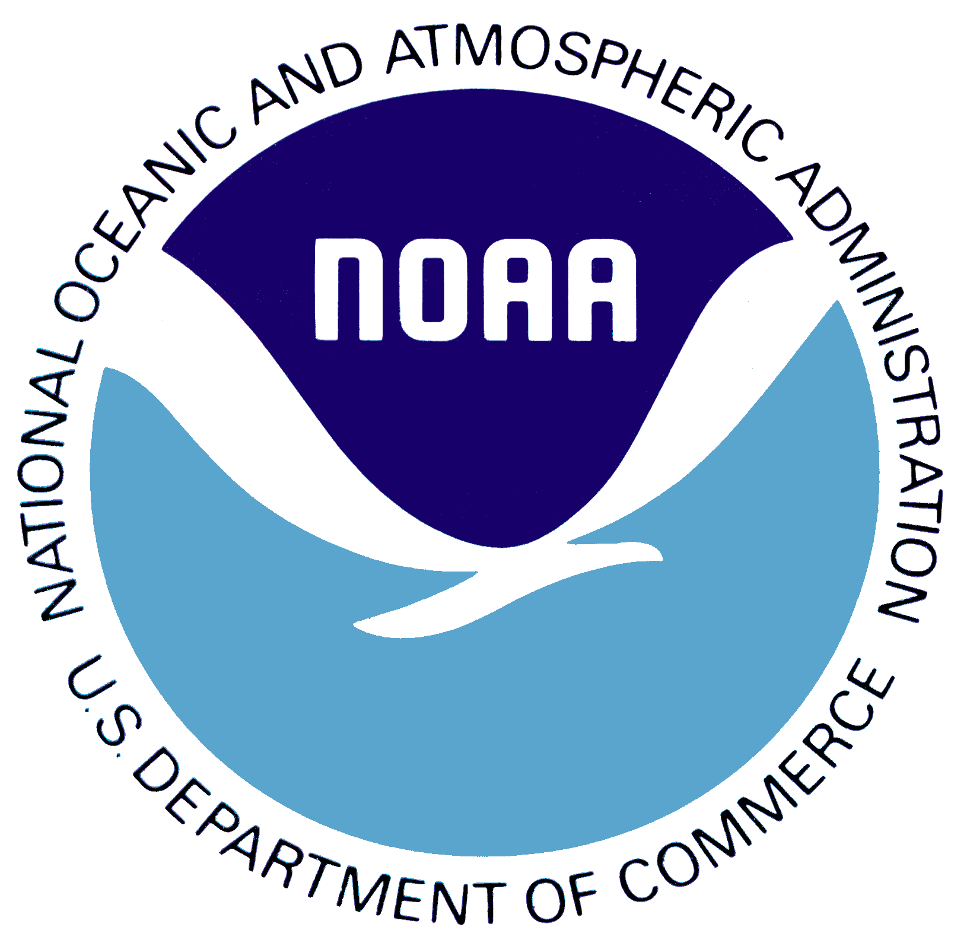
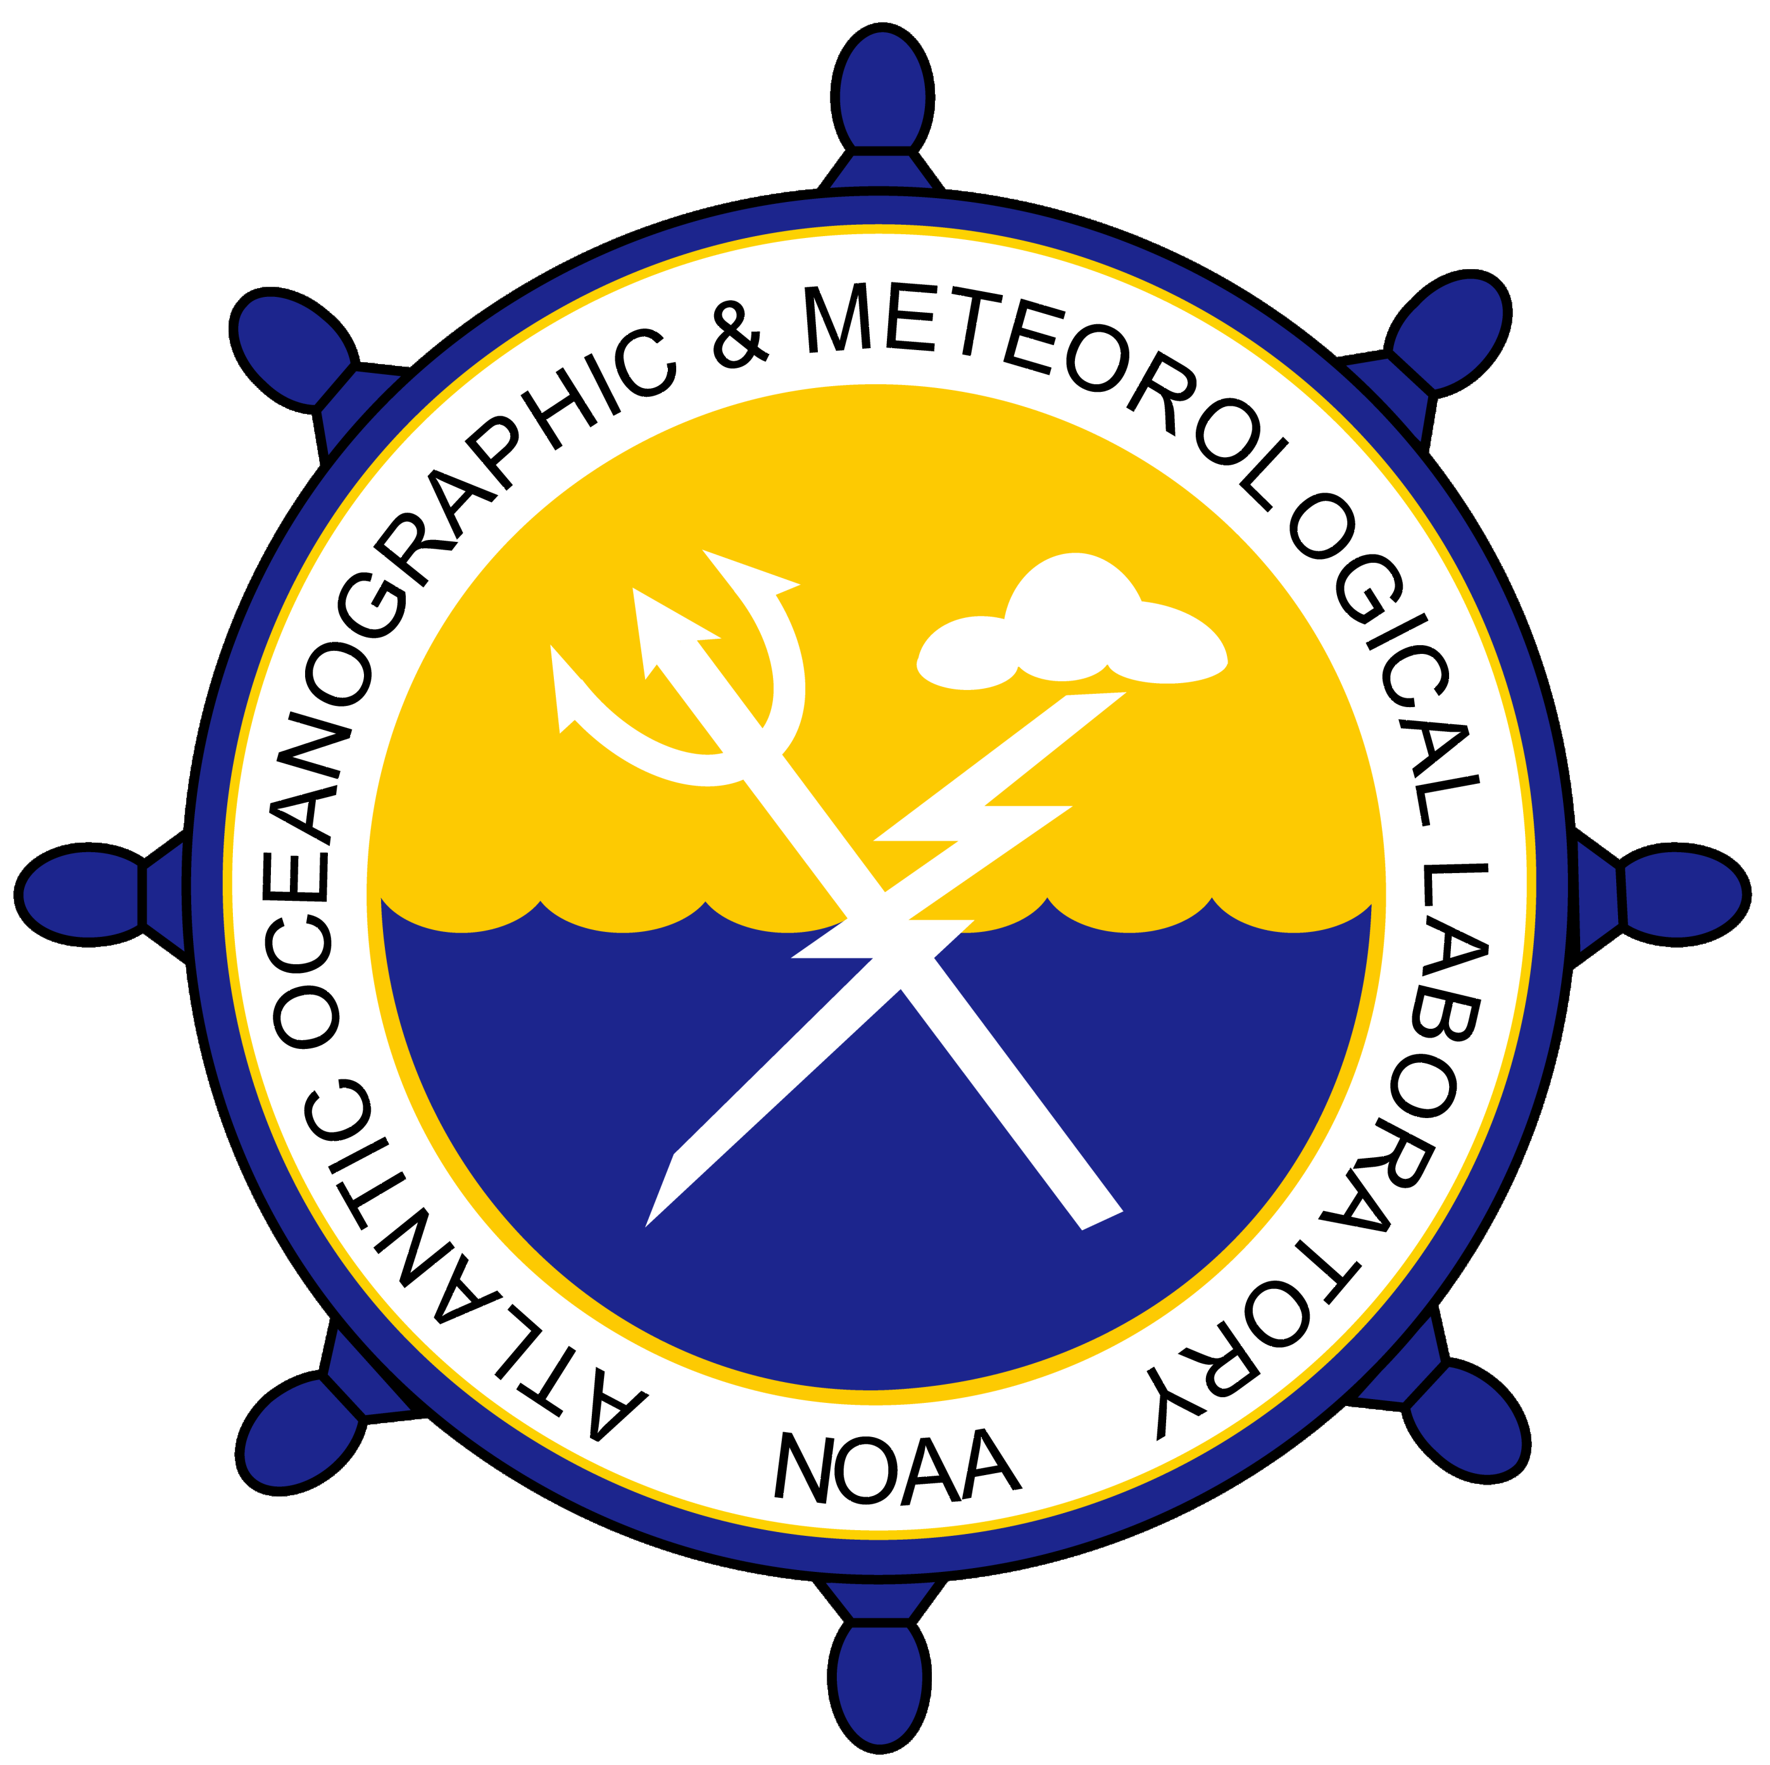
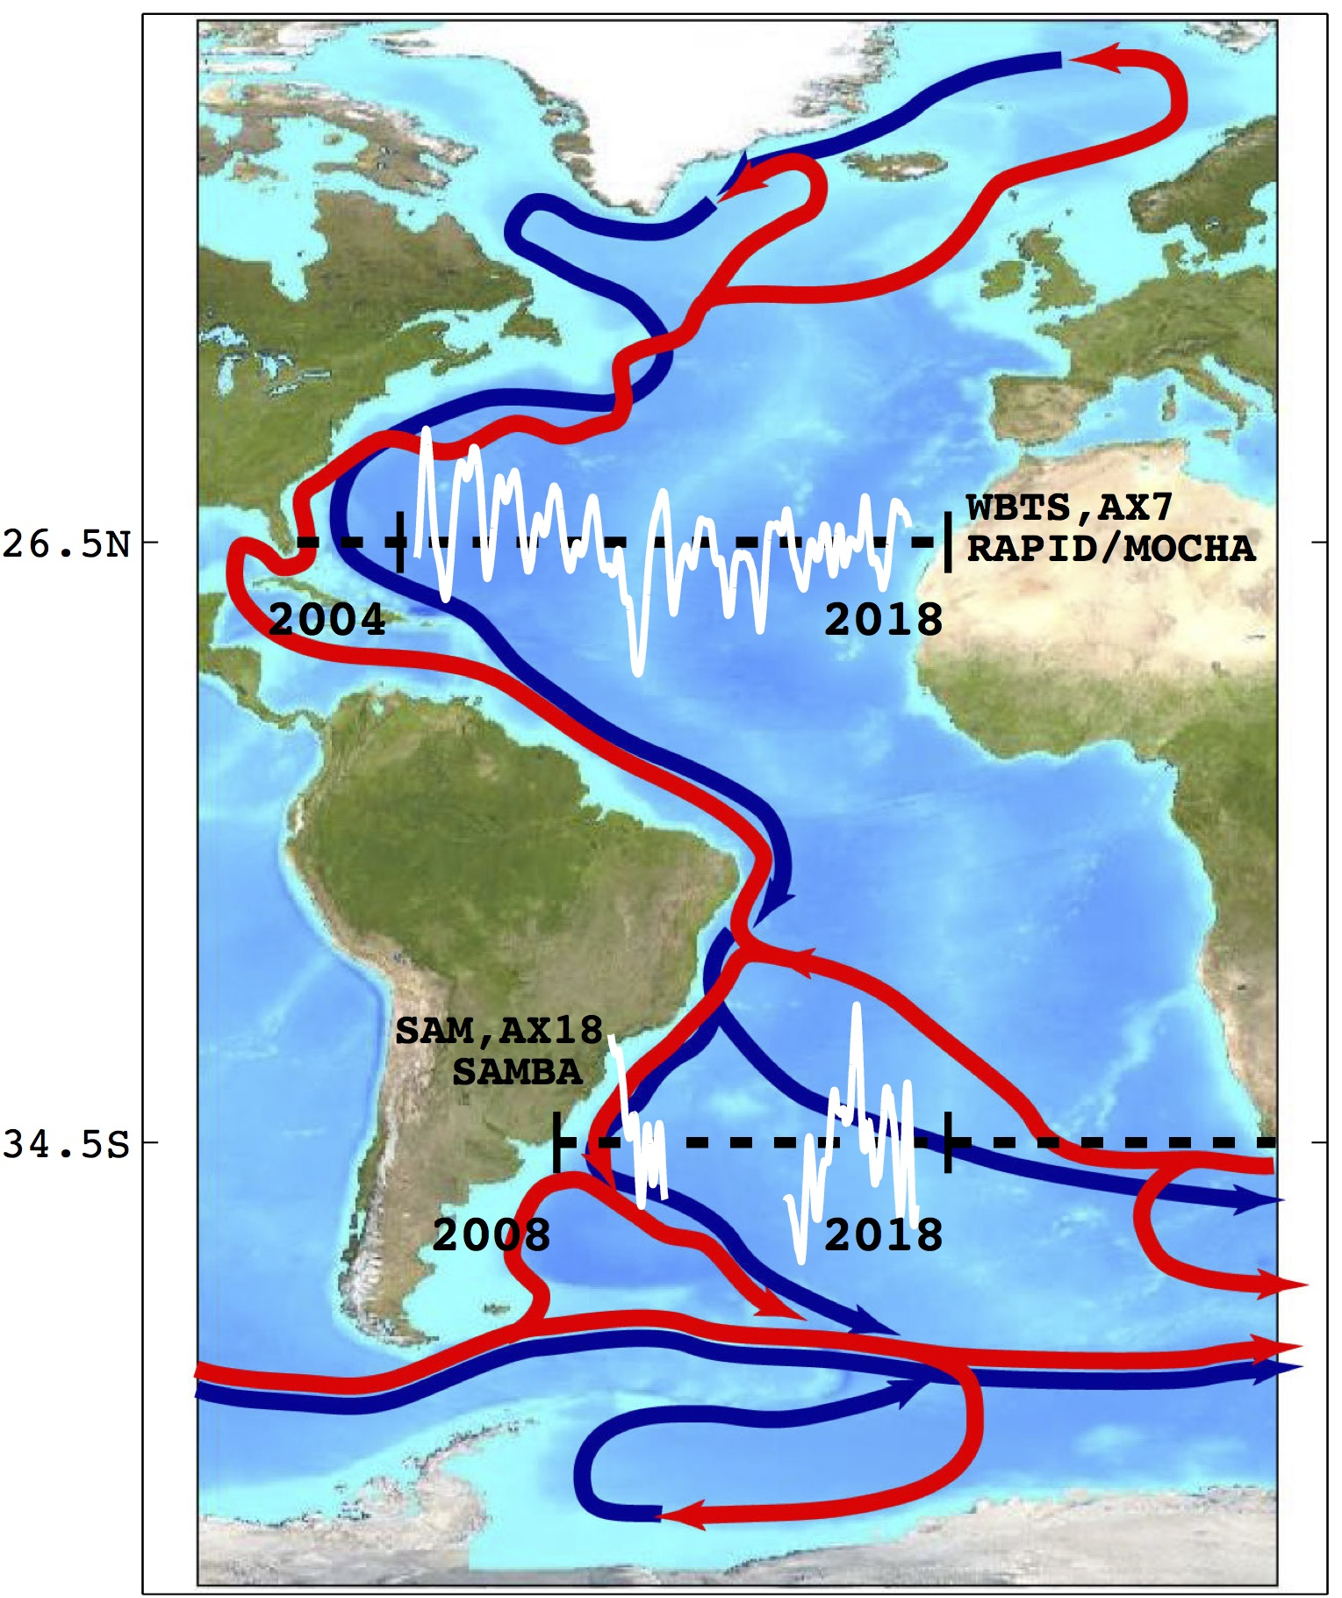
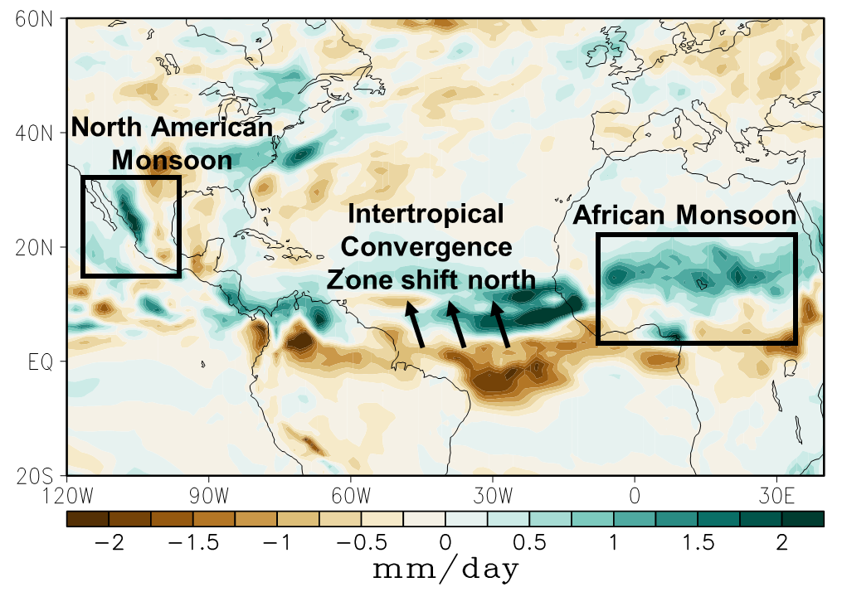
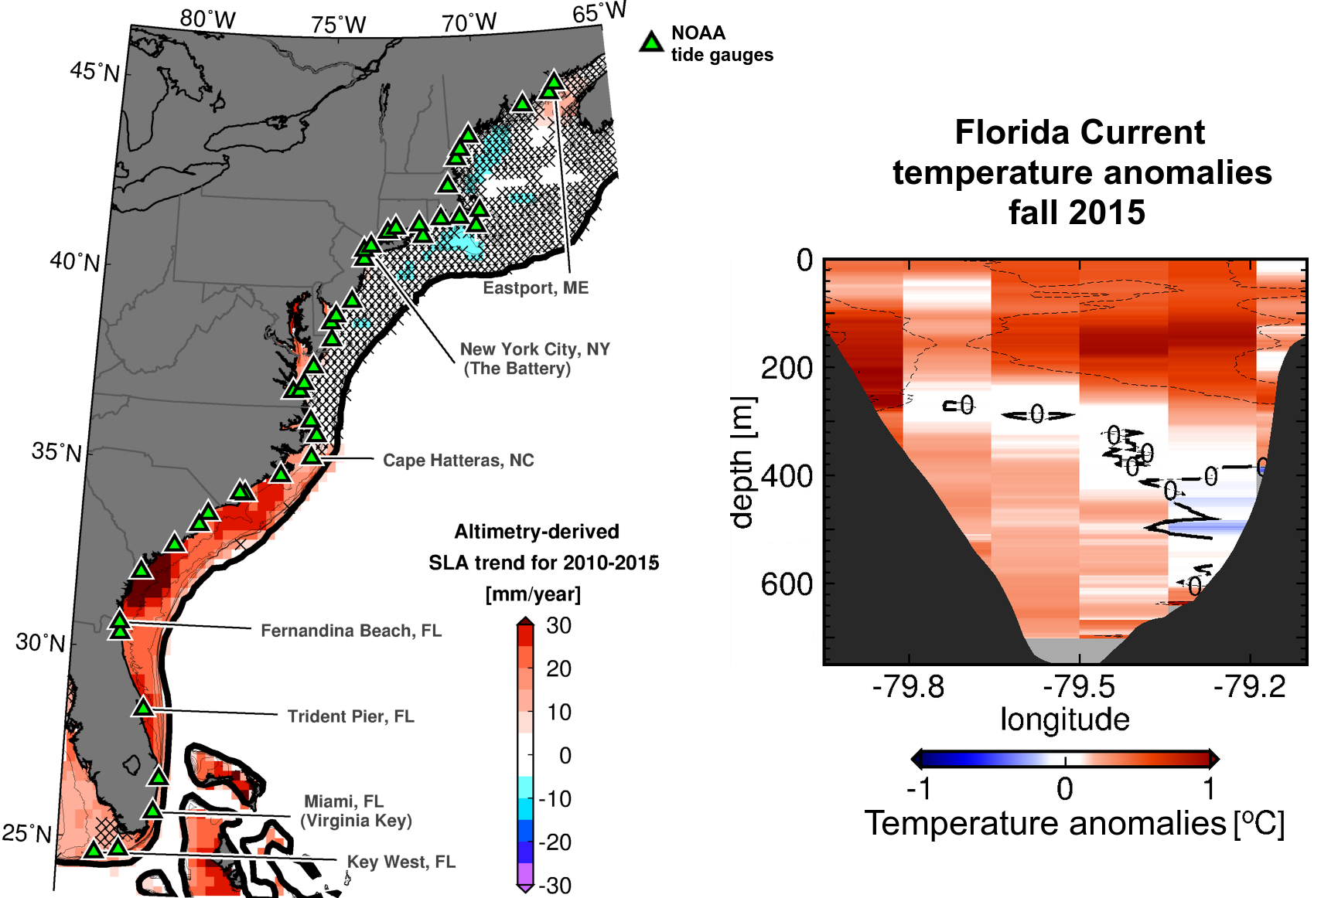
National Oceanic and Atmospheric Administration
Atlantic Oceanographic and Meteorological Laboratory
Physical Oceanography Division – PHOD
Miami, FL
Overturning Oceans and Societal Impacts
The overturning circulation is one of the main ways that the oceans move heat, salt, carbon and nutrients throughout the global oceans. Achieving a more complete understanding of the behavior of the Atlantic Meridional (north/south) Overturning Circulation (AMOC) requires an observational network that spans the entire basin.
PHOD scientists with national/international partners are leading several programs to observe AMOC: Western Boundary Time Series (WBTS), Southwest Atlantic MOC (SAM), GO-SHIP, and the eXpendable BathyThermograph (XBT) network.
Source: NOAA/AOML
Figure 1: Northward flowing warm, upper water (red) and southward cold, deep water (blue), known as the AMOC. White lines indicated changes in the AMOC strength at two latitudes.
Changes in the AMOC over time have a pronounced impact on a variety of socially important weather and climate phenomena, on the blue economy, and on commerce. PHOD scientists have shown that these changes predict precipitation changes around the world. Weaker heat transport when the AMOC slows leads to stronger Northern Hemisphere monsoons.
Source: NOAA/AOML
Figure 2: Changes in rainfall (mm/day) associated with a weaker AMOC 20 years earlier.
The Florida Current is a major component of the AMOC in the North Atlantic. Changes in Florida Current temperatures and transports impact sea level along the Southeast continental United States. These parameters are routinely monitored by PHOD.
PHOD scientists found that sea level south of Cape Hatteras has increased at rates over 5 times the global average during 2010-2015 because of Florida Current warming.
Source: NOAA/AOML
Figure 3: Changes in sea level from 2010 to 2015 (mm/year).
PDF of this poster
References:
Dong, S., et al. (2009): Interannual variations in the Atlantic meridional overturning circulation and its relationship with the net northward heat transport in the South Atlantic. Geophys. Res. Lett., 36(20), doi:10.1029/2009GL039356.
Domingues, R., et al.: Accelerated sea level changes along the east coast of United States: links with recent changes in the Florida Current and Gulf Stream temperature. In prep.
Garzoli, S. L., et al. (2015): The fate of the deep western boundary current in the South Atlantic. Deep Sea Res., Part I, 103, 125-136, doi: 10.1016/j.dsr.2015.05.008.
Lopez, H., et al. (2016): Decadal modulations of Interhemispheric Global Atmospheric Circulations and Monsoons by the South Atlantic Meridional Overturning Circulation. J. Climate, 29, 1831–1851, doi: 10.1175/JCLI-D-15-0491.1.
Meinen, C. S., et al. (2010): Florida Current transport variability: An analysis of annual and longer-period signals. Deep Sea Res., Part I, 57(7), 835-846, doi: 10.1016/j.dsr.2010.04.001.
Perez, R. C., et al. (2015): Measuring the Atlantic meridional overturning circulation. Mar. Technol. Soc. J., 49(2), 167-177, doi:10.4031/MTSJ.49.2.14.

