Slide 1
NOAA/AOML Ocean Observing Systems and Efforts Towards Understanding Attributions to Sea Level Changes Along the U.S. East Coast
Molly Baringer¹
Gustavo Goni¹
Ricardo Domingues^{2,1}
¹ NOAA Atlantic Oceanographic and Meteorological Laboratory - AOML, Miami, Florida, USA
² University of Miami, Cooperative Institute for Marine and Atmospheric Studies - CIMAS, Miami, Florida, USA

Slide 2
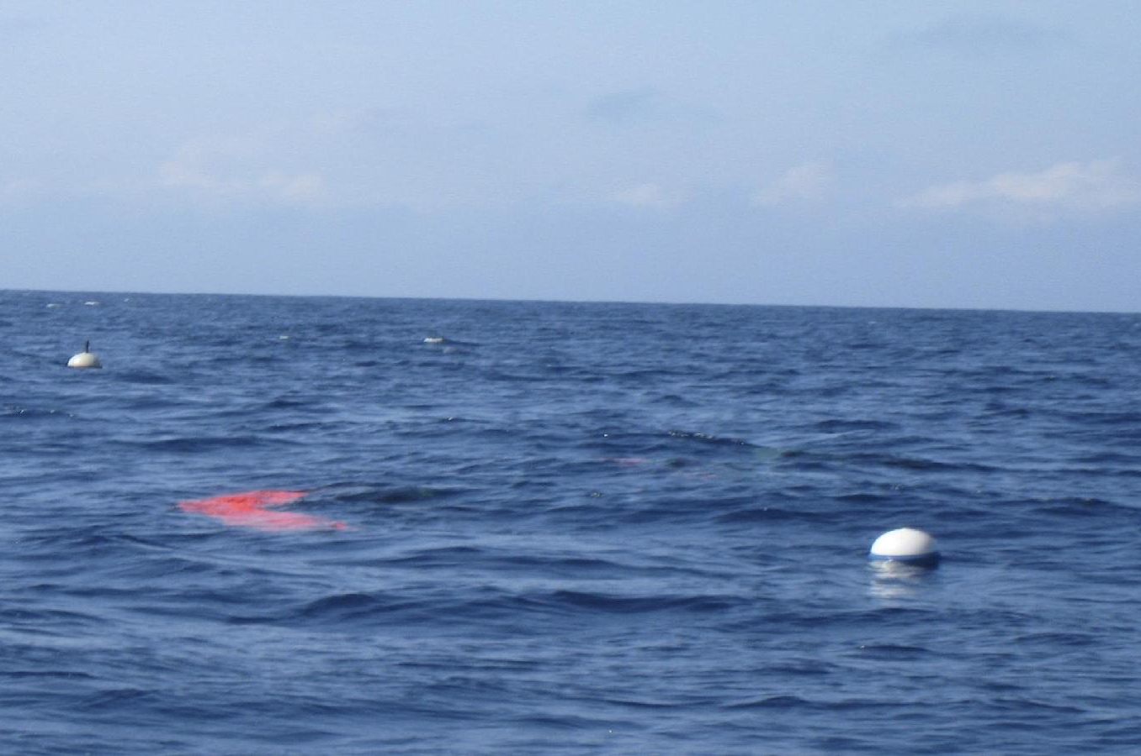
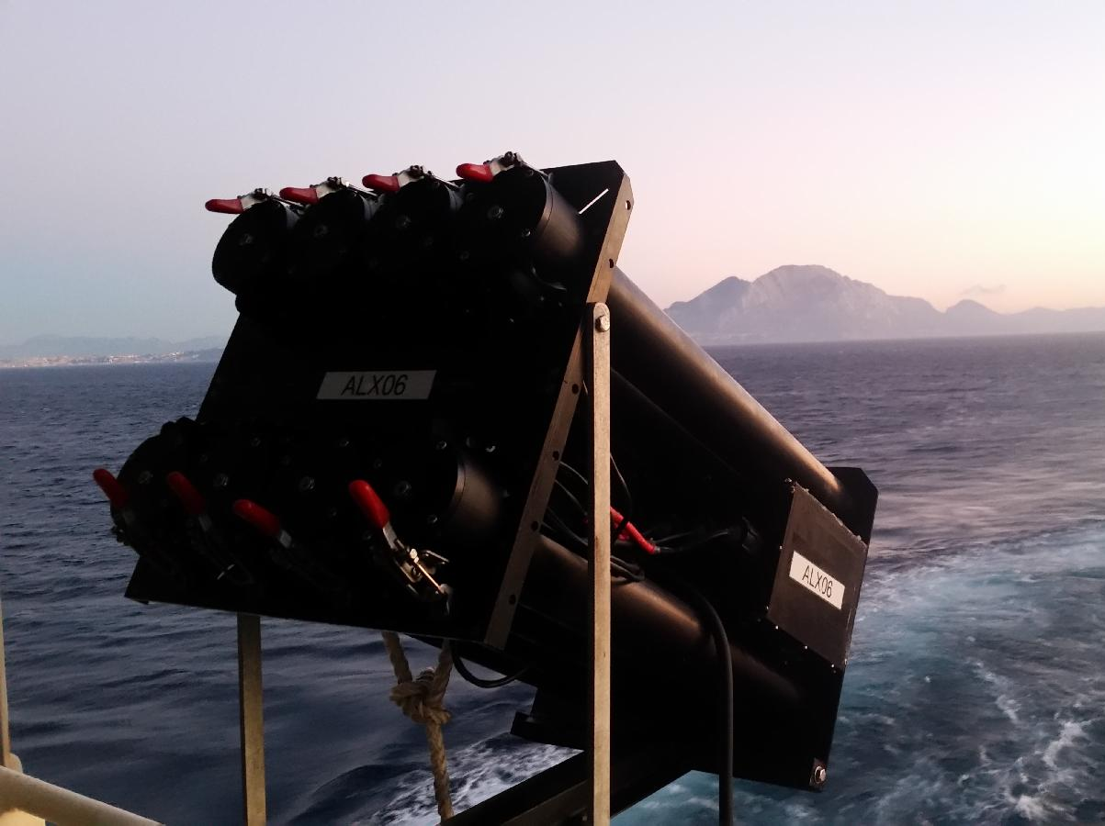
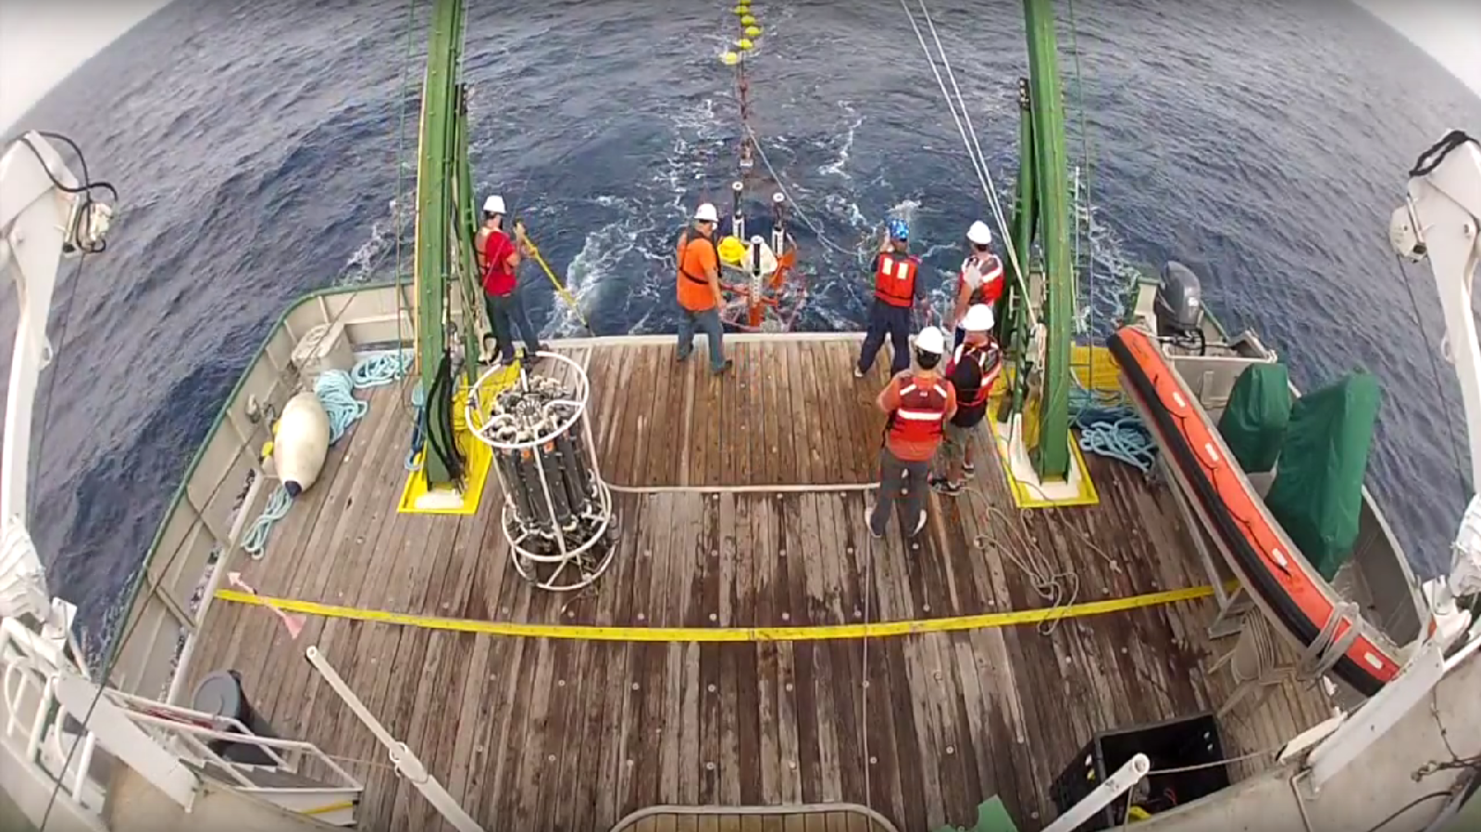
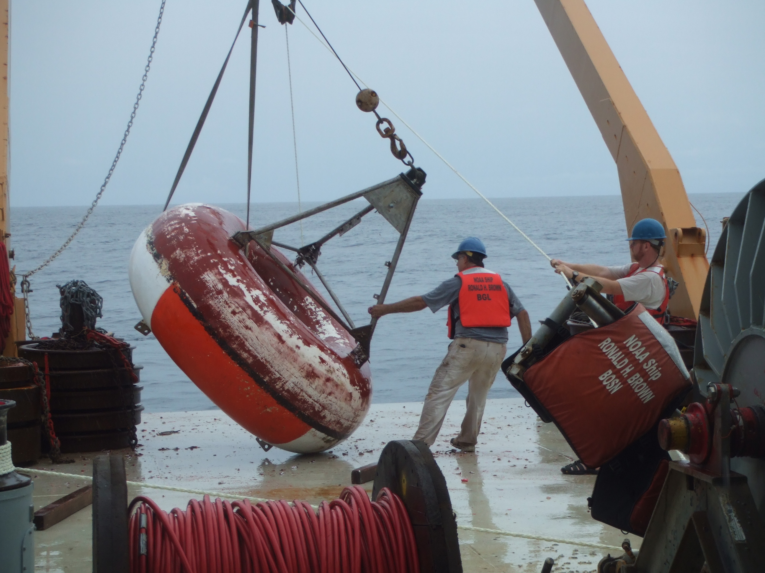
AOML contribution to the Global Ocean Observing System
The Global Drifter Program
Argo Project
The XBT Network
WBTS Project
PIRATA
Underwater Gliders
Improve the understanding on the role that the ocean plays on climate, extreme weather events, ecosystems, and sea-level changes

Slide 3
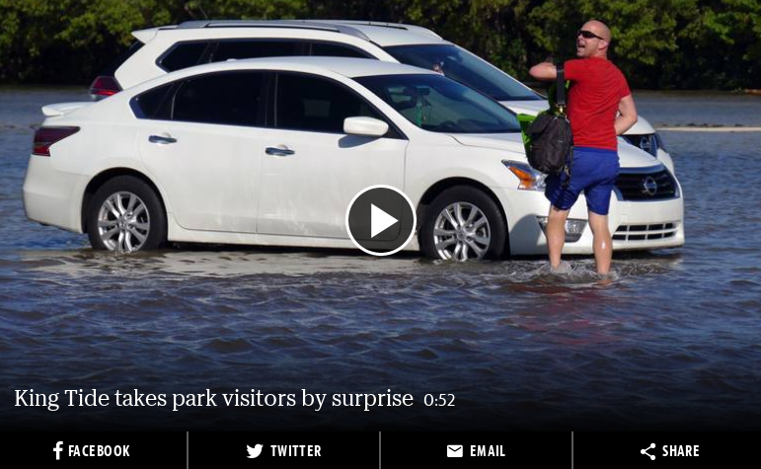
South Florida vs. Sea Level changes
www.miamiherald.com/news/local/environment/article146511584.html

Slide 4
Sources of Sea Level Changes
$Obs. SL= \overline{SL}+ ∆{SL}_{tides}+∆{SL}_{waves}+ ∆{SL}_{weather}$ + $∆{SL}_{land}$ $+ ∆{SL}_{GL}$
$$+ ∆{SL}_{Ocean Currents}$$
$\overline{SL}$ mean sea level
$∆{SL}_{tides}$ effect of astronomical tides
$∆{SL}_{waves}$ local effect of waves
$∆{SL}_{weather}$ effect of local winds and atm. pressure changes
$∆{SL}_{land}$ effect of land subsidence
$∆{SL}_{GL}$ effect of global changes in ocean mass and density
$∆{SL}_{Ocean Currents}$ effect of Ocean Currents in sea level changes

Slide 5
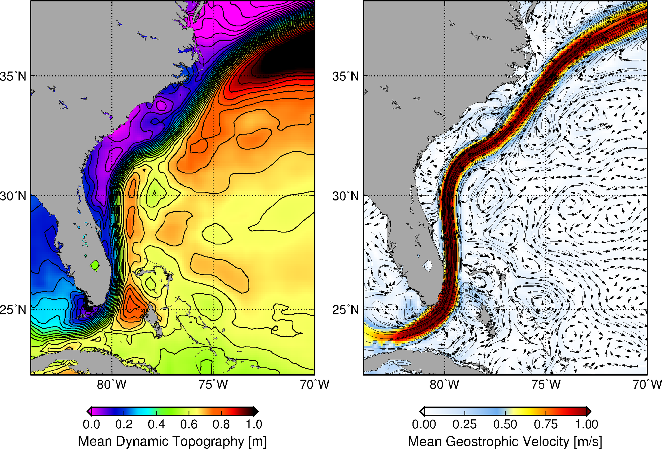
Florida Current and Gulf Stream Effect on Sea Level along east U.S. coast
$$∆{SL}_{Ocean Currents}$$
Intense Ocean Current Flowing very close to U.S. east coast

Slide 6
Florida Current and Gulf Stream Effect on Sea Level along east U.S. coast
$$∆{SL}_{Ocean Currents}$$
The Florida Current sustain a sea level difference between south Florida and the Bahamas of almost 1m

Slide 7
Florida Current and Gulf Stream Effect on Sea Level along east U.S. coast
$$∆{SL}_{Ocean Currents}$$
Mean sea level
FL
BHS
Changes in the intensity of the Florida Current and Gulf Stream are, therefore, associated with sea level changes along the east coast of U.S.
sea level
Mean Florida Current flow
FL - Florida
BHS - Bahamas

Slide 8
Florida Current and Gulf Stream Effect on Sea Level along east U.S. coast
$$∆{SL}_{Ocean Currents}$$
Mean sea level
FL
BHS
Changes in the intensity of the Florida Current and Gulf Stream are, therefore, associated with sea level changes along the east coast of U.S.
sea level
Intense Florida Current flow
FL - Florida
BHS - Bahamas
Decrease in sea level at Florida
Increase sea level at the Bahamas

Slide 9
Florida Current and Gulf Stream Effect on Sea Level along east U.S. coast
$$∆{SL}_{Ocean Currents}$$
Mean sea level
FL
BHS
Changes in the intensity of the Florida Current and Gulf Stream are, therefore, associated with sea level changes along the east coast of U.S.
sea level
Weak Florida Current flow
FL - Florida
BHS - Bahamas
Increase in sea level at Florida
Decrease sea level at the Bahamas

Slide 10
Florida Current and Gulf Stream Effect on Sea Level along east U.S. coast
0 lag
$$∆{SL}_{Ocean Currents}$$
For every 1 Sv decrease in FC transport on seasonal time-scales:
~5 cm increase in coastal sea-level in most locations between 25N-42N
~10 cm increase in coastal sea-level in locations at the mid-Atlantic bight (SLR hot spot, Ezer et al., 2012)
5 cm decrease in coastal sea-level at the Bahamas
1 Sv = 10⁶ m³ s⁻¹

Slide 11
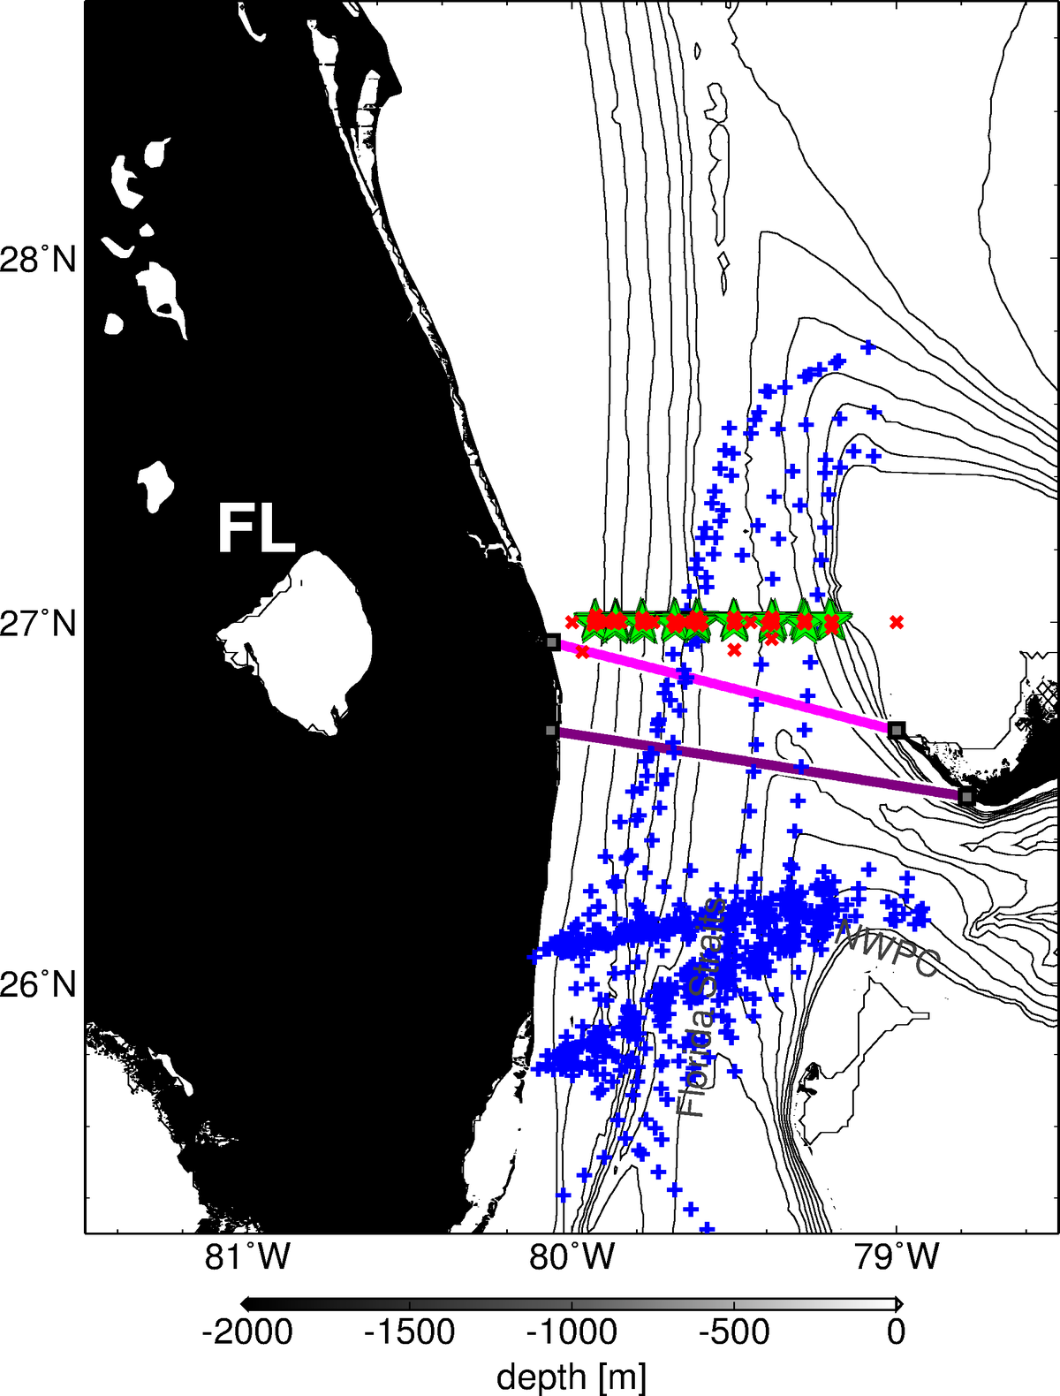
Current efforts by NOAA/AOML to monitor the Florida Current
Cape Canaveral
Bahamas
Miami

Slide 12
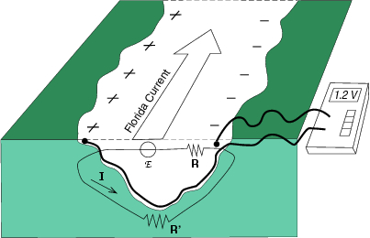
Continuous measurements of the Florida Current flow using telephone cables

Slide 13
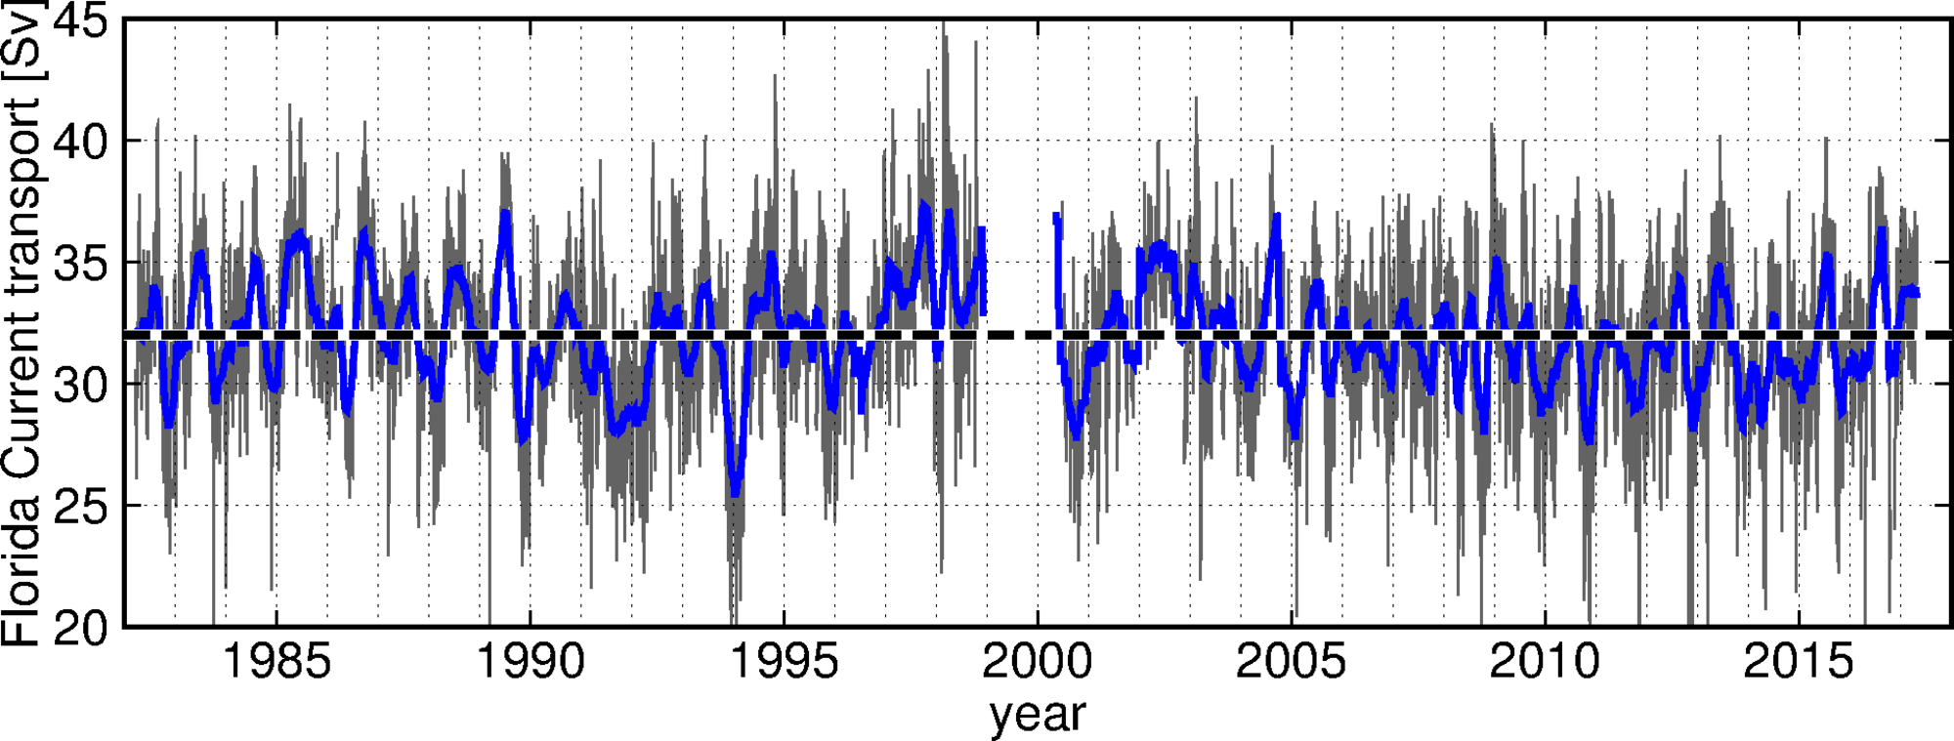
Continuous measurements of the Florida Current flow using telephone cables
Daily record of the Florida Current flow since 1982
Daily FC transport
1 Sv = 10⁶ m³ s⁻¹
90 days low-pass

Slide 14
Observed Florida Current changes and potential links with coastal sea-level
Daily FC transport
Observed – Predicted sea level 2016 (Lake Worth)
2016 FC transport
Low FC transport coincided with observed king tide events in October 2016
Baringer et al. (2017), Meridional overturning and oceanic heat transport circulation observations in the North Atlantic Ocean, State of the Climate in 2016, Bulletin of the American Meteorological Society, in press

Slide 15
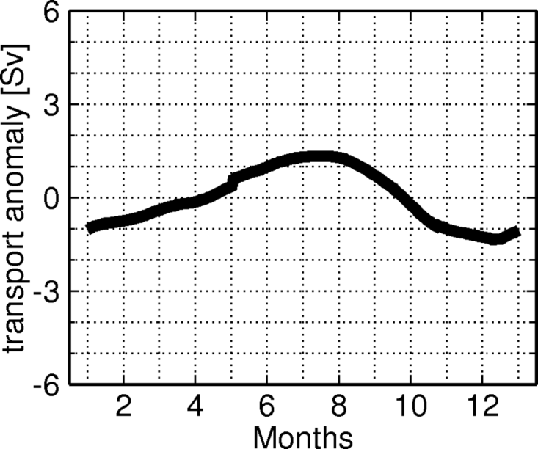
Seasonal changes in Florida Current flow
The FC annual variability
+30
High during late spring to summer
Low during fall to winter
+15
Niiler and Richardson (1973);
Leaman et al. (1987)
Schott et al., (1988)
Baringer and Larsen (2001);
Meinen et al., (2010)
0
sea level change [m]
-15
± 5 cm expected sea level change associated with the mean FC annual cycle
-30

Slide 16
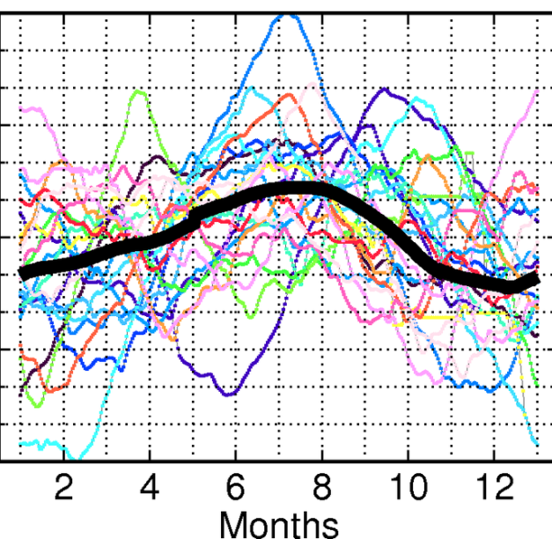
Seasonal changes in Florida Current flow
The FC annual variability
+30
Significant changes in the Florida Current annual variability from one year to the next
+15
0
sea level change [m]
-15
± 20 cm sea level changes usually associated with the seasonal FC flow
-30

Slide 17
Seasonal changes in Florida Current flow
Satellite Altimetry – Westward propagating signals
SHA – sea height anomaly measured by satellite altimetry
*displayed data is filtered for the 73-525 days band, after removal of average annual cycle

Slide 18
Year-to-year changes in the Florida Current seasonality: links with coastal sea-level changes
Satellite Altimetry vs. Florida Current transport

Slide 19
Year-to-year changes in the Florida Current seasonality: links with coastal sea-level changes
Satellite Altimetry vs. Florida Current transport

Slide 20
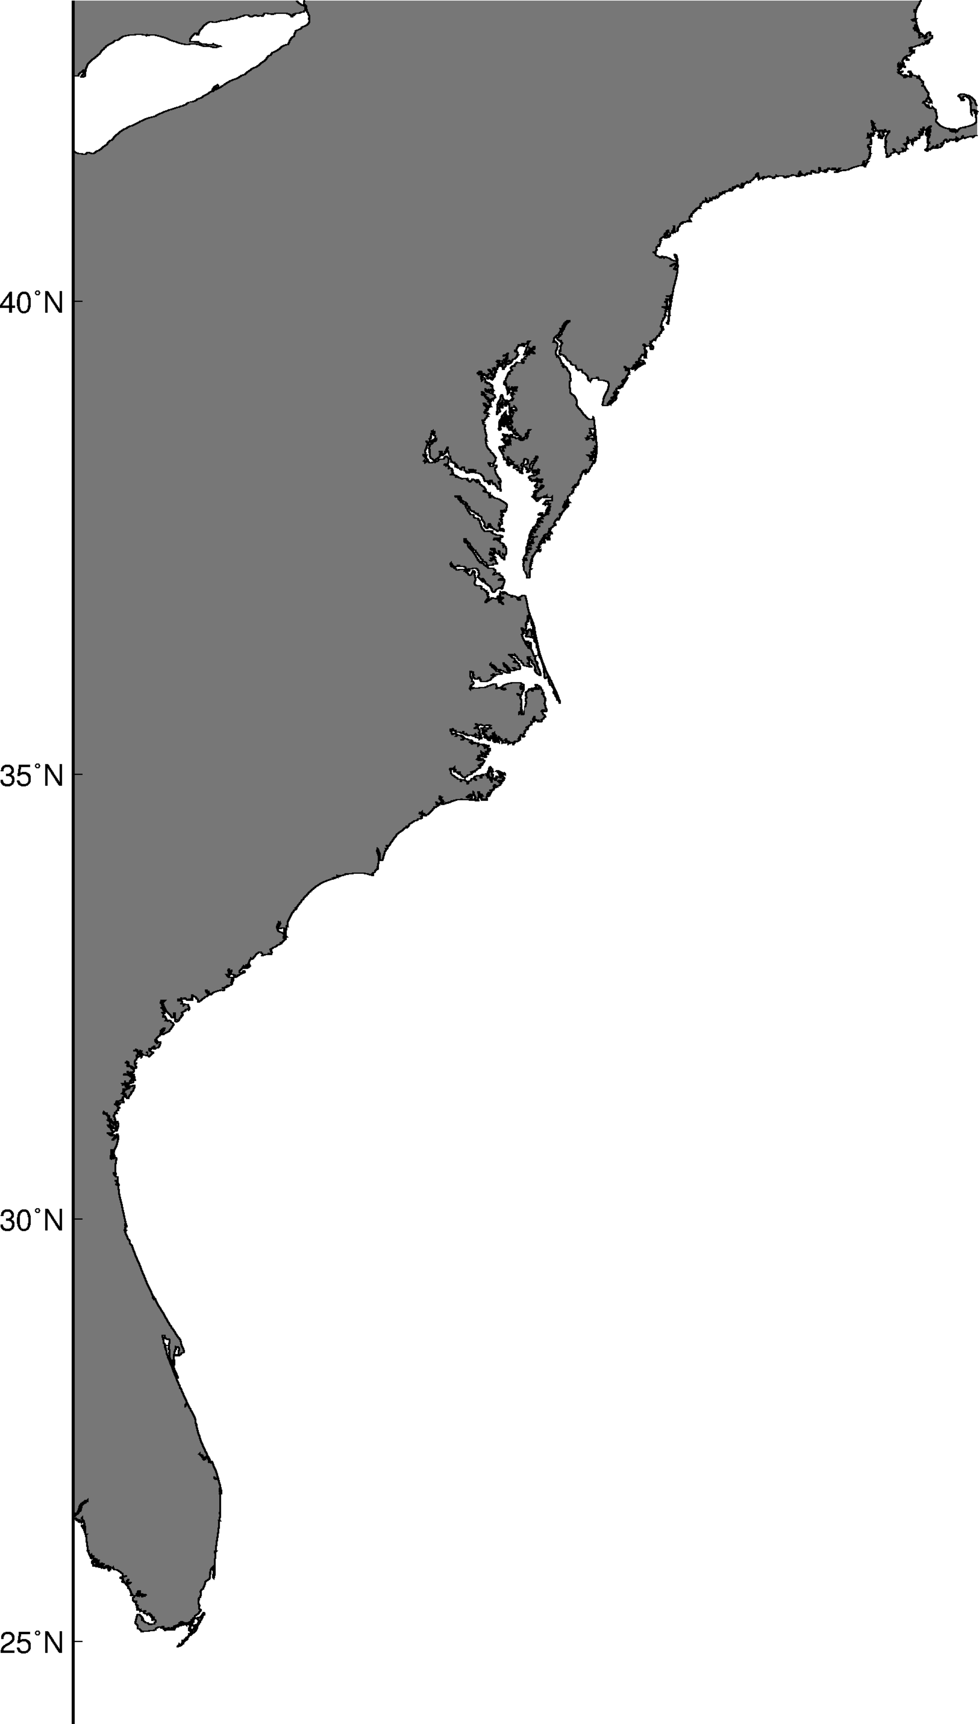
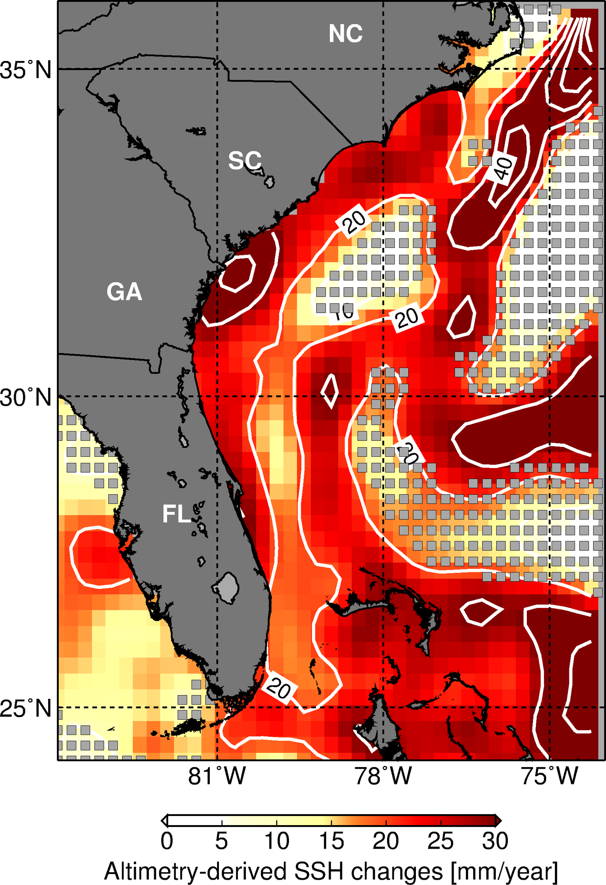
Sea level changes along the Southeast U.S. Coast during 2010-2015
Tide Gauges
Satellite-Altimetry: 2010-2015
entire record
2010-2015
16.8
17.7
3.9
10.0
3.9
19.6
3.5
18.6
4.0
20.1
4.2
20.7
2.5
22.4
Latitude
5.0
25.5
Miami
Miami
4.9
17.4
4.6
15.1

Slide 21
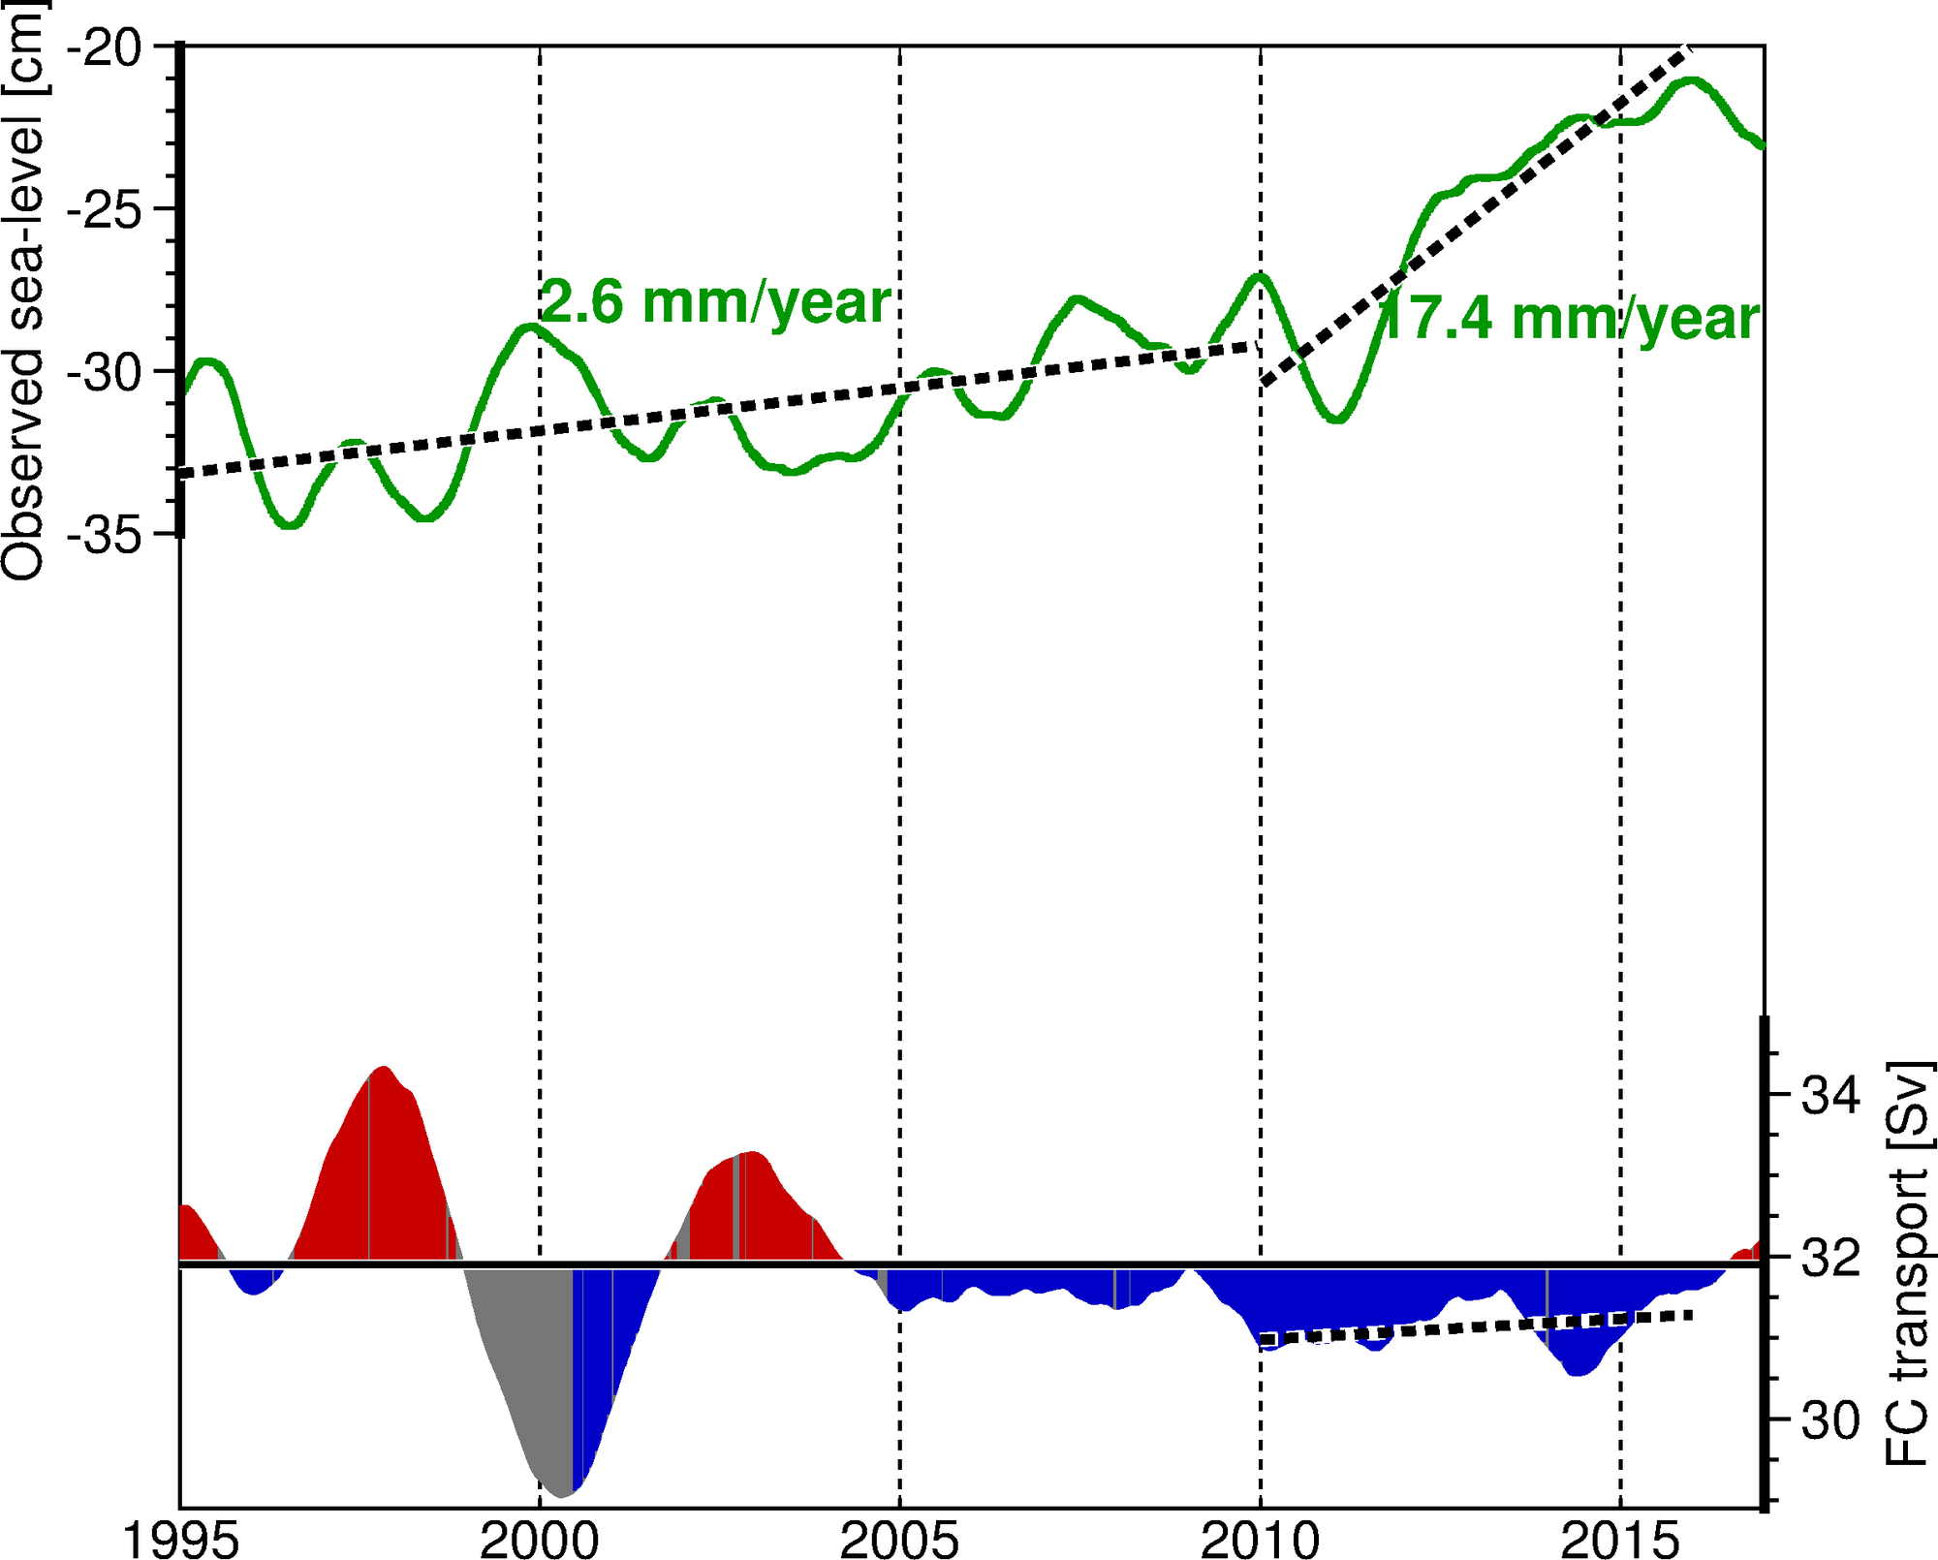
The Florida Current flow and sea level changes during 2010-2015
Observed Sea Level – Miami, FL
FC transport
1995 2000 2005 2010 2015

Slide 22
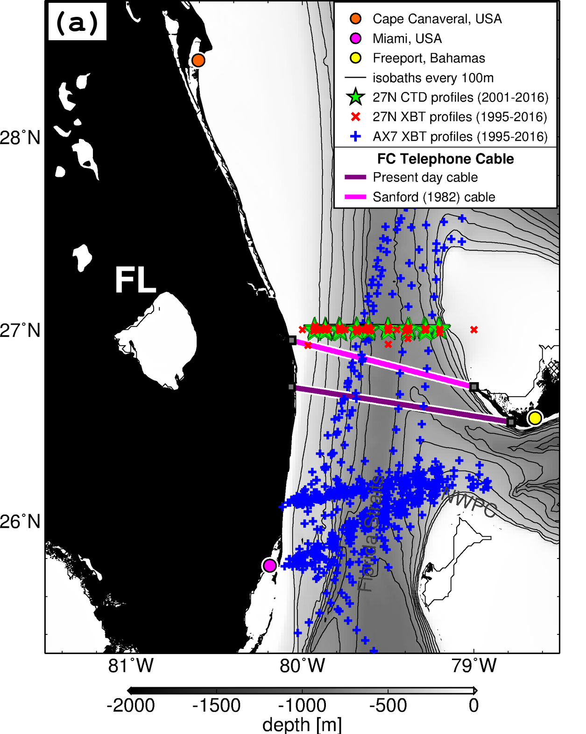
Recent Florida Current warming during 2010-2015
Over 250 in situ surveys since 1995

Slide 23
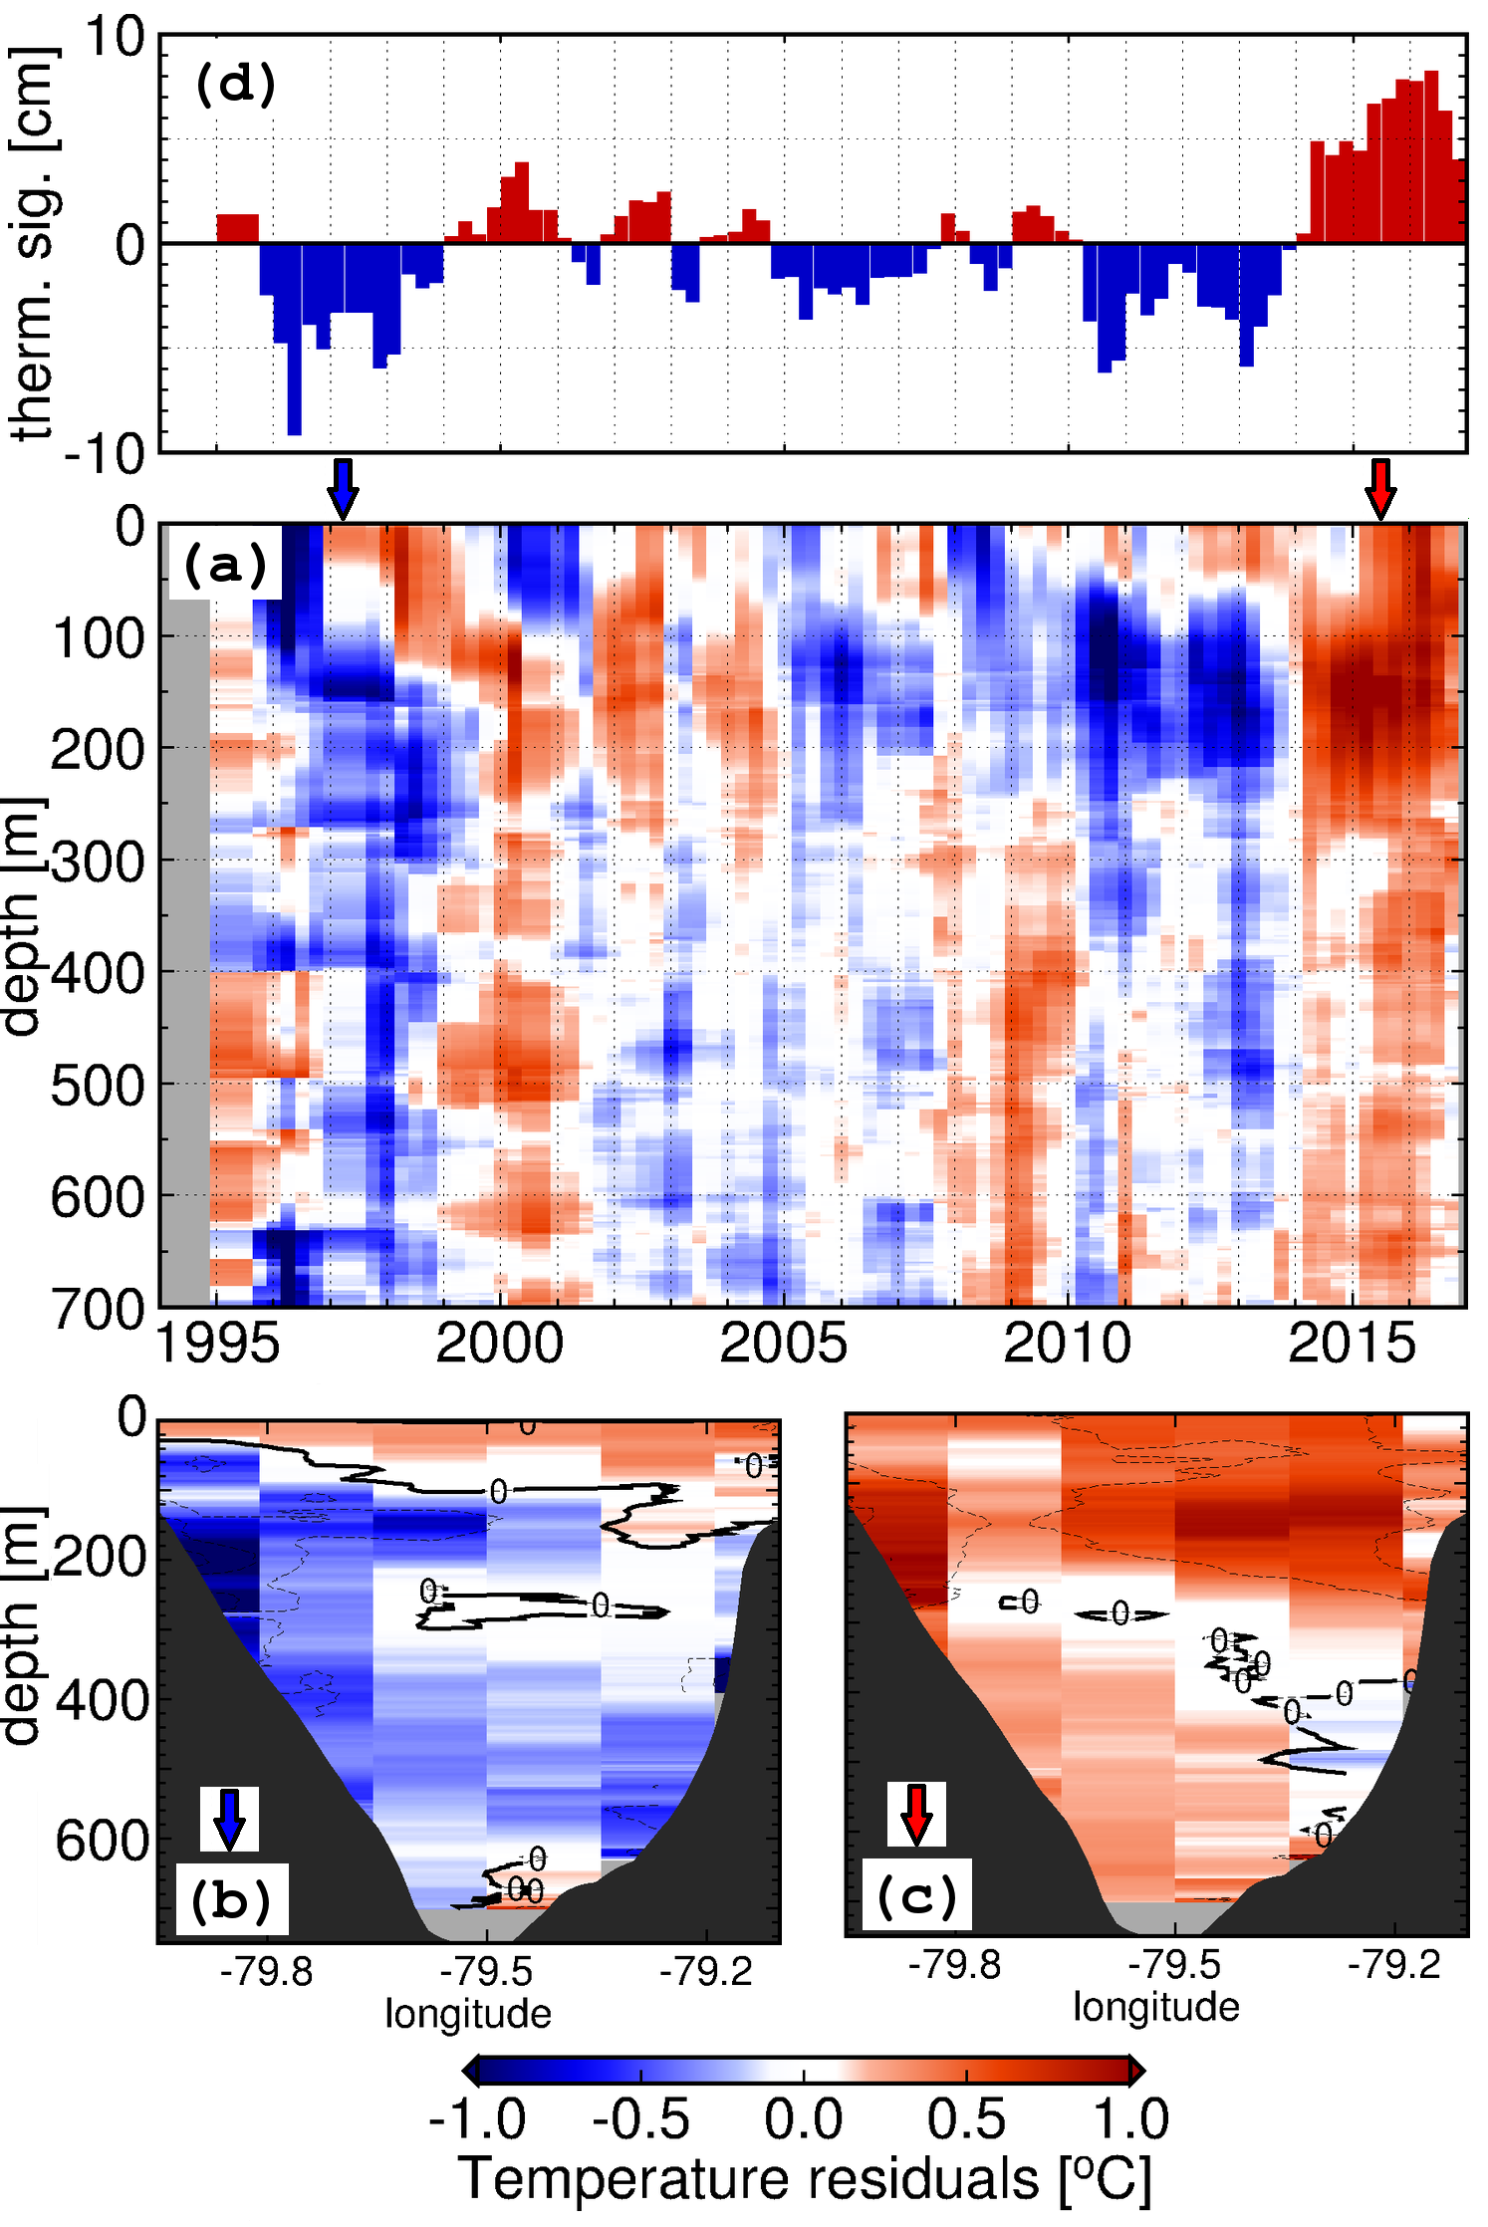
Recent Florida Current warming during 2010-2015
Temperature anomalies associated with:
Thermosteric height anomalies ranging between:
-10 and 10 cm
Trend of 2 cm / decade
The 2010-2015 event:
Florida Current temperature shifted from a cold regime during 2010-2013 to a warm regime during 2014-2015
The observed peak in late 2015 coincided with observed flooding events
November, 2011
Temperature anomalies with respect to the annual cycle, and averaged for the Florida Straits
Domingues et al., (in preparation). Accelerated sea level changes in the United States east coast: links with recent warming of the Florida Current

Slide 24
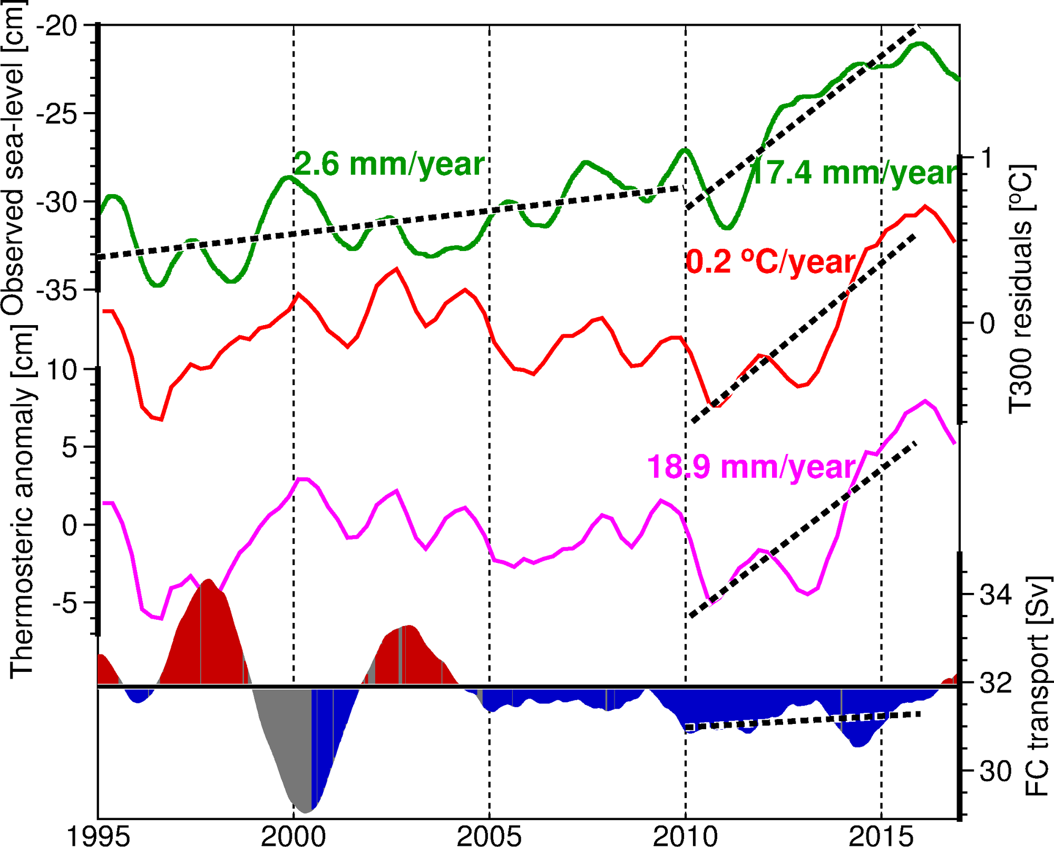
The Florida Current temperature and sea level changes during 2010-2015
Observed Sea Level – Miami, FL
FC temperature and transport changes likely contribute independently to coastal sea-level variability
FC temperature 0-300m
FC thermosteric anomaly
FC transport
1995 2000 2005 2010 2015
Domingues et al., (in preparation). Accelerated sea level changes in the United States east coast: links with recent warming of the Florida Current

Slide 25
Summary
The NOAA Atlantic Oceanographic and Meteorological Laboratory maintains a network of ocean observing platforms that provide real-time information of key ocean currents that cause coastal sea level changes.
Changes in the Florida Current flow can cause sea level changes of ±10 cm along the Southeast U.S. coast
Changes in the Florida Current temperature can account for an additional ±10 cm in coastal sea-level due to thermal expansion (contraction) of the water column
Accelerated sea-level changes observed during 2010-2015 along the Southeast U.S. east coast were mostly caused by warming of the Florida Current during the time period
Flooding events in Miami during the very large King Tide from September-October 2015 coincided with:
Lower than average Florida Current transport -> ~5cm increase in sea-level
Warmer than average Florida Current - > ~10 cm increase in sea-level

Slide 26
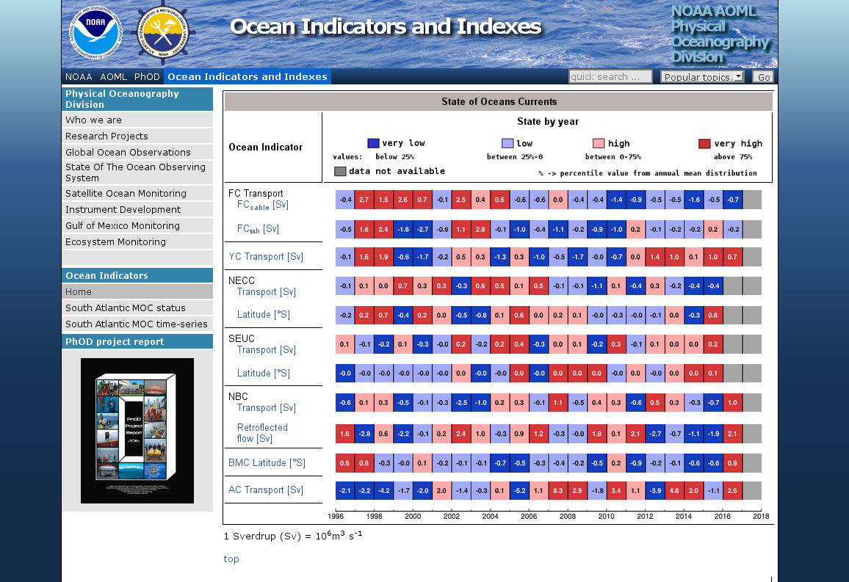
NOAA/AOML Ocean Indicators Webpage
www.aoml.noaa.gov/phod/indexes

