Slide 1
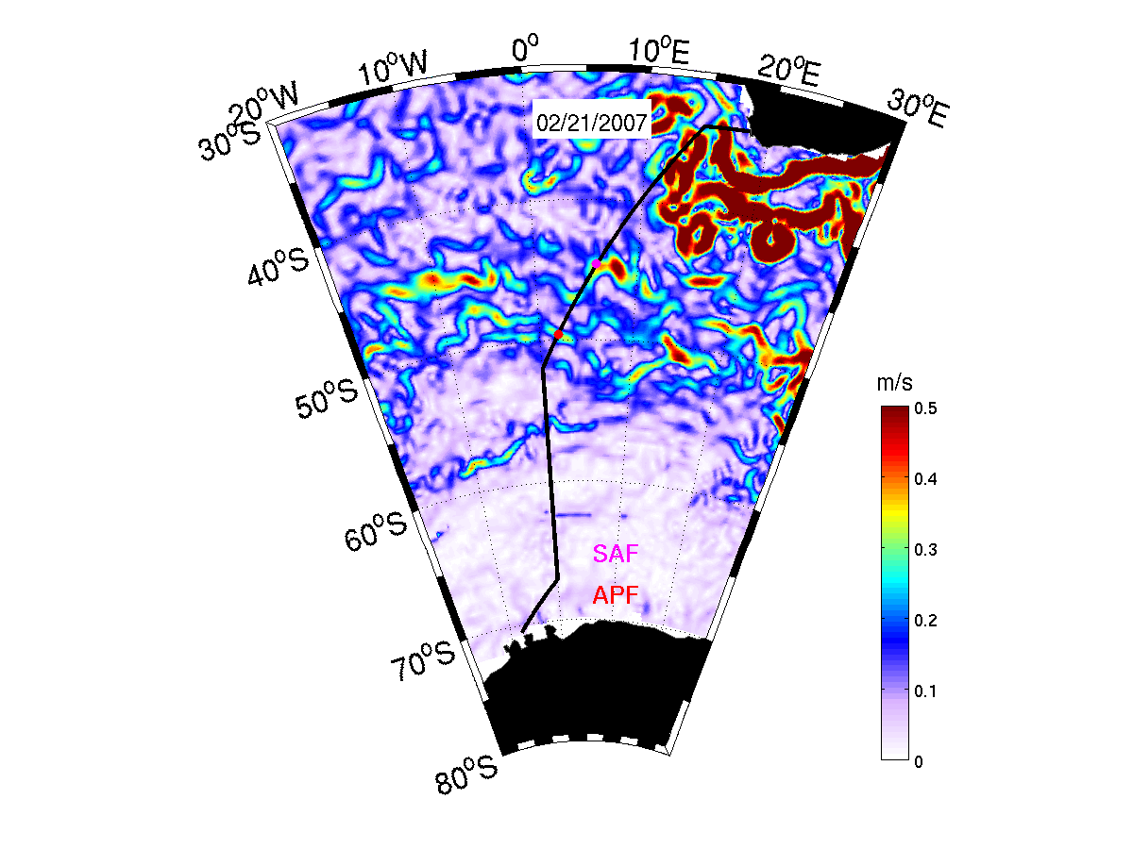
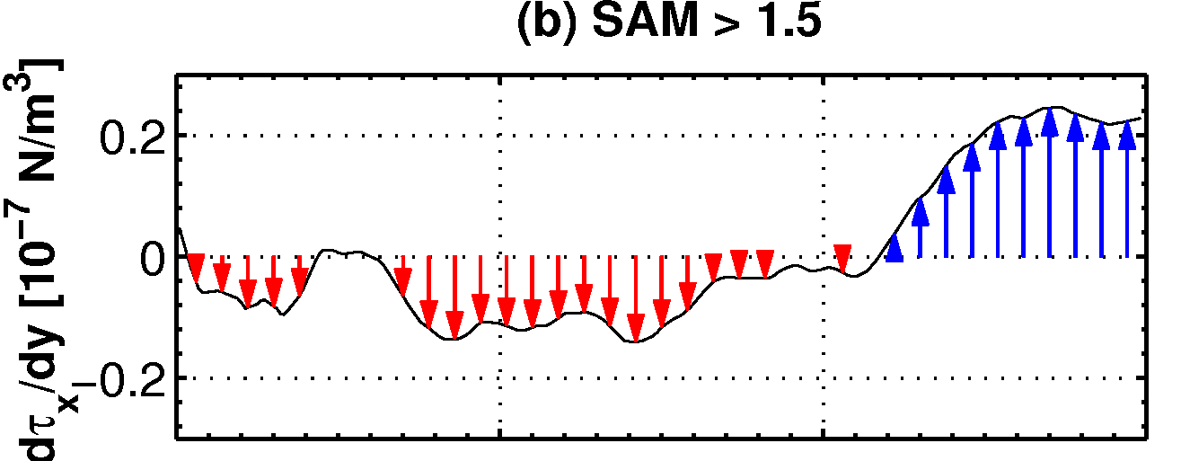
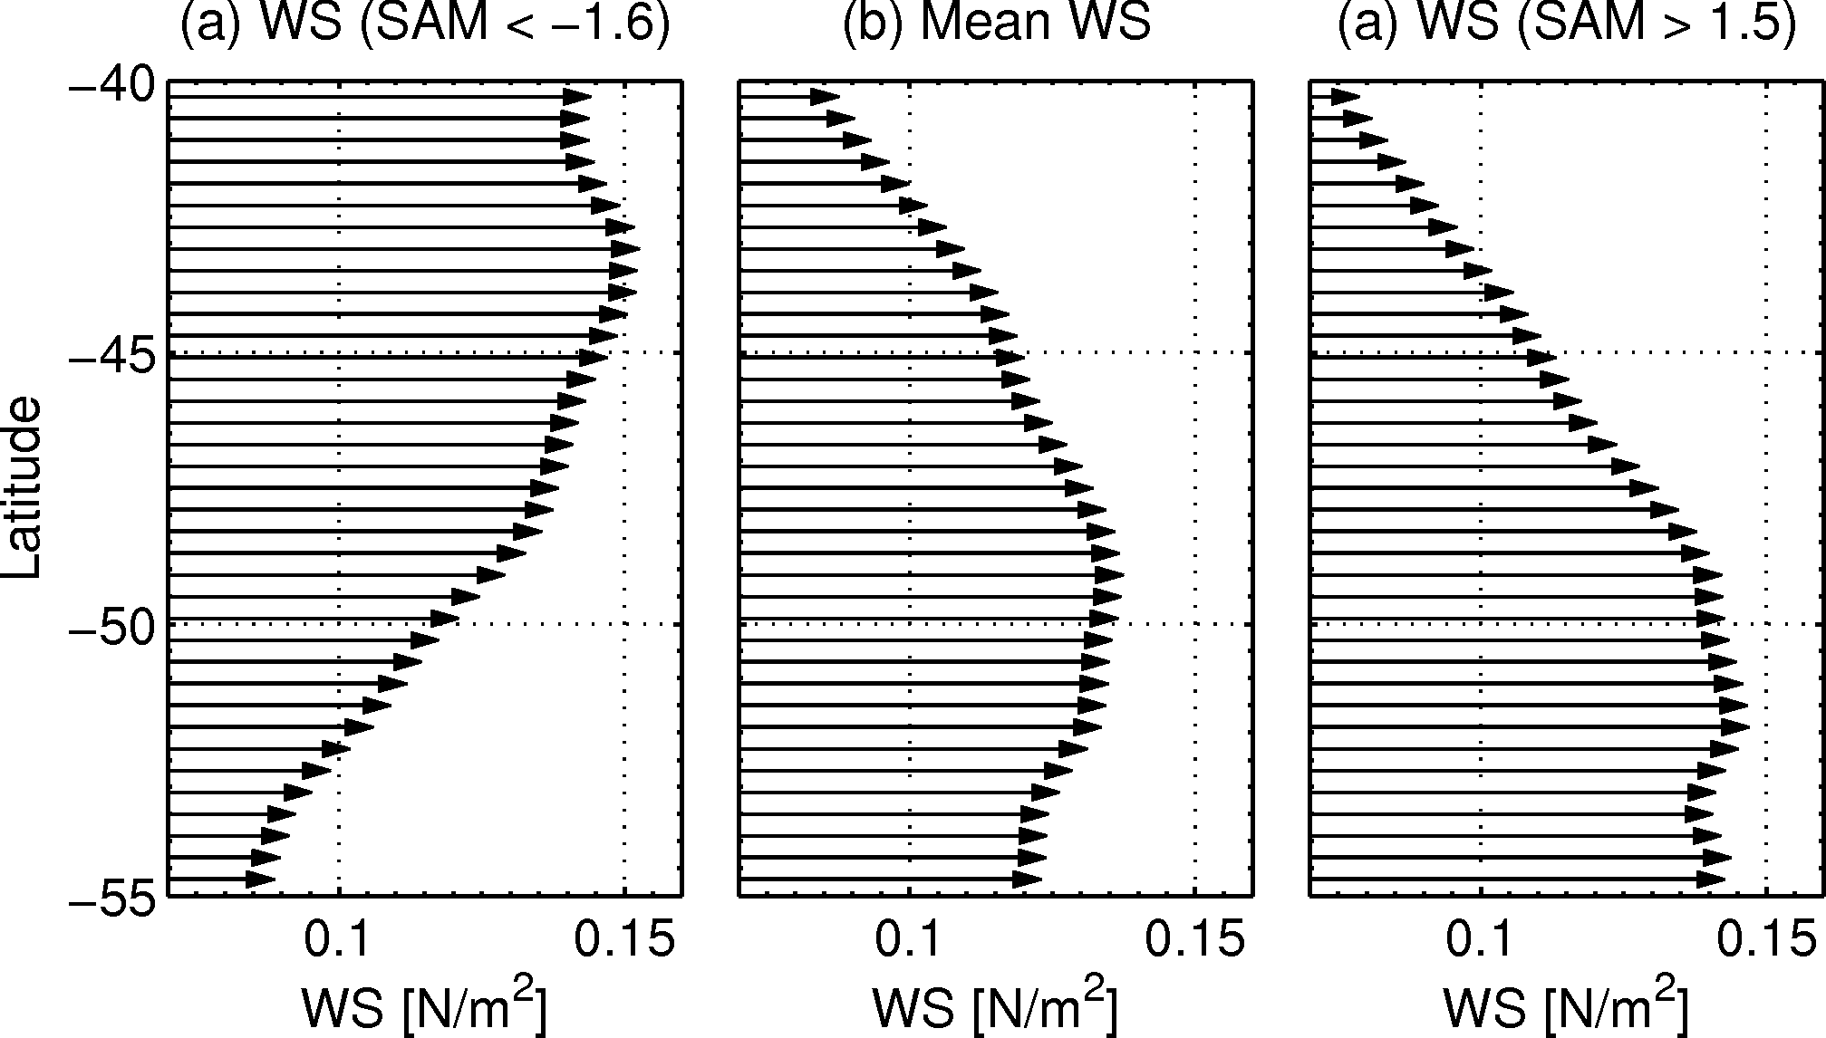
Wind forced variability of the Antarctic Circumpolar Current south of Africa between 1993-2010
η
0
Z_{ek}
Depth [m]
APF
SAF
-H
-55 -50 -45 -40
Latitude
Ekman transport
Ekman pumping
η = dynamic height
SAF – Subantarctic Front; APF – Antarctic Polar Front
Domingues, R., G Goni., S. Swart and S. Dong: Wind forced variability of the Antarctic Circumpolar Current south of Africa between 1993-2010, under review on the Journal of Geophysical Research

