Slide 1
NOAA/AOML XBT Operations
Francis Bringas, on behalf of the AOML XBT Network team
XBT Network Review. AOML, Miami. Feb. 7, 2017

Slide 2
50 Years of XBT Operations
NOAA/AOML XBT Operations
50 Years of XBT Operations
AOML started XBT operations in 1967 with deployments along AX10 (Newark to San Juan).
XBT operations have since been conducted in different modes (low density, frequently repeated, high density) according to scientific and operational needs, and have expanded to global coverage.
XBT-derived temperature profiles represent now between 10% and 15% of all global, non-mooring, temperature profiles. The main contribution of the XBT network is to provide temperature measurements to:
− Monitor changes of key surface and subsurface currents,
− Assess meridional heat transport in all ocean basins,
− Help initialize and validate climate and weather numerical forecast models, and
− Supplement other observational platforms to assess the variability of the global upper ocean heat content.
XBT Network Review. AOML, Feb. 2017

Slide 3
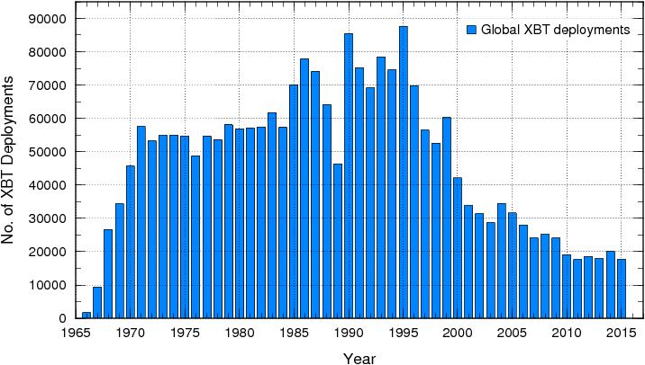
50 Years of XBT Operations
NOAA/AOML XBT Operations
50 Years of XBT Operations
OceanObs09
Number of global XBT deployments since 1965. US XBT operations have been consistently responsible for at least 50% of these global deployments (68% in average).
XBT Network Review. AOML, Feb. 2017

Slide 4
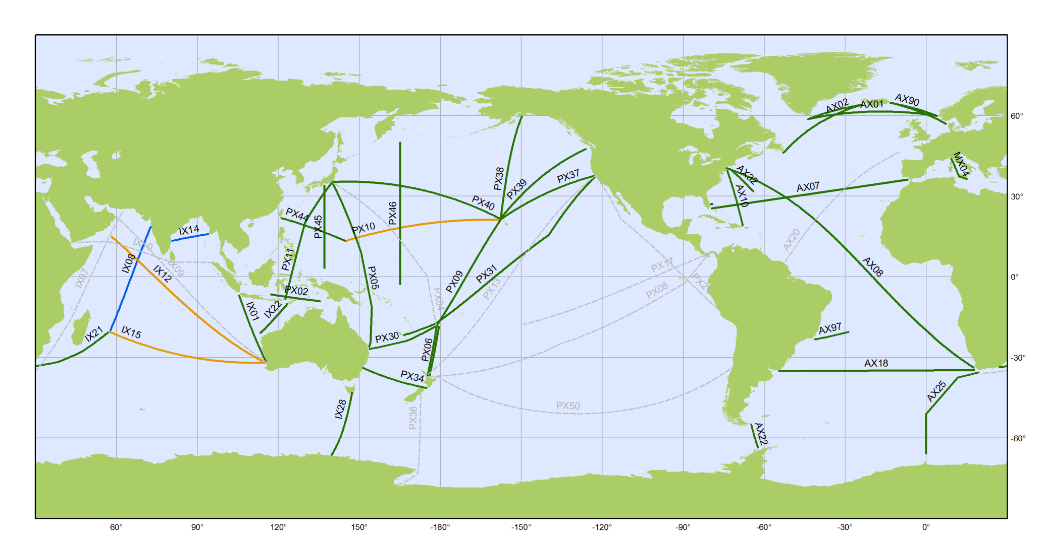
50 Years of XBT Operations
NOAA/AOML XBT Operations
Status of AOML XBT Operations
The Global XBT Network
AX02
AX01
AX90
AX32
MX04
AX07
AX10
AX08
IX01
AX97
AX18
AX25
Frequently Repeated:
6 - 8 deployments per day
1/100 km – 1/150 km
12 - 18 transects per year
High Density:
1 deployment every 25 - 50 km
18 - 35 deployments per day
4 transects per year
XBT Network Review. AOML, Feb. 2017

Slide 5
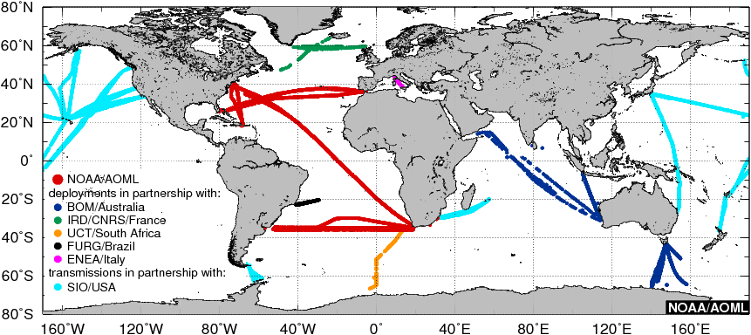
50 Years of XBT Operations
NOAA/AOML XBT Operations
Status of AOML XBT Operations
Location of the AOML XBT deployments and AOML-supported XBT deployments and/or transmissions during FY2016 carried out by AOML or in partnership with national and international collaborators.
XBT Network Review. AOML, Feb. 2017

Slide 6
50 Years of XBT Operations
NOAA/AOML XBT Operations
Status of AOML XBT Operations
Name | Since… | No. of Cruises* | No. of XBTs*
AX01 | 1997 | 90 | 2,438
AX02 | 2008 | 24 | 1,181
AX07 | 1994 | 89 | 20,437
AX08 | 2000 | 65 | 22,777
AX10 | 1996 | 78 | 7,894
AX18 | 2002 | 48 | 10,013
AX20 | 1995 | 9 | 1,463
AX25 | 2004 | 33 | 4,267
AX32 | 1975 | 149 | 3,277
AX97 | 2004 | 65 | 2,771
MX01 MX02 MX04 | 1999 | 223 | 11,135
IX01 | 1983 | 203 | 13,722
1. More than 100,000 XBTs deployed during ~1100 cruises since 2000.
2. Operations in partnership with 8 countries during recent years.
3. All data distributed in near real-time (GTS) in delayed mode (NCEI).
4. XBT data has been used in more than 1500 scientific and technical publications since 2000.
* Since 2000; AX01 in FR, all other in HD mode.
XBT Network Review. AOML, Feb. 2017

Slide 7
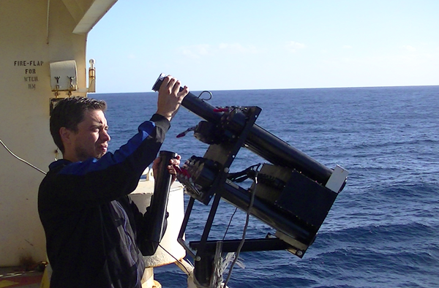
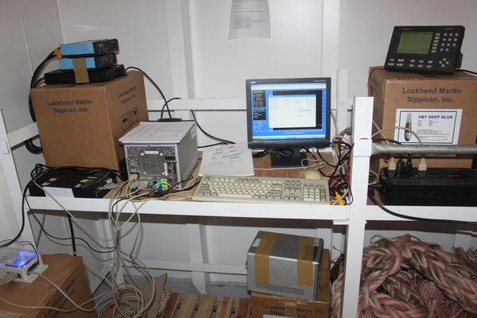
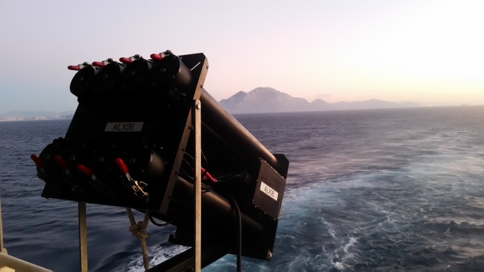
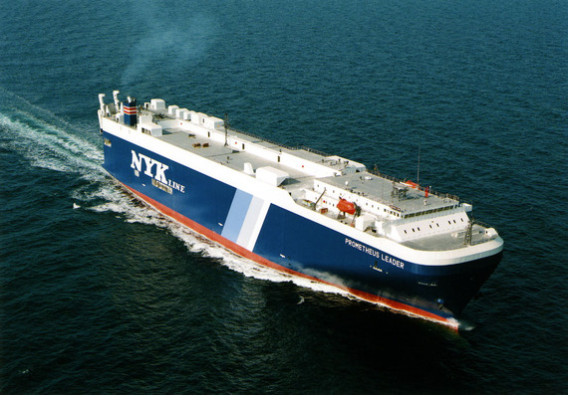
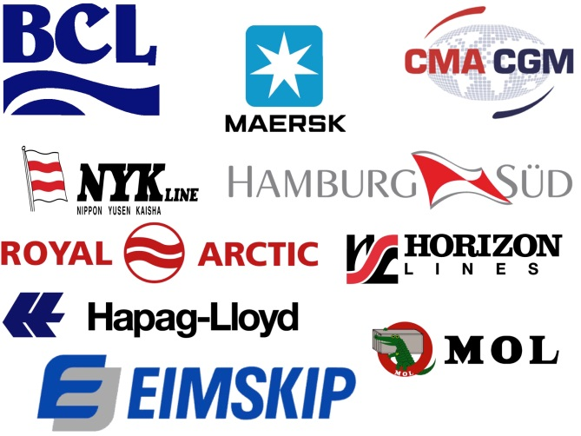
50 Years of XBT Operations
NOAA/AOML XBT Operations
Ship Recruitment, Logistics, Ship Riders
Luis Yurquina from the Argentine Hydrographic Service during an AX18 Cruise on MOL Triton Ace
High Density XBT cruise equipment installation
More than 15 shipping companies
Between 30 and 40 ships per year
More than 45 cruises per year in high density mode
Operations in partnership with 10 institutions from 8 countries
Approximately 20 riders from US and our partners
AX07 cruise starting at the Strait of Gibraltar
CMA CGM Rabelais and NYK Prometeus Leader ships used during AX07 and AX10 cruises
XBT Network Review. AOML, Feb. 2017

Slide 8
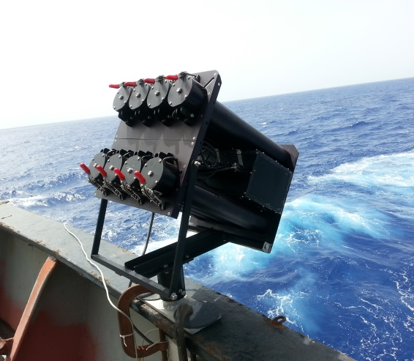
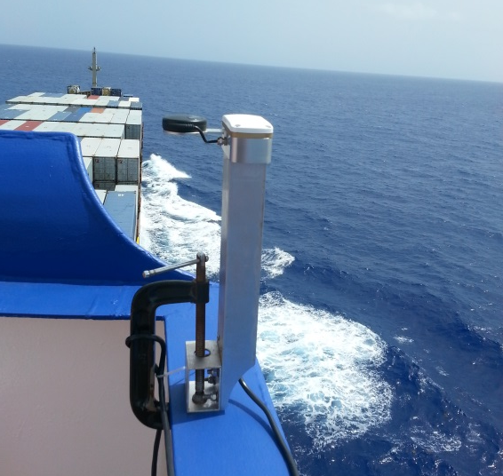
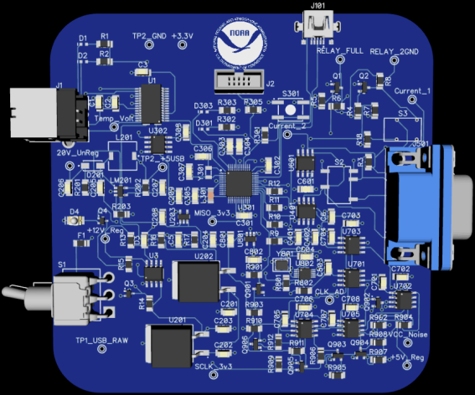
50 Years of XBT Operations
NOAA/AOML XBT Operations
Engineering Developments
AOML XBT Autolauncher
AOML XBT Autolauncher
Deployments at fix time or distance intervals, or at fixed locations.
Allows 24h operations with a single rider doing frequent deployments for weeks.
Portable. Easy installation and removal.
AOML Iridium Transmitter
Developed at AOML in 2010-2012, fully transitioned into operations since 2015.
Reliable and efficient transmissions of arbitrary types and amounts of data.
Reduced costs from $15 to $0.95 per profile (saving of over $200,000 a year).
Development team received a NOAA Team Member of the Month award and a NOAA Administrator’s Award during 2016.
AOML Iridium Transmitter
AOML XBT Data Recorder (AXR)
Under development, prototype already tested on the field.
Will replace current recording units ($9,000 per unit).
AOML XBT Data Recorder
XBT Network Review. AOML, Feb. 2017
Notes:
AL saves money for using a single rider working 24h a day operations. Can install multiple ALs

Slide 9
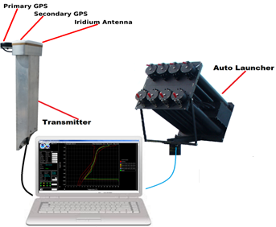
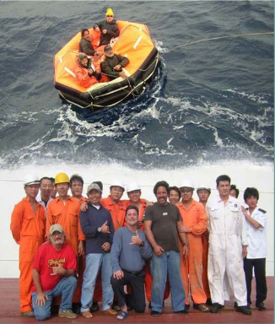
50 Years of XBT Operations
NOAA/AOML XBT Operations
Software Developments
AMVERSEAS and SEAS Server
AMVERSEAS software developed at AOML to collect and transmit XBT, TSG and MET observations
Installed in more than 50 ships of the XBT Network (14,000 XBT profiles per year)
Also used to send Amver bulletins to the US Coast Guard for search and rescue
AMVERSEAS and the SEAS server also distributes 500,000 marine weather reports obtained from 800 ships of the Voluntary Observing Ship program
Crew of the M/V Cape Nelson and survivors from the fishing vessel Abound that sank 625 miles off the coast of San Francisco, whose rescue was facilitated through AMVERSEAS on October 26, 2005
XBT Network Review. AOML, Feb. 2017

Slide 10
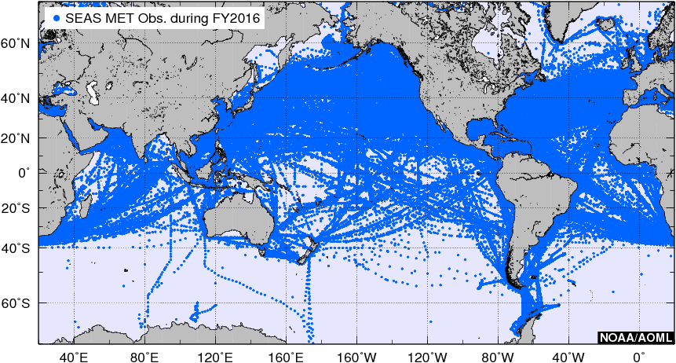
50 Years of XBT Operations
NOAA/AOML XBT Operations
Software Developments
Locations of the approximately 500,000 marine weather reports obtained from 800 ships of the VOS distributed through the GTS using SEAS software during FY2016.
XBT Network Review. AOML, Feb. 2017

Slide 11
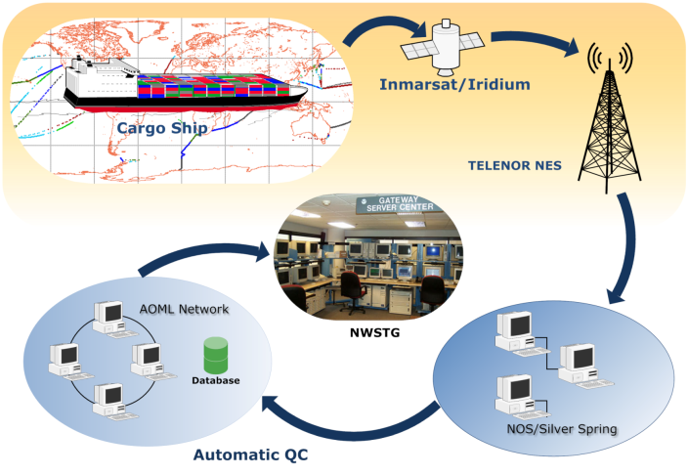
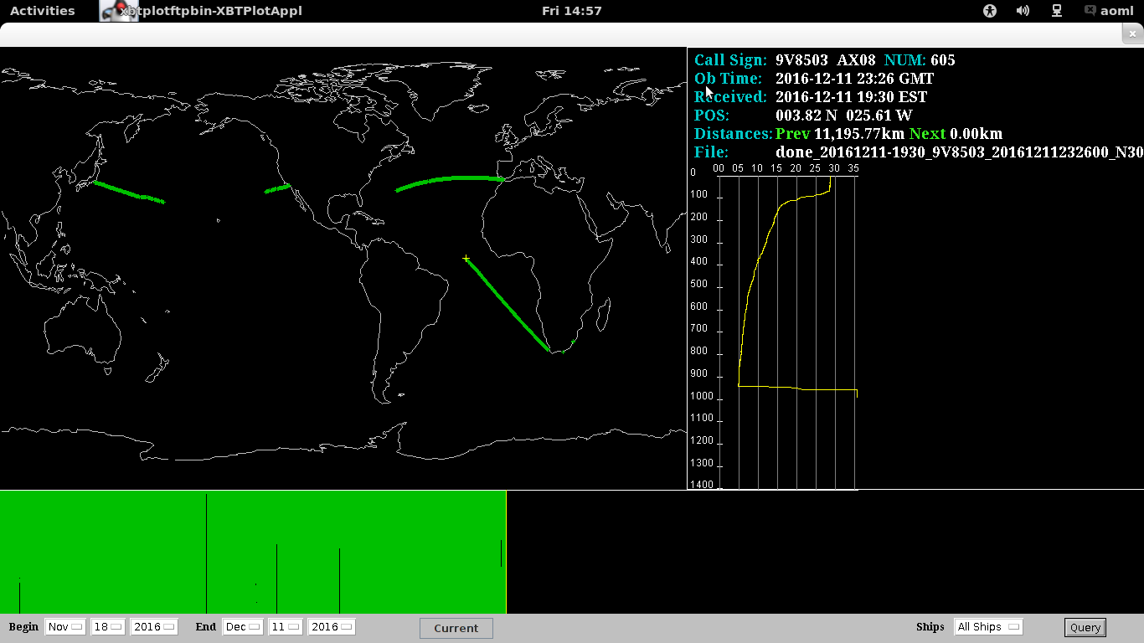
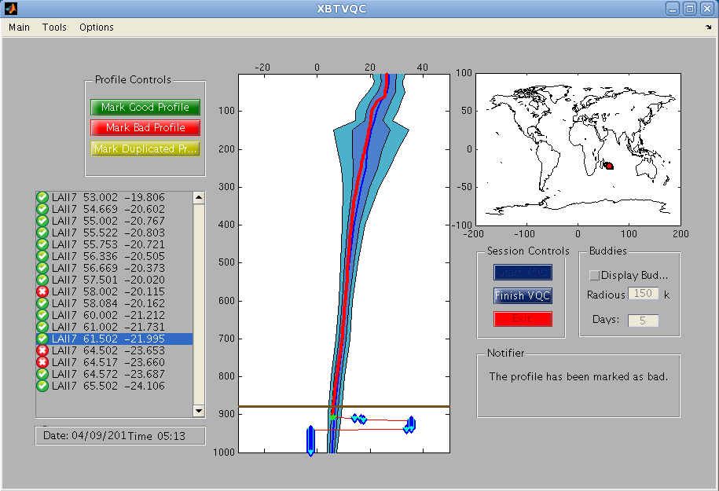
50 Years of XBT Operations
NOAA/AOML XBT Operations
Data Flow and Data Management
Almost 100% of XBT profiles are transmitted in real-time using Iridium Transmitters.
AOML and SIO XBT profiles undergo near-real time automatic quality control (AQC) procedures at AOML + Visual QC for profiles that fail the AQC.
Good profiles (95%) are transmitted to the GTS in near real-time and distributed / archived at NCEI (WOD and GTSPP).
AOML XBT profiles collected in HD cruises also undergo a science quality delayed time QC. Final QCed profiles are delivered to NOAA/NCEI for archival and replacement into the “Best Quality” GTSPP data set.
Transmission into the GTS are done according to all data format requirements, including data in BUFR format and additional meta-data.
Data management procedures ensure that the XBT data reaches the operational and scientific community in a timely manner and with the highest possible quality.
XBT Network Review. AOML, Feb. 2017

Slide 12
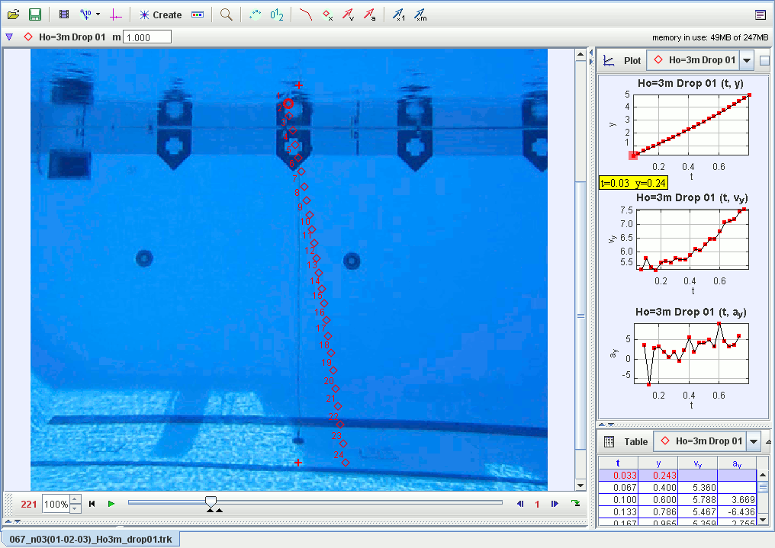
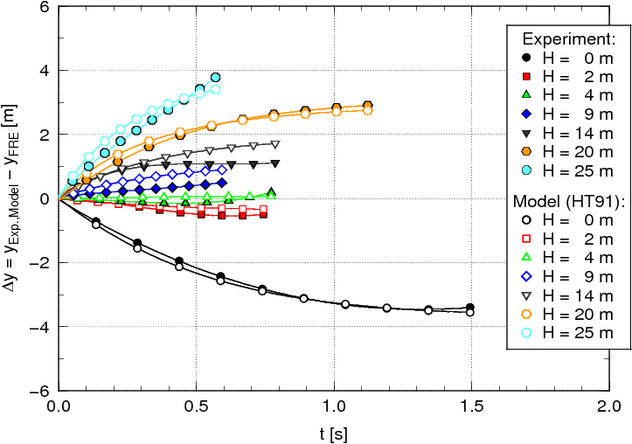
50 Years of XBT Operations
NOAA/AOML XBT Operations
Data Quality Improvements
AOML conducts experiments in order to improve XBT data quality.
AOML maintains a strong collaboration with Sippican for the improvement and development of new, more accurate, XBT probes.
AOML is actively involved in the use of new technologies for data collection and transmission, including the development of a new XBT data recorder.
New file formats (i.e. BUFR) are constantly used in order to include additional metadata needed for data corrections.
The integration of meteorological sensors in some cruises will increase the value of the XBT data collected.
XBT Network Review. AOML, Feb. 2017

Slide 13
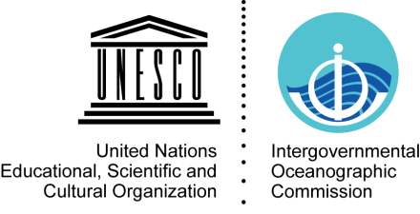
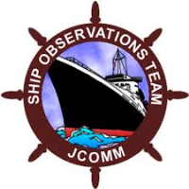
50 Years of XBT Operations
NOAA/AOML XBT Operations
Meetings and International Panels
AOML XBT Network is implemented through the Ship Of Opportunity Program, a participating member of JCOMM and JCOMMOPS.
AOML XBT Network is represented during bi-annual WMO/IOC Ship Observations Team (SOT) meeting. Dr. Gustavo Goni is the vice-chair of the WMO/IOC Ship Of Opportunity Program Implementation Panel (SOOPIP).
Other members of the AOML XBT group are part of Meta-T panel and the JCOMM Data Management Programme Area (DMPA) Task Team on Table Driven Code Forms, JCOMM DMPA Task Team on Table Driven Code Forms, the SOT Task Team on Instrument Standards and the SOT Task Team on Training.
Dr. Gustavo Goni is the co-chair for operations of the XBT Science Team, together with Dr. Janet Sprintall (SIO, for science) and Ms. Rebecca Cowley (CSIRO, for data management). Other members of the AOML XBT group are also part of the XBT Science Team.
AOML conducts an annual XBT Operations meeting.
AOML participate in other data management groups including GTSPP and IQuOD.
GTSPP
XBT Network Review. AOML, Feb. 2017
Notes:
Participation on these international panels provides an important mechanism for integrating and coordinating with other national or regional programs which, in the long run, improves our national climate mission by making more efficient and effective use of available resources.

Slide 14
50 Years of XBT Operations
NOAA/AOML XBT Operations
Future Work
Continue the application/development of new technologies for data acquisition and transmission (Amverseas, Iridium Transmitter, AOML XBT recorder).
Continue the development and maintenance of a flexible XBT data management system that meets all the community requirements for data dissemination and applications.
Add atmospheric sensors in some cruises to increase the value and applications of XBT data.
Take advantage of the BUFR format capabilities for the dissemination of XBT data in near real time in full resolution and with a complete set of meta-data and quality control (QC) flags.
Apply to the XBT profiles the QC experience and software development currently underway at AOML for glider observations.
XBT Network Review. AOML, Feb. 2017

