Slide 1

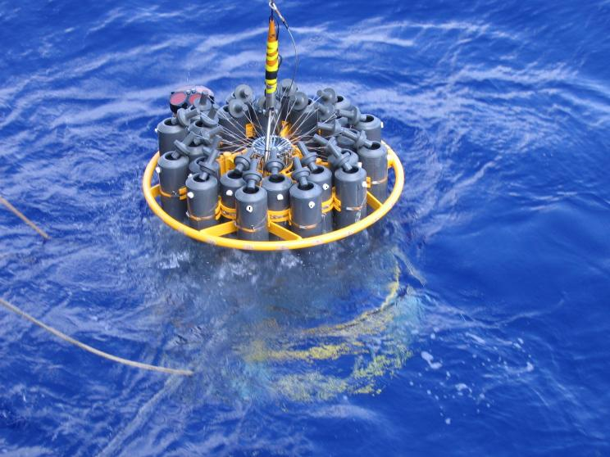
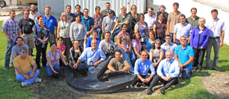
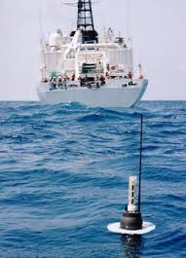
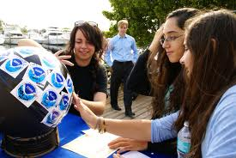
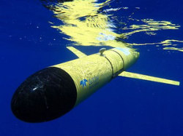



Using observations and models to better understand the meridional overturning circulation (MOC)
What is the state the MOC and do models get this right?
Presenter: Molly Baringer and Chris Meinen
AOML Program Review
4-6 March 2014

Slide 2
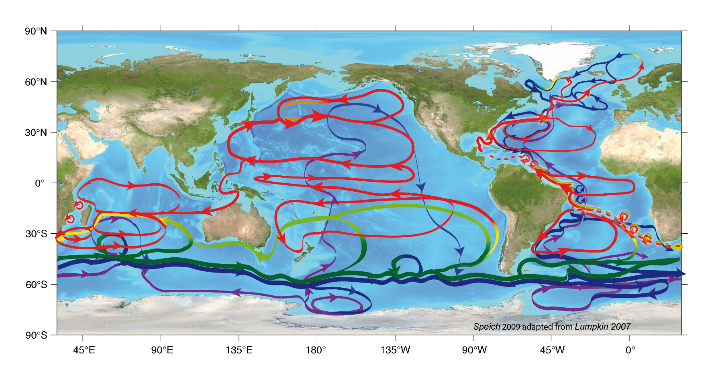
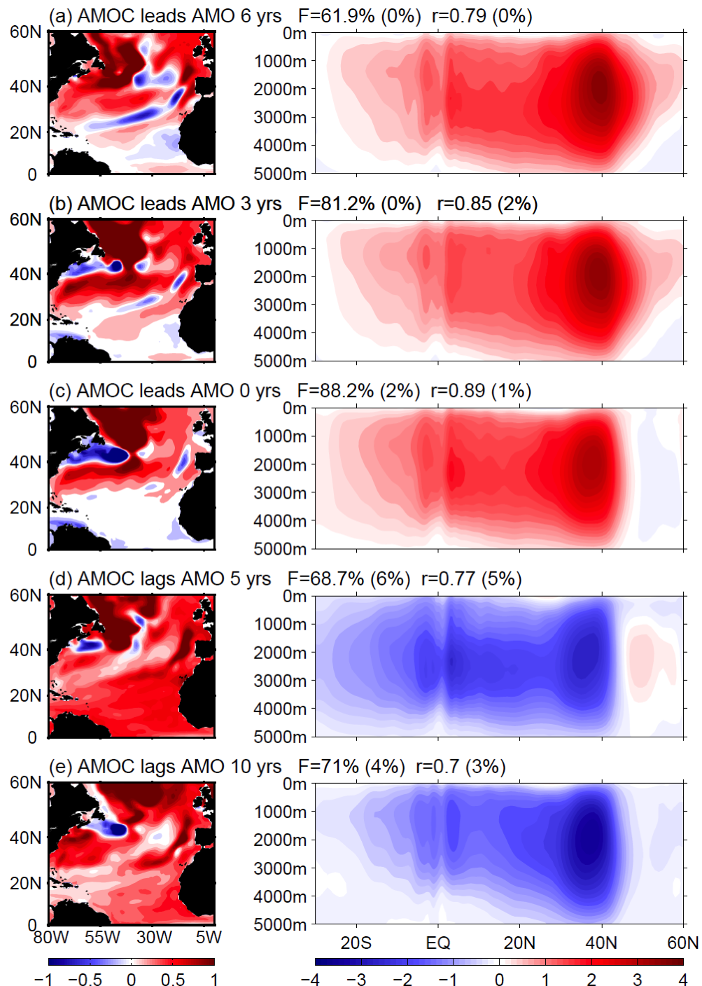
Overview
The MOC impacts temperature, salinity, sea-level and ecosystems
MOC =
A strong MOC is associated with warm SST in the North Atlantic.
PHOD is uniquely positioned to contribute to this effort through a combination of data collection and analysis and numerical model experiments
Zhang and Wang (2013, JGR)
Notes:
The Meridional Overturning Circulation (MOC) is the large scale global ocean conveyor belt that transports surface water towards the regions of deep water formation and deep water away from sinking regions to upwell in remote ocean basins. Complicated pathways and processes underlie this simple description.
The MOC is often described at the maximum of the meridional streamfunction (or integrated ocean velocity).

Slide 3
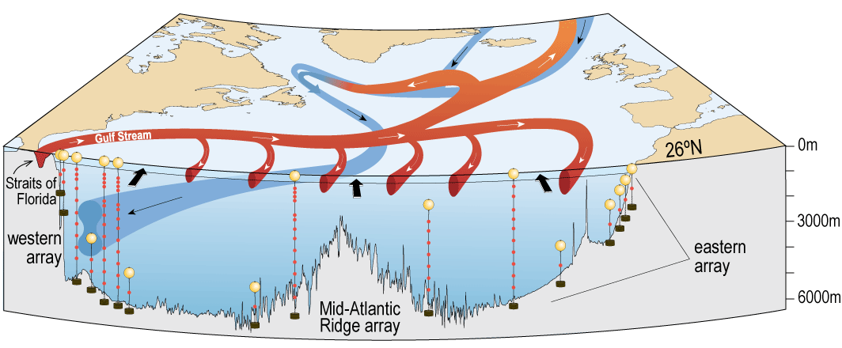
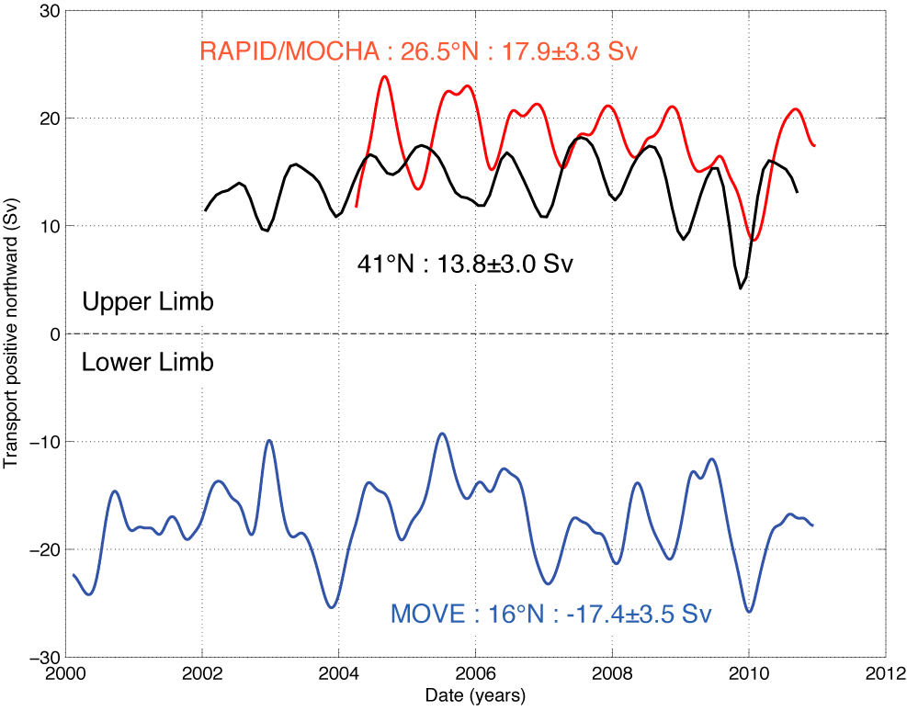
Observations of the MOC in the North Atlantic
Goals: NOAA partners with the National Science Foundation and the National Environmental Research Council to measure the MOC at 26N.
Our goals support NOAA’s mission to assess the state of the climate system and improve scientific understanding of a changing climate and its impacts. This leverages a long term NOAA program and a key strength in PHOD.
Baringer et al. (2012)
Notes:
The 26N array is the first of its kind trans basin array that directly measures the insitu ocean components of the circulation that make up the MOC. It is built upon the long standing NOAA program to measure the Florida Current with a submarine telephone cable in the straits of Florida since 1982. The Florida Current transport has been a standard benchmark used by numerical and inverse modelers to improve ocean circulation estimates, and as well as fisherman and fishery research efforts.
Shown here is a diagram of the mooring array components that form a picket fence across the North Atlantic Ocean (left).
On the right is the resulting MOC time series at 26N (red). On this slide the MOC transport is compared to two other time series of the MOC in the North Atlantic that are incomplete: the 41N data derived from Argo data (down to 2000m) and the 16N time series derived for the flow below 1000m – representing the lower limb of the MOC.
This time series has been widely successful, generating a lot of new interest in the MOC, its variability and predictability – as well as looking at its meridional coherence (as shown here). So far we’ve learned that the MOC is much more variable than previously thought, there is a strong seasonal cycle with all components of the circulation influencing its phasing (you can see the seasonal cycle in this time series). The seasonal cycle appears to be driven predominantly by the wind stress curl in the far eastern Atlantic. We’ve also looked at long term trends for the MOC time series.

Slide 4
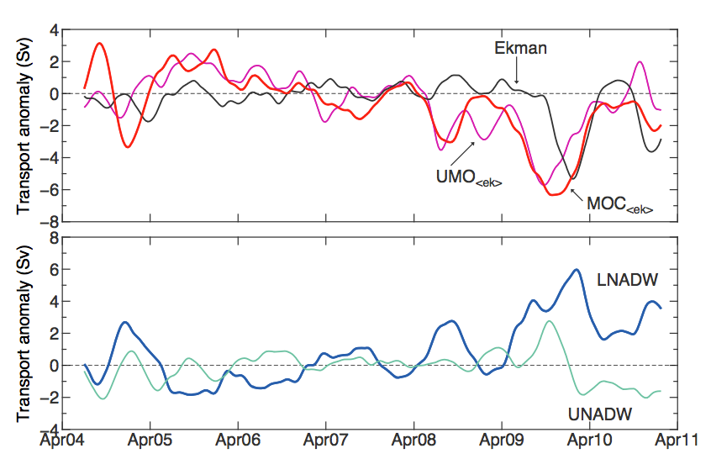
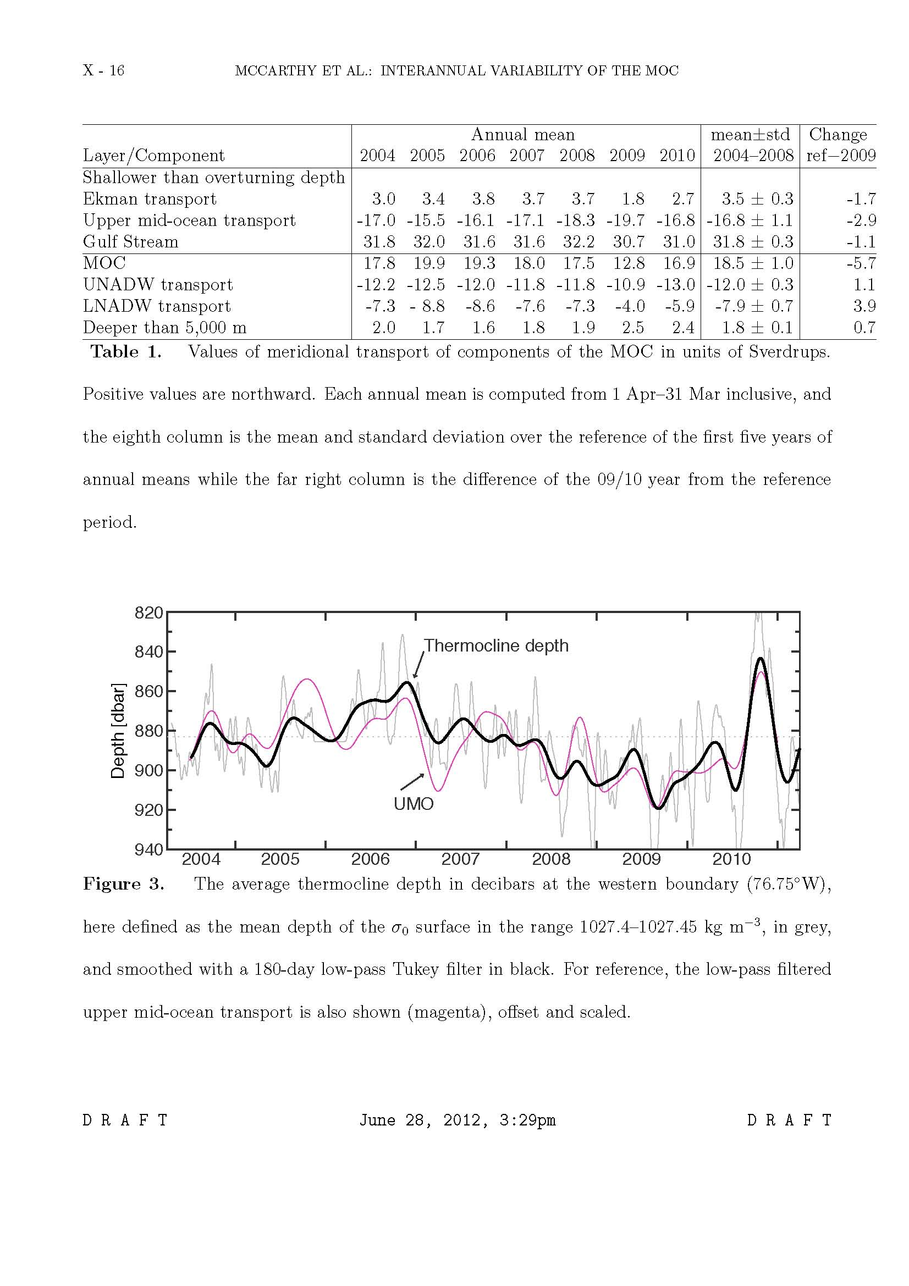
Understanding the state of the MOC at the 26°N array and its forcing
MOC variability forced by internal density changes in the ocean
The annual cycle was removed from all the MOC components of the 26N array.
The MOC showed a pronounced decrease in the winter on 2009 (6 Sv below average).
The MOC decrease was largely due to mid-ocean transport changes.
Interannual variability in the deepest part of the ocean is not always in phase.
Thermocline depth in west drives interannual variability
Upper Limb
Lower Limb
McCarthy et al 2012
Notes:
One example of understanding the forcing of MOC variability – we examined the Slow down of the MOC seem in the winter of 2009/2010
Interannual Meridional Overturning variability
(Ekman transport response and mean seasonal cycle removed)

Slide 5
Interannual variability of meridional heat transport in the North Atlantic
90% of the heat transport is associated with the overturning circulation
Florida Current
Meridional heat transport is derived from the 26N array using moorings, cable, XBTs, Argo and wind stress data.
The mean meridional heat transport is 1.25 ± 0.11 PW (about 25% of the total ocean and atmospheric heat transport at this latitude).
Ekman, Florida Current and Mid-Ocean all contribute similar variance to the total.
Total
Ekman
Mid-Ocean
Johns et al, 2010; McCarthy et al 2014
Notes:
The mean heat transport over the 2004-2012 period is smaller than the earlier estimate of 1.33 PW in (Johns et al. (2011)) based on the first four years of the record (2004-2008), This is due to the very low heat transports that occurred in 2009 and 2010, associated with the large downturn in the AMOC during those years. The annual mean MHT values recorded in those years were 1.07 and 1.08 PW, respectively.
The breakdown into the overturning and gyre MHT components is shown in Figure 5.2, where it is clear that most of the heat transport (~90%)—and essentially all of the interannual variability observed thus far—is contained in the overturning component. The gyre component on the other hand shows a fairly regular seasonal cycle which is mainly dominated by the annual cycle of the Florida Current.

Slide 6
PLACE holder for Chris

Slide 7
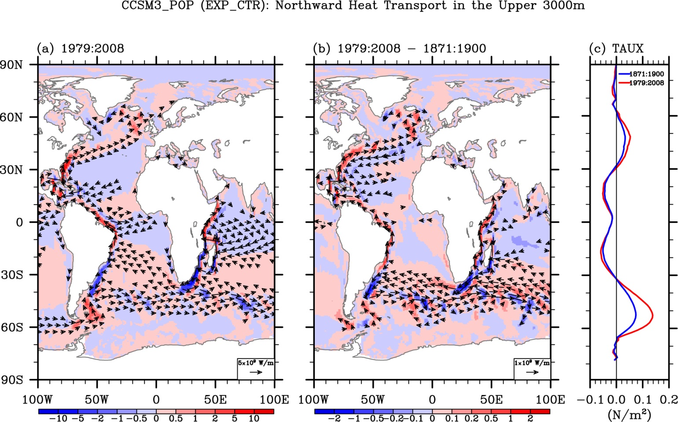
MOC pathway into South Atlantic effects North Atlantic SST
South Atlantic MOC and heat transport explains warming in the North Atlantic
(1979 to 2008) – (1871 to 1900)
Observations
Outside Atlantic
Fluxes
Atlantic Fluxes
The NCAR CCSM3 model is forced with fluxes isolated from the Atlantic only vs. from the rest of the ocean.
Flux forcing outside the Atlantic induces large heat advection south of Africa following the MOC pathway.
The South Atlantic MOC can modulate secular and multidecadal warming in the Atlantic Ocean.
Heat transport and vectors
Lee et al, 2011
Notes:
Numerical models were also used to show that interocean exchanges in the South Atlantic are needed to explain the model-observed multidecadal variability of the MOC and heat transport in the Atlantic; local air-sea forcing is insufficient to explain the variability (Lee et al., 2011). Figure 6 from Lee et al (2011)
shows the net heat content in the Atlantic and the MHT along 35S simulated in three models: one forced by the globally variable surface heat fluxes (EXP_CTR), one forced with variable heat fluxes only in the North Atlantic north of 30°S (EXP_ATL) and one model forced with variable heat fluxes outside the region of the North Atlantic (EXP_REM). These model results fully support the hypothesis that the enhanced warming of the Atlantic Ocean during the later half of the 20th century is largely due to the increased ocean heat transport into the Atlantic basin across 30°S.
This is a recent study that combined in situ observations of the global ocean heat content and ocean model simulations to understand why the Atlantic Ocean has been warmed much more than other ocean basins since the 1950s.
The left panel shows the changes in the simulated ocean heat transport from the 1950s onwards. You can see a sharp increase in heat transport from the Indian Ocean to South Atlantic Ocean. The right panel shows that the ocean model simulation successfully reproduced the large increase in the Atlantic Ocean heat content since the 1950s. Here, the black line is from observations (i.e., World Ocean Atlas 2009) and the green line is from the ocean simulation.
We think that the strengthening of rotating currents in the Indian and South Atlantic oceans is contributing to this trend. Previous studies have suggested that the degradation of Antarctic ozone may be contributing indirectly to this ocean-current strengthening. But, we don’t know if global warming contributes to this.

Slide 8
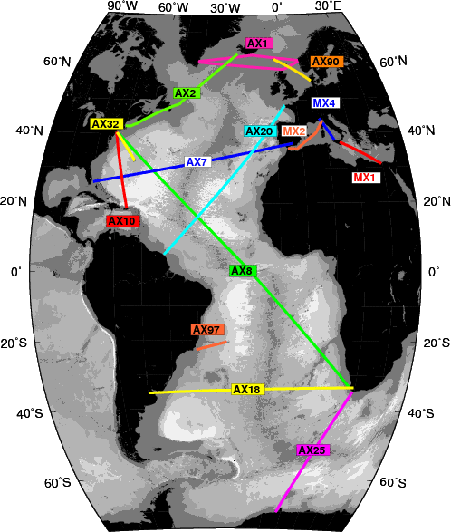
MOC associated fluxes and transports in the South Atlantic at 35°S
South Atlantic XBT observations can estimate MOC, heat and fresh water fluxes
Meridional heat transport at 35°S in the South Atlantic is 0.55 ± 0.14 PW, with larger variability than at 26°N.
MOC is 18.17 ± 2.3 Sv, similar in magnitude as 26°N, but with slightly lower variability.
Fresh Water fluxes are less than zero, implying that the MOC is bi-stable. Note that numerical models have a stable MOC with a positive slainity flux in the South Atlantic.
8
Garzoli et al., 2013; Dong et al., 2009
AOML Program Review
Notes:
Repeated occupations along nominally 35°S has been conducted as part of the high density XBT program, AX18.
In conjunction with other hydrographic data and we estimate MHT, AMOC, and Mov
Estimates of the Mov from data collected from three different kinds of observations, contrary to those
obtained from models, feature a positive salt advection feedback (Movo0) suggesting that freshwater
perturbations will be amplified and that the MOC is bistable. In other words, the MOC might collapse
with a large enough freshwater perturbation.
The direction of the freshwater flux within the South Atlantic sector, which is an indicator for the stability of the overturning circulation.
Observations: M_{ov}< 0 (positive freshwater flux feedback), MOC is bistable.
Models: M_{ov}> 0 (negative freshwater flux feedback), MOC is stable.

Slide 9
MOC seasonal cycle in observations not reproduced in models
Models do not reproduce seasonal cycle at 35S, regardless of resolution
Amplitude of geostrophic heat transport is too weak in models
Observations show opposing Ekman and geostrophic components
Model heat transport is dominated by Ekman heat transport
Perez et al., 2014
Notes:
Figure Caption: Seasonal cycle of MOC along 34.5S for (a) XBT observations 2002-2008 and three GFDL simulations: (b) CM2.1, (c) CM2.5, and (d) CM2.5 CORE. Shading corresponds to standard errors of total MOC and components. Note, XBT standard errors computed as the standard deviation of the seasonal cycle residuals computed over a sliding 3-month window divided the square root of the (N_{3months}-1) sampled. Model standard errors computed as the standard deviation of monthly values divided by the square root of the (N_{years}-1) sampled.
Take home message:
The amplitude of the geostrophic component of the seasonal cycle at 34.5S is still weak in the ¼ degree NOAA/GFDL coupled climate model (CM2.5) and CORE-forced ocean only simulation (CM2.5 CORE).
This work is being done by researchers at AOML in collaboration with Rym Msadek at NOAA/GFDL and Bill Johns and Jian Zha at UM/RSMAS

Slide 10
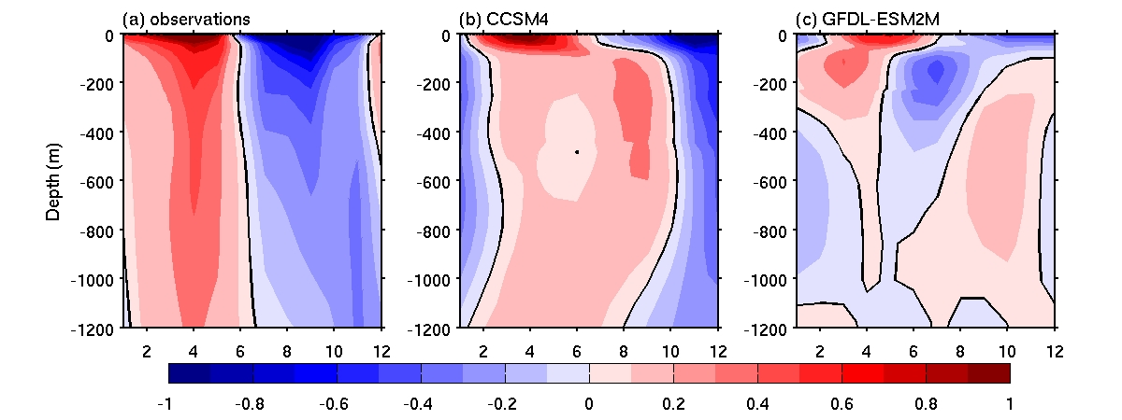
Models contain too much baroclinicity, reducing vertically coherent motions
South Atlantic XBT observations compared to models identifies deficiencies
Zonally-averaged Meridional Velocity Estimated from Observed and Modeled T/S Fields averaged by month (x axis).
Observations (Argo) show vertically coherent seasonal changes in the meridional velocity, but not in the models. Both models show strong baroclinicity.
Dong et al, (2014)
Notes:
10

Slide 11
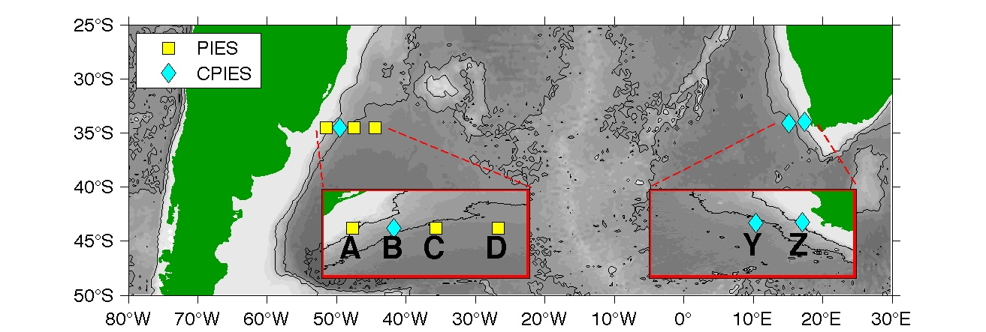
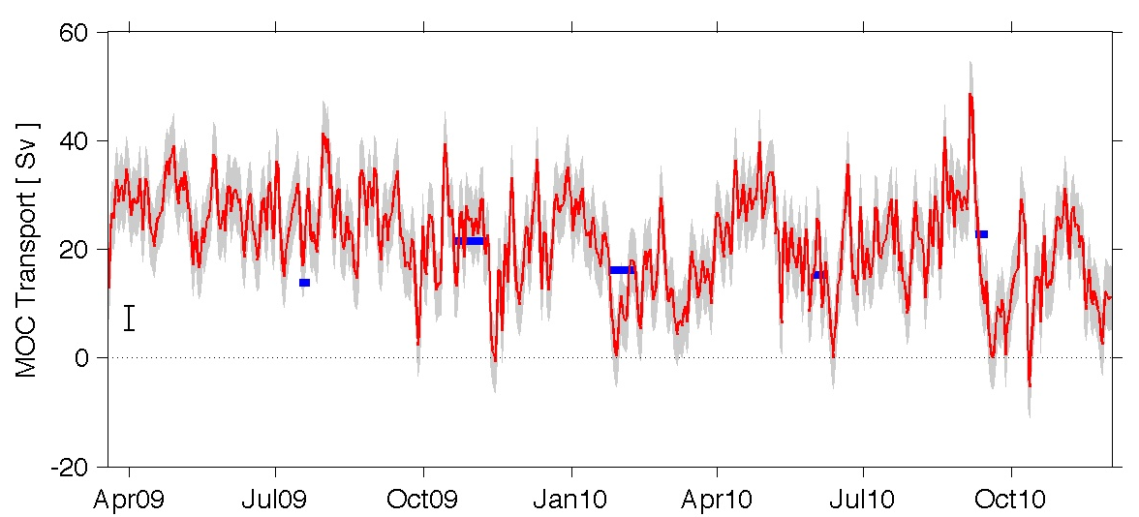
Pilot Array to Continuously Measure The South Atlantic MOC (SAMOC)
South Atlantic MOC estimated from a daily time series of dynamic height from inverted echosounders
An 18 month long pilot array and a novel technique using model output and Argo data helps determine the daily MOC strength at 35°S.
Eighteen-month long MOC time series compares favorably with XBT derived time series.
MOC variability is as large at that at 26N, with both eastern and western boundary flows contributing equally to the variance.
The full array was reestablished in the fall of 2013 in collaboration with France, Brazil, Argentina and South Africa.
Meinen et al, (2013)
Notes:
Pilot array for 1.5 yrs
Array has since tripled in size (10 instruments on east and 9 instruments on the west) Additional 4 tall and 7 short moorings to be deployed in the first half of 2014.
10 East mooring were deployed in Sep 2013.
West moorings completed in included two new moorings in Dec 2013.
Data void in center of basin – working on data pod development to get data back from remote regions where its difficult to get ships to
EAST
Sep 2013 8 French CPIES were deployed (and I think two ADCP moorings).
To be deployed early 2014
6 moorings for SHARP IEP/Benguela Jet Study (from 200-800m isobaths) - these are ADCP moorings
1 thermistor string (450 m isobath)
4 "SAMBA" tall moorings at 1000m, 2000m, 3000m, 4500m isobaths - these are have SMP's and ADCP's.

Slide 12
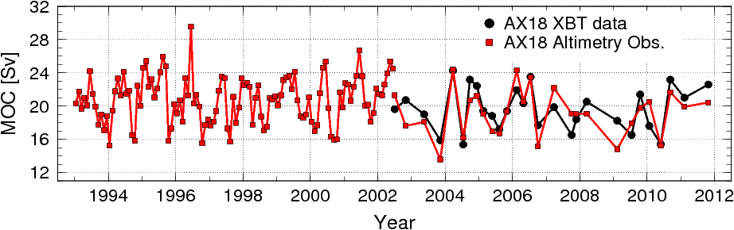
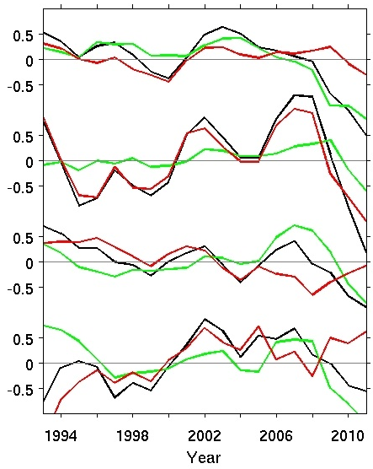
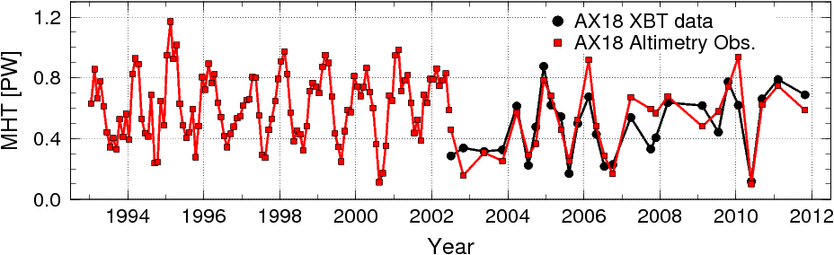
South Atlantic Altimetry-derived MOC Temporal and Spatial Variability
South Atlantic MOC and heat transport (MHT) estimates based on altimetry shows different leading contributors at different times.
20°S
MOC total
25°S
Geostrophic
30°S
Ekman
Largely dominated by geostrophic component before 2006.
Largely dominated by Ekman component after 2006 (except 25S).
At 34.5S, long period variability with high in mid 2000’s and low in mid 1990s.
34.5°S
12
Dong et al, (2014)
AOML Program Review

Slide 13
Summary:
PHOD is striving to characterize the three dimensional state of the MOC and improve our understanding of this important ocean-climate process.
PHOD houses a great number of critical observational platforms that are being used to evaluate models and determine physical processes of climate variability.
  26N MOC array
  Expanding 35S MOC array
  XBT, CTD/O2, Argo
Analysis done using observations and models shows the importance of the MOC on SST.
The large variability of the MOC/MHT including mesoscale, seasonal and longer variability.
The MOC on seasonal and longer time scales and models don’t reproduce the observations particularly well (e.g. seasonal cycle in heat transport, fresh water transport in the SA, changes in deep water properties, and phasing of AMO).

Slide 14
Thank you very much
Questions?
.

Slide 15
The Future
PHOD will continue to show critical value of the observing system
Observations:
Improving observations including Deep Argo, climate quality XBTs, data retrieval systems from moorings, South Atlantic MOC
Evaluating observing systems to make more cost effective (OSE, OSSE, etc)
Models:
Confronting models with observations on different time scales (seasonal to decadal and longer)
Testing a hierarchy of models to develop hypotheses of physical processes
Partnerships:
Expanding partnerships:
  e.g. South Atlantic Meridional Overturning Circulation (SAMOC) community and the expansion of the 35°S array
  UK Rapid community and the expansion of the 26°N array to include oxygen, nutrients and eventually carbon.
Notes:
O sys sim experiments – ossie – simulated data
Obs sys experimets Ozzy – real data

Slide 16
References
Zhang, L., and C. Wang, 2013: Multidecadal North Atlantic sea surface temperature and Atlantic meridional overturning circulation variability in CMIP5 historical simulations. J. Geophys. Res. , in press.
Baringer, M. O., S. A. Cunningham, C. S. Meinen, S. Garzoli1, J. Willis, M. Lankhorst, A. Macdonald, U. Send, W. R. Hobbs, E. Frajka-Williams, T. O. Kanzow, D. Rayner, W. E. Johns, and J. Marotzke, 2012. [Global Oceans] Meridional Overturning Circulation and Heat Transport Observations in the Atlantic Ocean [in “State of the Climate in 2011”], Bull. Am. Met. Soc., 93 (7), S78-81.
McCarthy, G., E. Frajka-Williams, W. E. Johns, M. O. Baringer, C. S. Meinen, H. L. Bryden, D. Rayner, A. Duchez, C. Roberts, and S. A. Cunningham, 2012. Observed Interannual Variability of the Atlantic Meridional Overturning Circulation at 26.5°N. Geophysical Research Letters, 39, L19609,
doi:10.1029/2012GL052933, 2012.
Johns, W. E., M. O. Baringer, L. M. Beal, S. A. Cunningham, T. Kanzow, H. L. Bryden, J. Hirschi, J. Marotzke, C. Meinen, B. Shaw, and R. Curry, 2011. Continuous, array-based estimates of Atlantic Ocean heat transport at 26.5 ºN. J. Clim., 24(10):2429-2449.
McCarthy et al 2014
Lee S.-K., W. Park, E. van Sebille, M. O. Baringer, C. Wang, D. B. Enfield, S. Yeager, and B. P. Kirtman, 2011. What Caused the Significant Increase in Atlantic Ocean Heat Content Since the mid-20th Century? Geophysical Research Letters, doi:10.1029/2011GL048856.
Garzoli, S.L., M.O. Baringer, S. Dong, R.C. Perez, and Q. Yao (2013). South Atlantic meridional fluxes. Deep-Sea Res. II, doi:10.1016/j.dsr.2012.09.003.

Slide 17
AOML Program Review
Dong, S. S. L. Garzoli, M. O. Baringer, C. S. Meinen, and G. J. Goni, 2009: The Atlantic Meridional Overturning Circulation and its Northward Heat Transport in the South Atlantic. Geophys. Res. Lett., 36, L20606, doi:10.1029/2009GL039356.
Perez, R. C., R. Msadek, S. Dong, J. Zhao, W. E. Johns, C. S. Meinen, 2014: Sensitivity of the Atlantic meridional overturning circulation seasonal cycle to wind forcing. In preparation for J. Geophys. Res.
Dong et al, 2014 What causes the MHT seasonal variability difference between models and observations?
Meinen, C. S., S. Speich, R. C. Perez, S. Dong, A. R. Piola, S. L. Garzoli, M. Baringer, S. Gladyshev, and E. Campos, 2013: Temporal variability of the meridional overturning circulation at 34.5°S: Results from two pilot boundary arrays in the South Atlantic. J. Geophys. Res., 118, 1-18, doi:10.1002/2013JC009228.
Dong, Goni et al 2014 Altimetric estimates of MHT/MOC

Slide 18
AOML Program Review
Perez et al 2014. MOC/MHT from high resolution models in the South Atlantic
Meinen, C.S., W.E. Johns, S.L. Garzoli, E. Van Sebille, D. Rayner, T. Kanzow, and M.O. Baringer, 2012: Variability of the Deep Western Boundary Current at 26.5°N during 2004-2009. Deep-Sea Res. Part II, 85:154-168, doi:10.1016/j.dsr2.2012.07.036.
Srokosz, M., M. Baringer, H. Bryden, S. Cunningham, T. Delworth, S. Lozier, J. Marotzke, and R. Sutton, 2012: Past, present, and future change in the Atlantic meridional overturning circulation. Bull. Am. Met. Soc., doi:10.1175/BAMS-D-11-00151.1.
Wang, C., L. Zhang, S.-K. Lee., L. Wu, and C. R. Mechoso, 2014: A global perspective on CMIP5 climate model biases. Nature Climate Change, in press.
Meinen, C. S., W. E. Johns, S. L. Garzoli, E. van Sebille, D. Rayner, T. Kanzow, and M. O. Baringer, 2012. Variability of the Deep Western Boundary Current at 26.5°N during 2004-2009. Deep-Sea Res. II, 10.1016/j.dsr2.2012.07.036
Garzoli and Schmid, 2014. Deep Western Boundary Current Pathways in the South Atlantic
Dong, S., M. Baringer, G. Goni and S. Garzoli, 2011. Importance of the assimilation of Argo Float Measurements on the Meridional Overturning Circulation in the South Atlantic. Geophysical Research Letters, 38, L18603, doi:10.1029/2011GL048982. (Sep 17, 2011)
Macdonald, A., and M. Baringer 2013. Observed Ocean Transport of Heat. Chapter 6.3 of "Ocean Circulation and Climate (Second edition)", ed. G. Siedler, J. Church, J. Gould and S. Griffies, Academic Press (Elsevier), in press.

Slide 19
Deep Ocean Water Mass Transformations and Pathways
Salinity
Abaco (26°N)
Salinity Anomaly at Abaco
Salinity
Labrador Sea (58°N)
Anomalies in the Labrador Sea decrease 50% and appear at Abaco 9 years later
Van Sebille et al 2011
Notes:
50% of the signal at Abaco – 9 years after LS
Two pathways in models – minimal influence of MOW
The first model is the 0.5° SODA model [Carton et al., 2000; Carton, 2008], which has 40 levels in the vertical
and is based on the POP code. The second model is the DePreSys model [Smith and Murphy, 2007], which has much lower resolution at 1.25° and 20 depth levels. The third model is the Cube84 run of ECCO2 [Marshall et al., 1997; Menemenlis et al., 2005], at a horizontal resolution of 0.25° and 50 depth levels.
The fourth and last model used is the OFES model [Sasaki et al., 2008]. At a horizontal resolution of 0.1° and 54 vertical levels the OFES model has the highest resolution used here. The OFES model is forced with NCEP winds and fluxes, but does not assimilate other data.

Slide 20
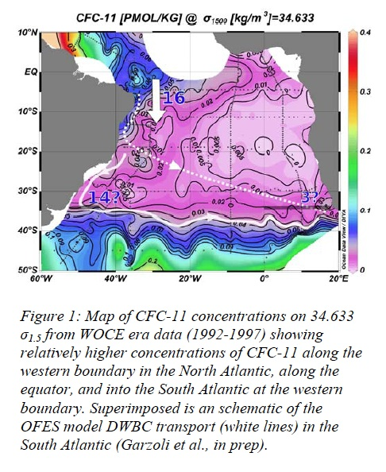
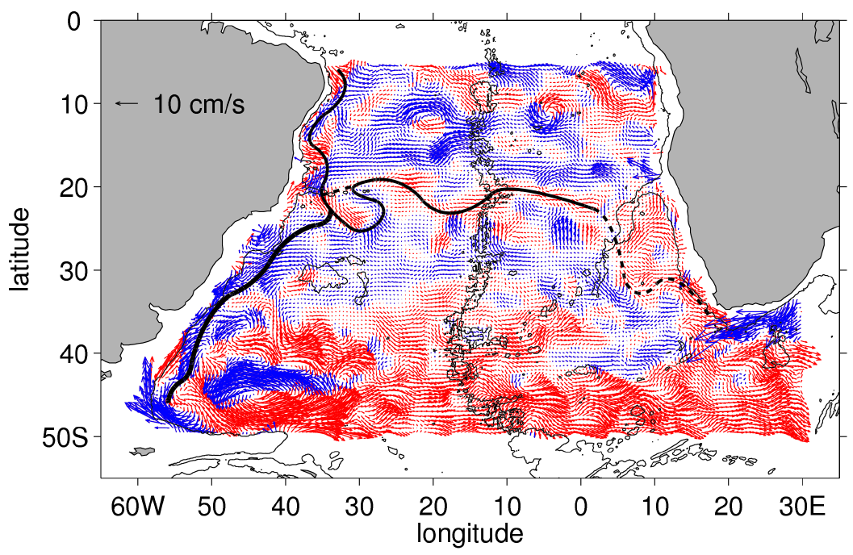
The DWBC, lower limb of AMOC
16 Sv
Data: Lagrangian and eulerian analysis of OFES.
Hydrographic sections, Argo data, CFCs
14 Sv
3 Sv
Conclusion:
~71% of the flow
Main branch of the DWBC flows along the continental shelf of SA.
~20% of the flow crosses the Atlantic.
Garzoli and Schmid (2014)
Notes:
The fate of the lower limb of the AMOC after it crosses the Atlantic is poorly known. For years based on results from observations and models, it was assumed that at around 18°S the DWBC breaks into ring and some non-steady flow crosses the Atlantic toward South Africa.
A recent study from Garzoli et al based on: observations, analysis of the OFES product and a Lagrangian experiment conducted with the OFES model indicate that
Of the ~14 Sv entering the SA at 5°S, 90% is concentrated at the western boundary. At the Trindade ridge (~18°S) the flow bifurcates. Most of the flow (~70%) is a steady flow along the South American Continent and constitute the main pathway of the DWBC, 20 % of the flow (eddy like flow) crosses the Atlantic.
The upper panel shows an schematic of the DWBC pathways overlap to the CFcs evidence.
Lower panel: From Argo data: flow at the upper bound of the NADW (2000m) from a product created by Schmid using the data.

Slide 21
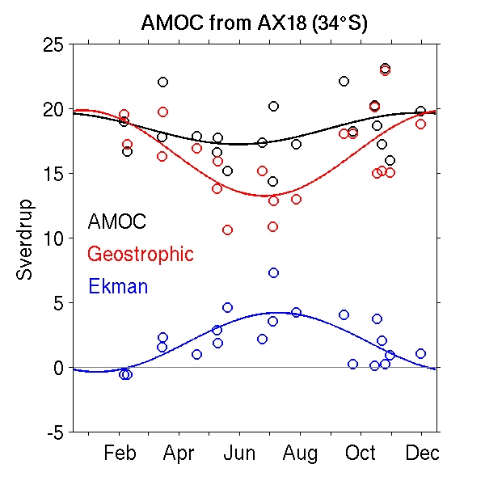
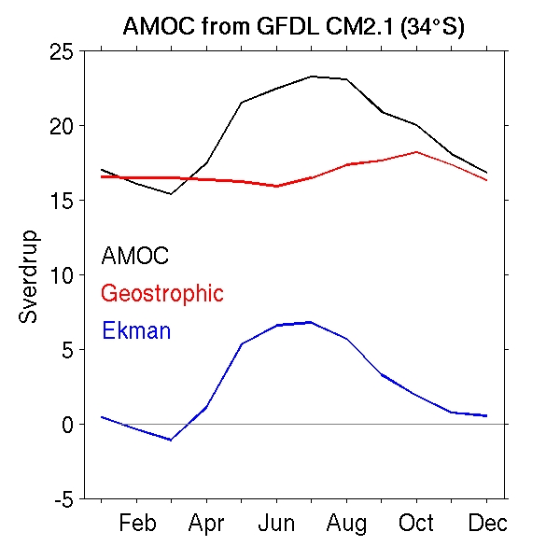
South Atlantic: Disagreements between models and observations:
Garzoli et al., 2013; ; Dong et al., 2011; Dong et al., 2009
Notes:
The observed annual cycles of the MHT and the MOC are almost non-existent. Models, in contrast, show a strong annual cycle for the MHT and MOC, which is dominated by the Ekman component.
GFDL collaboration - new

Slide 22
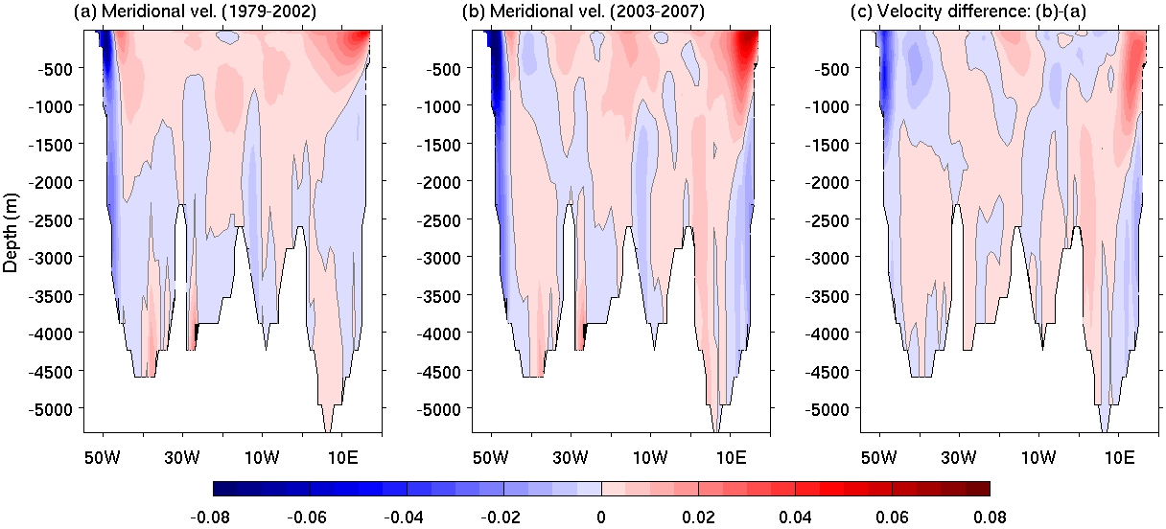
Meridional Velocity from GFDL CDA
Pre-Argo period
Argo period
Argo minus Pre-Argo
This shows the improvement of data-assimilation model in representation of boundary currents during Argo period.
CDA: coupled data assimilation
DONG
Notes:
22

Slide 23
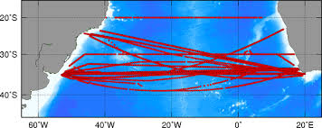
Time Sampling
Ocean Experiment to determine the optimal sampling for SAMOC estimates at 35S using XBT observations
GOES
Spatial Sampling
Notes:
Left: RMS errors (Sv) for the monthly climatology SAMOC estimation associated with the number of samples per year and the number of years. The star represents a rough location of the present day AX18 state, only account for the nearly zonal sections at 34.5S. We have already increased the number of cruises to 5 a year, and need a few more years of data in order to improve estimates.
Top right: Sections of the AX18 transect.
Bottom right: RMS error (Sv) of the total AMOC timeseries with respect to the distance between stations (in log scale). The star represents the current sampling (approximately 0.25 degrees). The lines are for western (red), eastern (black) and interior (blue) sampling. The current sampling shows to be a good strategy, or maybe reducing the sampling in the western boundary to 0.2 deg.

Slide 24
The Use of Numerical Models for Ocean Observing System Design: South Atlantic MOC
Mean and standard deviation of bottom-referenced v_{g} obtained using density profiles for a-b) the full resolution of the OFES model and c-d) a realistically-sized array of 19 sites deployed within OFES along 34.5ºS.
OFES a) MOC time series along 34.5ºS (black), with estimates of the MOC based on v_{g} measurement systems deployed in OFES at the 19 sites (blue: T-S, red: CPIES). Mean vertically-integrated b) volume transport.
PEREZ
AOML Program Review
* Based on work in Perez, Garzoli, Meinen, Matano (JTECH, 2011)
Mean and standard deviation of bottom-referenced geostrophic velocity obtained using density profiles for a-b) the full resolution of the OGCM For the Earth Simulator (OFES) model and c-d) a realistically-sized array of 19 sites deployed within OFES along 34.5ºS
Notes:
Numerical models were used to determine that 34.5S would be a suitable latitude for a South Atlantic MOC Basin-wide Array (SAMBA). Many moorings have already been deployed on the western (7) and eastern boundary (8) by NOAA and international partners – and more are planned. The locations of recently deployed moorings were determined through analysis of historical observations in the region and these model-based observing system experiments.

Slide 25
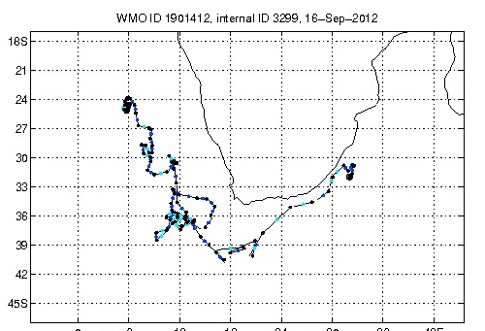
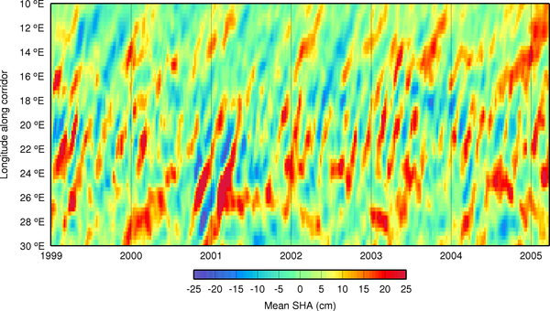
South Atlantic Upper Ocean Water Mass Transformations and Pathways
Transport
Density
(Garzoli and Matano, 2011)
(Goni, BAMS 2013)
Degrees East
Argo trajectory
Time
RMS SSH
Notes:
The South Atlantic is not just a passive conduit for NADW and other deep water-masses formed in the North Atlantic and Southern Ocean. There is an active water mass transformation within the South Atlantic basin, and that a large portion of this transformation occurs in the highly energetic boundary regions.

Slide 26
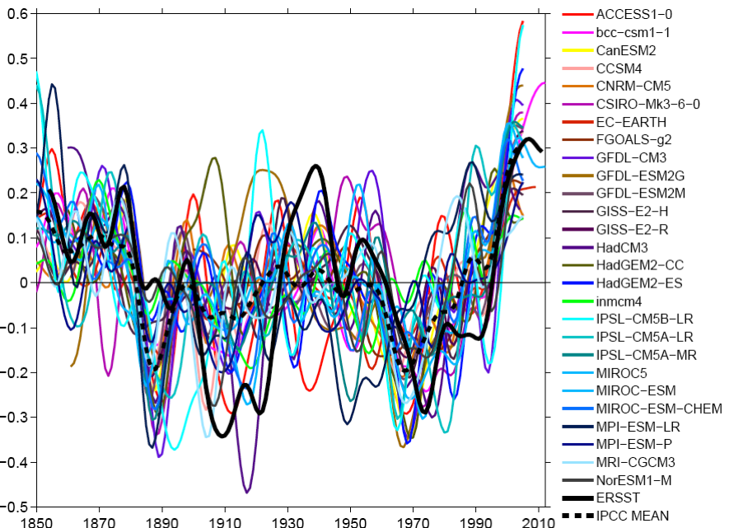
The Atlantic Multidecadal Oscillation (AMO) Simulated from 27 IPCC-AR5 Models
Zhang and Wang (2012)
Models show a large spread of uncertainty, but better than IPCC-AR4 simulations.
All models display a warming in the last two decades.
Models underestimate the cooling (1900-25) and the subsequent warming (1926-65).
Notes:
Validate/scatter
Scientists at PHOD/AOML analyze the performance of IPCC-AR5 (or CMIP5) climate models in simulating the AMO, AMO and Atlantic warm pool. This slide (Zhang and Wang 2012, Climate Dynamics) shows the simulated variability of the AMO – a fluctuating climate mode wherein the North Atlantic SST varies on multidecadal timescales.
The simulated AMO in IPCC-AR5 is generally better than that in IPCC-AR4.
The individual models show highly varying amplitudes and various phases, with a large spread of uncertainty.
All models display a warming in the last two decades.
Models underestimate the cooling (1900-25) and the subsequent warming (1926-65).

Slide 27
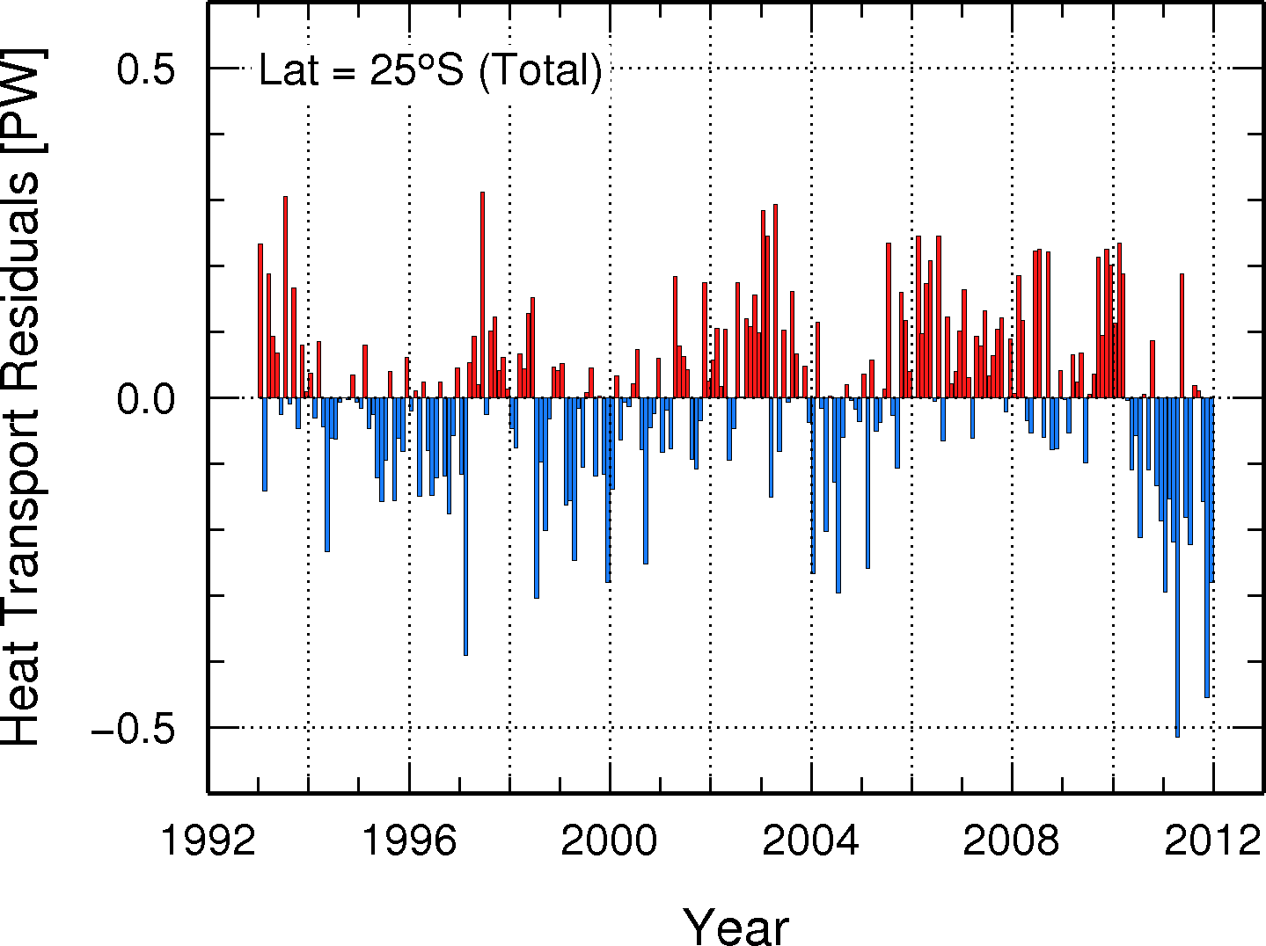
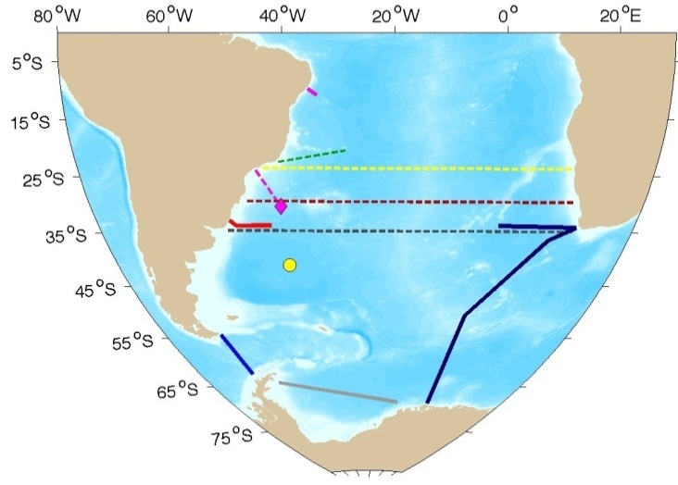
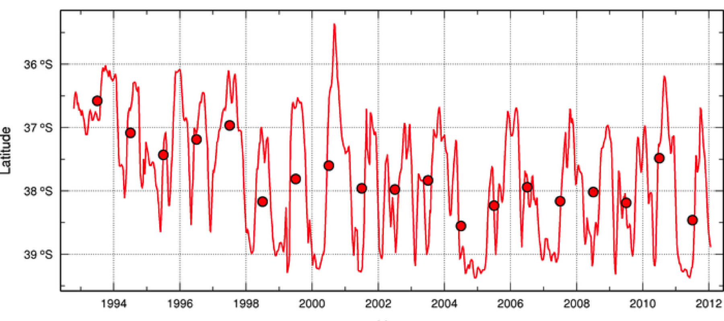
The international effort started and lead at AOML: SAMOC
South Atlantic: Future Plans
The SAM array
Latitude
Brazil Current Shifts Southward
Meinen et al, 2012, Perez et al, 2012
Notes:
The first direct estimates of the temporal variability of the absolute transport in the DWBC at 34.5°S in the South Atlantic Ocean are obtained from a line of four pressure-equipped inverted echo sounders.
Hydrographic sections collected in 2009 and 2010 confirm , based on neutral density, temperature, salinity, and oxygen values, the presence of the DWBC, one of the main deep pathways of the MOC.
Both sets of observations reaffirm that the DWBC reconstitutes itself after breaking into eddies in the western sub-tropical Atlantic near 8°S.
DWBC at 34.5°S exhibiting a transport standard deviation of 25 Sv and variations of ~40 Sv occurring within periods as short as a few days. Meinen et al., 2012
Future work on AMOC studies includes the monitoring of MHT using satellite derived methodologies. Satellite methods are particular important because
Their observations extend to areas where there are no in situ observations, and B) extend in situ estimates back in time when the in situ observations are recent.
For example, we show here preliminary Results of MHT at 25S in the Atlantic Ocean. These results indicate that there is large year to year variability, with a large decrease in 2010, similar to what has been found in the NA for 2009.

Slide 28
SST
AMOC streamfunction
Relationship of the AMOC with the AMO in IPCC-AR5 climate models:
When the AMOC leads or is in phase with the AMO, the strengthened AMOC is associated with the warm phase of the AMO.
However, when the AMO leads, the warm phase of the AMO corresponds to the weakened AMOC.
This indicates that the AMO is not only passively responded to the AMOC, but also can drive the AMOC variations.
The warm AMO phase with a warmer SST in high latitude and a relatively colder SST in low latitude is favorable for generating a decreased meridional density gradient, which lead to a weakened AMOC.
This is consistent with the theoretical work of the delayed advective oscillation for the AMOC by Lee and Wang (2010, JC).
Zhang and Wang (2013, JGR)
Notes:
In this paper, simulated variability of the Atlantic Multidecadal Oscillation (AMO) and the Atlantic Meridional Overturning Circulation (AMOC) and their relationship have been investigated. For the first time, climate models of the Coupled Model Intercomparison Project phase 5 (CMIP5) provided to the Intergovernment al Panel on Climate Change Fifth Assessment Report (IPCC-AR5) in historical simulations have been used for this purpose. The models show the most energetic variability on the multidecadal timescale band both with respect to the AMO and AMOC, but with a large model spread in both amplitude and frequency. The relationship between the AMO and AMOC in most of the models resembles the delayed advective oscillation proposed for the AMOC on multidecadal timescales. A speed up (slow down) of the AMOC is in favor of generating a warm (cold) phase of the AMO by the anomalous northward (southward) heat transport in the upper ocean, which reversely leads to a weakening (strengthening) of the AMOC through changes in the meridional density gradient after a delayed time of ocean adjustment. This suggests that on multidecadal timescales the AMO and AMOC are related and interact with each other.
27 coupled GCMs provided to IPCC-AR5
AMO used = area weighted detrended SST from 0-60N
Data from Smith et al monthly ERSST/NOAA (ncdc)
MOC max stream function as long as its below 500m
Seasonal cycle and linear trends removed, 15 yr lowpass filtered not sensitve in 8-15 filtering band)

Slide 29
Relationship of the MOC with the AMO in IPCC-AR5 climate models suggest oscillations
MOC streamfunction
SST
Stronger MOC
MOC leads
AMO 6 yrs
Weaker MOC
Warm AMO
No lag
MOC lags
AMO 10 years
Zhang and Wang (2013); Lee and Wang (2010)
Notes:
We are also looking at the mechanisms associated with this large scale relationship between SST and the MOC.
In this paper 27 couple GCMS used in the IPPC-AR5 report were examined to describe the lead/lag relationship between SST and the MOC. In this analysis the free runs of the models from about the 1850’s-2005 and again the NCDC SST product.
The relationship between the AMO and AMOC in most of the models resembles the delayed advective oscillation proposed for the AMOC on multidecadal timescales
A speed up (slow down) of the AMOC is in favor of generating a warm (cold) phase of the AMO by the anomalous northward (southward) heat transport in the upper ocean, which reversely leads to a weakening (strengthening) of the AMOC through changes in the meridional density gradient after a delayed time of ocean adjustment. This suggests that on multidecadal timescales the AMO and AMOC are related and interact with each other.
In this paper, simulated variability of the Atlantic Multidecadal Oscillation (AMO) and the Atlantic Meridional Overturning Circulation (AMOC) and their relationship have been investigated. For the first time, climate models of the Coupled Model Intercomparison Project phase 5 (CMIP5) provided to the Intergovernment al Panel on Climate Change Fifth Assessment Report (IPCC-AR5) in historical simulations have been used for this purpose. The models show the most energetic variability on the multidecadal timescale band both with respect to the AMO and AMOC, but with a large model spread in both amplitude and frequency. The relationship between the AMO and AMOC in most of the models resembles the delayed advective oscillation proposed for the AMOC on multidecadal timescales. A speed up (slow down) of the AMOC is in favor of generating a warm (cold) phase of the AMO by the anomalous northward (southward) heat transport in the upper ocean, which reversely leads to a weakening (strengthening) of the AMOC through changes in the meridional density gradient after a delayed time of ocean adjustment. This suggests that on multidecadal timescales the AMO and AMOC are related and interact with each other.
27 coupled GCMs provided to IPCC-AR5
11 of models drive this delayed advective oscillator
3 models show negative corr at all lead/lags
2 models show positive corr at all lead/lags
Spectral peaks of AMOC variation at 20-30 yrs and 50-70 yrs (but series is filtered at 15 yrs)
AMO used = area weighted detrended SST from 0-60N
Data from Smith et al monthly ERSST/NOAA (ncdc)
MOC max stream function as long as its below 500m
Seasonal cycle and linear trends removed, 15 yr lowpass filtered not sensitve in 8-15 filtering band)
When the AMOC leads or is in phase with the AMO, the strengthened AMOC is associated with the warm phase of the AMO.
However, when the AMO leads, the warm phase of the AMO corresponds to the weakened AMOC.
This indicates that the AMO is not only passively responded to the AMOC, but also can drive the AMOC variations.
The warm AMO phase with a warmer SST in high latitude and a relatively colder SST in low latitude is favorable for generating a decreased meridional density gradient, which lead to a weakened AMOC.
This is consistent with the theoretical work of the delayed advective oscillation for the AMOC by Lee and Wang (2010, JC).
Models used in study generally run from 1850’s to 2005

Slide 30
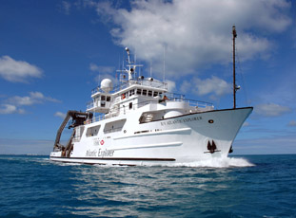
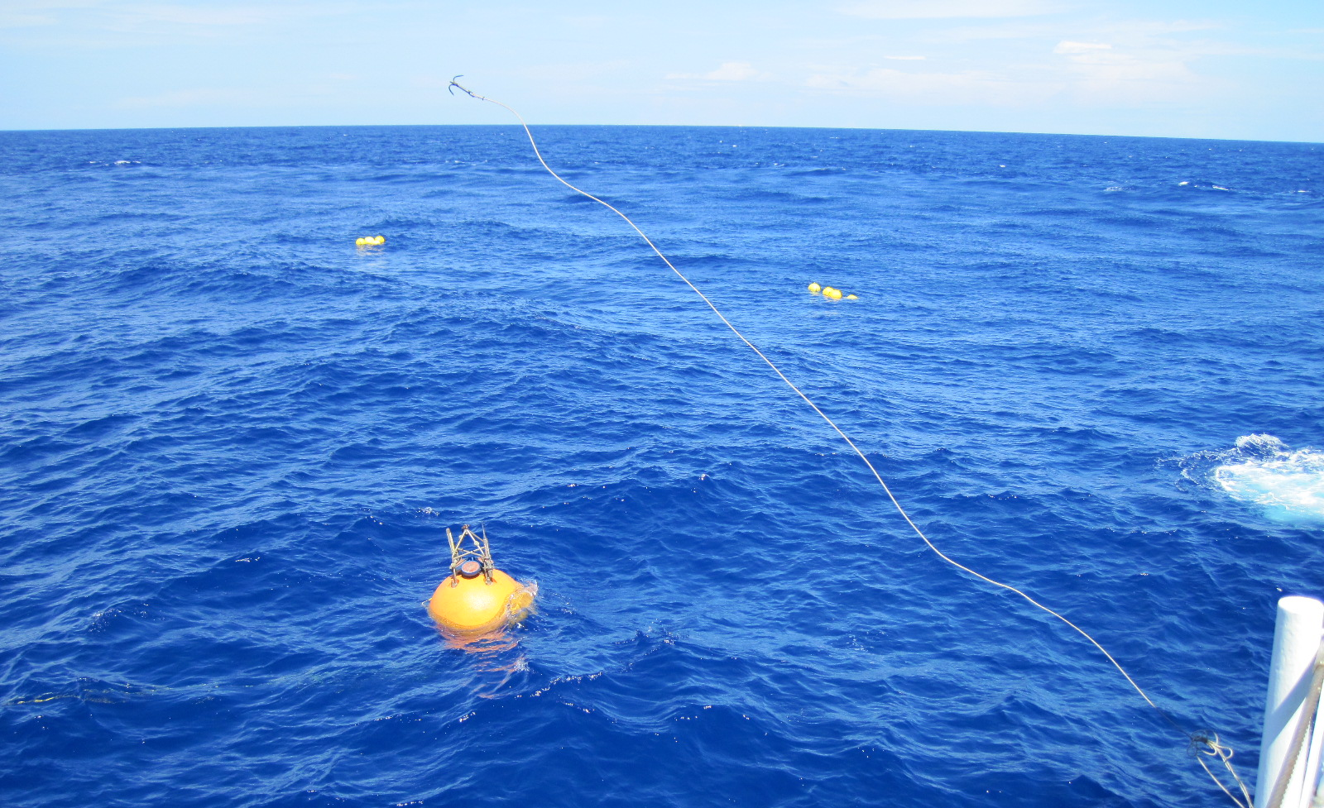
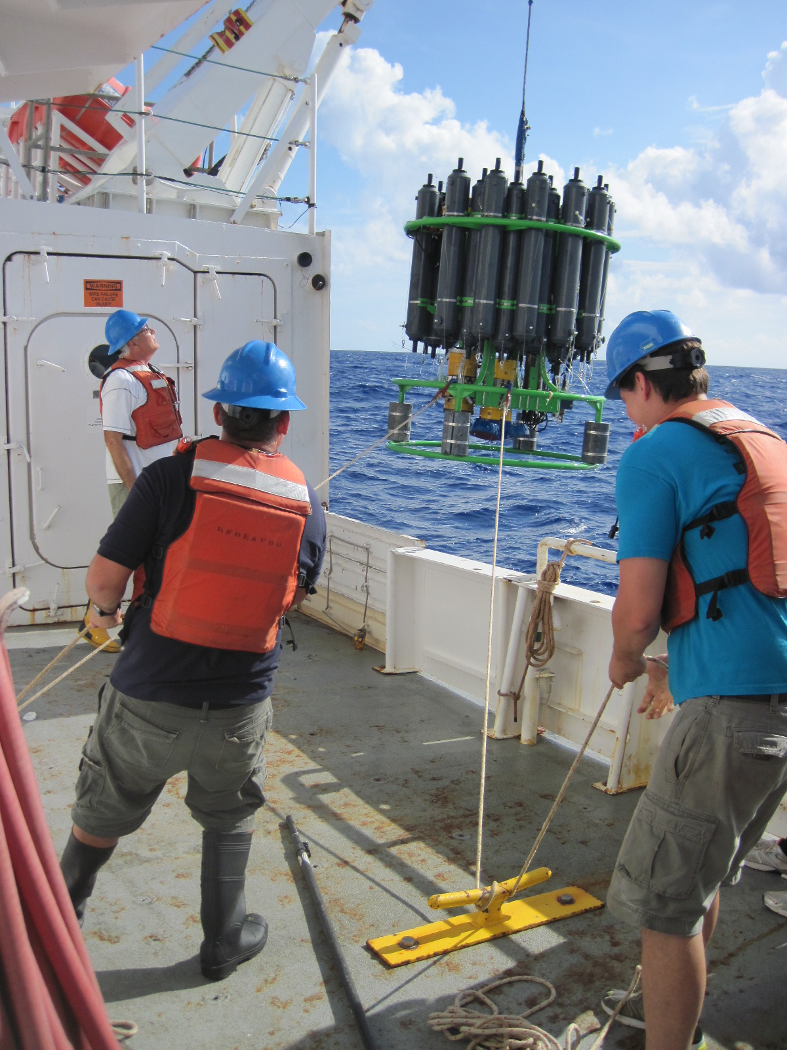
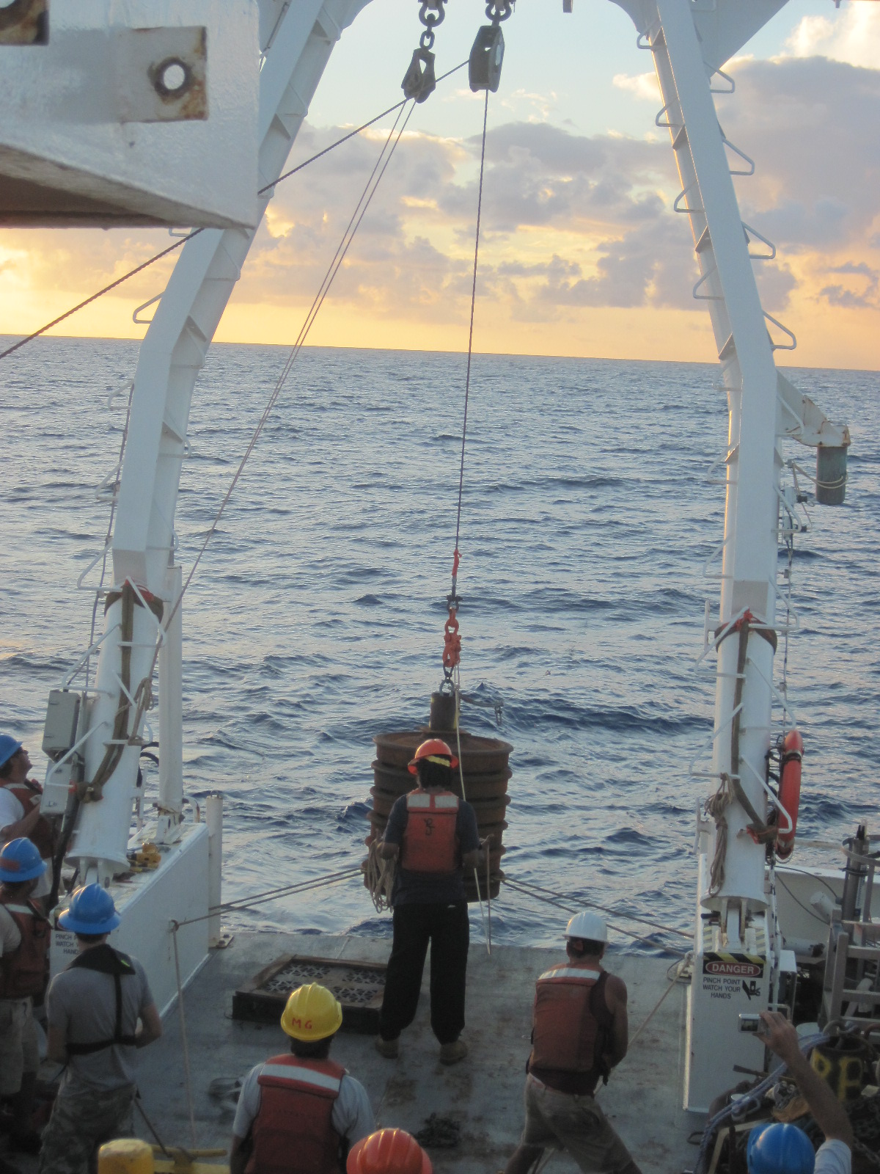
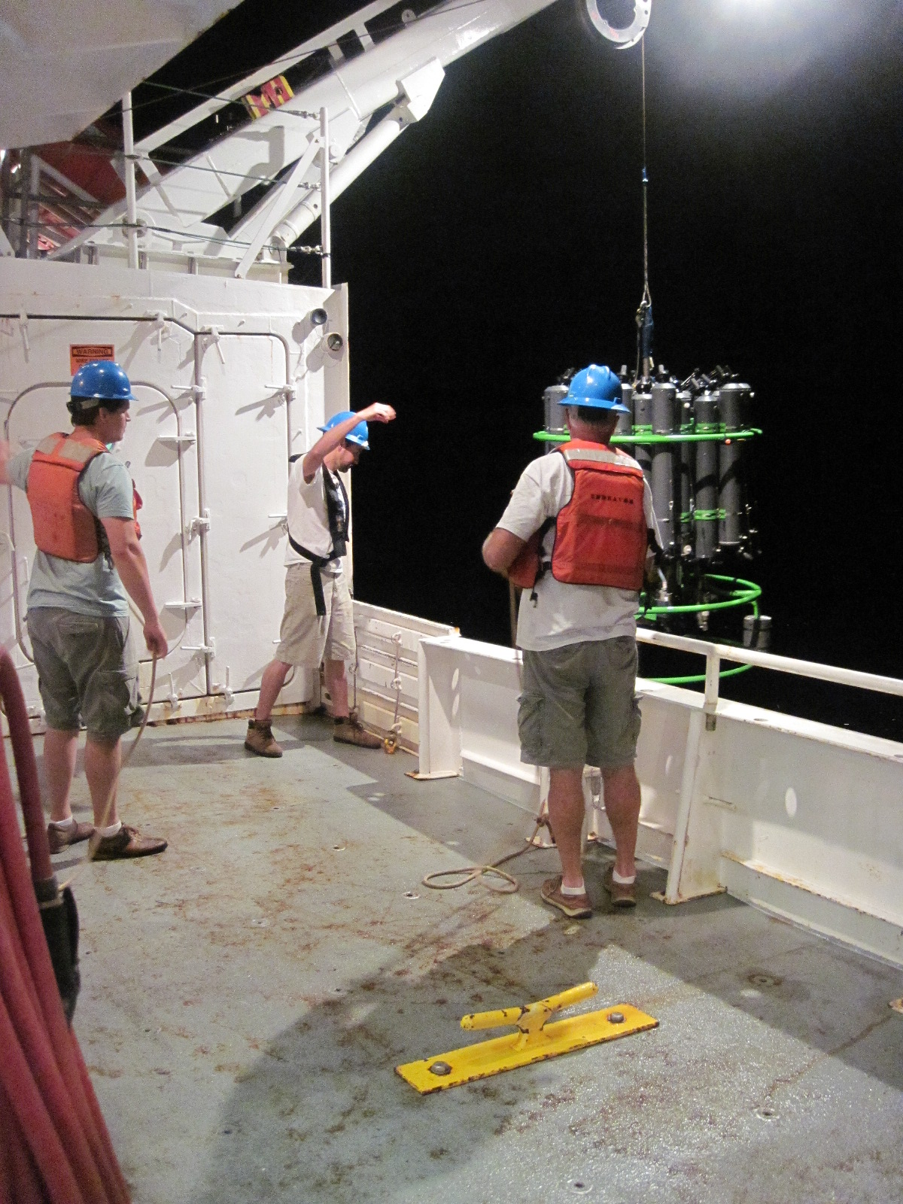
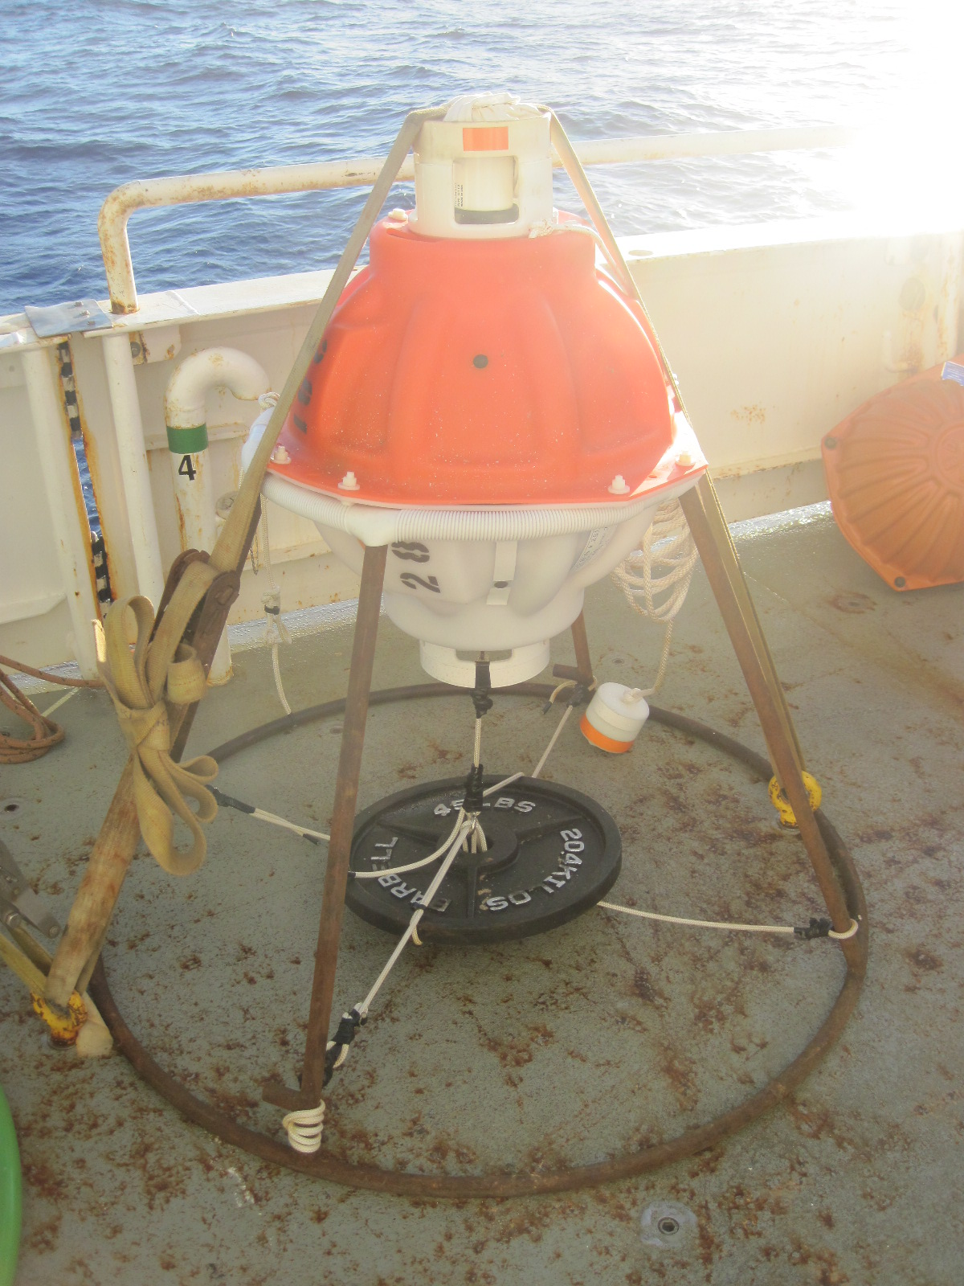
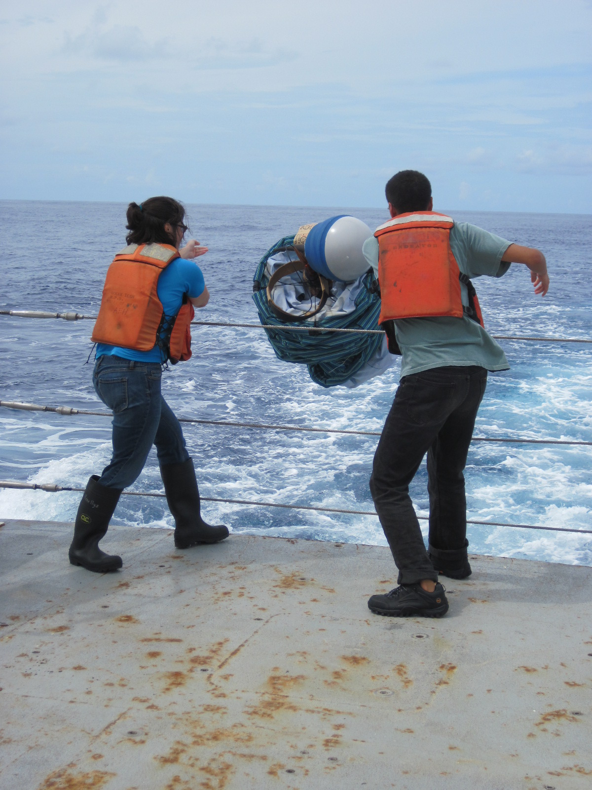
R/V Atlantic Explorer Joint cruise
Chris Meinen and Bill Johns
NSF-funded Meridional Overturning Circulation Heat-flux Array project and
the NOAA-funded Western Boundary Time Series project.
March 4-20, 2014
Science party of 11, including 5 people from AOML/PHOD and 6 from the University of Miami.
Photos from September 2012 MOCHA/WBTS cruise
AOML Program Review
Notes:
Chris is at sea on a joint research program aimed at measuring the meridional overturning circulation (which I’ll explain in a minute).
This is our first time on the Atlantic explorer – class III - UNOLS vessel operated by the Bermuda Biological station (used to be the Seward Johnson II owned by Harbour Branch) – purchased in 2005
Atlantic Explorer specs:
12 crew, 22 science berths
Lab space about 800 sqft broken into 3 areas
171 ft long, 38 ft beam, 11.5 ft draft
11 knots
Vs seward johnson at 204 ft length
13 knots
Vs oceanus
177 feet, 33 feet beam, 17.5 draft
11 knots
12 crew, 19 scientists
VS Brown Class 1
with 1745 sq ft in the largest lab, but have more than 1200 sq ft of additional space in 4 other labs.

Slide 31
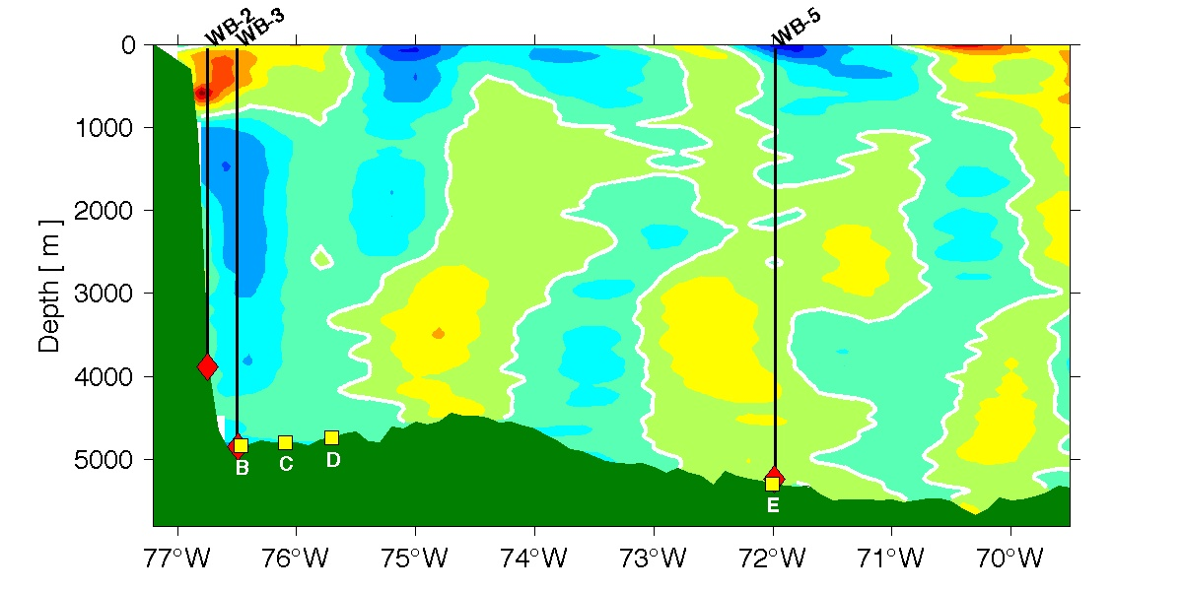
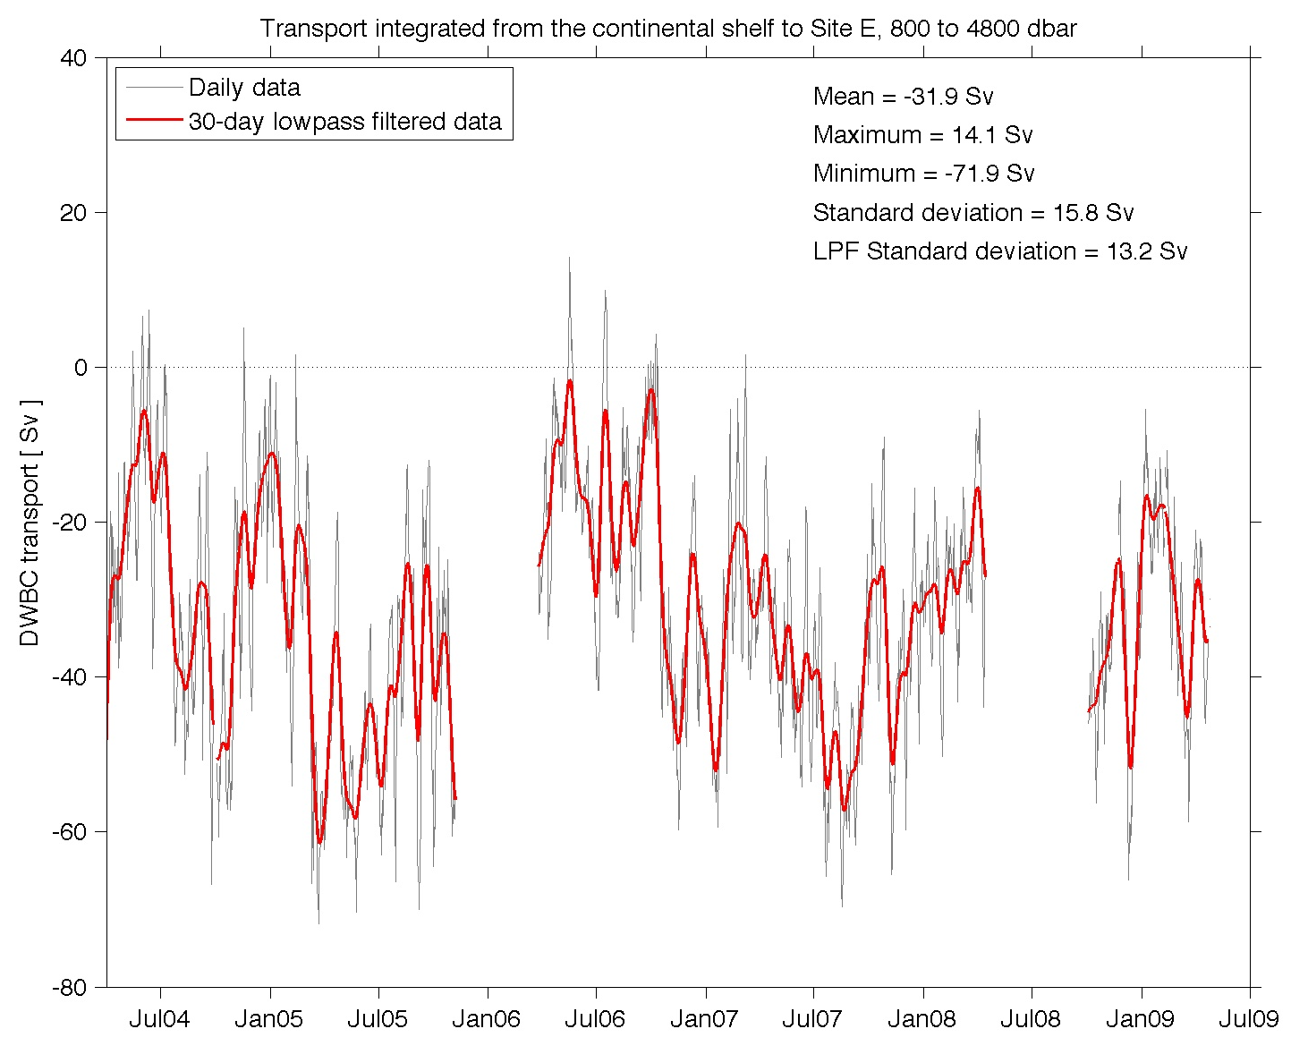
R/V Atlantic Explorer
Joint cruise
GOAL:
Variability of the Florida Current, the Antilles Current, and the Deep Western Boundary Current (DWBC)
Calibrate the long-term (30+ year) Florida Current cable observations.
Service 10-year long array of pressure-equipped inverted echo sounders (PIES) providing daily measurements of the DWBC. (Figure at right modified from Meinen et al., 2013)
Service the western boundary moorings of the basin-wide international array monitoring the MOC.
Mean transport
32 ±16 Sv to South
Range +14 to -72 Sv
DWBC transport, SV
Meinen et al., (2013)
Notes:
These arrays allow us to quantify changes in ocean currents – including flows that are hard to get at in other ways, like the DWBC. (Figure at right illustrates DWBC transport changes over 2004-2009; modified from Meinen et al., 2013.)
DWBC in North Atlantic – Analysis combining the measurements from the NOAA long-term WBTS program with the international MOCHA/RAPID-MOC projects at 26N demonstrates that the DWBC is much more variable than had previously been believed and that the deep flows west and east of the Mid-Atlantic Ridge must be compensating one another since the DWBC variability west of the Ridge significantly exceeds the variability of the total basin-wide MOC.
Mean transport
32 ±16 Sv
Vs. Mean MOC
18 ± 5 Sv
% Variance
37% T<2mos
36% 2<T<11 mos
1% 11<T<13 mos
26% T>13 mos
No annual cycle

Slide 32
Questions linked to NOAA goals
Climate Adaptation and Mitigation:
  What is the state of the climate (MOC) and how is it evolving?
  What causes climate variability and change on global to regional scales?
  What improvements in global and regional climate predictions are possible?
Weather-Ready Nation:
  How does climate affect seasonal weather and extreme weather events?
Cross-Cuts: Observing, Modeling, and Engaging.
  What is the best observing system to meet NOAA’s mission?
  How can emerging technologies improve ecosystem-based management?
Notes:
The questions that we are trying to answer about the MOC directly feed into NOAA’s goals of climate adaptation and mitigation – through assessments of the the state of the MOC for example), weather ready nations goals that focus on the impacts of climate on shorter term events as well as cross cutting issues such as the design of the optimal observing system and improved technologies to meet noaa needs
Climate Adaptation and Mitigation: An informed society anticipating and responding to climate and its impacts.
What is the state of the climate system and how is it evolving?
What causes climate variability and change on global to regional scales?
What improvements in global and regional climate predictions are possible?
Weather-Ready Nation: Society is prepared for and responds to weather-related events.
How does climate affect seasonal weather and extreme weather events?
How do environmental changes affect marine and coastal ecosystems?
Healthy Oceans: Marine fisheries, habitats, and biodiversity are sustained within healthy and productive ecosystems.
How can emerging technologies improve ecosystem-based management?
Cross-Cuts: Observing, Modeling, and Engaging.
What is the best observing system to meet NOAA’s mission?

Slide 33










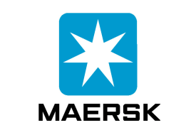
















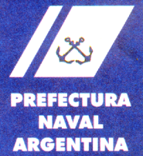


Partners and Stakeholders
Research at AOML on the MOC involves many national, international partners, collaborators and stakeholders. A special few include:
Notes:
The research I’m going to show you was heavily leveraged by our partners. For example the observing systems we’ve developed are too large for one country to take on in isolation and hence have resulted from years of negotiations and planning with national and international partners.
The data we collect is dependent on private industries who make instruments, provide data collection platforms and in the end use NOAA products. Also much of this work is tightly involved with other NOAA labs, of particular note is PMEL for data collection, GFDL and ESRL for modelling studies and NCDC with whom we collaborate to produce the annual state of the climate report.
NOAA: PMEL, GFDL, NODC, NESDIS, NCDC
Outside NOAA: University of Miami, WHOI, SOI, UW,
Private partners – e.g. ships, equipment suppliers etc

Slide 34
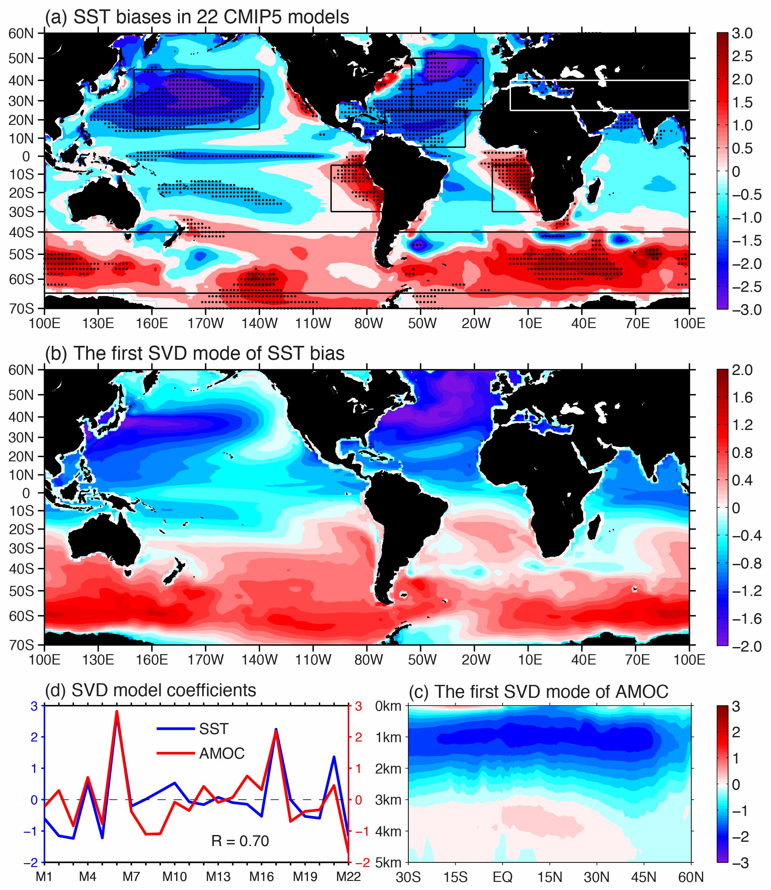
AMOC simulations cause global SST biases in IPCC-AR5 climate models
Global SST biases strengthen as the AMOC circulation weakens.
A weak AMOC is associated with cold biases in the entire Northern Hemisphere.
AMOC weakening is also associated with a strengthening of Antarctic bottom water formation and warm biases in the Southern Ocean.
Global processes errors (MOC) may overshadow local biases.
Wang et al. (2014, Nature CC)
Notes:
For example we use NOAA SST and and NOAA model data to examine the sensitivity of climate predictions on the reproduction of the MOC
The Intergovernmental Panel on Climate Change assessments depend upon simulations, predictions, and projections by climate models. However, most models have deficiencies and biases that raise large uncertainties in their products. Top figure shows the average model bias relative to the Smith et al SST data.
Over the last several decades, a tremendous effort has been made to improve model performance in the simulation of special regions and aspects of the climate system (for example those highlighted boxes).
In this recent Nature paper by Wang and coauthors they use 22 climate models and find regional sea surface temperature (SST) biases that are linked with the north atlantic MOC are in fact global.
Middle figure is the first EOF of the model SST biases. Lower right of the first EOF on the MOC strength. These EOFs are positively correlated with R=0.7 (lower left)
This shows that a simulated weak MOC is associated with cold biases in the entire Northern Hemisphere. The MOC weakening is also associated with a strengthening of Antarctic bottom water formation and warm SST biases in the Southern Ocean. It is also shown that cold biases in the tropical North Atlantic and West African/Indian monsoon regions during the warm season in the Northern Hemisphere have interhemispheric links with warm SST biases in the tropical southeastern Pacific and Atlantic, respectively.
The results suggest that improving the simulation of regional processes may not suffice for overall better model performance, as the effects of remote biases may override them.
Common patterns of global SST biases are found in in 22 climate models.
This indicates that the AMOC is very important for global climate.
Model period 1900-2005
No trend in bias – its quite stable
SST Data from Smith et al monthly ERSST/NOAA (ncdc)

Slide 35
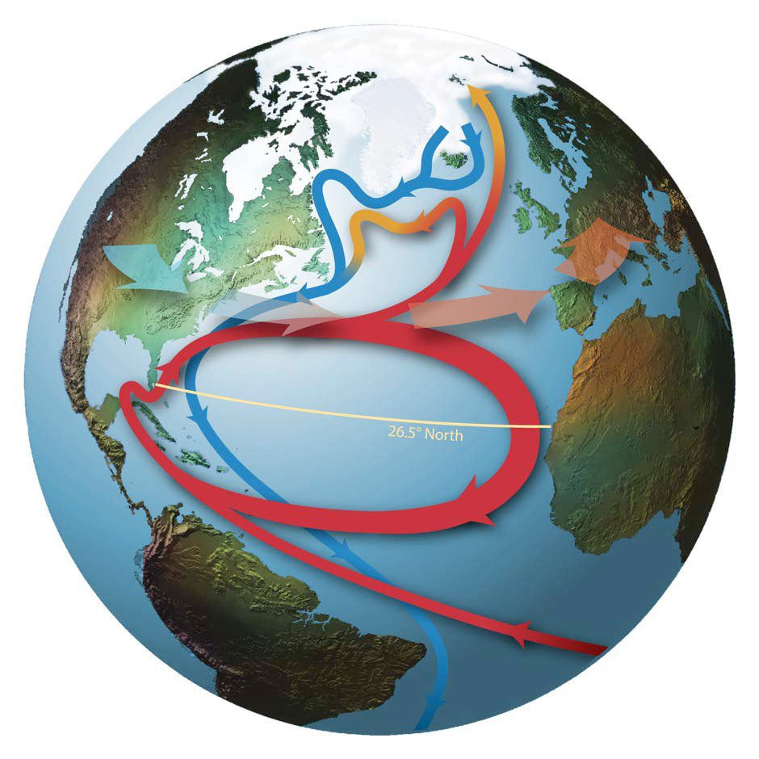
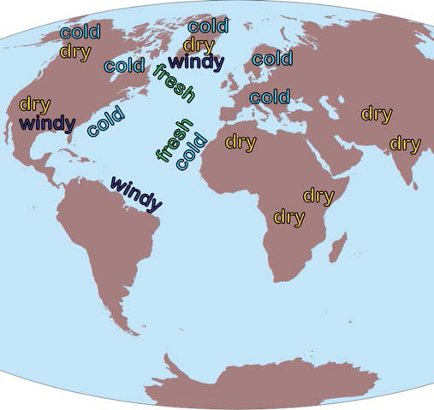
Definition and Impact
MOC =
A decrease in MOC has been shown to impact SST, continental climate, and coastal sea-level, to name a few.
Srokosz et al., (2012)
Notes:
The meridional overturning circulation has been narrowly defined as the maximum of the integrated basin-wide velocity (or streamfunction). We prefer to think of it as all those active circulation components in the ocean that produce mean north/south transport of warm/cold water. So for example in the north Atlantic that typically takes the form of near surface waters moving northward in the florida current/gulf stream system (red arrows) , cooling, sinking and returning south as the deep western boundary current (blue arrows). What is fundamental is that is is the slow climate time scale mechanism that the oceans redistribute heat, fresh water, carbon and nutrients (as well impacting fisheries….as entire life cycles of marine species take advantage of the “ride” through the subtropical gyre (e.g. the eel))
This heat transport plays an important role for setting climate (as shown in the left). Changes in the MOC strength – for example a rapid decrease in the MOC strength - have been linked to changes in SST (cooling), SSS (freshening of surface waters), an increase in surface winds and a decrease in rainfall.
The paper by Srokosz provides a nice summary of what is currently know about the MOC as well as the next directions in research.
If I didn’t say this before note that all the figures shown here were from papers with AOML/CIMAS authors and coauthors.

