Slide 1

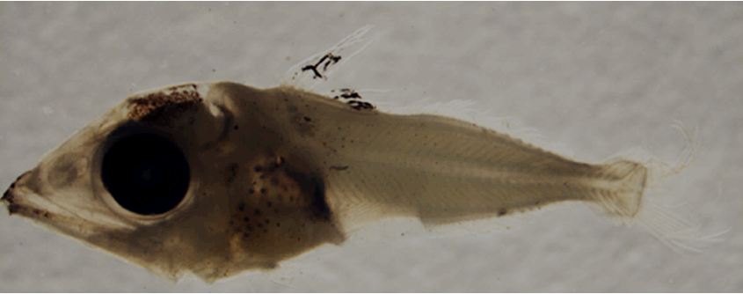
Improving NOAA-NMFS and ICCAT Atlantic Bluefin Tuna Fisheries Management Decision Support System
John T. Lamkin, PhD
Barbara Muhling, PhD
Notes:
Postflexion larva with pigment now present on mid-brain, well developed pigment on first dorsal fin, ventral midline pigment, dorsal midline pigment very small and not visible in photo, pigment on jaw tips, over dorsal gut and around kidney area, and some pigment developing laterally on trunk below first dorsal fin.

Slide 2
Our original research to date…
…provide fisheries independent data to improve NOAA-ICCAT bluefin stock assessments and management
Our research now, given DWH event…
…continue to support NOAA-ICCAT needs while responding to the DWH event with baseline data and future monitoring

Slide 3
What extent of the pelagic habitat is impacted by the oil
What are the impacts on pelagic fish and fish larvae
What are the impacts on other zooplankton
What are impacts on the food web
How will future fish stocks be impacted

Slide 4
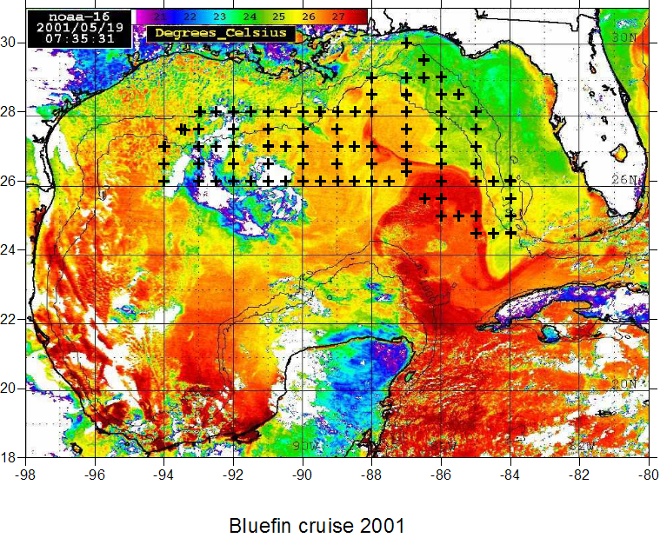
Introduction: Bluefin tuna survey stations

Slide 5
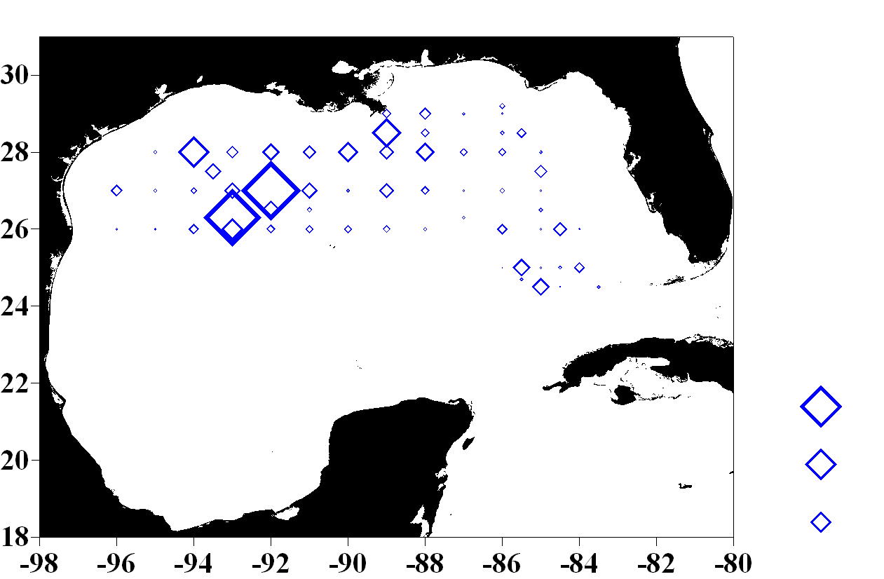
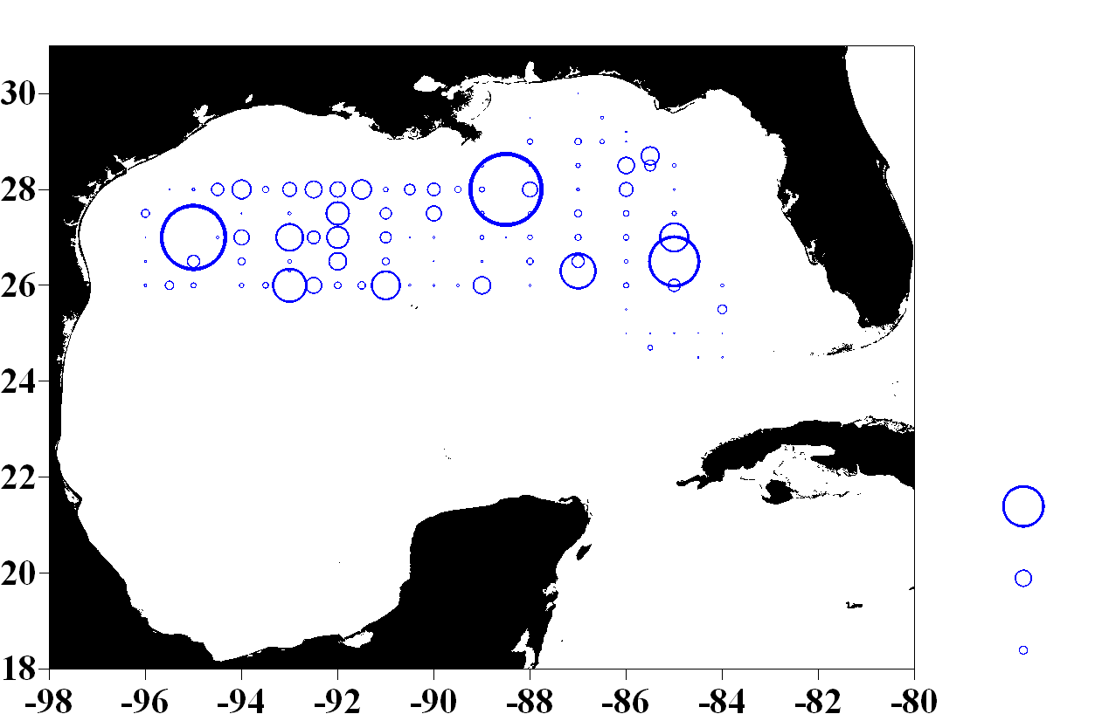
Presence/Absence
Larval BFT
Bongo (/m3)
0.1
0.075
0.005
Larval BFT:
Neuston (#)
5
2
1

Slide 6
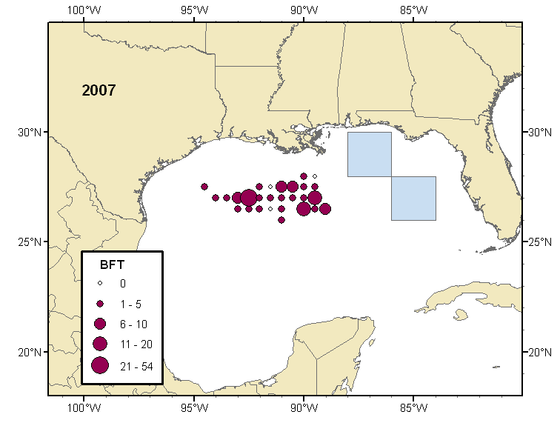
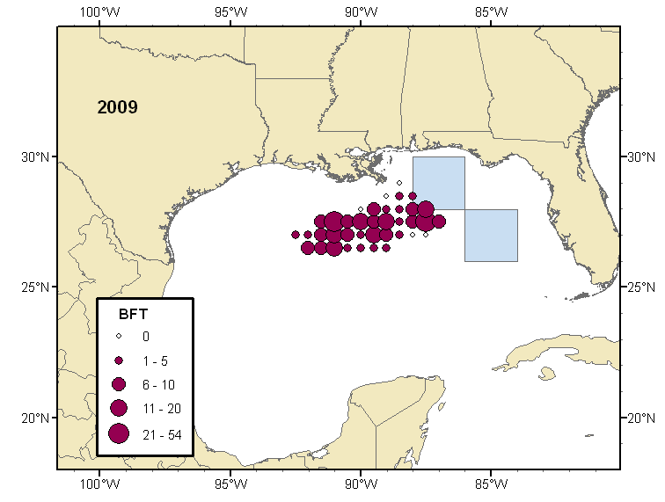
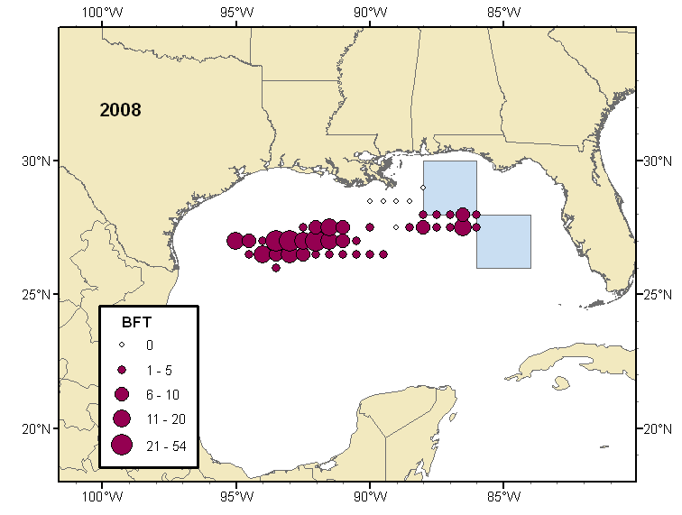
Summarized adult long-line catches…
with closed fishing areas (blue)

Slide 7
Date of Deepwater Horizon Incident
Date
Adults
Temperature
Larvae

Slide 8
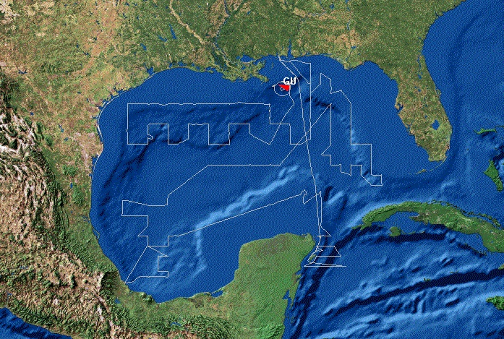
Bluefin tuna survey: legs 1, 2, 3

Slide 9
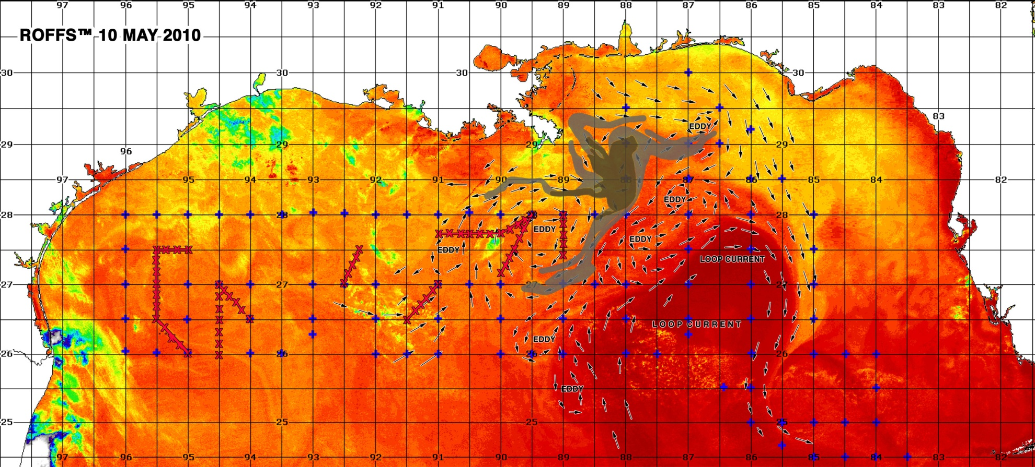
Planned stations: Leg 3 changes due to DWH event

Slide 10
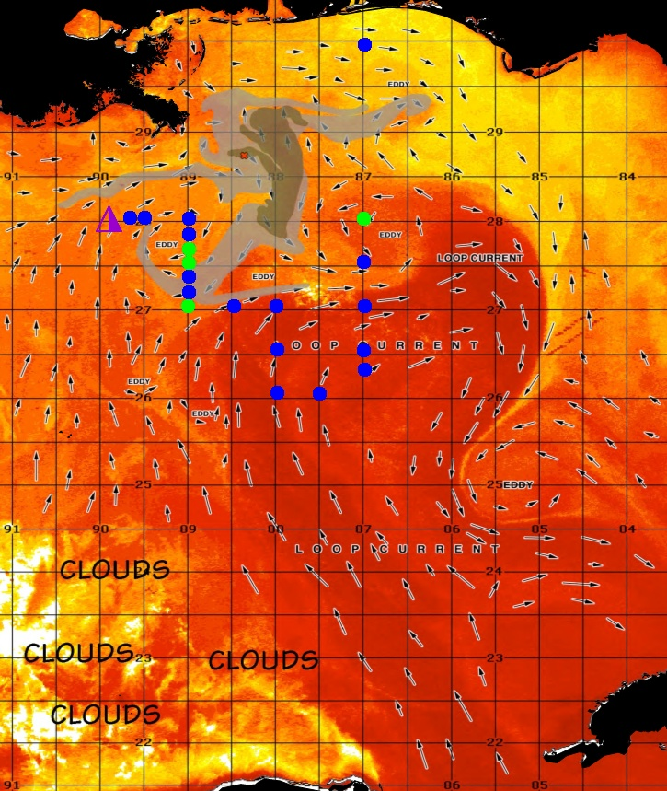
Bluefin tuna: leg 3

Slide 11
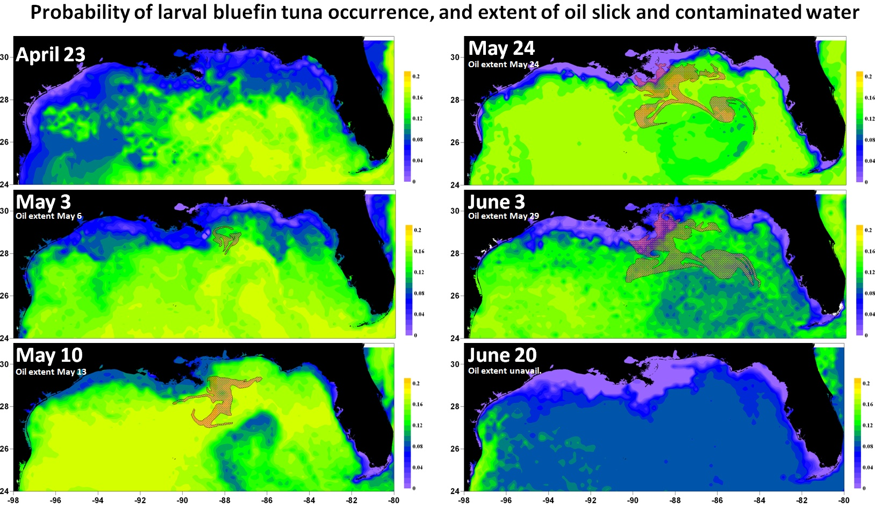

Slide 12
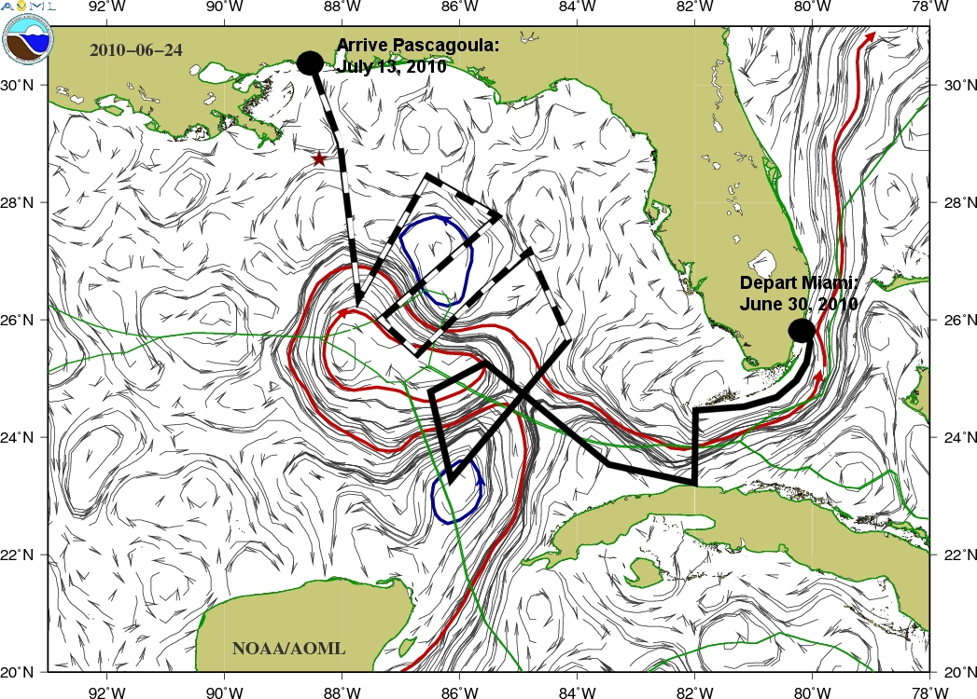

Slide 13
Future needs
Monitoring
Research

Slide 14
CONCLUSION
Our research moving forward provides…
…fisheries independent data with a consistent time and spatial series
…a pre-oil baseline
…samples for initial toxicology analyses
…distribution/abundance data for modeling
…development of spawning recruitment indices
…information for current response, on-going monitoring and future recovery plans
Special thanks to: Samantha Whitcraft for admin/presentation assistance…

