Slide 1
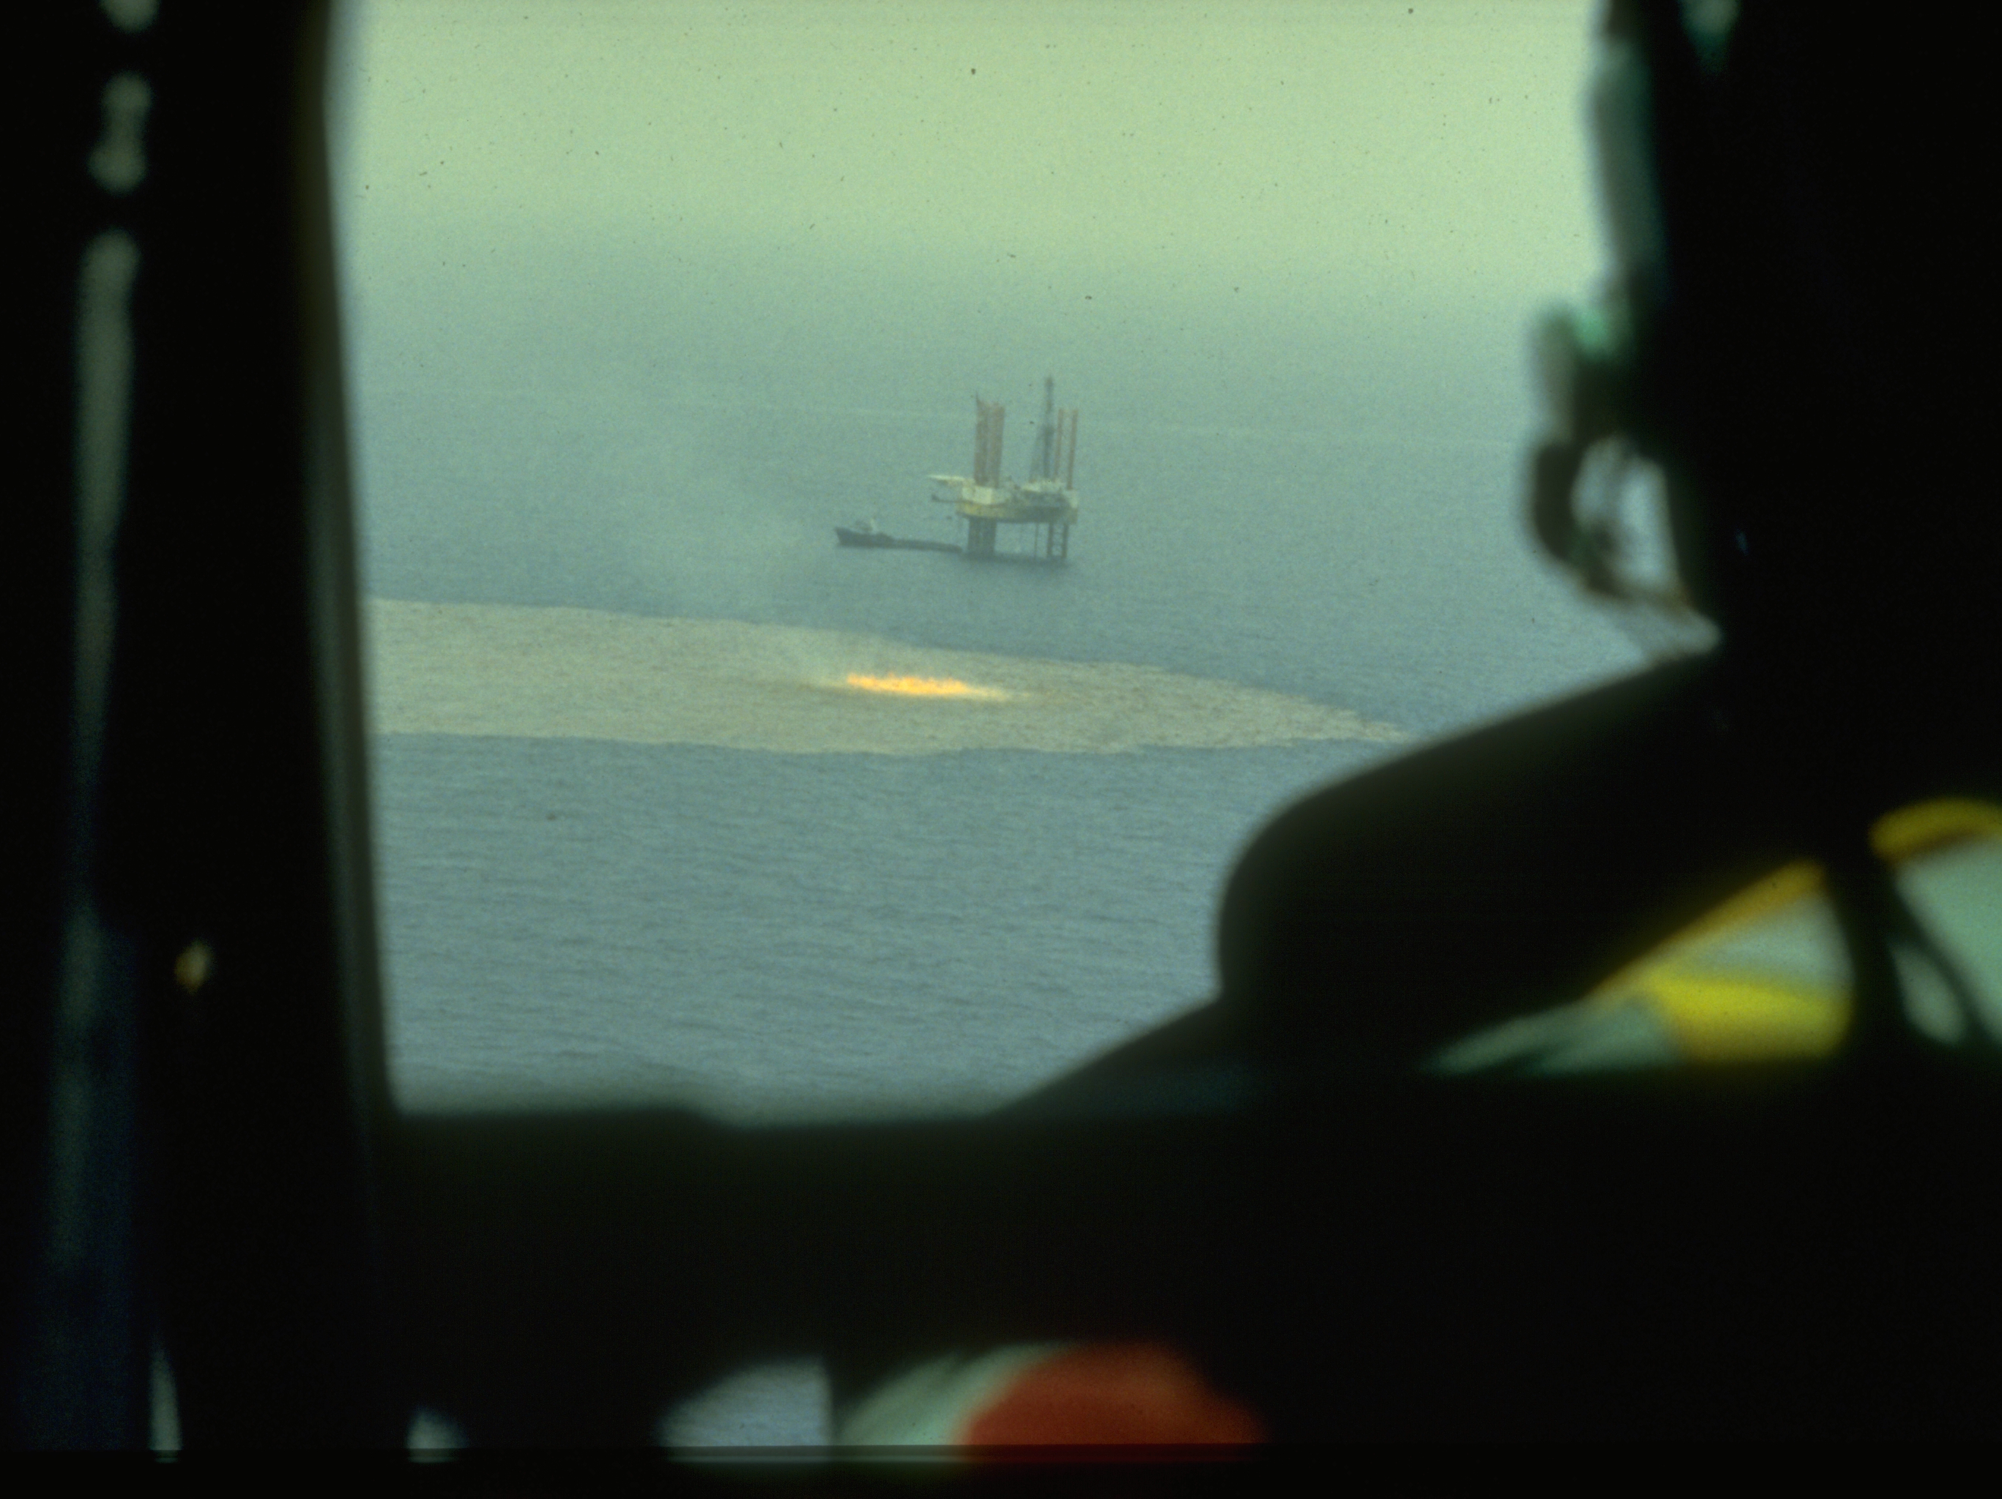
Joint Analysis Group
Robert Pavia, Ph.D.
Office of Response and Restoration
Seattle, WA

Slide 2
Joint Assessment Group
Chartered by the National Incident Command
Goal
Provide a comprehensive characterization of sub-surface oil and transport to inform:
Incident commands for strategic decisions;
Responders for tactical decisions;
Modelers for forecasting transport and fate.
Members
NOAA – NMFS (D.C.), ORR, AOML, AFSC, IOOS, NCDDC, OCL
EPA – Gulf Breeze Lab, R&D (Cincinnati), OER (D.C.), Region 1
White House - OSTP
USGS
UNH – Joint Hydrographic Institute
BP – Houston, UK
DFO - Canada
Organization
Federal Members
Coordination and Synthesis Team
Virtual Meeting– Daily Go-To-Meeting (2:00, 1:00, 11:00)

Slide 3
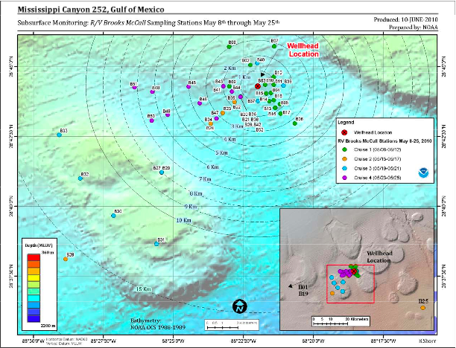

Slide 4
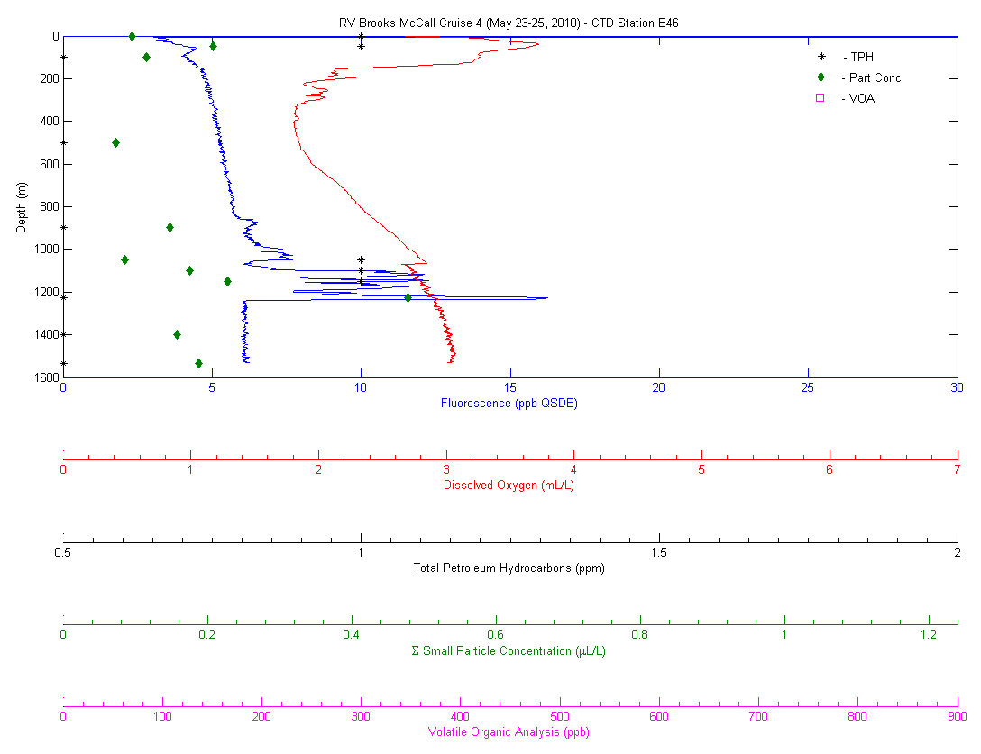

Slide 5
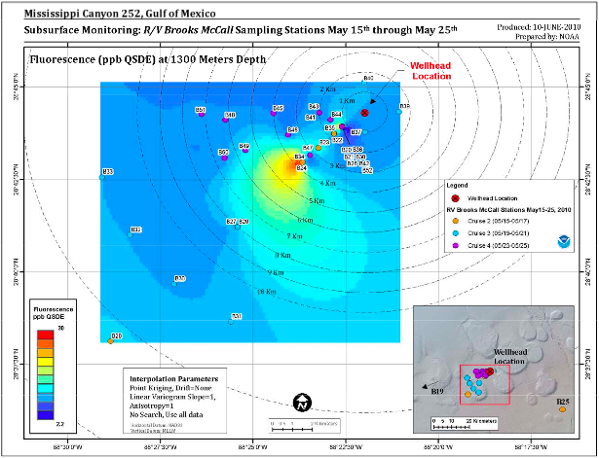
Strong evidence of diffuse subsurface oil between 1000m and 1400m. Decreases within the area sampled, especially beyond 10 km.
Evidence is consistent with laboratory sample analysis, models, and experimental data
Droplet size is consistent with chemically-dispersed oil
Dissolved oxygen levels in the water column are largely what are expected compared with historical data
Continue monitoring O₂ levels to understand the potential effects of subsurface oil releases.

Slide 6
05-23-2010_Brooks McCall | B45 | 5/24/10 | 50.3 | Sheen on Niskin water
05-23-2010_Brooks McCall | B45 | 5/24/10 | 499.6 | Sheen on Niskin water
05-23-2010_Brooks McCall | B45 | 5/24/10 | 899.3 | Sheen on Niskin water
05-23-2010_Brooks McCall | B45 | 5/24/10 | 1146.2 | Sheen on Niskin water
05-23-2010_Brooks McCall | B45 | 5/24/10 | 1198.5 | Sheen on Niskin water
05-23-2010_Brooks McCall | B45 | 5/24/10 | 1198.7 | Sheen on Niskin water
05-23-2010_Brooks McCall | B45 | 5/24/10 | 1233.7 | Sheen on Niskin water
05-23-2010_Brooks McCall | B45 | 5/24/10 | 1486.8 | Sheen on Niskin water
05-23-2010_Brooks McCall | B46 | 5/24/10 | 50.0 | Sheen on Niskin water
05-23-2010_Brooks McCall | B46 | 5/24/10 | 100.2 | Sheen on Niskin water
05-23-2010_Brooks McCall | B46 | 5/24/10 | 499.9 | Sheen on Niskin water
05-23-2010_Brooks McCall | B46 | 5/24/10 | 899.1 | Sheen on Niskin water
05-23-2010_Brooks McCall | B46 | 5/24/10 | 1049.4 | Sheen on Niskin water
05-23-2010_Brooks McCall | B46 | 5/24/10 | 1099.1 | Sheen on Niskin water
05-23-2010_Brooks McCall | B46 | 5/24/10 | 1148.8 | Sheen on Niskin water
05-23-2010_Brooks McCall | B46 | 5/24/10 | 1226.7 | Sheen on Niskin water
05-23-2010_Brooks McCall | B46 | 5/24/10 | 1398.3 | Slight sheen on Niskin water
05-23-2010_Brooks McCall | B46 | 5/24/10 | 1534.2 | Slight sheen on Niskin water
05-23-2010_Brooks McCall | B47 | 5/24/10 | 50.0 | Sheen on Niskin water
05-23-2010_Brooks McCall | B47 | 5/24/10 | 100.3 | Sheen on Niskin water
05-23-2010_Brooks McCall | B47 | 5/24/10 | 199.9 | Sheen on Niskin water
05-23-2010_Brooks McCall | B47 | 5/24/10 | 810.7 | Sheen on Niskin water
05-23-2010_Brooks McCall | B47 | 5/24/10 | 999.2 | Sheen on Niskin water
05-23-2010_Brooks McCall | B47 | 5/24/10 | 1098.6 | Sheen on Niskin water
05-23-2010_Brooks McCall | B47 | 5/24/10 | 1198.5 | Sheen on Niskin water
05-23-2010_Brooks McCall | B47 | 5/24/10 | 1298.9 | Slight sheen on Niskin water

Slide 8
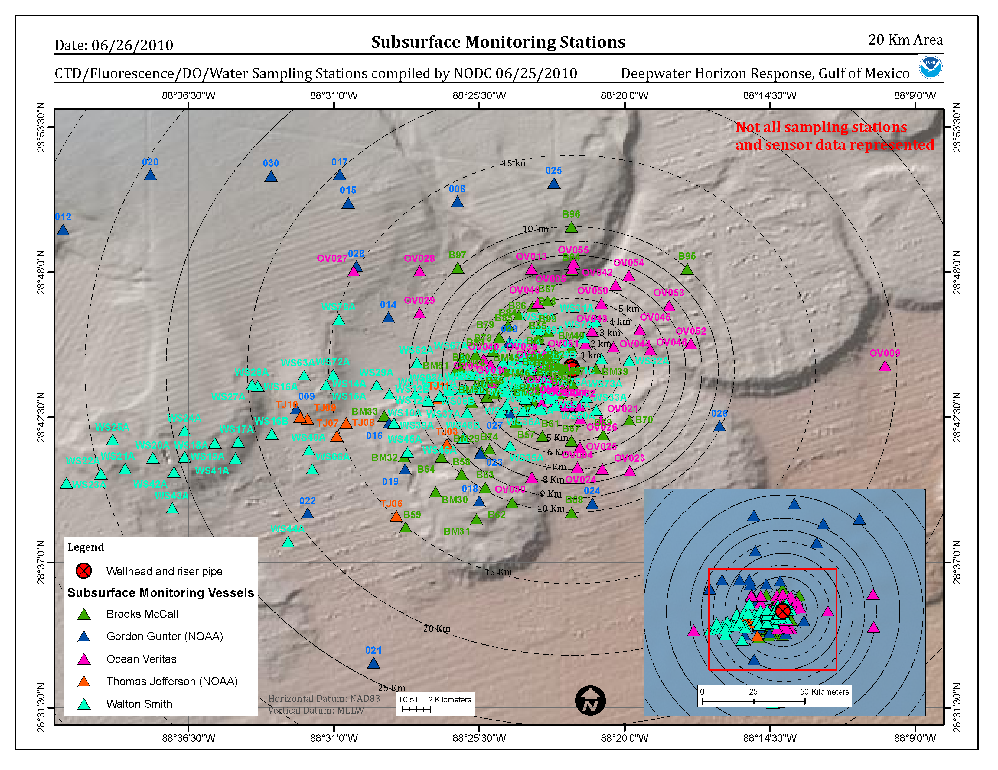
Figure 2: Subsurface Monitoring Stations within 20 km of the Wellhead

Slide 9
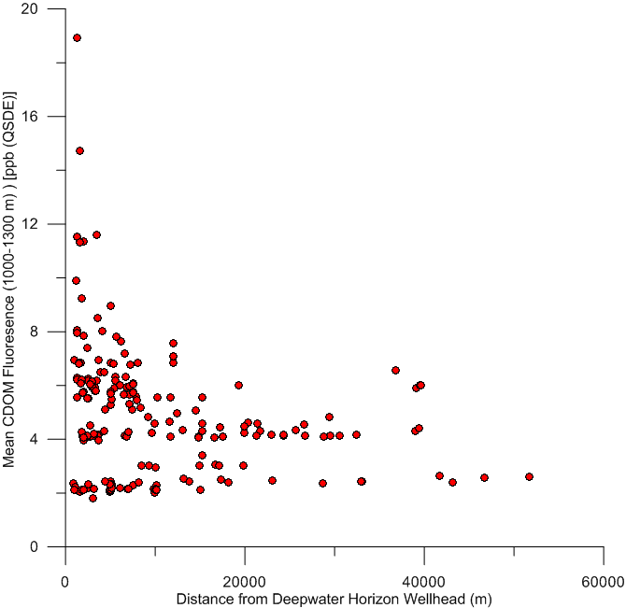
Figure 9: Mean Fluorescence (ppb QSDE) vs. Distance from the Wellhead
Preliminary Data Subject to Change

Slide 10
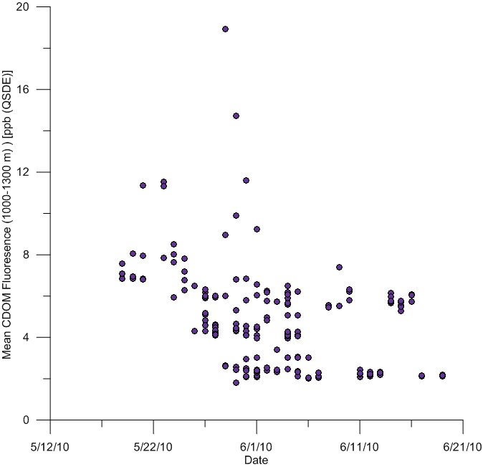
Figure 11: Mean Fluorescence (ppb QSDE) vs. Time of Observation
Preliminary Data Subject to Change

Slide 11
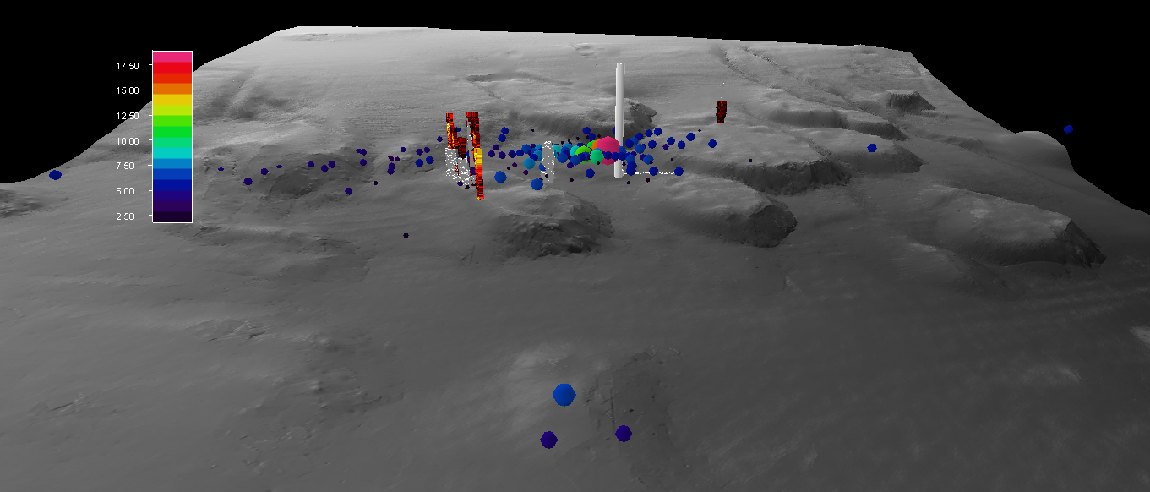
Figure 47: Mean Fluorescence ppb (QSDE) between
1000-1300m from 19 May through 19 June
Seeps
Preliminary Data Subject to Change

Slide 12
DO₂ measurements from CTD casts with SBE 43 DO₂ sensor made at or below 1000 m deep sometimes show a depression. This depression:
Could be due to biochemical O₂ demand from oxidation of subsurface oil and gas;
Currently does not show DO₂ to be depressed to levels considered to be hypoxic;
Cannot be reliably interpreted because of a lack of sensor calibration data and possible interference of oil;
Requires that Winkler titrations be performed on future cruises.

Slide 13
Reporting to Date
Review of R/V Brooks McCall Data to Examine Sub-Surface Oil
Review of Data to Examine Subsurface Oil May 19 to June 19, 2010
Sub-Surface Monitoring of Dissolved Oxygen at the Deepwater Horizon Site
Instrument Response of an eco cdom Fluorometer to mc 252 Oil
Field calibration check for CDOM Fluorometer
Data Processing in support of the Joint Analysis Group
Recommendations for sampling at DWH MC252
Methods for measuring bacterial degradation

