Slide 1
Delineating BP’s Oil Spill Extent with TCNNA
Oscar Garcia-Pineda - FSU
William Pichel – NOAA/NESDIS
Xiaofeng Li – NOAA/NESDIS

Slide 2
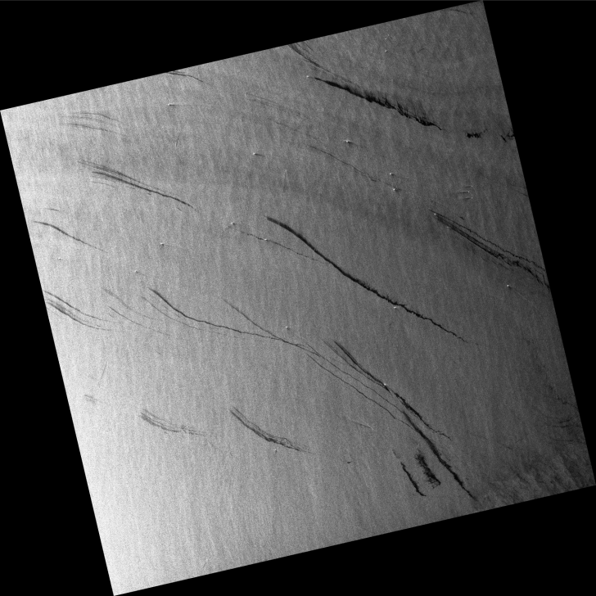
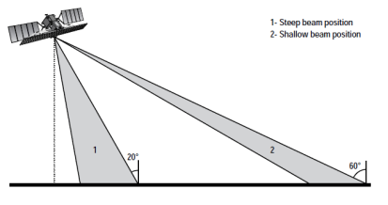
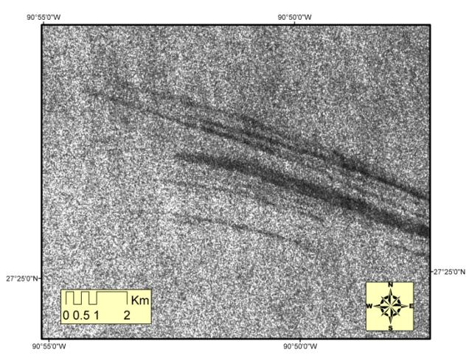
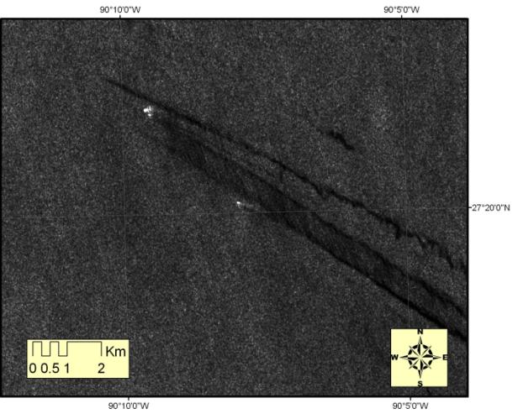
Complexity of SAR images
We needed a semi-automated methodology
To segmentate areas of oil slicks

Slide 3
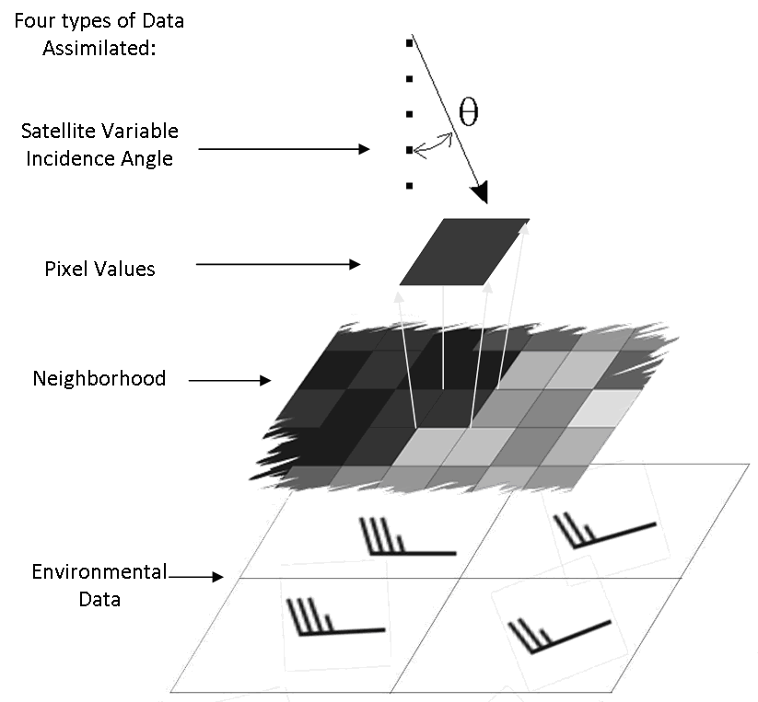
Integration of Satellite Remote Sensing Data with Ancillary Data
Garcia-Pineda, Zimmer, Howard, Pichel, Xiaofeng, MacDonald
Canadian Journal of Remote Sensing

Slide 4
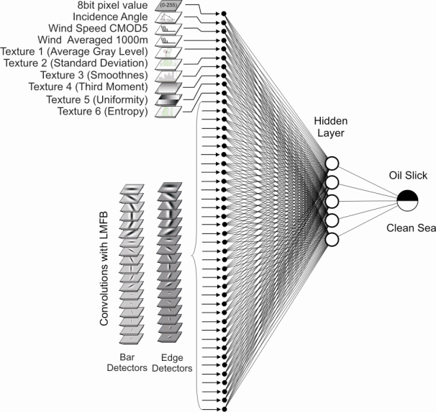
A neural network program is used to fit a function of many variables
Textural Classifier Neural Network Algorithm
TCNNA
Convolutions with Filters

Slide 5
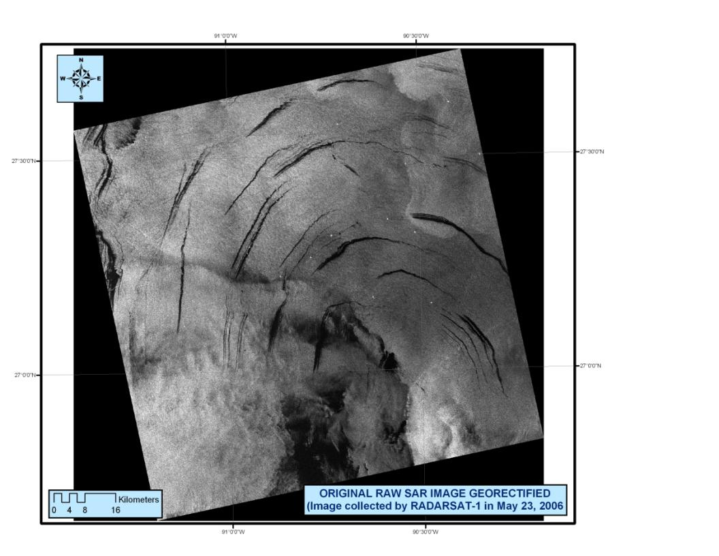
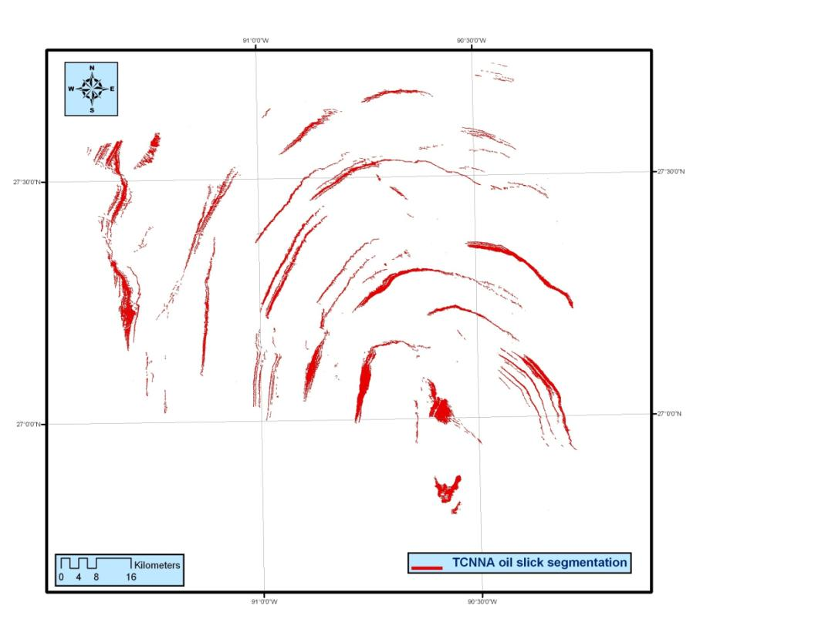
Garcia-Pineda, Zimmer, MacDonald (2008)
IEEE Geoscience & Remote Sensing

Slide 6
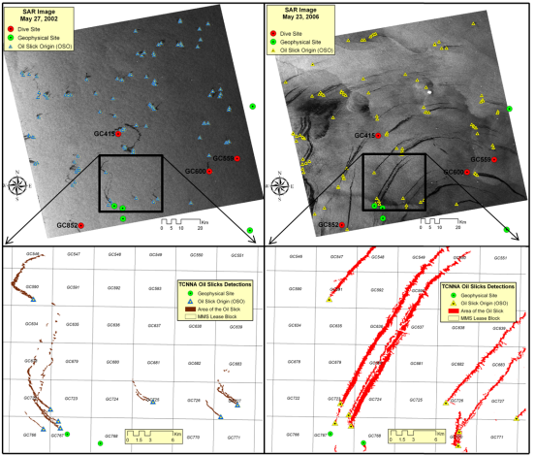
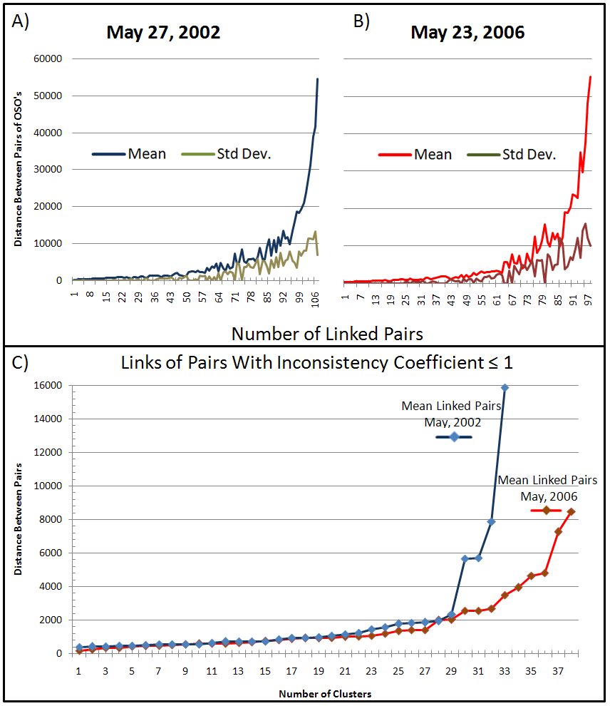
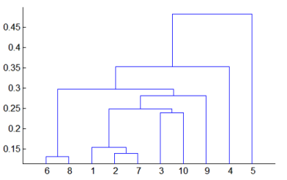

Slide 7
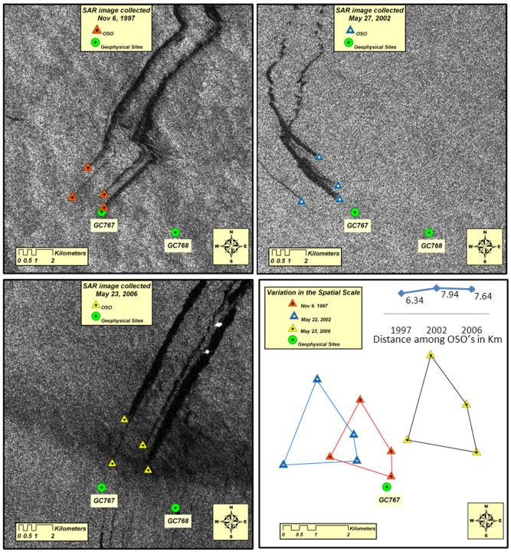

Slide 8
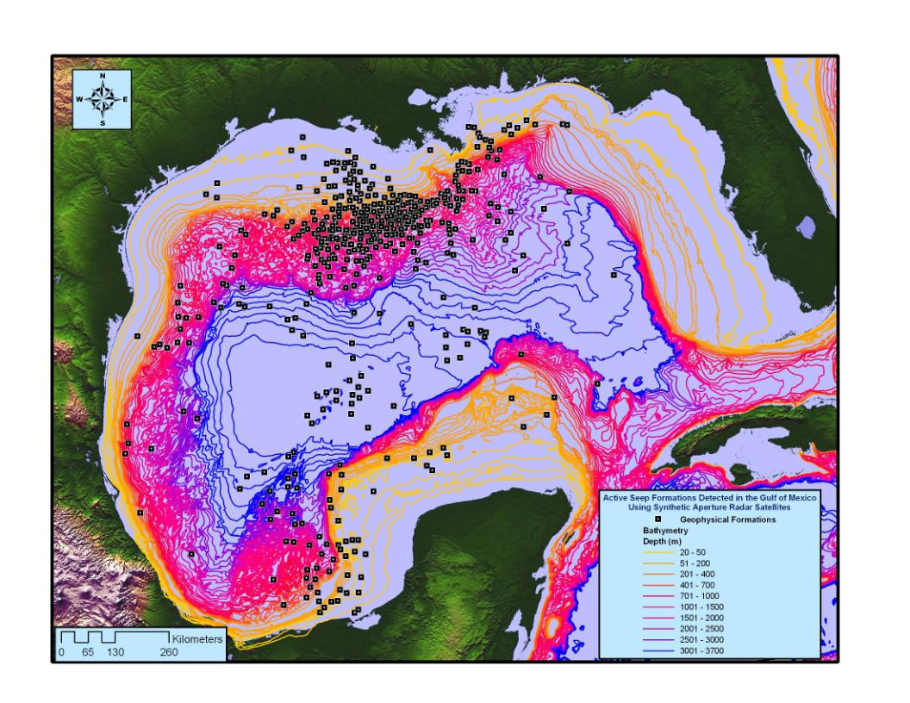

Slide 10
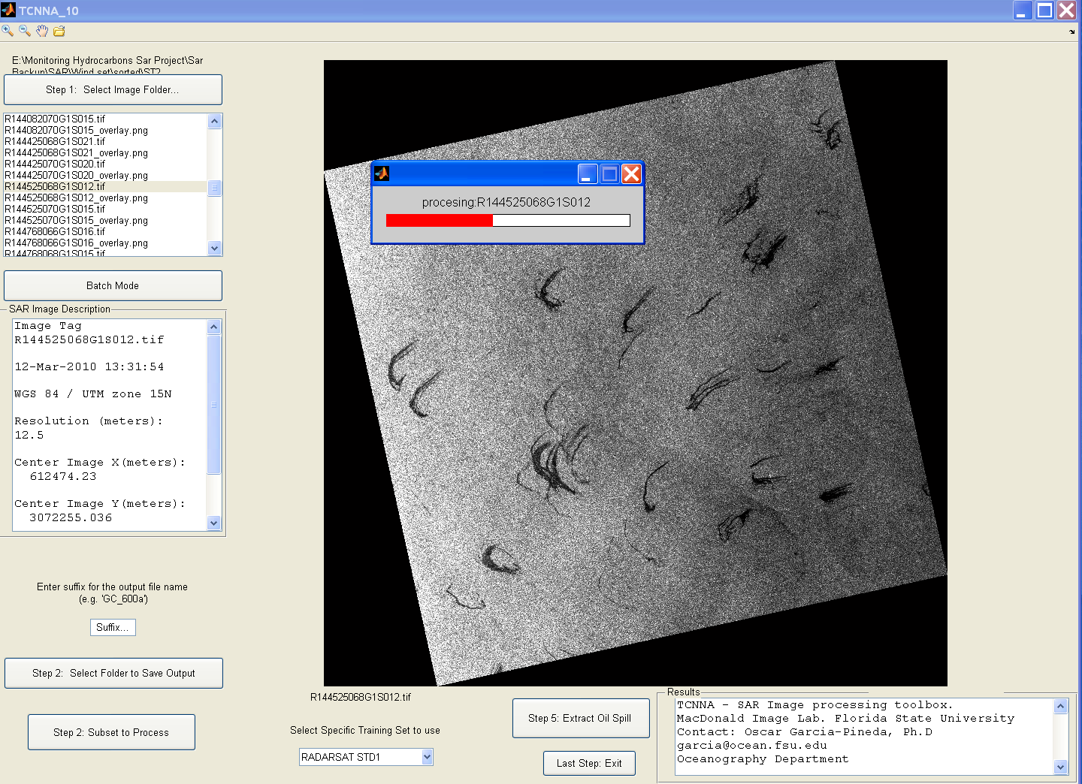

Slide 11
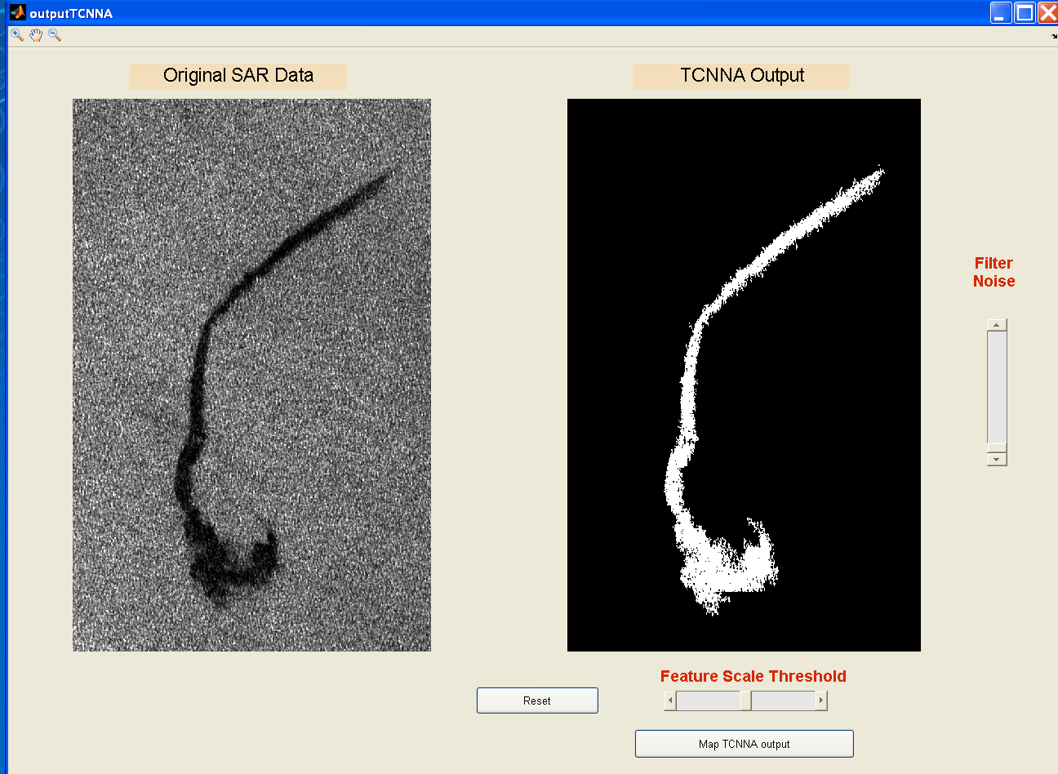

Slide 12
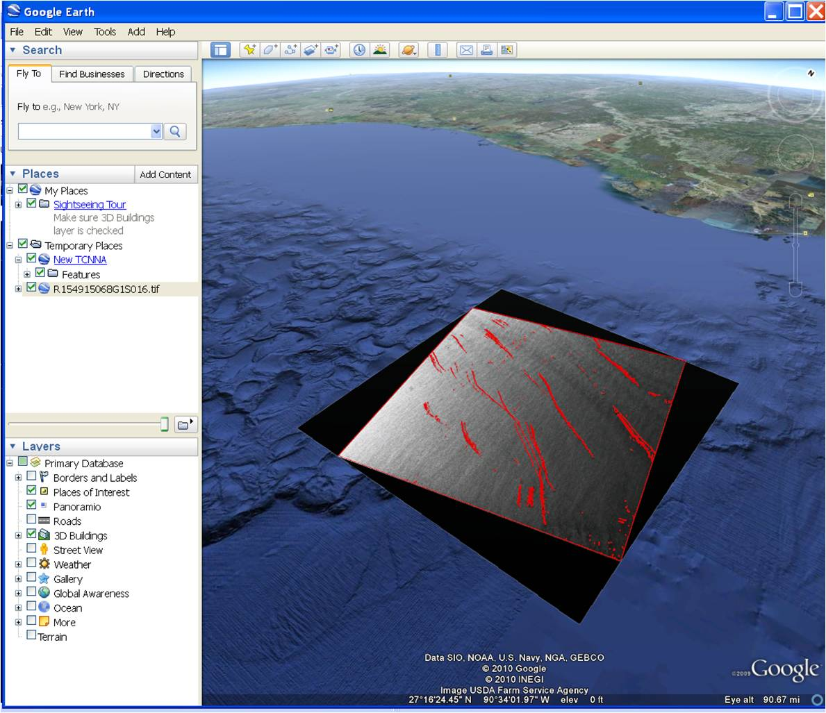

Slide 13
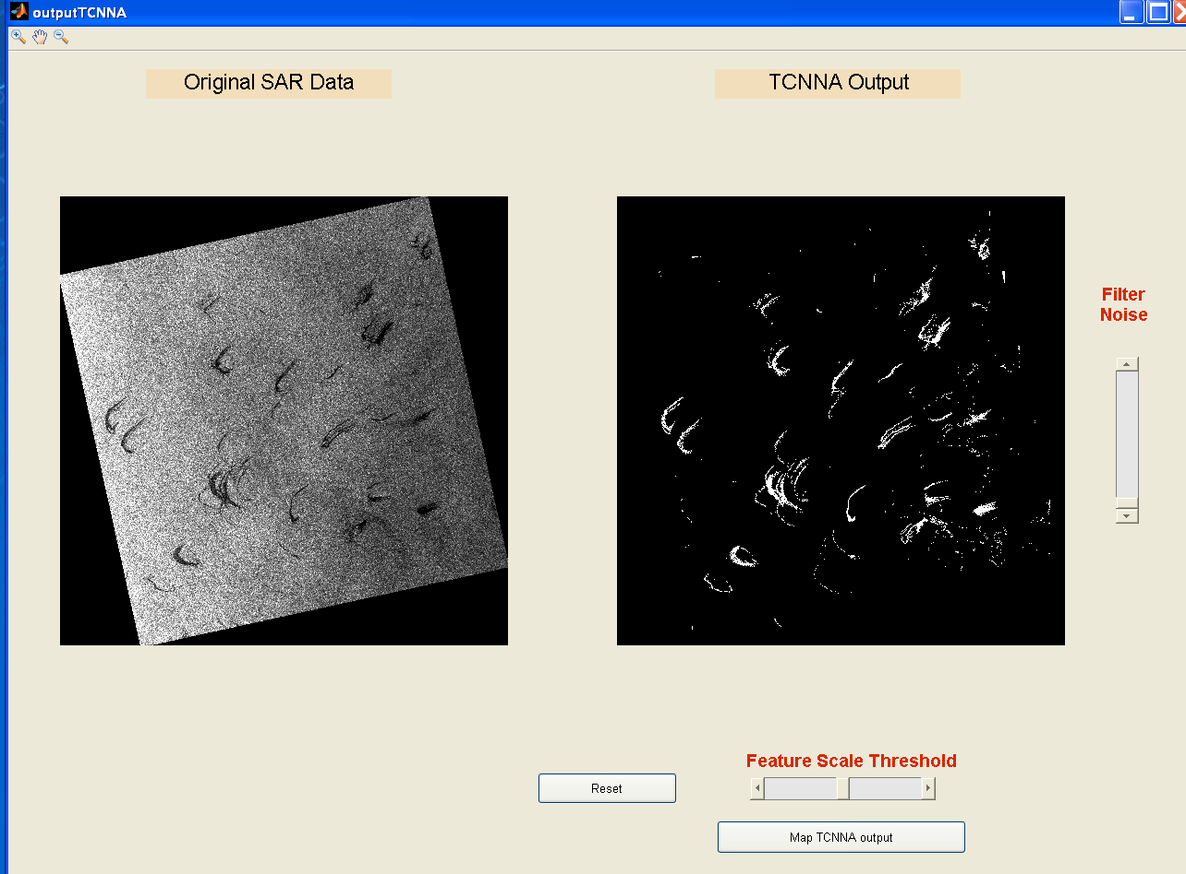

Slide 16
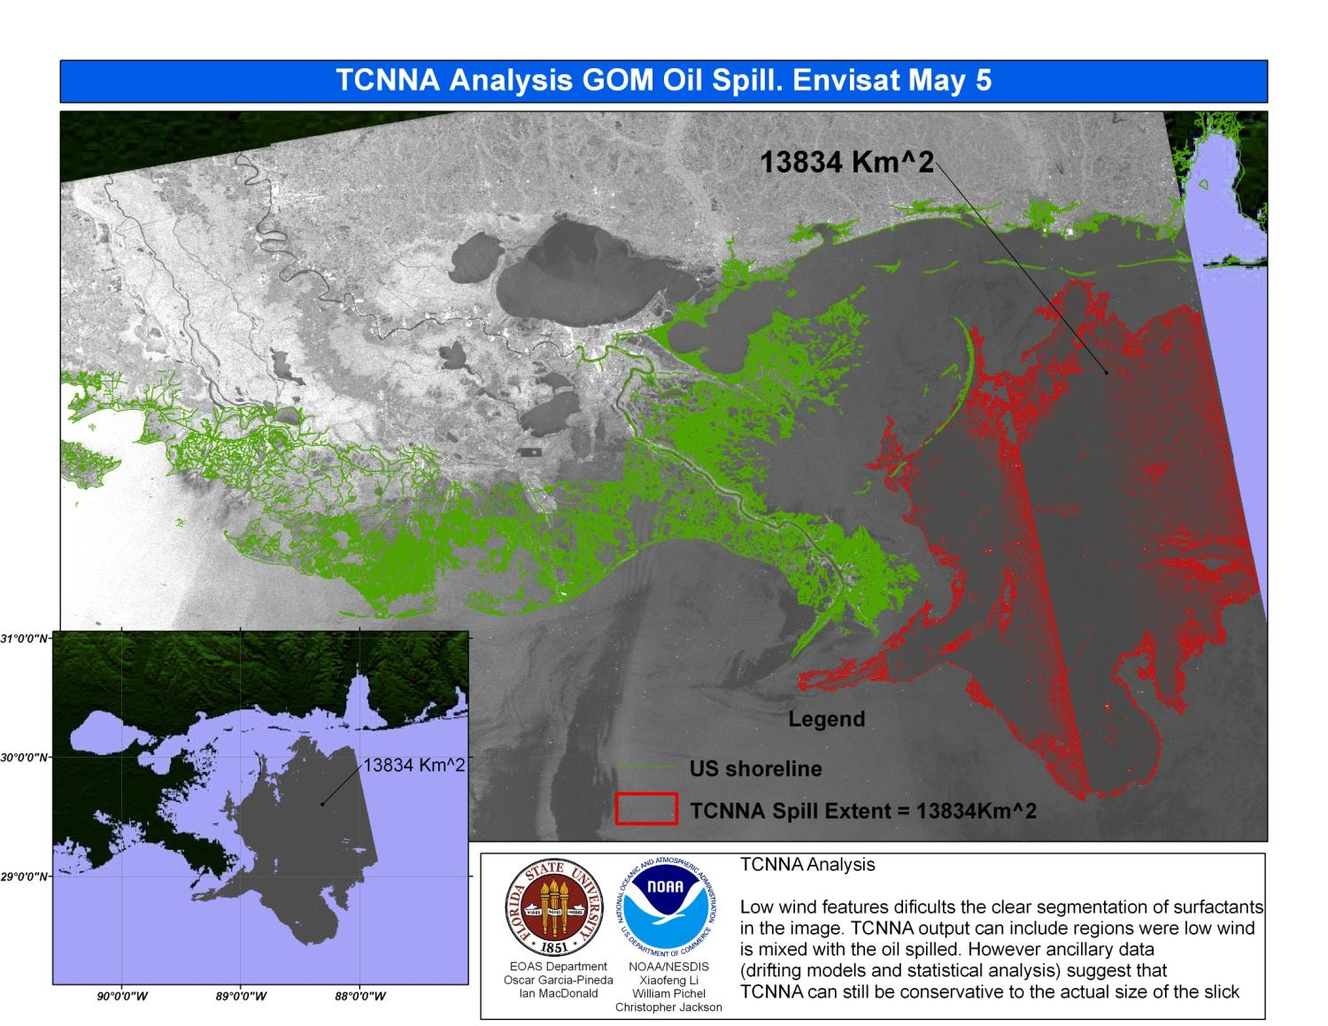

Slide 17
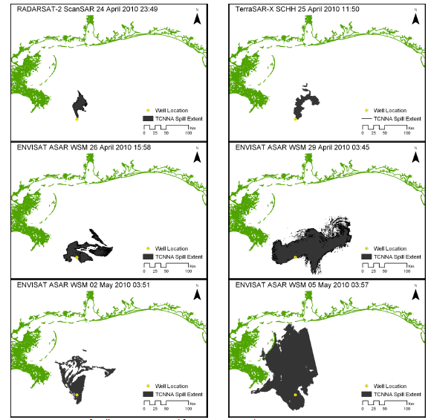

Slide 18
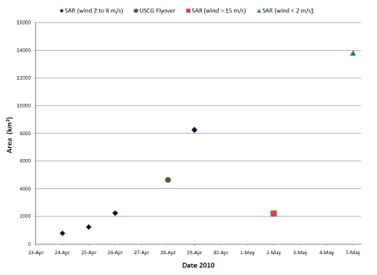
Wind > 12m/s

Slide 19
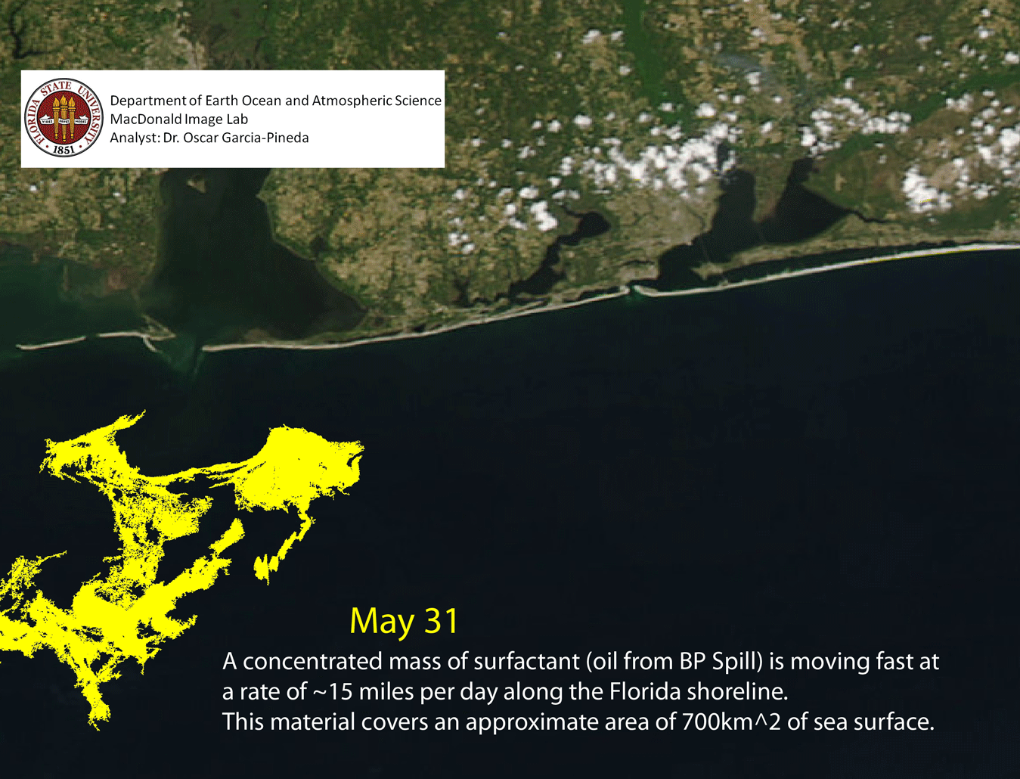

Slide 20
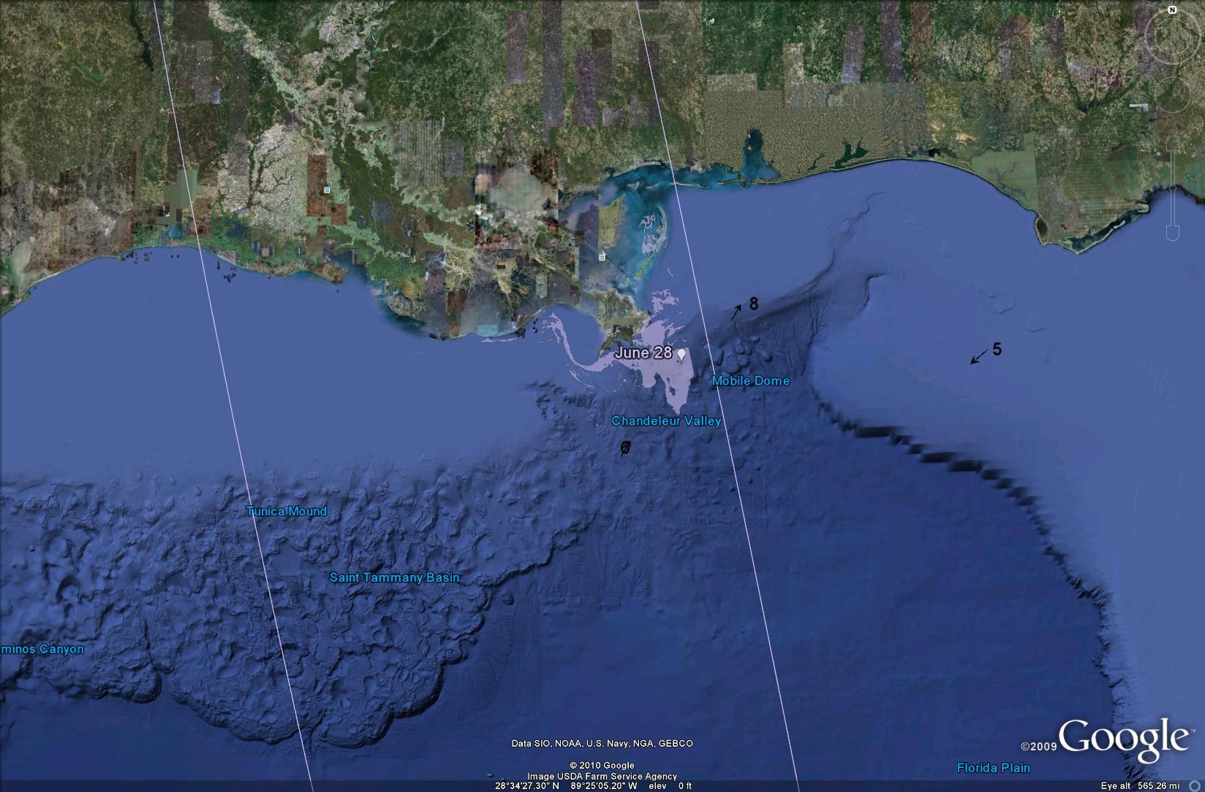

Slide 21
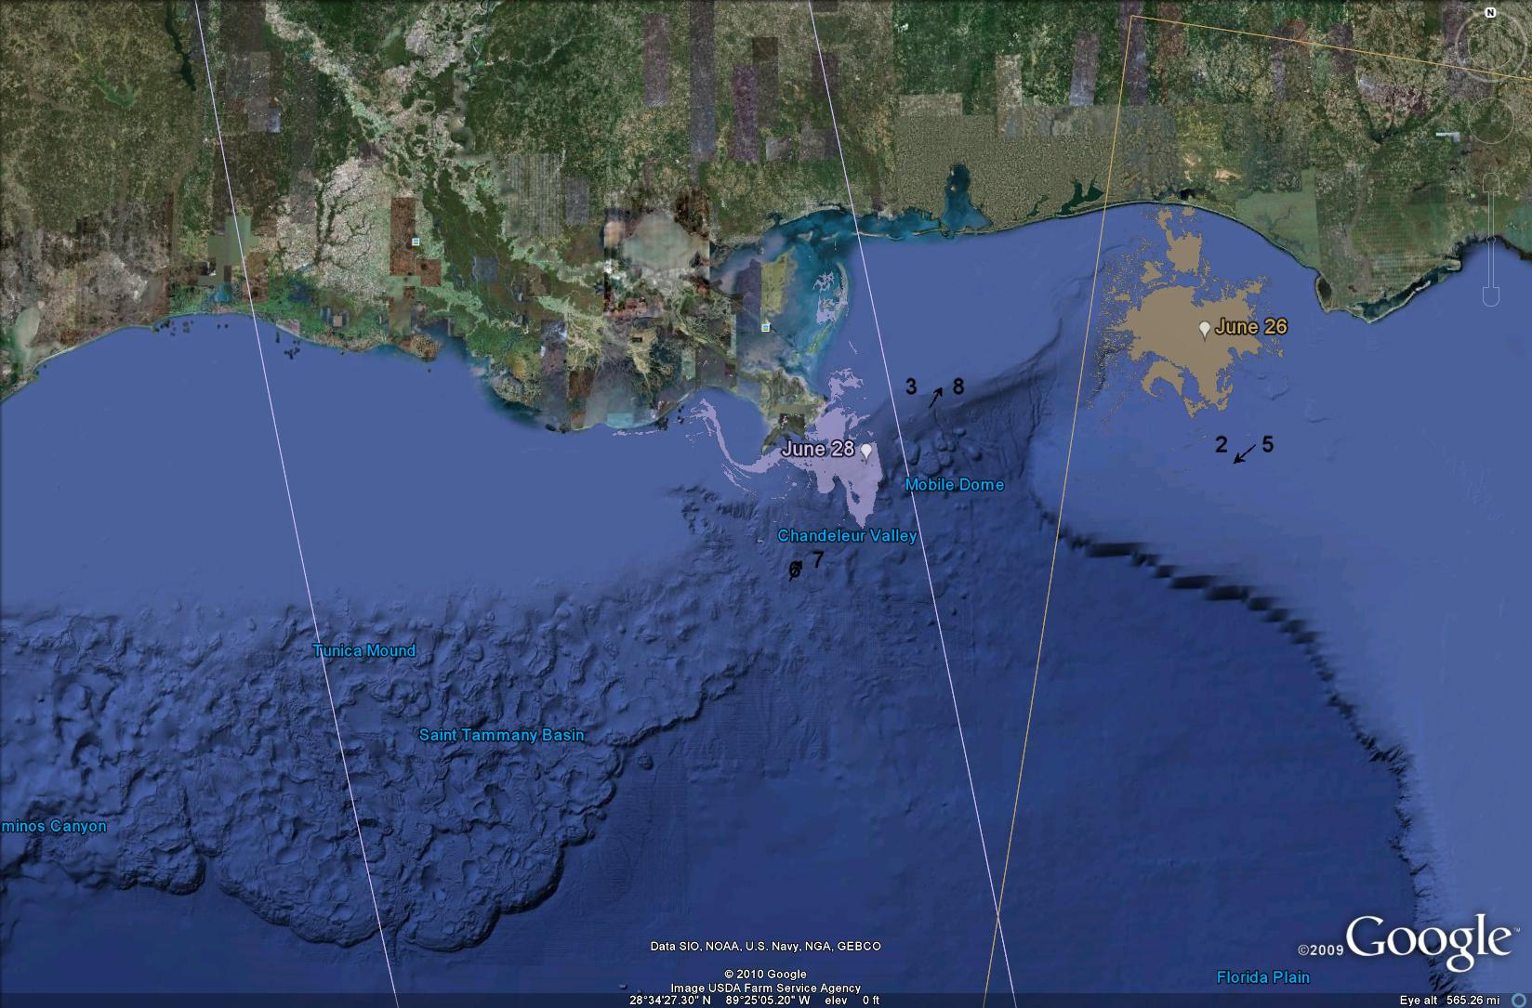

Slide 22
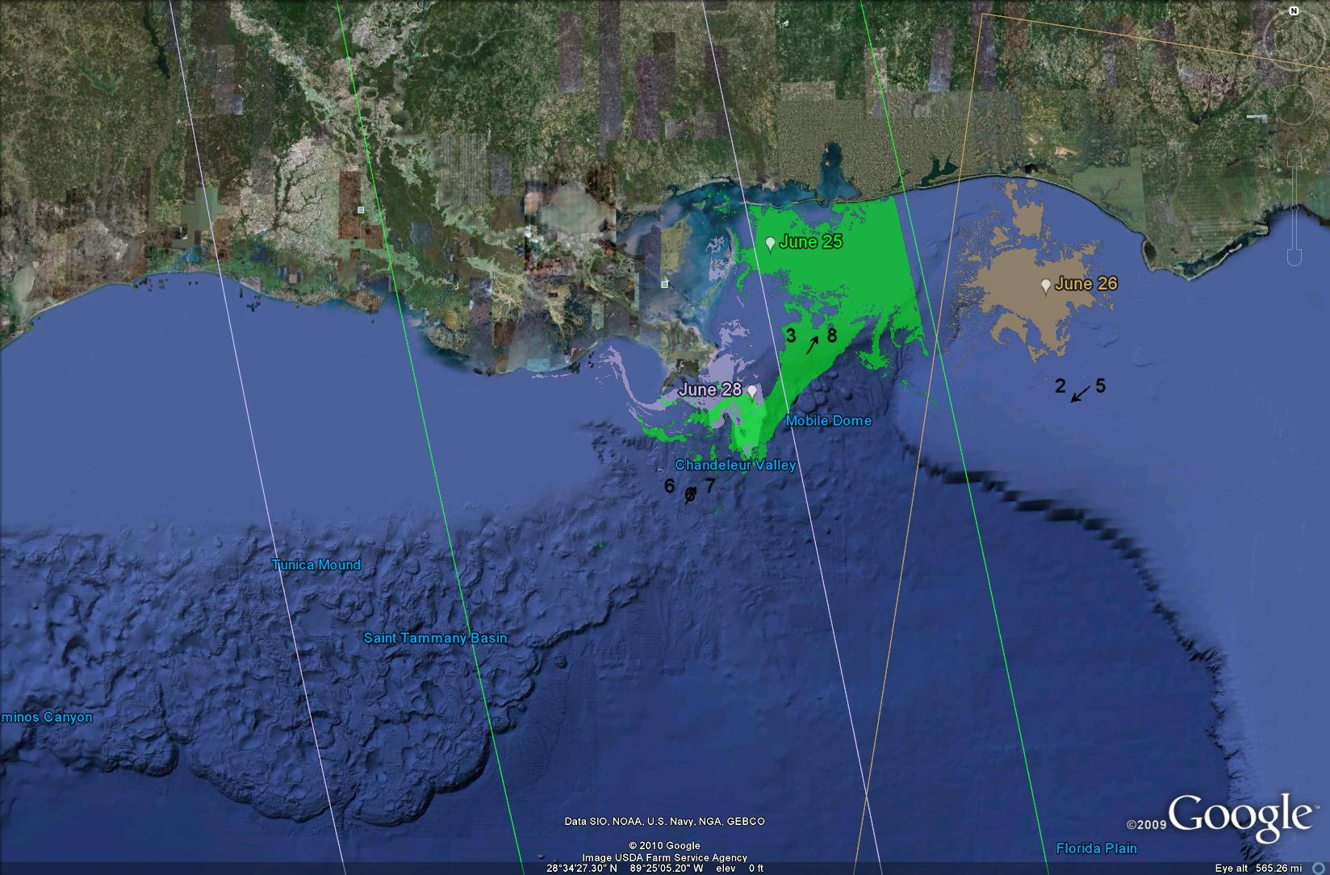

Slide 23
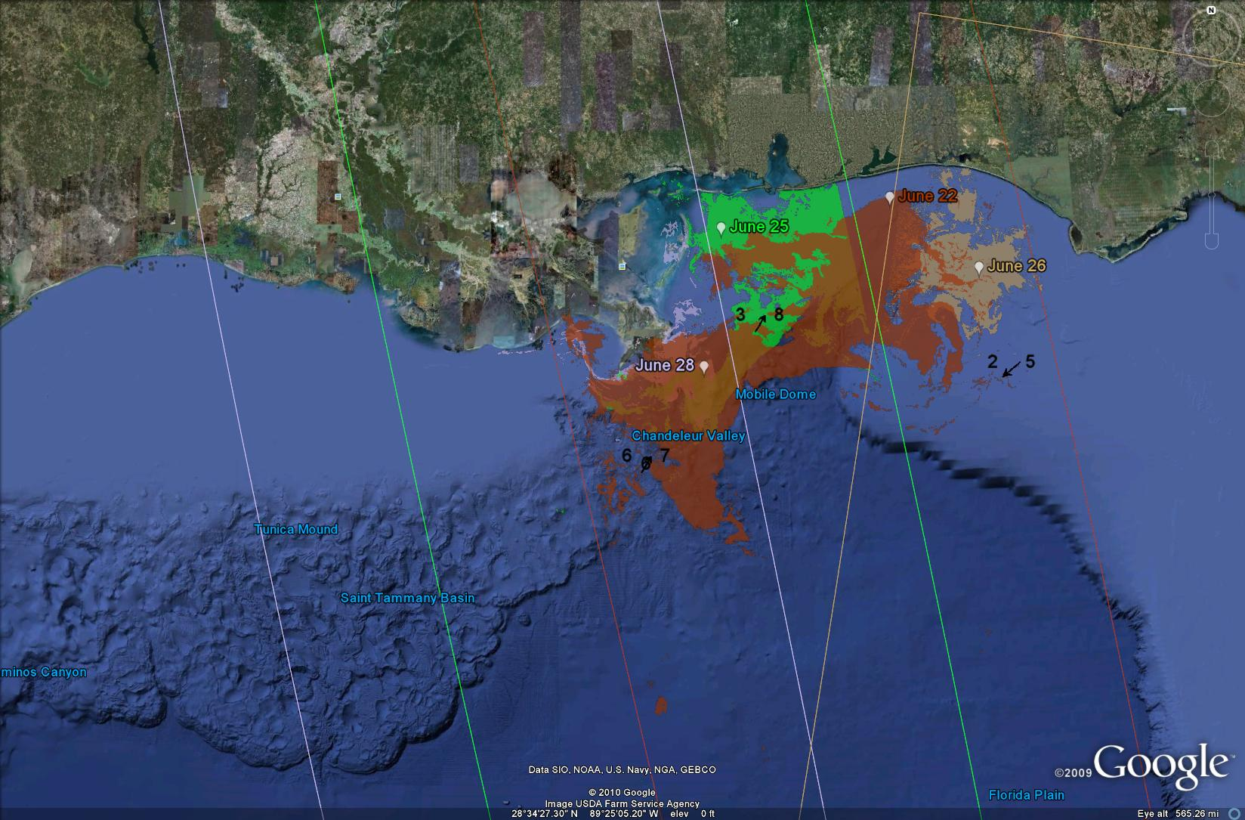

Slide 24
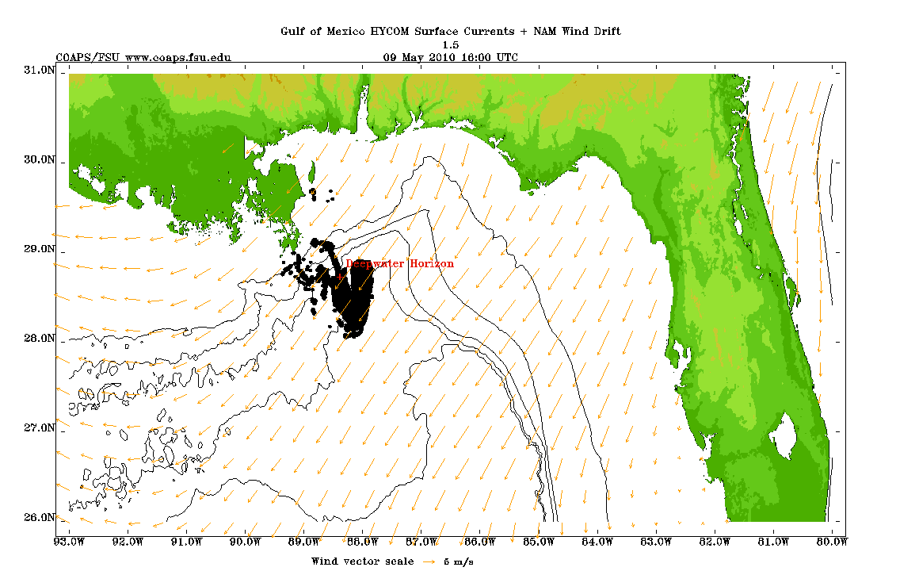
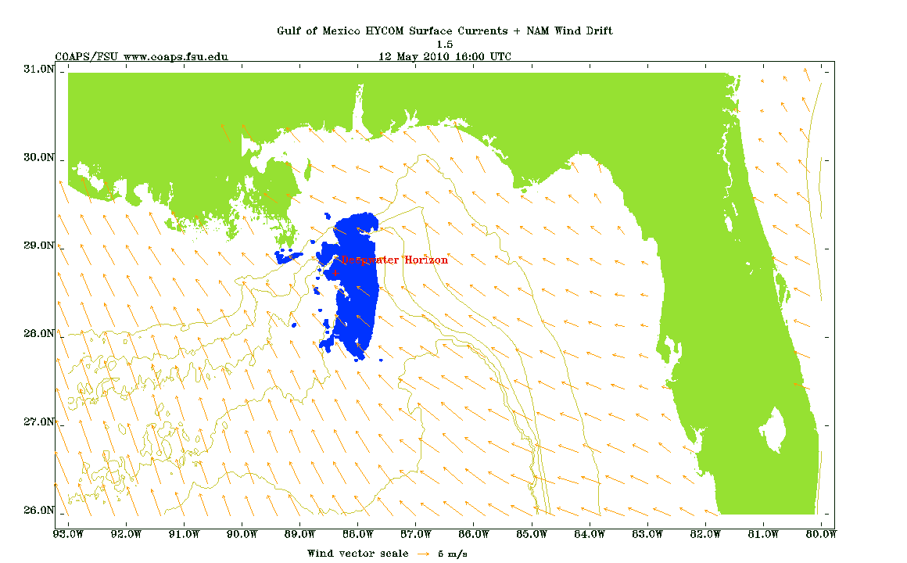
09 May 1600UTC
09 May 1600UTC
The oil spill model is initialized from the SAR-derived oil maps
The 3-day forecast oil position is objectively compared to the subsequent SAR map
Metrics are computed to assess forecasts with differing values of parameters (e.g. wind drift) or model formulations to determine which improvements should be implemented
12 May 1600UTC
12 May 1600UTC

Slide 25
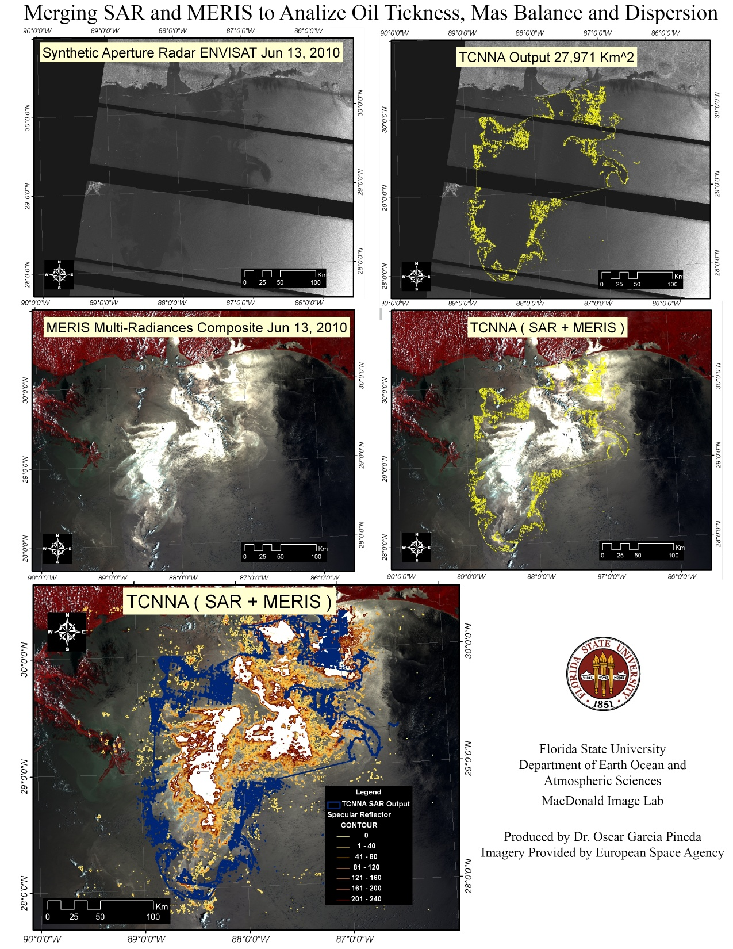

Slide 26
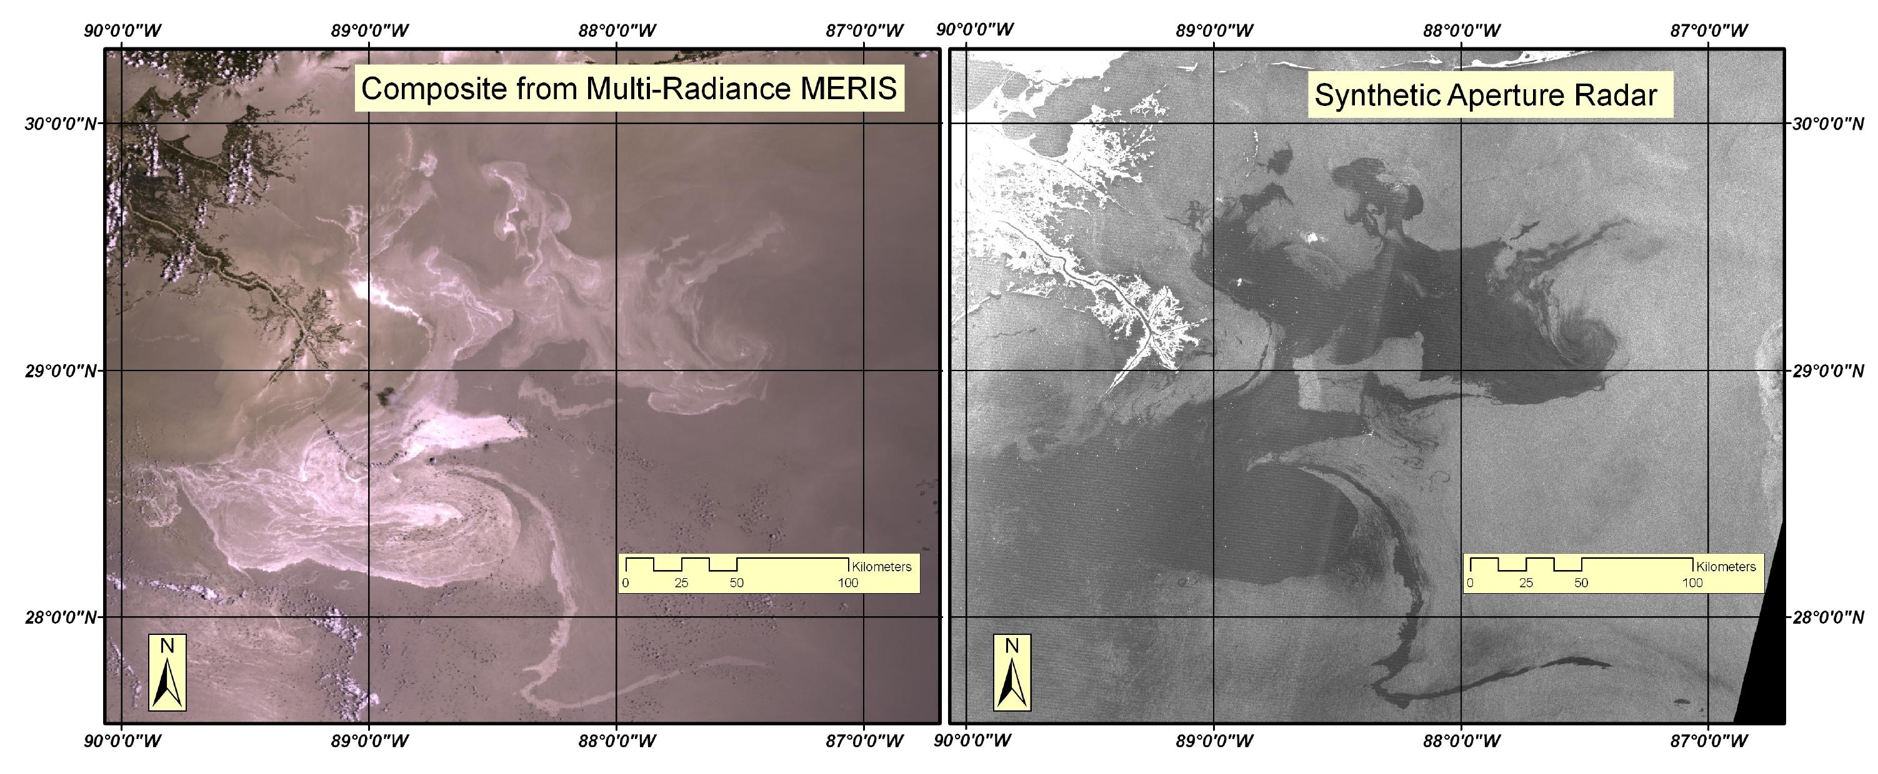

Slide 27
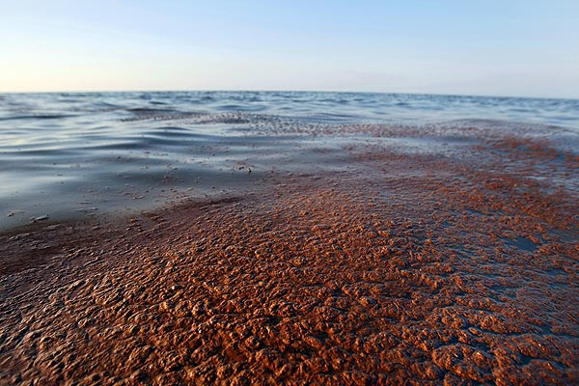

Slide 30
