Slide 1
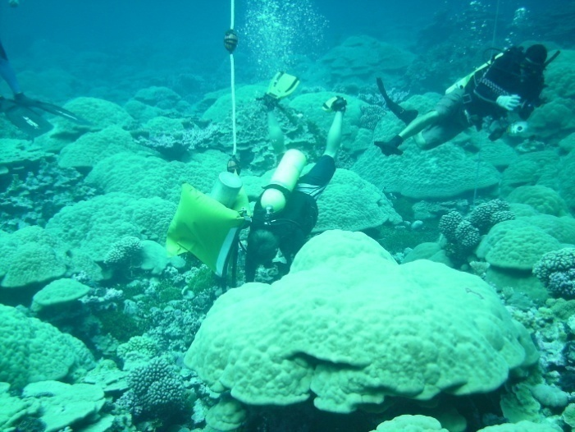
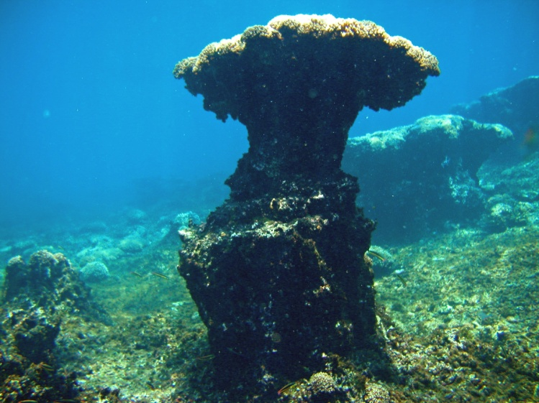
NOAA CRCP Ocean Acidification Science Plan
Presented for : NOAA CRCP
Principle Editor
Dwight Gledhill (OAR/AOML)
Contributing NOAA Authors
Derek Manzello (OAR/AOML)
Margaret Miller (NMFS SEFSC)
Libby Jewett (NOS NCCOS)
Kevin Helmle (OAR AOML)
Britt Parker (NESDIS)
Paulo Maurin (NOS OOCRM)
Rusty Brainard (NMFS PIFSC)
Charles Young (NMFS PIFSC)
Rational and Motivations (State-of-knowledge)
Science Plan Purpose & Scope
Policy & Strategic Drivers/CRCP G&O
Priority Research Activities
Management & Decision Support
Engagement & Outreach

Slide 2
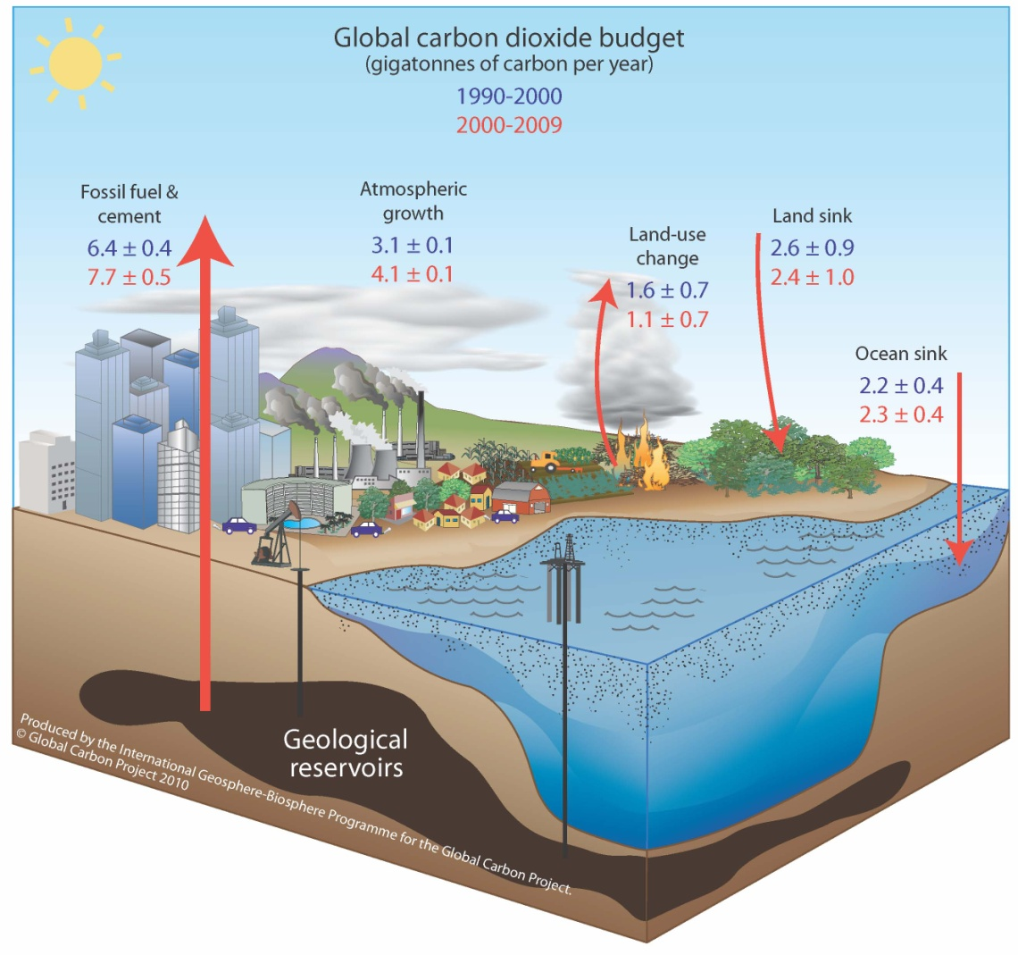
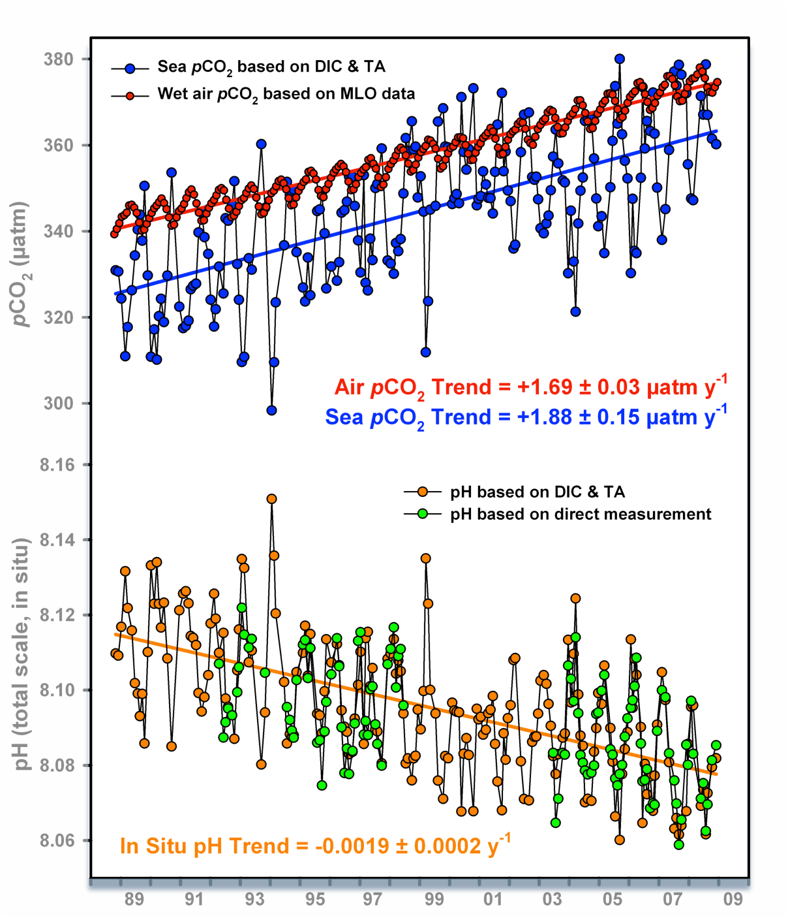
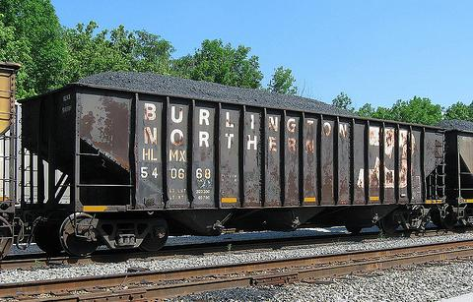

Rational and Motivations
The fundamentals…
Figure modified courtesy of Richard Feely (NOAA PMEL) reproduced from Doney, Science (2010) and Dore et al., PNAS (2009)
The importance of a well balanced carbon budget
Global Carbon Project 2010; Updated from Le Quéré et al. 2009, Nature Geoscience; Canadell et al. 2007, PNAS

Slide 3


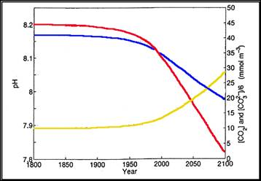
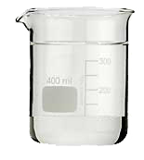

Rational and Motivations
The fundamentals…
pH
CO₃²⁻
CO_{2(aq)}
“Saturation State”
“Since the time of the HMS Challenger expeditions in the late 19th century, it has been recognized that that the saturation state of seawater overlying sediments in the deep ocean exerts a major influence on the distribution and abundance of calcium carbonate in these sediments” – J. Morse
Wolf-Gladrow et al., 1999

Slide 4
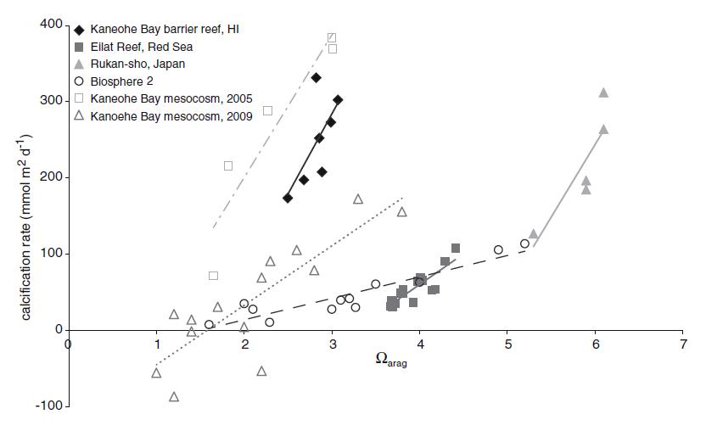
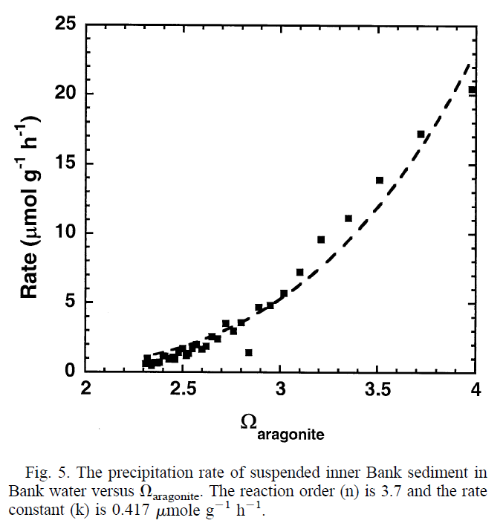
Rational and Motivations
The concerns…
Both inorganic precipitation and biologically mediated calcification rates are influenced by the degree to which seawater is supersaturated (Ω).
Precipitation Rate of Aragonite
Morse, Gledhill, Millero (2003)
Shamberger et al. (2011)
Inorganic
Biological

Slide 5
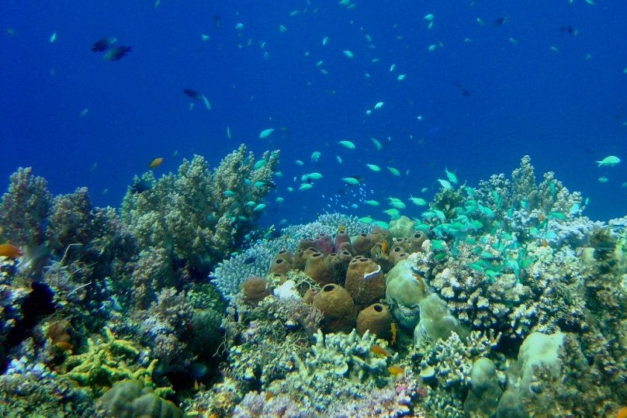
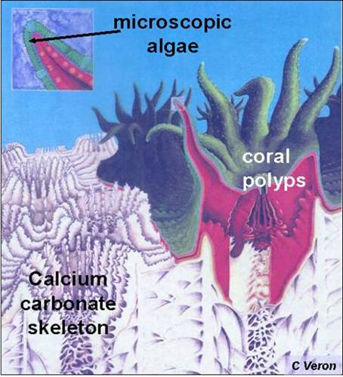
Rational and Motivations
The concerns…
Composed predominantly of scleractinian corals
High biodiversity (600,000 to 9 million reef species)
Structural complexity drives biodiversity
The more technical definition of "coral reef" includes an additional geological requirement that the reef organisms produce enough calcium carbonate to build the physical reef structure. – J. Kleypas
Figure from NOAA CRCP http:/http://coralreef.noaa.gov
Notes:
Here are common representatives of the major benthic calcifiers all of whom at least in part make there living secreting calcium carbonate in on form or another. (a) coralline algae, (b) Halimeda, (c) benthic foraminifera, (d) reef-building coral (dendrogyra cylindrus), (e) deep-water coral, (f) bryozoan, (g) mollusc (oyster reef), (h) echinoderm (brittle star), (i) crustacean (lobster)

Slide 6
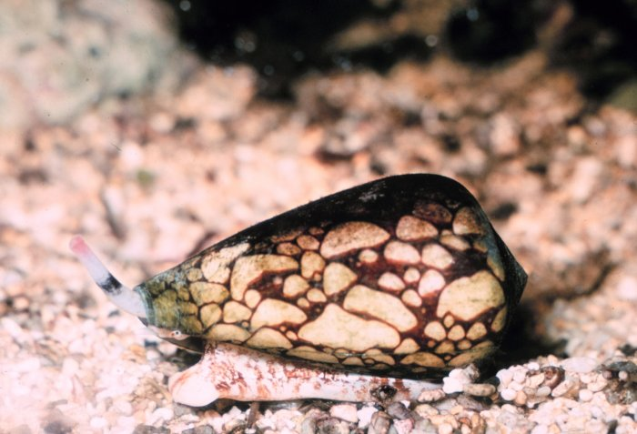
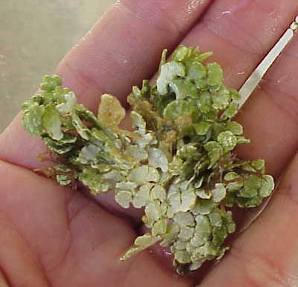
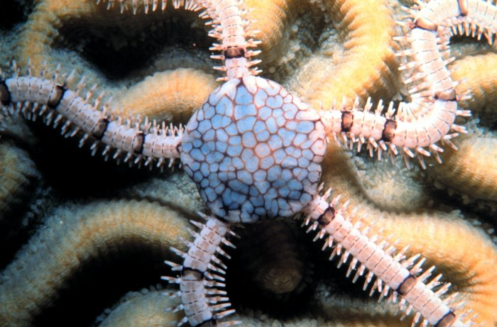
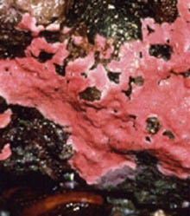
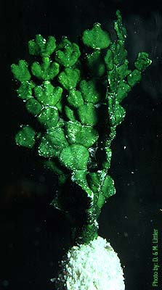
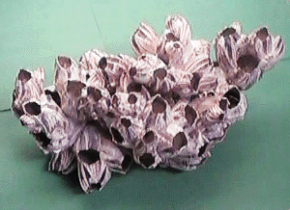
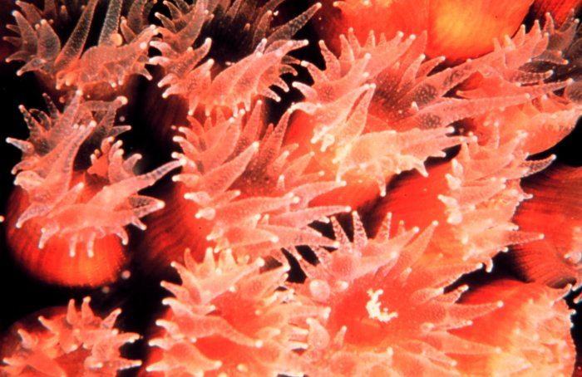
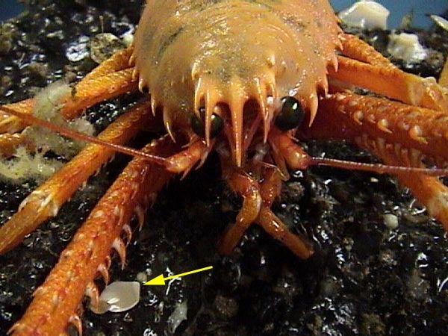
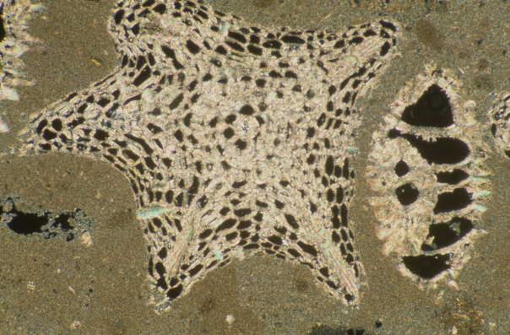

Rational and Motivations
The concerns…
Mollusks
Coralline Algae
(hi-mag calcite)
Halimeda
(aragonite)
Nancy Sefton
Benthic Forams
Calcite + hi-mag calcite
Corals (aragonite)
NOAA
Notes:
Here are common representatives of the major benthic calcifiers all of whom at least in part make there living secreting calcium carbonate in on form or another. (a) coralline algae, (b) Halimeda, (c) benthic foraminifera, (d) reef-building coral (dendrogyra cylindrus), (e) deep-water coral, (f) bryozoan, (g) mollusc (oyster reef), (h) echinoderm (brittle star), (i) crustacean (lobster)

Slide 7

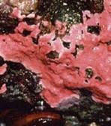
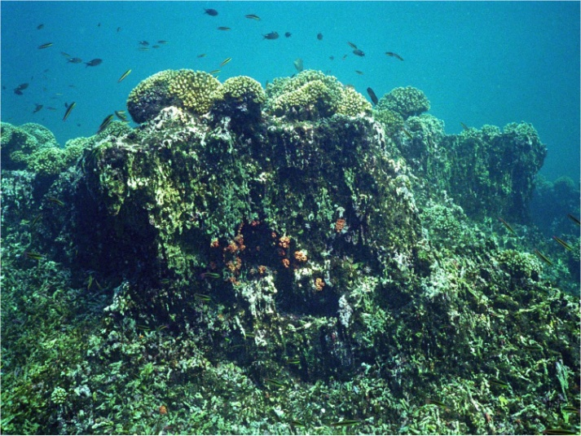
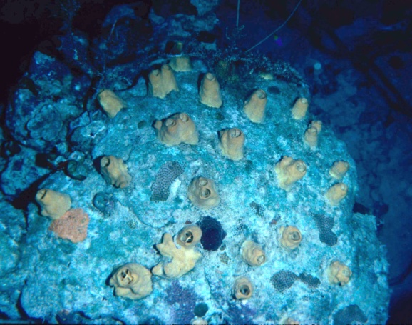
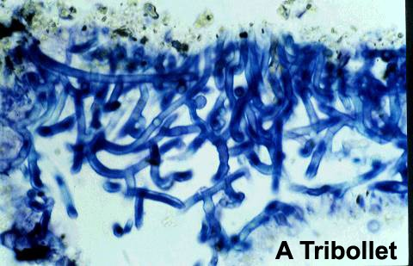
Rational and Motivations
The concerns…
“Crustose coralline algae (CCA) play an important role in the gowth and stabilization of carbonate reefs. Under present day pH, CCA had developed 25% cover in the control mesocosms and only 4% under the acidified measocosms”. – Jokiel et al., Coral Reefs (2008)
“Eastern Tropical Pacific (ETP) reefs represent a real-world example of coral reef growth in low-Ω waters that provide insights into how the biological-geological interface of coral reef ecosystems will change in a high-CO₂ world”. – Manzello et al., PNAS (2008)
Macroborers
At elevated pCO₂ (750 ppm) the depth of penetration of Euendolithic bioeroders increased increasing dissolution rates by 48% - Tribollet et al., Global Biogeochem. Cycles (2009)
Microborers

Slide 8
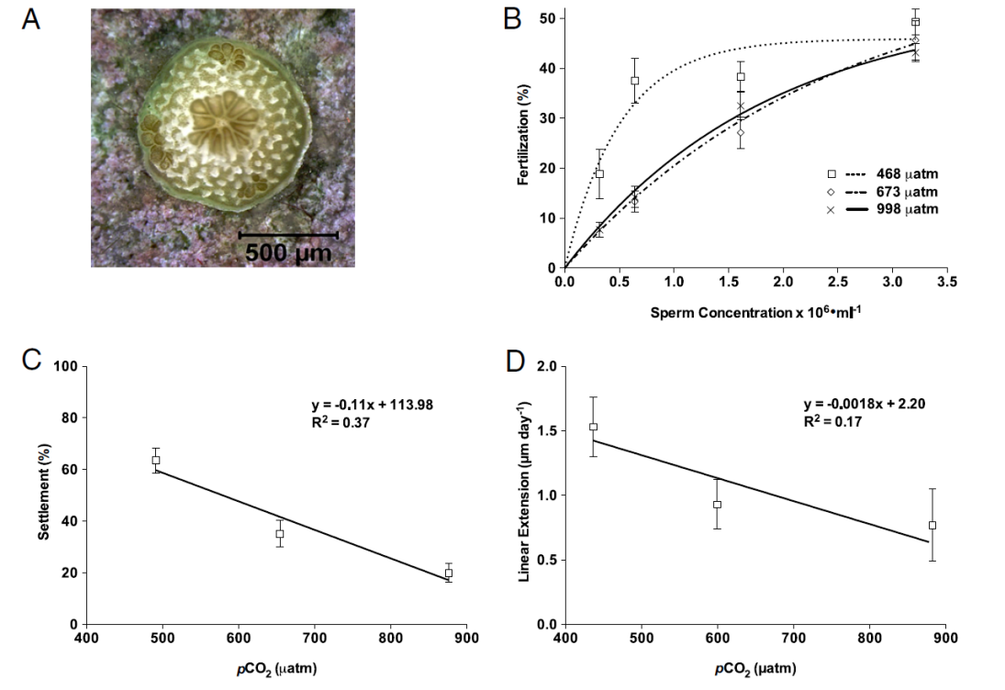
Rational and Motivations
The concerns…
“Coral recruitment, which necessitates successful fertilization, larval settlement, and postsettlement growth and survivorship, is critical to the
persistence and resilience of coral reefs…..
The cumulative impact of OA on fertilization and settlement success is an estimated 52% and 73% reduction in the number of larval settlers on the reef under pCO2 conditions projected for the middle and the end of this century, respectively…
Additional declines of 39% (mid-CO2) and 50% (high-CO2) were observed in postsettlement linear extension rates relative to controls…
These results suggest that OA has the potential to impact multiple, sequential early life history stages, thereby severely compromising sexual recruitment and the ability of coral reefs to recover from disturbance…”
- Albright et al., PNAS (2010)

Slide 9
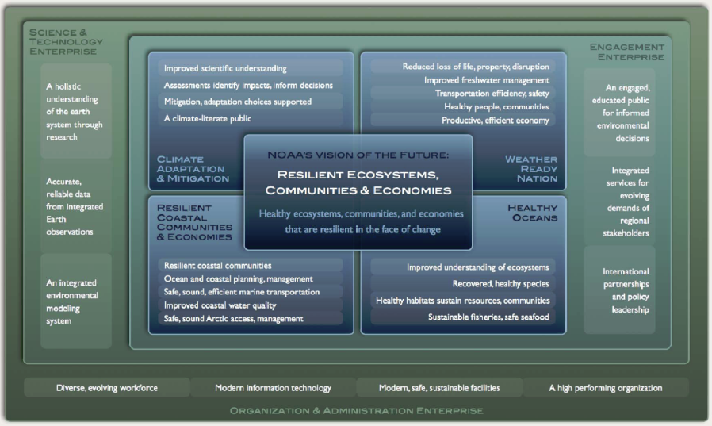
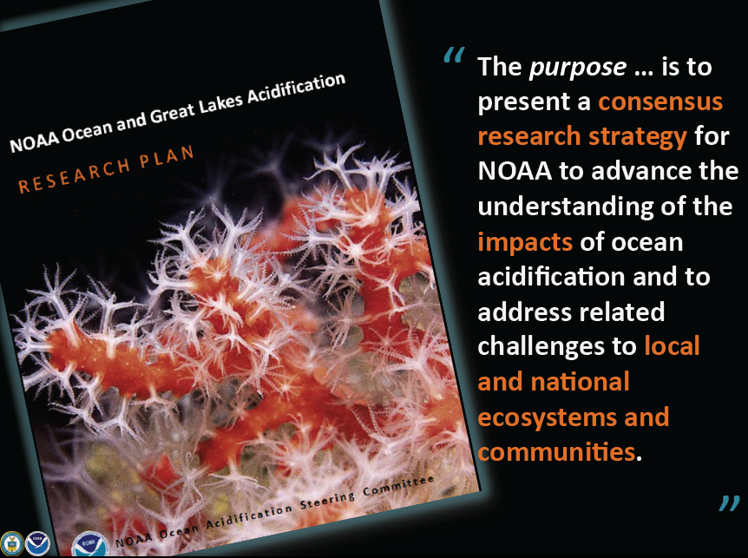
Policy & Strategic Drivers
The drivers…
The NOAA Next Generation Strategic Plan (NGSP)- NOAA’s Mission: To understand and anticipate changes in climate, weather, oceans, and coasts; share that knowledge and information with others; and to conserve and manage marine resources - Evidence of progress towards this objective includes understanding and characterization of the role of the oceans in climate change and variability and the effects of climate change on the ocean and coasts, including biological, chemical, and geophysical effects (e.g., sea level rise, ocean acidification, living marine resources).
NOAA National Ocean and Great Lakes Acidification Research Plan- The primary goals are to: develop the monitoring capacity (Theme 1); assess the response of organisms (Theme 2); forecast biogeochemical and ecological responses (Theme 3); develop management strategies for responding and adapting (Theme 4); provide synthesis data and information (Theme 5); and provide an engagement strategy (Theme 6).

Slide 10
Policy & Strategic Drivers
The drivers…
The NOAA Next Generation Strategic Plan (NGSP)- NOAA’s Mission: To understand and anticipate changes in climate, weather, oceans, and coasts; share that knowledge and information with others; and to conserve and manage marine resources - Evidence of progress towards this objective includes understanding and characterization of the role of the oceans in climate change and variability and the effects of climate change on the ocean and coasts, including biological, chemical, and geophysical effects (e.g., sea level rise, ocean acidification, living marine resources).
NOAA National Ocean and Great Lakes Acidification Research Plan- The guiding hypotheses are :
Rates/magnitude vary across time, space, and depth.
OA will change ecosystem structure and function.
Heterogeneity in species-specific responses, local secondary environmental factors and regional considerations will confer a broad range of vulnerabilities that differ both locally and regionally among marine ecosystems.

Slide 11
Policy & Strategic Drivers
The drivers…
NOAA CRCP Goals and Objectives : Need to identify, understand, and communicate risks and vulnerabilities confronting U.S. coral reef ecosystems, ecosystem services, and dependent human communities associated with climate change and OA.
Fostering this understanding is a means towards devising enhanced strategic management of coral reef ecosystems through improved and applied understanding, forecast, and projections of climate change and OA impacts.

Slide 12
Science Plan Purpose and Scope
The purpose…
Recommend CRCP priority areas of research and engagement necessary to advance and communicate an understanding of the potential consequences of OA to coral reef ecosystems (CRE).
Unite CRCP OA related activities towards common goals where activities comprise:
  NOAA research efforts (Internal & Extramural).
  Relevant NCRMP status & trends monitoring.
  Outreach & Engagement.
  Manager guidance.
Align CRCP OA activities with broader NOAA and external OA strategies to better leverage non-CRCP investments .
Remain flexible to allow for continual refinement and adjustment to address emerging needs, and enable prioritization based on funding and the current state-of-knowledge

Slide 13
Science Plan Purpose and Scope
The scope…
Address short-, mid- and long-term strategic research needs to achieving an applied understanding necessary to foster improved strategic management within the jurisdiction of the United States and Pacific Freely Associated States.
However, it is recognized that discerning the specific threat of OA to U.S. CRE’s may demand investments within non-U.S. jurisdictions where specific scientific criteria are met (e.g., regions where prevailing modern carbonate chemistry yields insight into future implications).
The plan identifies OA science needs specific to tropical and sub-tropical CRE’s including associated mangroves, seagrasses, and hard bottom communities, and mesophotic coral ecosystems.
This plan does not explicitly address the requirements necessary towards advancing an understanding to deep-sea coral ecosystems.
Fully achieve the objectives presented will demand partnership

Slide 14
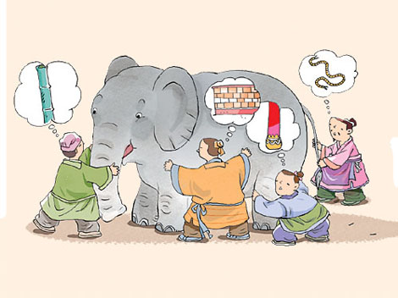
Science Plan Development
The not sole sourced…
Principle Editor
Dwight Gledhill (OAR/AOML)
Contributing NOAA Authors
Derek Manzello (OAR/AOML)
Margaret Miller (NMFS SEFSC)
Libby Jewett (NOS NCCOS)
Kevin Helmle (OAR AOML)
Britt Parker (NESDIS)
Paulo Maurin (NOS OOCRM)
Rusty Brainard (NMFS PIFSC)
Charles Young (NMFS PIFSC)
AOML
PMEL
SEFSC
PIFSC
OA Steering Committee:
Richard A. Feely
Rik Wanninkhof
John Stein
Michael F. Sigler
Felipe Arzayus
Beth Phelan
Simone Alin
Adrienne Sutton
Paul McElhaney
Shallin Busch
IWG:
Ned Cyr
Kenric Osgood
Chris Sabine
Erin Seney
NCRMP:
NESDIS STAR: Dr. Mark Eakin (Dr. Al Strong, alt.)
NMFS PIFSC: Dr. Bernardo Vargas-Angel, Dr. Ivor Williams
NMFS PIRO: Dr. Bob Schroeder (Danielle Jayewardene, alt.)
NMFS SEFSC: Dr. Ron Hill, Jen Schull
NMFS SERO: Jocelyn Karazsia
NOS NCCOS: Dr. Chris Caldow & Dr. Greg Piniak
NOS OCRM: Dr. Christy Loper
NOS ONMS: Dr. Randy Kosaki & Mitchell Tartt (Dr. Bill Kiene, and Steve Gittings alt.)
Reviewers

Slide 15
Priority Research Activities
Guiding science questions…
What recent past declines in coral reef health can be attributed in part to OA?
What aspects of contemporary coral reef communities are currently most susceptible to OA?
What are the future affects of continued OA in concert with other global and local threats within this century?

Slide 16
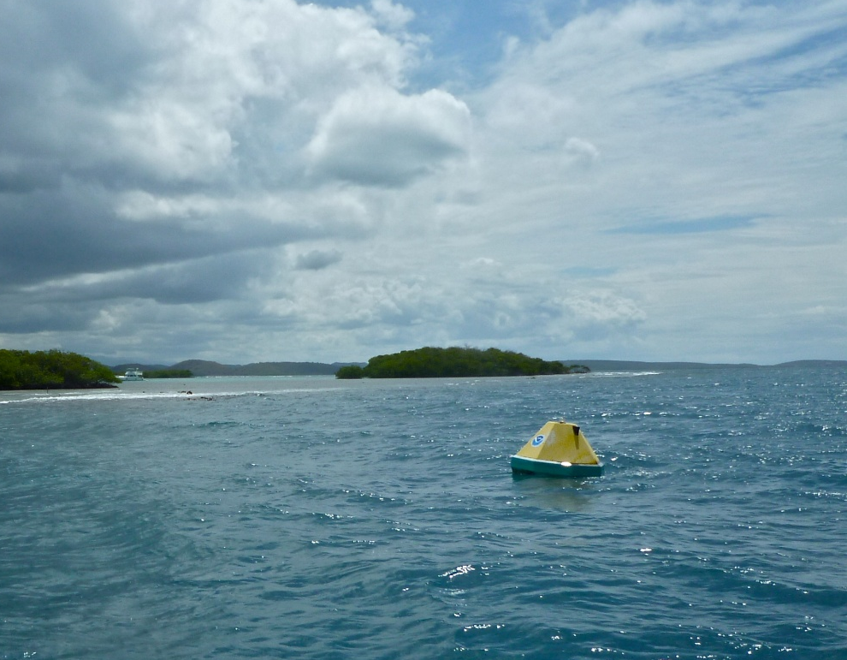
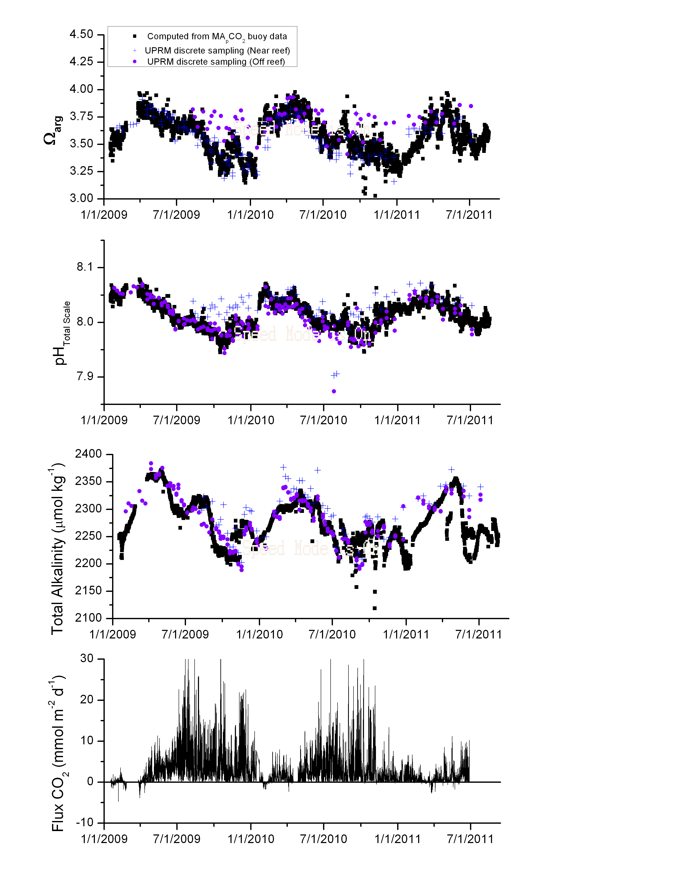
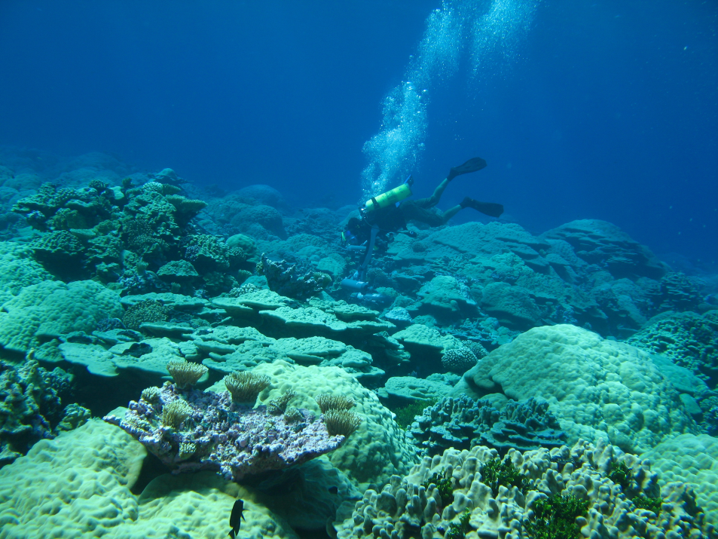
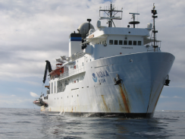
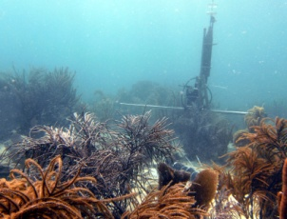
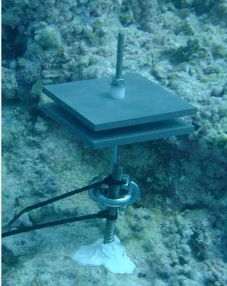
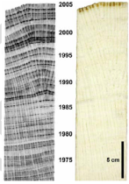
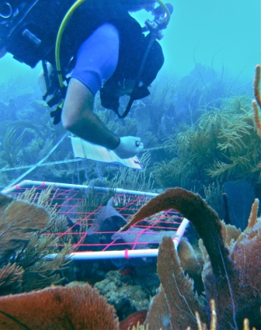
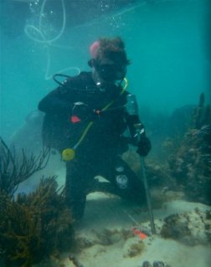
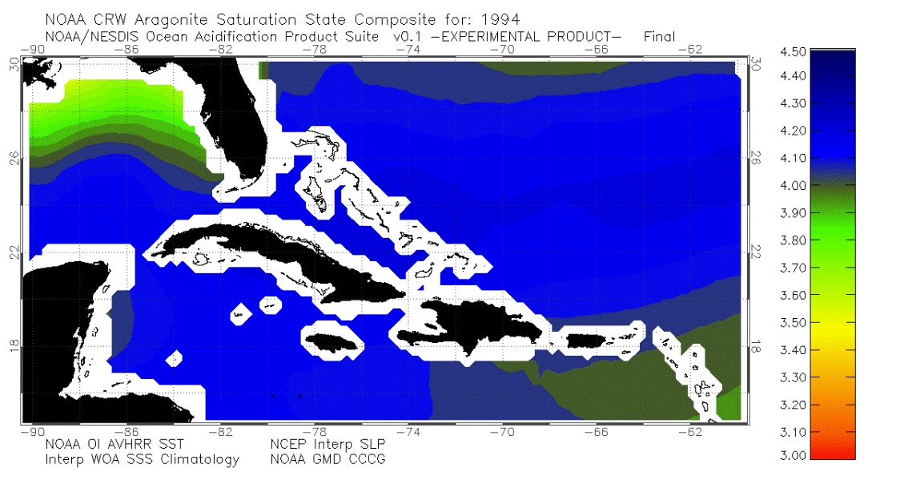
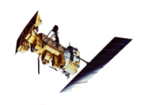
Priority Research Activities
The science plan…
Guiding Question – Overarching science question
Description of the problem – rational
Task (Current CRCP Investment) – specific science question to be addressed
  Approach – proposed scientific strategy or area of investment
  Locations – geographic (juristical) area best suited to address question considering scientific criteria and regional capacities.
  Expected Outputs – Tools, data products, educational materials, ect.
  Relevance to CRCP G&O – specific relevance to stated goals & objectives.

Slide 17
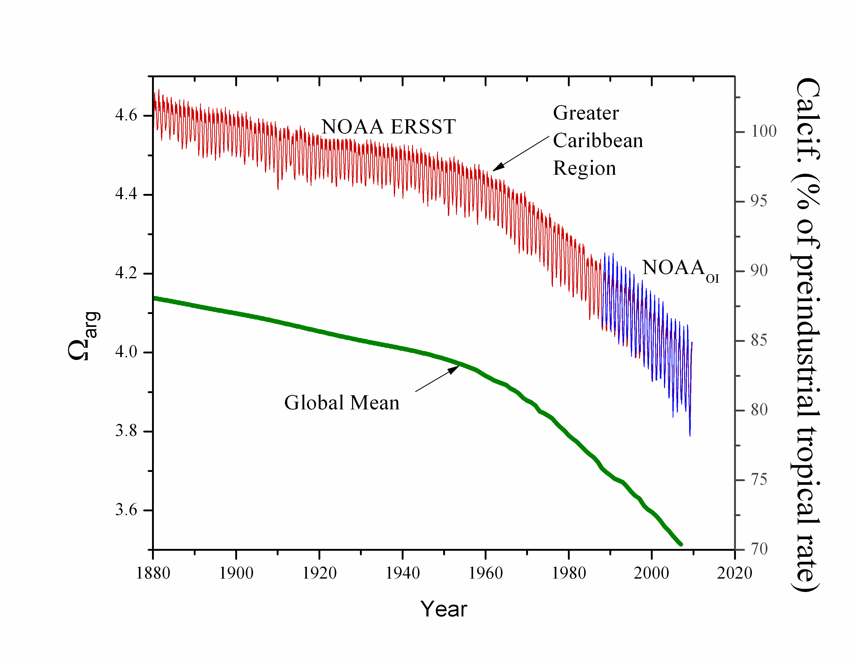
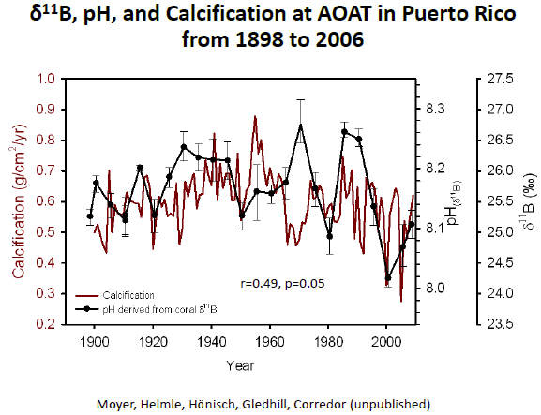
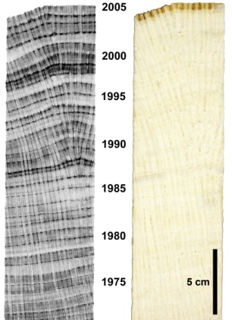
Priority Research Activities
The science plan…
Inferring the Past: Establishing a historical context of OA impacts
Description of the problem –Requirement to provide a means of constructing historical base-lines that will not only serve as a bench mark by which to track future changes, but also may identify specific regions and/or organisms which exhibit a natural resilience from such changes.
Task 1.1: What were the historical regional rates and distribution of OA (Current CRCP Investment: Low)?
Task 1.2: How have growth rates of dominant reef calcifiers changed in recent history (Current CRCP Investment: Low)?
Historical changes in surface ocean Ωarg derived from the OAPS model and expected decline in community calcification rates [Gledhill et al., 2009; Langdon & Atkinson, 2005].
X-radiographic positive print (left) with annual density bands
(right), [Helmle and Dodge 2011].

Slide 18
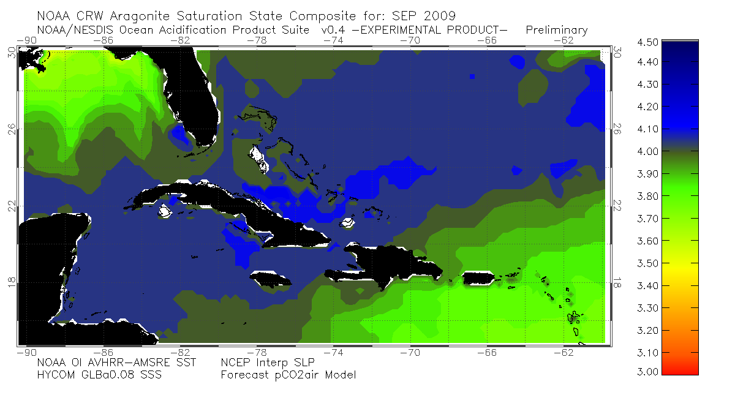
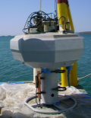
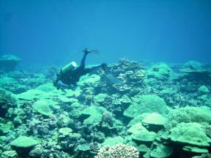
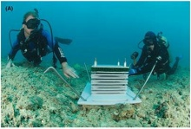
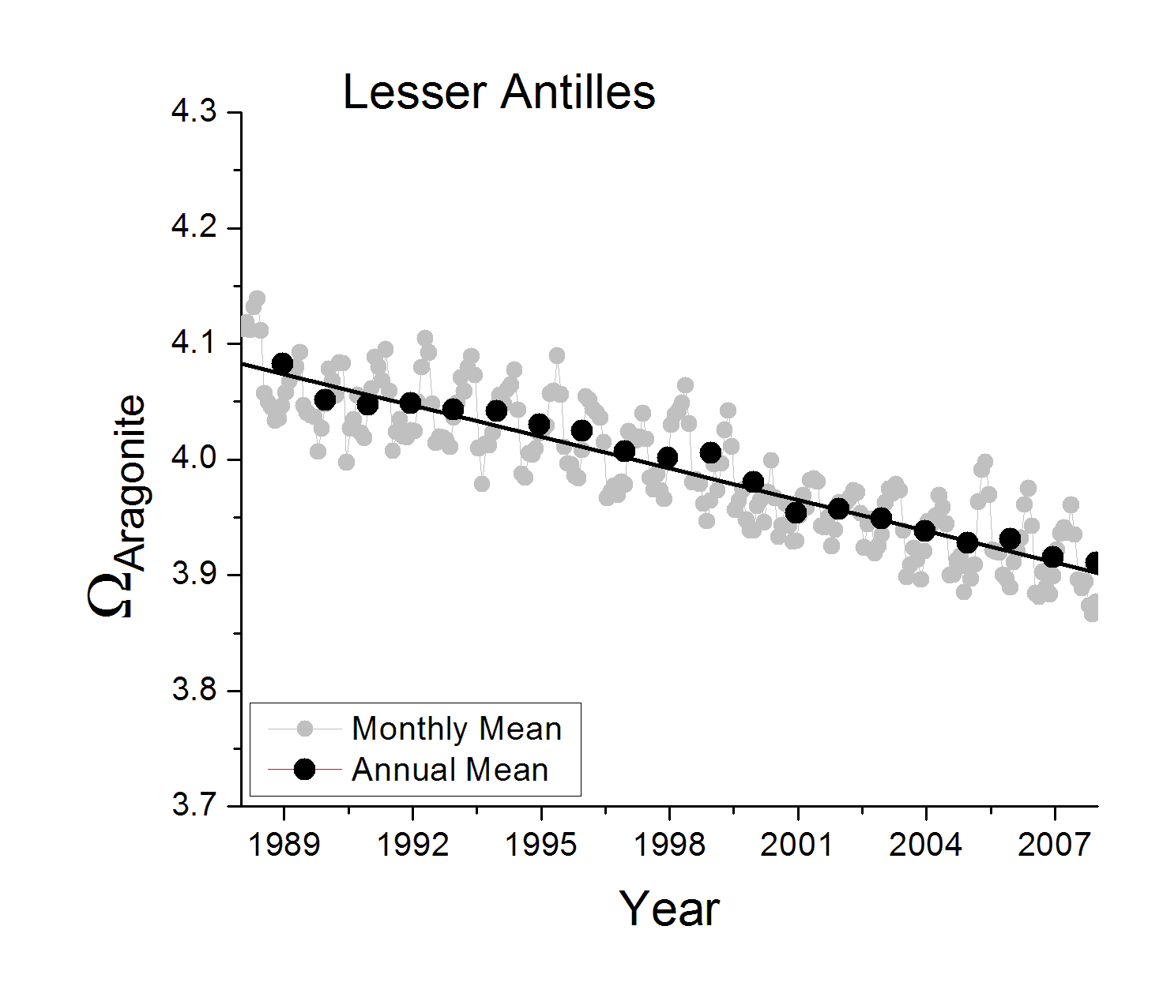

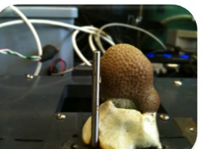
Priority Research Activities
The science plan…
Observing the Present: Understanding the contemporary coral reef vulnerabilities to OA
Description of the problem –Quantify/understand complexity of OA dynamics/feedback at multiple time/space scales. Obtain diagnostic-level observations of ecosystem response/interaction.
Task 2.1: What are the current regional dynamics of OA and how are these reflected locally within coral reef environments (Current CRCP Investment: Moderate)?
Task 2.2: What are the current carbonate budgets of U.S. jurisdictional reef systems (Current CRCP Investment: None)?
Task 2.3: What is the current level of net new reef accretion within the U.S. jurisdictional reef system across spatial and environmental gradients (Current CRCP Investment: Low)?
Task 2.4: What is the current level of biodiversity within the U.S. jurisdictional reef system across spatial and environmental gradients (Current CRCP Investment: Moderate)?
Caribbean Sea

Slide 19
Priority Research Activities
The science plan…
Observing the Present: Understanding the contemporary coral reef vulnerabilities to OA
Description of the problem –Quantify/understand complexity of OA dynamics/feedback at multiple time/space scales. Obtain diagnostic-level observations of ecosystem response/interaction.
Task 2.1: What are the current regional dynamics of OA and how are these reflected locally within coral reef environments (Current CRCP Investment: Moderate)?
NCRMP

Slide 20
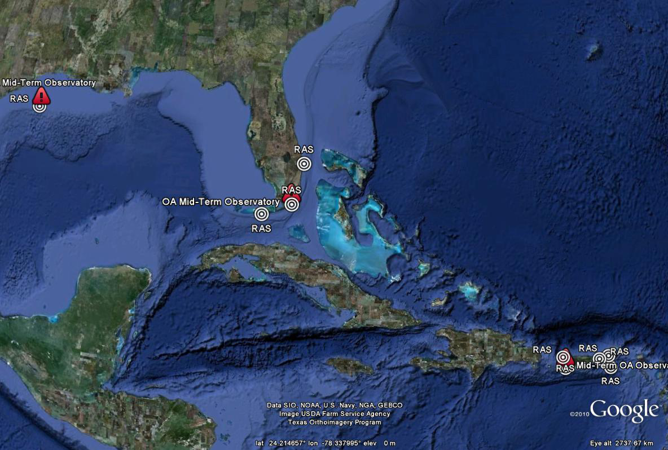
Priority Research Activities
The science plan…
Observing the Present: Understanding the contemporary coral reef vulnerabilities to OA
Description of the problem –Quantify/understand complexity of OA dynamics/feedback at multiple time/space scales. Obtain diagnostic-level observations of ecosystem response/interaction.
Task 2.1: What are the current regional dynamics of OA and how are these reflected locally within coral reef environments (Current CRCP Investment: Moderate)?

Slide 21
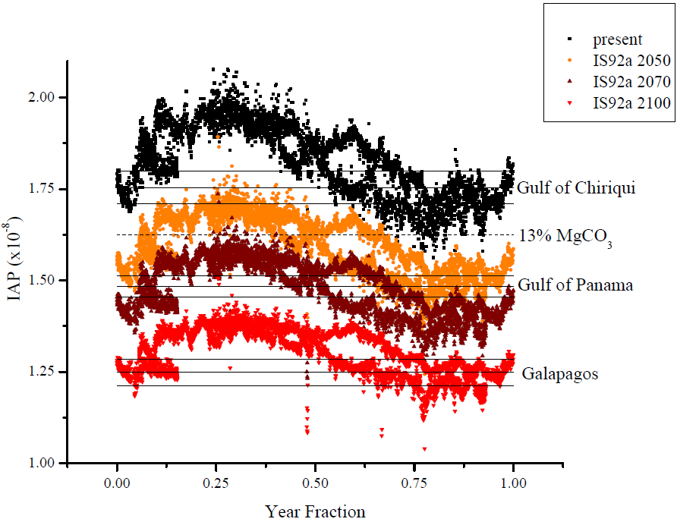
Priority Research Activities
The science plan…
Predicting the Future: Forecasting the effects of continued OA of the next century
Description of the problem –Projections are needed to enable management interventions and adaption. We must be able to anticipate not only the rates/magnitude of OA, but be able to predict the reef response.
Task 3.1: What are the chemical consequences of continued OA within near-reef waters under differing stabilizations of atmospheric CO2 (Current CRCP Investment: Low)?
Task 3.2: What are the solubility thresholds of critical carbonate mineral phases within coral reef ecosystems (Current CRCP Investment: None)?

Slide 22

Priority Research Activities
The science plan…
Predicting the Future: Forecasting the effects of continued OA of the next century
Description of the problem –Projections are needed to enable management interventions and adaption. We must be able to anticipate not only the rates/magnitude of OA, but be able to predict the reef response.
Task 3.1: What are the chemical consequences of continued OA within near-reef waters under differing stabilizations of atmospheric CO2 (Current CRCP Investment: Low)?
Task 3.2: What are the solubility thresholds of critical carbonate mineral phases within coral reef ecosystems (Current CRCP Investment: None)?
Task 3.3: Which physiological and population-level processes and taxa/species of coral reefs will be most impacted by or resilient to OA (Current CRCP Investment: None)?
Task 3.4: What potential exists within various reef taxa for evolutionary adaptation to changing ocean carbonate chemistry (Current CRCP Investment: None)?
Hofmann et al. (2008) Using functional genomics to explore the effects of OA

Slide 23
Priority Research Activities
The science plan…
Predicting the Future: Forecasting the effects of continued OA of the next century
Description of the problem –Projections are needed to enable management interventions and adaption. We must be able to anticipate not only the rates/magnitude of OA, but be able to predict the reef response.
Task 3.1: What are the chemical consequences of continued OA within near-reef waters under differing stabilizations of atmospheric CO2 (Current CRCP Investment: Low)?
Task 3.2: What are the solubility thresholds of critical carbonate mineral phases within coral reef ecosystems (Current CRCP Investment: None)?
Task 3.3: Which physiological and population-level processes and taxa/species of coral reefs will be most impacted by or resilient to OA (Current CRCP Investment: None)?
Task 3.4: What potential exists within various reef taxa for evolutionary adaptation to changing ocean carbonate chemistry (Current CRCP Investment: None)?
Task 3.5: What are the spatial, environmental, and temporal changes in reef diversity (Current CRCP Investment: Moderate)?
Task 3.6: Which jurisdictions will prove most vulnerable to OA (Current CRCP Investment: Low)?
Task 3.7: What are the trophic effects of continued OA within reef waters under differing stabilization scenarios of atmospheric CO2 (Current CRCP Investment: None)?

Slide 24
Priority Research Activities
The science plan…
Predicting the Future: Forecasting the effects of continued OA of the next century
Description of the problem –Projections are needed to enable management interventions and adaption. We must be able to anticipate not only the rates/magnitude of OA, but be able to predict the reef response.
Task 3.1: What are the chemical consequences of continued OA within near-reef waters under differing stabilizations of atmospheric CO2 (Current CRCP Investment: Low)?
Task 3.2: What are the solubility thresholds of critical carbonate mineral phases within coral reef ecosystems (Current CRCP Investment: None)?
Task 3.3: Which physiological and population-level processes and taxa/species of coral reefs will be most impacted by or resilient to OA (Current CRCP Investment: None)?
Task 3.4: What potential exists within various reef taxa for evolutionary adaptation to changing ocean carbonate chemistry (Current CRCP Investment: None)?
Task 3.5: What are the spatial, environmental, and temporal changes in reef diversity (Current CRCP Investment: Moderate)?
Task 3.6: Which jurisdictions will prove most vulnerable to OA (Current CRCP Investment: Low)?
Task 3.7: What are the trophic effects of continued OA within reef waters under differing stabilization scenarios of atmospheric CO2 (Current CRCP Investment: None)?

Slide 25



Priority Research Activities
The management & decision support plan…
Description of the problem –Critical need to integrate regional refugia into existing management frameworks and combined with policies to improve system-wide resilience to CC & OA. These refugia need to be identified before they can be preserved and what constitutes an area of refugia in terms of OA (e.g., chemical and community setting) must first be defined.
Task 4.1: What are the cumulative impacts of multiple stressors acting in conjunction or synergistically with OA (Current CRCP Investment: None)?
Task 4.2: What local management actions will foster the greatest resilience to OA (Current CRCP Investment: Low)?
Task 4.3: How can OA be explicitly incorporated into Fishery Models (Current CRCP Investment: None)?
“The effects of climate-scale processes on coral reef ecosystems appear spatially variable at multiple scales, with impacts and vulnerability affected by geography but not management regime… Existing no-take marine protected areas still support high biomass of fish; however they had no positive effect on the ecosystem response to large-scale disturbance. This suggests a need for future conservation and management efforts to identify and protect regional refugia, which should be integrated into existing management frameworks and combined with policies to improve system-wide resilience to climate variation and change.“ - Graham et al. [2008]
Selkoe et al. Coral Reefs (2008)
Selkoe et al. Aquatic Conserv. (2008)

Slide 26



Priority Research Activities
The engagement & outreach plan…
Description of the problem –Identify, understand, and communicate vulnerability of U.S. coral reef ecosystems, ecosystem services, and dependent human communities to OA. Independent of whether direct management intervention can mitigate the long-term effects of OA, understanding how these ecosystems may be altered in coming decades is crucial to adapting dependent societies to changes in ecosystem services that could transpire.
Task 6.1: Engage the Managers (Current CRCP Investment: Low)
Task 6.2: Engage the Media and Educators (Current CRCP Investment: Low)
Ocean Acidification Ed DVD and web page
(in production mode)
OA Data-in-the-Classroom Educational Module (beta)
- Paulo Maurin

Slide 27

Priority Research Activities
The engagement & outreach plan…
Description of the problem –Identify, understand, and communicate vulnerability of U.S. coral reef ecosystems, ecosystem services, and dependent human communities to OA. Independent of whether direct management intervention can mitigate the long-term effects of OA, understanding how these ecosystems may be altered in coming decades is crucial to adapting dependent societies to changes in ecosystem services that could transpire.
Task 6.1: Engage the Managers (Current CRCP Investment: Low)
Task 6.2: Engage the Media and Educators (Current CRCP Investment: Low)
Development underway of the "Reef Managers Guide to Climate Change" which will include ocean acidification.
Focused on proactive actions including vulnerability assessments and adaptation planning versus reactive response and monitoring.
The effort is just in its infancy and will not likely really get going till mid calendar year 2012. It will be involving the same partners (GBRMPA, NOAA, TNC, etc).
Ocean Acidification
- Britt Parker

Slide 28
Policy & Strategic Drivers
The authorities…
Primary
• Coral Reef Conservation Act (16 U.S.C. 6401 et seq.)
• Executive Order 13089: Coral Reef Protection (1998)
• Federal Ocean Acidification Research and Monitoring Act of 2009 (Public Law 111-11)
• Magnuson-Stevens Fishery Conservation and Management Act (16 U.S.C. 1801 et seq.) as amended by the 2006 Magnuson-Stevens Reauthorization Act (Public Law 109-479)
• U.S. National Ocean Policy Executive Order (July 2010)
Secondary
• Coastal Zone Management Act (16 U.S.C. 1451 et seq.)
• Endangered Species Act (16 U.S.C. 460 et seq.)
• Government Result and Performance Act of 1993 (31 U.S.C. 1115 et seq.)
• Marine Mammal Protection Act (16 U.S.C. 1361 et seq.)
• National Environmental Policy Act (42 U.S.C. 4321 et seq.)
• National Marine Sanctuaries Act (16 U.S.C. 1431 et seq.)
• NOAA Undersea Research Program Act of 2009 (Public Law 111-11)
• Ocean Exploration Act (Public Law 111-11)
• Presidential Proclamation 8031: Establishment of the Northwestern Hawaiian Islands Marine National Monument (2006)
• Presidential Proclamations 8335, 8337, and 8336: Establishment of the Marianas Trench, Pacific Remote Islands, and Rose Atoll Marine National Monuments (2009)

Slide 29

Policy & Strategic Drivers
The authorities…
S.46 - Coral Reef Conservation Amendments Act of 2011
H.R.738 - Coral Reef Conservation Act Reauthorization and Enhancement Amendments of 2011
SEC. 5. CRCP
  ‘(g) CRITERIA FOR APPROVAL- The Secretary may not approve a project proposal under this section unless the project is consistent with the coral reef action strategy under section 203 and will enhance the conservation of coral reef ecosystems nationally or internationally by—
    ‘(4) developing sound scientific information on the condition of coral reef ecosystems or the threats to such ecosystems and their biodiversity, including factors that cause coral disease, ocean acidification, and bleaching;
SEC. 103. NATIONAL PROGRAM.
  ‘(4) to develop sound scientific information on the condition of coral reef ecosystems and the threats to such ecosystems including large-scale threats related to climate change, such as ocean acidification, to benefit local communities and the Nation, and to the extent practicable to support and enhance management and research capabilities at local management agencies and local research and academic institutions;’; and

Slide 30

Thanks…..
Questions?

