Slide 1
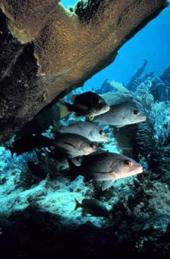
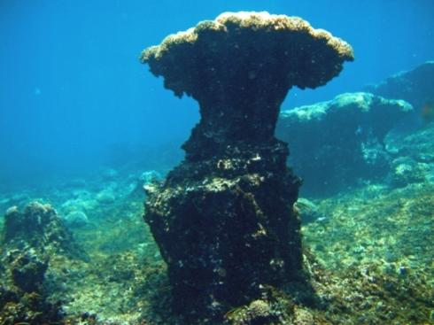
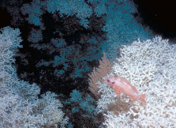
Ocean Acidification
The Other CO₂ Problem
Outline
What is Ocean Acidification?
Overview of ecological concerns
NOAA National Ocean & Great Lakes Acidification Research Plan
Presented for :
Blue Vision Summit
Presented by:
Dr. Dwight Gledhill
Atlantic Oceanographic and Meteorological Laboratory (AOML)
Cooperative Institute of Marine and Atmospheric Science (CIMAS)
Rosenstiel School of Marine and Atmospheric Science, University of Miami, Miami, FL

Slide 2
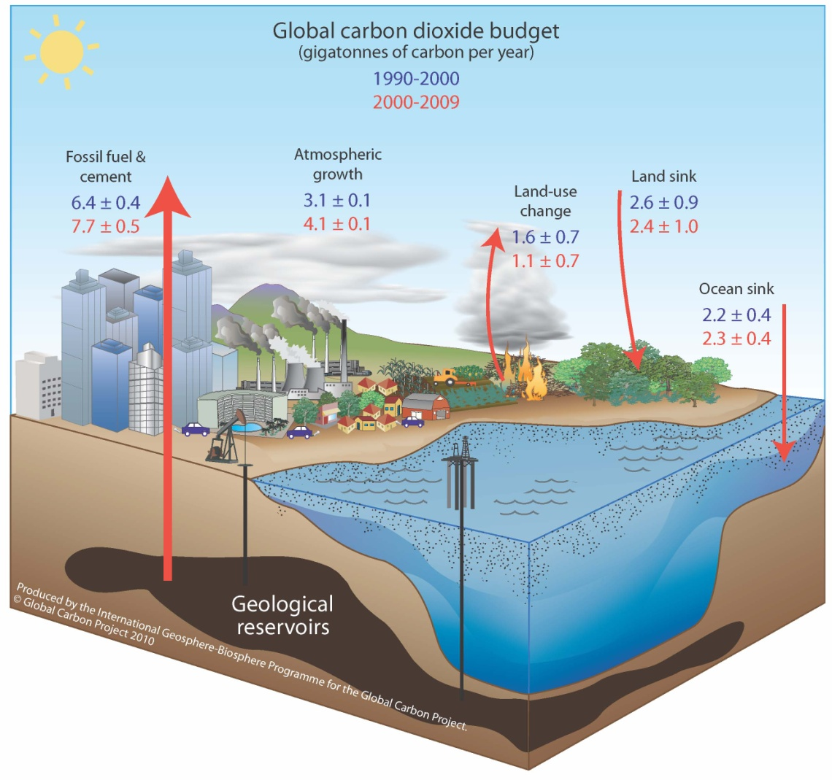
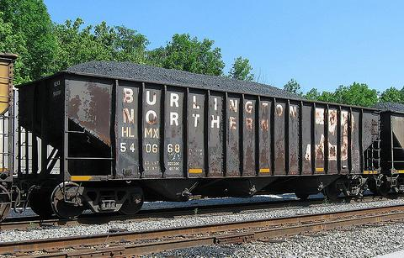

Global Carbon Cycle
A railroad train carrying 2.3 Pg of carbon would stretch around the Earth 14 times! – Chris Sabine (NOAA PMEL)
The importance of a well balanced carbon budget
Global Carbon Project 2010; Updated from Le Quéré et al. 2009, Nature Geoscience; Canadell et al. 2007, PNAS

Slide 3
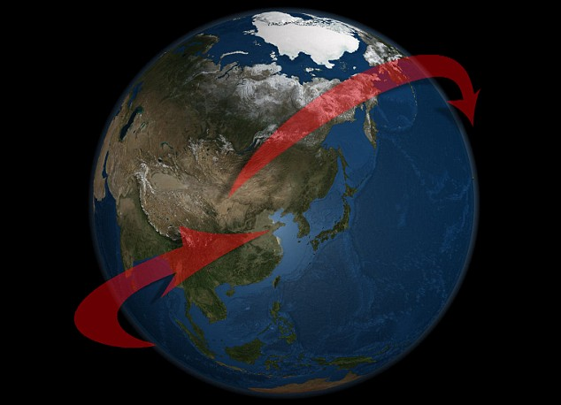
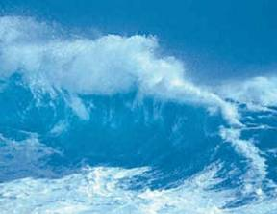
What is Ocean Acidification?
The fundamentals…
≈ 48% of anthropogenic
CO₂ taken up by the ocean
Ocean acidification (OA) represents a direct chemical change to global ocean chemistry in response to rising levels of atmospheric carbon dioxide (CO₂) and is in addition to any possible effects of CO₂ on the climate system.
CO₂

Slide 4

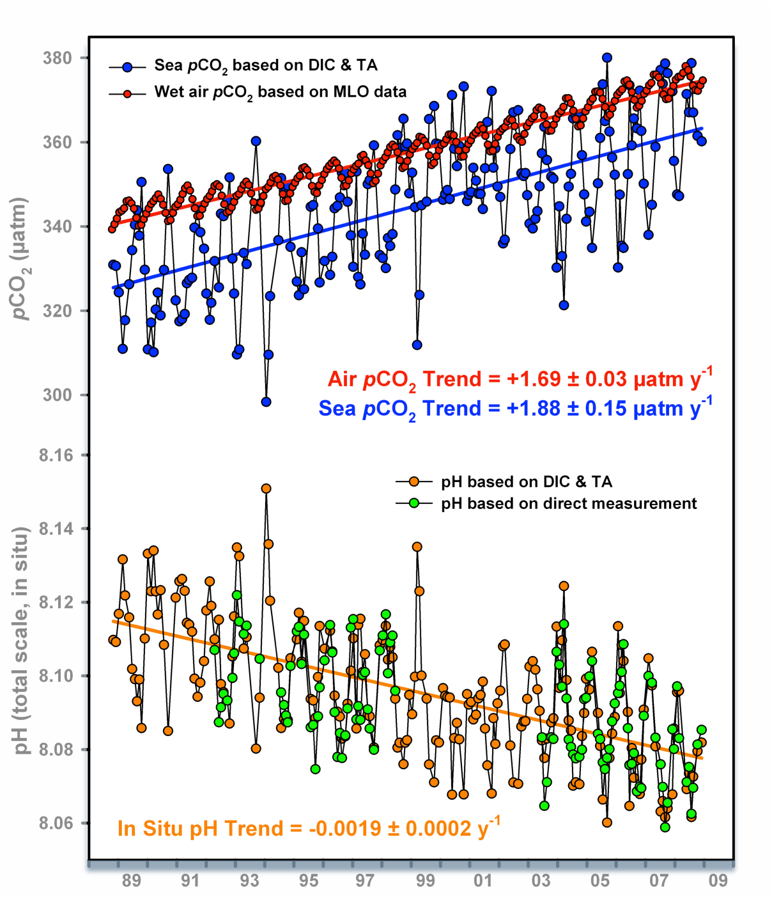

What is Ocean Acidification?
The fundamentals…
Station Aloha
Station Mauna Loa
Figure modified courtesy of Richard Feely (NOAA PMEL) reproduced from Doney, Science (2010) and Dore et al., PNAS (2009)

Slide 5
The fundamentals…
What is Ocean Acidification?
Calcium Carbonate (CaCO₃, a.k.a.“Chalk”)

Slide 6
What is Ocean Acidification?
The fundamentals…
“Since the time of the HMS Challenger expeditions in the late 19th century, it has been recognized that that the saturation state of seawater overlying sediments in the deep ocean exerts a major influence on the distribution and abundance of calcium carbonate in these sediments” – J. Morse
Calcium Carbonate (CaCO₃, a.k.a.“Chalk”)

Slide 7
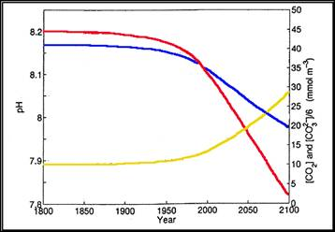
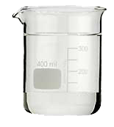

What is Ocean Acidification?
The fundamentals…
“Since the time of the HMS Challenger expeditions in the late 19th century, it has been recognized that that the saturation state of seawater overlying sediments in the deep ocean exerts a major influence on the distribution and abundance of calcium carbonate in these sediments” – J. Morse
pH
CO₃²⁻
“Saturation State”
CO_{2(aq)}
Ω
>
1
=
precipitation
Ω
<
1
=
dissolution
Wolf-Gladrow et al., 1999

Slide 8
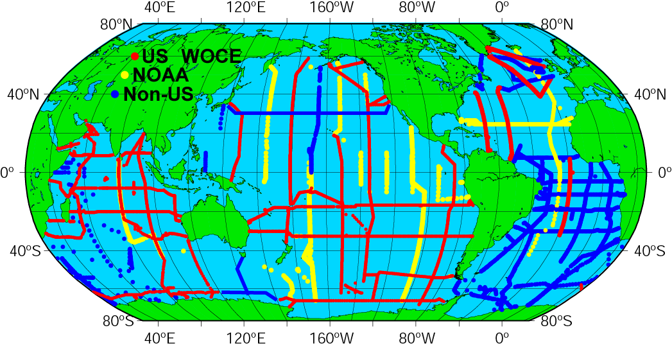
Ocean CO₂ Chemistry
Global Ocean Carbon Inventories
WOCE/JGOFS/OACES Global CO₂ Survey
~72,000 sample locations collected in the 1990s
DIC ± 2 µmol kg⁻¹
TA ± 4 µmol kg⁻¹
Sabine et al. (2004)
Notes:
Turley, C.M. (2006) Ocean acidification and its impacts. In: CONFRONTING CLIMATE CHANGE: CRITICAL ISSUES FOR NEW ZEALAND Edited by Ralph Chapman, Jonathan Boston and Margot Schwass, Published by Victoria University Press,125-133.

Slide 9
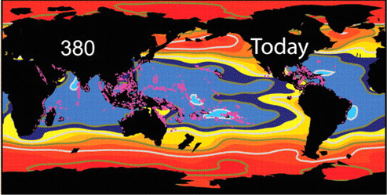

Global Distribution of Ω
Figure adapted from Hoegh-Guldberg et al., (2006). Values derived using Uvic Earth System Climate Model
Notes:
**Mark**

Slide 10

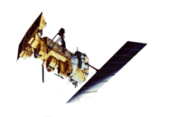
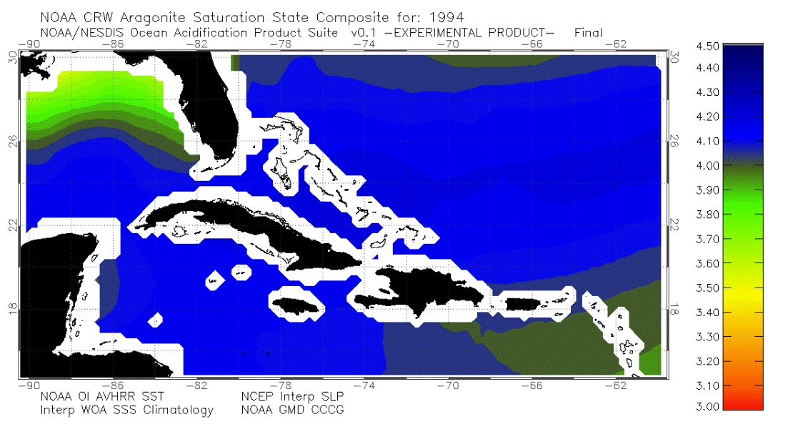
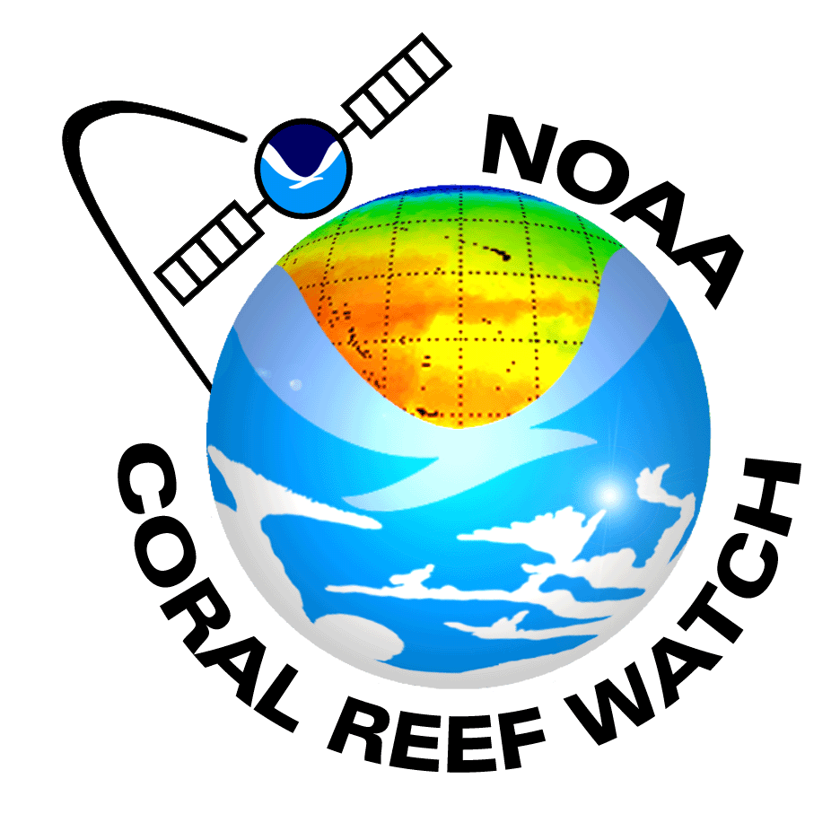
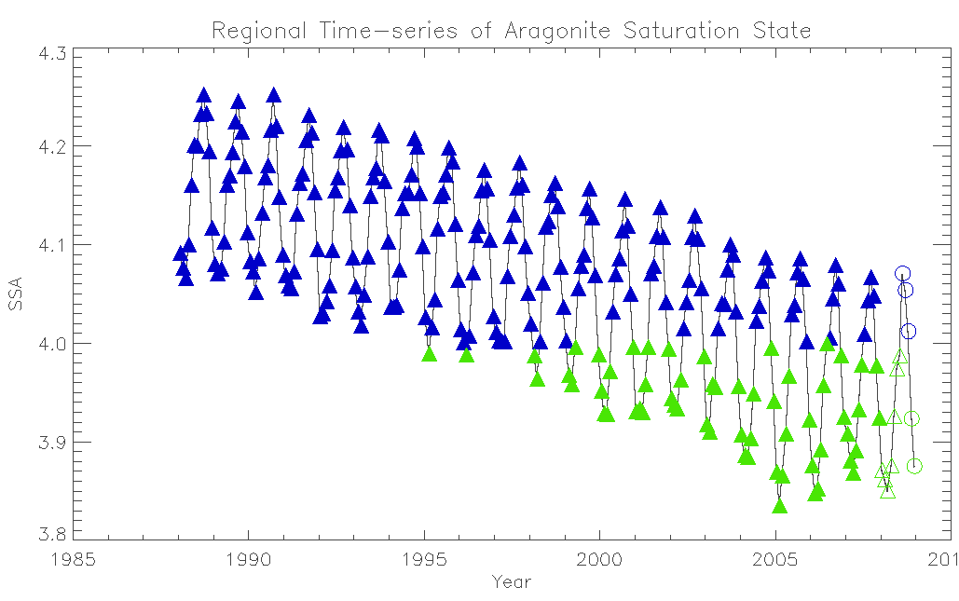
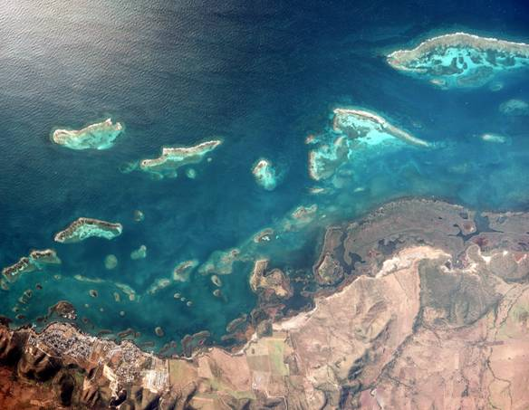

Regional Distribution of Ω
Ocean Acidification Product Suite:
Offers monthly synthesis of satellite and modeled environmental datasets to provide a synoptic estimate of sea surface carbonate chemistry in the Greater Caribbean Region. This tool compliments on-going geochemical surveys and monitoring efforts in the region by providing estimates of changing ocean chemistry on a broader spatial and temporal scale than shipboard observations alone can permit. http://coralreefwatch.noaa.gov/satellite/current/experimental_products.html.
CRCP Atlantic OA Test-bed
La Parguera, PR

Slide 11
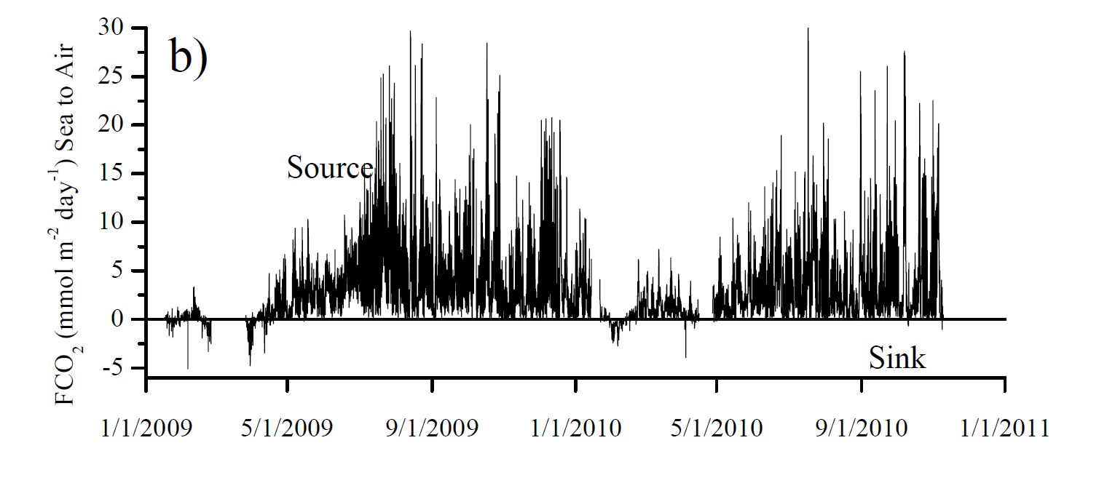
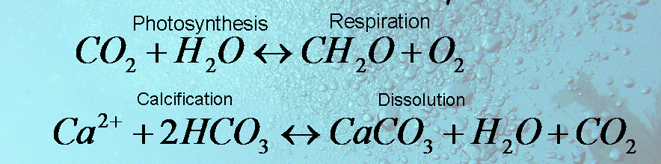
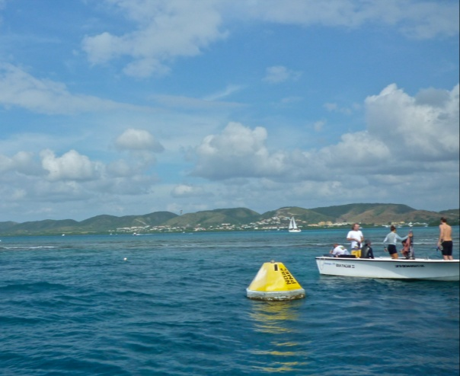
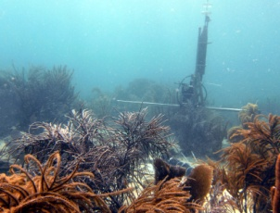
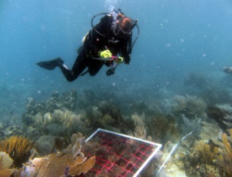
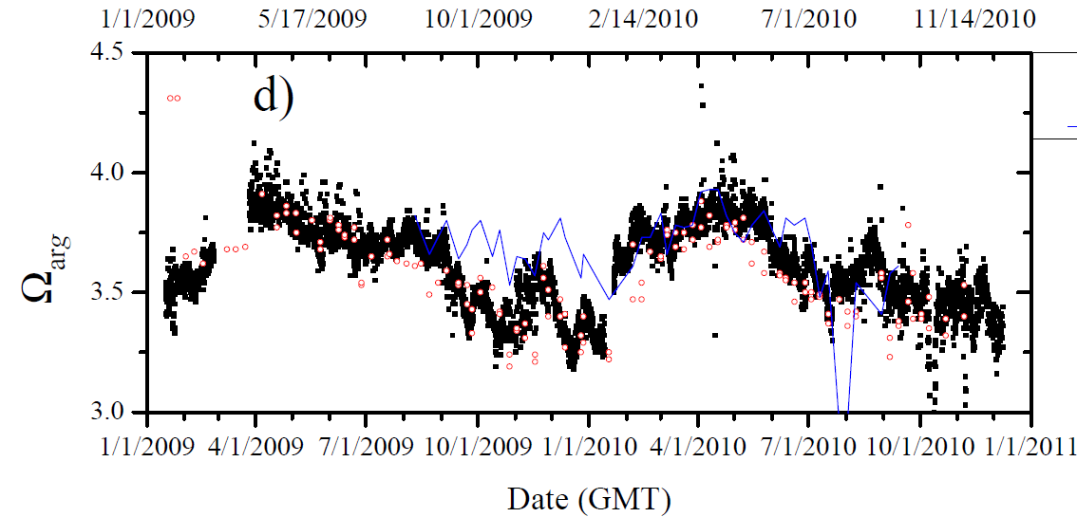
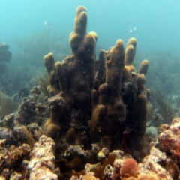


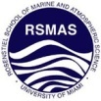




Local Distribution of Ω
CRCP Atlantic OA Test-bed
Regional
Near Reef
La Parguera, PR

Slide 12
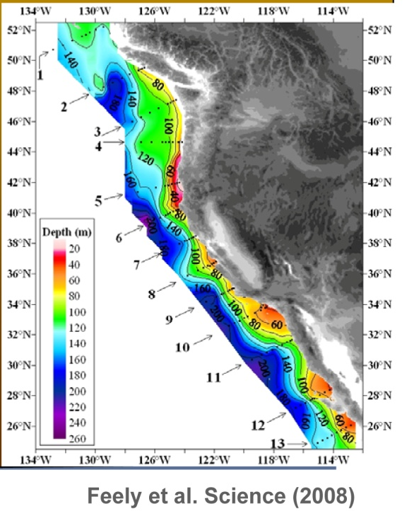
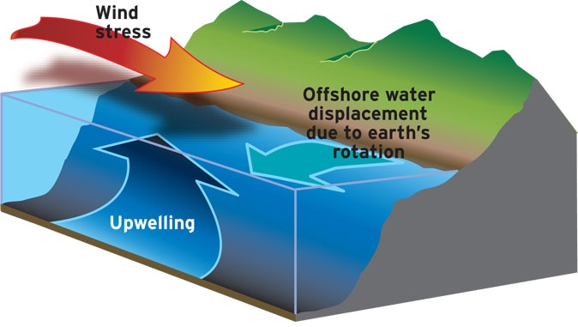
Coastal Upwelling
Local Distribution of Ω
brings high CO₂, low pH, low Ω, low O₂ water to surface
NACP West Coast Survey Cruise
11 May – 14 June 2007

Slide 13
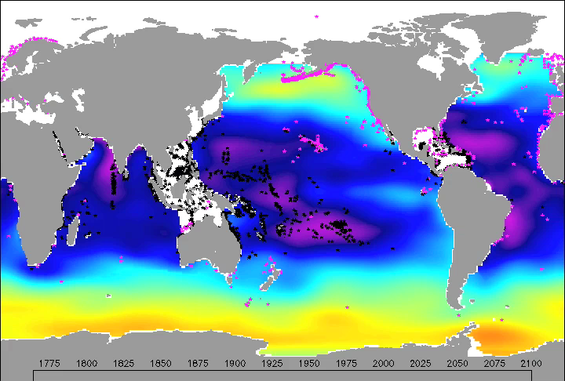
Future Distribution of Ω
Aragonite Saturation State

Slide 14
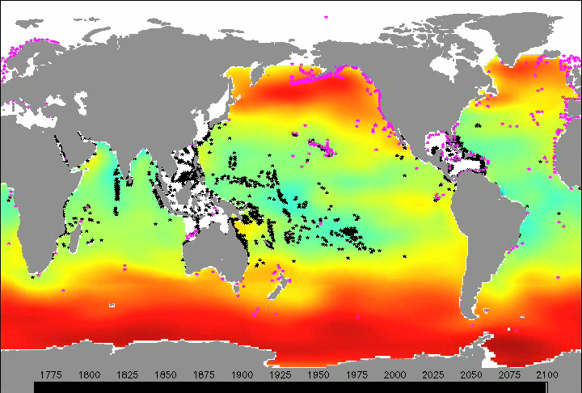
Future Distribution of Ω
Aragonite Saturation State

Slide 15
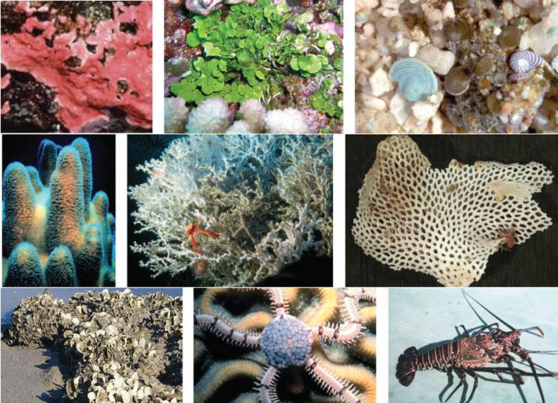
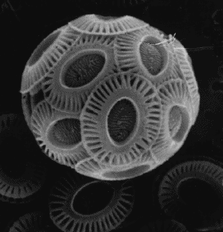
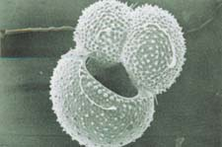
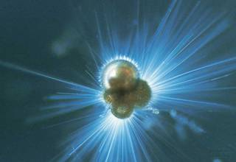
What are the ecological concerns?
Benthic
Planktonic
NOAA
SW Ross
Important Calcifiers
Produce shells composed of calcium carbonate (i.e. chalk)
Impacts of Increasing Ocean Acidification on Coral Reefs and Other Marine Calcifiers: A Guide for Future Research, 2006
Notes:
Here are common representatives of the major benthic calcifiers all of whom at least in part make there living secreting calcium carbonate in on form or another. (a) coralline algae, (b) Halimeda, (c) benthic foraminifera, (d) reef-building coral (dendrogyra cylindrus), (e) deep-water coral, (f) bryozoan, (g) mollusc (oyster reef), (h) echinoderm (brittle star), (i) crustacean (lobster)

Slide 16
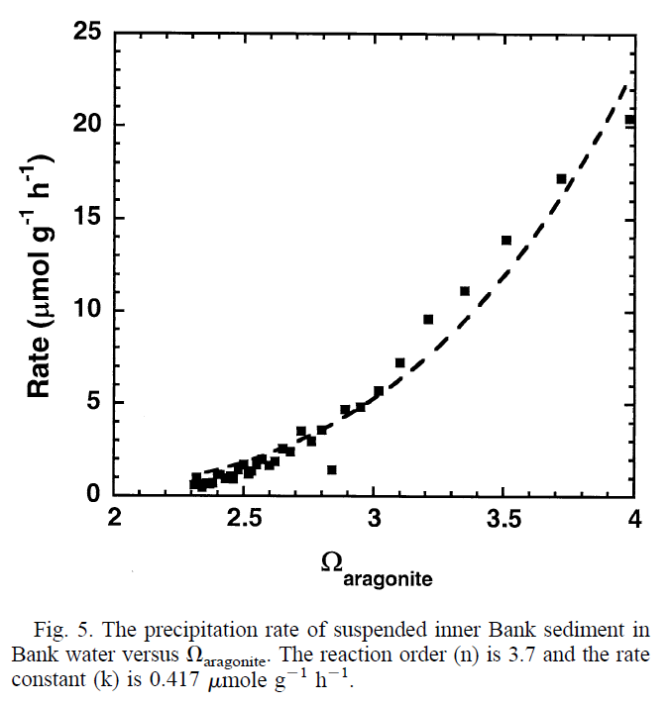
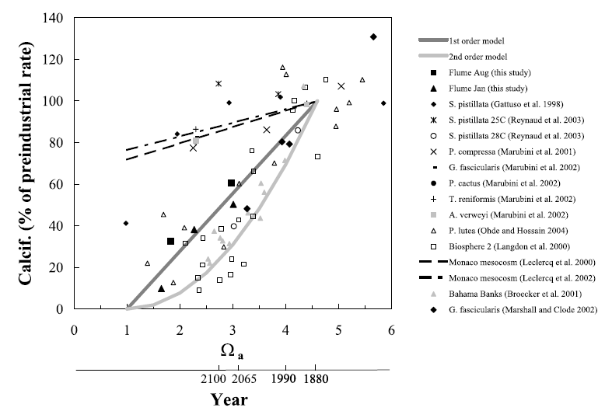
What are the ecological concerns?
Both inorganic precipitation and biologically mediated calcification rates are affected by the degree to which seawater is supersaturated Ω.
Precipitation Rate of Aragonite
Calcification Rate of Aragonite
Morse, Gledhill, Millero (2003)
Langdon & Atkinson (2005)
Inorganic
Biological

Slide 17
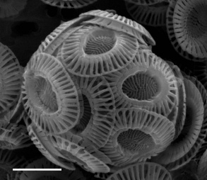
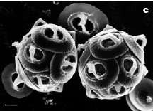
Coccolithopores
Single-cell algae
manipulation of CO₂ system by addition of HCl or NaOH
pCO₂
280-380 ppmv
780-850 ppmv
Emiliania huxleyi
Gephyrocapsa oceanica
Calcification decreased
- 9 to 18%
- 45%
Riebesell et al.(2000); Zondervan et al.(2001)
Notes:
A landmark study of Riebesell et al and related work by Zondervan et al, measured the response of 2 cocco spp - E hux…..These workers manipulated the CO2 system by…
[Click] Measured a Decrease in calcification – G. oceanic more sensitive to elevated pCO2; Documented malformed coccoliths in both spp.

Slide 18
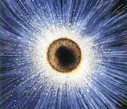
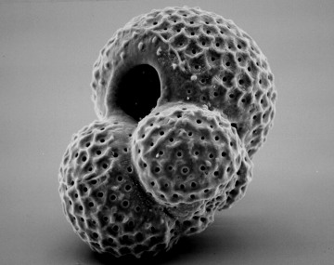
Formanifera
single-celled protists
-4 to -8% decline in calcification at pCO₂= 560 ppm
-6 to -14% decline in calcification at pCO₂= 780 ppm
Bijma et al. (2002)
Shell mass is positively correlated with [CO₃²⁻]
Notes:
2 spp of forams have been investigated by Dr. Jelle Bijma and co-workers. In both, shell mass was positively correlated with [CO3]
Shell mass decreased by 4 to 8% at 2x CO2 (560 ppm) and by 6 to 14% at 3xCO2 (740 ppm)
No studies have directly measured foram calcification rates as a function of pCO2.

Slide 19
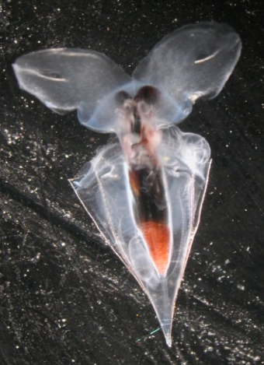
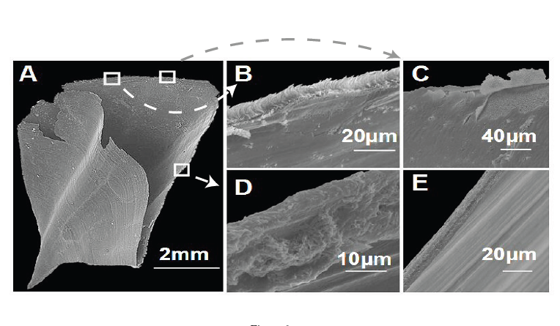
Shelled pteropods
planktonic snails
Whole shell:
Clio pyramidata
Arag. rods exposed
Prismatic layer
(1 µm) peels back
Aperture (~7 µm):
advanced dissolution
Normal shell:
no dissolution
Respiratory CO₂ forced Ω_{A} <1
Shells of live animals start to dissolve within 48 hours
Orr et al. (2005)
Notes:
Turning to shelled pteropods – we have even less information on these aragonite-producing zooplankton.
Orr et al. report qualitative changes in the shells of live pteropods when they were exposed to undersaturated conditions for 48 hours. SEM examination of shells show that shell dissolution begins near the shell aperature with the formation of etch pits and exposure of the aragonitic rods at the growing edge.
SEM examination of shells shows that shell dissolution begins near the shell aperature with the formation of etch pits and exposure of the aragonitic rods at the growing edge. [go through panels]
Orr et al. report qualitative changes in the shells of live pteropods when they were exposed to undersaturated conditions for 48 hours.

Slide 20
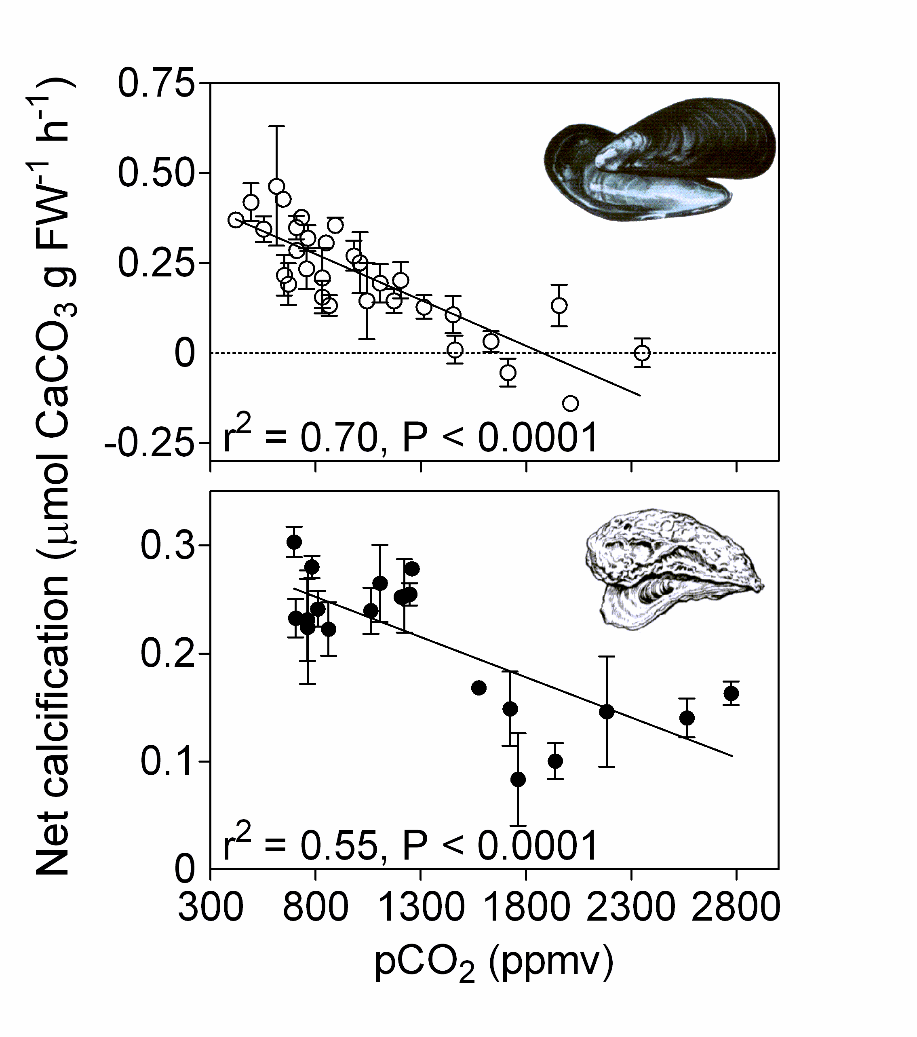
Mussels & oysters
Mytilus edulis & Crassostrea gigas
Decrease in calcification rates for the both species
Significant with pCO₂ increase and [CO₃²⁻] decrease
At pCO₂ 740 ppmv:
  25% decrease in calcification for mussels
  10% decrease in calcification for oysters
Gazeau et al., 2007
Notes:
Mylitus edulis; common blue mussel ; oyster Crassostrea gigas is the most cultivated species in the world
Difference in calcification response - may be related to shell mineralogy – oyster shells are calcite but mussel shells are a mixture of calcite and aragonite – aragonite can be as high as 80%

Slide 21
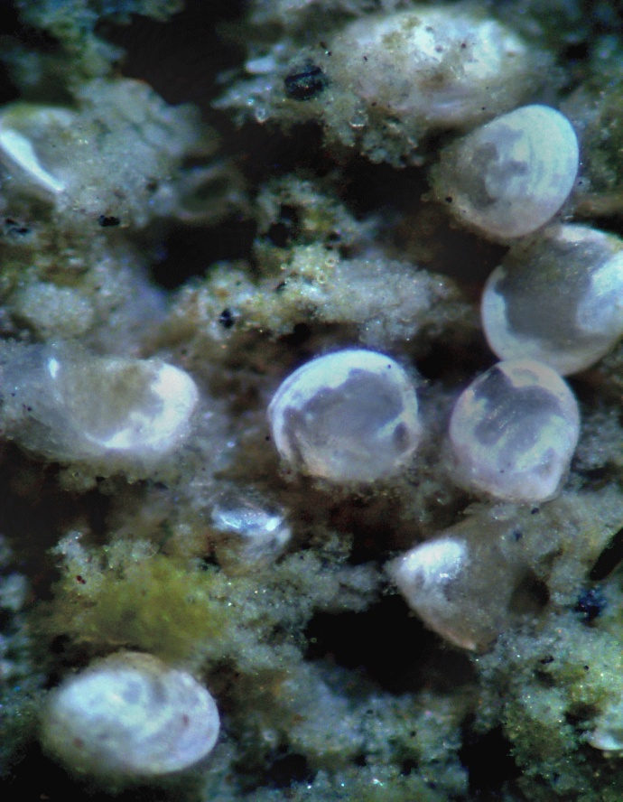
Bivalve juveniles
Hard shell clam Mercenaria
0.3 mm newly settled clams
Massive dissolution within 24 hours in undersaturated water; shell gone within 2 weeks
Dissolution causes mortality in estuaries & coastal habitats
- Mark Green¹ and George G. Waldbusser²
¹St. Josephs’s College of Maine
²UM Center for Envi. Sci. Chesapeake Biological Lab.
Common in soft bottom habitats
Notes:
What about the juvenile stages of molluscs?
Strong evidence comes from the work of Mark Green. He looked at hard shell clam – Mercenaria mercenaria – aragonite shell. Introduced these juv clams to sediments that were undersaturated w/respect to aragonite - at levels are typical of estuarine surface sedmts
Shell gone w/in 2 wks – leaving only the protein matrix
Dissolution is an impt source of mortality for newly settled clams

Slide 22
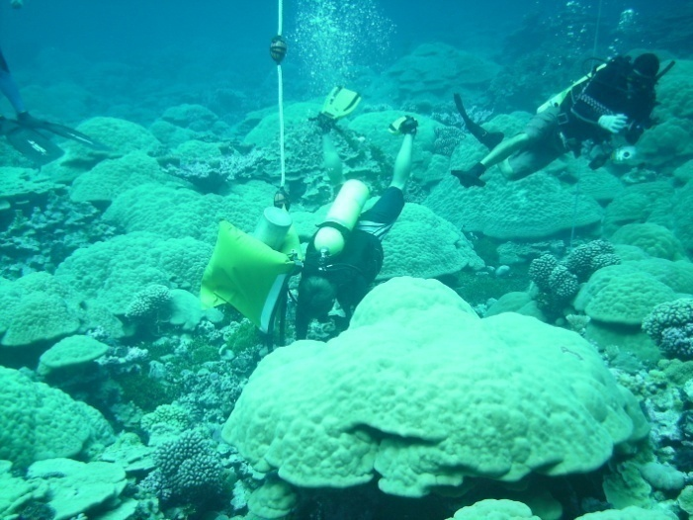

Reef’s in the Balance
Coral Reef Ecosystems
The more technical definition of "coral reef" includes an additional geological requirement that the reef organisms produce enough calcium carbonate to build the physical reef structure. – J. Kleypas

Slide 23
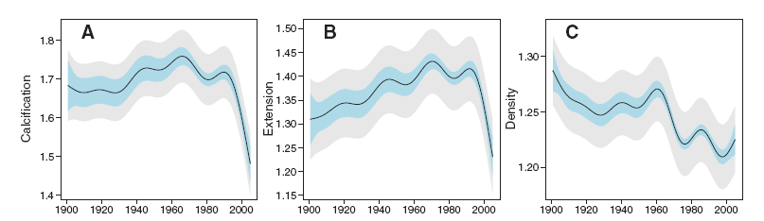
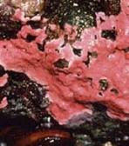
Calcification Decrease
Coral Reef Ecosystems
Coral Reef CaCO₃ Budget
Production
Precipitation
Calcification
Loss
Dissolution
Bioerosion
Mechanical erosion
“Skeletal records show that throughout the Great Barrier Reef (Australia), calcification has declined by 14.2% since 1990, predominantly because extension (linear growth) has declined….the causes of the decline remain unknown..” - De’ath et al., Science (2009)
“Crustose coralline algae (CCA) play an important role in the gowth and stabilization of carbonate reefs. Under present day pH, CCA had developed 25% cover in the control mesocosms and only 4% under the acidified measocosms”. – Jokiel et al., Coral Reefs (2008)

Slide 24
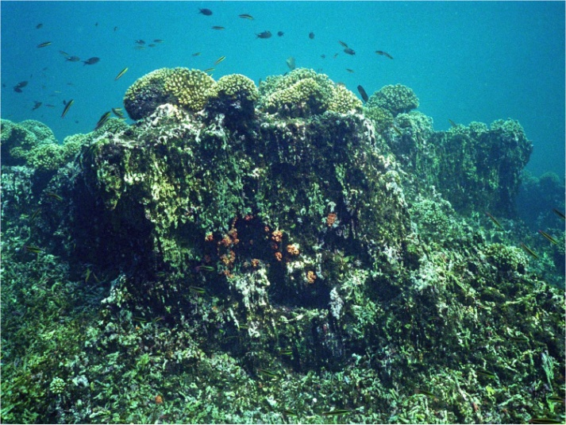
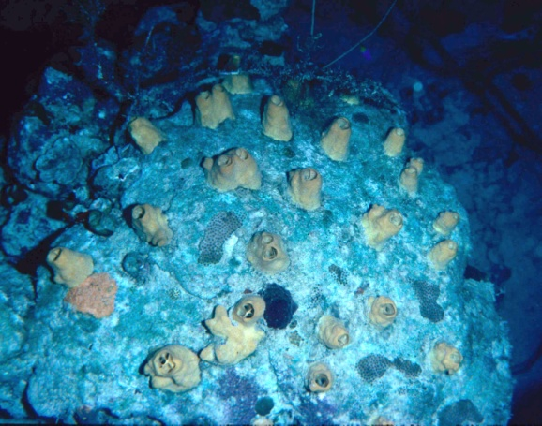
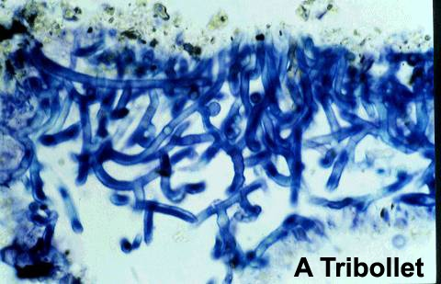

Bioerosion Increase
Coral Reef Ecosystems
Coral Reef CaCO₃ Budget
Production
Precipitation
Calcification
Loss
Dissolution
Bioerosion
Mechanical erosion
“Eastern Tropical Pacific (ETP) reefs represent a real-world example of coral reef growth in low-Ω waters that provide insights into how the biological-geological interface of coral reef ecosystems will change in a high-CO₂ world”. – Manzello et al., PNAS (2008)
Macroborers
At elevated pCO₂ (750 ppm) the depth of penetration of Euendolithic bioeroders increased increasing dissolution rates by 48% - Tribollet et al., Global Biogeochem. Cycles (2009)
Microborers

Slide 25
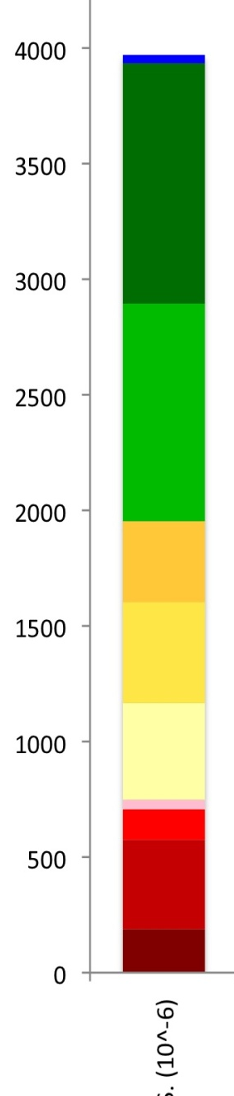

Potential Economic Impacts
$4B primary commercial sales in 2007
fed a $70B industry, adding $35B to GNP
Varying regional importance of fishery groups calls for local adaptation
Total consequences could be far-reaching for ecosystems and marine-dependent societies
4
1.5
Uninfluenced
Predators
Crustaceans (crabs, etc)
Bivalves (oysters, etc.)
3
1
Billions of U.S. $
2
0.5
1
0
0
U.S.
New
Engl.
Mid-
Atl.
Gulf
Pac.
HI
AK
Cooley & Doney, 2009
Notes:
Revenues from National Marine Fisheries Service data partitioned by species into large groups. The yellow and red tones represent fisheries that are directly susceptible to acidification because they make shells and skeletons out of calcium carbonate. Some groups in green (fin-fish) may experience indirect foodweb effects (there may be direct effects on fish larvae but they are currently ill-defined). Primary commercial sales are ex-vessel values, or the amount paid to fishermen by wholesalers and processors. Primary revenue is amplified greatly (factor of ~10x to 20x) in overall industry fisheries support.
Bivalves: clams, scallops, mussels, oysters
•Valuable commercial fisheries
• Mussels & oysters: ecosystem engineers
Echinoderms: sea urchins, sea stars, sea cucumbers
• Commercial fisheries: sea urchins & sea cukes
• Sea stars: keystone species
Crustaceans: shrimp, crabs, lobsters, copepods
• Valuable commercial fisheries
• Copepods: central role in marine food webs

Slide 26


Pacific Northwest oyster emergency
Willapa Bay
seed crisis
Failure of larval oyster recruitments in recent years
Commercial oyster hatchery failures threatens $100M industry (3000 Jobs)
Low pH “upwelled” waters a possible leading factor in failures
Larval oyster may be “canary in goldmine” for near-shore acidification?
Notes:
http://www.visit.willapabay.org/graphics/north-co-grn..gif

Slide 27








Potential impacts: marine organisms & ecosystems
    Reduced calcification rates
    Significant shift in key nutrient and trace element speciation
    Shift in phytoplankton diversity
    Reduced growth, production and life span of adults, juveniles & larvae
    Reduced tolerance to other environmental fluctuations
    Changes to:
      Fitness and survival
      Species biogeography
      Key biogeochemical cycles
      Food webs
    Reduced:
      Sound Absorption
      Homing Ability
      Recruitment and Settlement
Uncertainties great
RESEARCH REQUIRED
Changes to ecosystems & their services

Slide 28

Complex Responses
"never make predictions, especially about the future" - Casey Stengel, the baseball legend
In terms of calcification rates, a range of sensitivities and responses to OA have been experimentally determined precluding a simple narrative

Slide 29


Slide 30


Legislative Drivers
“Development and coordination of a comprehensive interagency strategy to:
Monitor and conduct research on the processes and consequences of ocean acidification on marine organisms and ecosystems;
Establish a NOAA research and monitoring program on ocean acidification;
Establish a program at NOAA for assessment and consideration of regional and national ecosystem and socioeconomic impacts of increased ocean acidification research adaptation strategies and techniques for effectively conserving marine ecosystems as they cope with increased acidification.”
Federal Ocean Acidification Research and Monitoring (FOARAM) Act of 2009
Notes:
Change picture to Movie and bottom notes.

Slide 31









NOAA National Ocean and Great Lakes Acidification Research Plan
Monitor trends
Overall Guiding Questions….
The research objectives detailed in the NOAA National OA Plan are guided by the following overarching hypotheses:
Hypothesis 1. Rates and magnitude of OA will vary across time, space, and depth as a consequence of local and regional geochemical, hydrological, and biological mechanisms.
Hypothesis 2. OA will change ecosystem structure and function.
Hypothesis 3. Heterogeneity in species-specific responses, local secondary environmental factors and regional considerations will confer a broad range of vulnerabilities that differ both locally and regionally among marine ecosystems.
Ecosystem responses
Model changes & responses
Develop adaptation strategies
Conduct education and outreach
Notes:
Message: We are pleased that we are getting a great deal of support for the program. The Implementation Plan is taking shape. (Draft 3 is dated August 14/from Dick Feely).
The overarching goal of the NOAA Ocean Acidification Research Program is to monitor trends in ocean acidification, to predict how ecosystems will respond to ocean acidification, and to provide information that managers can use to address issues related to ocean acidification.
NOAA’s approach to addressing the overarching goal:
Monitoring of temporal and spatial trends – Accomplished through ship-based and moored observations of key physical, chemical and biological parameters.
Ecosystem responses – Will use same platforms as monitoring, but will also require laboratory physiological response experiments.
Modeling studies - Purpose is to delineate large-scale changes in ocean water chemistry and ecosystem responses.
Utility of research - Findings will be used to develop adaptation strategies in response to ocean acidification.
Primary goals (6 themes) of this research are to: (Source: Aug. 14, 2009 draft of NOAA OA Implementation Plan)
Develop the monitoring capacity to quantify and track ocean acidification and its impacts in open-ocean and coastal systems (Theme 1) – e.g. VOS & repeat hydrography, technology development
Assess the response of marine organisms to ocean acidification (Theme 2) – lab & field studies, marine phytoplankton, higher tropic levels
Forecast biogeochemical and ecological responses to ocean acidification (Theme 3)
Develop management strategies for responding and adapting to the consequences of ocean acidification from a human dimensions perspective (Theme 4)
Provide a synthesis of ocean acidification data and information (Theme 5)
Provide an engagement strategy for educational and public outreach (Theme 6)
Segue: Ecosystem study priorities
Photo credits, top to bottom: Monitoring – An underwater CO2 sampling system attached to one of NOAA's Integrated Coral Observing Systems (ICON) in the Bahamas, MAPCO2 deployment off Puerto Rico; Ecosystems – coral, teacher at sea measuring coral; Modeling – Science On a Sphere ocean acidification with coral reefs; Adaptation Strategies - Klamath Basin stakeholders meeting; Eduction/Outreach - Students at the UCAP school in Providence, RI talk by satellite phone with NOAA scientist and former UCAP employee Catalina Martinez, who is in a submersible more than 8,000 ft deep in the Gulf of Alaska.

Slide 32
NOAA Resources and Research
Oceanic and Atmospheric Research
  Monitoring and modeling
  Sample analysis (AOML, PMEL)
  Sensor Technology development
  NOAA Program Office (Established on Monday)
NOAA’s Fisheries Service (NMFS)
  Species specific experiments on commercial or recreational fishery species or their food/prey including primary producers
  Modeling
  Building mesocosms. NEFSC, NWFSC, AKFSC
National Ocean Service
  Coral Reef Conservation Program (Caribbean, Pacific Islands)
  Marine Sanctuaries
  National Estuarine Research Reserves
  Extramural Ecosystem Impacts of OA research
  Labs in Kasitsna Bay, AK, Southeast (NC/SC), Chesapeake Bay
National Environmental Satellite, Data, and Information Service
  Coral Reef Watch
  Satellite sensing of phytoplankton blooms

Slide 33

AFSC: King crab, Tanner crab, Pollock eggs and larvae…coldwater corals/sponges…socioeconomic models & decision tools…
PMEL: Ocean/coastal fixed & ship CO2 monitoring, tech. development, geochemical modeling, analytical center…
NWFSC: Pacific oyster, Olympia oyster, geoduck, pinto abalone…
NEFSC: Phytoplankton, fin fish larvae, Scrup larvae, surf clam…
PIFSC: cataloging chemistry within remote island systems, coral growth rates, CCA accretion…
AOML: Ocean/coastal fixed & ship CO2 monitoring, coral reef monitoring/modeling, satellite applications, analytical center…
SEFSC: Coral reef species including multiple life stages…

Slide 34

Notes:
Where is NOAA with regards to this implementation timeline?
What single species experiments are currently engaged and give an example of some of the economically important species being investigated?
Which socio-economic models and decision tools are currently being developed?

Slide 35
Concluding Remarks
Ocean Acidification represents a global scale change in ocean chemistry in direct response to rising atmospheric CO₂.
These changes represent perhaps the most rapid shift in ocean chemistry in millions of years.
High latitude systems will likely experience under-saturation with respect to aragonite within this century.
Most (but not all) species-specific response experiments demonstrate a negative affect to ocean acidification even before dissolution.
The precise ecological implications remains uncertain and considerable research needs remain.
The socioeconomic impacts are understood less so.
An observational network for ocean acidification is under development. Physiological response studies have begun, mitigation and adaptation studies need to be developed and integrated with the models. Modeling studies need to be expanded into coastal regions.

Slide 36
Special Thanks to Contributors to this Talk
Richard Feely (NOAA PMEL)
Chris Sabine (NOAA PMEL)
Joanie Kleypas(NCAR)
And many others….The Global Carbon Project ,EPOCA, ect.

