Slide 1
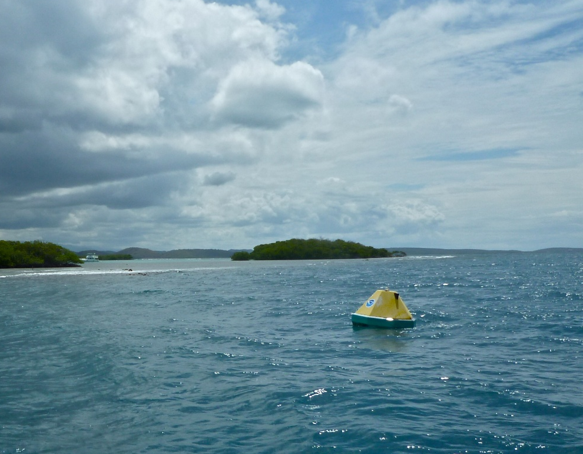
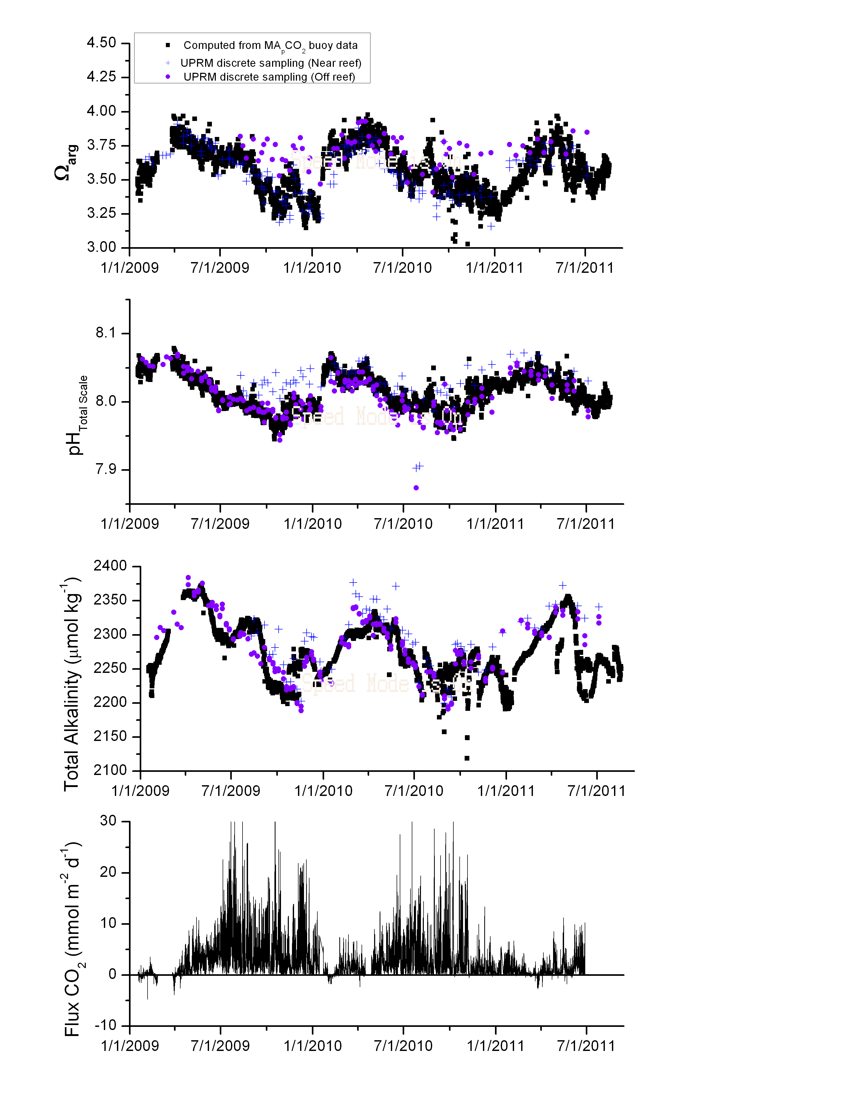
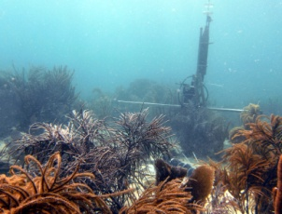
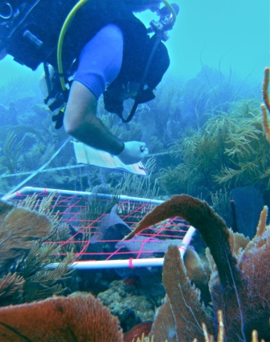
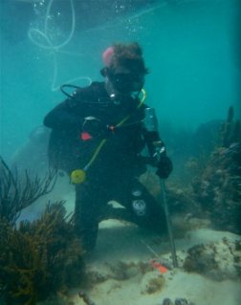
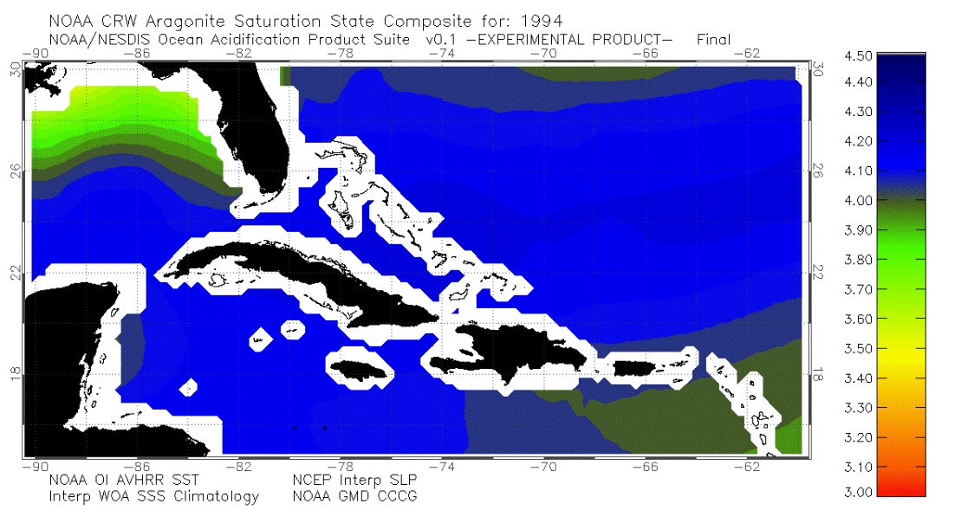

Atlantic Ocean Acidification
Test-bed
AOAT
Presented for : NOAA AOML OCD
Principle Investigator
Dwight Gledhill (AOML
Community Metabolic Measurements
Chris Langdon (RSMAS)
Wade McGillis (CICAR)
Brice Loose (WHOI)
et al.
Discrete Time-series
Jorge Corredor (UPRM)
Melissa Meléndez Oyola (UPRM)
Et al.
Coral Growth/Bioerosion
Derek Manzello (AOML/CIMAS)
Ian Enochs (AOML/CIMAS)
Community Characterization
Greg Piniak (NCCOS)
Shay Viehman (NCCOS)
Ryan Moyer (USGS)
Autonomous Time-series
Chris Sabine (PMEL)
Sylvia Musielewicz (PMEL)
Noah Lawrence-Slavas (PMEL)
Others…
Photo’s by Ryan Moyer (USGS)
Rational and Motivations
Ocean Acidification Product Suite (OAPS v0.6)
Atlantic Ocean Acidification Test-bed (AOAT) FY09 – FY11
NCRMP/Atlantic Ocean Acidification Test-bed (AOAT) FY12 -

Slide 2
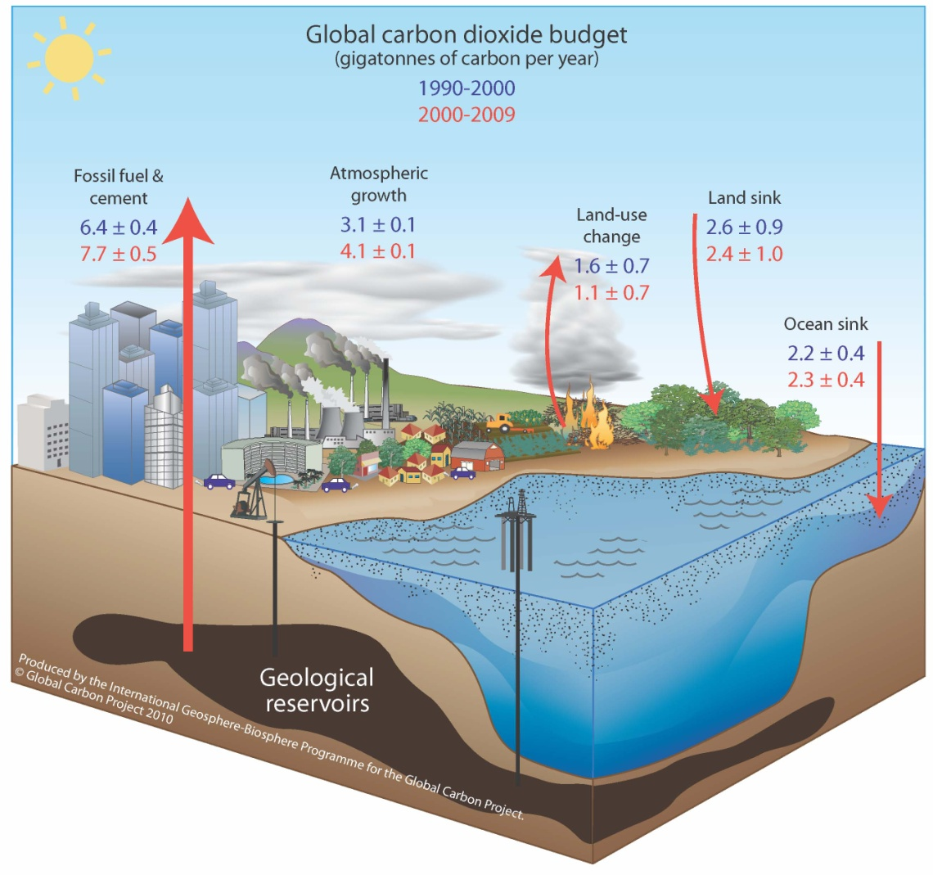
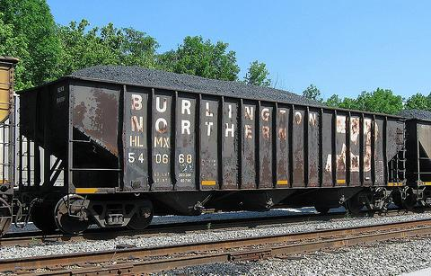

Global Carbon Cycle
A railroad train carrying 2.3 Gigatones of carbon would stretch around the Earth 14 times! – Chris Sabine (NOAA PMEL)
The importance of a well balanced carbon budget
Global Carbon Project 2010; Updated from Le Quéré et al. 2009, Nature Geoscience; Canadell et al. 2007, PNAS

Slide 3

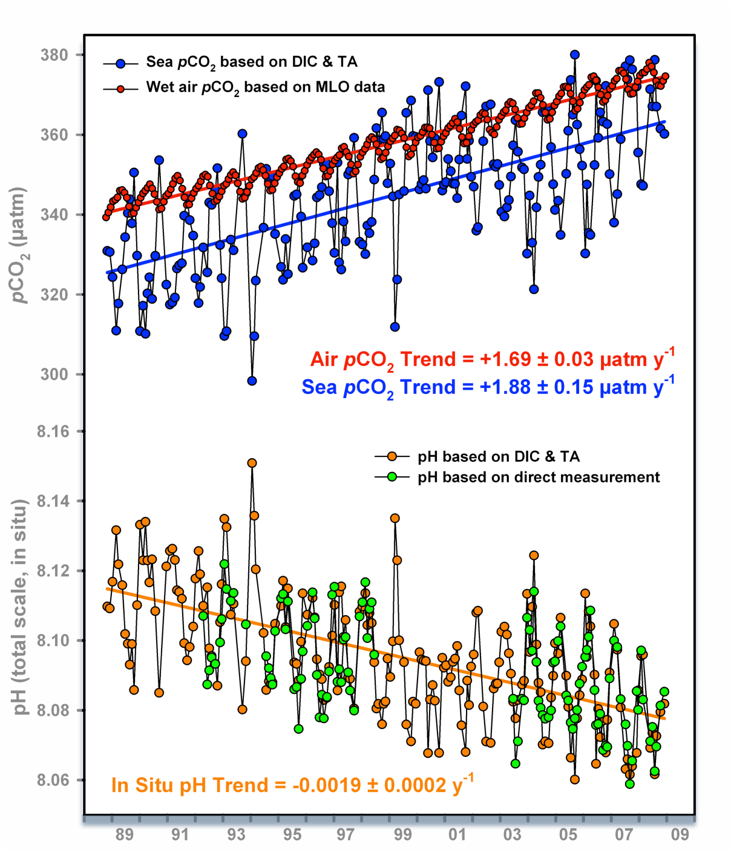
What is Ocean Acidification?
The fundamentals…
Station Aloha
Station Mauna Loa
Figure modified courtesy of Richard Feely (NOAA PMEL) reproduced from Doney, Science (2010) and Dore et al., PNAS (2009)

Slide 4
The fundamentals…
What is Ocean Acidification?
Calcium Carbonate (CaCO₃, a.k.a.“Chalk”)

Slide 5

What is Ocean Acidification?
The fundamentals…
“Since the time of the HMS Challenger expeditions in the late 19th century, it has been recognized that that the saturation state of seawater overlying sediments in the deep ocean exerts a major influence on the distribution and abundance of calcium carbonate in these sediments” – J. Morse
Calcium Carbonate (CaCO₃, a.k.a.“Chalk”)

Slide 6
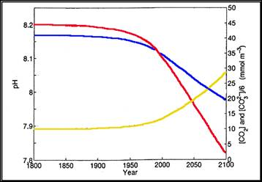
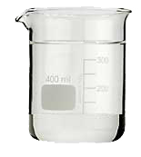

What is Ocean Acidification?
The fundamentals…
“Since the time of the HMS Challenger expeditions in the late 19th century, it has been recognized that that the saturation state of seawater overlying sediments in the deep ocean exerts a major influence on the distribution and abundance of calcium carbonate in these sediments” – J. Morse
pH
CO₃²⁻
“Saturation State”
CO_{2(aq)}
Ω
>
1
=
precipitation
Ω
<
1
=
dissolution
Wolf-Gladrow et al., 1999

Slide 7
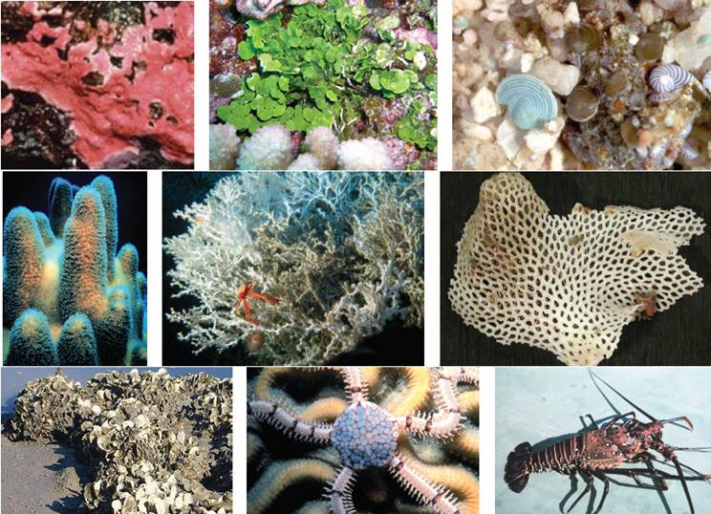
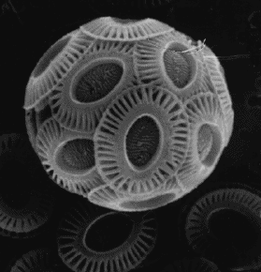
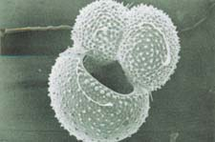
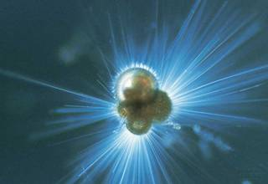
What are the ecological concerns?
Benthic
Planktonic
NOAA
SW Ross
Important Calcifiers
Produce shells composed of calcium carbonate (i.e. chalk)
Impacts of Increasing Ocean Acidification on Coral Reefs and Other Marine Calcifiers: A Guide for Future Research, 2006
Notes:
Here are common representatives of the major benthic calcifiers all of whom at least in part make there living secreting calcium carbonate in on form or another. (a) coralline algae, (b) Halimeda, (c) benthic foraminifera, (d) reef-building coral (dendrogyra cylindrus), (e) deep-water coral, (f) bryozoan, (g) mollusc (oyster reef), (h) echinoderm (brittle star), (i) crustacean (lobster)

Slide 8
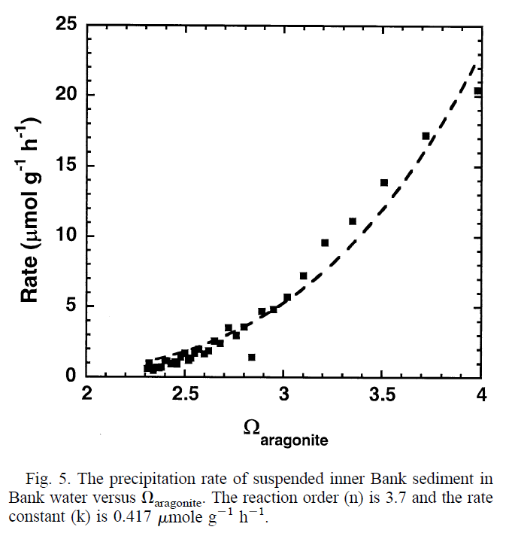
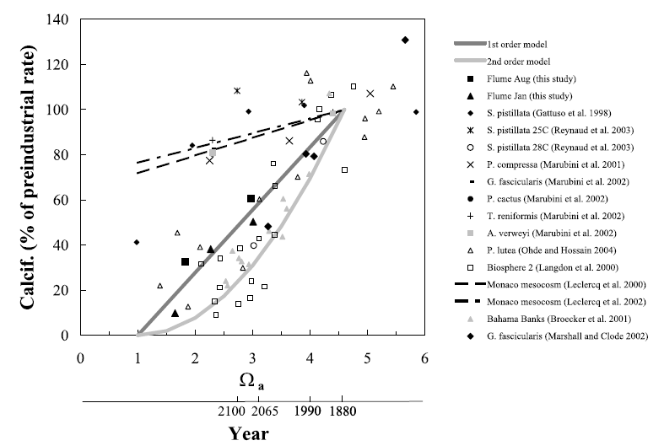
What are the Coral Reef Ecosystem concerns?
Both inorganic precipitation and biologically mediated calcification rates are affected by the degree to which seawater is supersaturated Ω.
Precipitation Rate of Aragonite
Calcification Rate of Aragonite
Morse, Gledhill, Millero (2003)
Langdon & Atkinson (2005)
Inorganic
Biological

Slide 9

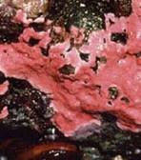
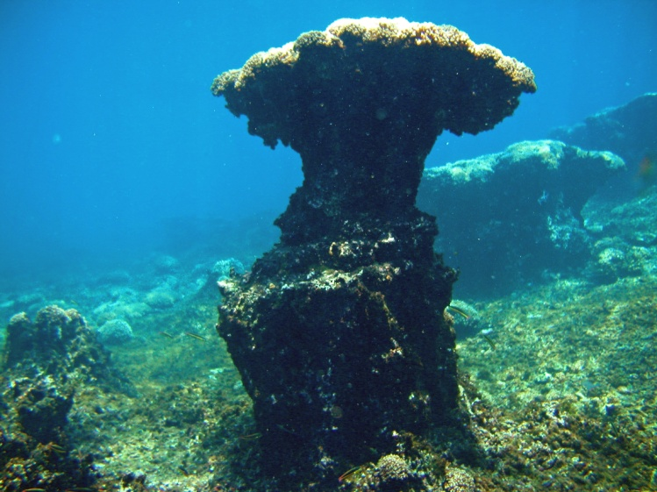
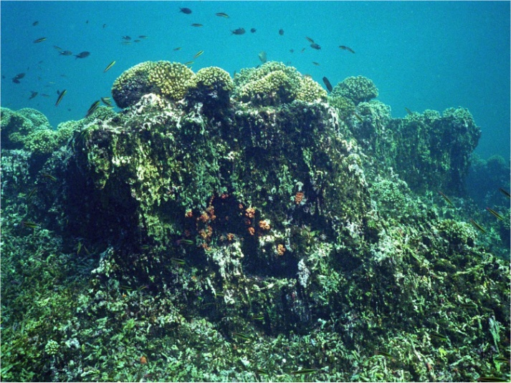
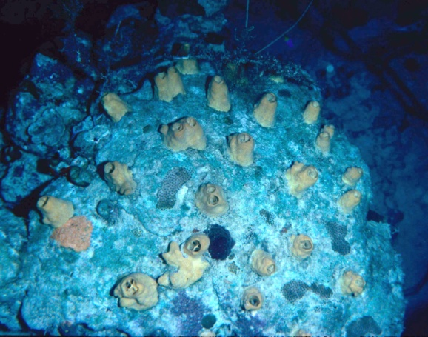
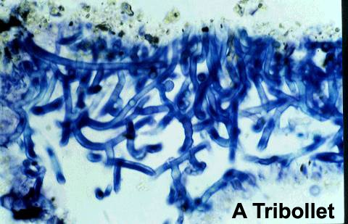

Reef’s in the Balance?
“Crustose coralline algae (CCA) play an important role in the gowth and stabilization of carbonate reefs. Under present day pH, CCA had developed 25% cover in the control mesocosms and only 4% under the acidified measocosms”. – Jokiel et al., Coral Reefs (2008)
The more technical definition of "coral reef" includes an additional geological requirement that the reef organisms produce enough calcium carbonate to build the physical reef structure. – J. Kleypas
“Eastern Tropical Pacific (ETP) reefs represent a real-world example of coral reef growth in low-Ω waters that provide insights into how the biological-geological interface of coral reef ecosystems will change in a high-CO₂ world”. – Manzello et al., PNAS (2008)
Macroborers
At elevated pCO₂ (750 ppm) the depth of penetration of Euendolithic bioeroders increased increasing dissolution rates by 48% - Tribollet et al., Global Biogeochem. Cycles (2009)
Microborers

Slide 10
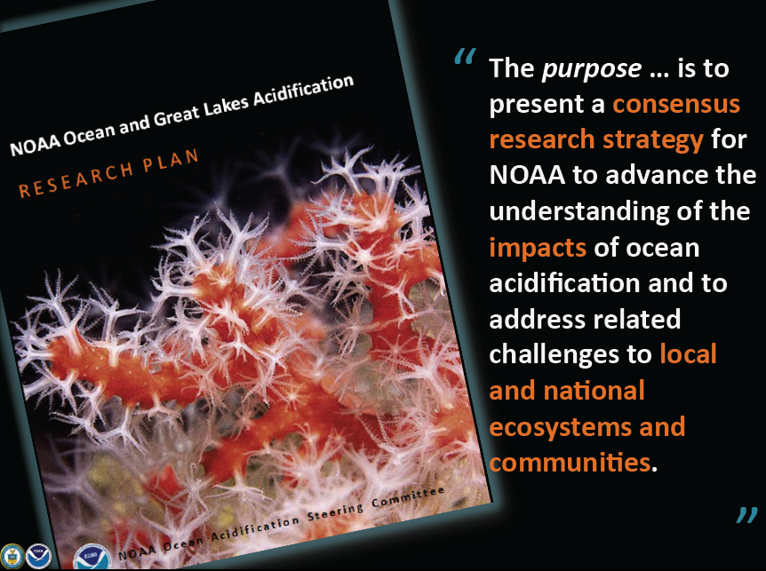
Overall Guiding Questions….
The research objectives detailed in the NOAA National OA Plan are guided by the following overarching hypotheses:
Hypothesis 1. Rates and magnitude of OA will vary across time, space, and depth as a consequence of local and regional geochemical, hydrological, and biological mechanisms.
Hypothesis 2. OA will change ecosystem structure and function.
Hypothesis 3. Heterogeneity in species-specific responses, local secondary environmental factors and regional considerations will confer a broad range of vulnerabilities that differ both locally and regionally among marine ecosystems.

Slide 11
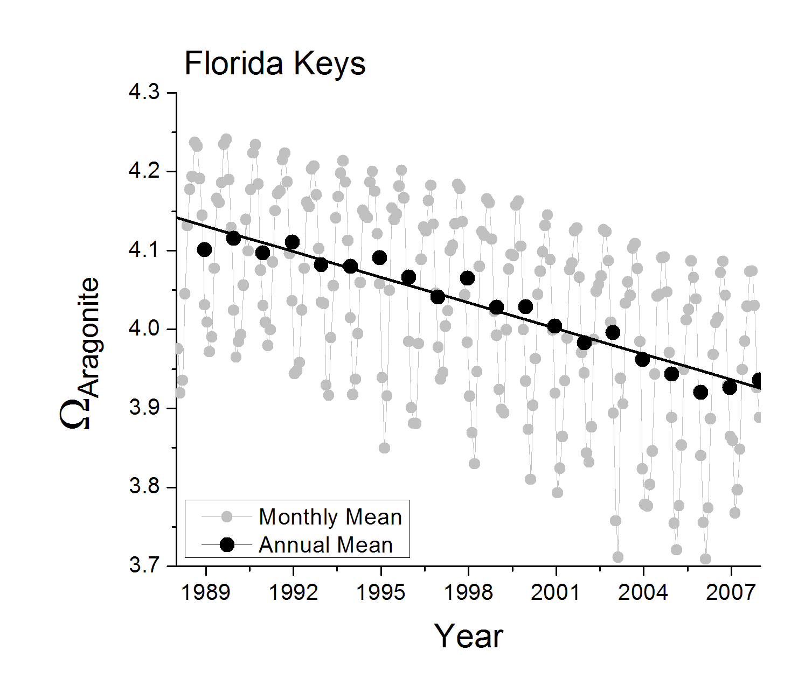
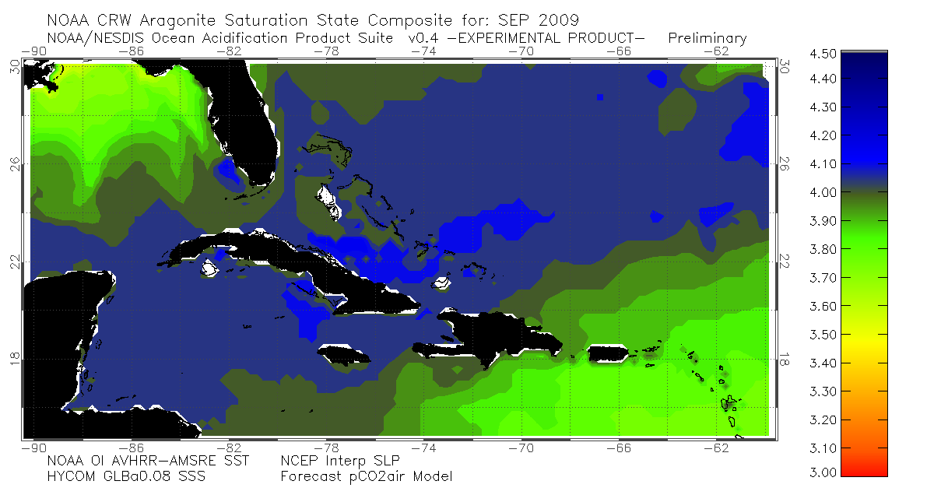
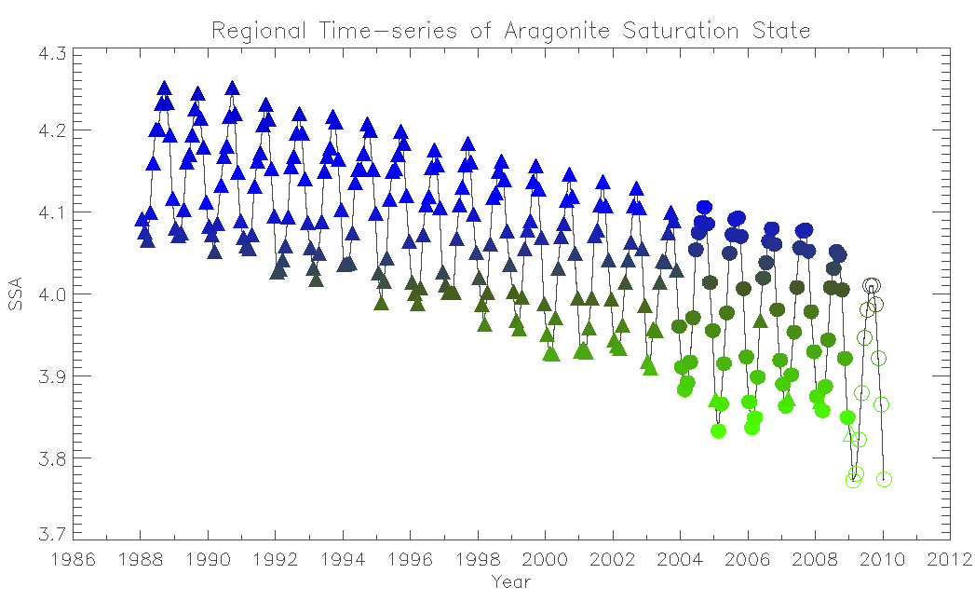
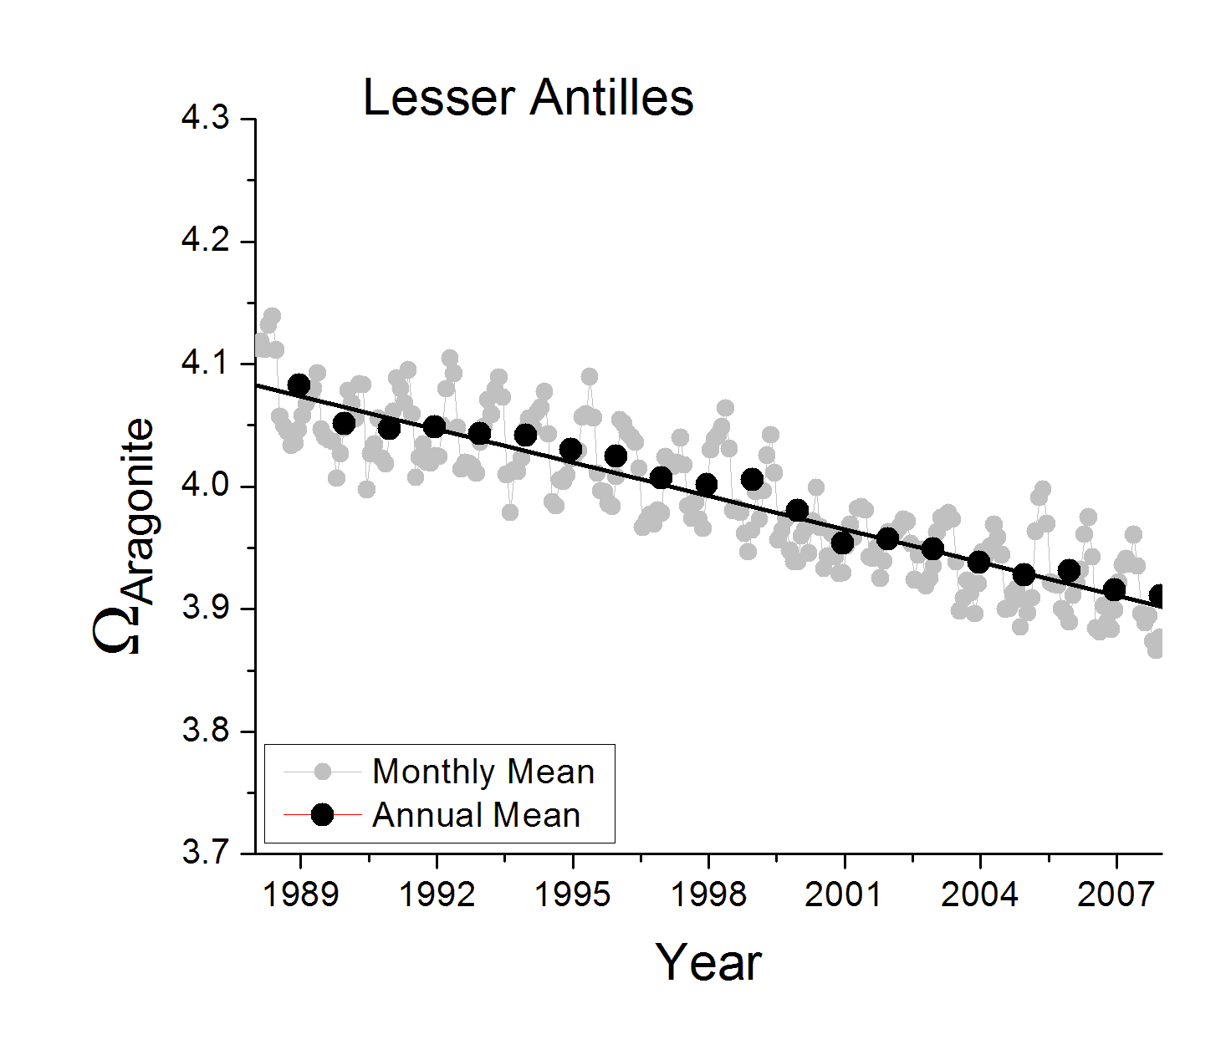



Overall Guiding Questions….
Hypothesis 1. Rates and magnitude of OA will vary across time, space, and depth as a consequence of local and regional geochemical, hydrological, and biological mechanisms.
Ocean Acidification Product Suite v0.6
Florida Keys
The OAPS offers monthly synthesis of satellite and modeled environmental datasets to provide a synoptic estimate of sea surface carbonate chemistry in the Greater Caribbean Region. Currently, carbonate mineral saturation state is decreasing across the region at a rate of about 3% per decade and exhibits considerable spatial and seasonal variability.
Caribbean Sea
http://coralreefwatch.noaa.gov/satellite/current/experimental_products.html
Dwight Gledhill,Wanninkhof, Pierrot, Eakin, Liu
Gledhill, D. K., R. Wanninkhof, F. J. Millero, and M. Eakin (2008), Ocean acidification of the Greater Caribbean Region 1996–2006, J. Geophys. Res., 113, C10031, doi:10.1029/2007JC004629.
Gledhill, D, R. Wanninkhof, and M. Eakin (2010) Observing ocean acidification from space, Oceanography 22(4): 48-59.

Slide 12
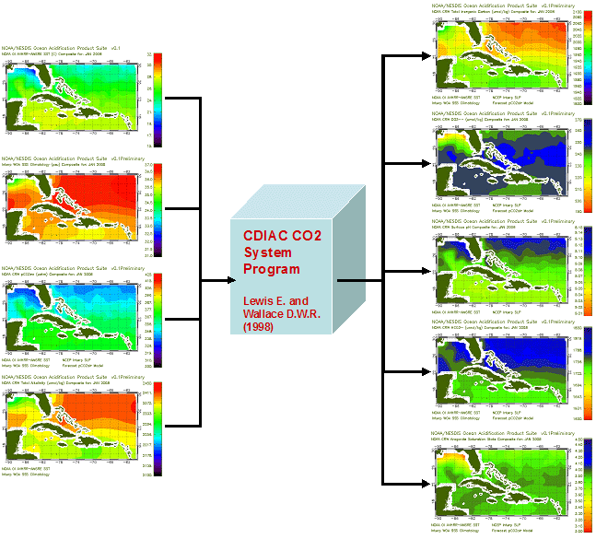
Model Processing
TCO₂
SST
CO₃²⁻
SSS
pH
pCO_{2,sw}
HCO₃⁻
Alk
Ω

Slide 13
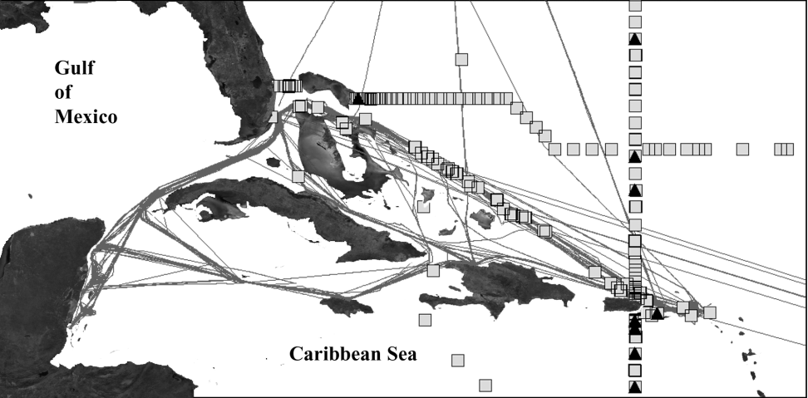
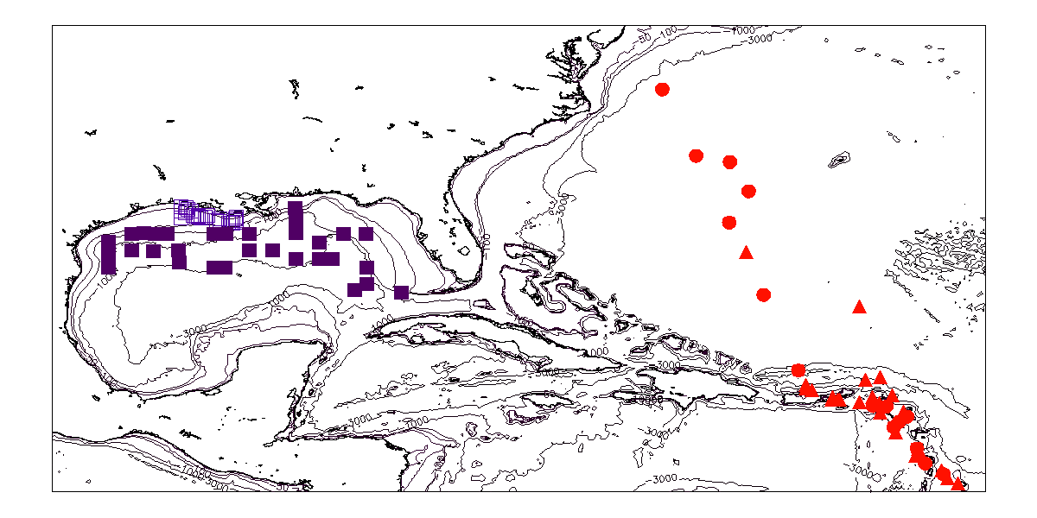
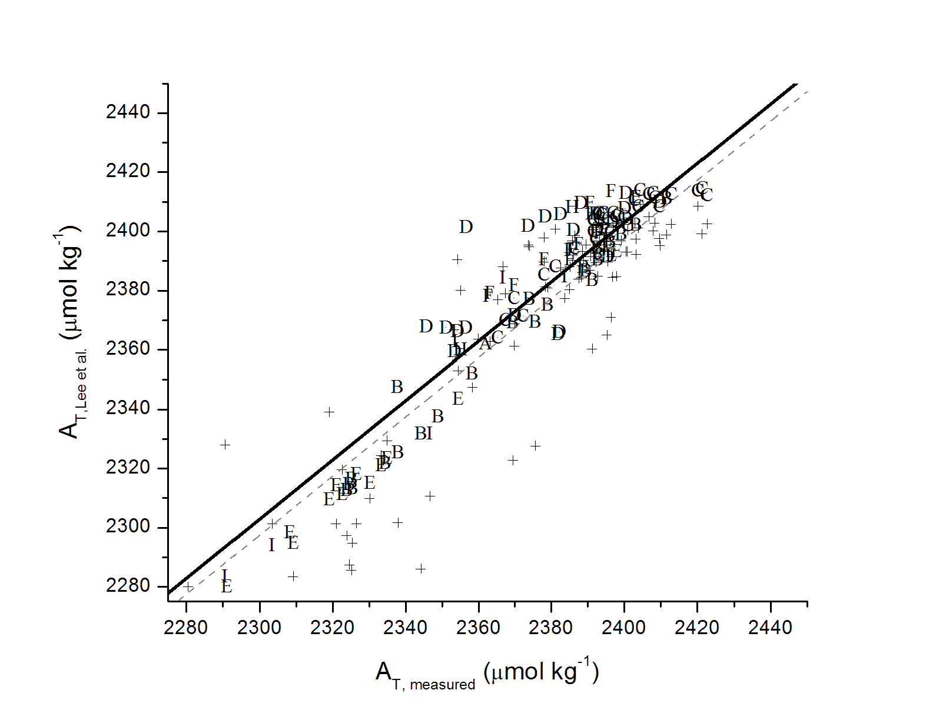
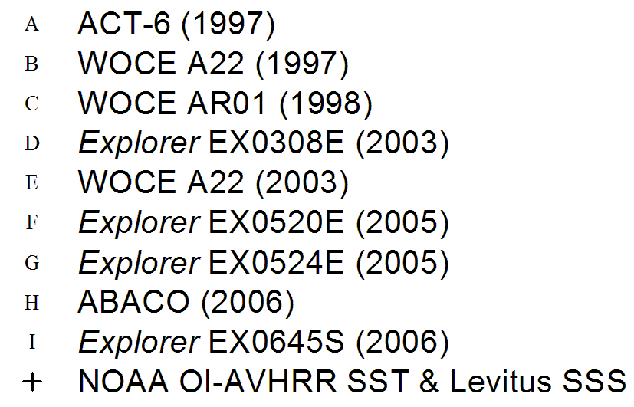
Total Alkalinity Model
Lee, K., L. T. Tong, et al. (2006). "Global relationships of total alkalinity with salinity and temperature in surface waters of the world’s oceans." Geophysical Research Letters 33.
Does Lee et al. (2006) work for the
Greater Caribbean?
NASA ROSES-2007 Element A.3: Carbon Cycle Science
‘Ocean Acidification of the Greater Caribbean Region’
Lead by TAMU

Slide 14
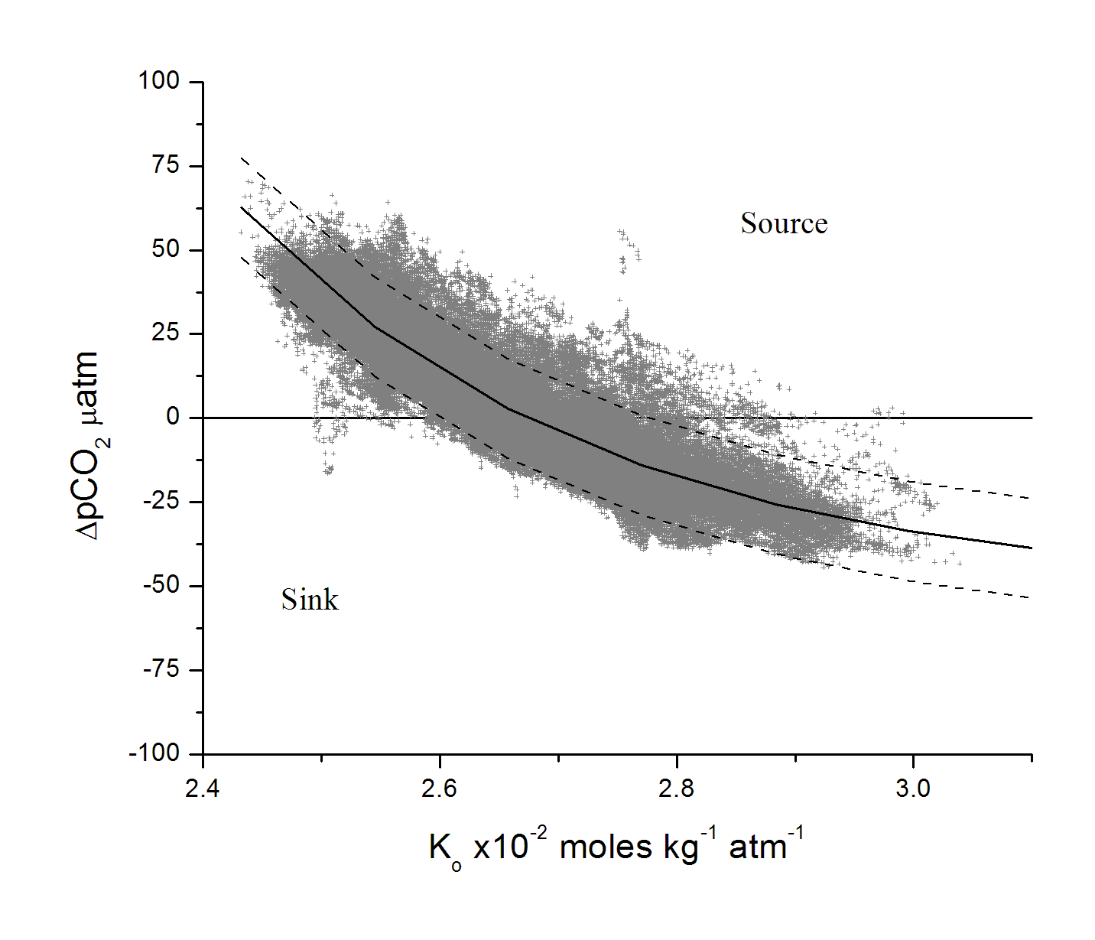
pCO_{2,sw} Model
Continuous and high resolution pCO_{2,sw}
Primarily oligotrophic surface waters
r² = 0.85, RMSD = 7.2 µatm, n=314395
* CO₂ gas solubility (K₀) calculated according to Weiss, 1974

Slide 15
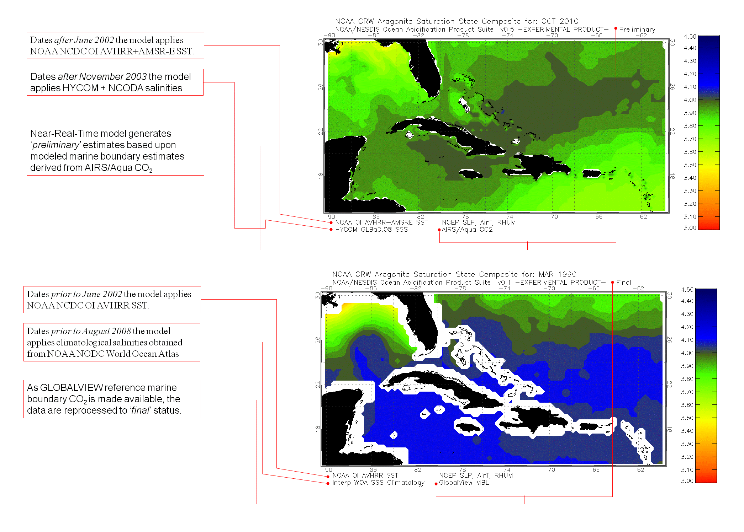

Slide 16
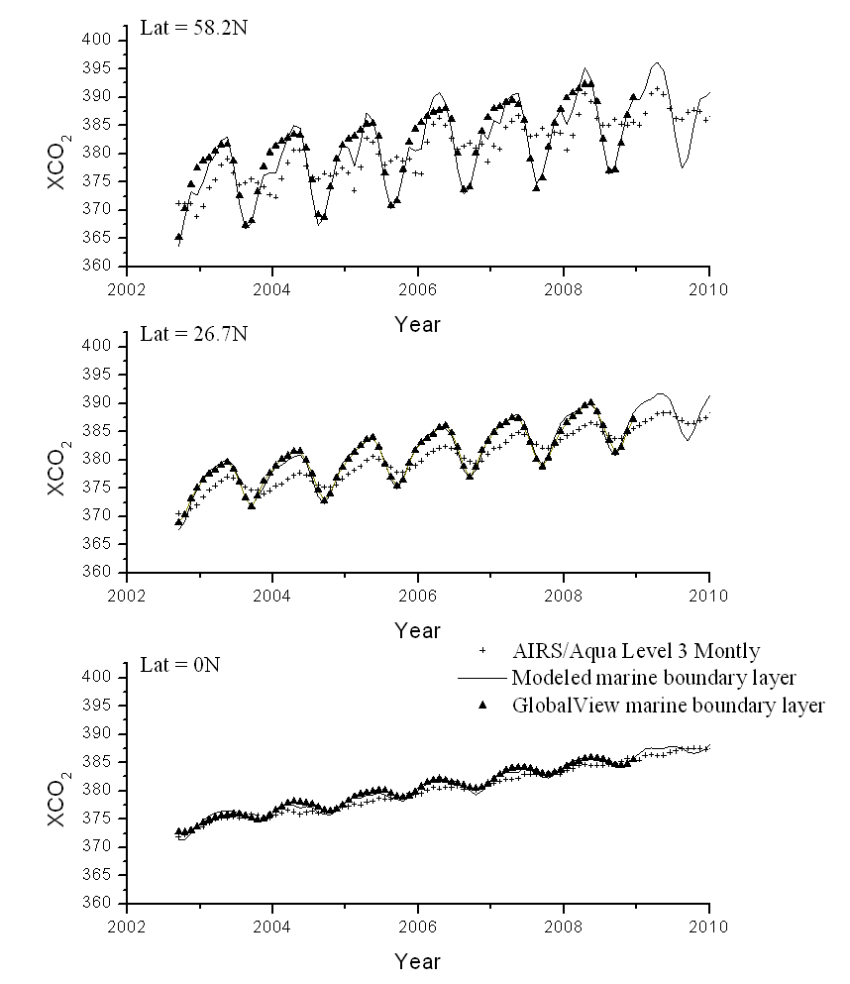
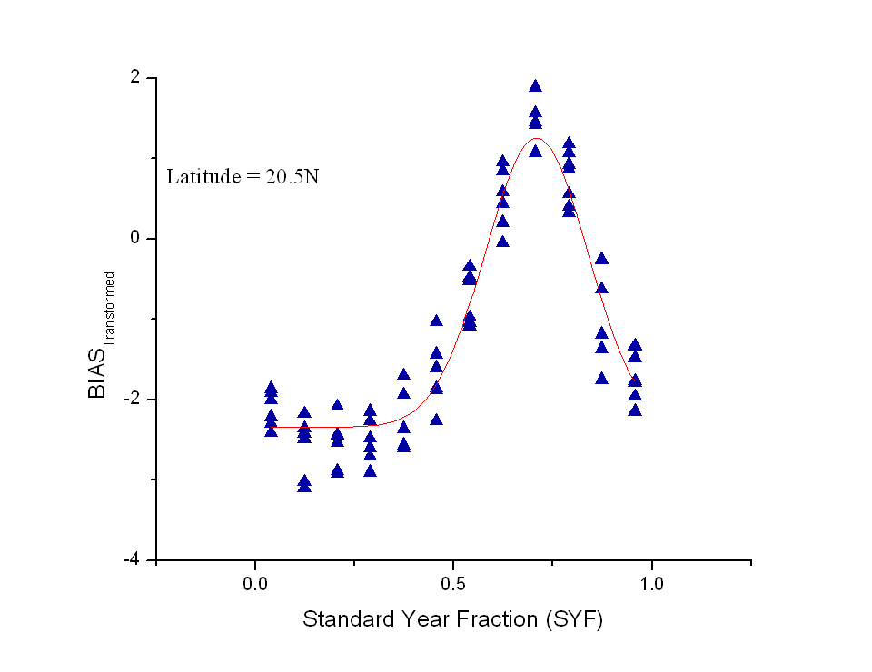
AIRS/Aqua Marine Boundary xCO₂ Estimates
For 'preliminary' estimates of atmospheric CO₂ mole fraction data (XCO₂) the model estimates the marine boundary layer based upon AIRS/Aqua Level 3 mid-tropospheric CO₂. Shown here is the bias between the GVMBL and AIRS/Aqua CO₂(2003-2009) modeled as a function of year fraction at 20.5N.

Slide 17
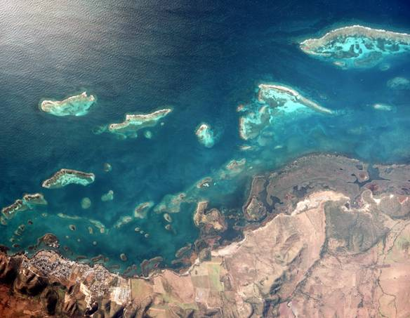
Overall Guiding Questions….
Hypothesis 1. Rates and magnitude of OA will vary across time, space, and depth as a consequence of local and regional geochemical, hydrological, and biological mechanisms.
Ocean Acidification Product Suite v0.6
The OAPS offers monthly synthesis of satellite and modeled environmental datasets to provide a synoptic estimate of sea surface carbonate chemistry in the Greater Caribbean Region. Currently, carbonate mineral saturation state is decreasing across the region at a rate of about 3% per decade and exhibits considerable spatial and seasonal variability.
CRCP Atlantic OA Test-bed
http://coralreefwatch.noaa.gov/satellite/current/experimental_products.html
Dwight Gledhill,Wanninkhof, Pierrot, Eakin, Liu
La Parguera Marine Reserve, PR
Gledhill, D. K., R. Wanninkhof, F. J. Millero, and M. Eakin (2008), Ocean acidification of the Greater Caribbean Region 1996–2006, J. Geophys. Res., 113, C10031, doi:10.1029/2007JC004629.
Gledhill, D, R. Wanninkhof, and M. Eakin (2010) Observing ocean acidification from space, Oceanography 22(4): 48-59.

Slide 18






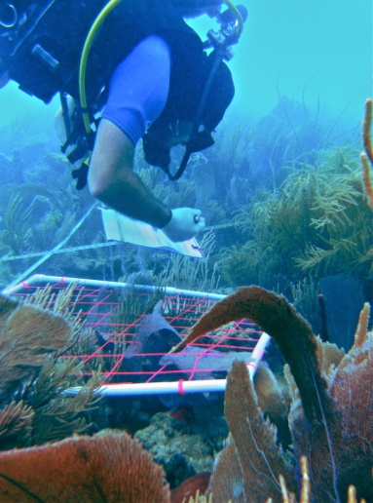



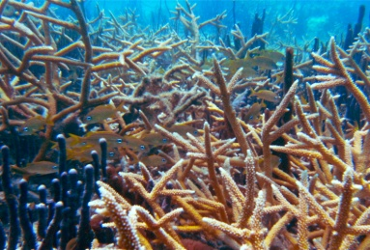
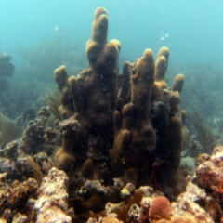
FY09 – Fy11
CRCP Atlantic Ocean Acidification Test-bed
Nexus of federal and academic monitoring and research exploring the dynamics of Atlantic tropical coral reef carbonate chemistry, ecosystem response and feedback.
Atlantic Ocean Acidification Test-bed (FY09 – FY11)
Gledhill, Langdon, Corredor, Sabine, McGillis, Piniak, Moyer, Manzello, Enochs, Loose, et al.
Provide data rich observing environment offering a means to model CO2SYS dynamics while leveraging the support of field process investigations.
3 year high-resolution CO2SYS time-series, intercomparison and development of advanced techniques to monitoring coral reef community metabolism
Carbonate budgets, community characterization and metabolism, coral growth, bioerosion studies
La Parguera, Puerto Rico

Slide 19
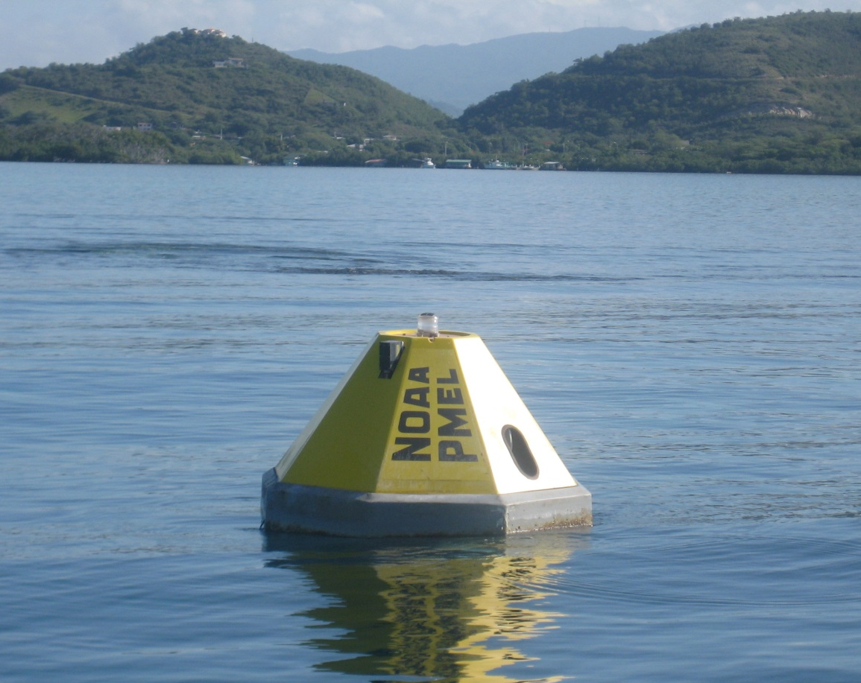
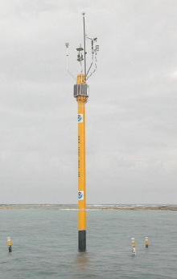
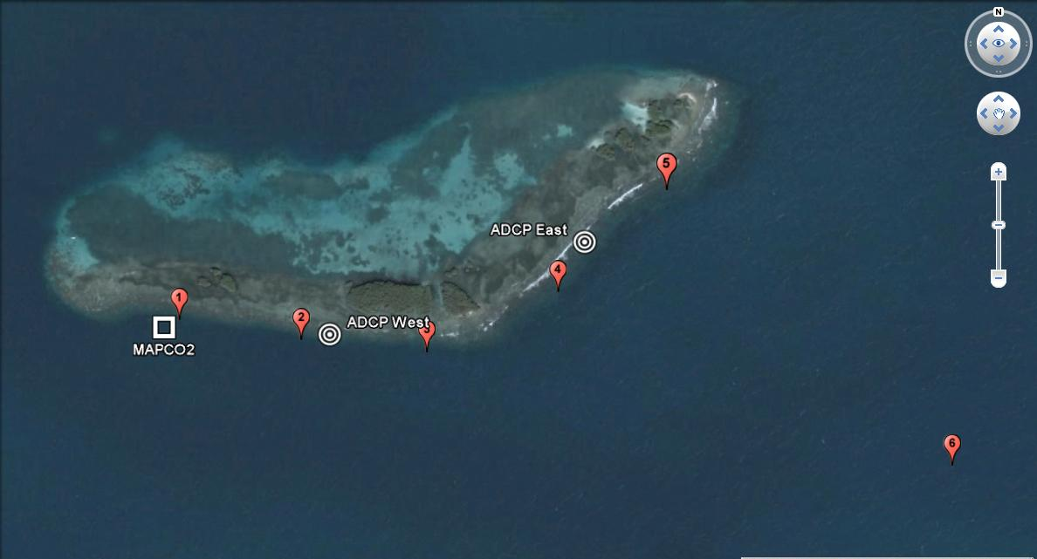
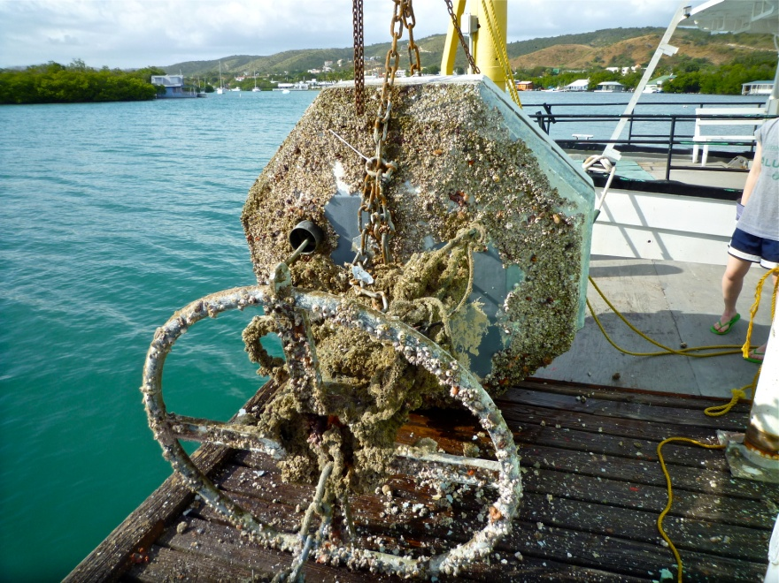
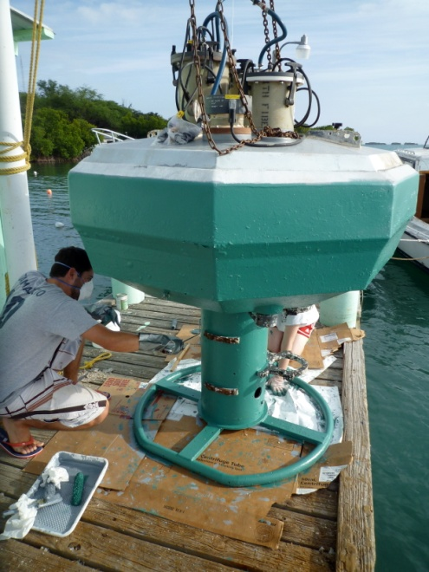
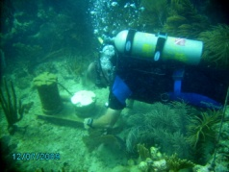

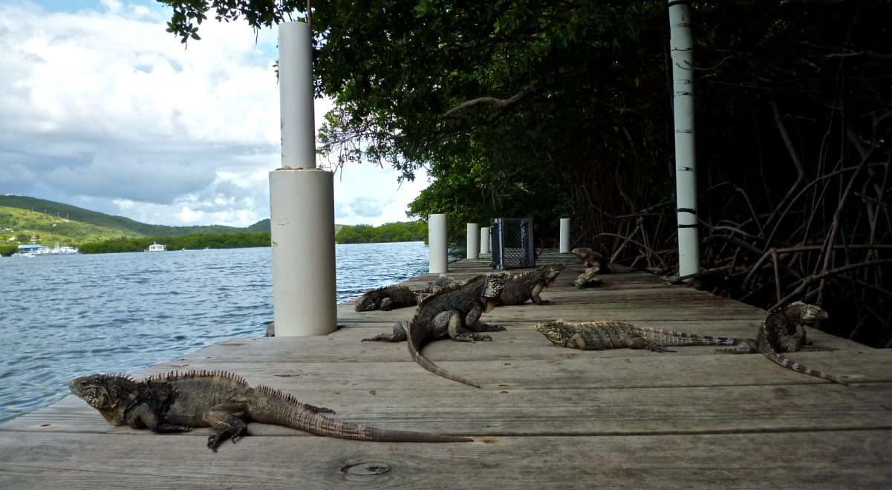
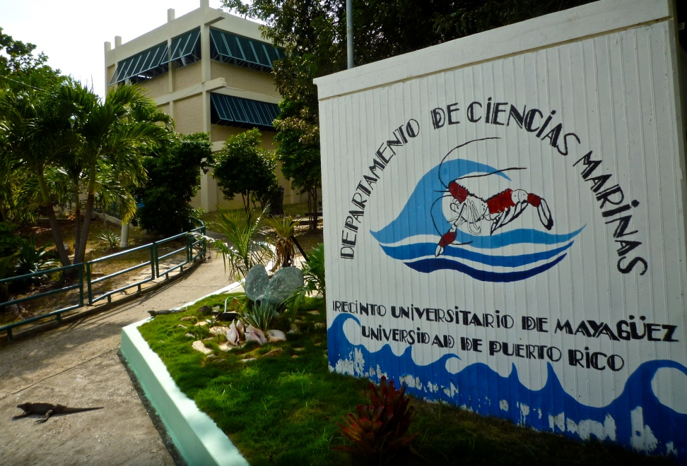
AOAT Time-Series Observation
FY09 – Fy11
Moored Autonomous pCO₂
USGS ADCP’s
CHAMP ICON LPPR1
Prevailing unidirectional flow takes approx. 1 day to traverse the forereef
(2010 only)
UPRM Discrete Data

Slide 20
AOAT Derived Quantities
FY09 – Fy11
Total Alkalinity (TA) derived from CTD 3 hrly measurements according to
 | S>35 | S<35
TA’ | 2299 | 2258
S’ | 35.7 | 34.8
T’ | 28.6 | 30.0
b | 105±10, p <0.001 | -49±64, p =0.46
c | -7±20, p =0.7 | -119±144, p =0.42
d | -10±3, p <0.001 | -33±13, p =0.03
e | -3±2, p =0.05 | -14±12, p =0.28

Slide 21

AOAT Derived Quantities
FY09 – Fy11
Pairing MApCO₂ pCO_{2,sw} values with derived TA permits us to solve for the CO₂SYS
MApCO_{2,sw} derived Ω_{arg}-values compare well to quantities derived from pairing discrete pH and TA

Slide 22
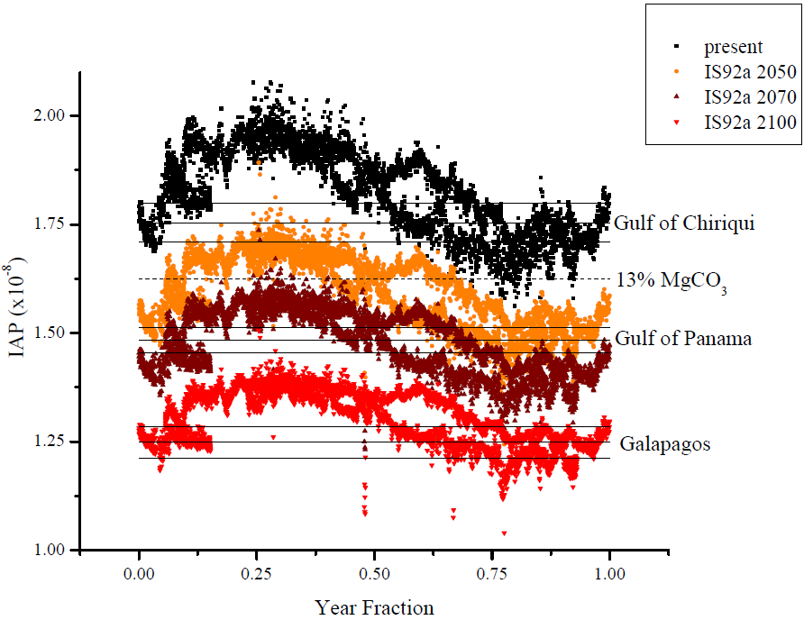
AOAT Time-Series Projections
FY09 – Fy11

Slide 23
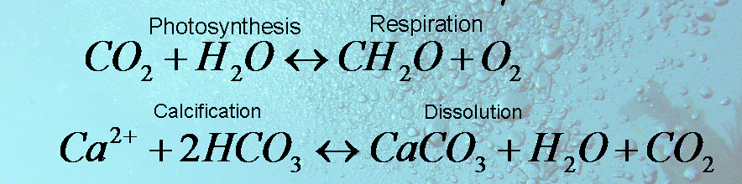
AOAT Time-Series Observation
FY09 – Fy11
Overall Guiding Questions….
Hypothesis 1. Rates and magnitude of OA will vary across time, space, and depth as a consequence of local and regional geochemical, hydrological, and biological mechanisms.
-

Slide 24





AOAT Targeted Process Studies
FY09 – Fy11
Fy11
To elicit the primary controls on local Ω dynamics, a multi-agency, -intuitional team of investigators engaged a broad suite of techniques to quantify community net P, R, G and D.
P,R
G
D
growth
Community

Slide 25




Benthic Community Characterization
FY09 – Fy11
Cayo Enrique
El Paulo
San Cristobal
Different benthic communities may impart dissimilar influences on local chemistry and may change over time. Therefore, the study has targeted three sites within the La Parguera Marine Reserve whereby the communities have been carefully characterized and tracked seasonally in tandem with the biogeochemistry efforts. The Cayo Enrique and San Cristobal sites are both coral reef habitats, though they differ in reef structure and coral community composition. Cayo Enrique had the greatest amount of calcifying and metabolically active organisms that would affect the water chemistry.

Slide 26



Benthic Community Metabolism
FY09 – Fy11
Boundary Layer Gradient Flux (GF) Technique
Modular Acoustic Velocity Sensor (MAVS)
R = Rate (mmol m⁻² hr⁻¹
ρ = density (km m⁻³)
u* = friction velocity (m sec⁻¹)
ĸ = Kármán contant (0.41)
C = concentration (mmol kg⁻¹)
Acoustic Doppler Velocimeter (ADV)
U = instant. velocity
z = m (above seafloor)
McGillis, Langdon, Loose, Yates, and Corredor (2011) Productivity of a coral reef using boundary layer and enclosure methods. GRL, Vol. 38

Slide 27

Benthic Community Metabolism
FY09 – Fy11
Boundary Layer Gradient Flux (GF) Technique
R = Rate (mmol m⁻² hr⁻¹
ρ = density (km m⁻³)
u* = friction velocity (m sec⁻¹)
ĸ = Kármán contant (0.41)
C = concentration (mmol kg⁻¹)
Aanderaa O₂ optode
Aanderaa O₂ optode
McGillis, Langdon, Loose, Yates, and Corredor (2011) Productivity of a coral reef using boundary layer and enclosure methods. GRL, Vol. 38

Slide 28
Benthic Community Metabolism
FY09 – Fy11
Boundary Layer Gradient Flux (GF) Technique
-PRLIMINARY-

Slide 29


Benthic Community Metabolism
FY09 – Fy11
Boundary Layer Gradient Flux (GF) Technique
R = Rate (mmol m⁻² hr⁻¹
ρ = density (km m⁻³)
u* = friction velocity (m sec⁻¹)
ĸ = Kármán contant (0.41)
C = concentration (mmol kg⁻¹)
Pumped Integrated Samples

Slide 30

Benthic Community Metabolism
FY09 – Fy11
Boundary Layer Gradient Flux (GF) Technique
Cayo Enqrique
January 2010
-PRLIMINARY-

Slide 31

Benthic Community Metabolism
FY09 – Fy11
Boundary Layer Gradient Flux (GF) Technique
Cayo Enqrique
January 2011
-PRLIMINARY-

Slide 32


Sediment Dissolution
FY09 – Fy11
R_{D}= 0.19 mmol m⁻² h⁻¹
Melissa Meléndez Oyola, UPRM
-PRLIMINARY-

Slide 33

Coral Growth
FY09 – Fy11
Overall Guiding Questions….
Hypothesis 2. OA will change ecosystem structure and function.
Hypothesis 3. Heterogeneity in species-specific responses, local secondary environmental factors and regional considerations will confer a broad range of vulnerabilities that differ both locally and regionally among marine ecosystems.
Buoyant weight method (Manzello, Enochs)
W_{w},W_{a} = weight (buoyant, dry)
D_{w},D_{a} = density (water, skeletal)
Laser micrometer - Langdon

Slide 34





Intercomparisons & Add-on’s
FY09 – Fy11
Submersible Habitat for Analyzing Reef Quality (SHARQ) – Yates, USGS
Small Craft pCO_{2,sw} – Langdon, UM/ McGillis, CICAR
Dissolved Org. Carbon – Moyer, USGS
Lagrangian drogued drifter – Bernstein, WHOI

Slide 35
NOAA Coral Reef Conservation Program
National Coral Reef Monitoring Plan
FY12 –
Benthic Community
Physiochemical
Human dimension
Pelagic Community
Tier 1
1) The frequency, intensity, and spatial distributions of thermal stress events influencing the Nation’s shallow water coral reefs (0-30 m), measured both regionally and at sub-jurisdictional scales, and
2) The rates, magnitude, and spatial distributions of ocean acidification within the Nation’s coral reef environments.
Status & Trends

Slide 36


NOAA Coral Reef Conservation Program
National Coral Reef Monitoring Plan
FY12 –
Climate and Ocean Acidification Implementation Schedule.

Slide 37
NCRMP/AOAT
FY12 –
NCRMP
AOAT
Tier 1 Observations
  Thermal Stress
    Temp. Arrays
  Ocean Acidification
    MA_{p}CO2
    Auto-sampler Deployments
    Spatial Discrete Sampling
Technology/Technique Development
Process Investigations
Hydodynamic’s
Multi-agency Field Laboratory
Biogeochemical Model
‘Risk/vulnerability’ Mapping

Slide 38
Overall Guiding Questions….
Hypothesis 1. Rates and magnitude of OA will vary across time, space, and depth as a consequence of local and regional geochemical, hydrological, and biological mechanisms.
Ocean Acidification Product Suite v0.6
Florida Keys
The OAPS offers monthly synthesis of satellite and modeled environmental datasets to provide a synoptic estimate of sea surface carbonate chemistry in the Greater Caribbean Region. Currently, carbonate mineral saturation state is decreasing across the region at a rate of about 3% per decade and exhibits considerable spatial and seasonal variability.
Caribbean Sea
http://coralreefwatch.noaa.gov/satellite/current/experimental_products.html
Dwight Gledhill,Wanninkhof, Pierrot, Eakin, Liu
Gledhill, D. K., R. Wanninkhof, F. J. Millero, and M. Eakin (2008), Ocean acidification of the Greater Caribbean Region 1996–2006, J. Geophys. Res., 113, C10031, doi:10.1029/2007JC004629.
Gledhill, D, R. Wanninkhof, and M. Eakin (2010) Observing ocean acidification from space, Oceanography 22(4): 48-59.

Slide 39


Pre-NCRMP/AOAT FY12 FLKYS
FY12 –
Phase 1 – Site Selection
Mid/upper FLKEY
‘Typical’ Reef system
Engineering Limits
Scientific Criteria
Max Leverage

Slide 40



Pre-NCRMP/AOAT FY12 FLKYS
FY12 –
Submersible Habitat for Analyzing Reef Quality (SHARQ) – Yates, USGS
Project Investigators
Principle Investigator
Dwight Gledhill (AOML
Community Metabolic Measurements
Chris Langdon (RSMAS)
Wade McGillis (CICAR)
Brice Loose (WHOI)
et al.
Hydrodyn. Control Volume
Lew Gramer
Coral Growth/Bioerosion
Derek Manzello (AOML/CIMAS)
Ian Enochs (AOML/CIMAS)
Community Characterization
Ryan Moyer (USGS)
Autonomous Time-series
Chris Sabine (PMEL)
Sylvia Musielewicz (PMEL)
Noah Lawrence-Slavas (PMEL)
Nutrients
Jia-Zhong Zhang
Multiparameter Inorganic Carbon Analyzer (MICA) - Bob Byrne (USF)
Demonstration test of the LRI Waveglider
Coral recruitment & OA – Miller (SEFCS)

Slide 41


Thanks
Coral Reef Conservation Program
Ocean Acidification Program
NASA Earth Science Enterprise

