Slide 1
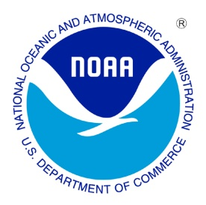
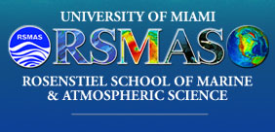
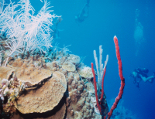
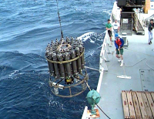
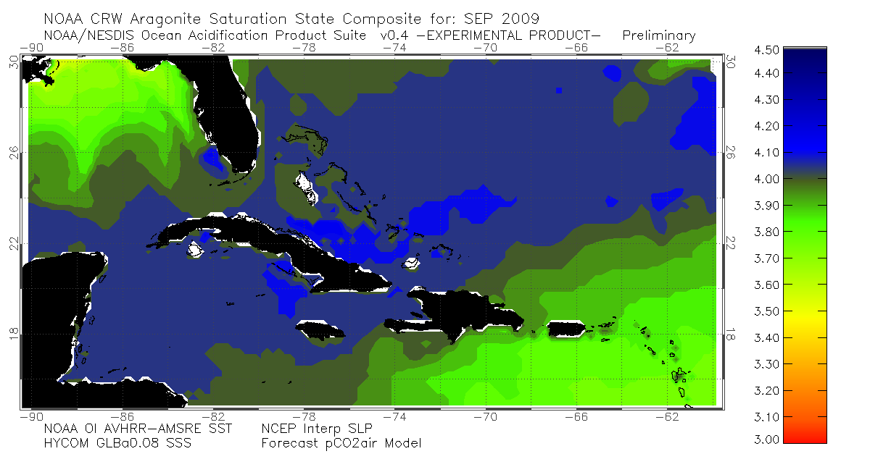
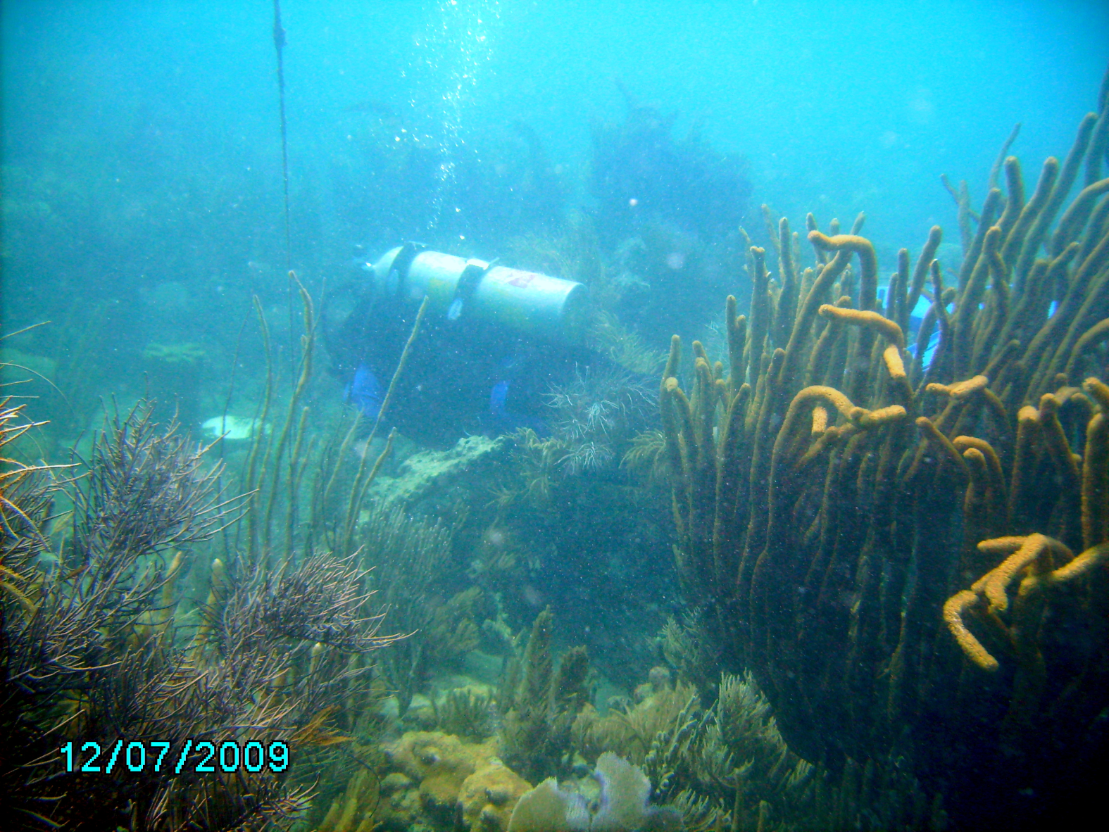
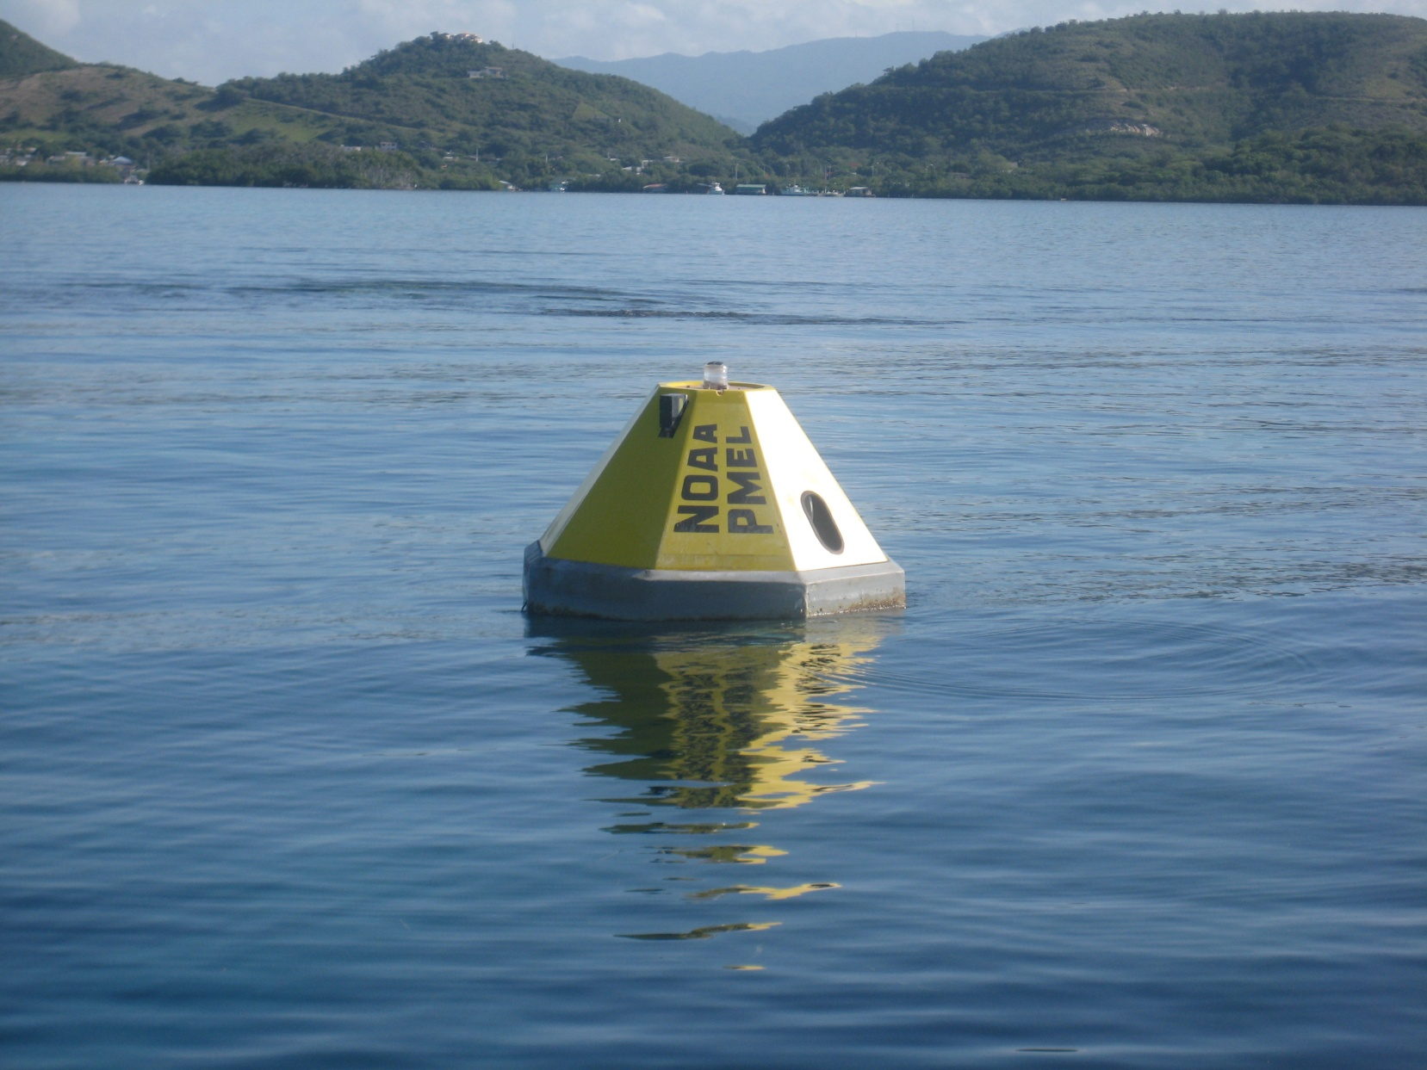
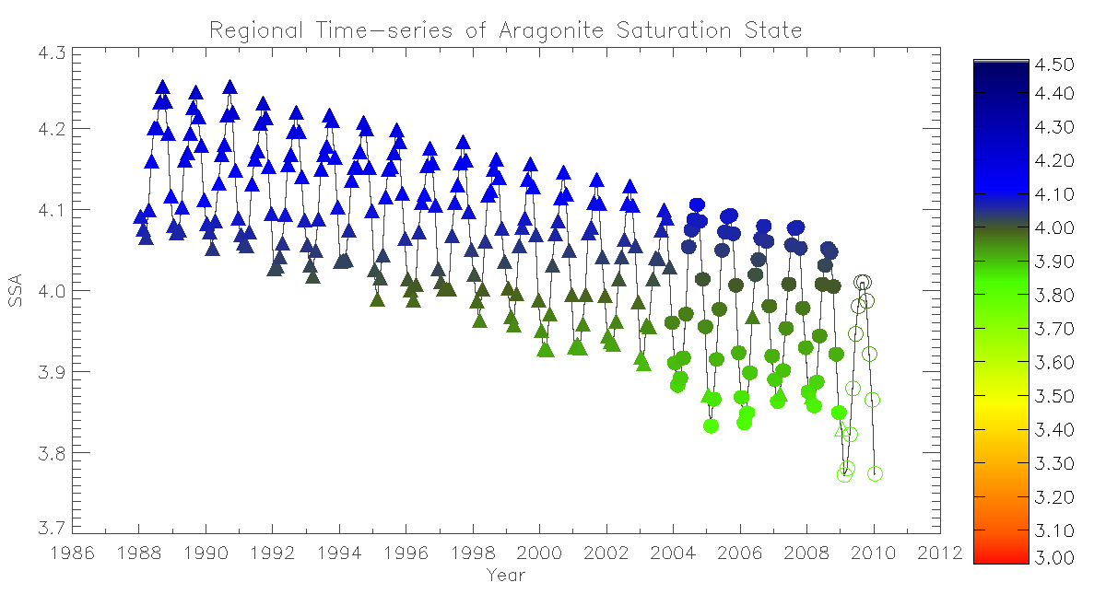
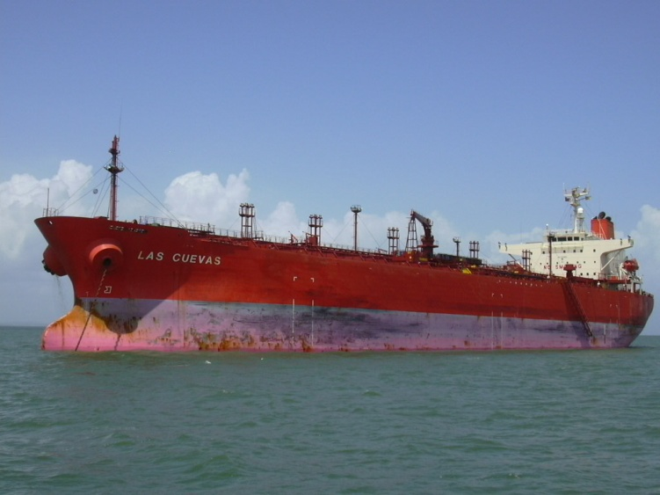
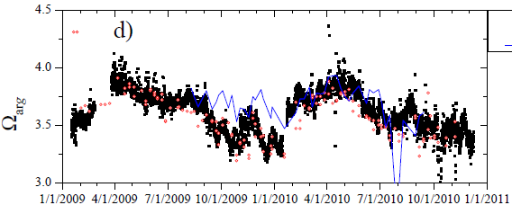
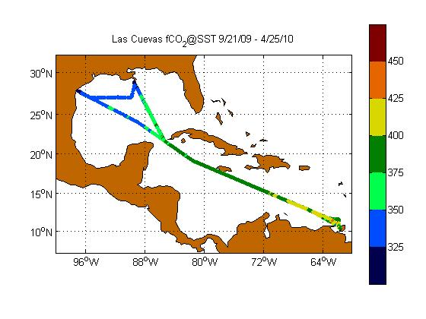
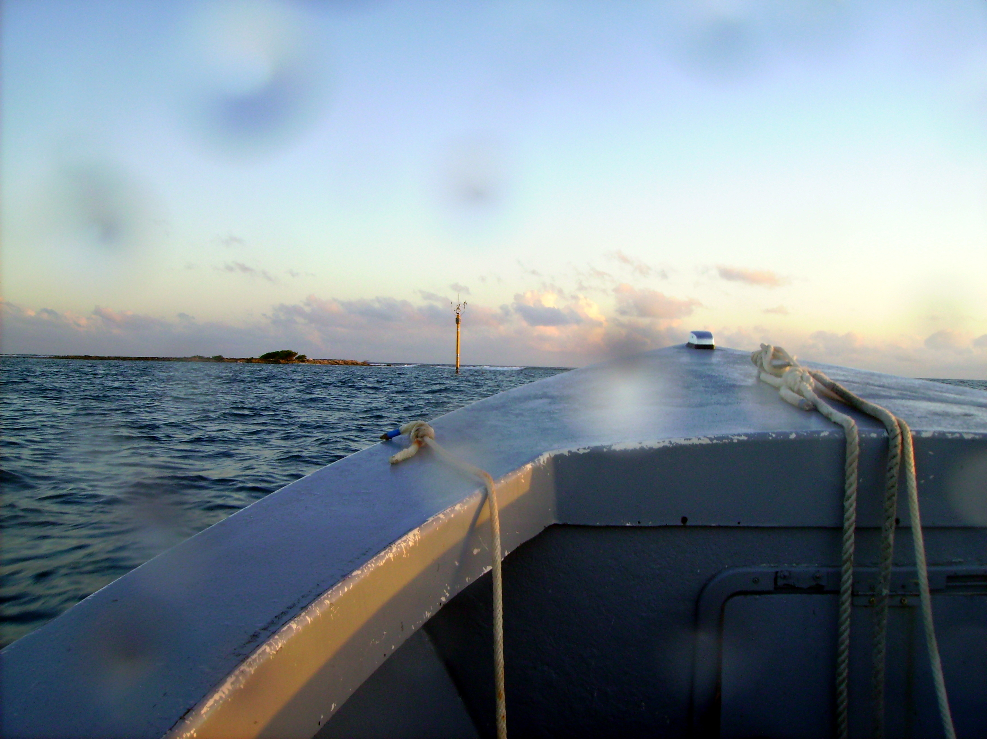
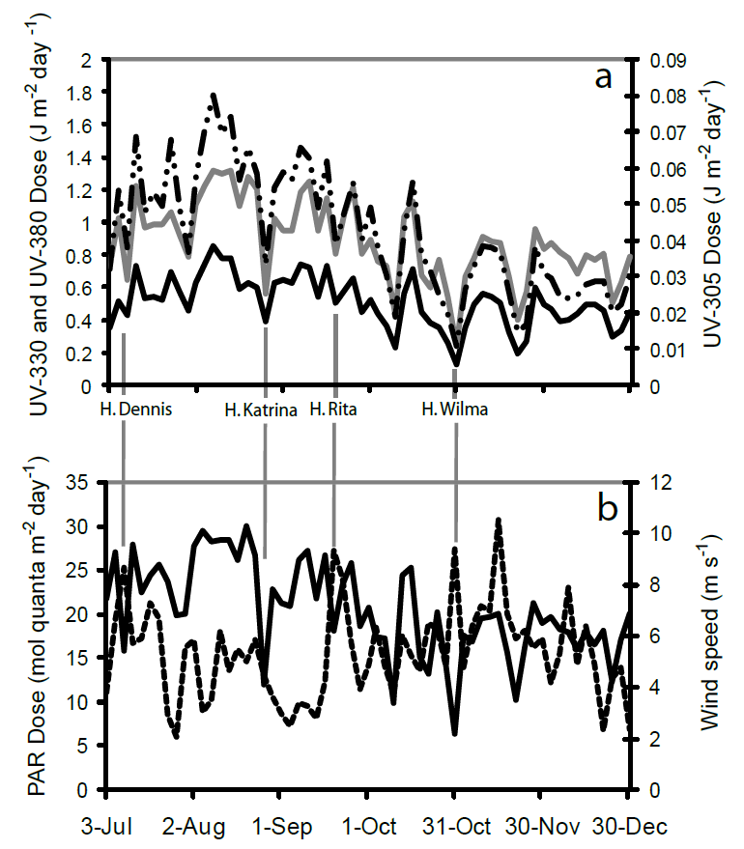
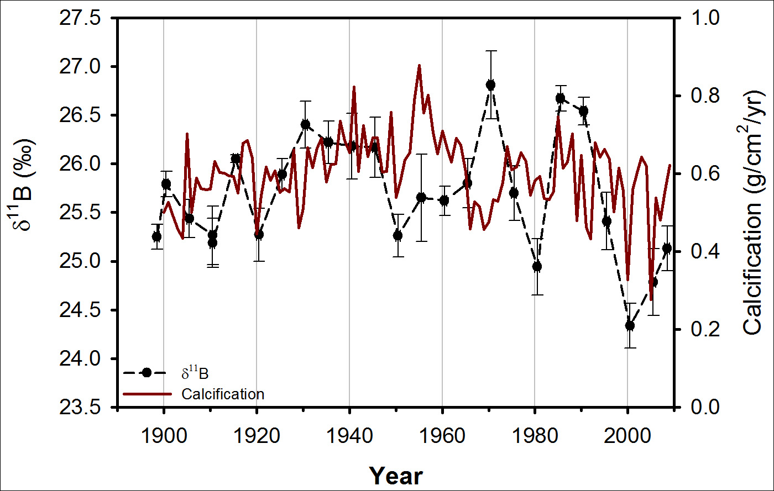
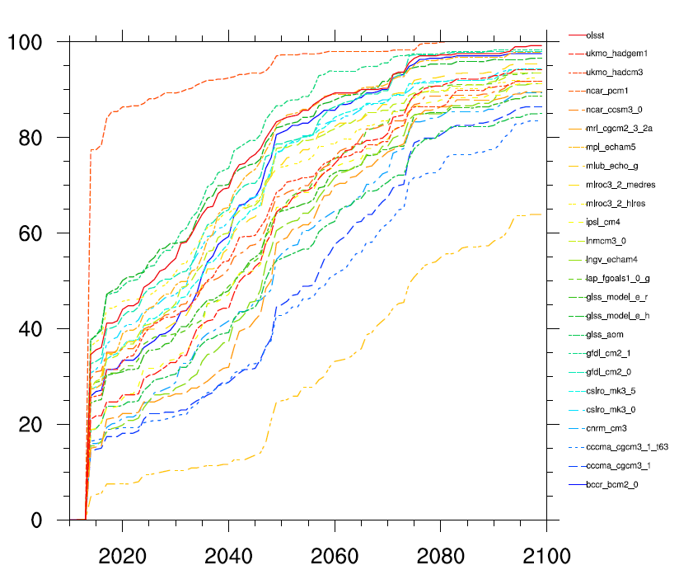
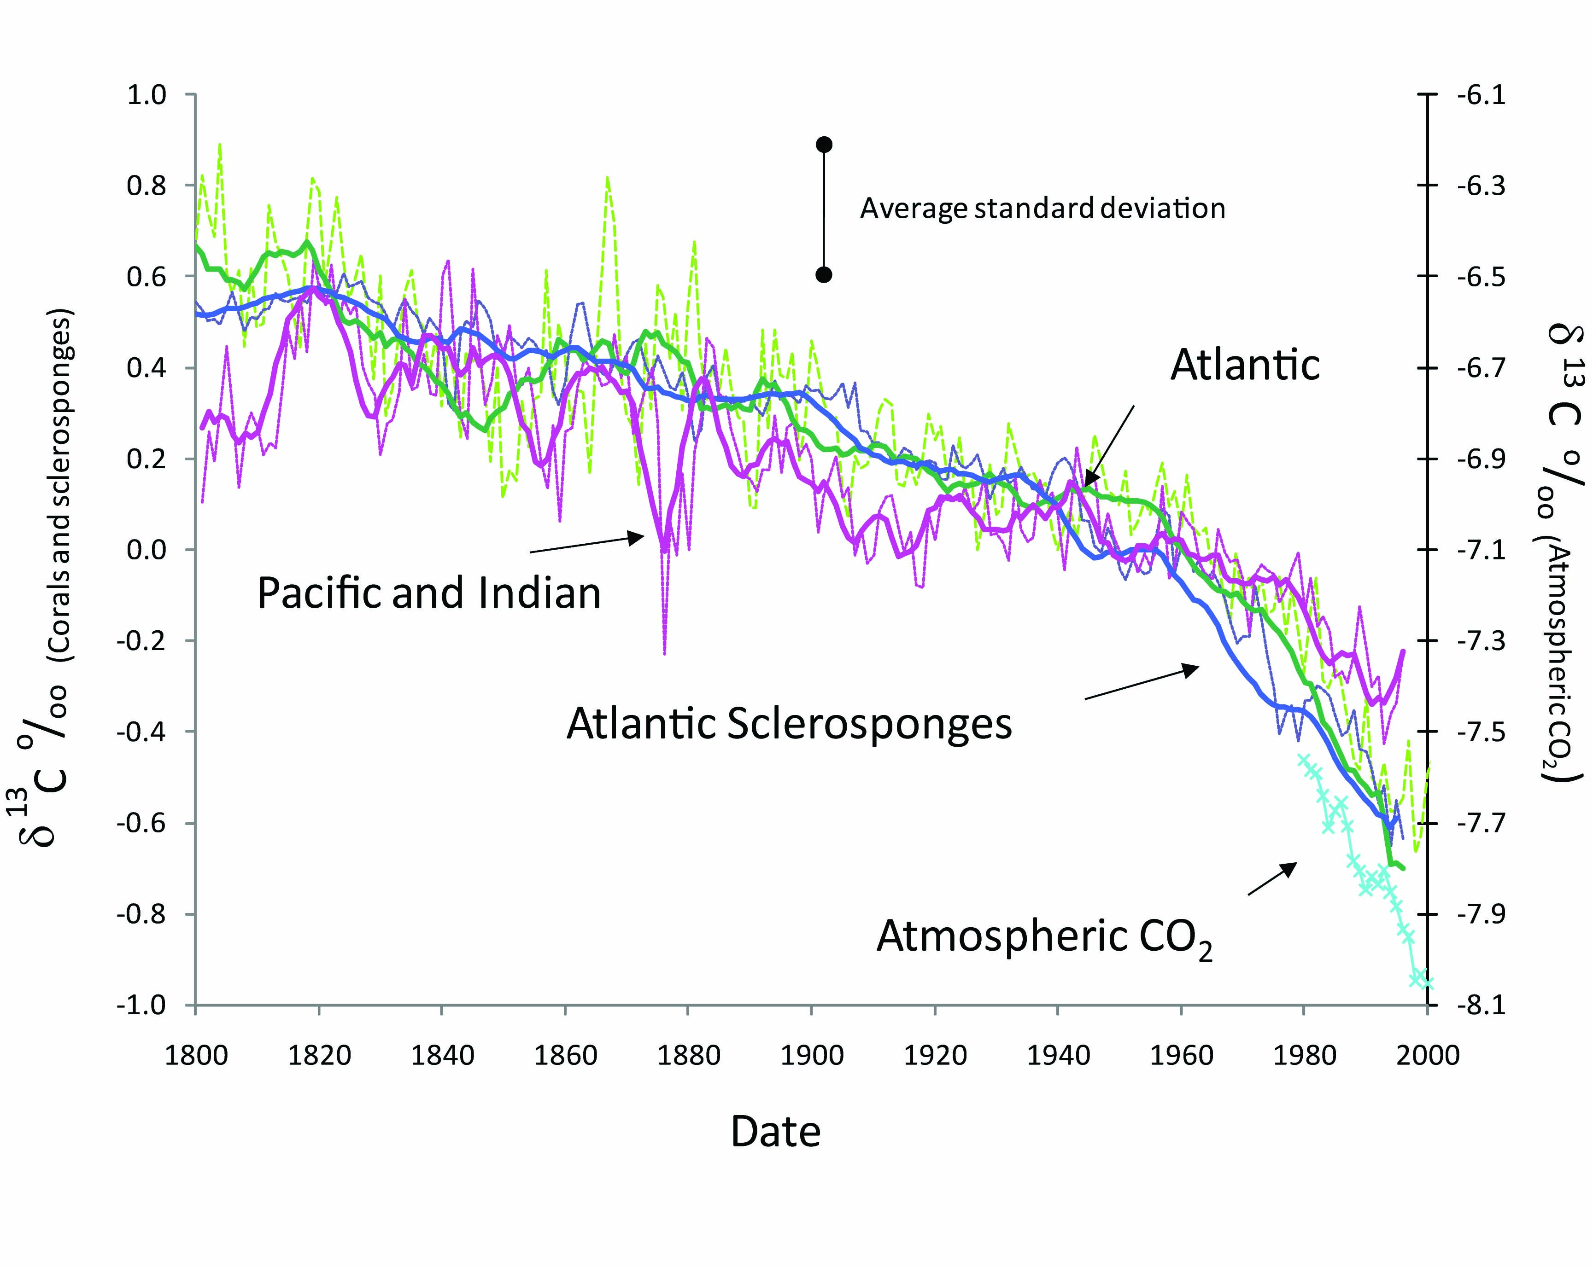
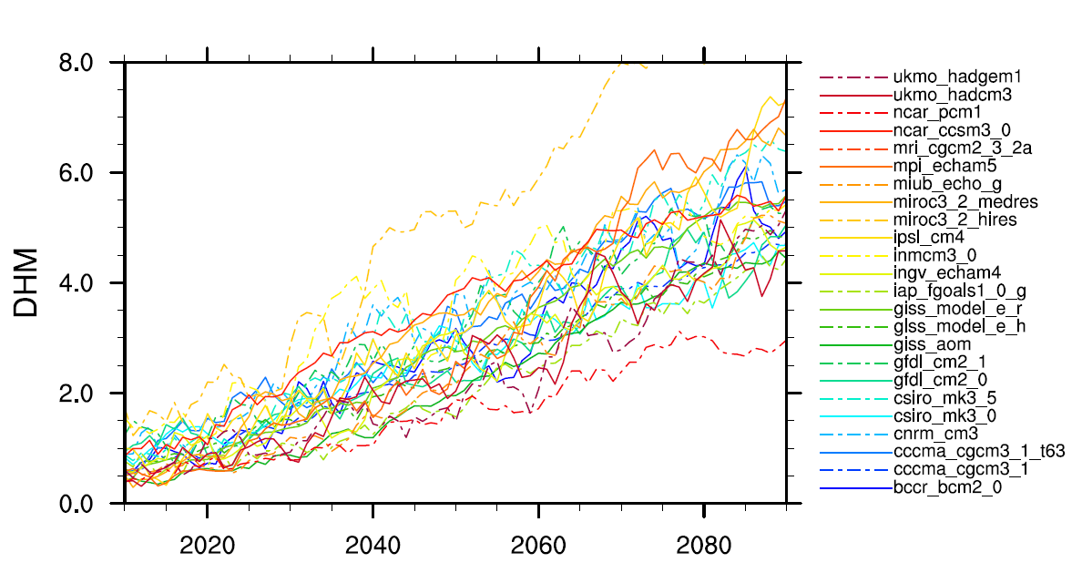
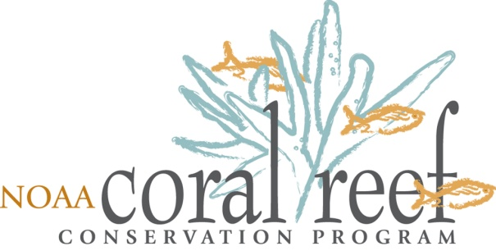
Integrated Assessment of Ocean Acidification within Coral Reef Ecosystems
D.K. Gledhill^{1,2}, Kevin Helmle^{1,3}, Ruben van Hooidonk¹, Jim Hendee¹, Derek Manzello^{1,2}, Rik Wanninkhof¹.
¹Atlantic Oceanographic and Meteorological Laboratory, National Oceanic and Atmospheric Administration, 4301 Rickenbacker Causeway, Miami, FL 33149;
²Rosenstiel School, University of Miami, 2600, Rickenbacker Causeway, Miami, FL 33149
INTRODUCTION
Ocean acidification (OA) describes the secular global-scale changes in surface ocean carbonate chemistry in response to oceanic uptake of rising concentrations of atmospheric CO2. Increasing rates of OA in coming decades could alter coral reef communities in a number of ways including changes in carbonate budgets, community structure and function. Most of these concerns have emerged solely from laboratory investigations under simplified carbonate chemistry regimes. Relatively few field studies have been conducted to adequately characterize the spatiotemporal dynamics of carbonate chemistry within reef waters nor investigated how this variability interacts with the fundamental processes of reef construction and breakdown.
The National Oceanic and Atmospheric Administration’s (NOAA) Atlantic Oceanographic and Meteorological Laboratory (AOML) is actively engaged in monitoring the progression of OA from regional to local-scales and evaluating the effects on coral reef growth and persistence within select coral reefs of Puerto Rico and the Florida Reef Tract. AOML researchers are utilizing an integrated and holistic approach that includes in situ synoptic near-real-time monitoring of reef carbonate chemistry, historical and recent measurements of coral calcification, and investigation of the processes that control the persistence of reef framework structures, such as inorganic cementation, bioerosion, and the community feedbacks to local carbonate chemistry. These studies will help elucidate the potential vulnerability of coral reef ecosystems in a high-CO₂ world by documenting rates of OA, its affects, and the local feedback processes within the real-world.
NOAA AOML/OCD
The Ocean Chemistry Division (OCD) is one of the three scientific research divisions within the Atlantic Oceanographic and Meteorological Laboratory (AOML). The diverse Ocean Chemistry Division scientific staff is comprised not only of chemical oceanographers and atmospheric chemists but also biological and physical oceanographers. OCD typically employs multi-disciplinary approaches to solve scientific research questions central to the National Oceanic and Atmospheric Administration (NOAA) mission requirements. The division's research includes projects that are important both in enhancing our basic understanding of the coupled atmospheric/ocean system but also in assessing the current and future effects of human activities on the coastal and oceanic environments
Modeling Regional Changes
Monitoring Local Processes
Historical Indicators/Effects
Ocean Acidification within the Greater Caribbean Region
The OAPS offers monthly synthesis of satellite and modeled environmental datasets to provide a synoptic estimate of sea surface carbonate chemistry in the Greater Caribbean Region. Carbonate mineral saturation states have declined in tropical oceanic waters by more than 20% over the industrial period. Currently, carbonate mineral saturation states are decreasing across the region at a rate of about 3% per decade and exhibits considerable spatial and seasonal variability.
MAPCO2
Current Capabilities:
Moored Autonomous pCO2 (MAPCO2) Buoy – [pCO2,sw, pCO2,air ,O2]
Coral Reef Early Warning System (CREWS) Station – [Temp, Salinity, PAR, UV, Wind, Rain, ect..]
UPRM Discrete Sampling Transects (weekly) – [Total Alkalinity, Spec. pH]
ADCP’s – [current u,v,z]
Atlantic OA Test-bed
The Atlantic Ocean Acidification test-bed (AOAT) in La Parguera, PR is an on-going project advanced by the NOAA Coral Reef Conservation Program. This joint effort by NOAA, the University of Miami/RSMAS (Rosenstiel School of Marine and Atmospheric Science) and the University of Puerto Rico Mayagüez (UPRM) has sought to serve as a nexus of federal and academic monitoring and research related to assessing the impacts of ocean acidification on coral reef ecosystems since 2008.
Carbonate cements within the pore spaces of corals from areas with naturally different CO₂ levels. The Galapagos sample (where seawater is similar to what is expected for the rest of the tropics with a tripling of atmospheric CO₂) contains no cement. The absence of cement is evidenced by a clearly defined boundary between the inner skeletal wall and open pore space. This is contrary to the sample from the Bahamas (where seawater has very low CO₂ levels) — the boundary between the skeletal wall and pore space is blurred by the abundance of cements. Minor amounts of cement are present from the intermediate CO₂ environment from Pacific Panama, but these are still trivial relative to the Bahamas. From Manzello et al. (2008).
Mean maximum coral reef framework thickness (m, ±Std. error) from eastern tropical Pacific relative to the saturation state of aragonite, Ωarag. Estimated values of Ωarag for average tropical surface ocean as a function of differing levels of atmospheric CO2 shown in red. Figure from Manzello (2009).
Las Cuevas
Regular autonomous transects are now being conducted through the Caribbean Sea and GOM.
AOML Gobal Carbon Cycle CO2 program
NOAA AOML currently oversees the deployment, maintenance and data management of several ship-board autonomous CO2 analyzers which track the uptake of CO2 into the surface oceans. These datasets subsequently serve as the basis for synoptic models such as the OAPS which tracks the rate and seasonal dynamics of OA.
ICON/CREWS
Puerto Rico coral δ¹¹B (proxy pH) and calcification since 1900 Corals possess proxy environmental records of seawater pH through skeletal boron isotope ratios. Coral growth and calcification rates are recorded through the presence of annual density bands. These records are used to identify change is seawater pH over past centuries along with the impacts on coral growth and calcification rates.
Increase in pH
OA in Context
Acidification does not occur in isolation and it is critical to understand its effects within the context of a changing climate (e.g. thermal stress, sea-level, stratification and nutrient availability, storm intensity) and direct human impacts (over fishing, land-based pollution, etc.). Sea surface temperature data from coupled ocean-atmosphere general circulation models is used in combination with records of observed bleaching to create and verify thermal thresholds above which coral bleaching is likely. Multiple climate models are analyzed and to
improve robustness of predictions.
Decrease in pH
Light and wind time-series from Bahamas ICON stations a Daily dose of UV-305 nm (dashed line), UV-330 nm (black line) and UV-380 nm (gray line) at 1 m. b Daily dose of PAR (400–700 nm, solid line) and daily average wind speed (m s-1, dashed
line). Time-series were smoothed by plotting the running 3-day mean.
Boron data courtesy of R.P. Moyer
Global mean Degree Heating Months (DHM), a measure of thermal stress,
for the Great Barrier Reef from 2005 to 2095 calculated from 22
unaltered GCMs present in the SRES A1B scenario smoothed with a 5 year
running average.
ICON/CREWS Network
The growing ICON network is currently comprised of stations in St. Croix, U.S. Virgin Islands; La Parguera, Puerto Rico; Little Cayman Island, Cayman Islands; Lee Stocking Island, Bahamas; and Saipan, CNMI (in 2010-2011). New stations, including in Belize, are planned for the Caribbean through collaboration with the Caribbean Community Climate Change Center. The stations are designed to deliver hourly measurements of important meteorological and oceanographic variables and will eventually serve to establish longterm databases at the world’s most threatened and important coral reef areas
Anthropogenic CO₂ The accelerating decrease in δ¹³C of coral skeletons towards present is attributed to the input of anthropogenically derived CO2. The coral δ¹³C in the Atlantic, where storage capacity/uptake is larger, corresponds with the lighter δ¹³C of atmospheric CO2 driven by the burning of fossil fuels.
Percentage of reef cells predicted to experience at least two
bleaching episodes (a threshold considered lethal) in the preceding
decade. Data is from the SRES A1B scenario GFDL CM2.1 model with the
annual cycle replaced with the annual cycles of the other GCMs and
observations (OISST).
For Further Reading See….
1. Gledhill, D.K., Wanninkhof, R., Millero, F.J., Eakin, C.M., 2008. Ocean acidification of the Greater Caribbean Region. J. Geophys. Res. 113, C10031. 2. Gledhill, D, R. Wanninkhof, and M. Eakin (2010) Observing ocean acidification from space, Oceanography 22(4): 48-59. 3. Keul, N., Morse, J. M., Wanninkhof, R., Gledhill, D. K., & Bianchi, T. S., 2010. Carbonate Chemistry Dynamics of Surface Waters in the Northern Gulf of Mexico. Aquatic Geochemistry 16(3):1573-1421. 4. Manzello, D., et al. 2008. Poorly cemented coral reefs of the eastern tropical Pacific: possible insights into reef development in a high-CO2 world. PNAS 105:10450-10455. 5. Manzello, D. 2009. Reef development and resilience to acute (El Niño warming) and chronic (high-CO2) disturbances in the eastern tropical Pacific: a real-world climate change model. Proc. 11th Int. Coral Reef Symp., 1299-1304. 6. Manzello, D. 2010. Coral growth with thermal stress and ocean acidification: Lessons from the eastern tropical Pacific. Coral Reefs 29:749-758. 7. Manzello, D. 2010. Ocean acidification hotspots: Spatiotemporal dynamics of the seawater CO2 system from eastern Pacific coral reefs. Limnol. Oceanogr. 55:239-248. 8. Swart PK, Greer L, Rosenheim BE, Moses CS, Waite AJ, Winter A, Dodge RE, Helmle K (2010) The ¹³C Suess effect in scleractinian corals mirror changes in the anthropogenic CO₂ inventory of the surface oceans. Geophys. Res. Lett. 37: L05604
From Swart et al. 2010

