Slide 1
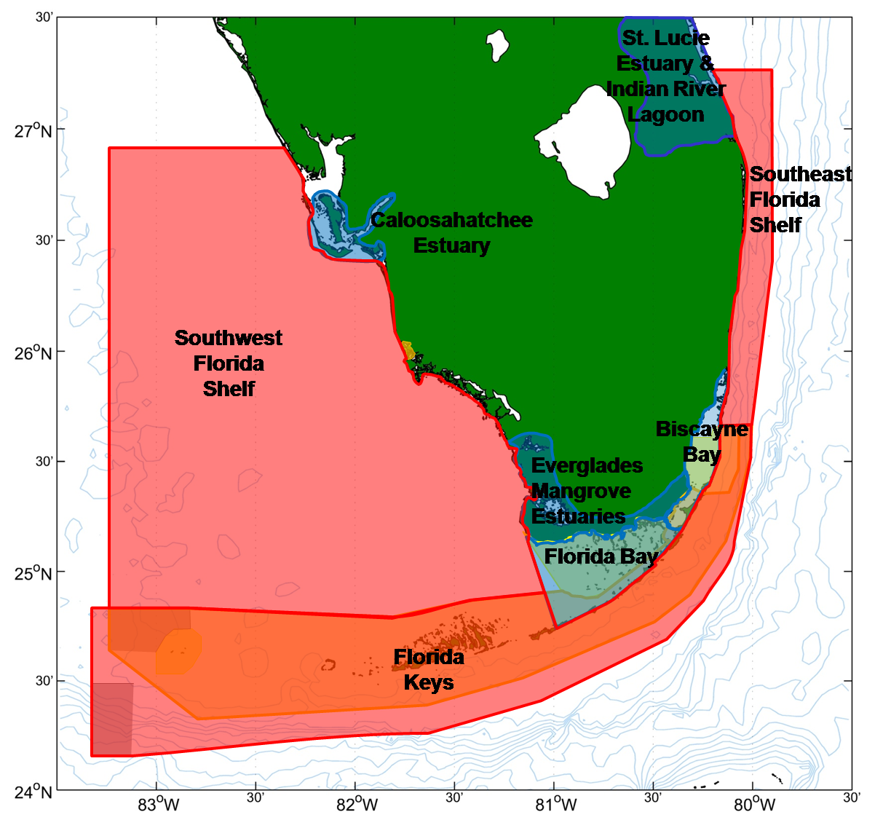
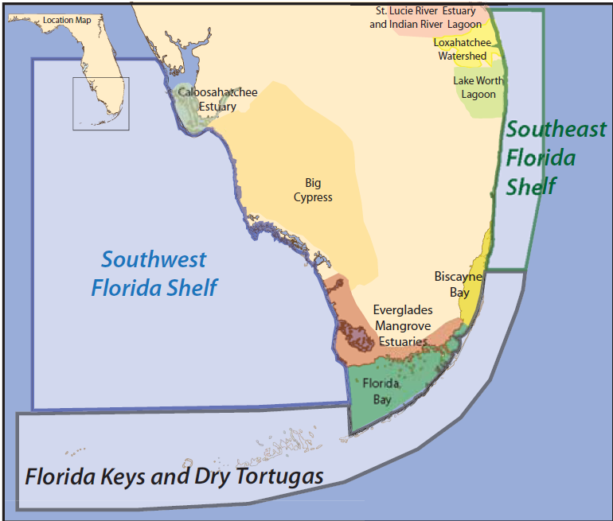

Slide 2
Drivers
Land-based sources of pollution
Contaminant spills
Climate Change - atmosphere
Marine construction
Debris
Invasive species
C.C - storms
Dredging and fill
Stormwater runoff
C.C. – air temperature
Altered shoreline
F.W. – nutrient loads
C.C. – altered rainfall and evap.
Disease
Altered circulation
Damage from boating
Fish harvesting
Climate Change - ocean
Water management
C.C. - Ocean acidification
FW Quantity
Harmful Algae Blooms
Marine debris – ghost traps
FW Timing
Sea level rise
FW Distribution
Damage to bottom
Increased impervious area
Dredging and fill
Altered shoreline
Damage from boating

Slide 3
Florida Keys / Dry Tortugas
Water Column

Slide 4
Southwest Florida Shelf
Water Column

Slide 5
Southeast Florida Coast
Water Column

Slide 6
Attributes that people care about
Southeast Florida Coast
Lots and large variety of fish
Lots and variety of marine wildlife
Seafood safety
Fish and Shellfish
Coral Reef Fisheries Complex:
Greater amberjack
Black grouper
Blue angelfish
French angelfish
Gray angelfish
Gray triggerfish
Great barracuda
Hogfish
Mangrove(gray) snapper
Mutton snapper
Parrotfish
Queen angelfish
Red grouper
Rock beauty
Tomtate
White grunt
Yellowtail snapper
Bonefish
Atlantic tarpon
Attributes we measure
Coral reef complex and sport fish
Spiny lobster and pink shrimp
Population statistics
Catch/yield
Landings
Effort
Altered inshore habitat
Mangroves
Juveniles and prey base
Seagrass beds
Fishing / harvesting
?
Water management
Invasive species
Inshore water quality
Marine construction
FW Quantity
F.W. – nutrient loads
Dredging and fill
FW Timing
Disease
F.W. – contam-inant loads
Altered shoreline
FW Distribution

Slide 7
Attributes that people care about
Southwest Florida Shelf
Lots and large variety of fish
Lots and variety of marine wildlife
Seafood safety
Fish and Shellfish
Attributes we measure
Sawfish
Golliath grouper
Inshore commercial fishery
Offshore commercial fishery
Occurrence
Occurrence
Landings
Effort
Landings
Effort
Inshore fishery:
Red drum
Spotted sea trout
Mullet
Blue crab
Offshore fishery:
Stone crab
King mackerel
Pompano
Red grouper
Other grouper
Snapper
Juveniles and prey base
Altered inshore habitat
Offshore benthic habitat
Water column
Inshore flats
SAV
Coastal wetlands
Oyster reefs
Harmful Algae Blooms
Fishing / harvesting
Land-based sources of pollution
Water management
Climate Change - atmosphere
Contaminant spills
FW Quantity
F.W. – nutrient loads
FW Distribution
FW Timing
C.C - storms

Slide 8
Attributes that people care about
Florida Keys / Dry Tortugas
Lots and large variety of fish
Lots and variety of marine wildlife
Seafood safety
Fish and Shellfish
Attributes we measure
Snapper-grouper complex and sport fish
Caribbean spiny lobster
Long-spined urchin
Diversity
Pop. stats
Catch/yield
Landings
Effort
Occurrence
Juveniles and prey base
?
Grazing
Altered inshore habitat
Altered reef habitat
Mangroves
Water column
?
Seagrass beds
Coral and hardbottom
Fishing / harvesting
Invasive species
Keys nearshore water quality
Ocean W.Q. – Harmful Algae Blooms
Disease
F.W. – nutrient loads
F.W. – contam-inant loads
Marine debris – ghost traps

Slide 9
Attributes that people care about
Southeast Florida Coast
Habitat: Seagrass beds
Lots and large variety of fish
Critical habitat for protected species
Ecosystem resili-
ence to disturbance
Protect from erosion and storms
Natural filter/ nu-trient regulation
Carbon sequestration
Attributes we measure
Seagrass beds
Spatial extent
Species composition
Nutrient reduction
Eutrophication
Changes in salinity
Water column sub-model
Damage to bottom
Water management
Dredging and fill
Land-based sources of pollution
FW Quantity
Altered shoreline
FW nutrient loads
FW Timing
Damage from boating
Stormwater runoff
FW Distribution

Slide 10
Attributes that people care about
Florida Keys / Dry Tortugas
Critical habitat for protected species
Ecosystem resili-
ence to disturbance
Habitat: Seagrass Beds
Lots and large variety of fish
Protect from erosion and storms
Natural filter/ nu-trient regulation
Carbon sequestration
Attributes we measure
Spatial extent
Chemical content
Genetic diversity
Nutrient uptake
Biomass
Depth distribution
Species composition
Nursery habitat
Eutrophication
Changes in food web
Water column sub-model
Damage from boating
Fish and shellfish
Nutrient and contaminants
Freshwater inflow - nutrients
Stormwater
Fish harvesting
Wastewater

Slide 11
Attributes that people care about
Southwest Florida Shelf
Habitat: SAV beds
Lots and large variety of fish
Critical habitat for protected species
Ecosystem resili-
ence to disturbance
Protect from erosion and storms
Natural filter/ nu-trient regulation
Carbon sequestration
Attributes we measure
Plant mor-phology
Max depth
Area covered
Density
Species compos.
Nursery habitat
Nutrient uptake
Reprod., growth and survival
Fish and Shellfish
Plankton, and turbidity
Salinity thresholds
Water column Submodel
F.W. – nutrient loads
C.C - storms
Contaminant spills
F.W. timing – salinity change
Dredging – sed-iment remobile
Stormwater runoff
F.W. quantity – salinity change

Slide 12
Attributes that people care about
Southeast Florida Coast
Lots and large variety of fish
Variety and number of birds
Aesthetics – on land
Habitat: Mangroves
Carbon sequestration
Filter wastewater and runoff
Critical habitat for protected species
Attributes we measure
Functioning of mangrove forest
Structure of mangrove forest
Bird and fish use
Fish nur-sery hab.
Nesting habitat
Prey-base fish
Forest type
Spatial extent
Species composition
Competition
Habitat loss
Mangrove die-off
Invasive species
Land-based sources of pollution
Climate change - atmosphere
Marine construction
Offshore oil spills
Contaminant spills
Sea level rise
Altered shoreline
Debris
Storms
Altered circulation
Stormwater runoff
Air temperature

Slide 13
Attributes that people care about
Florida Keys / Dry Tortugas
Lots and large variety of fish
Variety and number of birds
Aesthetics – on land
Habitat: Mangroves
Carbon sequestration
Filter wastewater and runoff
Critical habitat for protected species
Attributes we measure
Functioning of mangrove forest
Structure of mangrove forest
Bird and fish use
Fish nur-sery hab.
Nesting habitat
Prey-base fish
Forest type
Spatial extent
Species composition
Mangrove die-off
Conversion
of habitat
Competition
Habitat loss
Exogenous contaminants
Climate Change
Altered shoreline and circulation patterns
Contaminant spills
Invasive species
C.C - storms
Dredging –
altered circulation
Debris
C.C. – air temperature
Marine
stormwater runoff
Altered shoreline
Sea level rise

Slide 14
Attributes that people care about
Southwest Florida Shelf
Lots and large variety of fish
Variety and number of birds
Aesthetics – on land
Protect from erosion and storms
Habitat: Coastal Wetlands
Carbon sequestration
Filter wastewater and runoff
Critical habitat for protected species
Environmental edu-cation and research
Attributes we measure
Soil and water
Vegetation
Landscape structure
Water levels
Nutrients & contaminants
Chemical content
Biomass
Biodiversity
Species comp.
Spatial
extent
Habitat con-nectivity
Habitat
Coastal nutrient dynamics
Vegetation dynamics
Tidal channel dynamics
Fish and Shellfish
Coastal salinity gradients
Marl/peat accretion & erosion
Water levels / hydroperiods
Water column sub-model
Climate Change - ocean
Water management
Climate Change - atmosphere
Land-based sources of pollution
FW Quantity
F.W. – nutrient loads
FW
Timing
FW Distribution
C.C - storms
Sea level rise

Slide 15
Attributes that people care about
Florida Keys / Dry Tortugas
Habitat: Coral reefs and
hardbottom
Lots of healthy coral
Lots and large variety of fish
Aesthetics
Ecosystem resili-ence to disturbance
Protect from erosion and storms
Critical habitat for protected species
Recreation
Attributes we measure
Reef structure
Diversity
Species abundance
Species distribution
Colony Sizes
Habitat
Coral growth, mortality, reproduction, recruitment
Macroalgae
Damage from boating
Fish and Shellfish
Climate Change
Water Column Sub-model
C.C - storms
Disease
C.C. – air temperature
Fishing / harvesting
C.C. - Ocean acidification
Wastewater discharge

Slide 16
Attributes that people care about
Southeast Florida Coast
Lots of healthy coral
Lots and large variety of fish
Aesthetics
Ecosystem resili-ence to disturbance
Habitat: Coral reefs and
hardbottom
Protect from erosion and storms
Critical habitat for protected species
Recreation
Attributes we measure
Reef structure
Diversity
Species abundance
Species distribution
Colony Sizes
% cover by species/group
Habitat
Macroalgae
Fish and Shellfish
Coral growth, mortality, reproduction, recruitment
Water Column Sub-model
Boating (damages from anchoring)
Disease
Navigation and port operations
Fishing / harvesting
Climate Change - atmosphere
Marine construction
Climate Change - ocean
Dredging and fill
C.C. – sea temperature
C.C - storms
Wastewater discharge (outfalls)
Altered circulation
C.C. - Ocean acidification

Slide 17
Southwest Florida Shelf
Attributes that people care about
Habitat: Inshore Flats
Protect from erosion and storms
Critical habitat for protected species
Lots and large variety of fish
Carbon sequestration
Attributes we measure
Subtidal flats
Intertidal flats
Epifauna, infauna
Mortality events
Algal blooms
Intertidal infauna
Feeding habitat
Water quality:
- Altered salinity
- Dissolved Oxygen
- Nutrient conc.
- Turbidity
Fish and Shellfish
Water column Sub-model
Erosion and sedimentation
Increased impervious area
Water management
Climate Change - atmosphere
Land-based sources of pollution
Marine construction
FW Quantity
Climate Change - ocean
Dredging and fill
FW Timing
C.C - storms
F.W. – nutrient loads
Sea level rise
Altered circulation
FW Distribution

Slide 18
Ecosystem Services -Attributes that people care about
Southeast Florida Coast
Protect from erosion and storms
Quality of beaches and shoreline
Tourism-related jobs
Recreation
Habitat: Beaches
Ocean access
Critical habitat for protected species
Aesthetics – on land and water
Unique oceanfront environment
Human health
Shoreline geomorphology
Area of nearshore hardbottom buried
Beach cleanup assessment
Area of vegetated dune habitat
Water quality parameters
Attributes we measure and analyze
State
Beach erosion/accretion
Impacts to nearshore hardbottom
Water column sub-model
Impacts or loss of dune habitat
Nutrient upwelling (offshore)
Drivers and Pressures
Climate Change - atmosphere
Marine Debris
Land-based sources of pollution
Marine construction
Urban services
C.C – storms, wind, wave climate
Climate Change - ocean
F.W. – nutrient loads
Dredging and fill
Outdoor lighting
Altered shoreline (beach structures)
Sea level rise
Beach cleaning, grooming
Solid Waste (trash)

Slide 19
Attributes that people care about
Southwest Florida Shelf
Habitat: Oyster reefs
Lots and large variety of fish
Protect from erosion and storms
Critical habitat for protected species
Natural filter / nutrient regulation
Attributes we measure
Habitat use
Reef structure
Density & cover
Condition index
Larval/ spat #’s
Feeding habitat
Filtration
Sedimentation
Reprod., growth and survival
Predation
Fish and Shellfish
Salinity
Plankton (incl. Red tides)
Water column sub-model
Land-based sources of pollution
Climate Change - atmosphere
Water management
Contaminant spills
Marine construction
FW Quantity
Stormwater runoff
C.C - storms
Dredging and fill
FW Timing
F.W. – nutrient loads

Slide 20
Attributes that people care about
Southwest Florida Shelf
Lots and variety of marine wildlife
Lots of healthy coral
Lots and large variety of fish
Habitat: Offshore benthic
Quality of beaches and shoreline
Attributes we measure
Pen shell/mobile invertebrates
Macroalgae, coral, invertebrates
Density
Distribu-tion
Area covered
Percent cover
Density
Nursery habitat
Excessive macroalgae
Sediment scour and deposition
Red tide
Fish and Shellfish
Water column transparency
Trichodesium
Marine construction
Water column sub-model
Climate Change - atmosphere
Dredging and fill
Land-based sources of pollution
Water management
C.C - storms
Stormwater runoff
FW Quantity
F.W. – nutrient loads
FW Timing

Slide 21
Ecosystem Services
Opportunity for beach activities
Opportunity for bird watching
Supply of high quality seafood
Opportunity for recreational fishing
Opportunity for wildlife recreation
Opportunity for div-ing, snorkel, boating
Opportunity for comm. fish harvest
Opportunity for subsistence fishing
Marine dependent people
Primary users
Secondary users
Tertiary users
Various drivers, Effects on environment
Lots of healthy coral
Air quality - odor
Lots and variety of marine wildlife
Aesthetics – on water
Seafood safety
Ecosystem resili-ence to disturbance
Aesthetics – on land
Protect from erosion and storms
Lots and large variety of fish
Envi . education and research
Quality of beaches and shoreline
Other State sub-models
Variety and number of birds
Critical habitat for protected species
Attributes that people care about

Slide 22
Ecosystem Services
Marine dependent people
Primary users
Secondary users
Tertiary users
Water
Fish
Attributes that people care about
column
Mangrove
Seagrasses
Coral and hardbottom
Coastal Marine environment

