Slide 1
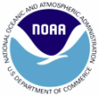
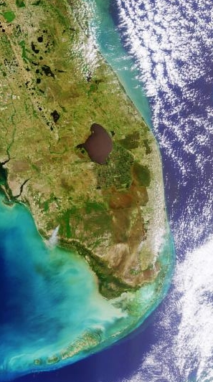
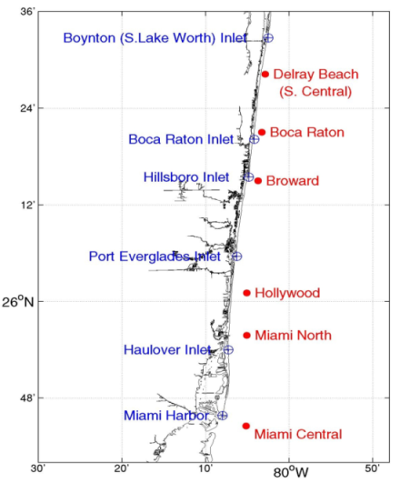
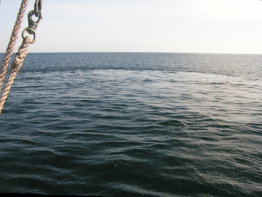
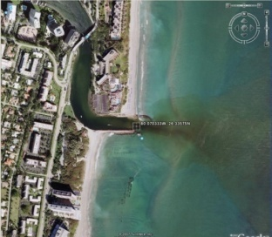
The Florida Area Coastal Environment
(FACE) Program
CHEMISTRY
outfalls
septic tanks
shipping
watershed drainage
atmospheric deposition
PUBLIC
recreation, tourism, fishing
interest groups (divers, surfers)
drinking water
treated-wastewater release
OCEANOGRAPHY
ocean currents
salinity stratification
fresh/saltwater interface
upwelling
tides
GOVERNMENT
outfall permits
shipping regulations
water quality standards
UTILITIES
treated-wastewater plants
water management districts
Inlets and TWWP Outfalls
Boca Raton boil
(Nancy Foster, Oct. 2006)
Boca Raton Inlet
(GoogleEarth)

Slide 2
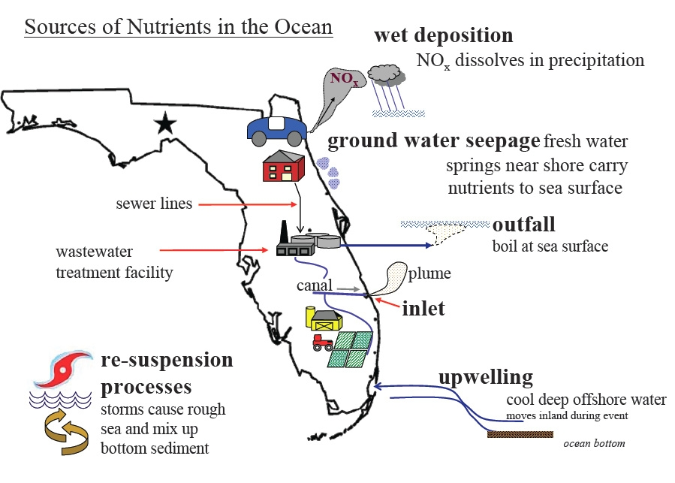
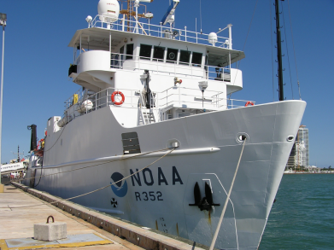
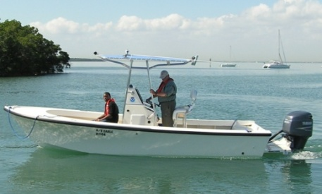
FACE mission and approach
FACE Mission
FACE is a multi-agency program including federal, state, local governments, and water and sewer authorities.
Provide scientific information for management decision-making
Develop a multi-decadal database on coastal environmental parameters
Communicate results to the general public.
FACE Approach
Quantify nutrient and microbiological sources
Determine natural (background) concentrations
Determine potential effects of the anthropogenic substances
NOAA R/V Cable
NOAA R/V Nancy Foster

Slide 3
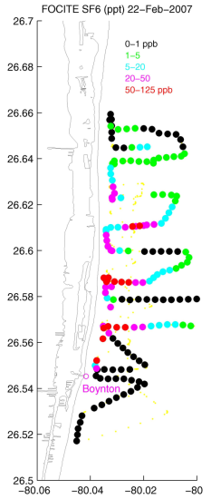
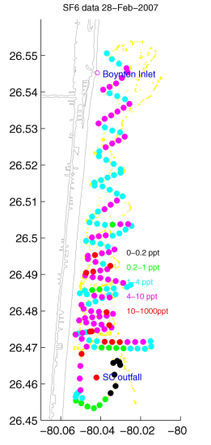
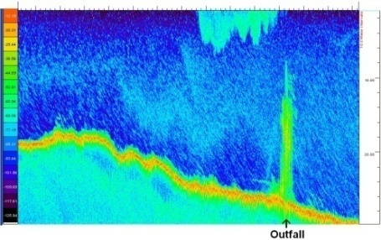
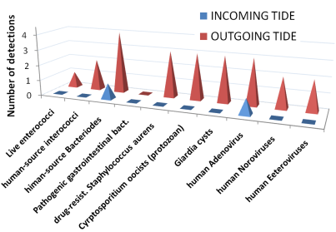
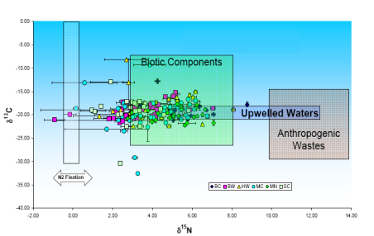
FACE field program and results
Tracer Experiments at Inlets and Outfalls
Water quality monitoring programs
Inlet Characterization
Ocean Current measurements
Microbiology investigations
Acoustic backscatter profiles
Stable isotope studies (¹⁵N, ¹³C)
Acoustic backscatter image of SC plume
SF₆ concentrations at Boynton Inlet (L)
and S.C. outfall plume (R), Feb. 2007
Stable Isotope analysis
of TWWP plume water
Microbiology of Boynton Inlet
Publications
P. Swart and C. Drayer, FACE 1st Year Report, Sampling of Nitrogen Compounds for Determination of Isotopic Values in Benthic Macroalgae, Sediment Organics, and Seawater, 2008.
J. Proni et al., Brevard County Near Shore Ocean Nutrification Analysis, NOAA Technical Report OAR-AOML-37, July, 2005.
R. Wanninkhof et al., Farfield Tracing of a Point Source Discharge Plume in the Coastal Ocean Using Sulfur Hexafluoride, Environ. Sci. Technol. 39, 8883-8890, 2005.
J. Proni and R. Williams, Acoustic Measurement of Currents and Effluent Plume Dilutions in the Western Edge of the Florida Current, in Acoustic Remote Sensing Applications, p. 537-550, 1997.
SEFLOE Final Report, Hazen and Sawyer, 1994.

Slide 4
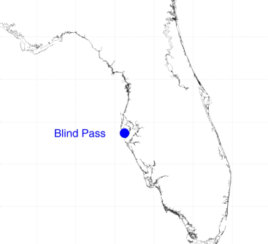
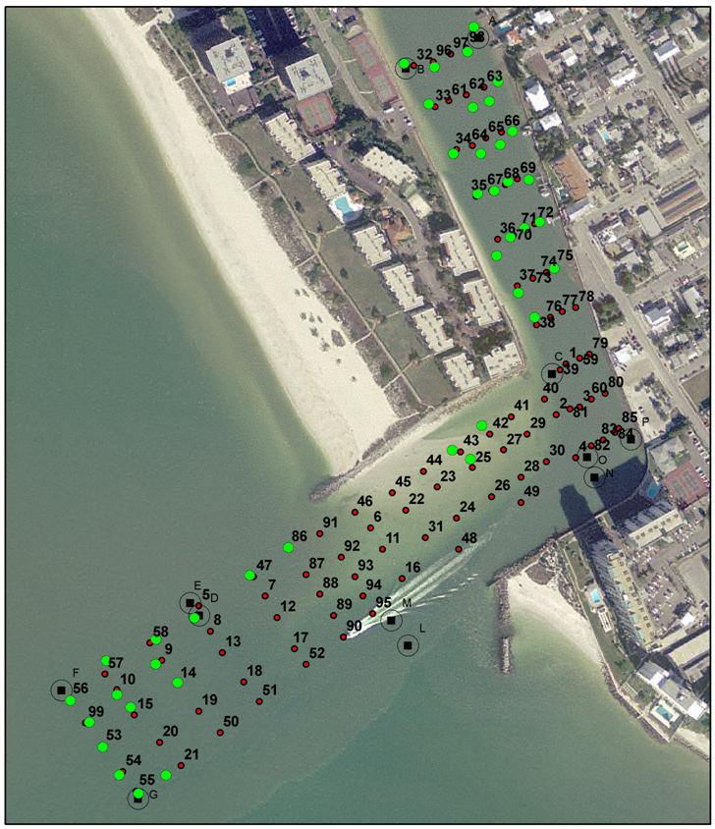
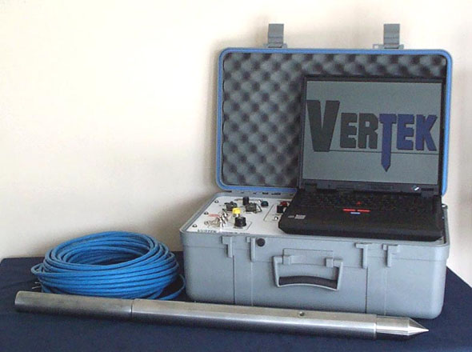
Petroleum in Sediments: Blind Pass
Field Program
~100 cores will be extracted (P. Wang, U.S.F)
Core extracts analyzed for hydrocarbons by GC-MS (P. Blackwelder, UM-RSMAS)
Evaluation of the Vertek Penetrometer for analysis of hydrocarbons in marine sediments
Core locations map.
Green: cores obtained to date
MS-GC analysis of BP-70,
shallow sediments, probable
storm water run-off or small
boat contamination.
GS-MS results for PB24, deep
sediments, similar to results from
a sample from a 1993 oil spill.
Cone Penetrometer

Slide 5
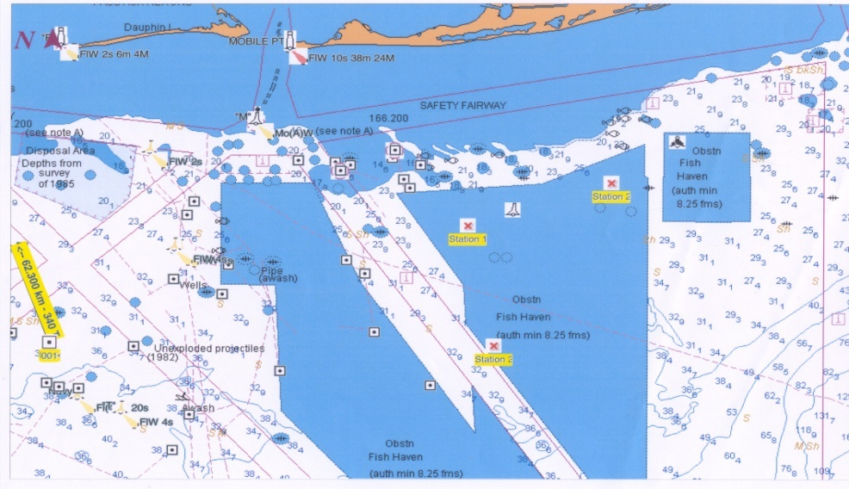
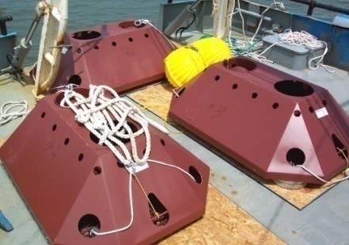
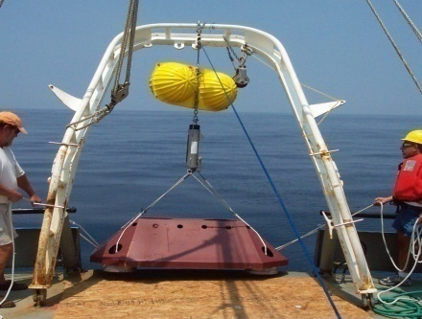
Hurricane Impacts on the Coast
J. Proni (AOML), S. Kimble (USA) B. Black (AOML)
Collaborators and Co-workers
Sytske Kimble, Kieth Blackwell, Ryan Wade, Donald Wright and Todd Murphy from U. of South Alabama, Mobile, AL.
Eric Siegle and Don Conlee of Nortek USA
Mike Dardeau, Rodney Collier, Tom Guoba and ClarkLollar of Dauphin Island Sea Lab, Dauphine Isand, AL
James Cappellini and Doug Dooner, Mooring Systems Inc. Cautamet, Ma.
Jon Wood, Ocean Data Technologies, Inc. Marstons Mills MA.
Outline
Measure the development of waves during a hurricane or strong storm.
Measure sub-surface water currents.
Recover the instruments and make available quality controlled data to test hurricane and storm surge models.
Disseminate results to science and public through peer-reviewed publications.
Waves And Currents (AWAC) Gear Deployed in the Northern Gulf of Mexico, August 7-8, 2007
Chart showing location of three upward-looking ADCP units

