Slide 1
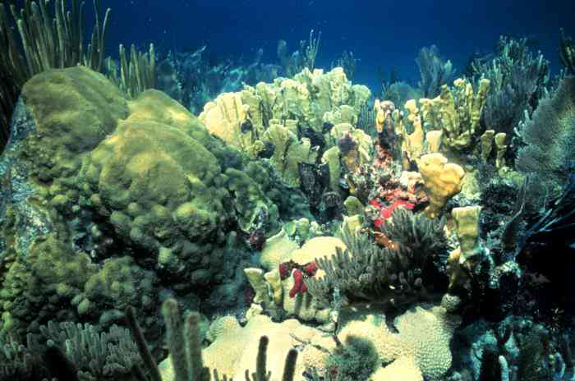
Ocean Acidification: The other CO₂ challenge
Leticia Barbero
NOAA Atlantic Oceanographic and Meteorological Laboratory

Slide 2
Outline:
What is OA and its impacts
CO2 system
NOAA OAP activities
Our lab’s work

Slide 3
Concerns about Ocean Acidification
Ocean Acidification refers to a reduction in the pH of the ocean over an extended period of time, caused primarily by uptake of carbon dioxide (CO₂) from the atmosphere.
oceanservice.noaa.gov/facts/acidification.html
Ocean acidification is affecting the entire world’s oceans [ecosystems], including coastal estuaries and waterways.
From a socioeconomic and ecosystem perspective it’s the nearshore ecosystems and fisheries that are of primary interest in OA research.

Slide 4
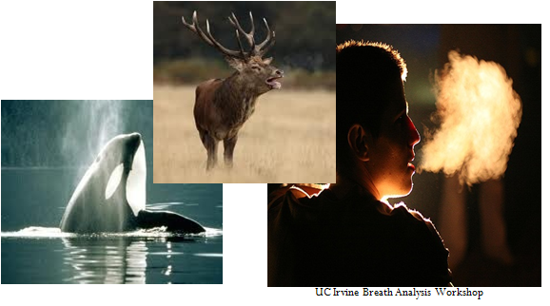
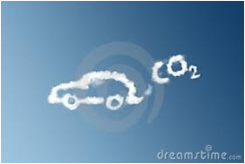
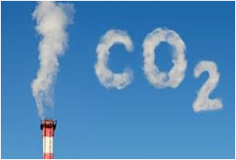
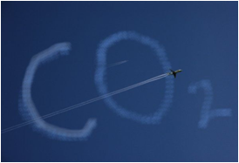
The source: carbon dioxide (CO₂)
Notes:
Looking at our planet – it is quick to notice one thing – Earth is Blue!
The planet is covered by one massive ocean! In fact, 71% of the planet is covered by ocean.
The ocean affects every human life. It provides us with the air we breathe! Did you know that most of the oxygen in the atmosphere originally came from the activities of photosynthetic organisms in the ocean.
It supplies fresh water (most rain comes from the ocean). It moderates the Earth’s climate, influences our weather, and affects human health.
From the ocean we get food, medicine, and mineral and energy resources. It provides jobs, supports our nation’s economy, serves as a highway for transportation of goods and people.
And we cannot forget the ocean is a source of recreation and inspiration. And it plays an important role in many cultures.
“How inappropriate to call this planet Earth, when clearly it is Ocean.” – Arthur C. Clark
4

Slide 5
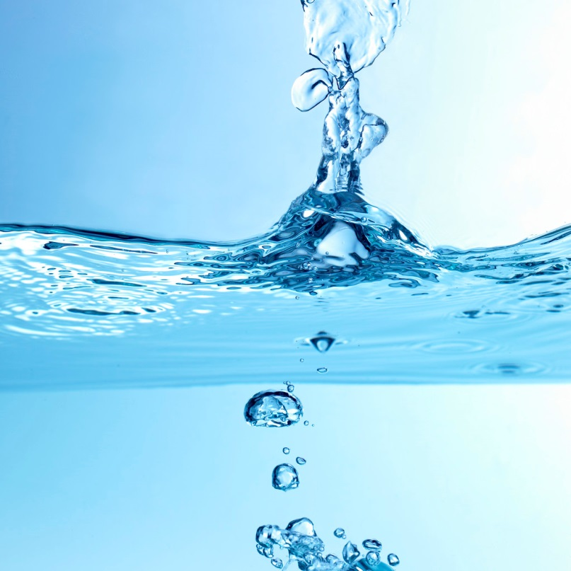
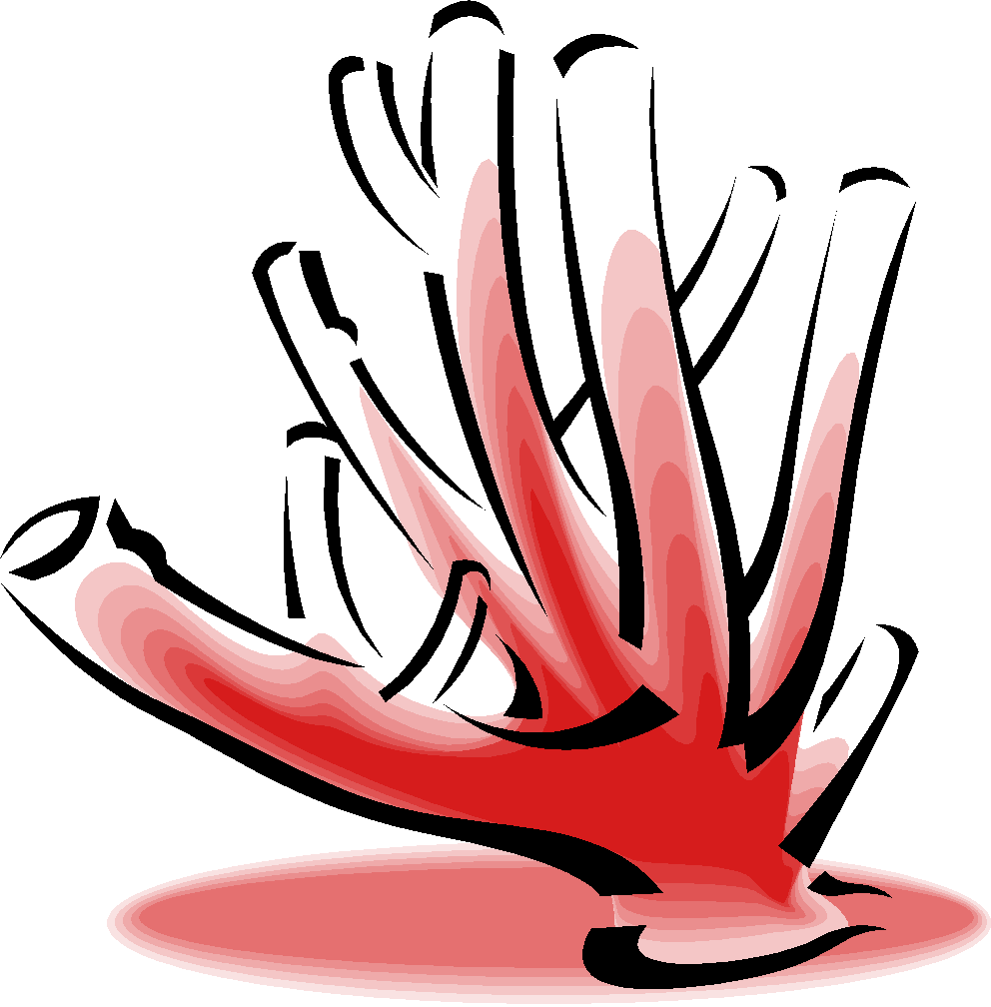
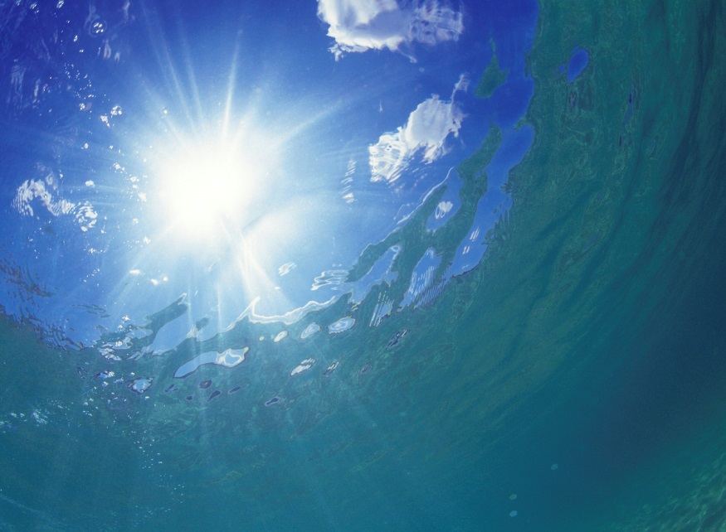

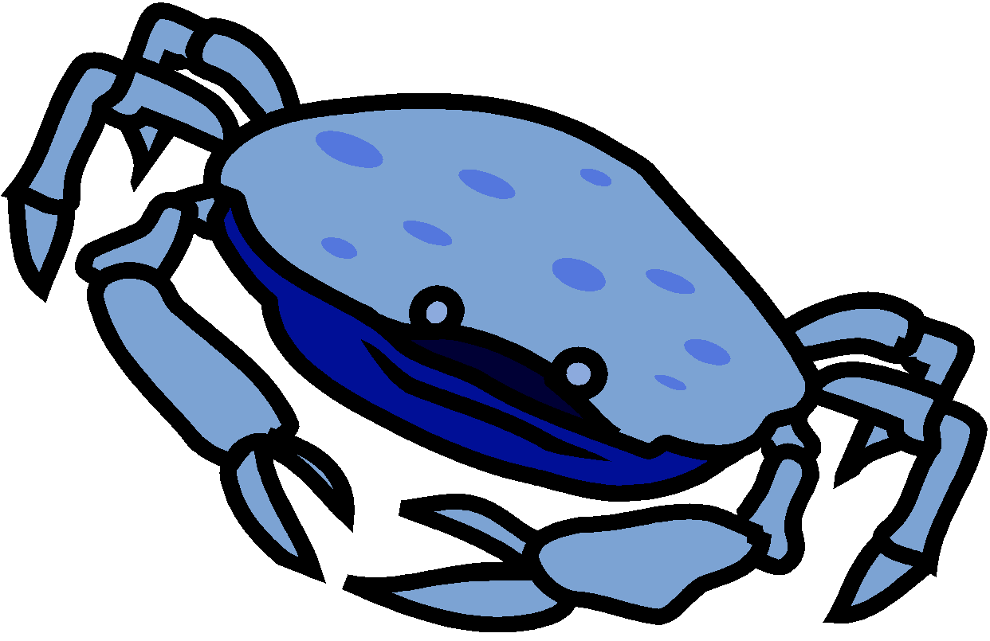
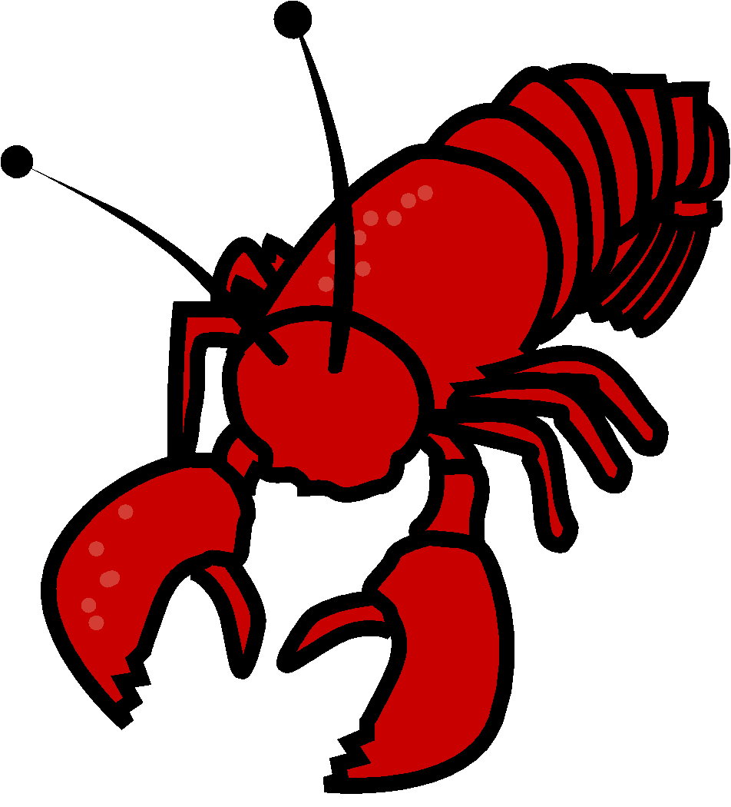
Ocean acidification
H₂O
H₂CO₃
H⁺
CO₃⁻
CO₃⁻
HCO₃⁻
CO₃⁻
H⁺
Notes:
PRESS FOR ANIMATION
About ¼ of the CO2 we emit is absorbed by our ocean
PRESS for ANIMATION
CO2 is oftern referred to as an acid gas because when CO2 combines with seawater it forms carbonic acid which quickly dissociates..
PRESS FOR ANIMATION
To form
PRESS FOR ANIMATION
Ultimately increasing the number of H ions,
PRESS FOR ANIMATION
And making CO3 less abundant and more challenging for orgnais

Slide 6
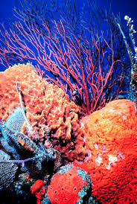
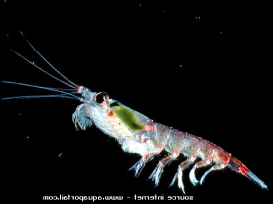
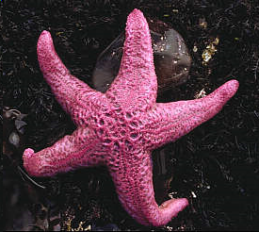
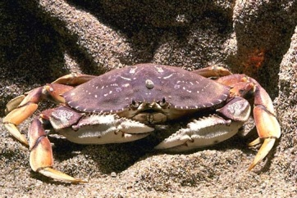
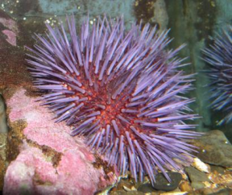
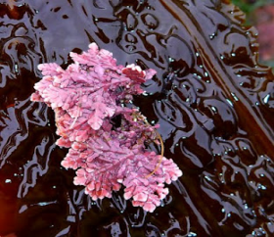
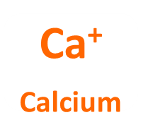
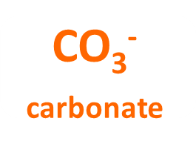
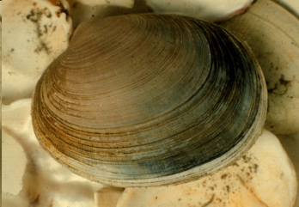
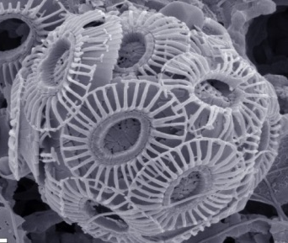
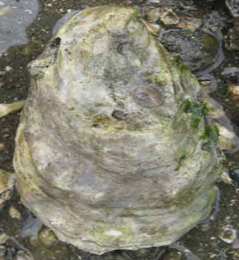
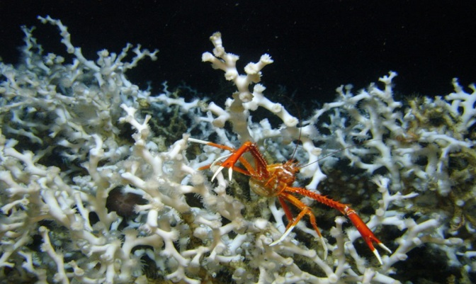
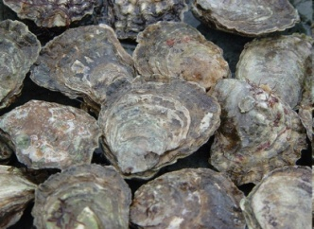
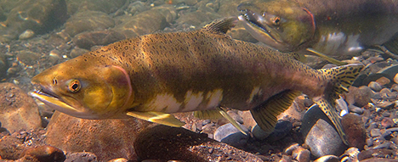
Notes:
The chemistry link to biology

Slide 7
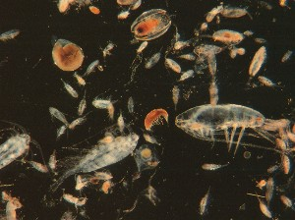
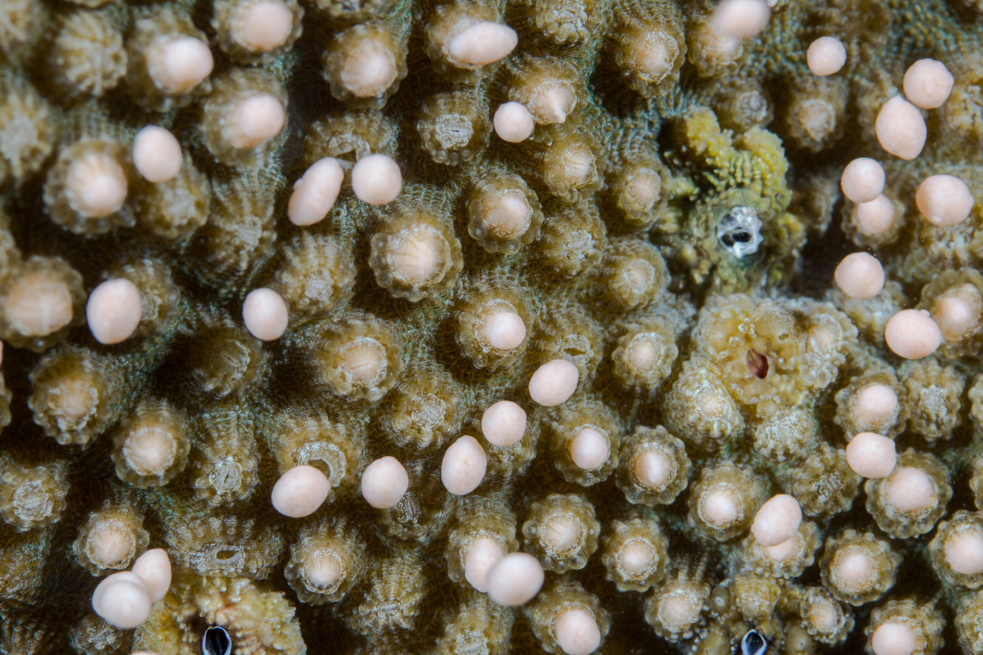
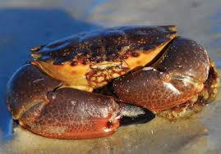
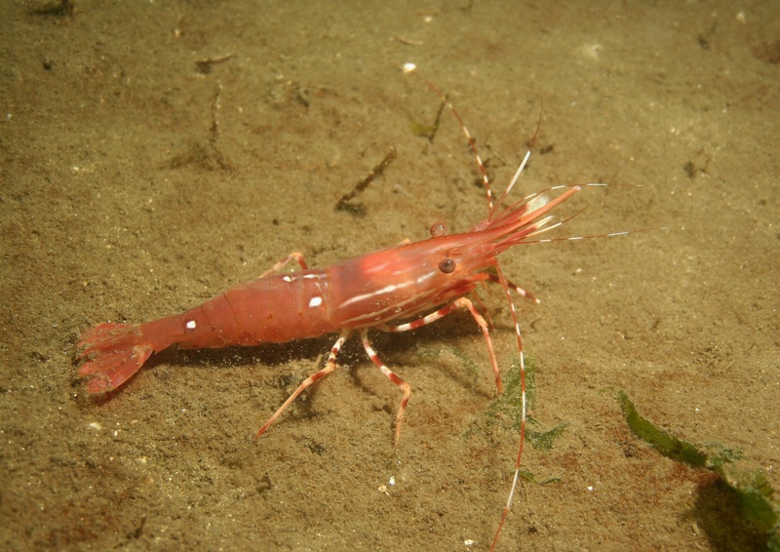
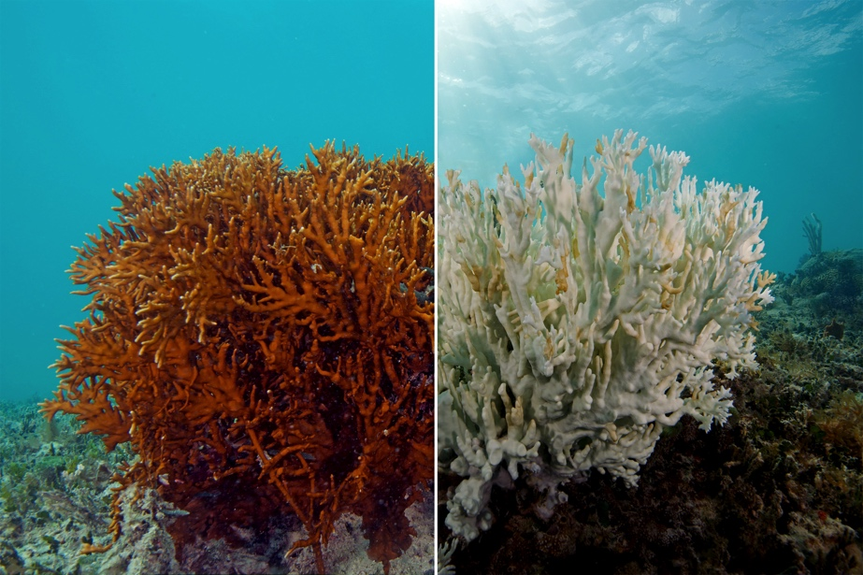
If animals and ecosystems, end up becoming weaker, then we will be weaker as well.
Notes:
Not just coral reefs, but other important species: stone crab, shrimp and the animals they rely on for food
Coral spawning
Stone crab
clams

Slide 8
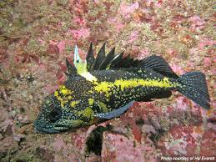
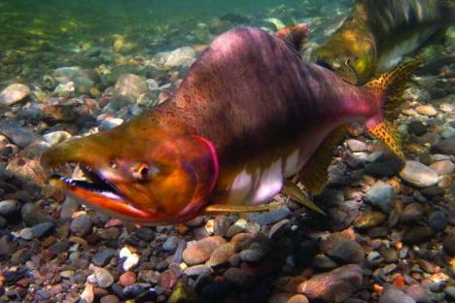
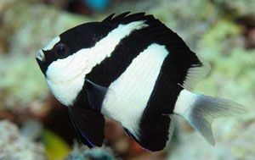
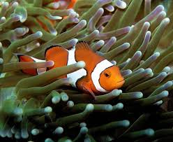
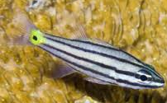
Fish challenged by Carbon Dioxide
Notes:
Upper left: Chinese rock fish, increased anxiety https://www.ncbi.nlm.nih.gov/pmc/articles/PMC3866405/
Lower right: Clownfish, in high CO2 compromised cues to find their way back to their home anemone http://www.pnas.org/content/pnas/106/6/1848.full.pdf
Lower left and righ: damselfish and cardinalfish respectively, decrease detecton of predators, prefer lower Co2 waters https://www.nature.com/articles/nclimate2195?utm_source=Daily+Carbon+Briefing&utm_campaign=fe2fe983c3-DAILY_BRIEFING&utm_medium=email&utm_term=0_876aab4fd7-fe2fe983c3-303421281
Lower right: CohoSalmon, high Co2 compromised ability to find their way back to home river, and ability to avoid predators
Feel free to just highlight a few or one!

Slide 9
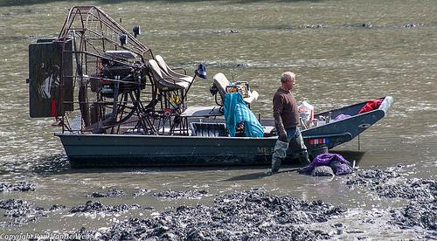
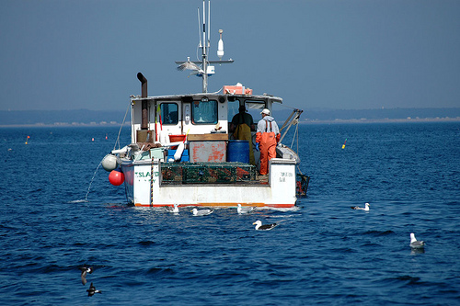
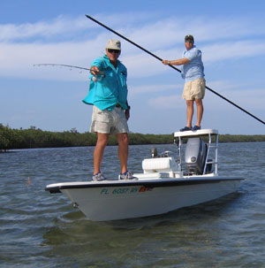
People are part of the food web

Slide 10
What’s at stake
Saltwater recreational fishing supports 109,341 jobs
Coral reef tourism supports more than 70,000 jobs
What’s downstream? Tackle shops, marinas, gas, fits shops, hotels
And… these amazing ecosystems and animals!
Notes:
For FL

Slide 11
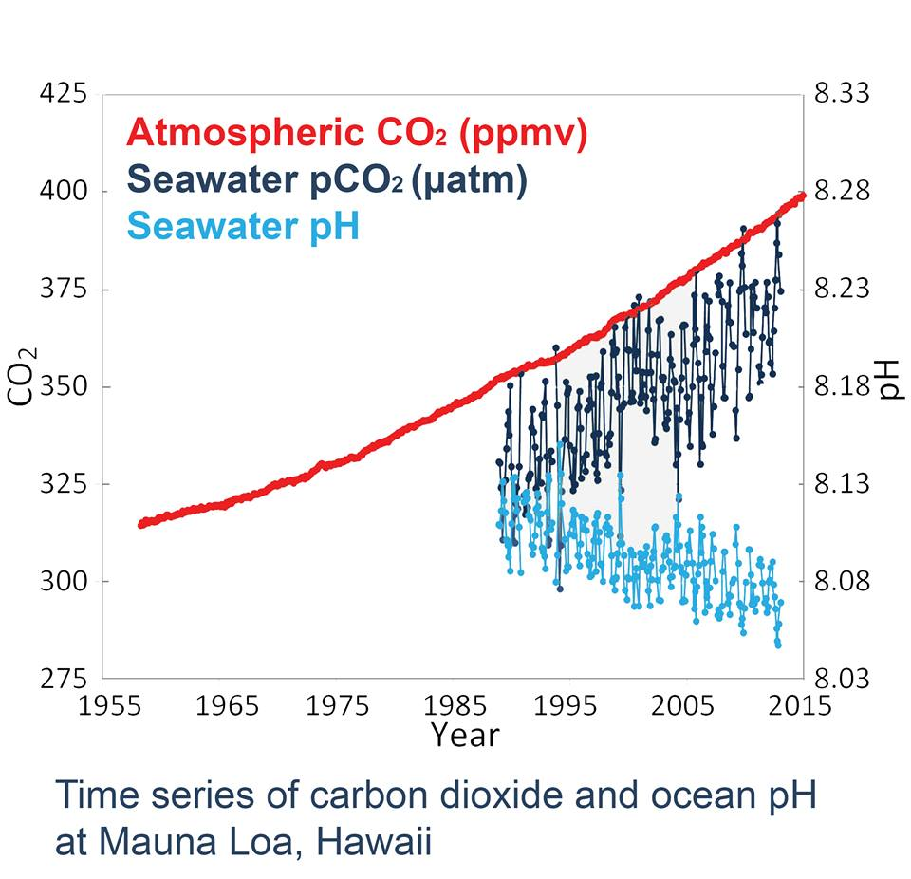
Our environment is changing

Slide 12
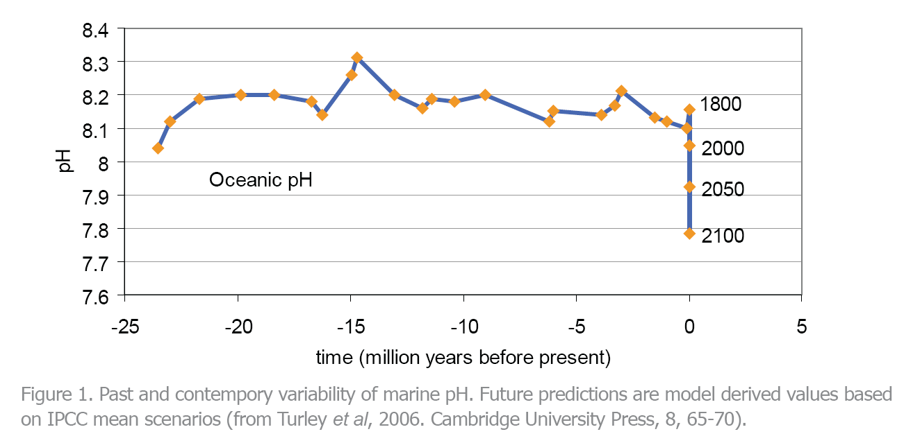
Average Ocean pH over the last 20 million years

Slide 13
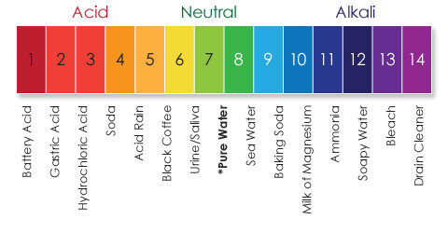
pH⁺ scale
H⁺
H⁺
H⁺
H⁺
H⁺
H⁺
H⁺
H⁺
H⁺
H⁺
H⁺
pH = -log [H⁺]
pH = 3 → [H⁺] = 0.001M
pH = 4 → [H⁺] = 0.0001M
Notes:
More hydrogen ions

Slide 14
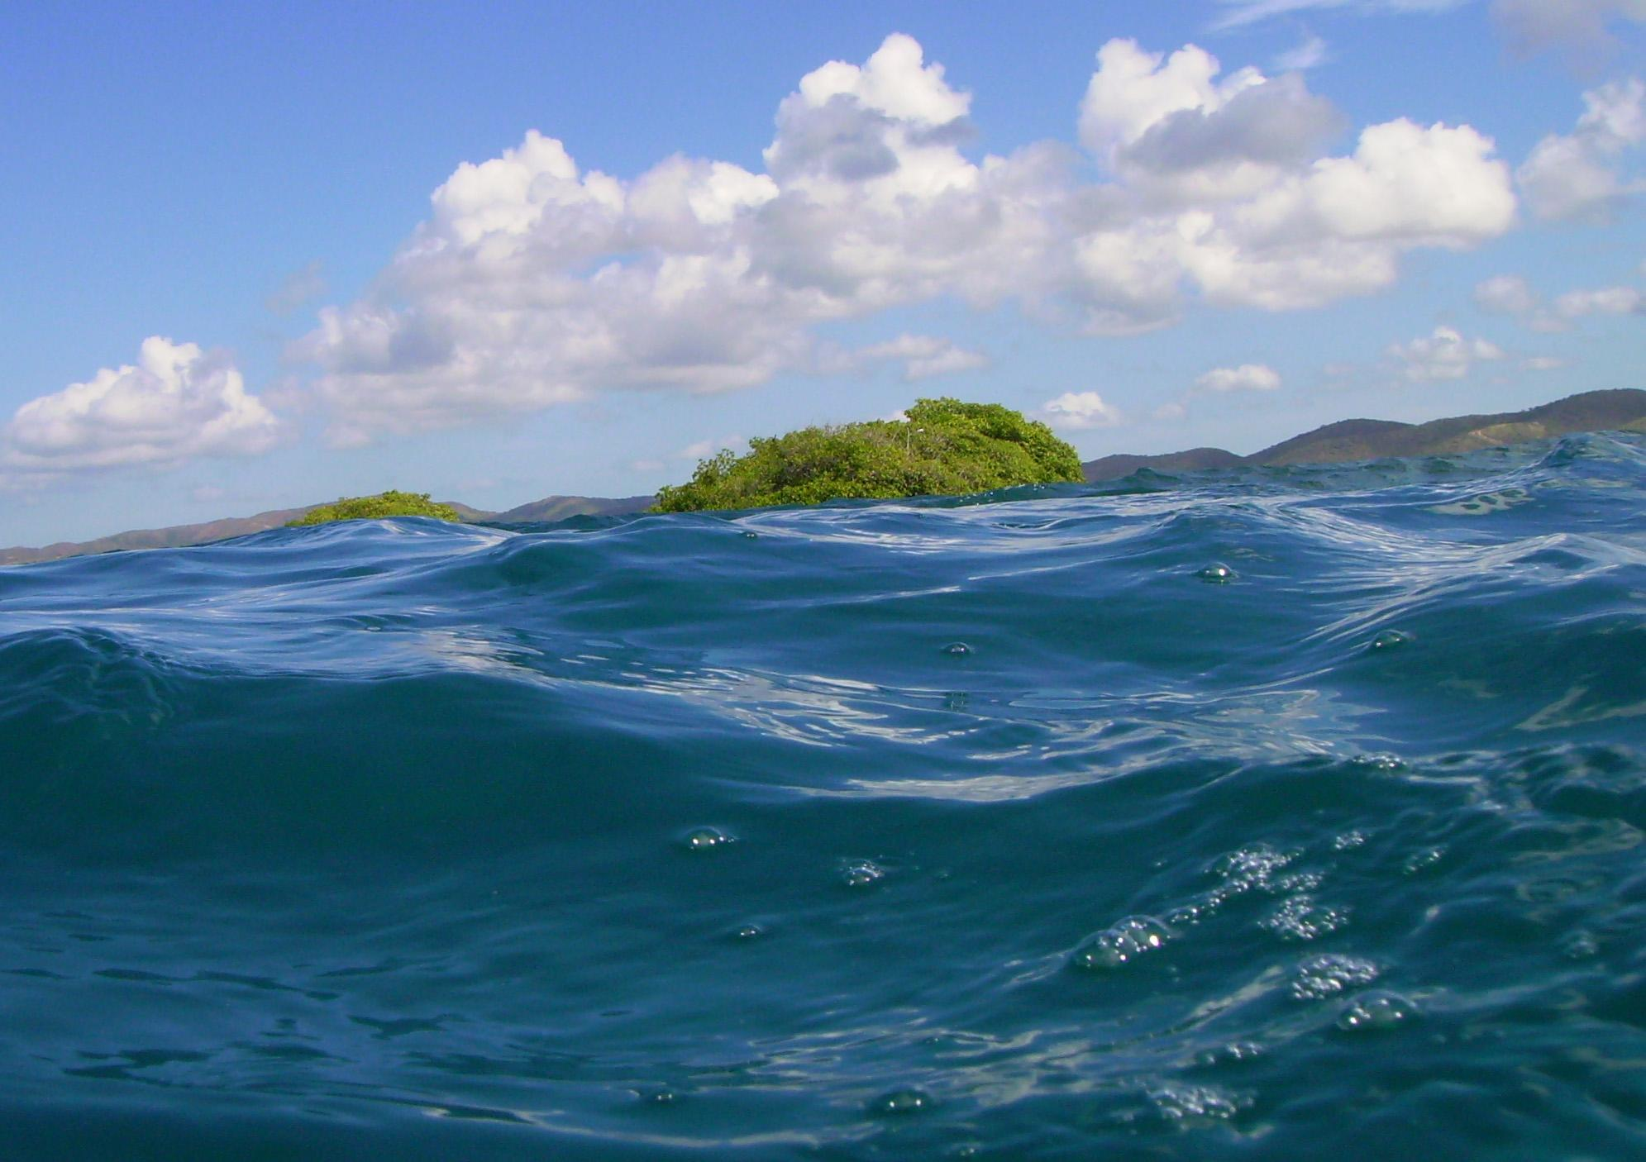

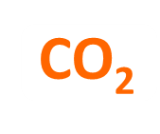

H⁺
H⁺
H₂C0₃⁻
carbonic acid
HC0₃⁻
bicarbonate
C0₃⁻
carbonate
+
H₂O
HC0₃⁻
bicarbonate
pH
C0₃⁻
carbonate
H⁺
Notes:
Usually animated – to describe the chemistry

Slide 15
Studying the CO₂ system in the ocean
pH
pCO₂
- Total alkalinity
TA = [HCO₃–] + 2[CO₃^{2–}] + [B(OH)₄–] + [OH–] + 2[HPO₄^{2–}] + ...
Dissolved Inorganic Carbon
DIC = [CO₂] + [H₂CO₃] + [HCO₃⁻] + [CO₃²⁻ ]
- Saturation State (Ω_{Ar}): available CO₃^{2–}
Notes:
Alcalinidad en agua de mar: concentración de todas las bases que pueden aceptar protones cuando se realiza una valoración con HCl hasta el punto final del ácido carbónico (pH=4.5).
A_{T} = [HCO₃–] + 2[CO₃^{2–}] + [B(OH)₄–] + [OH–] + 2[HPO₄^{2–}] + 3[PO₄^{3–}] + [SiO(OH)₃–] + [NH₃] + [HS–] – [H⁺]_{F} ...
DIC es la suma de las especies de carbono inorgánico disueltas en una solución.

Slide 16
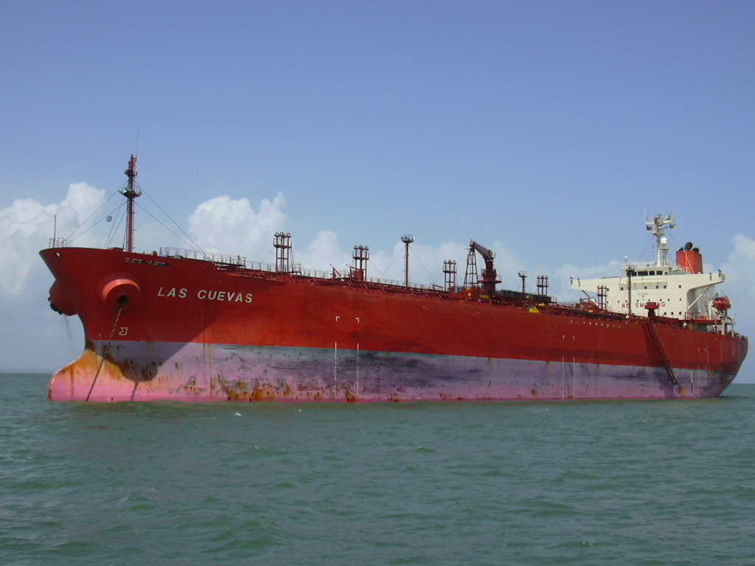
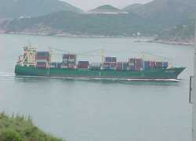
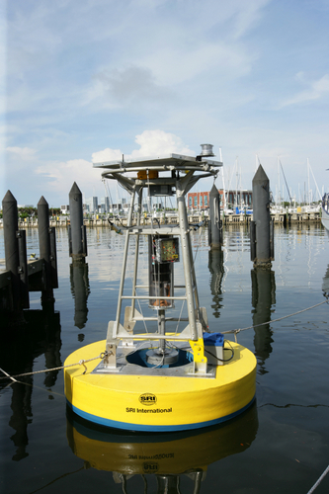
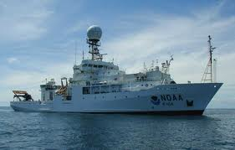
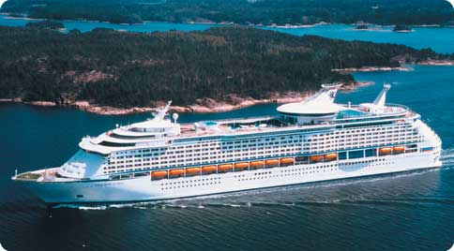
Studying the CO₂ system in the ocean: AOML’s OCC group
Air-Sea CO₂ fluxes: Ships of opportunity program (SOOP)

Slide 17
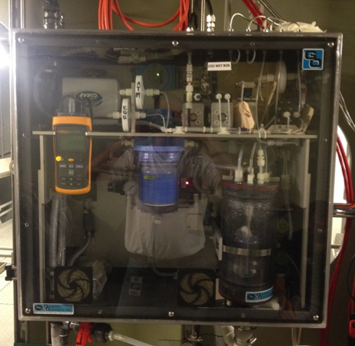
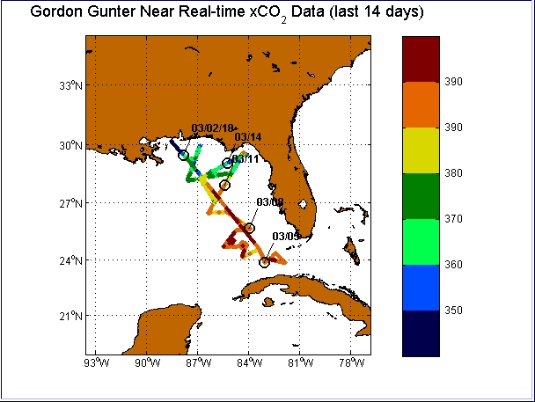
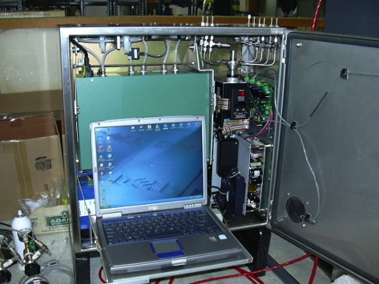
Studying the CO₂ system in the ocean: AOML’s OCC group
Air-Sea CO₂ fluxes: Ships of opportunity program (SOOP)
http://www.aoml.noaa.gov/ocd/ocdweb/gunter/gunter_realtime.html

Slide 18
Studying the CO₂ system in the ocean: AOML’s OCC group
- Air-Sea CO₂ fluxes: Ships of opportunity program (SOOP)
Changes in carbon storage in the ocean on decadal scale (GO-SHIP)

Slide 19

Studying the CO₂ system in the ocean: AOML’s OCC group
GO-SHIP
Global Ocean Ship-based Hydrographic Investigations Program

Slide 20
Studying the CO₂ system in the ocean: AOML’s OCC group
- Air-Sea CO₂ fluxes: Ships of opportunity program (SOOP)
- Changes in carbon storage in the ocean on decadal scale (GO-SHIP)
Coastal Ocean Acidification Cruises (ECOA and GOMECC)

Slide 21



What we did last summer: GOMECC-3
NOAA RV Ronald H. Brown

Slide 22



How do we get our samples?

Slide 23



How do we get our samples?

Slide 24





And besides water samples?
Phytoplankton (diatoms, copepods, dynoflagellates)
Zooplankton (ichthyoplankton)

Slide 25




And besides water samples?
Surface drifters to survey the ocean currents of the Gulf
Satellite validation data

Slide 26
What we learned last summer: GOMECC-3

Slide 27


OA conditions in your neck of the woods
pH in Summer 2017

Slide 28


OA conditions in your neck of the woods
Saturation state in Summer 2017

Slide 29

Are OA conditions the same in the whole Gulf?
Saturation state in Summer 2017
Notes:
Based on models and a few observations
There is a high degree of certainty that Saturation state in the GOM has decreased by ≈ 15 %

Slide 30




Many challenges
Notes:
Increased temperature, increased freshwater runnoff bringing nutrients
With many stresses comes the opportunity for more solutions

Slide 31




Communities stepping up to the challenge
Notes:
Moving toward renewable energy,
Expanding public transport
Limiting nutrient runoff

Slide 32



Are you willing to step up to the CO₂ challenge
Notes:
Are you willing to step up to the CO2 Challenga
Reduce carbon footprint
Drive less – Create a bike share, use public transportation , or carpool
Use less electricity
Consider using renewable energy sources
Reduce amount of animal protein in your diet
Shop for fresh, local food
Or join your local CSA (Community Supported Agriculture)

Slide 33

It is our responsibility to take care of the ocean for all the living things that depend on it… including us!
Improve water quality
Maintain biodiversity
Preserve and enhance habitat

Slide 34
Questions
Notes:
Will add pretty image and contact info

