Slide 1
HEDAS: Hurricane Ensemble Data Assimilation System Semi-real-time runs for Hurricane Earl
Presented by Altug Aksoy (HRD)
HRD DA Group: Tomi Vukicevic, Altug Aksoy, Kathryn Sellwood, Sim Aberson
HRD Modeling Group: Gopal, Lisa R. Bucci, Thiago Quirino
From H*Wind Group: Bachir Annane

Slide 2
HEDAS Real-Time Runs under HFIP
High-resolution data assimilation system using a square-root ensemble Kalman filter (EnKF)
Only runs when aircraft data is available
Initial ensemble perturbations from GFS-EnKF (Jeff Whitaker, ESRL)
3-hour ensemble spin-up
Data cycling for the duration of aircraft data (usually, 4-5 hours)
Final analysis is provided to the HRD modeling group: Deterministic HWRFx run from final mean vortex analysis

Slide 3
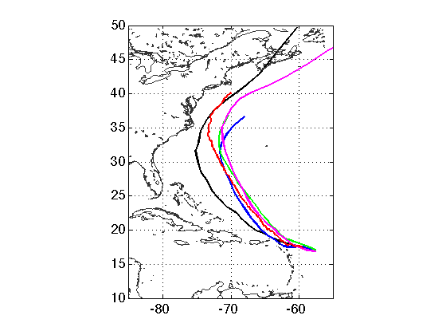
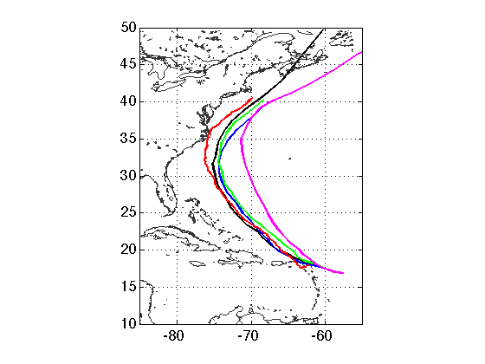
Comparison of Track and Intensity Forecasts
08-29 12Z
08-30 00Z
BEST
GFDL
HWRF
GFS
HWRFx-HEDAS

Slide 4
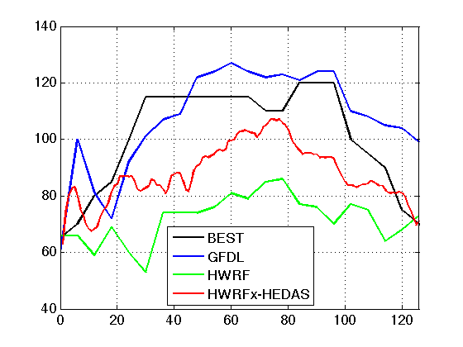
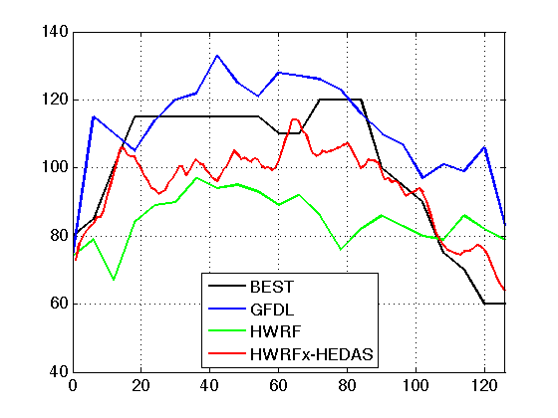
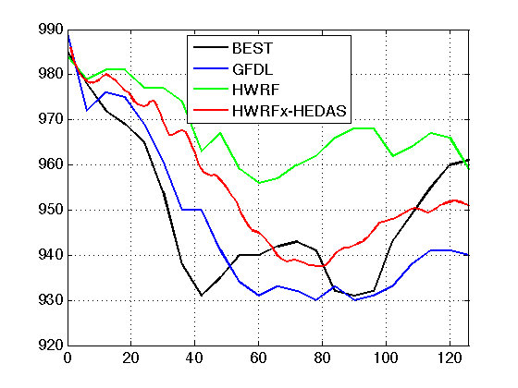
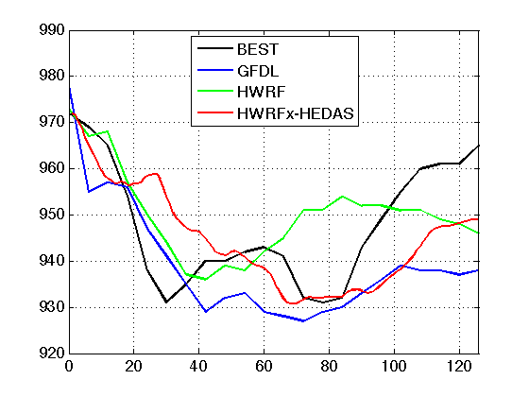
Comparison of Track and Intensity Forecasts
08-29 12Z
08-30 00Z

Slide 5
2010-08-29 12Z
HEDAS 10-m Wind Analysis
H*Wind 10-m Wind Analysis
RMW = 40 nm Max winds = 70 knots IKE for hur. winds = 2 TJ IKE for TS winds = 44 TJ
Destructive potential from wind = 1.9 Destructive potential from surge/wave = 3.6
RMW = 35 nm Max winds = 64 knots IKE for hur. winds = 0 TJ IKE for ts winds = 36 TJ
Destructive potential from wind = 1.6 Destructive potential from surge/wave = 3.3
Through collaboration with Bachir Annane (HRD)

Slide 6
2010-08-30 00Z
HEDAS 10-m Wind Analysis
H*Wind 10-m Wind Analysis
RMW = 18 nm Max winds = 85 knots IKE for hur. winds = 6 TJ IKE for TS winds = 62 TJ
Destructive potential from wind = 2.3 Destructive potential from surge/wave = 4.0
RMW = 19 nm Max winds = 85 knots IKE for hur. winds = 5 TJ IKE for ts winds = 31 TJ
Destructive potential from wind = 2.2 Destructive potential from surge/wave = 3.1
Through collaboration with Bachir Annane (HRD)

Slide 7
Results from HEDAS-HWRFx system test Hurricane Earl Comparison to satellite observations
On-line simulation of microwave brightness temperatures was introduced into HWRFx system in 2010 season (Vukicevic, Gopalakrishnan and Quirino)
37 and 85 GHz (equivalent of SSMIS sensors)
Radiative transfer model used is from SDSU suite of models from Nagoja University (H. Masunaga)
2D simulated imaging is tailored for direct comparison to MW satellite observation images as displayed by Navy/NRL Tropical Cyclone page
http://www.nrlmry.navy.mil/tc_pages/tc_home.html
From Tomi Vukicevic (HRD)

Slide 8
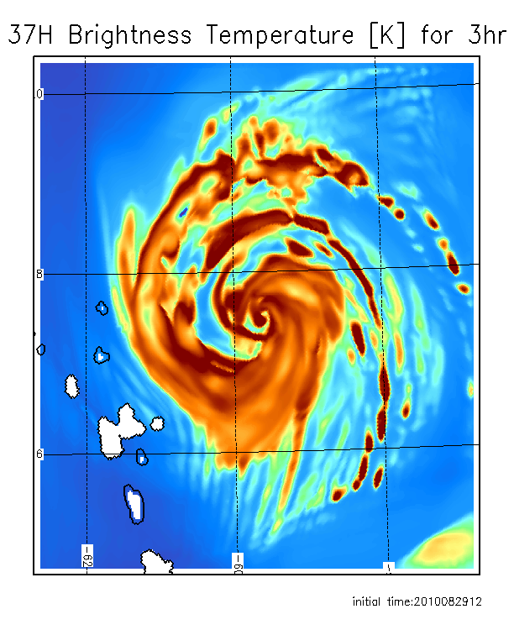
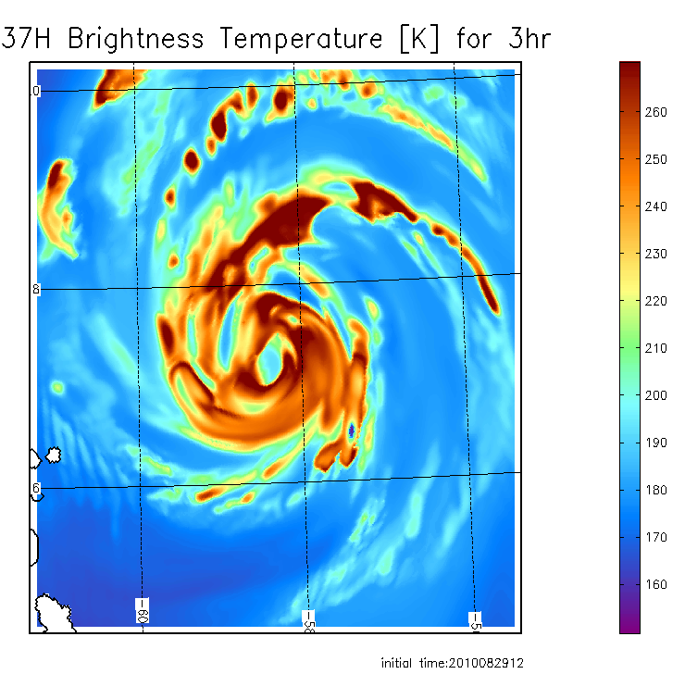
Comparison of observed and forecast images for hurricane Earl from HEDAS and HWRF ICs
36 GHz observed AQUA closest time within 1 h
3h 37 GHz forecast from HEDAS IC
3h 37 GHz forecast from HWRF IC
Forecast initial time 12:00Z, 08/29/2010
From Tomi Vukicevic (HRD)

Slide 9
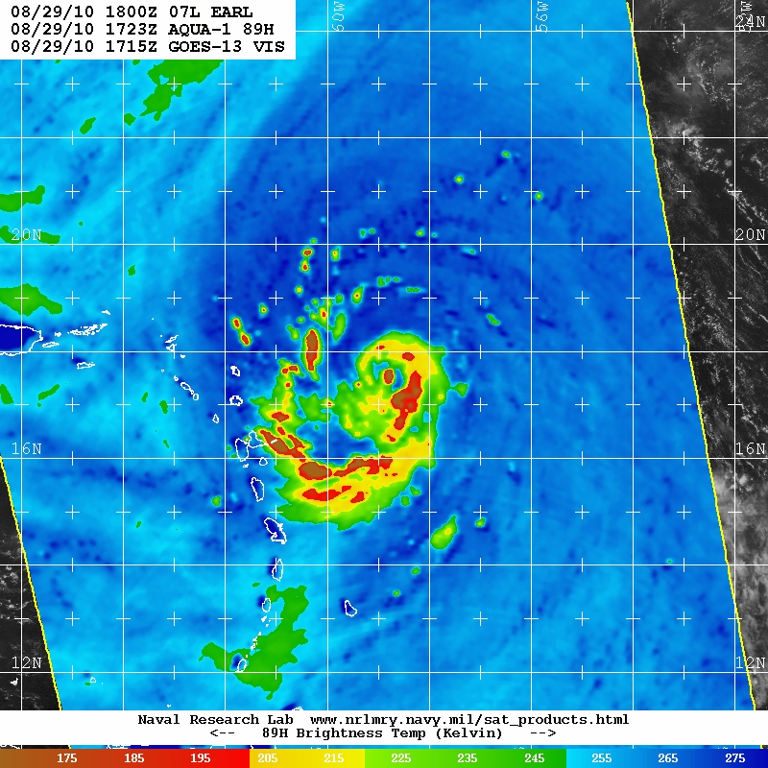
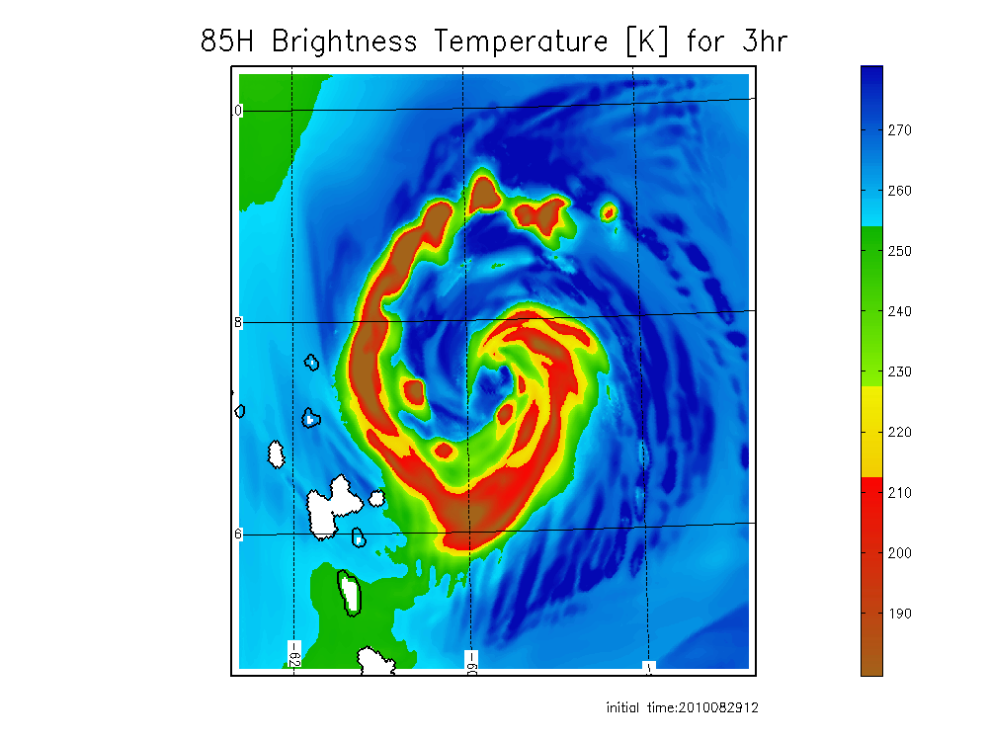
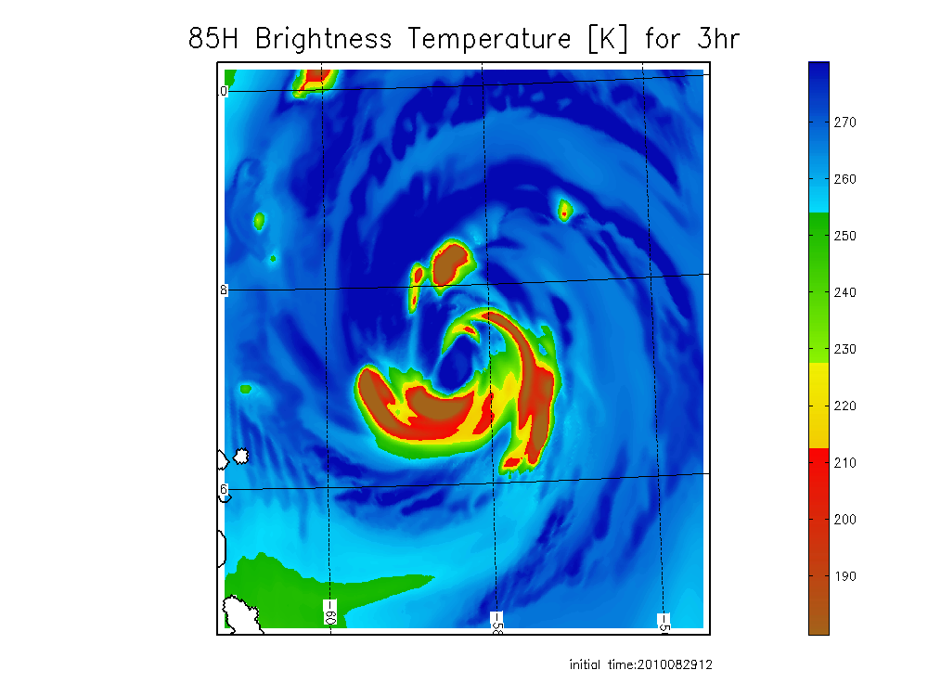
Comparison of observed and forecast images for hurricane Earl from HEDAS and HWRF ICs
89 GHz observed AQUA closest time within 1 h
3h 85GHz forecast from HEDAS IC
3 h 85 GHz forecast from HWRF IC
Forecast initial time 12:00Z, 08/29/2010
From Tomi Vukicevic (HRD)

Slide 10
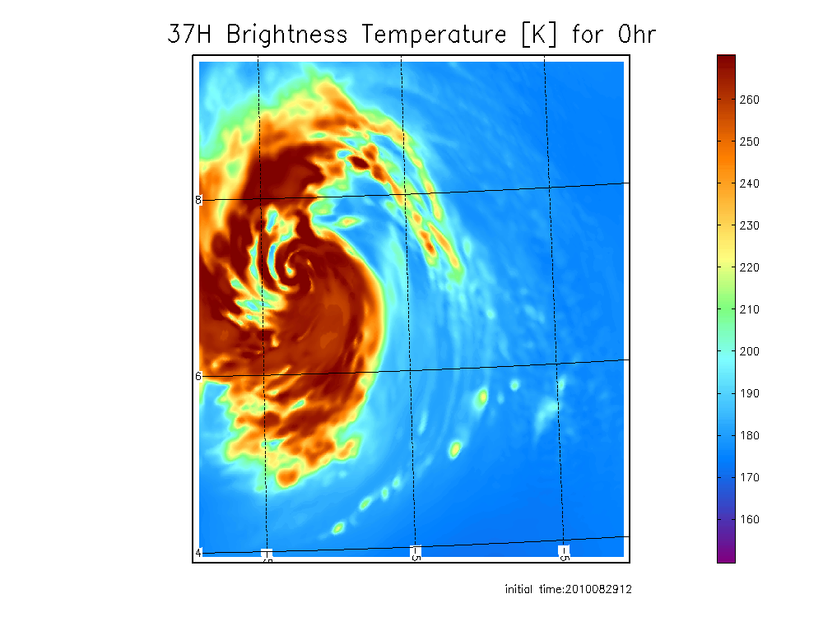
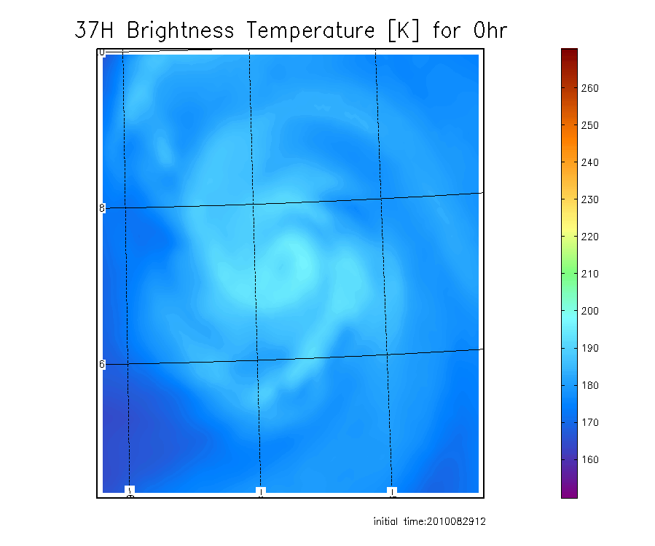
Difference between HEDAS and HWRF IC
37 GHz from HEDAS IC
37 GHz from HWRF IC
From Tomi Vukicevic (HRD)

