Slide 1
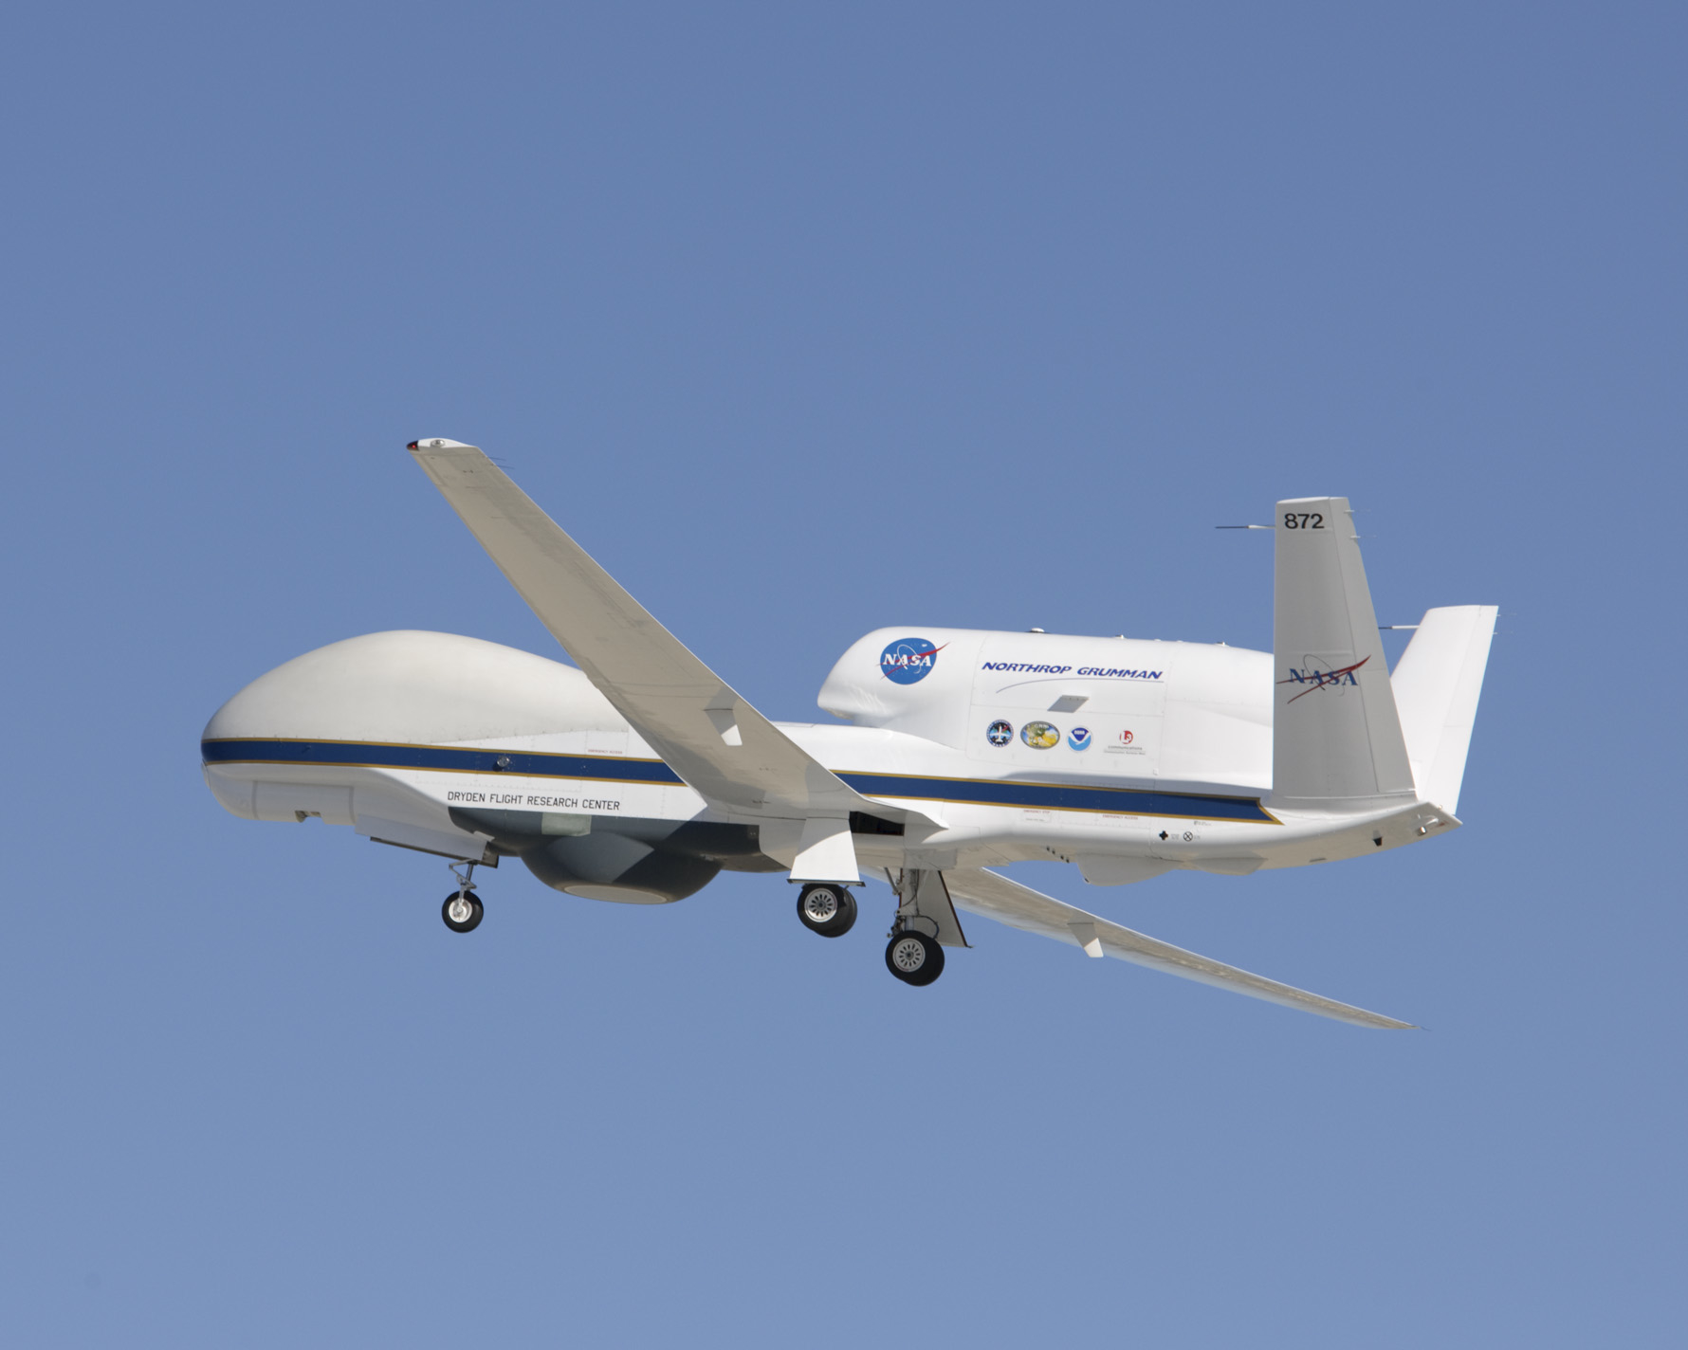


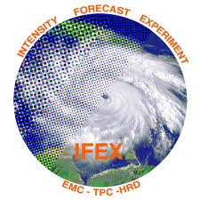
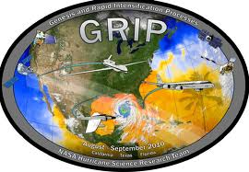
The Global Hawk UAS flights into tropical low Frank and Hurricane Earl
A NASA-NOAA collaboration as part of IFEX & GRIP
Gerry Heymsfield- NASA-Goddard
Michael Black- NOAA/HRD
Mission Scientists

Slide 2
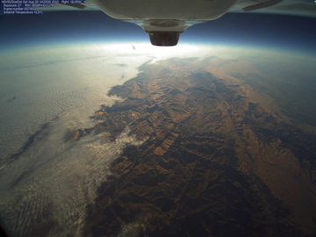
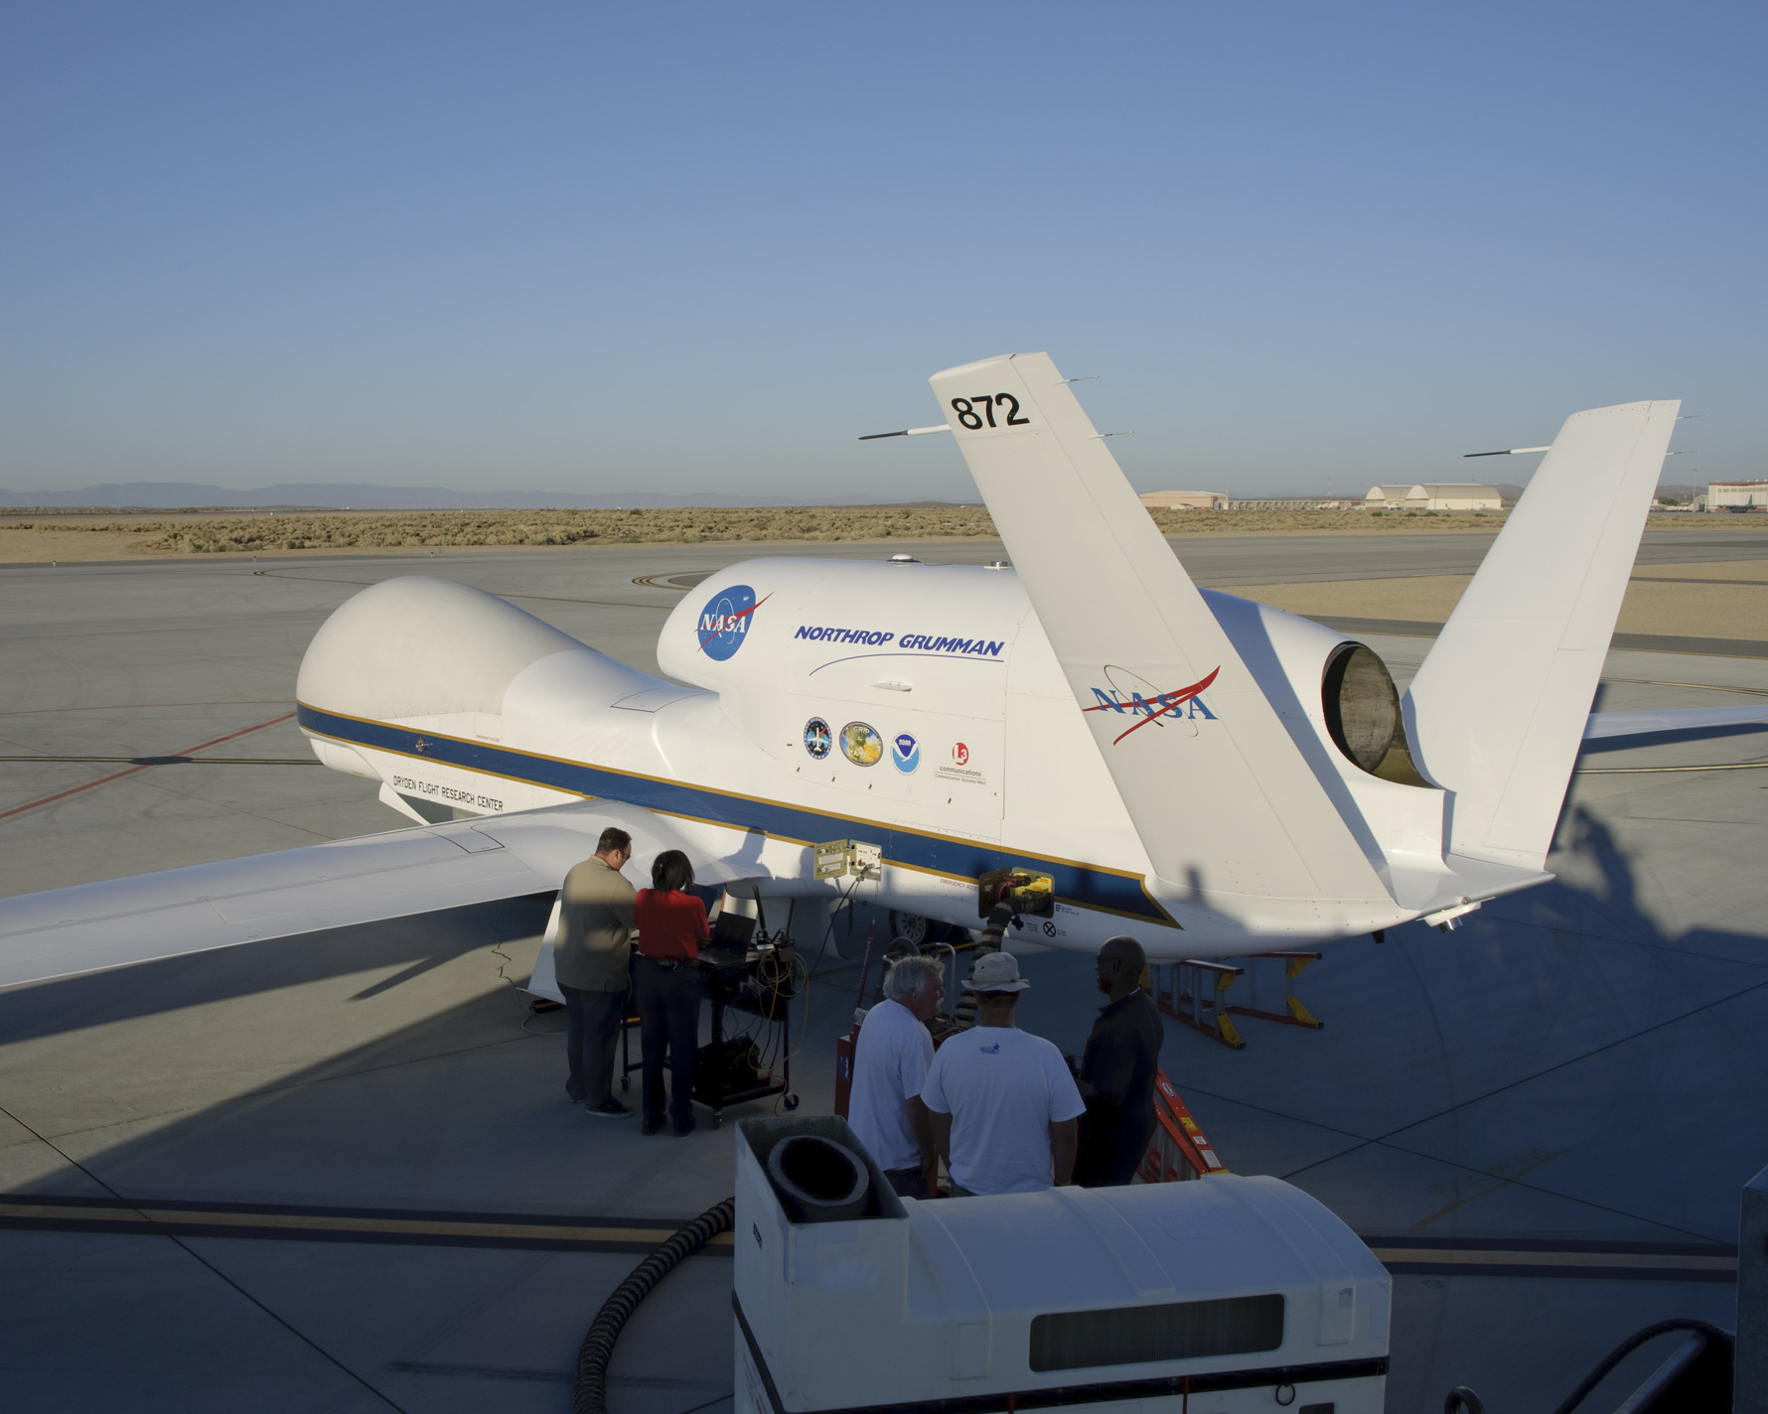
Global Hawk Instrumentation
High Altitude Microwave Sounding Radiometer (HAMSR)
High Altitude Imaging Wind and Rain Airborne Profiler (HIWRAP)
Lightning Instrument Package (LIP)
Hi-def, wide angle photography
Automated GPS dropsonde system*
* not ready for flight yet

Slide 3
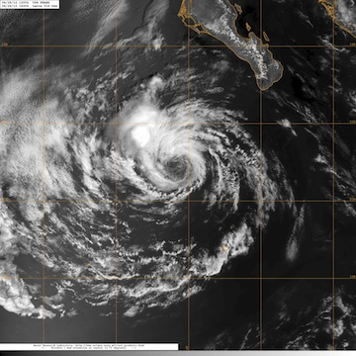
August 28 flight into (former) Hurricane Frank
Maiden TC flight of GH
Tropical Low Frank
Short ferry from Dryden at Edwards AFB, CA
Limited convection
Ideal proof of operations flight for GH and crew
Pre-designed plan was a square-spiral
Instead, made real time flight changes to target convection
13-hr flight

Slide 4
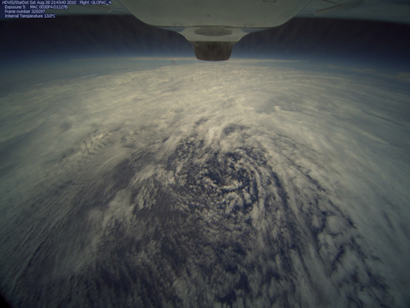
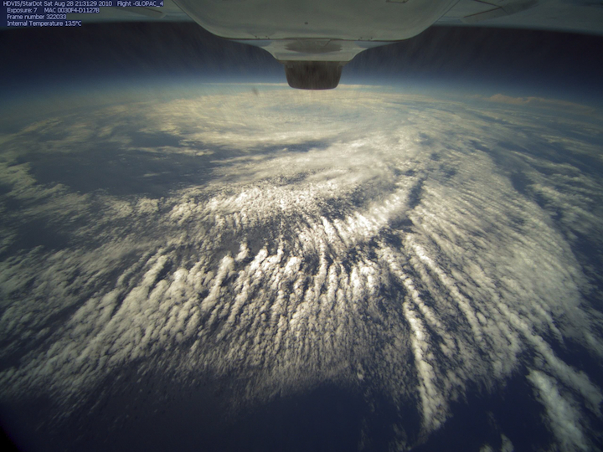
GH imagery from August 28 flight into tropical low Frank
Swirl of low clouds near center
Roll clouds in spiral bands south of center

Slide 5
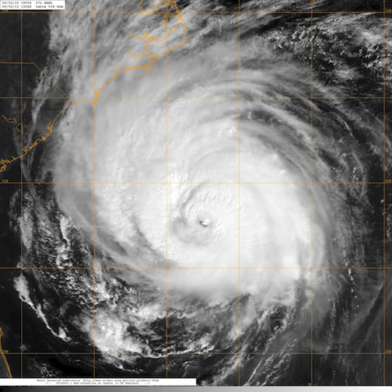
September 2 flight into (above) Hurricane Earl
First hurricane over flight by a UAS
Hurricane Earl 18Z 2 Sep
7 eye passes attempted, 5 directly over, 1 near miss, 1 detoured around eyewall due to lightning
3 passes were coordinated with NASA DC8 beneath the GH
Very little turbulence encountered at 60 kft
Many real time flight changes were made
24-hr flight (8-hr ferry x 2)

Slide 6
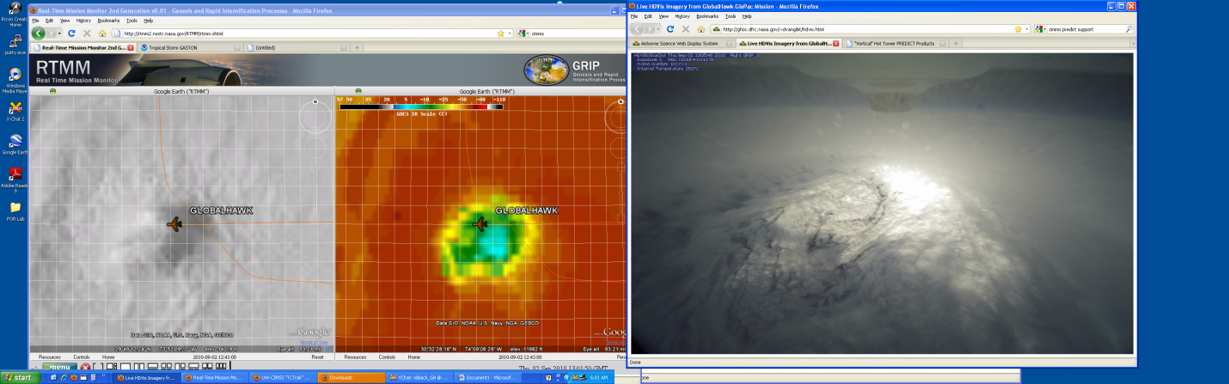
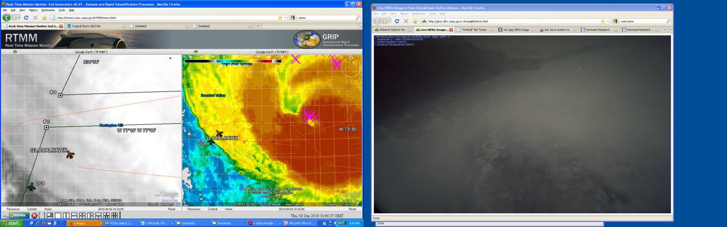
NASA’s Real Time Mission Monitor (RTMM) allows for “virtual” flying,
track changes, coordination with other aircraft

Slide 7
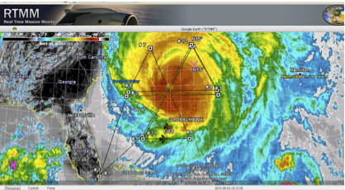
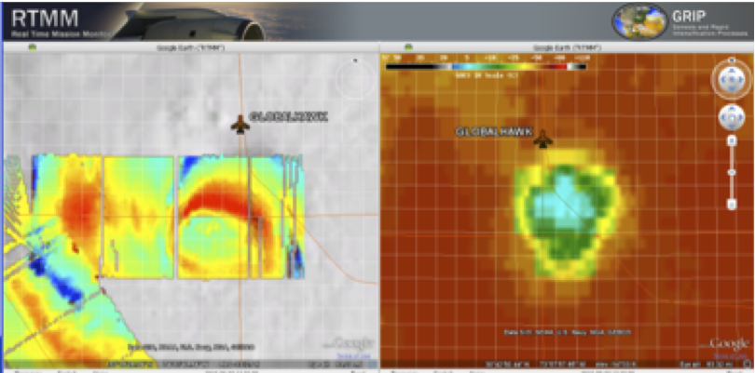
Successes from Earl Flight
RTMM GH-DC8 Coordination (top) and HAMSR imagery overlaid on satellite images (bottom)
Ability to overfly a major hurricane
Mission scientists able to work with GH pilots on real time track changes
Coordination with other aircraft possible and effective
All installed instruments worked well and most provided real-time data and/or imagery

Slide 8
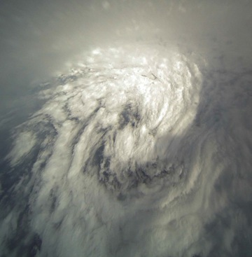
Some of the pros and cons for the Global Hawk as a tropical cyclone research platform
Pros
Long (+24 hr) duration flight time
Nearly continuous monitoring of storm for 15-20 hrs if GH can be deployed closer to targets
Large payload for remote-sensing instrument
Ability to profile entire depth of troposphere
Cons
Long (days) turnaround time between flights
Complicated and expensive support needed to fly
Very little in-situ measurements
Earls eye/eyewall from 60,000 feet

