Slide 1
Advances in the Operational HWRF Development
Xuejin Zhang (张雪金)
(迈阿密大学, UM/CIMAS)
V. Talapragada (NCEP/EMC) and S. G. Gopalakrishnan (AOML/HRD)
Contributors:
F. D. Marks, Jr., R. Rogers, and J. A. Zhang (AOML/HRD)
Samuel Traham and Q. Liu (NCEP/EMC)
J-W. Bao (ESRL/PSD)
Acknowledge:
HRD Modeling group
EMC Hurricane team
DTC

Slide 2
Outline
Introduction
Background
HFIP Scientific Objectives
Challenges and Strategies
HWRF development
Model Framework Expansion
Physics Improvement
Ocean–Atmosphere Coupling
Vortex Initialization & Cycling
Data Assimilation
Advances in HWRF forecast
Model Configuration
Retrospective Forecasts
Idealized case
Megi Forecasts
Future development and applications

Slide 3
Hurricane Category (Saffir-Simpson Hurricane Wind Scale)
Category One Hurricane
Sustained wind: 74-95 mph, 64-82 kt, 33.0-42.0 m∙s⁻¹ or 119-153 km∙hr⁻¹
Severity: Very dangerous winds will produce some damage
Category Two Hurricane
Sustained wind: 96-110 mph, 83-95 kt, 42.5-49.0 m∙s⁻¹ or 154-177 km∙hr⁻¹
Severity: Extremely dangerous winds will cause extensive damage
Category Three Hurricane
Sustained wind: 111-130 mph, 96-113 kt, 49.5-58.0 m∙s⁻¹ or 178-209 km∙hr⁻¹
Severity: Devastating damage will occur
Category Four Hurricane
Sustained wind: 131-155 mph, 114-135 kt, 58.5-69.5 m∙s⁻¹ or 210-249 km∙hr⁻¹
Severity: Catastrophic damage will occur
Category Five Hurricane
Sustained wind: >155 mph, >135 kt, >69.5 m∙s⁻¹ or >249 km∙hr⁻¹
Severity: Catastrophic damage will occur

Slide 4
Costliest and Deadliest Tropical Storms
Table 1. The 10 normalized costliest mainland United States tropical cyclones (1900-2010)
Rank | Tropical Cyclone | Location | Year | Category | Damage (millions dollars)
1 | KATRINA | LA/MS/FL | 2005 | 3 | 105,840
2 | ANDREW | SE FL/SE LA | 1992 | 5 | 45,561
3 | IKE | Upper TX/SW LA | 2008 | 2 | 27,790
4 | WILMA | SW/SE FL | 2005 | 3 | 20,587
5 | IVAN | NW FL/AL | 2004 | 3 | 19,832
6 | CHARLEY | SW FL | 2004 | 4 | 15,820
7 | HUGO | SC | 1989 | 4 | 12,775
8 | RITA | LA/TX/FL | 2005 | 3 | 11,797
9 | AGNES | FL/NE U.S. | 1972 | 1 | 11,760
10 | BESTY | SE FL/SE LA | 1965 | 3 | 11,227
Table 2. The 10 deadliest mainland tropical cyclones (1851-2010)
Rank | Tropical Cyclone | Year | Category | DEATHS
1 | TX (Galveston) | 1900 | 3 | >8,000
2 | FL (SE/Lake Okeechibee) | 1928 | 4 | >2500
3 | KATRINA (SE LA/MS) | 2005 | 3 | 1,200
4 | LA (Cheniere Caminanda) | 1893 | 4 | 1,100-1,400
5 | SC/GA (Sea Islands) | 1893 | 3 | 1,000-2,000
6 | GA/SC | 1881 | 2 | 700
7 | AUDREY (SW LA/N TX | 1957 | 4 | >=416
8 | FL (Keys) | 1935 | 5 | 408
9 | LA (Last Island) | 1856 | 4 | 400
10 | FL (Miami)/MS/AL/Pensacola | 1926 | 4 | 372
(Blake et al. 2011)

Slide 5
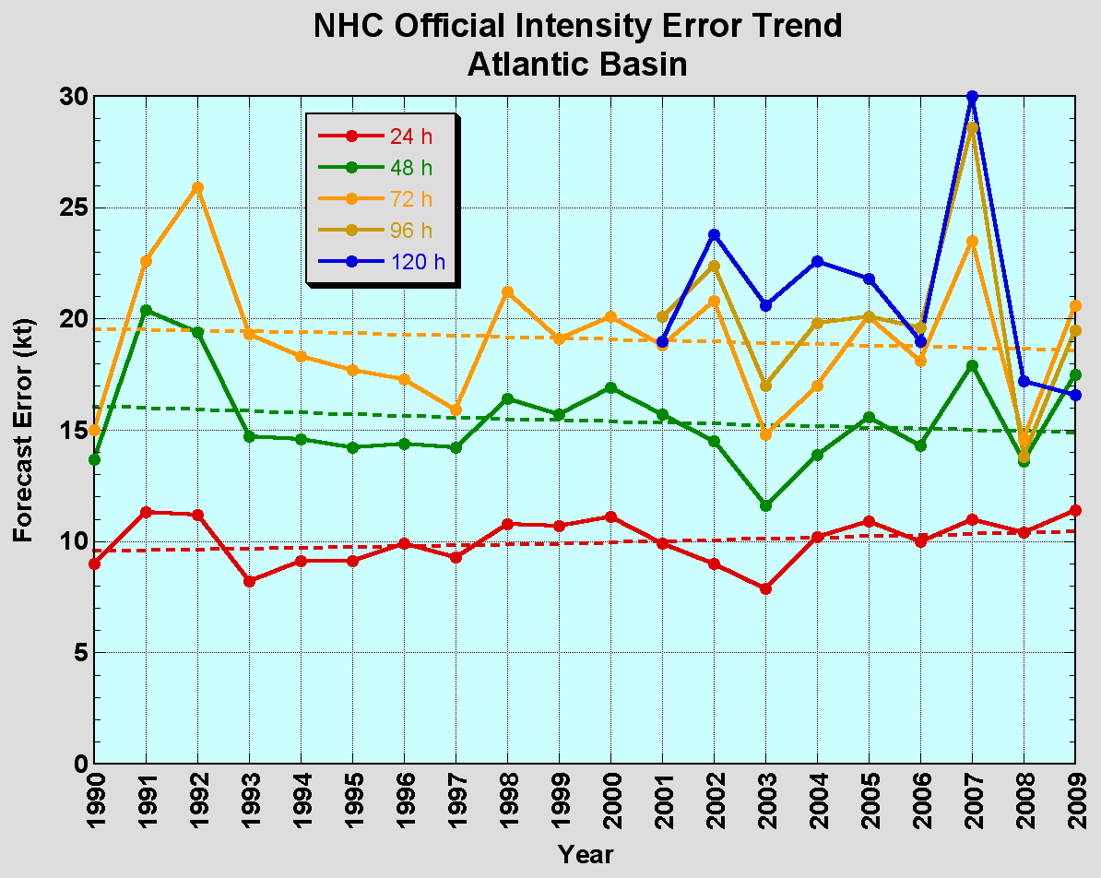
The Good – Track forecast improvements
The Bad - Intensity forecasts no real gains
No progress with intensity in last 15-20 years
Error cut in half over past 15 years
10-year improvement - As accurate at 48h as we were at 24h in 2000
24-48h intensity forecast off by 1 category
Off by 2 categories 5-10% of time

Slide 6
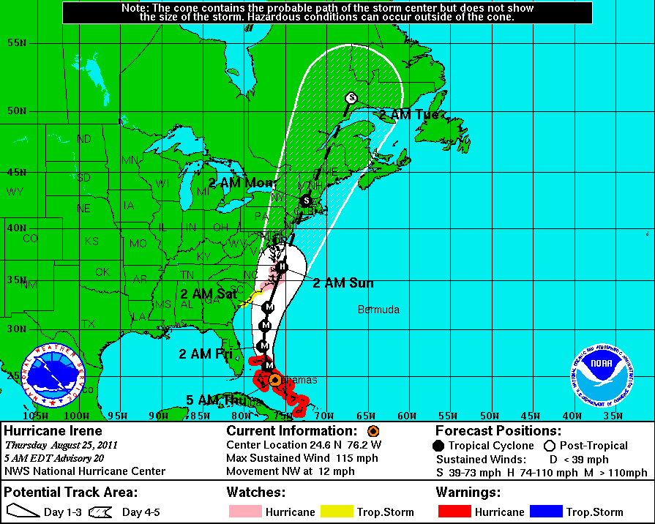
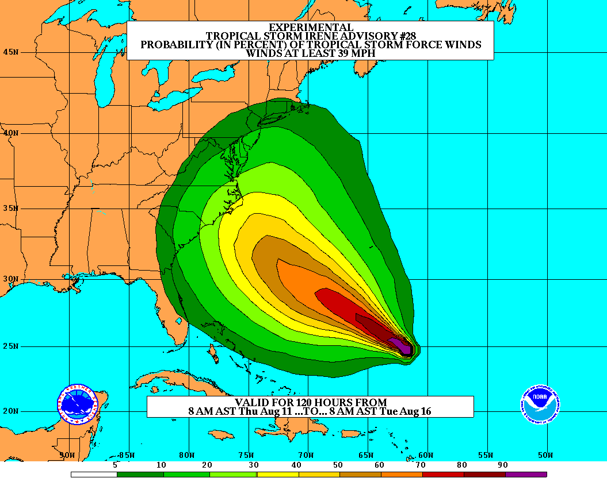
HFIP Objectives
Improving forecast accuracy
Hurricane impact areas (track): 50% in 10 years
Severity (intensity): 50% in 10 years
Special focus: Rapid intensity change
Increase probability of detecting rapid intensification at day 1 to 90% and 60% at day 5
Extend forecast reliability out to 7 days
Quantify, bound and reduce forecast uncertainty to enable risk management decisions
Improve storm surge forecast
More information on HFIP website: http://www.hfip.org
Notes:
With recent catastrophic events like Katrina (2005) and Wilma (2005), back- to-back Category 5 storms in the Caribbean Sea like Dean (2007) and Felix (2007), and rapid intensifying storms just prior to landfall like Charley (2004) and Humberto (2007)

Slide 7
HFIP Challenges and Strategies
Challenges
Limited operational high performance computing availability
Model initialization issues within the first 24-36 hrs
Better utilization of existing satellite data
Development of useful probabilistic forecast products and effectively communicate the information
Strategies
High-resolution approach
Adequately resolve the hurricane structure
5-15 km in the global forecast model
1-3 km in the regional forecast model
Global modeling
Track
Uncertainty
Extend 4-7 days forecast
Regional modeling
Intensity at medium forecast lead time
rapid intensity at a shorter lead times
Ensemble approaches
Single model ensemble
Physics ensemble
Multi-model ensemble
Mixture of the above ensemble approaches
Ultimate approach: High-resolution ensemble approaches

Slide 8
Major HWRF developments
Model framework expansion
New model internal storm track algorithm (HRD-EMC)
Multiple nest framework (HRD-EMC)
Idealized test (HRD-ESRL)
Physics improvement
New GFS convection and shallow convection (EMC)
Modified PBL (HRD-EMC)
GFDL surface scheme (EMC-HRD)
Modifications to treatment of eddy diffusivity (HRD-EMC)
Vortex initialization & Cycling (EMC-HRD)
Improve vortex initialization for more realistic storm size and intensity corrections
Cycle multiple-nest fields
Couple to HYCOM ocean model in the Atlantic (EMC)
Data assimilation
Hybrid DA (EMC)
HEDAS & Regional Hybrid DA (HRD-EMC)
Model compatibility (EMC)
Add configuration flexibility
Add multi-platform compatibility
Notes:
8

Slide 9
NCEP Operational HWRF (2.0) 2007
AOML/HRD HWRFX (V3.0.1) 2008 (HFIP Stream 2)
HWRF Vortex
Assimilation & GSI
WRF pre-processing system
Flexibility for testing initial
Conditions for research
NMM dynamics with
one moving nest
NMM dynamics with
multiple moving nests
Operating resolution 27:9
Operating resolution
27:9, 9:3 and 27:9:3
Hurricane EnKF Data
Assimilation System (HEDAS)
Ocean Coupled
GFDL/GFS Physics/
Slab LSM
GFDL/GFS Physics/
NOAH LSM
Consistent w/ 3 km res.
Framework also
Includes Idealized
Cases/ 1-D HYCOM
HWRF post-processor
& HPLOT
Diapost: High Res. Hurricane Post-Processing system
Release Version HWRF V3.2
2010
Tropical Prediction System
(HWRF-GEN)
Basin-Scale &
Multiple-Movable Nests
27:9:3 REAL-TIME HFIP STREAM 1.5 SYSTEM (2011)
HWRF V3.2/V3.4

Slide 10
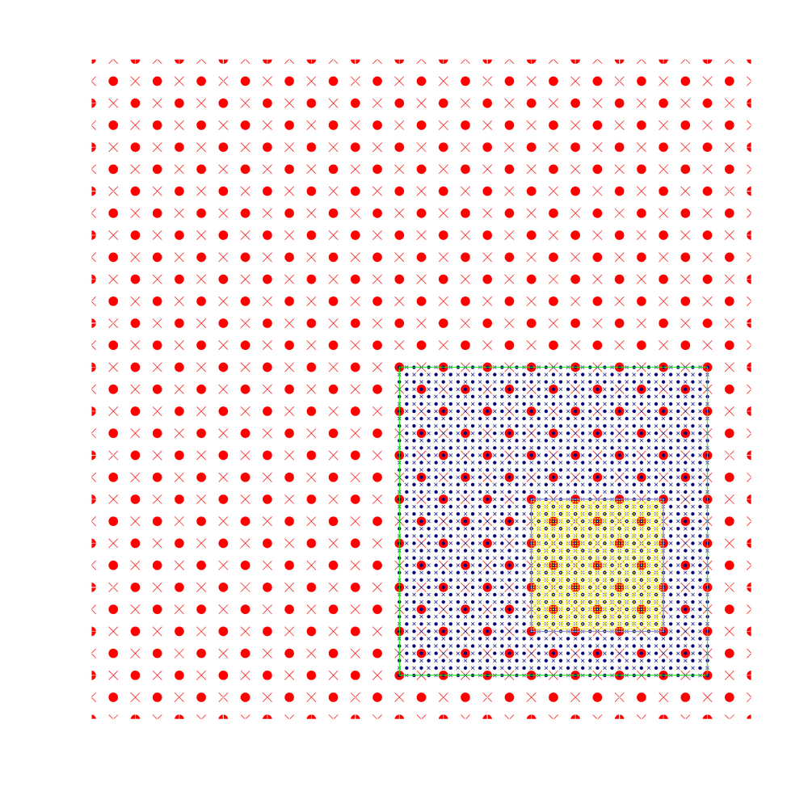
Main Development Activities
Moving Nest (HRD/EMC)
Starting point at mass points
Aligning at mass points
Mediate domain follows the inner most domain
Nest following centroid MSLP minima
Main Developments
Idealized framework (HRD/PSD)
Physics configuration (EMC/HRD/PSD)
3rd Nest Initialization (EMC/HRD)
Ongoing Developments
Hybrid DA (EMC/HRD/GSD)
Multiple moving nests (HRD/EMC)
3-Nest Oper. Implementation--2012 (EMC)
Repository Version (EMC/DTC)
• Mass points × Wind points
Successful O2R and R2O story under HFIP direction!

Slide 11
Coupling processes
Atmospheric Component
SST
Coupler
SST
Oceanic Component
Fluxes
Winds
Domain attributes
Fluxes
Winds
Domain attributes
Coupler functions
Interpolation
Data passing
Synchronize oceanic and atmospheric components
Initialize the moving nest leading edge

Slide 12
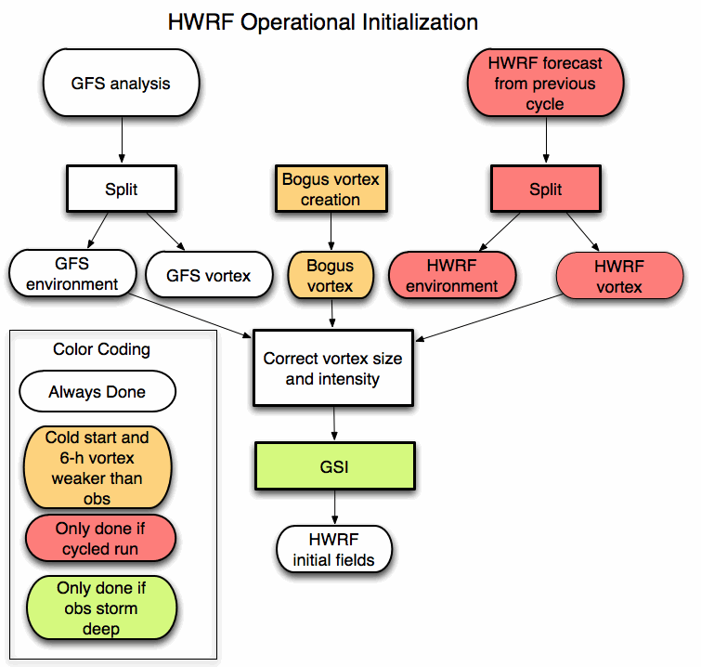
Vortex initialization and cycling processes

Slide 13
Data Assimilation
For Vortex scale
T – 6 h
T
T + 126 h
Ensemble
Spin-up
DA Cycling
with EnKF
Deterministic HWRF-X Forecast from Ens. Mean
1-hour Cycles
Ensemble
Initialization from T-6h GFS-EnKF
Real-Time
Observation
Pre-Processing
Mean of Final Analysis Assumed Valid for T
Credit: A. Aksoy

Slide 14
Current Model Configurations
 | 2011 Oper. HWRF | Proposed 2012 HWRF
Domain | 27 KM: 77.76˚X 77.76˚ 9 KM: 7.2˚ X 6.0˚ | 27 KM: 77.76˚ X 77.76˚ 9 KM: 10.56˚ X 10.2˚ 3 KM: 6.12˚ X 5.42˚
Vortex Initialization | 27-9 KM: Yes, with GSI | Modified Vortex Initialization at 3 KM, with 30x30º analysis domain and GSI
Cycling | Yes(Vortex only) | Yes (3 km vortex only)
Ocean Coupling | 27-9 KM: Yes | 27-9 KM: Yes 3 KM: No, Downscaled
Physics schemes
Microphysics | Ferrier | Modified Ferrier (High-Res)
Radiation | GFDL | GFDL
Surface | GFDL (2011) | GFDL (High_res)
PBL Scheme | GFS | 2012 GFS (High_res)
Convection | New SAS | SAS (High-Res), No CP (3 KM), Shallow Convection
Land Surface | GFDL Slab | GFDL Slab
GWD | Yes(27km); No(9km) | Yes(27km); No(9-3km)
Notes:
14

Slide 15
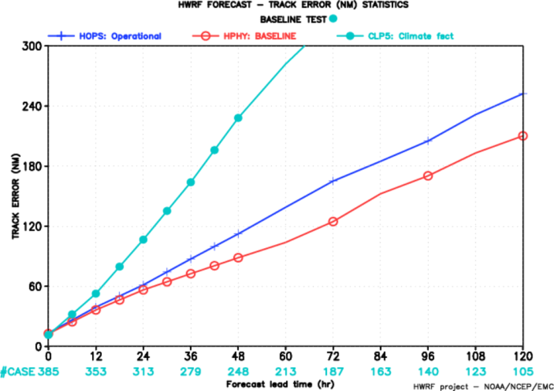
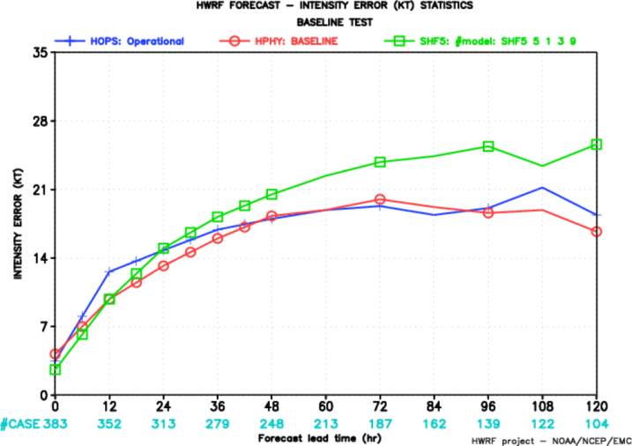
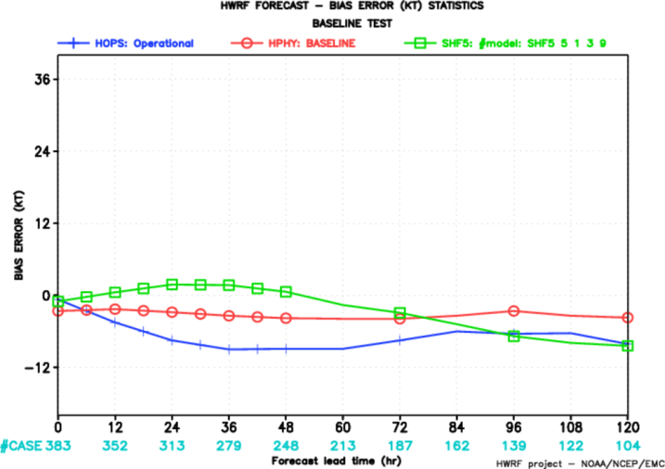
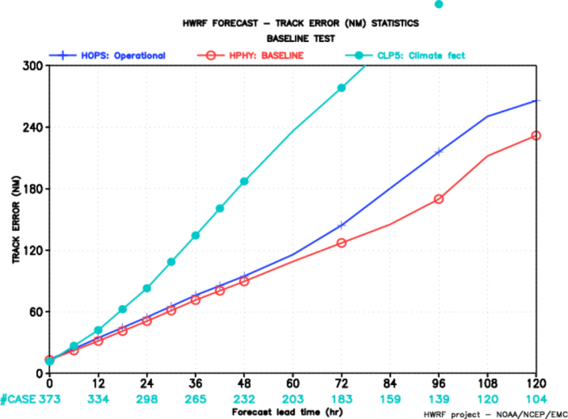
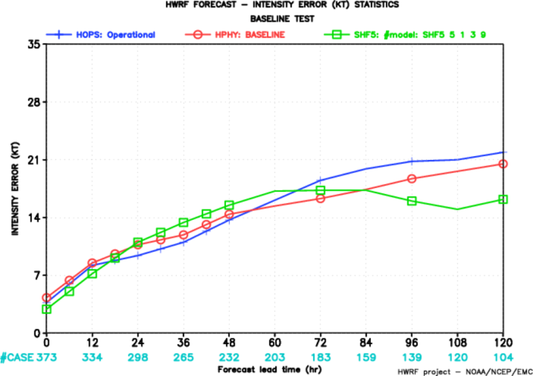
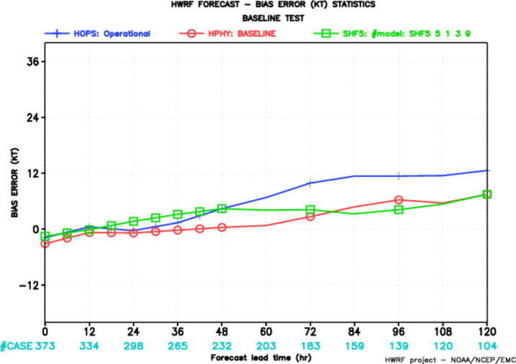
2010 AL
Track Error
Intensity Error
Bias Error
2011 AL
HOPS
HPHY
CLP5
SHF5

Slide 16
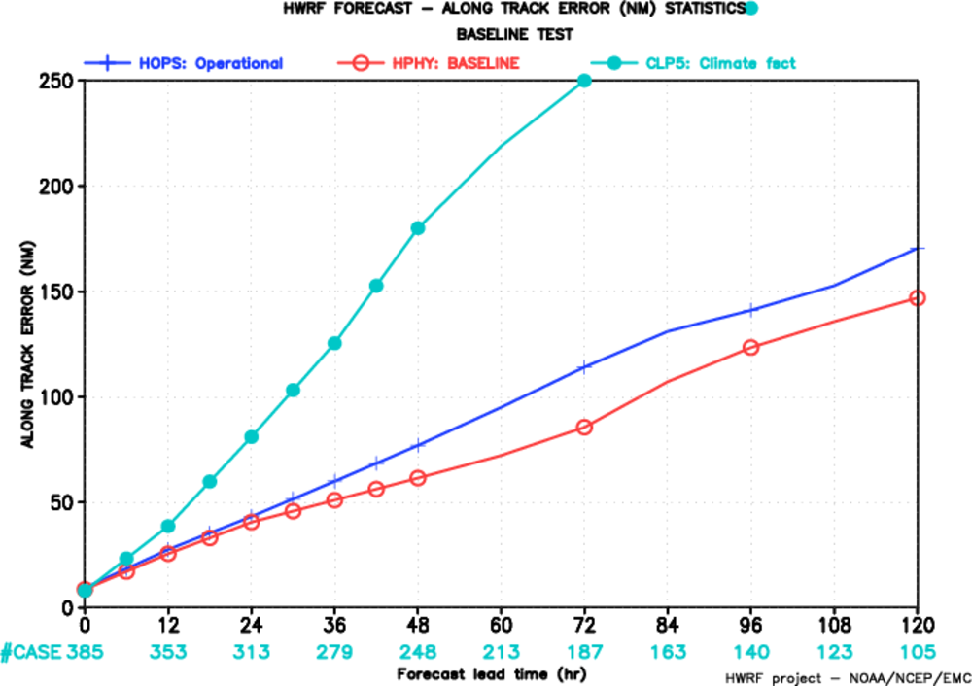
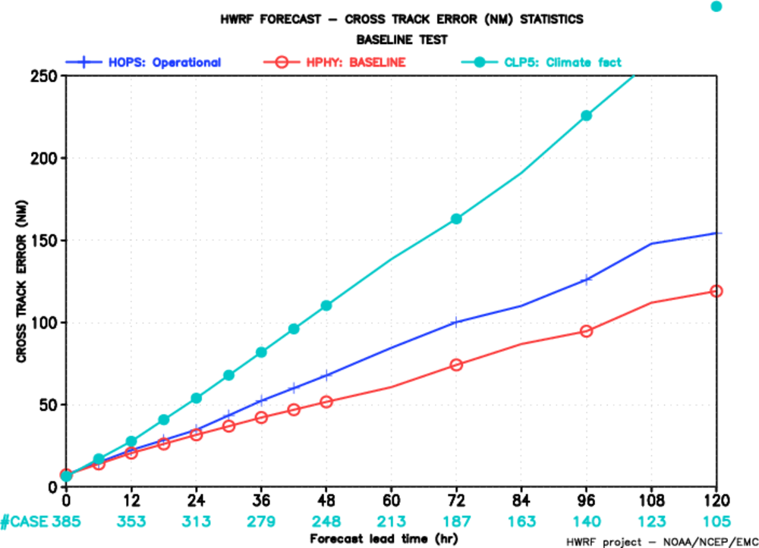
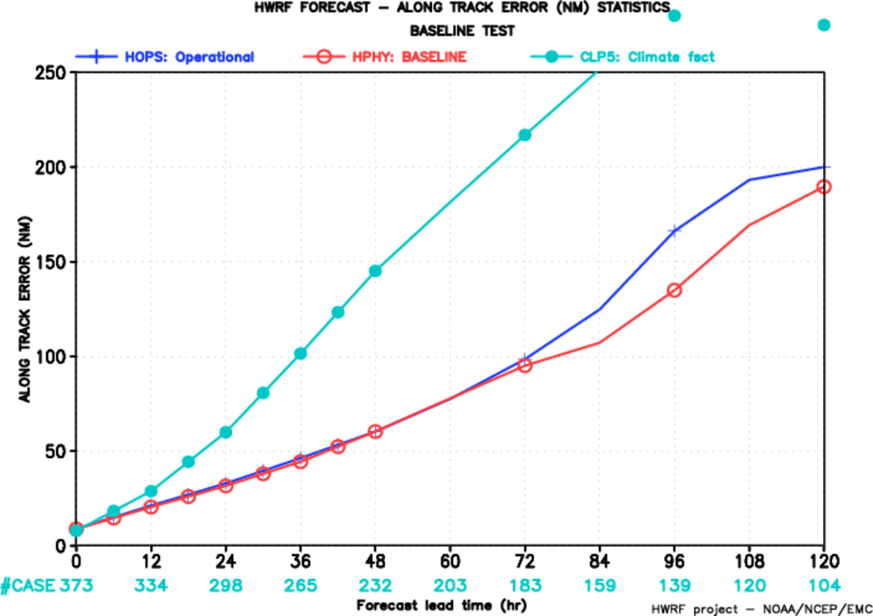
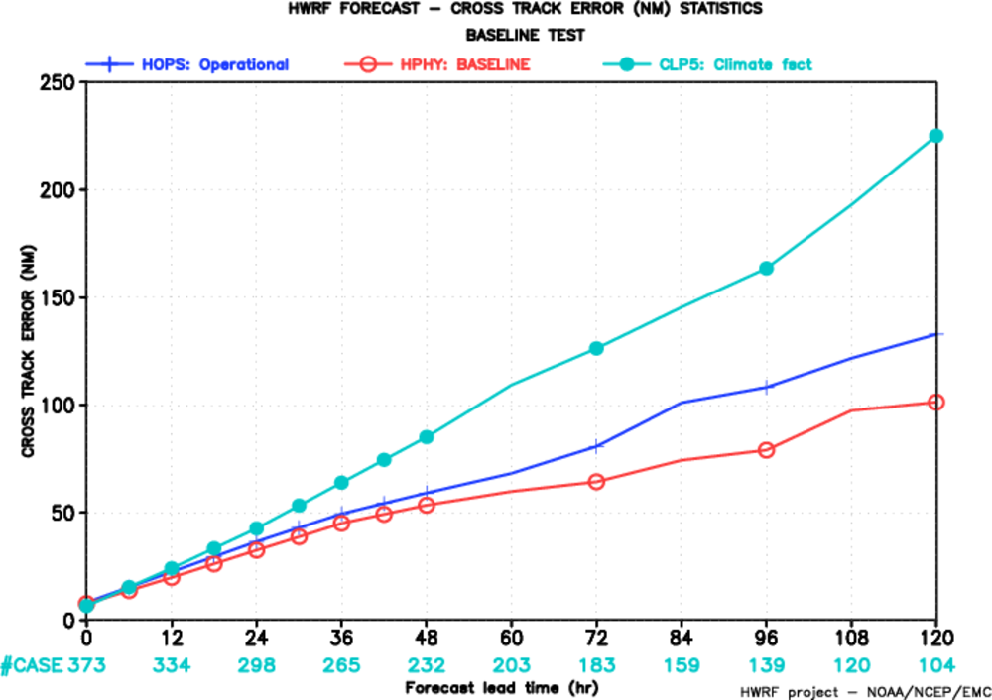
2010 AL
Along Track Error
Cross Track Error
2011 AL
HOPS
HPHY
CLP5

Slide 17
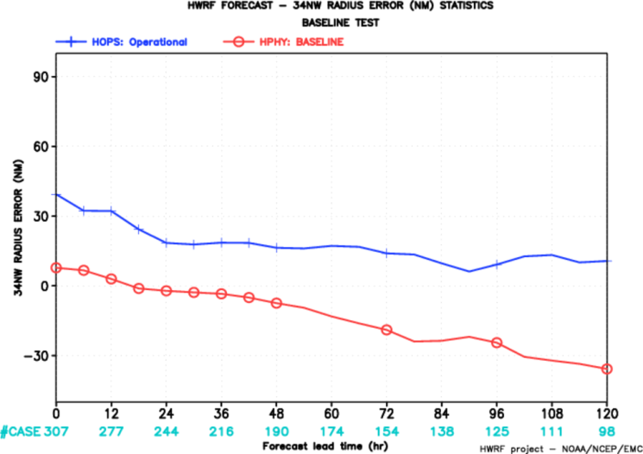
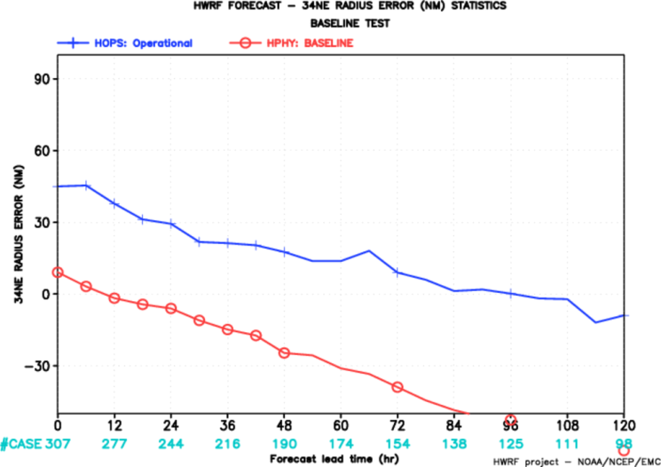
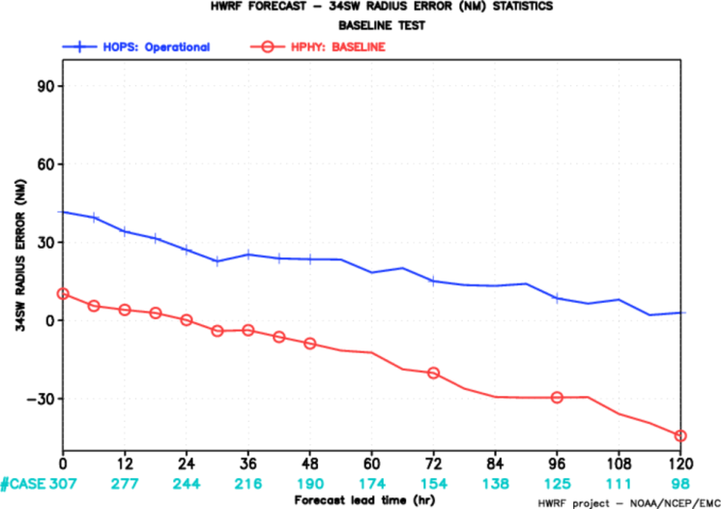
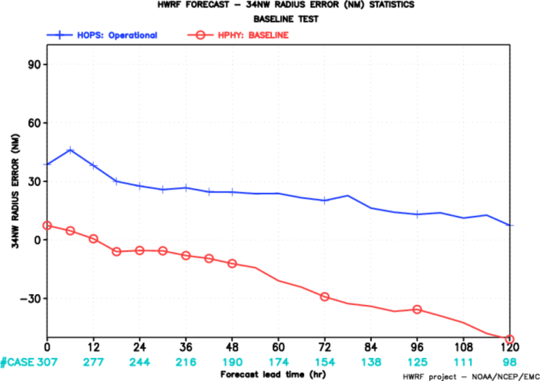
Radius 34kts
2010 AL
NW
NE
SW
SE
HOPS
HPHY

Slide 18
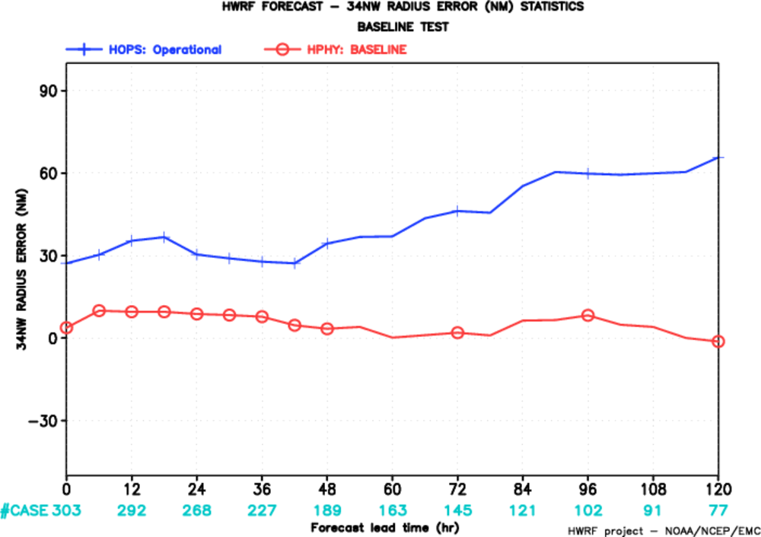
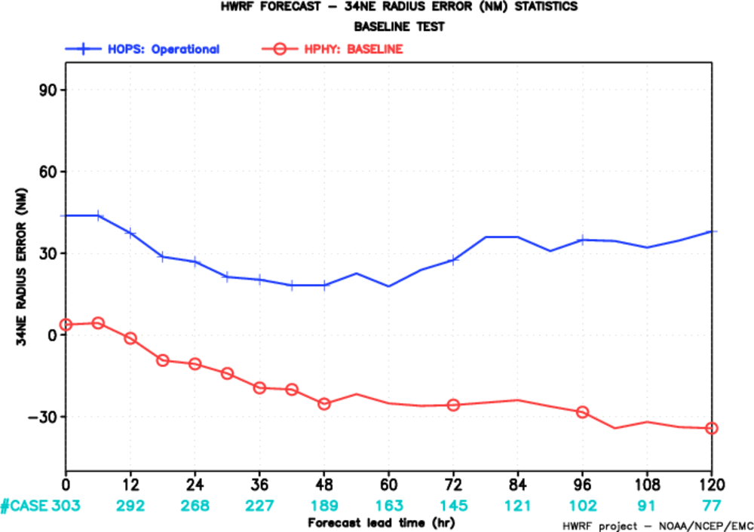
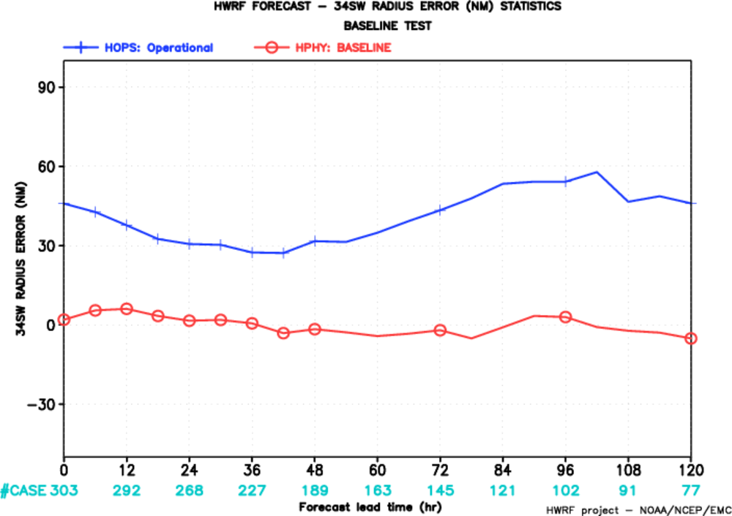
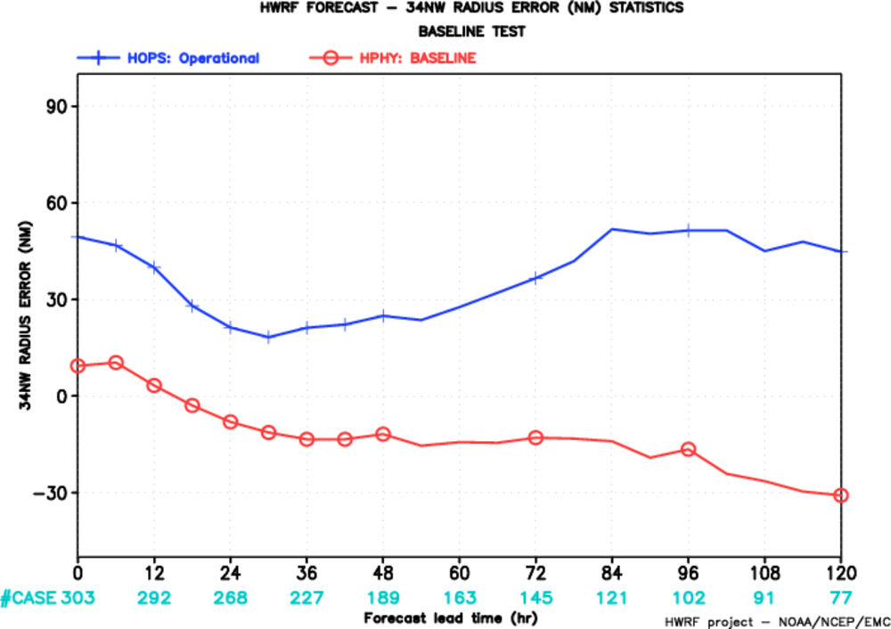
Radius 34kts
2011 AL
NW
NE
SW
SE
HOPS
HPHY

Slide 19
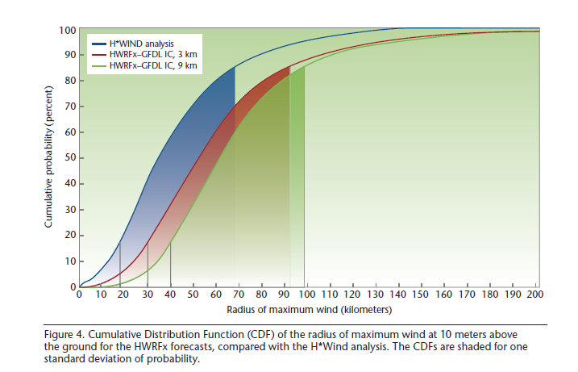

Slide 20
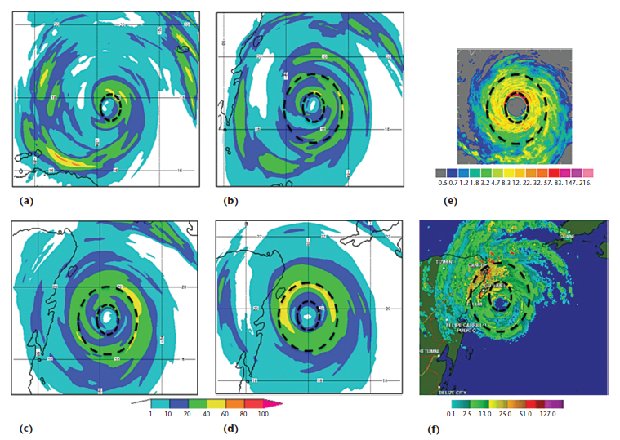
HWRFx’s forecast for Hurricane Wilma eyewall replacement compared to radar-estimated precipitation rate. The HWRFx 9/3-km resolution forecast was initiated at 1200 UTC 19 October 2005. Dashed circles indicate the approximate eyewall positions before and after the replacement process

Slide 21
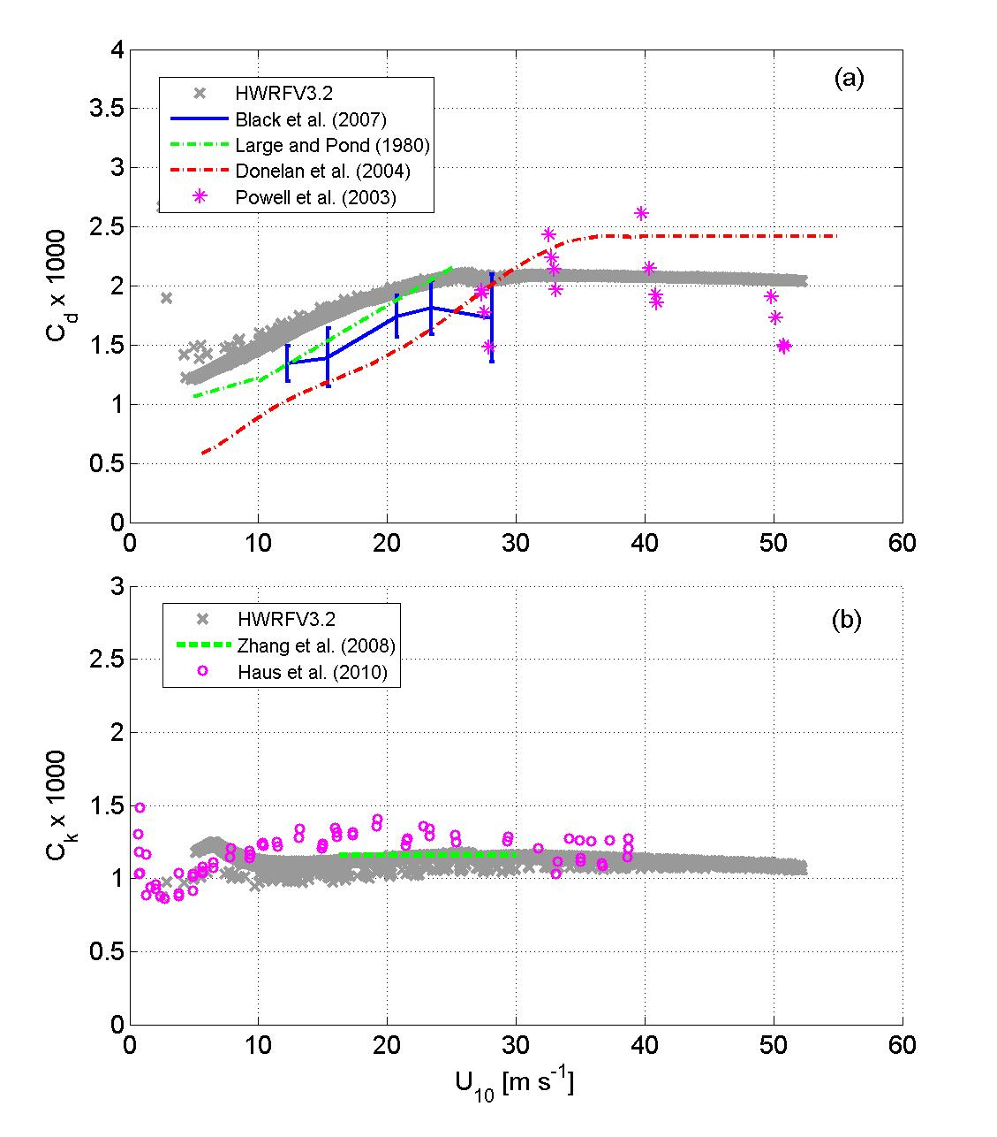
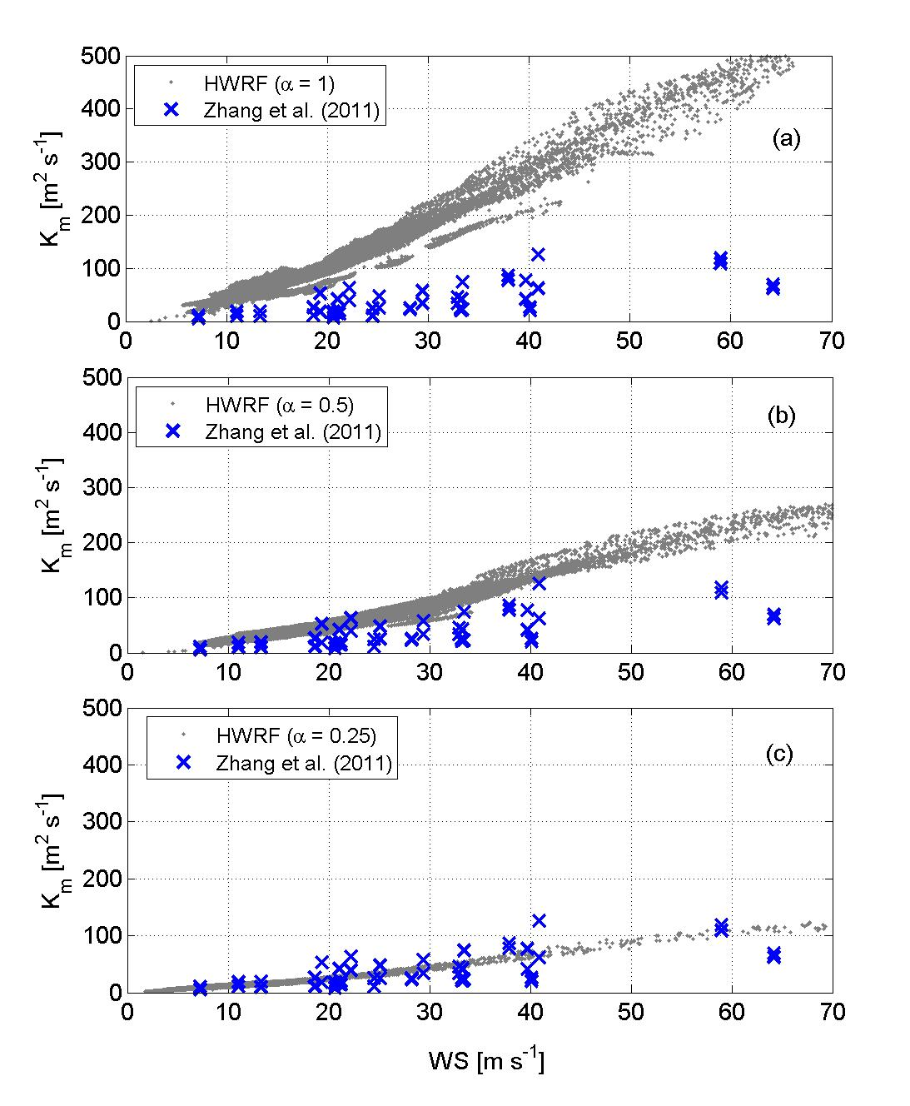
High Resolution PBL Physics Parameters
C_{d}: Surface exchange coefficient for momentum
K_{mc}: Eddy diffusivity for momentum
K_{m} =1/2 K_{mc}
C_{k}: Surface exchange coefficient for moisture & heat
K_{m} =1/4 K_{mc}
Gopalakrishnan et al. 2011

Slide 22
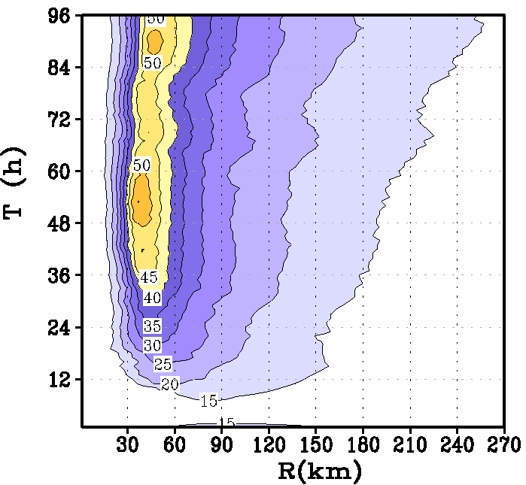
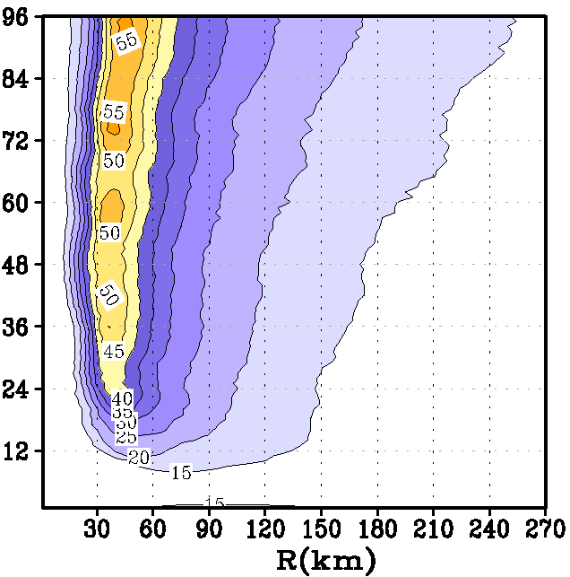
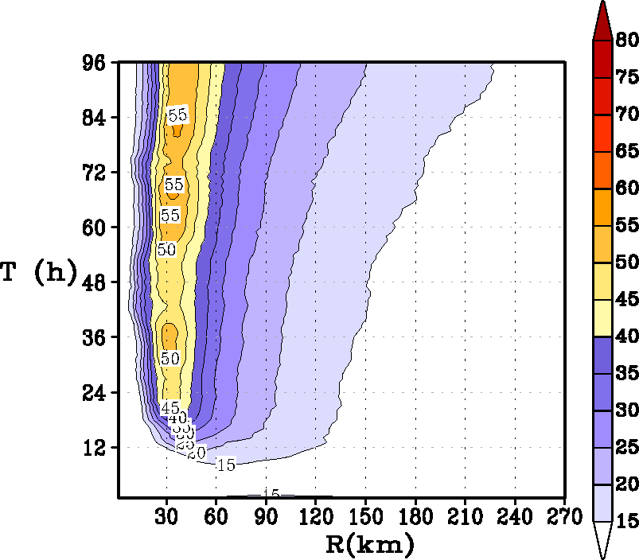
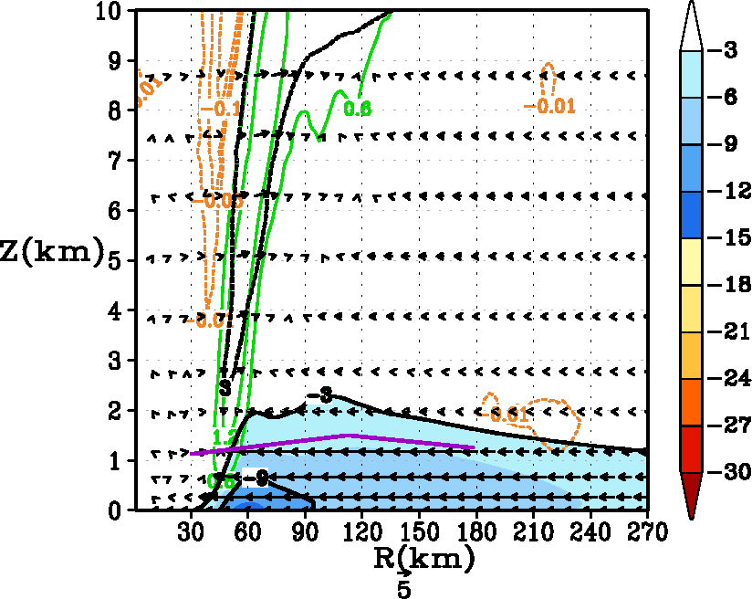
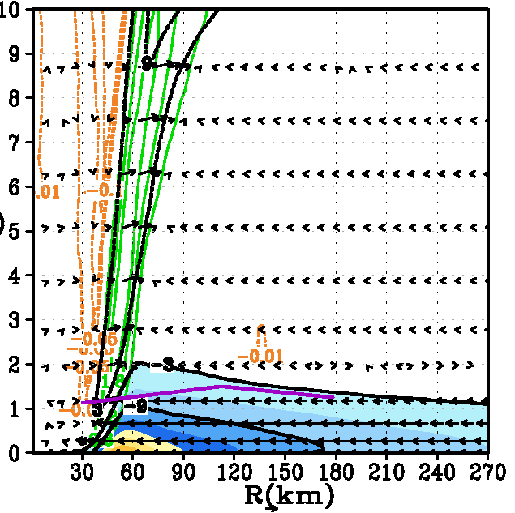
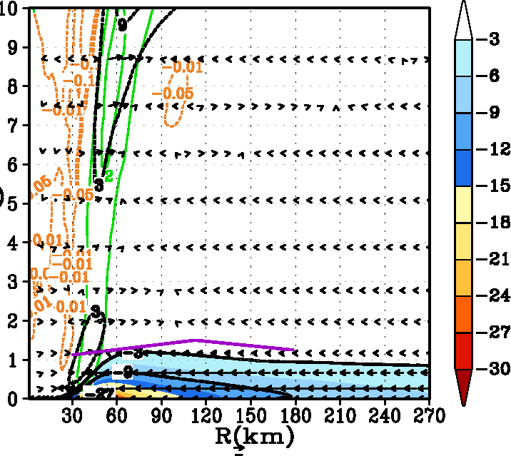
K_{m}
K_{m1}=0.5*K_{m}
K_{m2}=0.25*K_{m}
Time history of the intensification process in an idealized storm for the three simulations (Top panels); Tangentially averaged, 6-hourly time averaged, radius-height cross-section of the secondary circulation at 93 hours (Bottom panels).

Slide 23
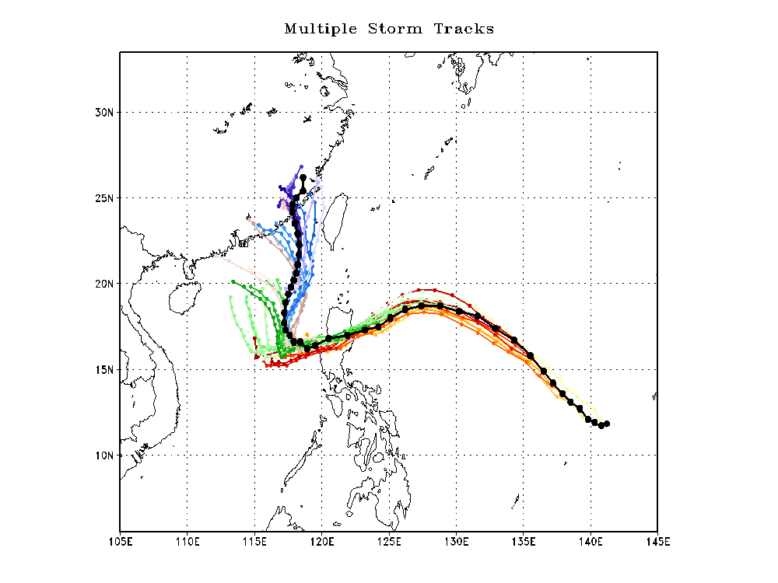
Megi Track forecast

Slide 24
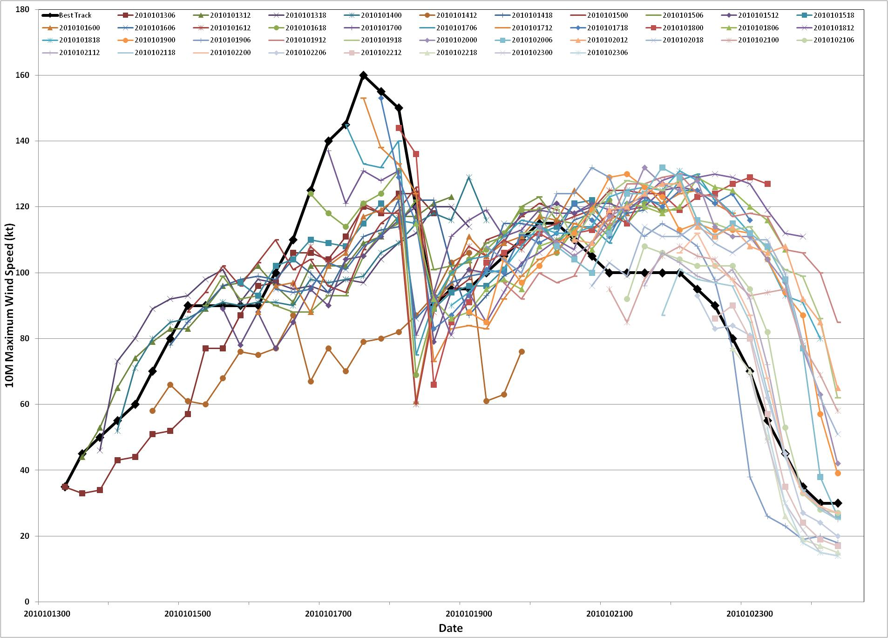
Megi Intensity Forecast
CAT-5
CAT-4
CAT-3
CAT-2
CAT-1
TS

Slide 25
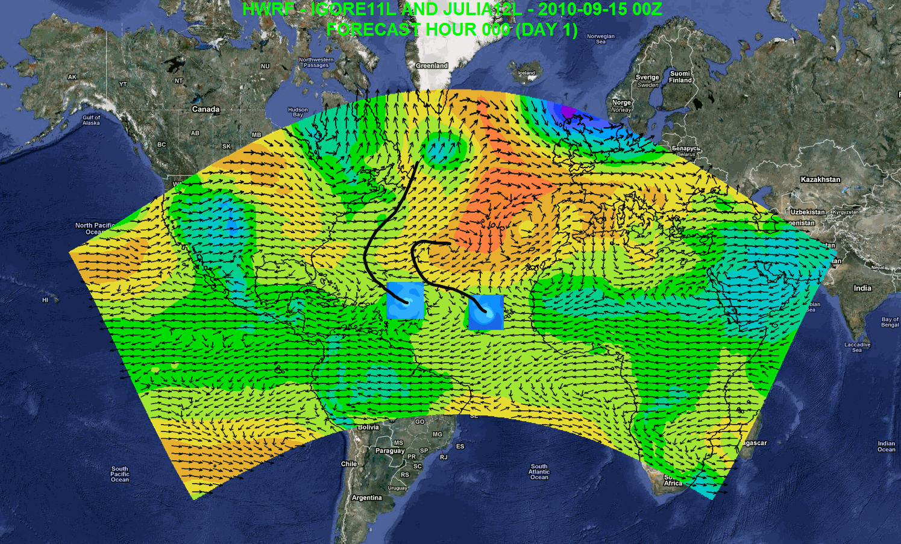
Possible Applications
Independent DA and cycling system
7-day forecast
Track forecast
Local applications
Regional ensembles/products
Daily Tropical Outlook/genesis
Website at AOML: https://storm.aoml.noaa.gov/realtime
Notes:
Independent DA system including vortex scale DA
Genesis
Track forecast
Local application
Drive local-scale model
Website at AOML: https://storm.aoml.noaa.gov/realtime

Slide 26
Advancing the HWRF System FY2012 & Beyond
 | 2012 |  | 2013 | 2014* |  | 2015* | 2016*
Resolution/ Infrastructure | Triple nested HWRF (27/9/3 km) |  | Increased vertical resolution, higher model top | community R2O efforts (HFIP) |  | Upgrades to WRF infrastructure, Multiple moving domains, NEMS/ESMF/NMM-B, Other oceanic basins
Physics | PBL, Shallow Convection & Microphysics |  | Microphysics, Radiation, Surface Physics, Coupling to Waves and Land Surface, Physics for high-resolution
DA/ Vortex Initialization | Storm size correction, dynamic mass-wind consistency |  | Inner core DA (Doppler Radar, satellite) |  | Hybrid-EnKF DA, advanced vortex relocation procedure, improved GSI
Ocean | HYCOM Coupling |  | Improved ocean data assimilation, physics and resolution, unified coupled system for ATL & EPAC
Waves | One-way Wave Coupling |  |  | Two-way wave coupling, multi-grid surf zone physics, effects of sea spray
Diagnostics and Product Development |  | HWRF Ensembles, Coupling to Hydrological/ Surge/ Inundation models, diagnostics, product development
.
Ongoing Work
2012 upgrades
Planned developments
*Computer upgrade

