Slide 1
Introduction to Marine Forecast in North Atlantic Basin
Xuejin Zhang
University of Miami
Credit to
National Hurricane Center website
http://www.nhc.noaa.gov

Slide 2
Marine forecast Products
Atlantic
East Pacific

Slide 3
Marine Forecasts (Cont’)
Grid Marine Products (Experimental)
Mean Sea Level Pressure
Surface (10-m) winds
Significant Wave Heights
The average wave height (trough to crest) of the one-third largest waves

Slide 4
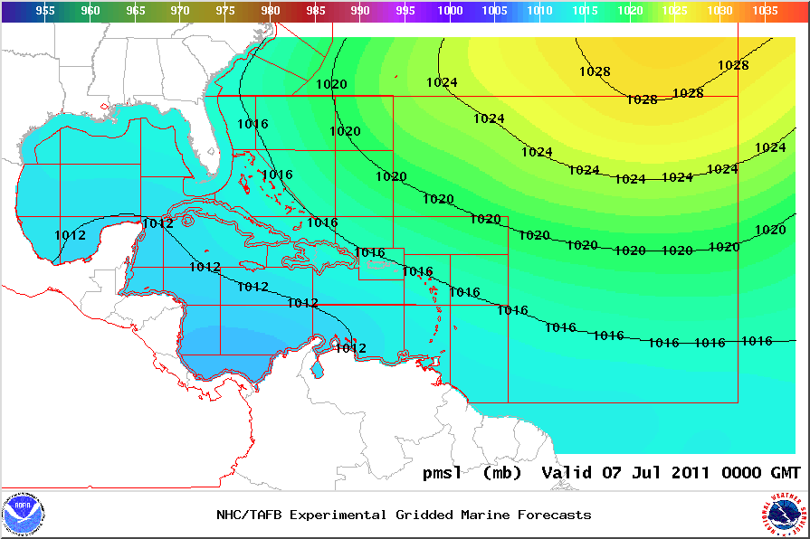
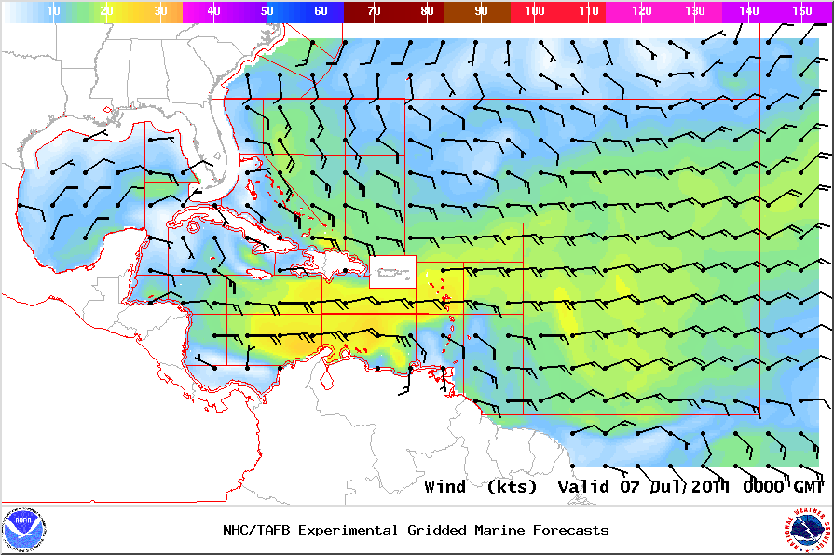
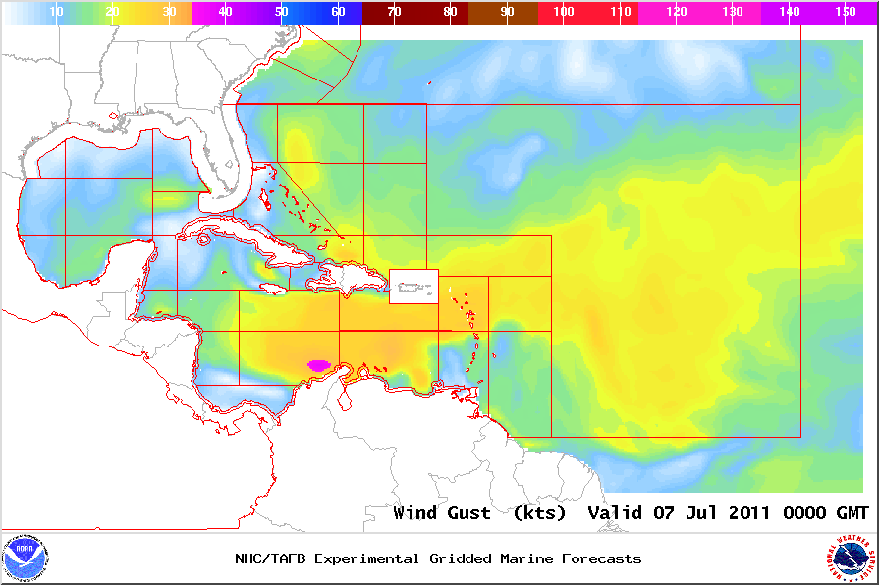
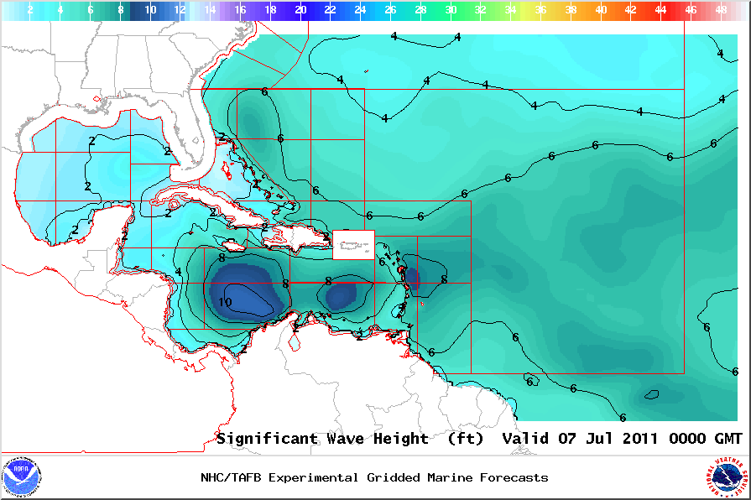
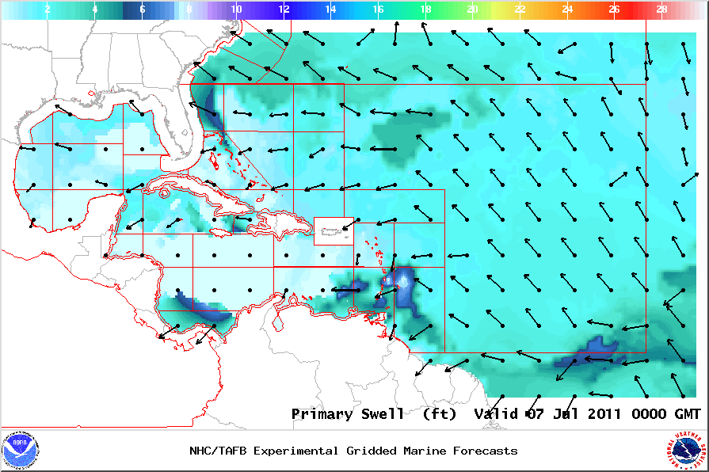
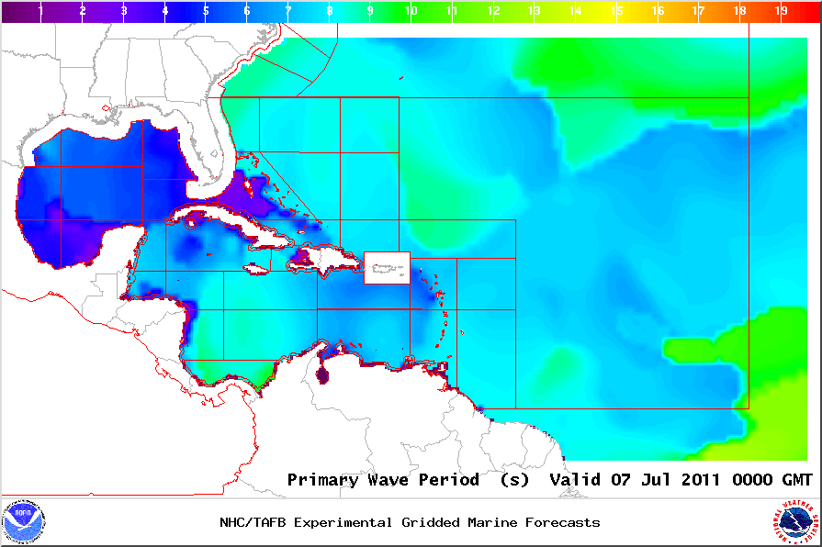
Marine forecasts (Cont’)
MSLP
Wind
Wind Gust
Wave Height
Swell
Period

Slide 5
Marine Forecast (Cont’)
Forecast length
5 days
Forecast frequency
6 hourly

Slide 6
Forecast tools
 | Atlantic | East Pacific
Hovmöller Diagram (5 day Satellite) | Tropical Atlantic and Caribbean (GOES-E) Gulf of Mexico and subtropical Atlantic Eastern Atlantic and Africa (METEOSAT-9) Southern CONUS and subtropical Atlantic (GOES-E) | East Pacific (GOES-W)
Upper-Air Time Sections | Selected Observing Stations
GFS Pressure Change Analysis | See image | See image
ASCAT Ocean Wind Data | See recent data
Streamlines | GFS NAM | GFS NAM
Sea Surface Temperature | Analysis and Anomalies

Slide 7
Forecast tools (Cont’)
National Data Buoy Center | NOAA Recent and Historic Marine Data
CDIP Buoys | SCRIPPS Recent and Historic Buoy Data
ASCAT | EUMETSAT Satellite Derived Ocean Surface Winds
NOAA Wavewatch III | NOAA/NCEP Operational Wave Models
FNMOC Wavewatch III | FNMOC Operational Wave Models
NOAA nowCOAST | Web Mapping Portal to Real-Time Coastal Observations and NOAA Forecasts
VOS Program | United States Voluntary Ship Observing Program
VOS Monitoring | Meteo-France VOS info, data, and QC plots
UW-CIMSS WAVETRAK | Satellite Derived Tropical Wave Tracking Tools
MAROB Program | MAROB Voluntary Marine Observation Program
Safe Boating | Safe Boating Practices

Slide 8
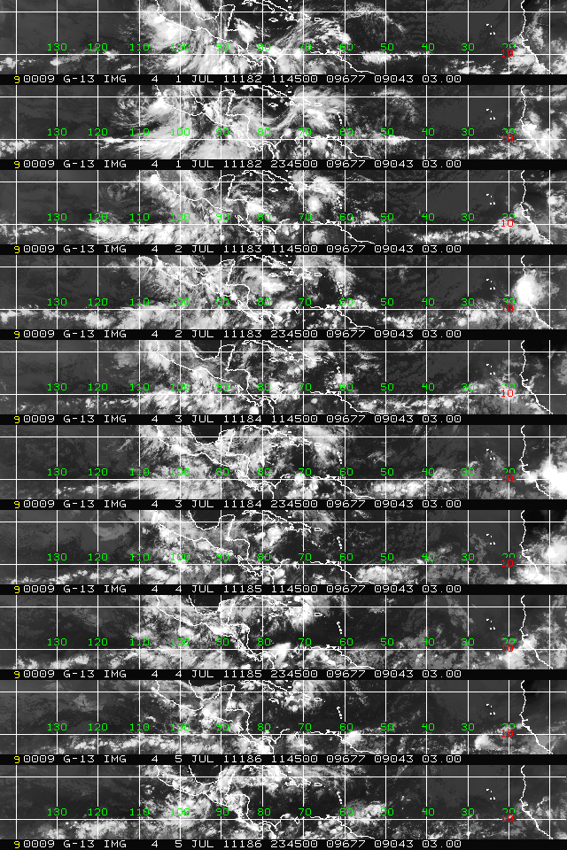
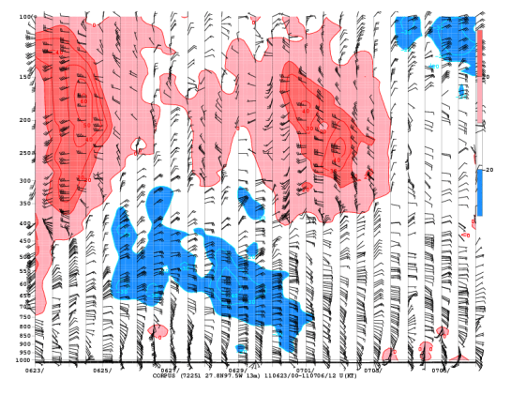
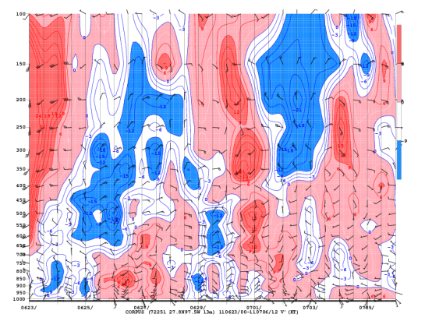
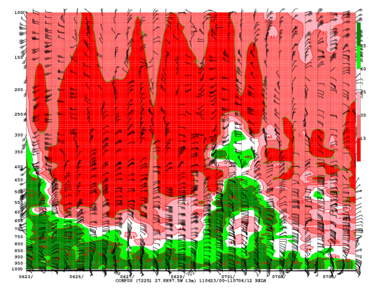
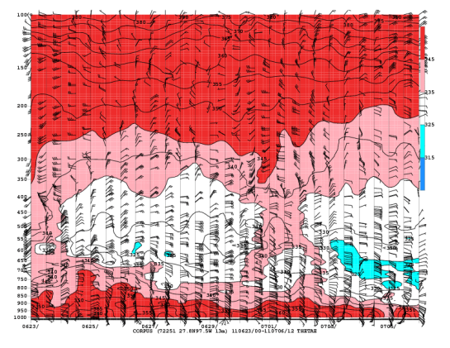
Forecast tools (cont’)
Actual Wind
Anomalous Wind
RH
Theta-e
GOES-E

Slide 9
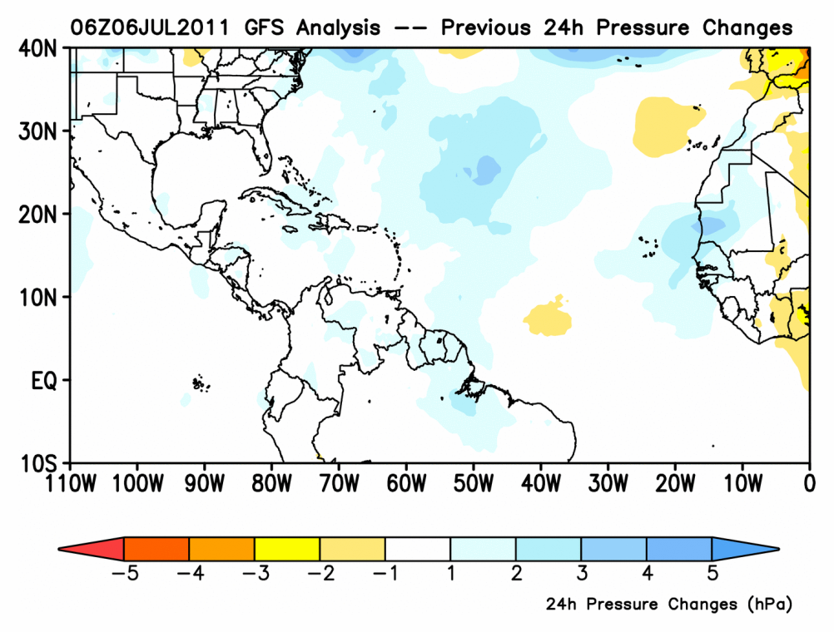
Forecast tools (cont’)
GFS Pressure change
GFS 850hPa Streamline (24h fcst)

Slide 10
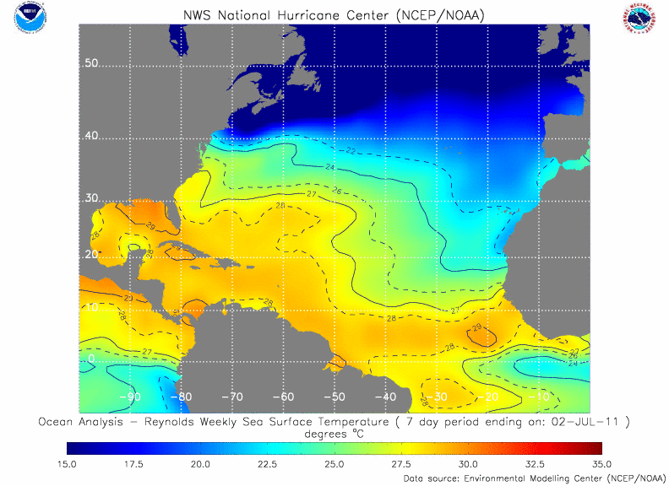
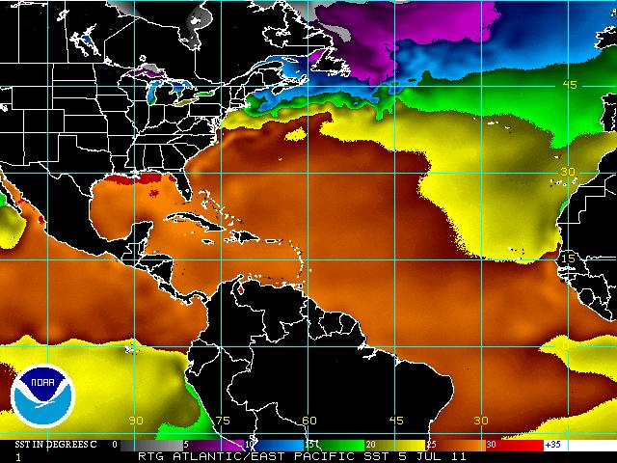
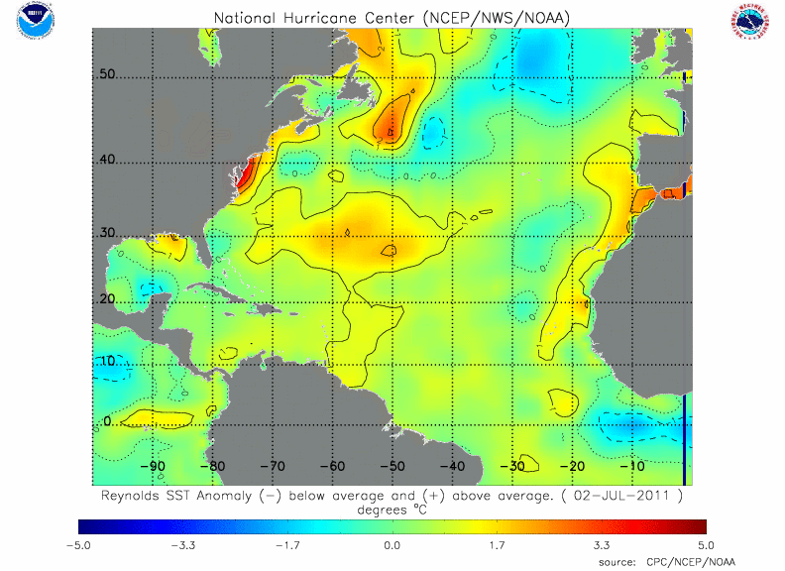
Forecast tools (cont’)
7-day SST
Daily SST
SST Anomaly

