Slide 1
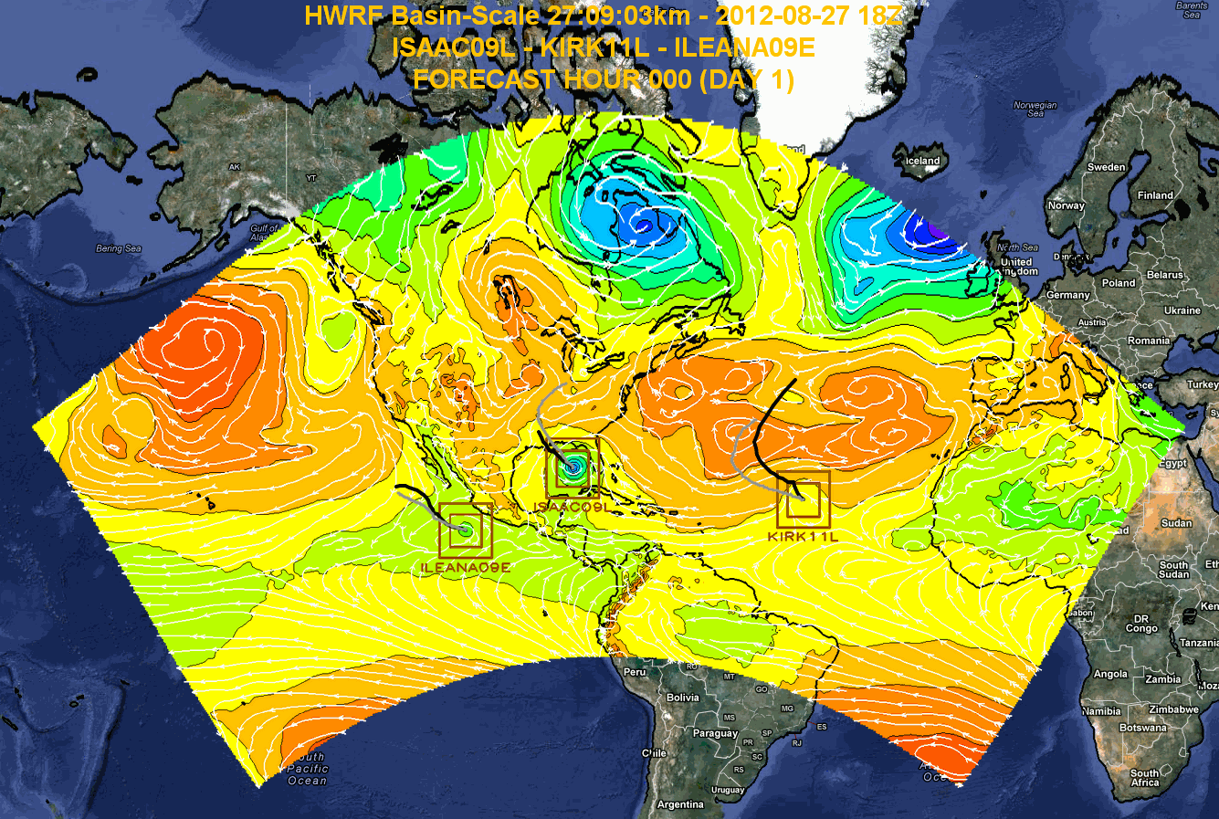
Research Applications
Storm-storm interactions
Model bias diagnostics
Physics parameterization evaluation and improvement
Initialization and its sensitivity
Extended forecasts and genesis
Data impact and Data Assimilation
Hurricane vortex reanalysis
R2O Transitions
Triple nest algorithm
Idealized capability
Multiple movable nests
Multiple movable nest initialization
Calibrated PBL and surface parameterization at hurricane wind regime
Horizontal and vertical diffusion
Hurricane diagnostic tool
Begin R&D for the next generation global-to-local scale TC forecast system
Multiple Movable-Nest HWRF Modeling System

