Slide 1
Toward Improving Hurricane Intensity Forecast: the Operational Regional Model Perspective
Xuejin Zhang (UM/CIMAS)
Sundararaman Gopalakrishnan (AOML/HRD)
Vijay Talapragada (NCEP/EMC)
Acknowledgement
Frank Marks, Robert Rogers, and Shirley Murillo
HRD Modeling team
HRD DA team
EMC HWRF team
DTC

Slide 2
Outline
Background
  HFIP objectives
  Observations
  Understanding
HWRF development
  Framework expansion
  Physics improvement
  Ocean coupling
  Vortex initialization & Cycling
  Data Assimilation
Advances in HWRF forecast
  Model configuration
  Retrospective forecasts
  Real-time parallel forecast effort
  Genesis effort
Summary

Slide 3
Background

Slide 4

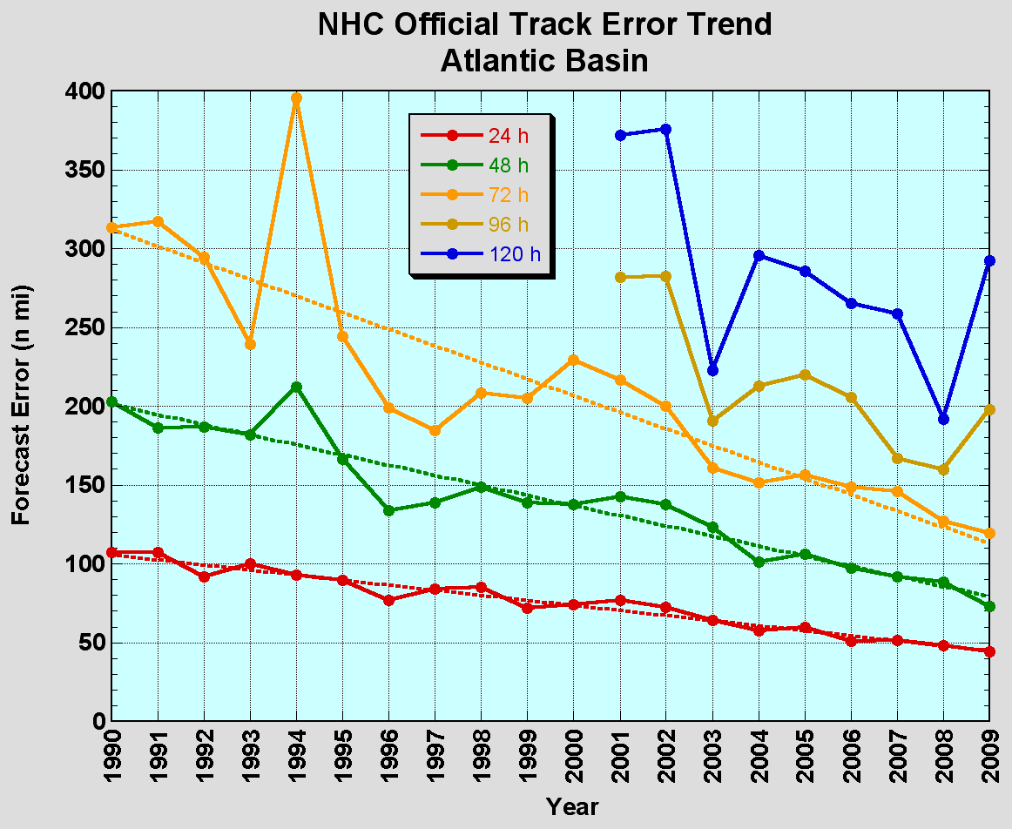
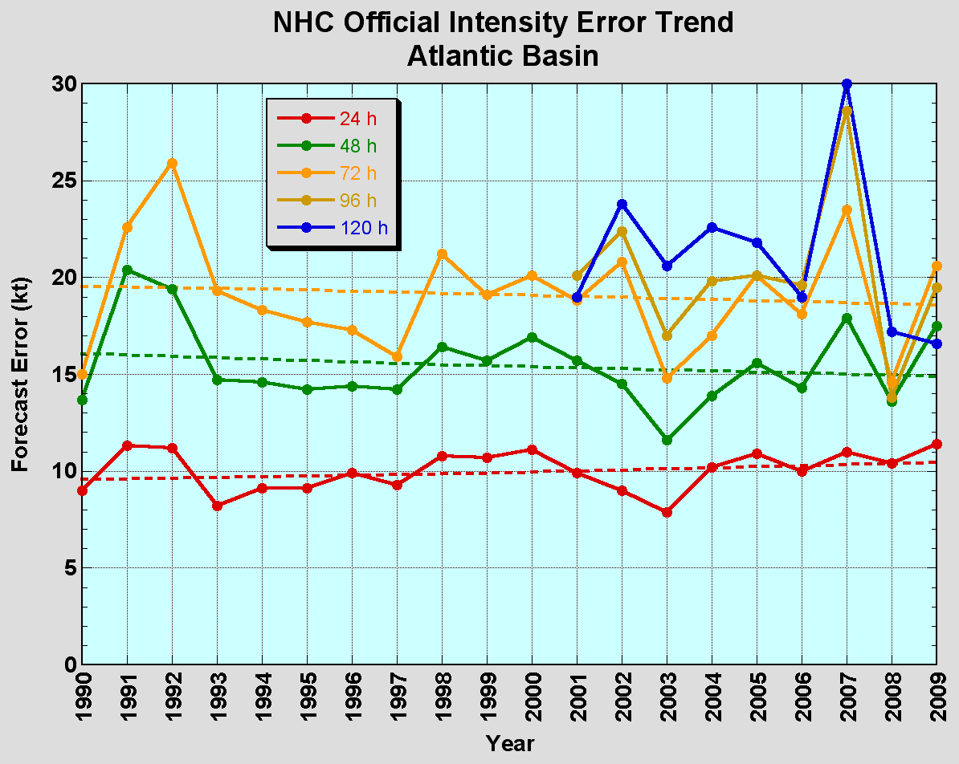
The Good – Track forecast improvements
The Bad - Intensity forecasts no real gains
No progress with intensity in last 15-20 years
Errors cut in half over past 15 years
10-year improvement - As accurate at 48h as we were at 24h in 2000
24-48h intensity forecast off by 1 category
Off by 2 categories 5-10% of time
Credit: F. Marks

Slide 5
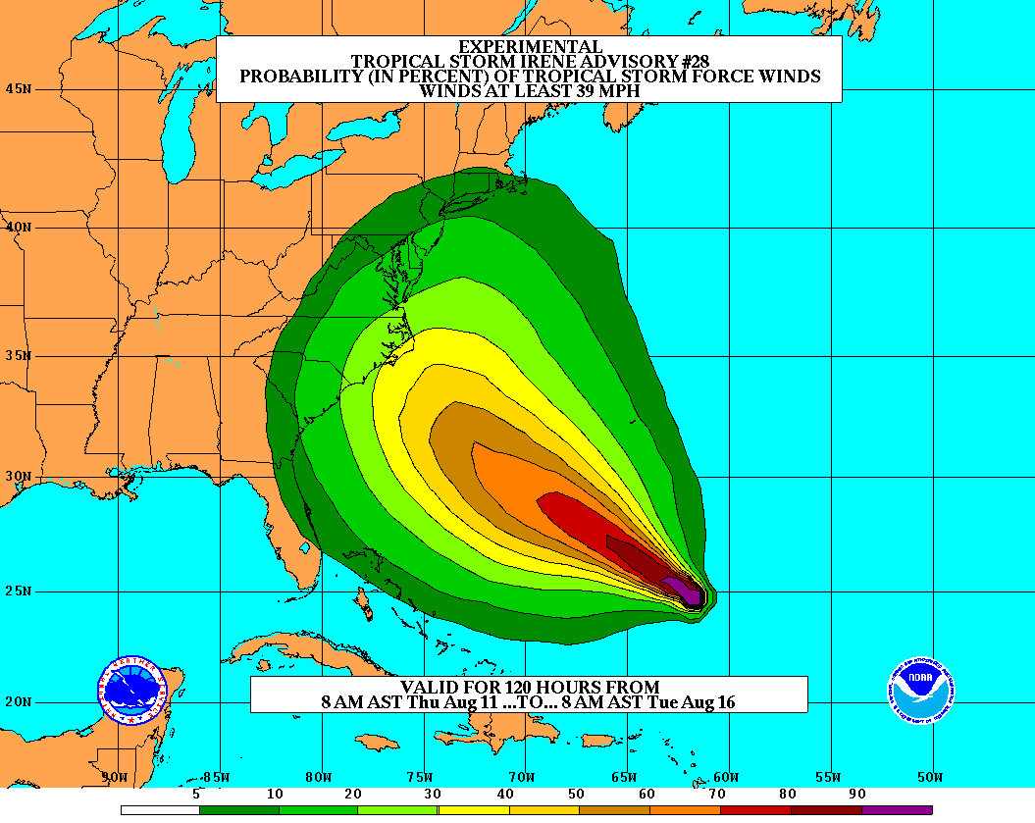
Goals
Improve Forecast Accuracy
  Hurricane impact areas (track) – 50%
  in 10 years
  Severity (intensity) – 50% in 10 years
  Special Focus on Rapid Intensity Change (RI)
Extend forecast reliability out to 7 days
Quantify, bound and reduce forecast uncertainty to enable risk management decisions
http://www.hfip.org/
Credit: F. Marks

Slide 6


Airborne Observation
NOAA Gulfstream-IV jet:
High attitude: ~45,000 ft
Purpose
  Hurricane synoptic environment
Instruments
  GPS dropsonde
  1 Hz flight level data
  Workstation with HAPS data processing
NOAA P-3:
Low attitude: ~25,000 ft
Purpose
  Hurricane inner core environment
Instruments:
  GPS dropsonde
  AXBT
  Doppler Radar
  SFMR, DWRL etc.
  Scientific payload up to 9000 lb
Credit: R. Rogers & S. Murillo

Slide 7
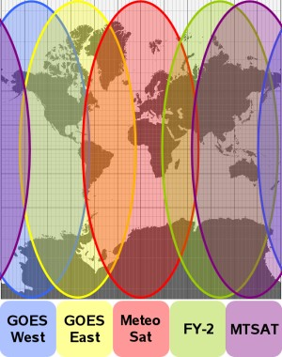
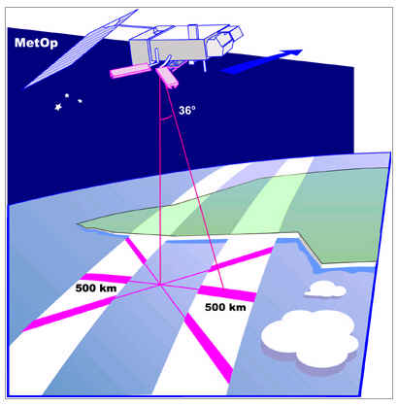
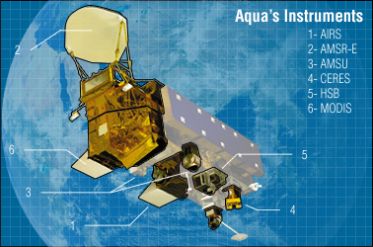
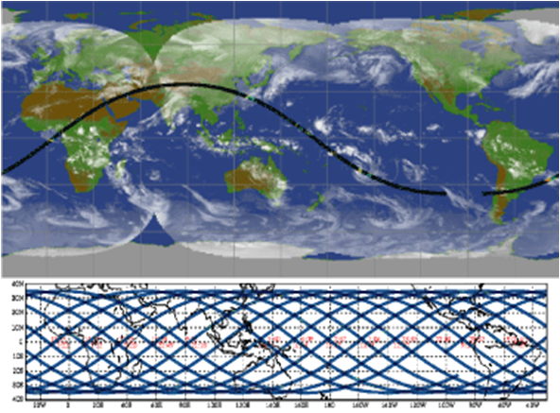
Satellite Observation
Geostationary
  visible, infrared, water vapor channels
  cloud structure, cloud-drift winds
Polar-orbiting
  active scatterometer
  surface wind speed and direction
Polar-orbiting
  passive microwave channels
  precipitation structure, ice scattering
Credit: R. Rogers

Slide 8
Understanding from Observations
Synoptic environment
Vortex structure
Convective structure
PBL structure
Microphysical structure
3D storm structure
Important parameters for model input

Slide 9
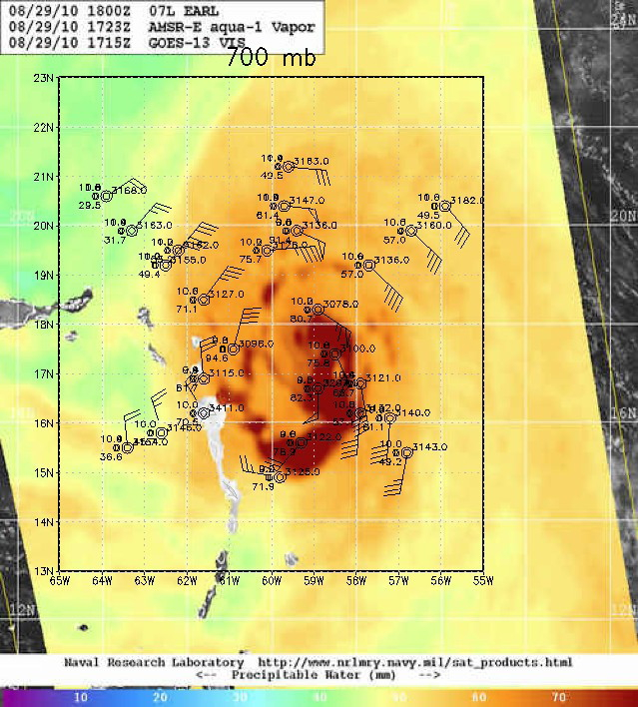
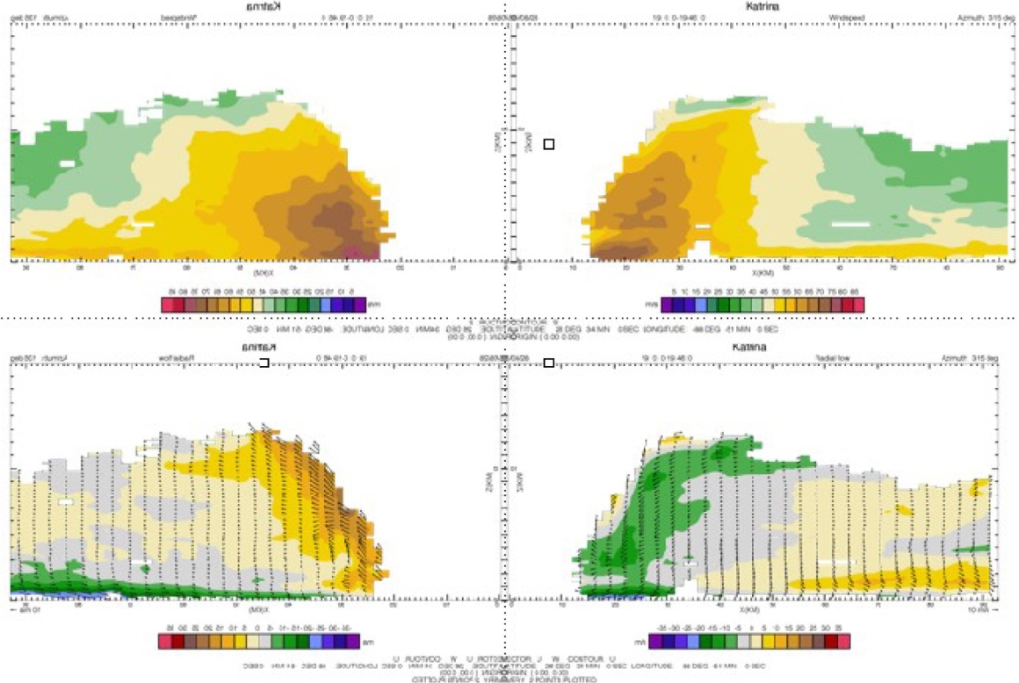
Understanding from Observation
Synoptic environment
Vortex Structure
Tangential wind
Radial and vertical wind
Credit: R. Rogers

Slide 10
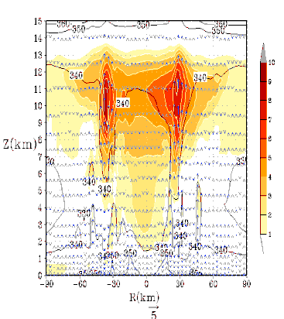
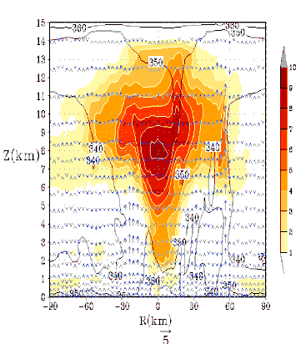
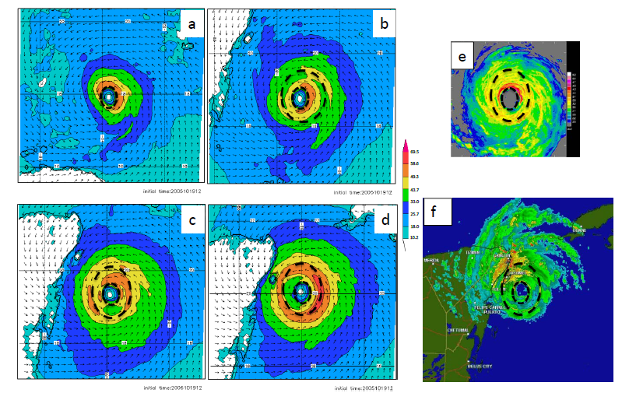
Understanding from simulation
3 km
The Experimental HWRF System: A Study on the Influence of Horizontal Resolution on the Structure and Intensity Changes in Tropical Cyclones Using an Idealized Framework By S.G. Gopalakrishnan, Frank Marks, Jr, Xuejin Zhang, Jian-Wen Bao,Kao-San Yeh, and Robert Atlas ; Monthly Weather Review (in press).
HWRFx: Improving Hurricane Forecast with High-Resolution Modeling By Zhang, Xuejin, T. S. Quirino, K.-S. Yeh, S. G. Gopalakrishnan, F. D. Marks, Jr., S. B. Goldenberg, and S. Aberson, 2011; Computing in Science and Engineering, Vol. 13, No. 1, pp. 13-21.
Performance of the experimental HWRF in the 2008 hurricane Season Yeh, K.-S., X. Zhang, S. Gopalakrishnan, S. Aberson, R. Rogers, F.D. Marks and R. Atlas; Natural Hazards ( To appear)
Sensitivity of the NOAA Hurricane Research and Forecasting Model (HWRFX) to Various Cloud and Boundary Layer Parameterizations By J.W.Bao, S.G.Gopalakrishnan and Sara A.Michelson Presented at AMS 2010- Tuscon
Warm Core: Fundamental Pathway to
Model intensification
3 km
Hwind
3 km
9 km
Finer resolution (3 –vs – 9 km) captures details of the inner core structure better than coarser resolution grid
Improved Predictions of the radius of maximum wind
Notes:
1. The initial anomaly is 2 K and is also seen in the background. In this example, an average 6–9-K temperature anomaly is carried by individual updrafts with a vertical velocity of 4–5 m s21 during the rapid intensification period.
2. As depicted by the temperature anomaly and ue contours (indicated by black color), updrafts with a life cycle of about 15 min and an origin near the top of the boundary layer transport moisture and heat (higher ue air) into the upper troposphere (Emanuel 2003).
3. In addition, heat is also added by cumulus convection.
4. Willoughby (1979) showed that the radial gradient of convective heating alone is sufficient to create weak subsidence and radial motion (w and ur). Consistent with Willoughby’s findings, and aided by weak subsidence and by radial advection (not shown and the subject of future investigation), an initially weak warm core strengthens rapidly within the first 24 h.

Slide 11
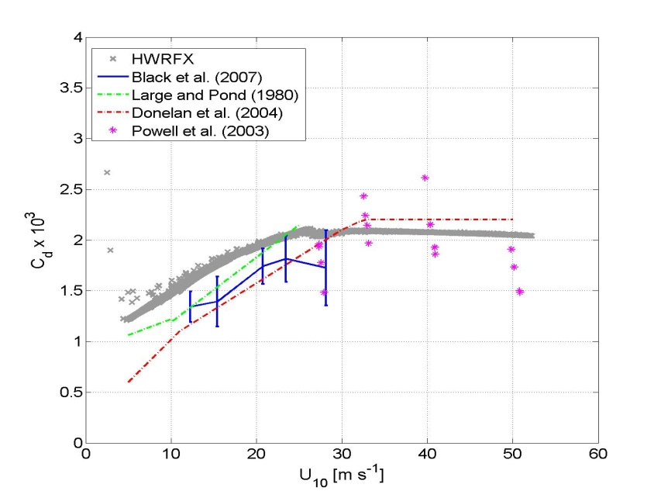
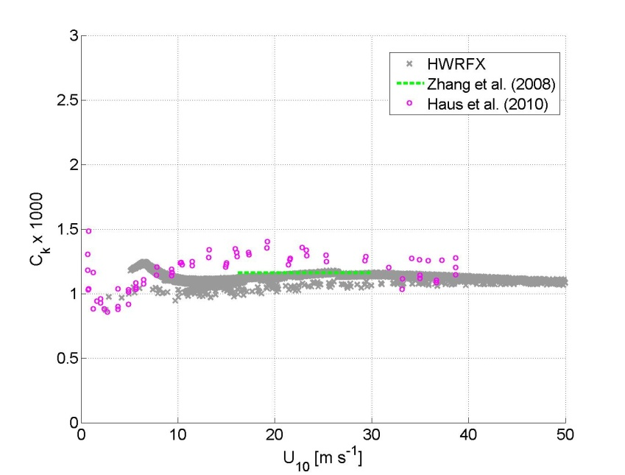
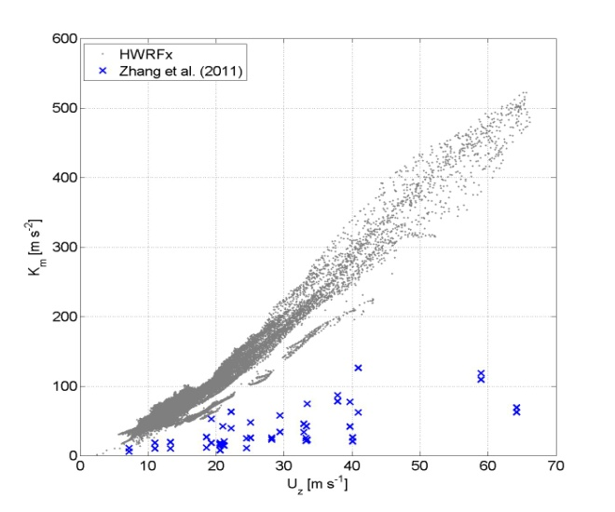
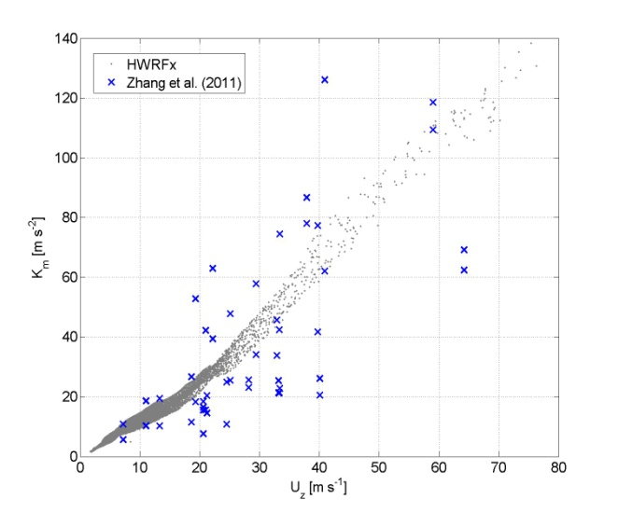
Pathway from Observation to Simulation
Current HWRF
Current HWRF
Current HWRF
Original GFS
Gopalakrishnan et al. 2011

Slide 12
HWRF Development

Slide 13
Major HWRF active developments
Model framework expansion
  New model internal storm track algorithm (HRD-EMC)
  Multiple nest framework (HRD-EMC)
  Idealized test (HRD-ESRL)
Physics improvement
  New GFS convection (EMC)
  Modified PBL (HRD-EMC)
  GFDL surface scheme (EMC-HRD)
  Modifications to treatment of horizontal diffusion (HRD-EMC)
Vortex initialization & Cycling (EMC-HRD)
  Improve vortex initialization for more realistic storm size and intensity corrections
  Cycle multiple-nest fields
Couple to HYCOM ocean model in the Atlantic (EMC)
Data assimilation
  GSI & Hybrid DA (EMC)
  HEDAS & Regional Hybrid DA (HRD-EMC)
Model compatibility (EMC)
  Add configuration flexibility
  Add multi-platform compatibility
Code management (EMC-DTC)
  Establish a community repository of the operational HWRF
  Upgrade HWRF infrastructure to V3.2+
Notes:
13

Slide 14
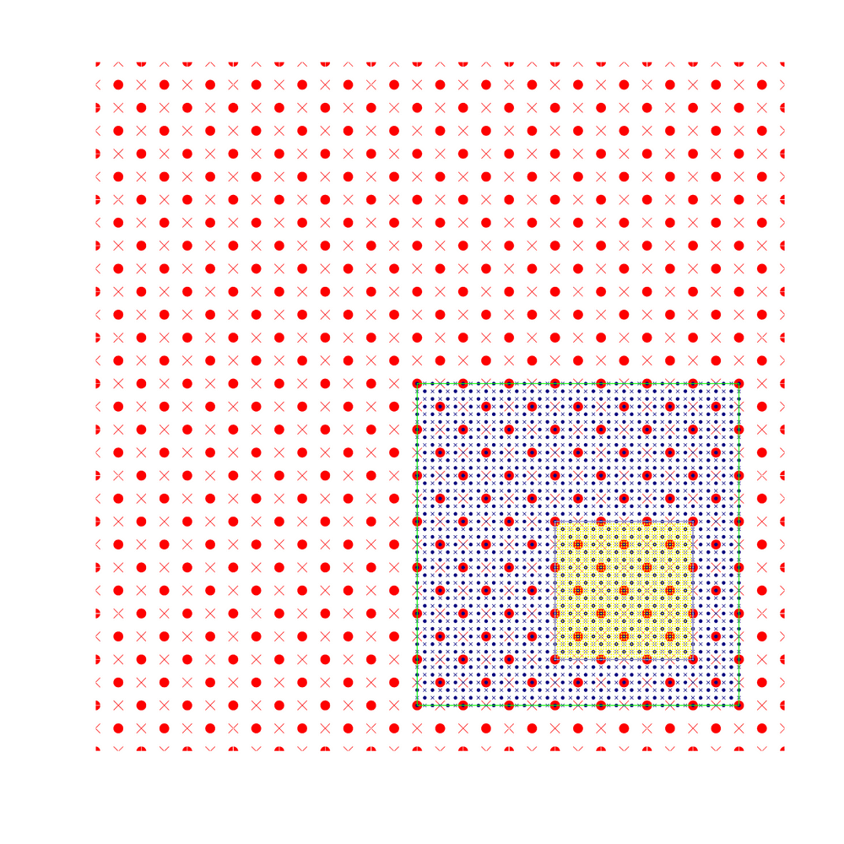
Moving Nest
Moving Characteristics
Starting point at mass points
Aligning at mass points
Mediate domain follows the inner most domain
Centroid MSLP follow
• Mass points
× Wind points

Slide 15
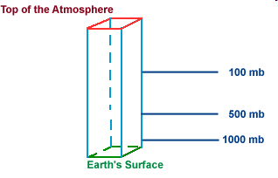
Vertical Mass Adjustment
50 hPa
50 hPa
50 hPa
100 hPa
420 hPa
Downscale
420 hPa
500 hPa
Feedback
850 hPa
Earth’s Surface
1000 hPa
Earth’s Surface
Coarse Grid
Reference Surface
Fine Grid
Pressure indirectly interpolated between parent hybrid and nested hybrid
The height, temperature and moisture fields from the parent domain are vertically interpolated onto pre-defined standard pressure surfaces.
The above meteorological fields from the mother domain are further interpolated horizontally onto nested grids on the same pressure surface.
Finally, by using the high-resolution topography over the nested domain, hydrostatic mass balancing is carried out to prescribe the initial values in the nested domain.

Slide 16
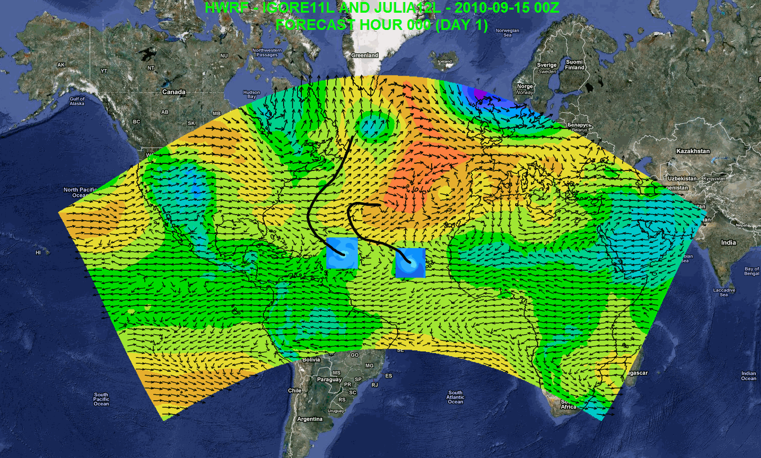
Possible Applications
Independent DA and cycling system
7-day forecast
Track forecast
Local applications
Regional ensembles/products
Daily Tropical Outlook/genesis
Website at AOML: https://storm.aoml.noaa.gov/realtime
Notes:
Independent DA system including vortex scale DA
Genesis
Track forecast
Local application
Drive local-scale model
Website at AOML: https://storm.aoml.noaa.gov/realtime

Slide 17
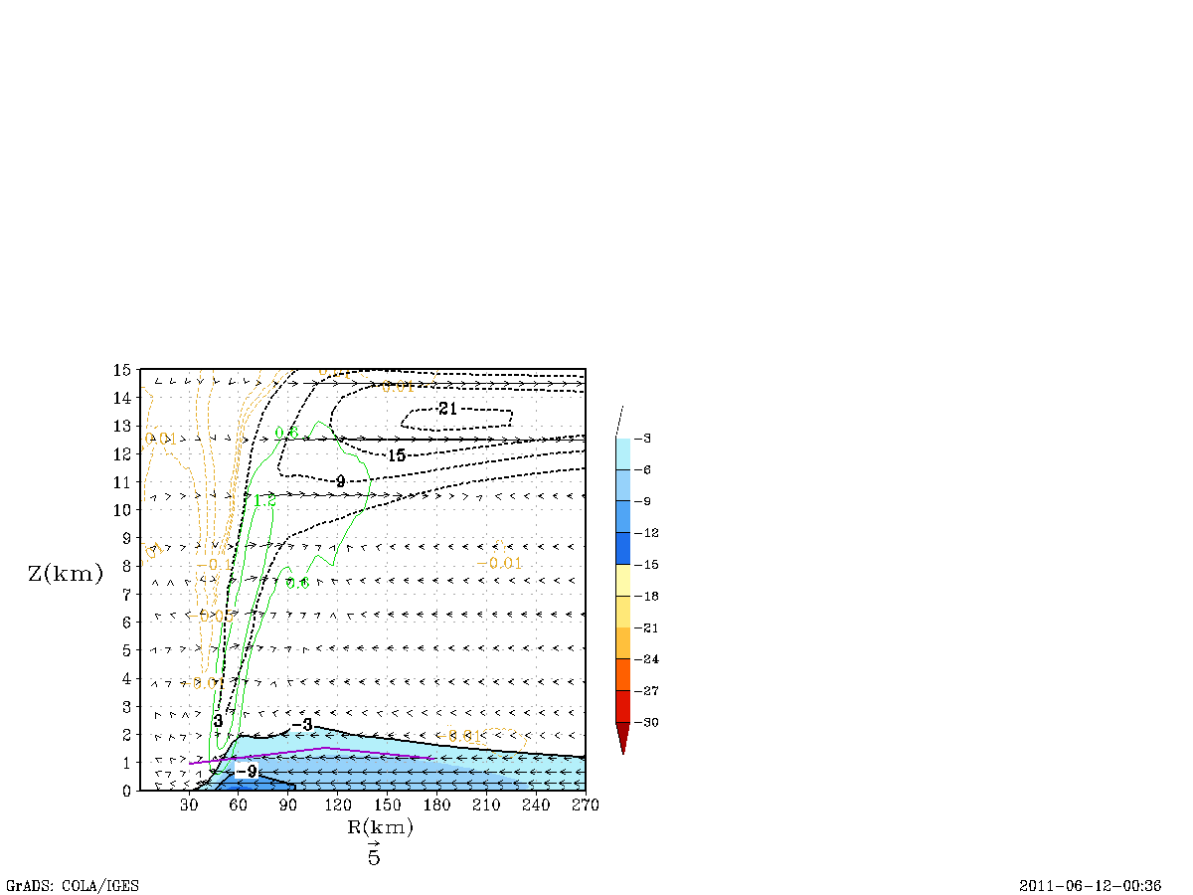
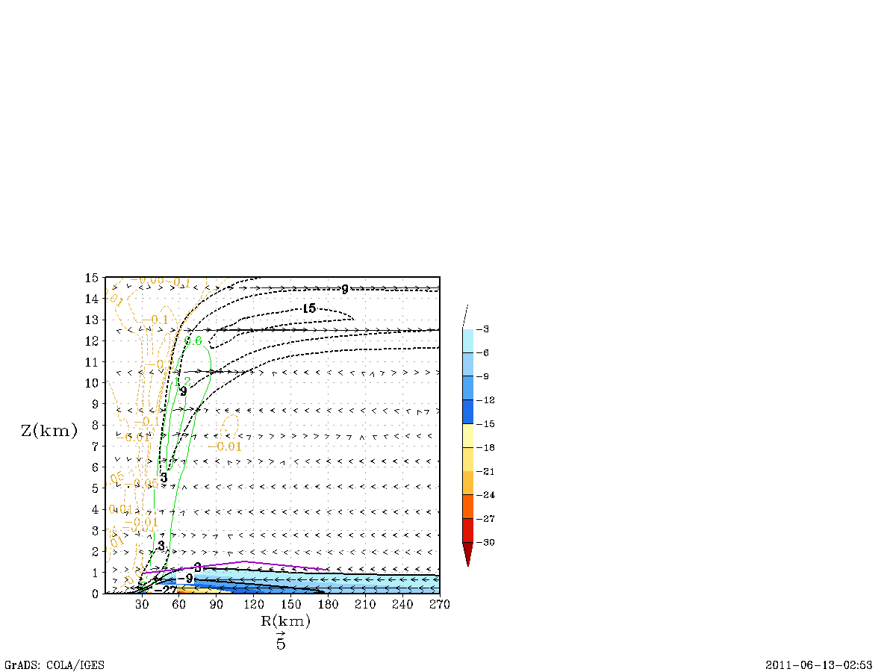
Improved Structure Predictions
Original Formulation
Latest Formulation
Cross Isobaric flow is coupled to Intensity predictions!

Slide 18
Coupling processes
Atmospheric Component
SST
Coupler
SST
Oceanic Component
Fluxes
Winds
Domain attributes
Fluxes
Winds
Domain attributes
Coupler functions
Interpolation
Data passing
Synchronize oceanic and atmospheric components
Initialize the moving nest leading edge
Summarized from DTC Tutorial

Slide 19
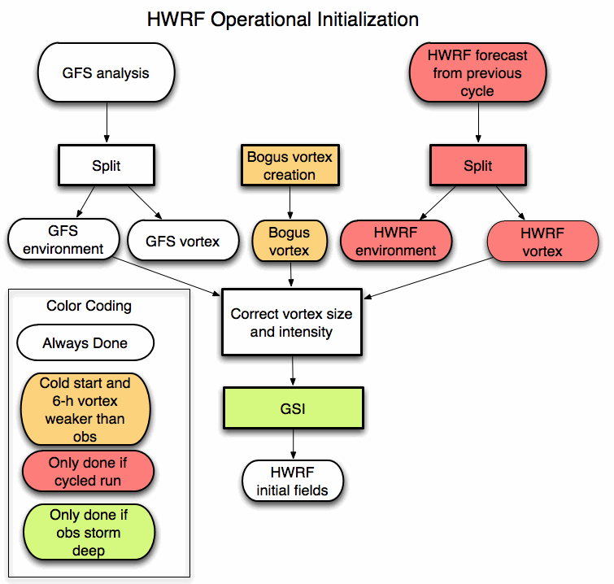
Vortex initialization and cycling processes
Credit: Q. Liu

Slide 20

Data Assimilation
For Vortex scale
T – 6 h
T
T + 126 h
Ensemble
Spin-up
DA Cycling
with EnKF
Deterministic HWRF-X Forecast from Ens. Mean
1-hour Cycles
Ensemble
Initialization from T-6h GFS-EnKF
Real-Time
Observation
Pre-Processing
Mean of Final Analysis Assumed Valid for T
Credit: A. Aksoy

Slide 21
Advances in HWRF forecast

Slide 22
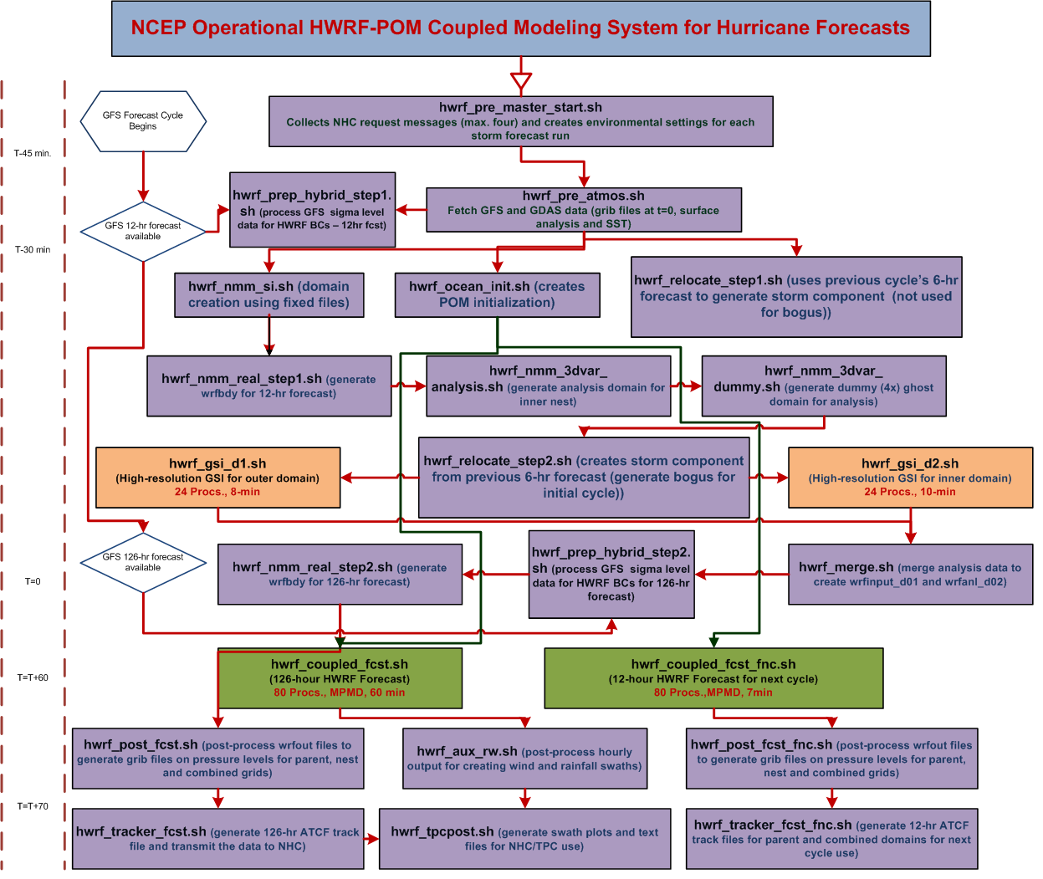

Slide 23
Model Configuration
 | Stream 1.5 HWRF | Operational HWRF | HWRFx | GFDL
Domain | 27 KM: 77.76˚ X 77.76˚ 9 KM: 10.56˚ X 10.2˚ 3 KM: 7.6˚ X 6.4˚ | 27 KM: 77.76˚ X 77.76˚ 9 KM: 7.2˚ X 6.0˚ | 9 KM: 57.12˚ X 55.56˚ 3 KM: 5.84˚ X 5.8˚ | 36 KM: ~75˚ X ~75˚ 18 KM: ~11˚ X ~11˚ 9KM: ~5˚ X ~5˚
Vortex Initialization | 27-9 KM: Yes 3 KM: No (Downscaling) | 27-9 KM: Yes | 9KM: Yes 3KM: No (Downscaling) | 36-18-9KM: Yes
Cycling | Yes | Yes | No | No
Ocean Coupling (Ocean model: POM) | 27-9 KM: Yes 3 KM: No (Downscaling) | 27-9 KM: Yes | No | Yes
GSI | Yes | Yes | No | No
Platform | JET-Linux | IBM | JET-Linux | IBM
Physics schemes
Microphysics | Ferrier | Ferrier | Ferrier | Ferrier
Radiation (SW) | GFDL | GFDL | NCAR SW | GFDL
Radiation (LW) | GFDL | GFDL | RRTM | GFDL
Surface Scheme | GFDL (2010 implementation) | GFDL (2011 implementation) | GFDL (2009 implementation) | GFDL
PBL Scheme | GFS (Modified for HR implementation) | GFS | GFS | GFS
Cumulus Parameterization | New SAS (27-9 KM) no CP (3 KM) | New SAS | SAS (9 KM) no CP (3KM) | SAS
Land Surface | GFDL Slab | GFDL Slab | GFDL Slab | GFDL Slab

Slide 24
High-Resolution HWRF Upgrades and Bug-fixes
 | Stream 1.5 HWRF | Upgrade or Bug-fix
Moving nest | New algorithm | Upgrade
Microphysics | Ferrier | Bug-fix (moving nest hydrometer initialization)
Surface scheme | GFDL | Upgrade (based on observation C_{D} & C_{H})
PBL scheme | GFS | Upgrade (based on observation K_{m})
Cumulus Parameterization | New CP (27-9 KM) No CP (3-KM) | Upgrade (Random cloud top, Convection overshoot, Max cloud base mass flux, Convection-induced pressure gradient force)
Explicit Lateral Diffusion | COAC=0.75 (27 KM) COAC=5.0 (9-3 KM) | Empirical determined by computational damping and stability criterion
Vortex initialization | New vortex initialization Downscale (3 KM) | Upgrade (Vortex cycling, surface pressure correction, Storm size correction)
Post-processor | Diapost | Upgrade

Slide 25
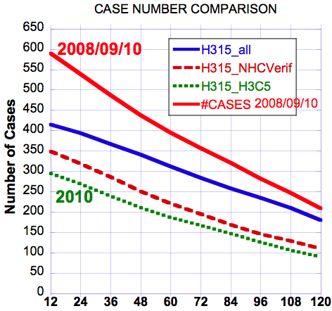
2008/09/10 & 2010 Verifications -- Sample Sizes
Notes:
H315: HWRFv3.2 2011 Stream 1.5 27-9-3km model
H3C5: HRD HWRF experimental 2010 version (HWRFx)
This is shown the homogeneous cases for each verification. H315_all: all H315 cases; H315_NHCVerif: homogeneous cases used in NHC verification package; H315_H3C5: homogeneous cases including H3C5 model forecasts

Slide 26
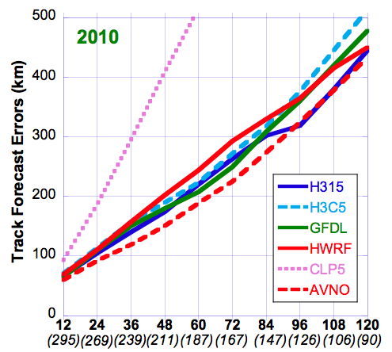
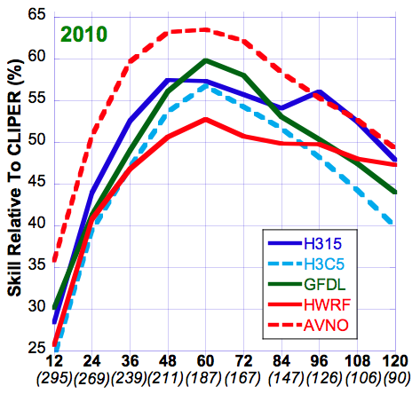
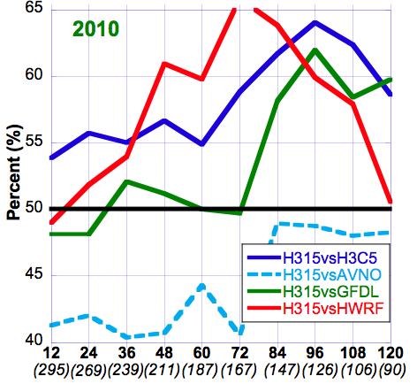
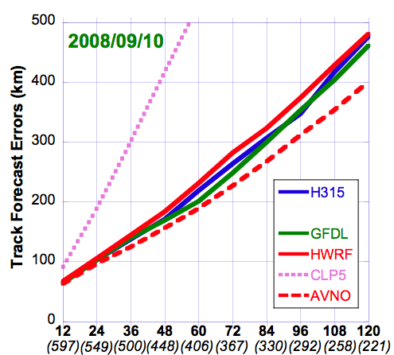
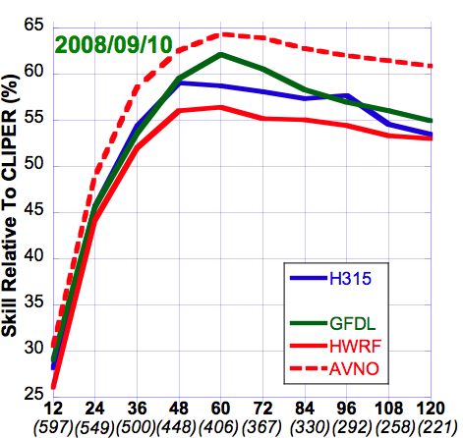
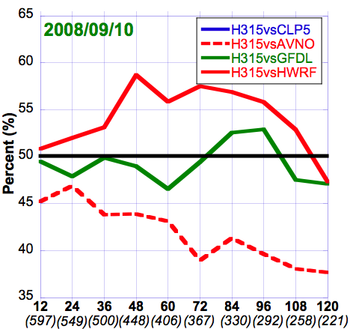
Verifications – Track Forecasts
HWRF (operational 27:9km), H3C5 (HWRFx 9:3km), H315 (27:9:3km), GFDL (operational 54:18:9km)
Cliper5(dotted), AVNO(dashed)
Absolute Errors
Skill vs CLP5
FSP
Notes:
H315: HWRFv3.2 2011 Stream 1.5 27-9-3km model
H3C5: HRD HWRF experimental 2010 version (HWRFx)
HWRF: NCEP/EMC operational HWRF 27-9km
GFDL: NCEP/EMC operational GFDL (54-18-9km). http://www.gfdl.noaa.gov/operational-hurricane-forecasting
CLP5: CLIPER5 (Climatology and Persistence model, statistical model)
AVNO: NWS Global Forecast System (GFS)
FSP: Frequency of Superior Performance. Here H315 is compared to all other models to obtain FSP (i.e. H315 vs. H3C5, H315 vs. HWRF, H315 vs. GFDL, H315 vs. CLP5, the red line didn’t show because FSP is above 65% and above the y-axis limit). 50% is the divided line that means 50% H315 is better than the compared model; 50% worse. 55% means H315 is 55% better than the compared model and vice versa.

Slide 27
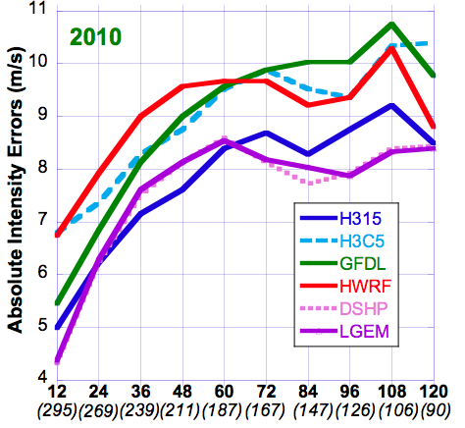
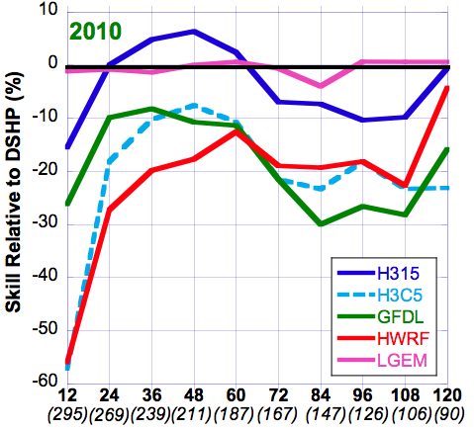
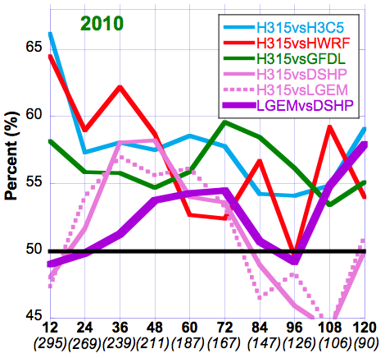
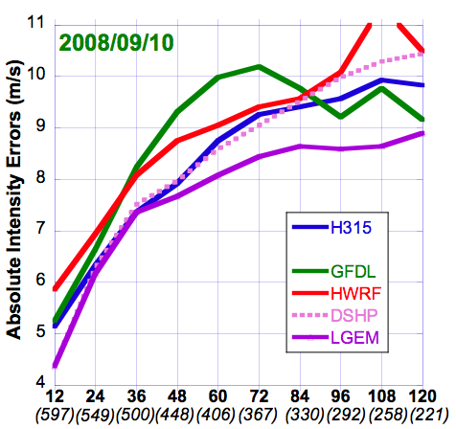
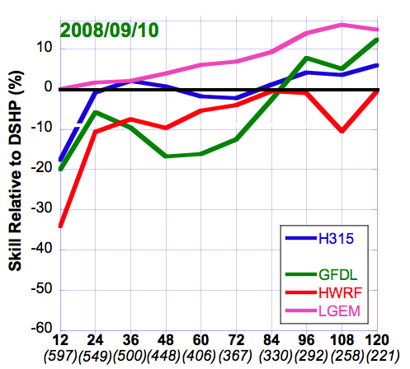
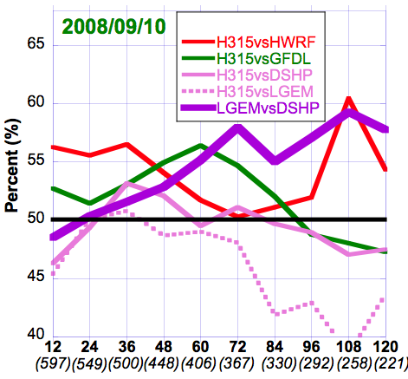
Verifications – Intensity Forecasts
HWRF (operational 27:9km), H3C5 (HWRFx 9:3km), H315 (27:9:3km), GFDL (operational 54:18:9km)
LGEM(solid), DSHP(dotted)
Absolute Errors
“Skill” vs DSHP
FSP
Notes:
DSHP: SHIPS with inland decay (Statistical-dynamical model)
LGEM: Logistic Growth Equation Model (Statistical-dynamical model)
FSP: all lines are H315 is compared to other models (H315 vs. H3C5, H315 vs. HWRF, H315 vs. GFDL, H315 vs. DSHP, H315 vs. LGEM) except thick purple line (LGEM vs. DSHP)

Slide 28
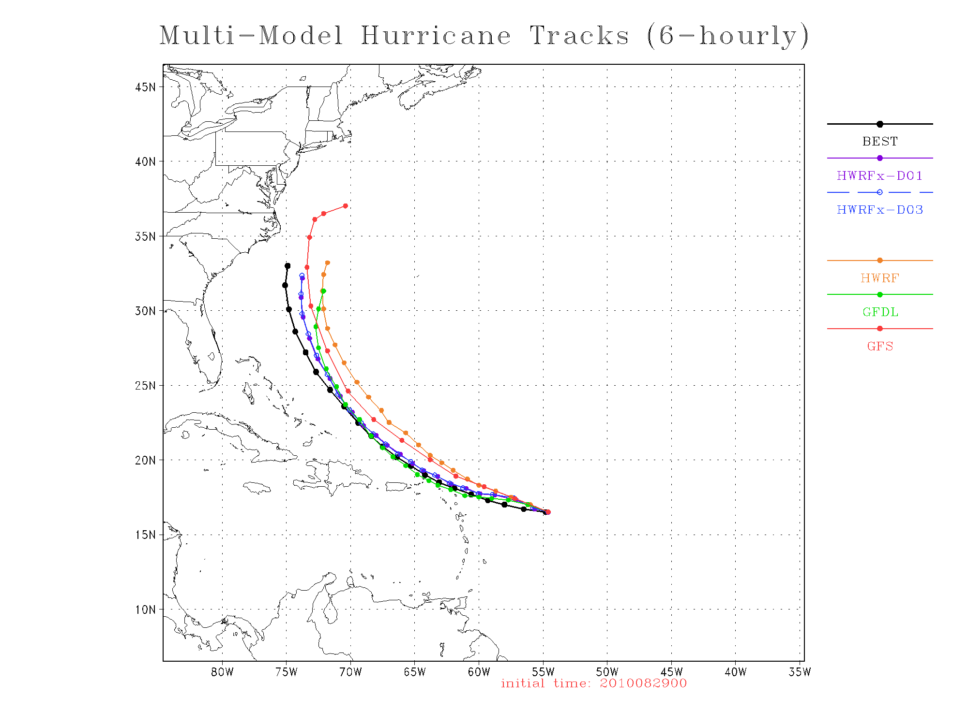

Slide 29
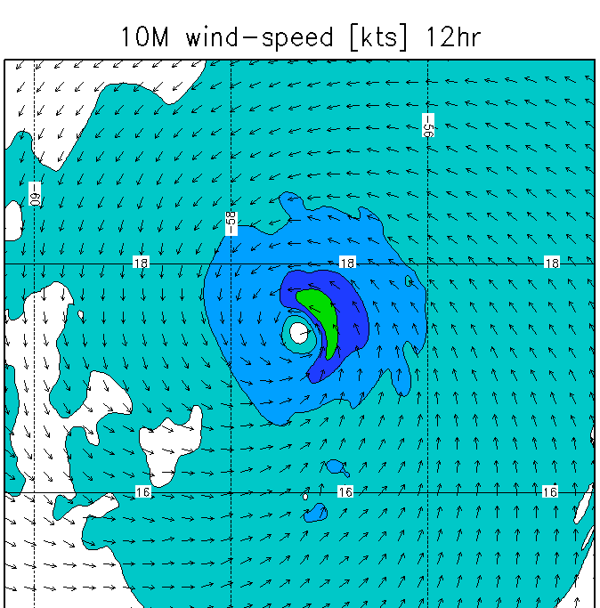
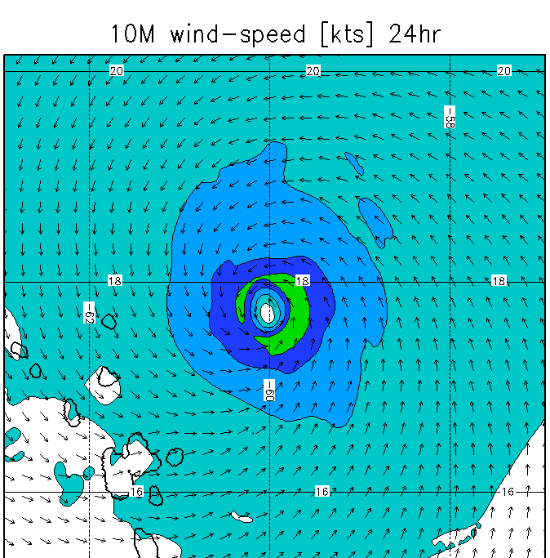
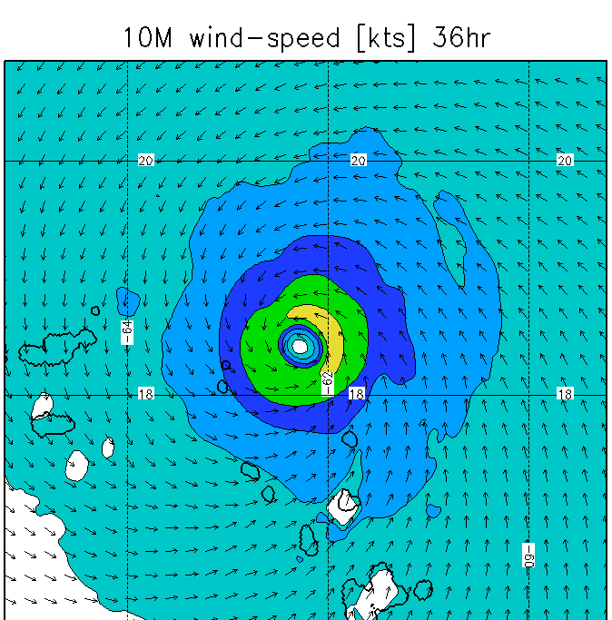
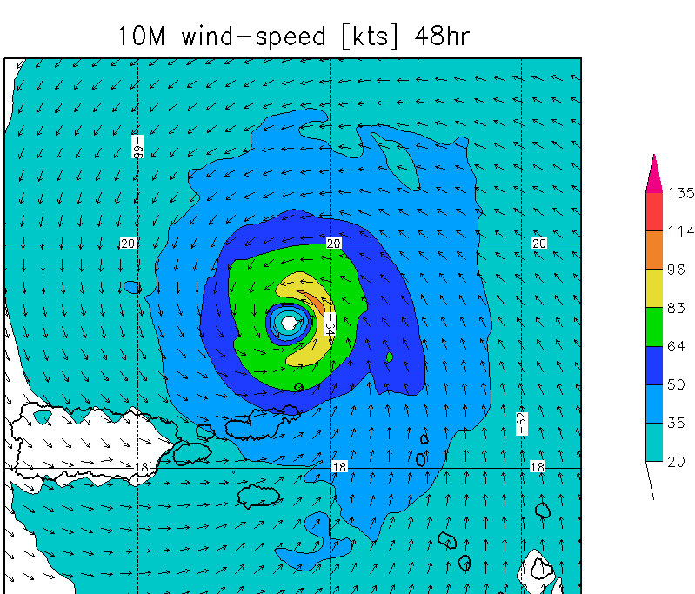
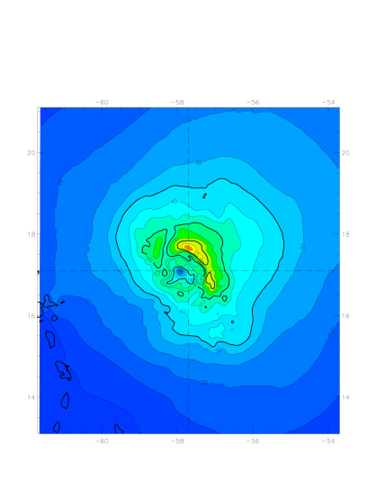
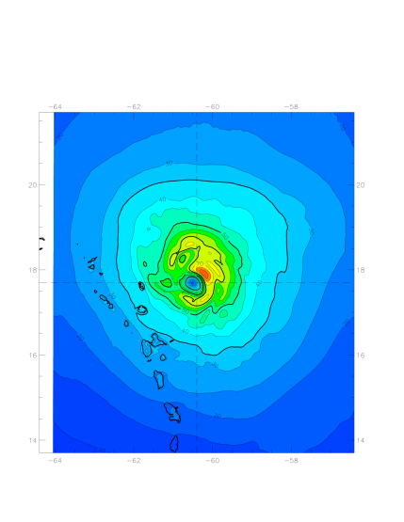
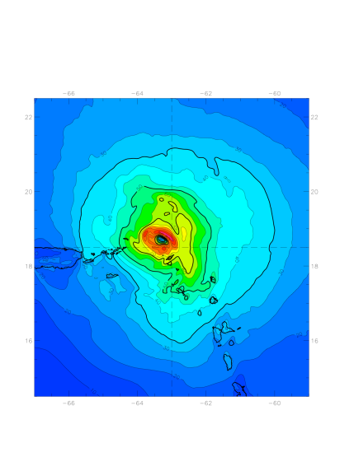
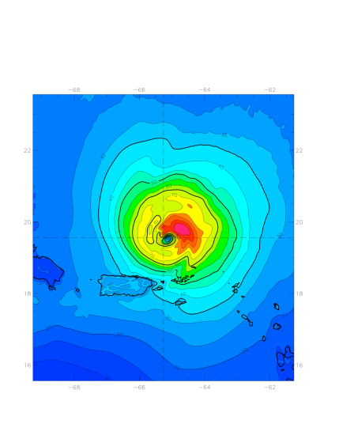
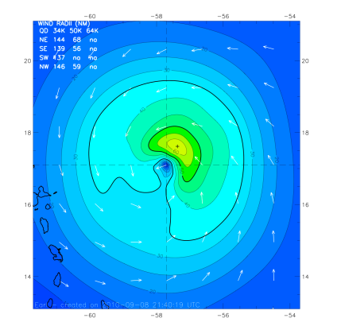
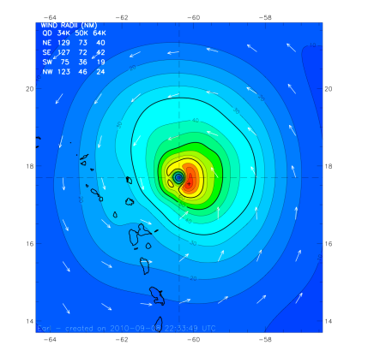
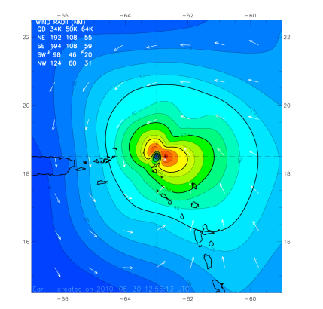
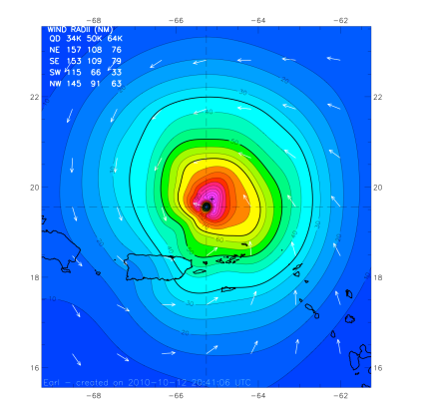
Earl forecast structure
Initial time: 2010082900
08-29 12Z
08-30 00Z
08-30 12Z
08-31 00Z
HWRF v3.2
10-m Wind
Speed
HEDAS
10-m Wind
Speed
Corresponding
H*Wind
Analysis
H*wind and HEDAS plots from A. Aksoy

Slide 30
Atmospheric circulation systems
Schematic representation of conditions during the peak (Aug.–Oct.) of the above-normal 2003 Atlantic hurricane season. (Landsea et al. 2004, BAMS)
Major Circulation Systems:
Subtropical High/Ridge
200hPa Tropical Easterly Jet
700hPa AEJ
850hPa Easterly Trades
200-850hPa Vertical wind shear
Leading Climate Factors:
El Nino and Southern Oscillation
The multi-decadal signal
Madden-Julian oscillation

Slide 31
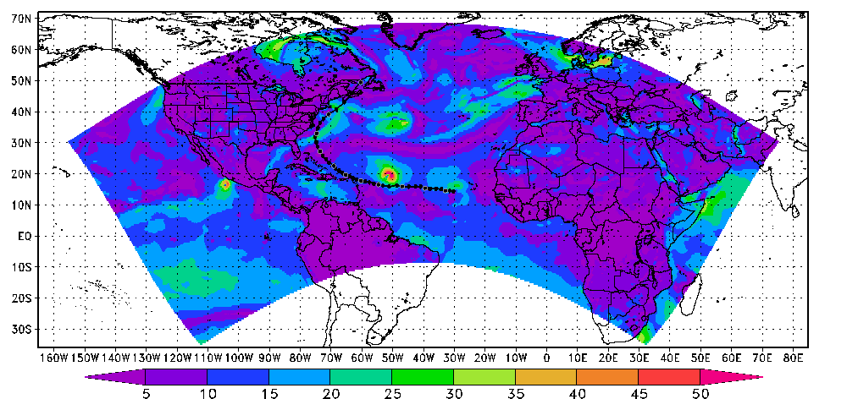



Operational forecast initialization
  GFS environmental flows
  Vortex init
  GSI DA for deep cases
Experimental forecast initialization
  HWRF environmental flows
  Vortex init
  GSI DA for deep cases
Genesis Model forecast initialization
  HWRF-cycled environmental flows
  GSI DA for all cases
Credit: K. Yeh
Notes:
HWRF track forecast is improved by 30% for 3-day fcst, and 20% for 5-day fcst, based on 33 cases of Earl (2010)

Slide 32





Genesis application
GFS
UKMET
NOGAPS
ECMWF
HWRF-GEN can forecast the pouch coming off the W. Africa coast like global model
HWRF-GEN similar to GFS forecast has a turn at 50W
Credit: M. Boothe
Notes:
1. Okubo-Weiss (hereafter OW) parameter is a frame-independent measure of the tendency for a rotational flow to be shape preserving
2. A positive values of OW indicate that the flow is vorticity dominant and shape preserving, whereas negative values of OW indicate a strain-rate dominated flow susceptible to rapid filamentation. A negative OW region is unfavorable for rotational organization of deep convection and aggregation of vortical remnants of prior convective activity.
3. OW is defined here as OW = ζ^2 – S1^2 – S2^2 = (Vx – Uy)^2 – (Ux – Vy)^2 – (Vx + Uy)^2, where S1 and S2 denotes strain deformation, denotes vertical vorticity, (U, V) denotes zonal and meridional velocity, respectively, and subscripts x and y denote partial differentiation in the zonal or meridional directions.

Slide 33
Summary
The objective of HFIP is to improve both track and intensity forecast, and up to 7-day forecast guidance
Current observations can improve the understandings of the hurricane 3D structure and physical processes and create a pathway to improve hurricane modeling
High resolution model could provide an effective tool to apply DA from inner core and environmental observations and may obtain better forecast
Basin-scale model could be an promising tool to apply on both research and operational forecast such physical processes, Hybrid DA, extended forecast guidance, genesis, ensemble, and local high resolution application
Further work will focus on improving model physics and DA

