Slide 1


HFIP Advancements in Hurricane Research
Frank Marks
NOAA/AOML Hurricane Research Division
NOAA HFIP Lead
12 August 2011

Slide 2
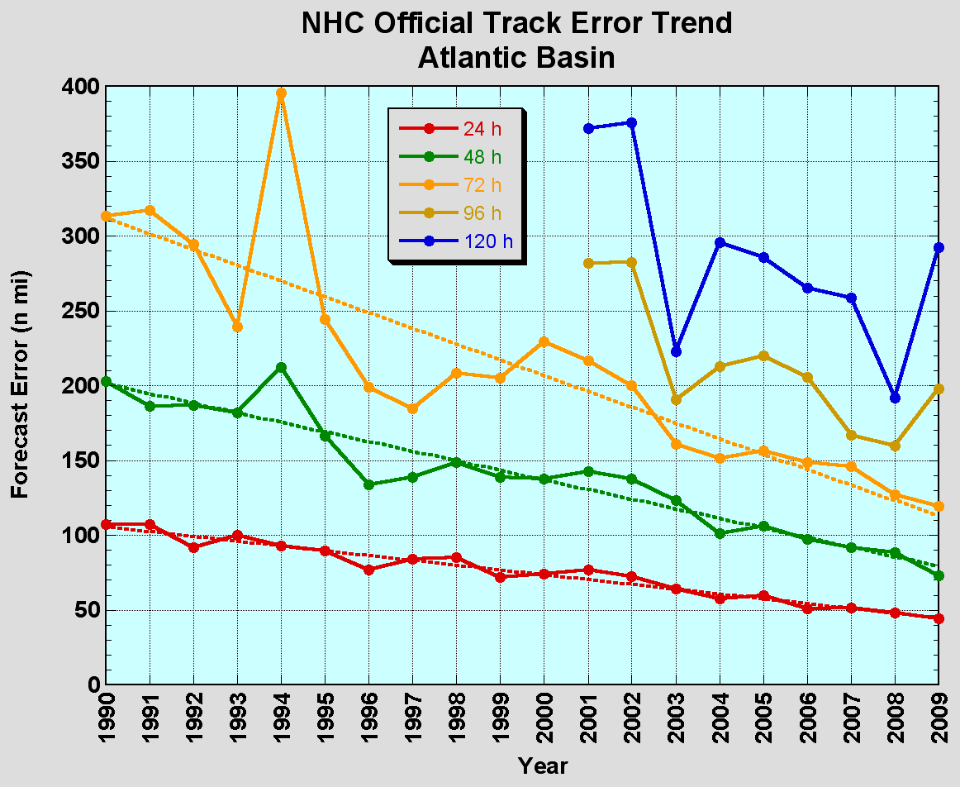
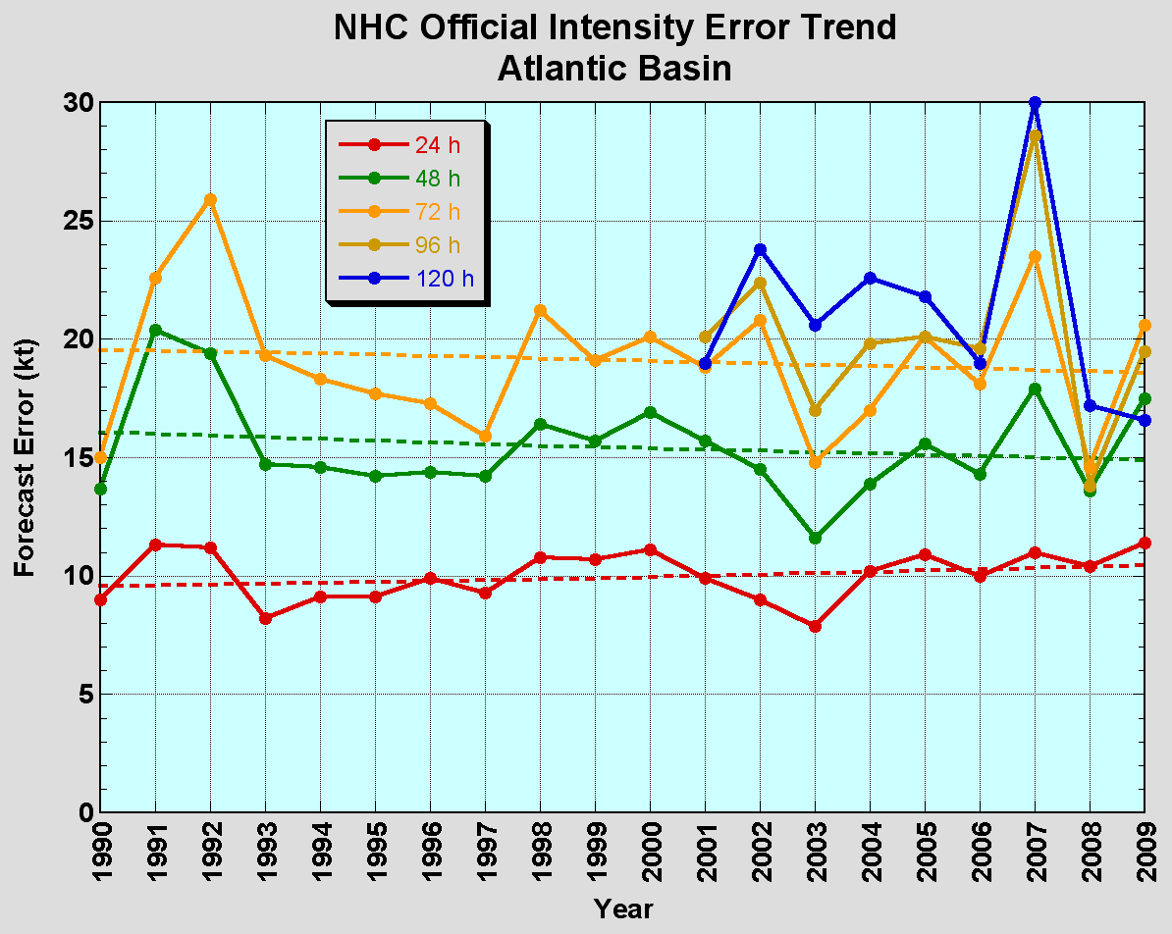
The Good – Track forecast improvements
Current Capabilities
The Bad - Intensity forecasts no real gains
No progress with intensity in last 15-20 years
Errors cut in half over past 15 years
10-year improvement - As accurate at 48h as we were at 24h in 2000
24-48h intensity forecast off by 1 category
Off by 2 categories 5-10% of time

Slide 3

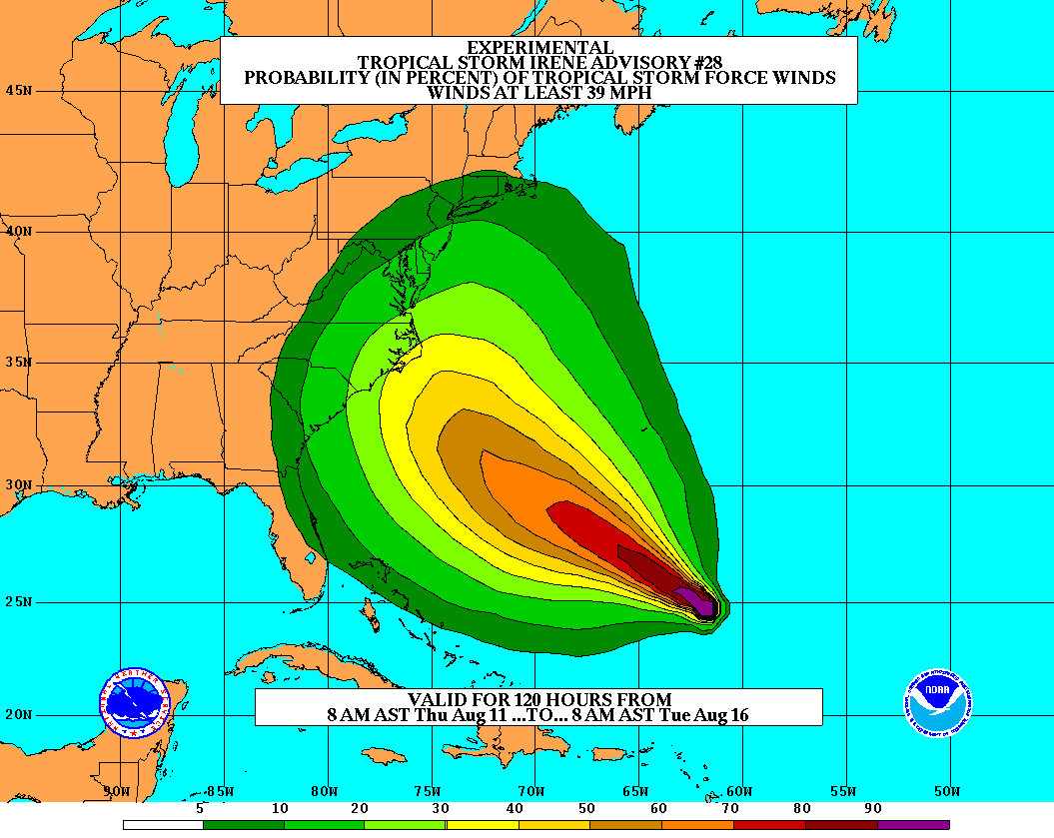
Goals
Improve Forecast Accuracy
  Hurricane impact areas (track) – 50%
  in 10 years
  Severity (intensity) – 50% in 10 years
  Special Focus on Rapid Intensity Change (RI)
Extend forecast reliability out to 7 days
Quantify, bound and reduce forecast uncertainty to enable risk management decisions
http://www.hfip.org/
Notes:
http://www.nrc.noaa.gov/HFIPDraftPlan.html
HFIP Team
Frank Marks, research lead
Ed Rappaport, operations lead
Fred Toepfer, project manager
Robert Gall, development manager
Mark DeMaria
Chris Fairall
Jim McFadden
Scott Kiser
Daniel Melendez
Roger Pierce
HFIP executieve oversight board:
OAR DAA/Sandy MacDonald, co-chair
NWS AA/Jack Hayes, co-chair
NCEP/Louis Uccellini,
TPC/Bill Read,
NESDIS/Mark DeMaria,
NOS/Jesse Feyen,
AOML/Bob Atlas
PPI/Paul Doremus
NMFS/Bonnie Ponwith,
NOS/Liz Scheffler,
NMAO-PM Aircraft/Phil Kenul,
OFCM/Sam Williamson
Executive Secretariat: OAR/Joseph Bartosik and NWS/John Iacabucci

Slide 4
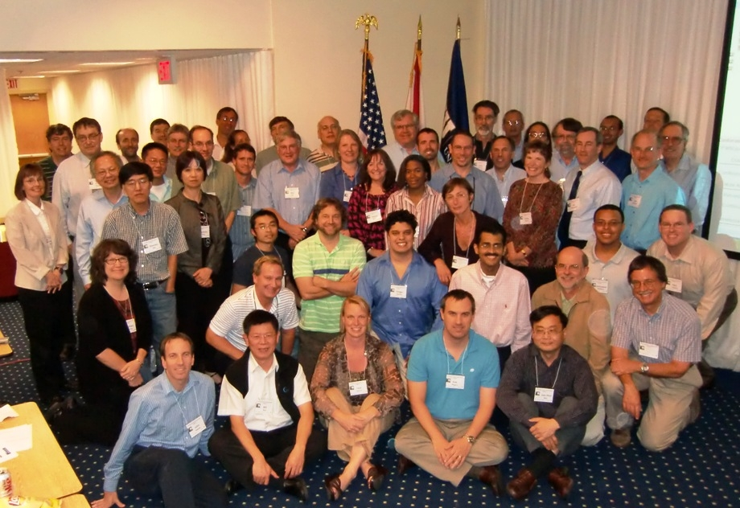
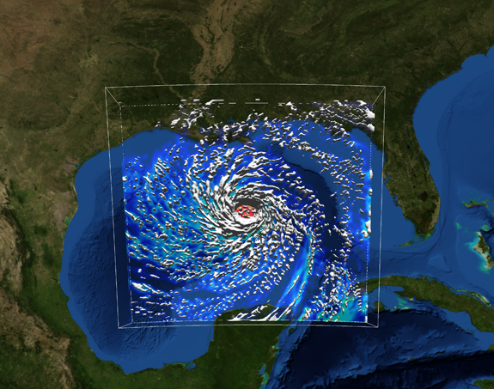
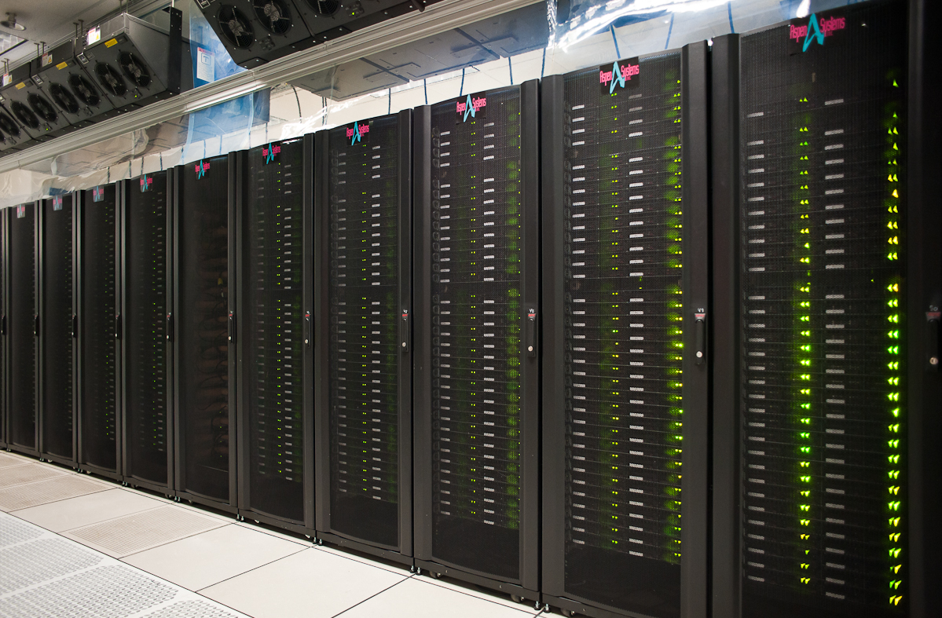
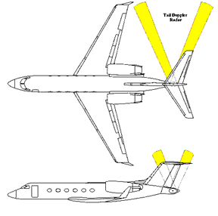

How to get there?
Science (8 Teams)
  Improved understanding from combining observations & models
  Higher resolution coupled models – critical to storm evolution forecasts – especially intensity changes
  Forecast techniques to understand, reduce & communicate uncertainty
Information Technology
  Increased computing power - run advanced hurricane/global models & reduce uncertainty
  IT infrastructure for interagency data exchange
Observing Strategy
Improved use of existing and planned systems
Improved Products for Forecasters
Notes:
HFIP 2008-2009 activities
HRH Workshop:
http://www.dtcenter.org/plots/hrh_test/workshop2009/presentations/1_Gall_HRH%20HFIP%20presentation.pdf
http://www.dtcenter.org/plots/hrh_test/index.php
HFIP-TACC Real-time test
ftp://ftp.aoml.noaa.gov/pub/hrd/marks/HFIP-TACC_Summary.pdf
Diagnostics Team Workshop:
http://rammb.cira.colostate.edu/research/tropical_cyclones/hfip/workshop_2009/

Slide 5
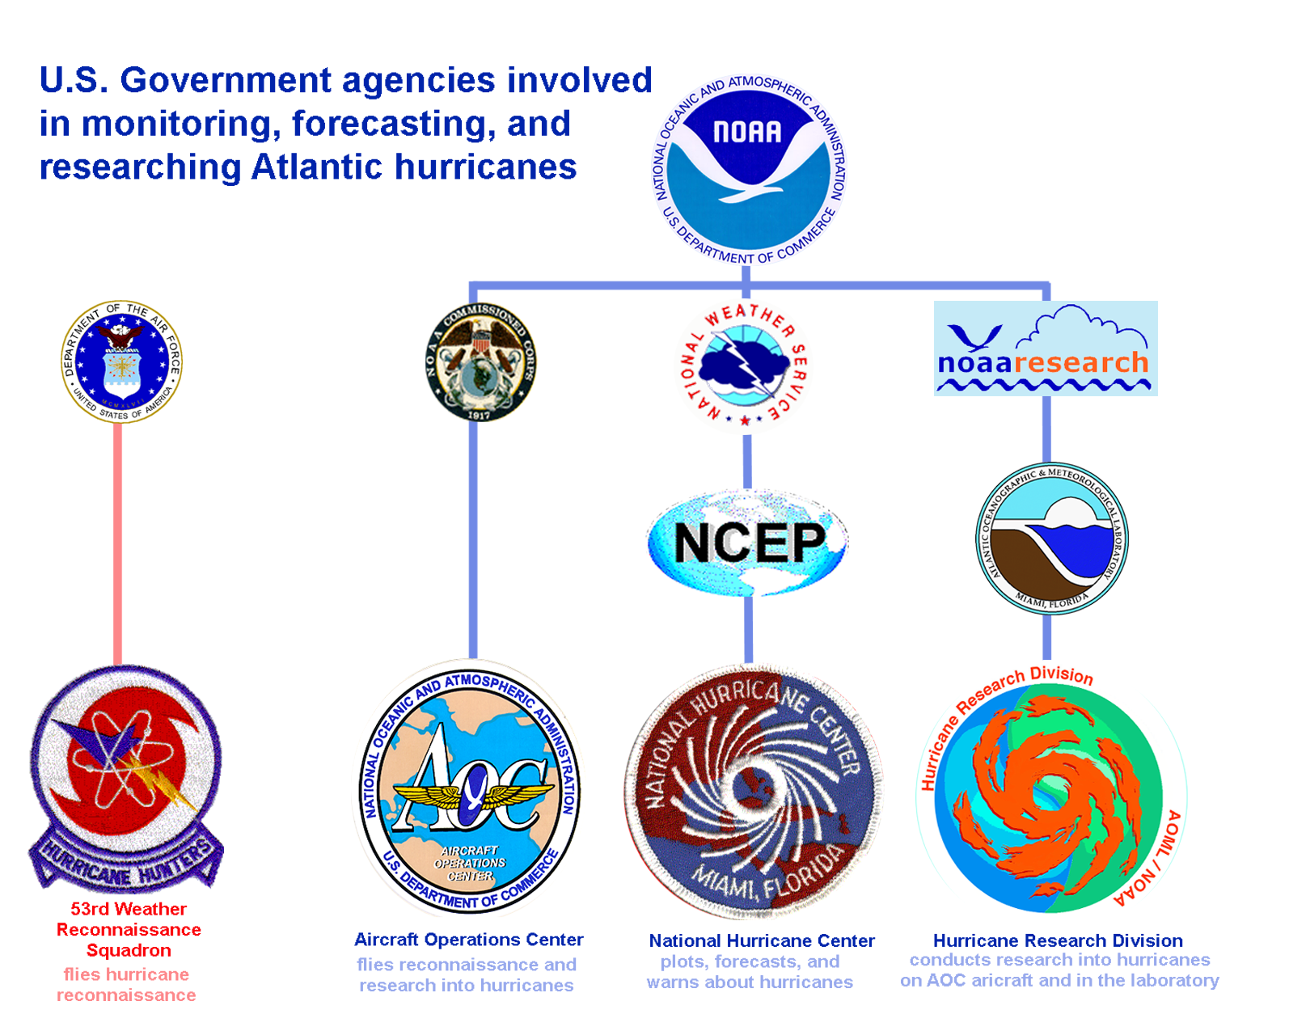


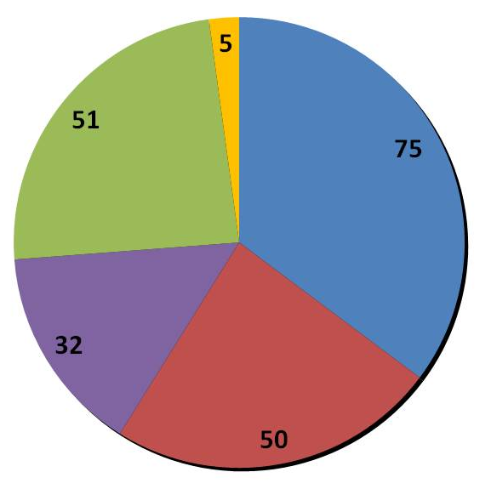


Who: U. S. Hurricane Team
2008 Snapshot
(Total Man-years: 211)
Notes:
Operations: $500M/year (NOAA & DoD)– observing, forecasting, instrumentation (satellites)
Research: $50M/year (10%) – leveraged across multiple agencies

Slide 6
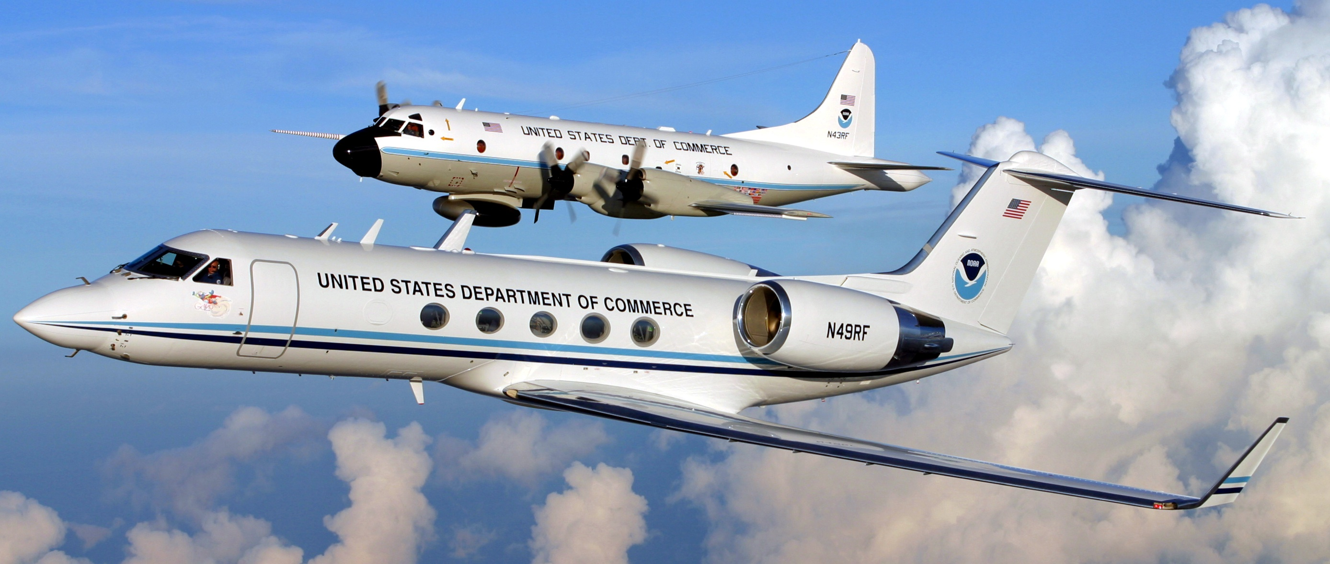
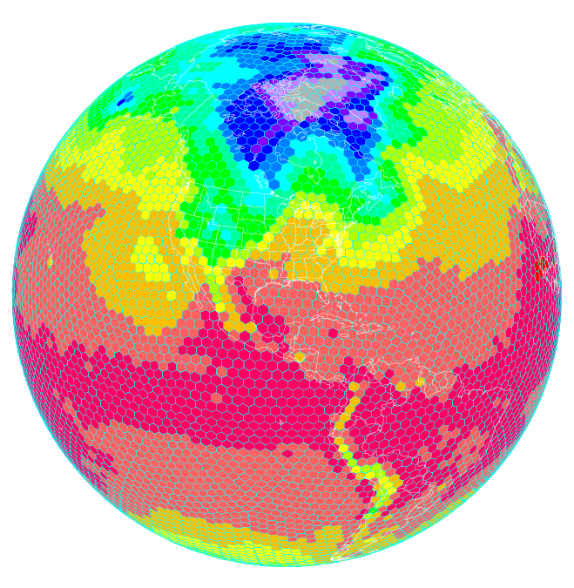
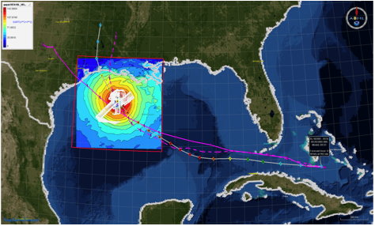
What: HFIP Activities
Traditional Hurricane Research Activities:
Observations, analysis, database, & instrument R&D (IFEX)
Statistical-dynamical model development
Advances in operational models (Stream 1)
New HFIP Research Thrusts:
Experimental global and regional hurricane model development (Stream 2)
Data assimilation techniques and observing system strategy analysis development (Stream 1 & 2)
Model evaluation tool development
Application and tool development for forecasters
D1
D2
Partnership: NCEP, AOC, AOML, ESRL, GFDL, DTC, USWRP, NESDIS/STAR
Notes:
Two Stream Approach to HFIP developments:
Stream 1– Operational Transition and Implementation
Stream 2 – Advanced Technology Demonstration
Unconstrained by near-term availability of operational computing
Uses both NOAA’s and computing resources from major supercomputing centers for testing and evaluation.
Emphasis is on high resolution global and regional models run as ensembles
Real-time or near real time runs during hurricane season
Stream 1.5 (JHT-like)
NHC Forecaster Defined.
Subset of Stream 2 that forecasters see as particularly promising or provides demonstrated capability
Will be configured to run in real-time and products made available to NHC.

Slide 7
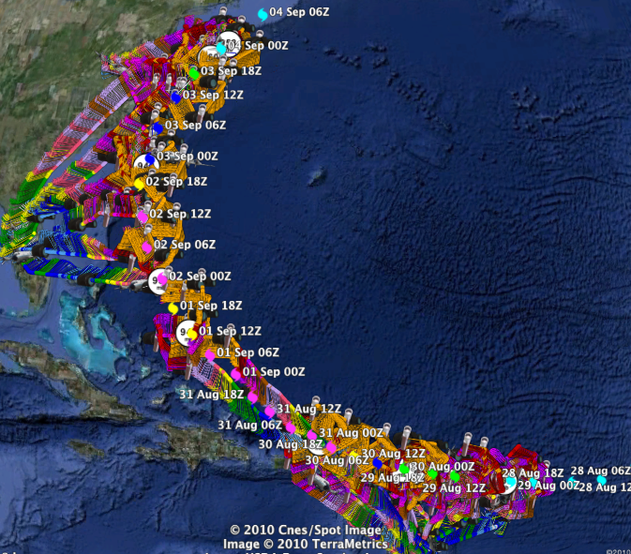
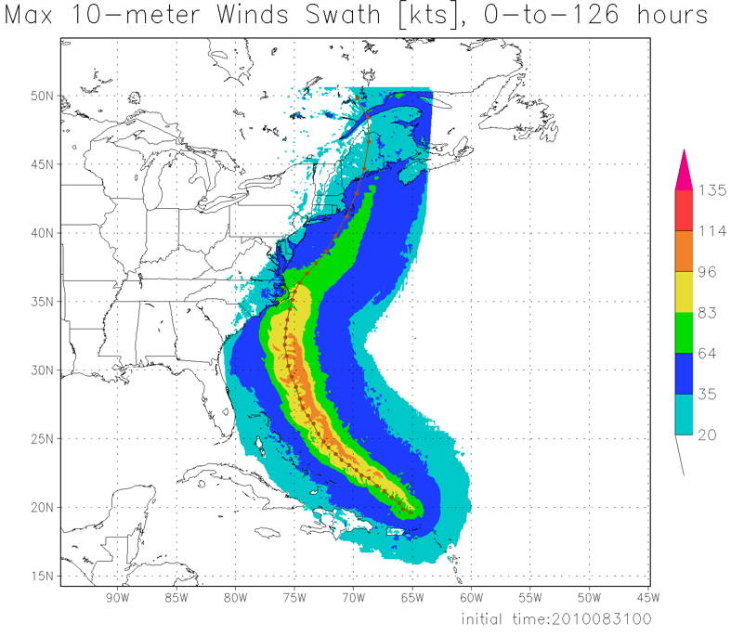
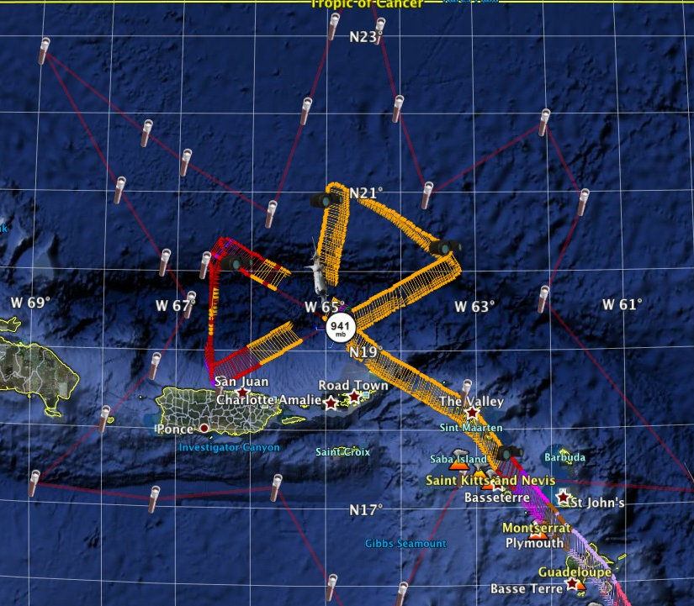
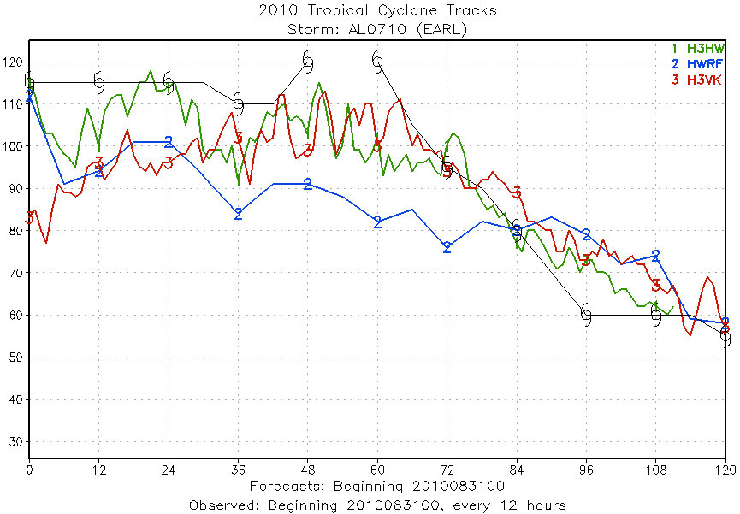
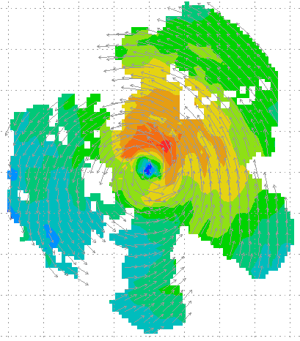
Improved Use of Observations:
HFIP 2010 Demo: Earl
11 P-3 Flights
28 August – 3 September 2010
HWRFx/HEDAS
20100831 00UTC
Doppler SO (EnKF) transmitted in real-time to HRD for assimilation into HWRFx model
20100830I1
2126-0229 UTC
5 missions at 12-h intervals
00Z 28 – 12Z 30 August, 6 missions at 12-h intervals 00Z 1 September – 00Z 3 September collecting Doppler SO (HEDAS)
HWRFx/HEDAS
20100831 00UTC
J. Gamache, A. Aksoy, T. Vukicevic, Gopal (AOML/HRD)
Notes:
Left hand image - Flight pattern for 11 P-3 Doppler mission For Earl beginning 00Z 28 August 2010, ending at 12Z 3 September 2010
middle image – show real-time Doppler analyses for three legs mission centered on 00Z 30 August used to generate Sos
Right images – HWRFx forecasts track and maximum wind swath (top), and intensity (bottom) initialized at 00Z 30 August
IFEX 2010: Hurricane Earl WP-3D (11 missions: 5 missions at 12-h intervals, 00Z 28 – 12Z 30 August, & 6 missions at 12-h intervals, 00Z 1 September – 00Z 3 September collecting Doppler SO (HEDAS)
Deployed 756 dropwindsondes and 238 AXBTs. 55 real-time TDR analyses transmitted to NHC and Doppler radial files transmitted to EMC. TDR superobs transmitted in Paloma, Bill and Danny provided real-time assimilation of TDR data into ARW model at TACC. 60 real-time H*Wind surface analyses

Slide 8
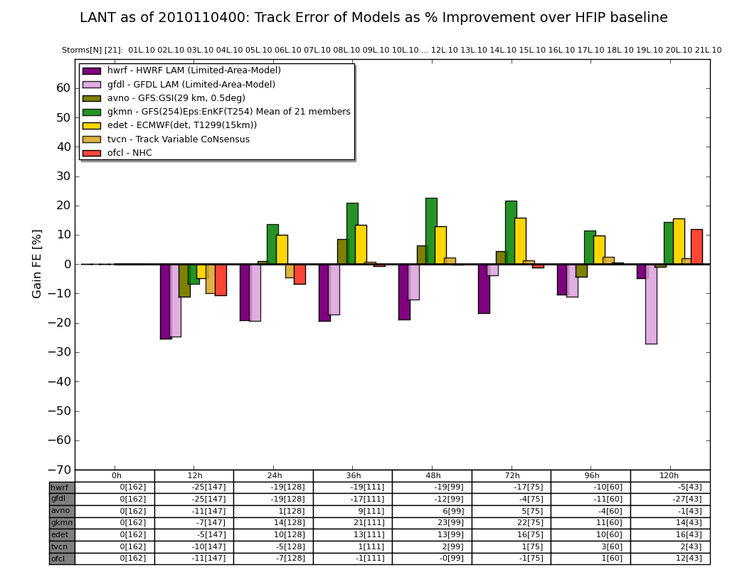
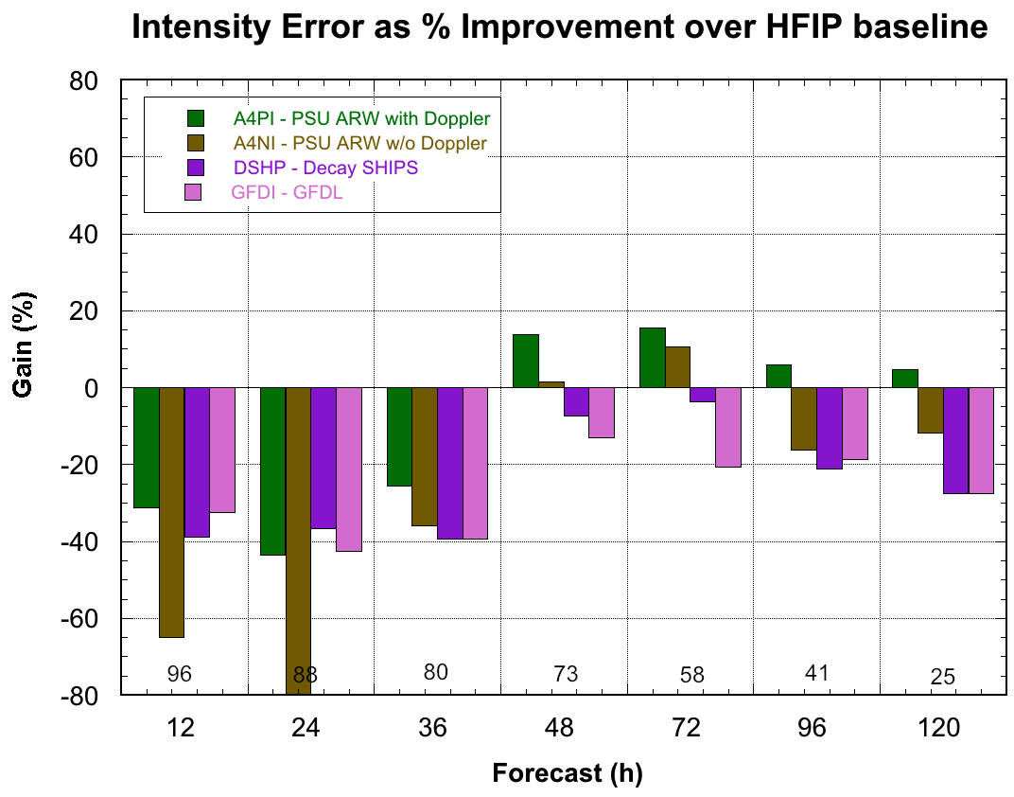
HFIP 2010 Demonstration
Can reach HFIP track goals out to at least 5 days using current global models initialized with EnKF
    Will need to be run at higher than current resolution to ensure continued gains
Radar data appears to be critical in initializing regional models (may require ENKF to use effectively)
    May solve intensity problem for storms effecting U.S.
    Need increased use of satellite data for storms further away
Statistical post processing provides a several percentage point improvement over raw scores (Bias Correction, Correlation Based Correction, other)
Notes:
2004-2010 for Intensity improvement

Slide 9
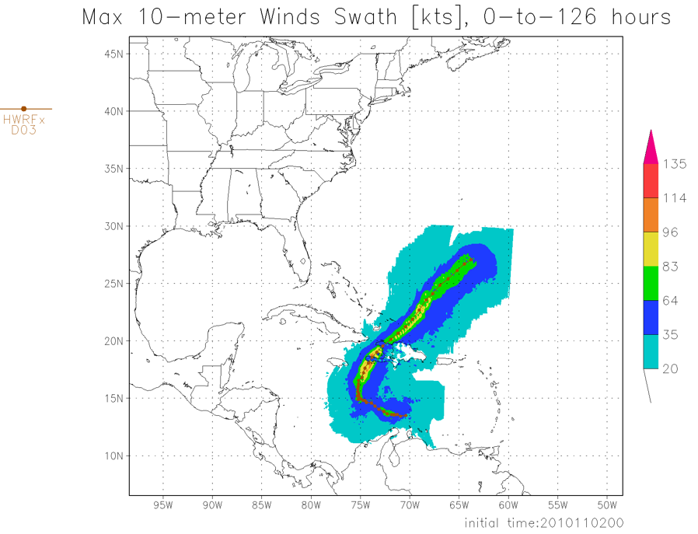
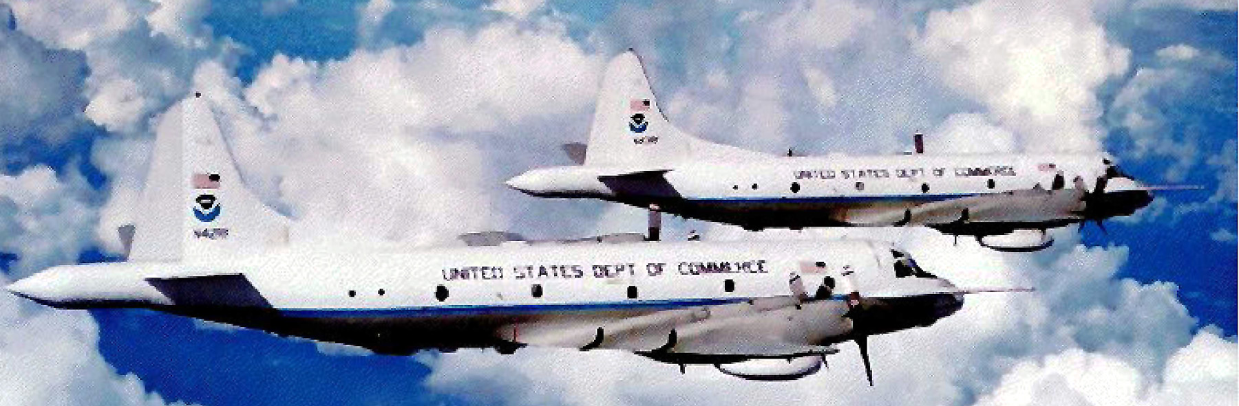
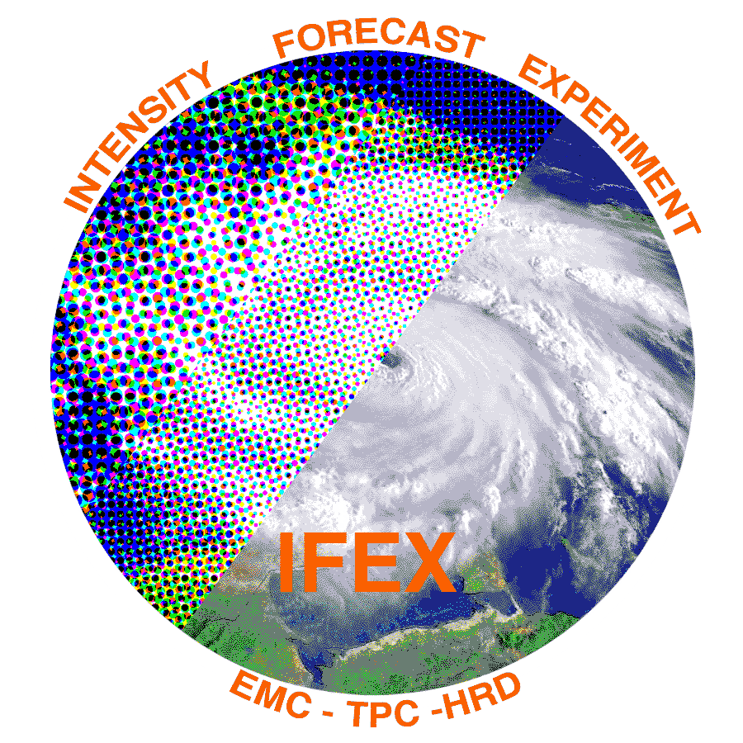
What in 2011?
2011 HFIP model demonstration
  Global model ensemble
    80 member GFS hybrid-EnKF
  Regional model ensemble
    ≥15 HWRF members (2@27:9:3 km, ≥10@9:3 km)
    ≥10 COAMPS-TC members (45:15:5 km)
    ≥10 ARW members (40.5:13.5:4.5 km)
IFEX 2011
  Continuation of IFEX objectives (Rogers et al, 2006)
  320 flight hours two P-3s & G-IV available in June
  Crews available for 2-per-day missions
  IFEX 2011 home page (see Shirley’s presentation)

Slide 10
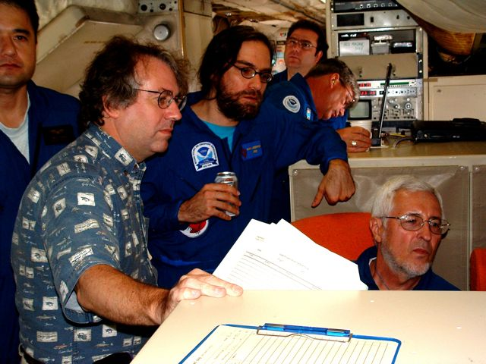
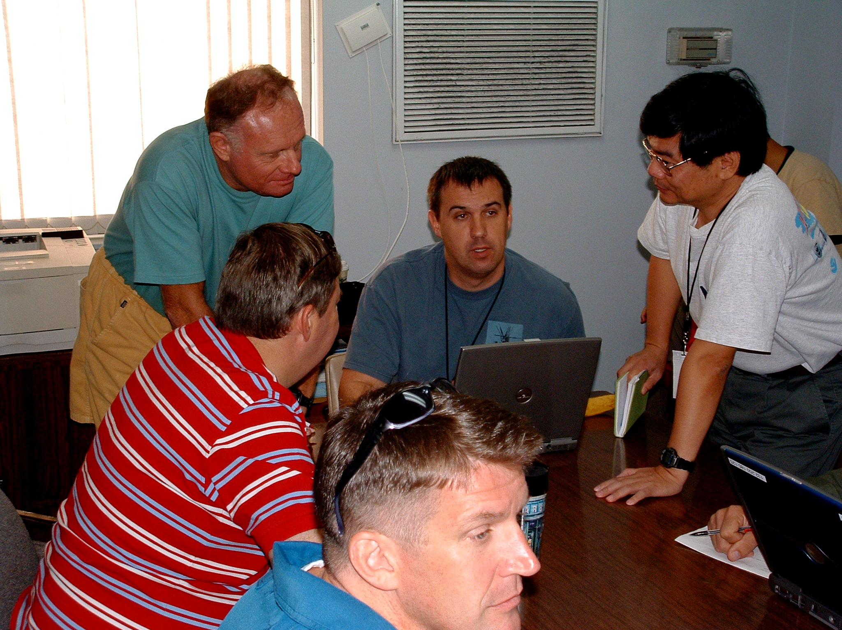
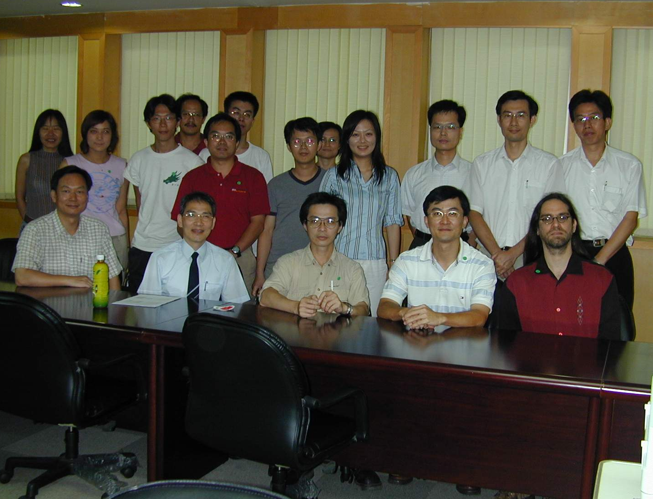
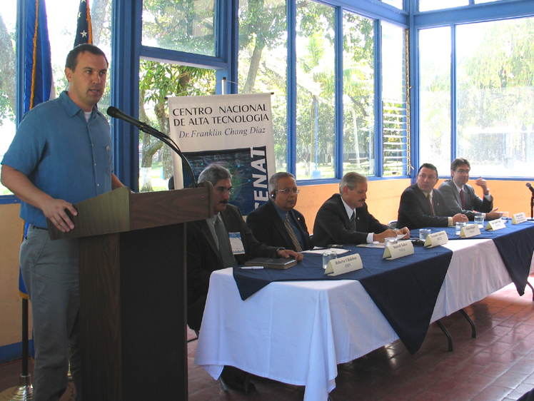
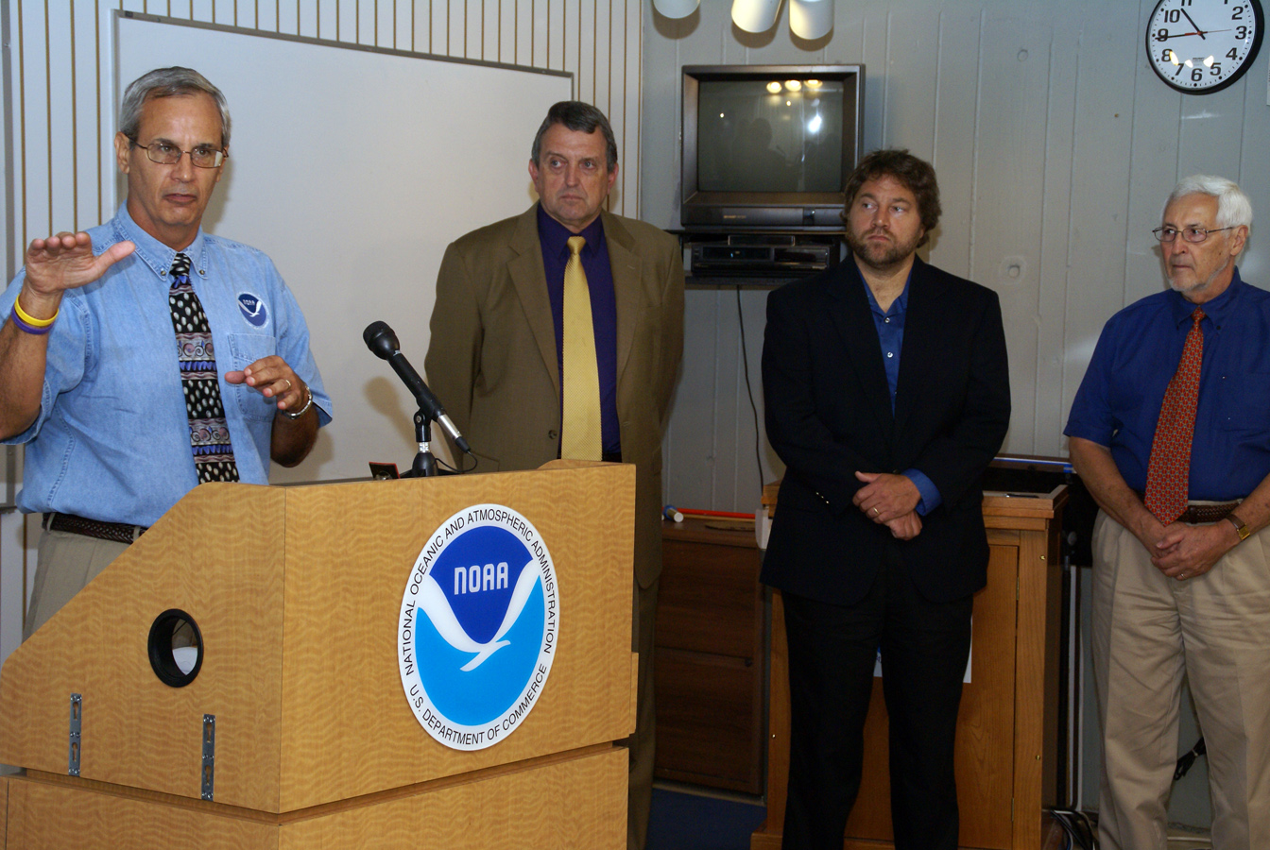
Keys to Success
  Partnership: AOML, ESRL, GFDL, DTC, USWRP, NESDIS/STAR working closely with Operations (EMC, NHC, AOC) and Federal & Academic Partners (NASA, NSF, ONR, NRL, NCAR, MMS)
  More integrated use & support of Testbeds: JHT, DTC, JCSDA
  Blend Traditional hurricane research activities and HFIP research activities
  Manpower (diversity) to evaluate model performance with hurricane data sets is a critical need
CBLAST
IFEX/RAINEX
DOTSTAR
IFEX/TCSP
IFEX/PREDICT/GRIP

Slide 11
Questions?

