Slide 1
Model Development and R2O Transition
Xuejin Zhang
UM/CIMAS & AOML/HRD
CIMAS program review, 18-19 September 2014

Slide 2
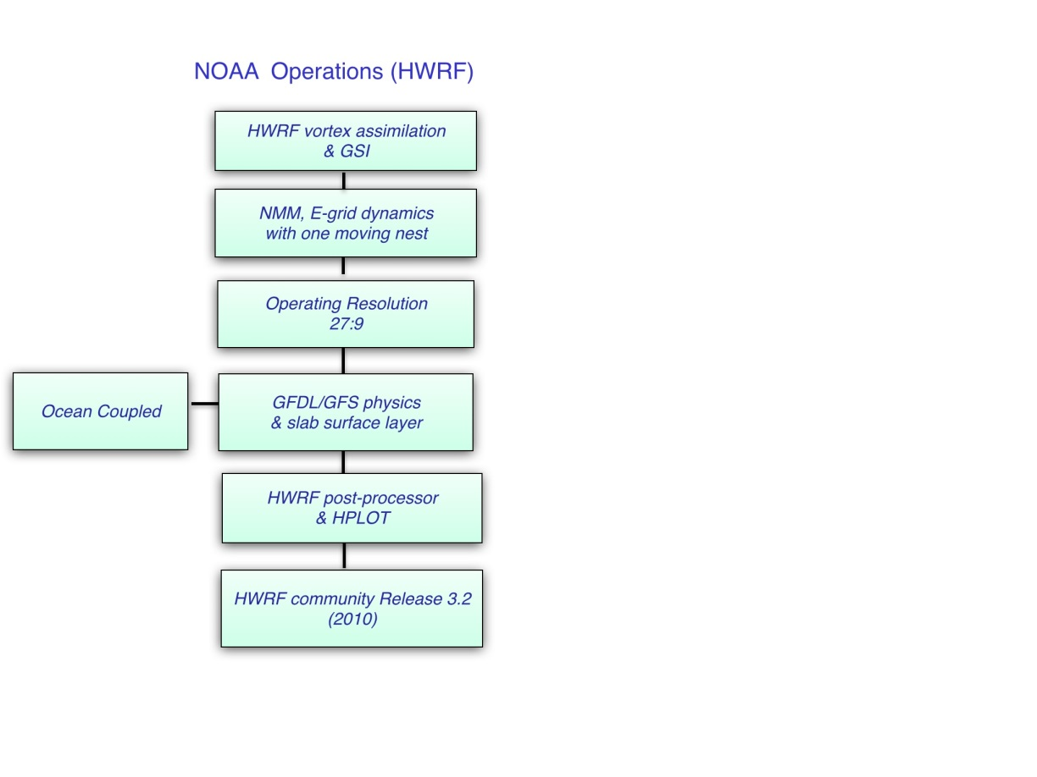
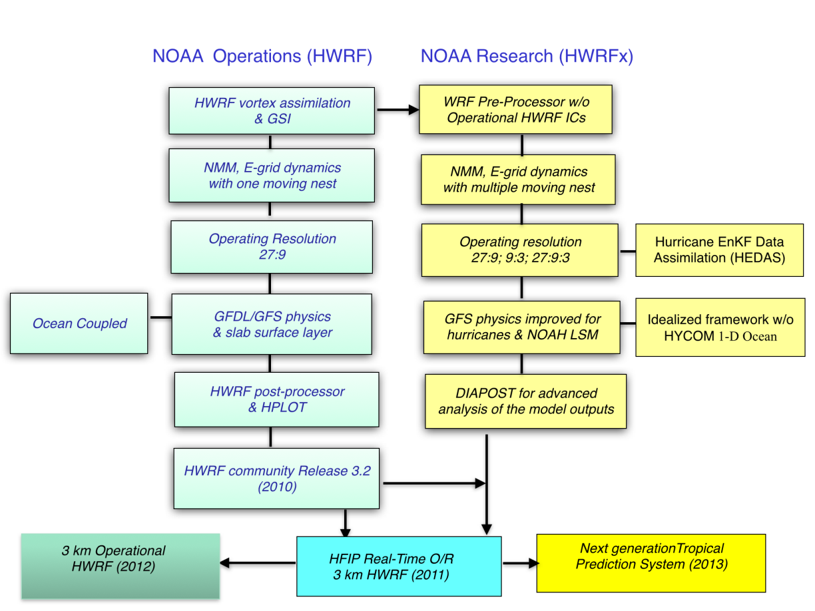
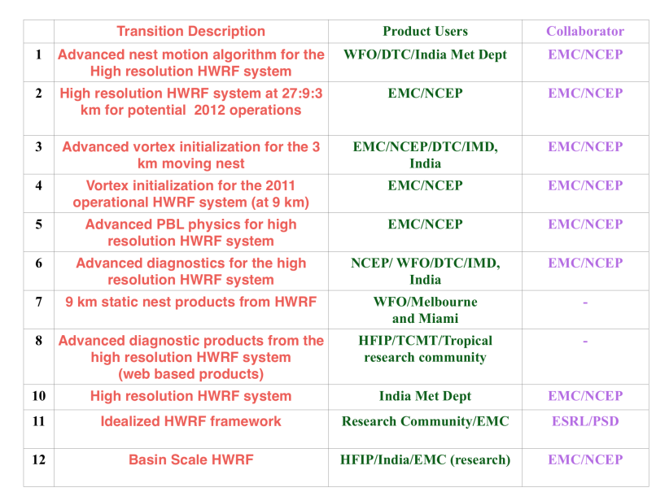
HWRF Development and Transition
AOML-CIMAS Research Transitions
HIGHLIGHTS
  2011: First cloud resolving operational TC forecasting system for Atlantic and East Pacific basins
  2012: Official guidance model for JTWC and India Meteorological Department
  2013: Significant progress in TC structure, intensity and RI predictions over all basins
  2013: 11 Peer Reviewed publications, 4 in preparation/review, 1 text book chapter, 12 R2O transitions
Notes:
AOML’s contribution to HWRF model improvements: Emphasis on resolution, high resolution, TC supportive physics advanced by extensive use of observations, Idealized framework for testing physics as well as for understanding processes. The merger framework; i.e., 3km operational HWRF and the next generation Tropical Prediction system is due to the sustained interactions between NOAA operations and Research. Noteworthy: Operations use idealized framework for rapid testing before running a suite of cases.

Slide 3
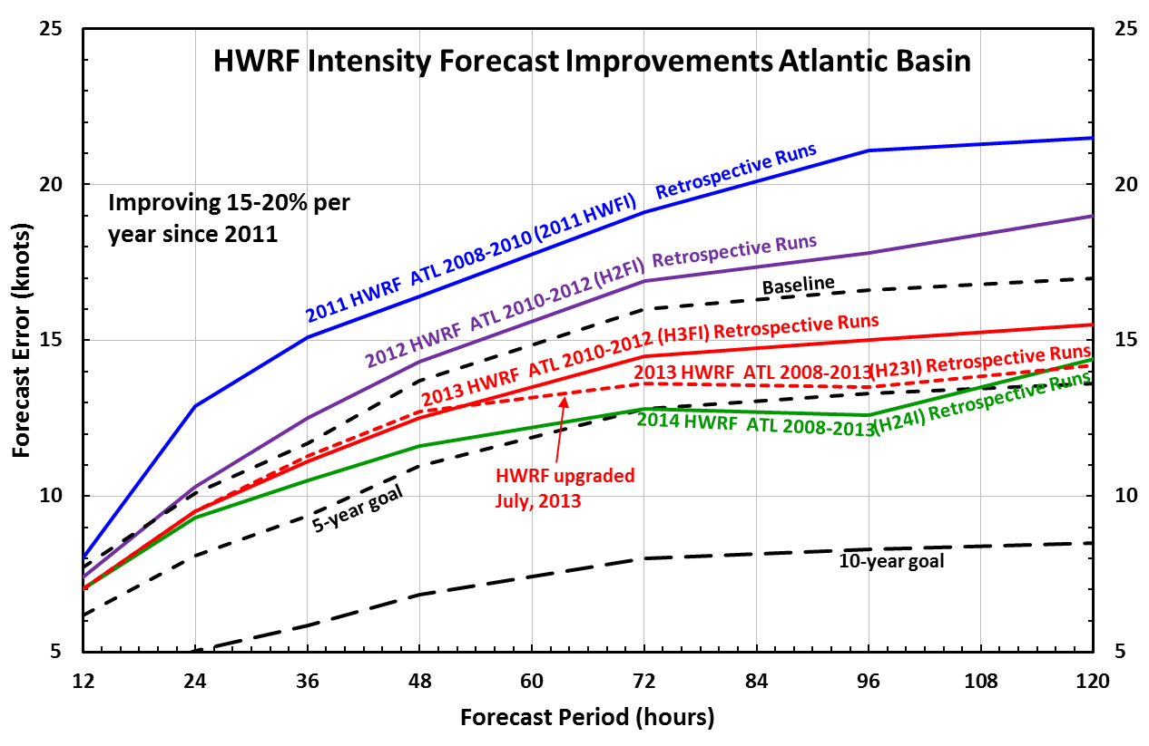
Operational HWRF: State-of-the-Art
Steep-step progress in intensity and track predictions with operational HWRF, largely due to improved resolution (3-km nest) and physics carefully calibrated using NOAA P3 aircraft observation

Slide 4
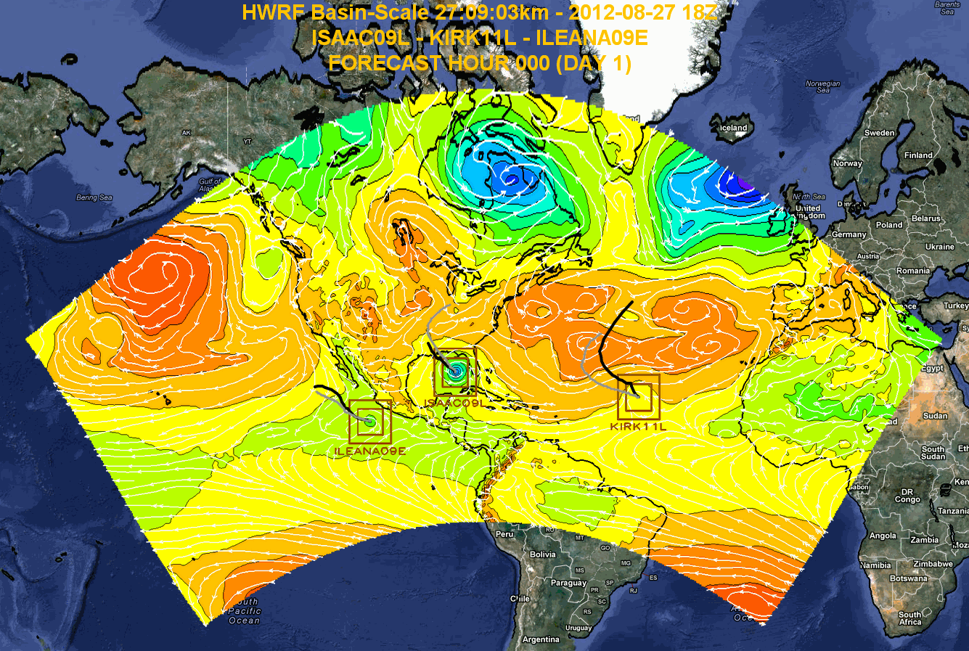
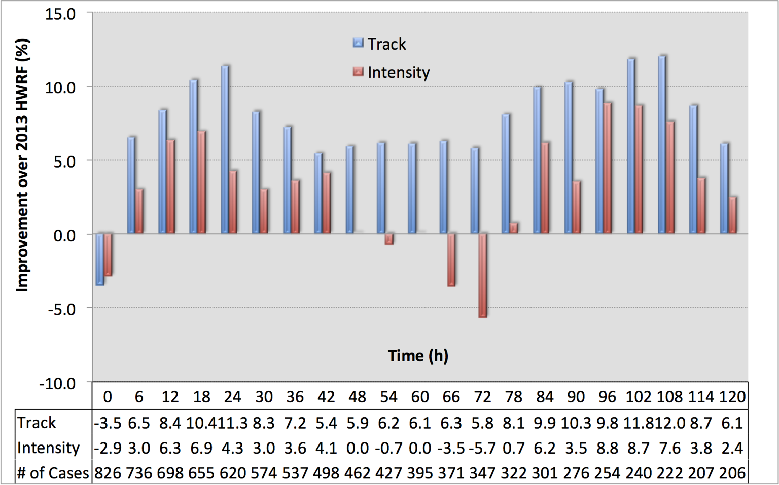
Basin-Scale HWRF: Next Operational System
Basin-scale HWRF with multiple movable nests is expected to improve the predictions of TC-TC interactions and land-TC interactions. It is a testbed of NOAA’s next-generation tropical prediction system
Sponsored by HFIP

Slide 5
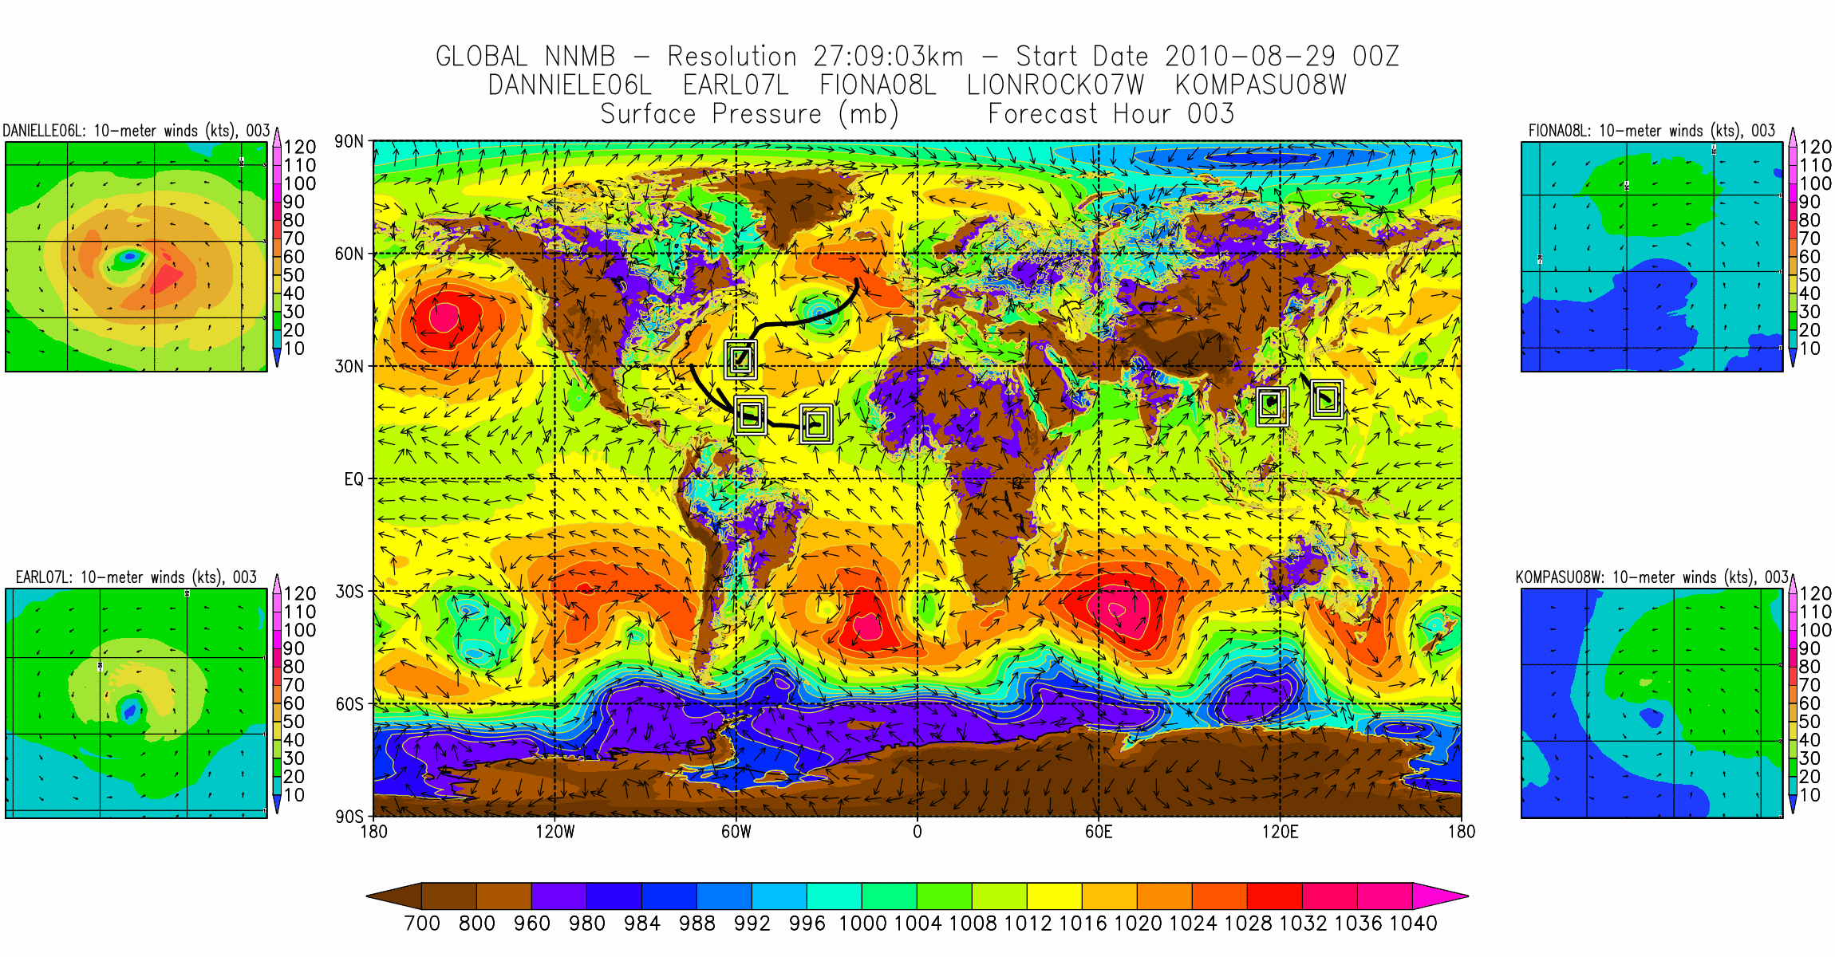
A Global Tropical Prediction System
Sponsored by HIWPP

