Slide 1


Advancing the Operational HWRF Through Observation
--A pathway from research to operation
Xuejin Zhang (张雪金)
(迈阿密大学, UM/CIMAS)
V. Talapragada (NCEP/EMC) and S. G. Gopalakrishnan (AOML/HRD)
Contributors:
F. D. Marks, Jr., R. Rogers, and J. A. Zhang (AOML/HRD)
Samuel Traham and Q. Liu (NCEP/EMC)
J-W. Bao (ESRL/PSD)
Acknowledge:
HRD Modeling group
EMC Hurricane team
DTC

Slide 2
Outline
Background
  HFIP Scientific Objectives
  Hurricane Observations
  Scientific Understanding
HWRF development
  Model Framework Expansion
  Physics Improvement
  Ocean–Atmosphere Coupling
  Vortex Initialization & Cycling
  Data Assimilation
Advances in HWRF forecast
  Model Configuration
  Retrospective Forecasts
  Megi forecasts
Future development and applications

Slide 3
Hurricane Category
(Saffir-Simpson Hurricane Wind Scale)
Category One Hurricane
  Sustained wind: 74-95 mph, 64-82 kt, 33.0-42.0 m∙s⁻¹ or 119-153 km∙hr⁻¹
  Severity: Very dangerous winds will produce some damage
Category Two Hurricane
  Sustained wind: 96-110 mph, 83-95 kt, 42.5-49.0 m∙s⁻¹ or 154-177 km∙hr⁻¹
  Severity: Extremely dangerous winds will cause extensive damage
Category Three Hurricane
  Sustained wind: 111-130 mph, 96-113 kt, 49.5-58.0 m∙s⁻¹ or 178-209 km∙hr⁻¹
  Severity: Devastating damage will occur
Category Four Hurricane
  Sustained wind: 131-155 mph, 114-135 kt, 58.5-69.5 m∙s⁻¹ or 210-249 km∙hr⁻¹
  Severity: Catastrophic damage will occur
Category Five Hurricane
  Sustained wind: >155 mph, >135 kt, >69.5 m∙s⁻¹ or >249 km∙hr⁻¹
  Severity: Catastrophic damage will occur

Slide 4
Costliest and Deadliest Tropical Storms
Table 1. The 10 normalized costliest mainland United States tropical cyclones (1900-2010)
Rank | Tropical Cyclone | Location | Year | Category | Damage (millions dollars)
1 | KATRINA | LA/MS/FL | 2005 | 3 | 105,840
2 | ANDREW | SE FL/SE LA | 1992 | 5 | 45,561
3 | IKE | Upper TX/SW LA | 2008 | 2 | 27,790
4 | WILMA | SW/SE FL | 2005 | 3 | 20,587
5 | IVAN | NW FL/AL | 2004 | 3 | 19,832
6 | CHARLEY | SW FL | 2004 | 4 | 15,820
7 | HUGO | SC | 1989 | 4 | 12,775
8 | RITA | LA/TX/FL | 2005 | 3 | 11,797
9 | AGNES | FL/NE U.S. | 1972 | 1 | 11,760
10 | BESTY | SE FL/SE LA | 1965 | 3 | 11,227
Table 2. The 10 deadliest mainland tropical cyclones (1851-2010)
Rank | Tropical Cyclone | Year | Category | DEATHS
1 | TX (Galveston) | 1900 | 3 | >8,000
2 | FL (SE/Lake Okeechibee) | 1928 | 4 | >2500
3 | KATRINA (SE LA/MS) | 2005 | 3 | 1,200
4 | LA (Cheniere Caminanda) | 1893 | 4 | 1,100-1,400
5 | SC/GA (Sea Islands) | 1893 | 3 | 1,000-2,000
6 | GA/SC | 1881 | 2 | 700
7 | AUDREY (SW LA/N TX | 1957 | 4 | >=416
8 | FL (Keys) | 1935 | 5 | 408
9 | LA (Last Island) | 1856 | 4 | 400
10 | FL (Miami)/MS/AL/Pensacola | 1926 | 4 | 372
(Blake et al. 2011)

Slide 5

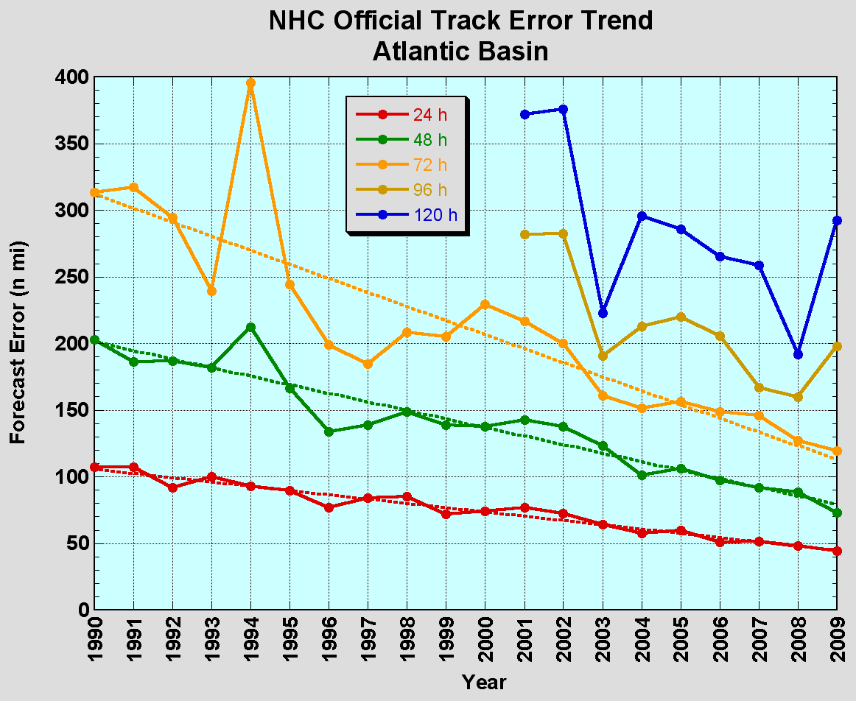
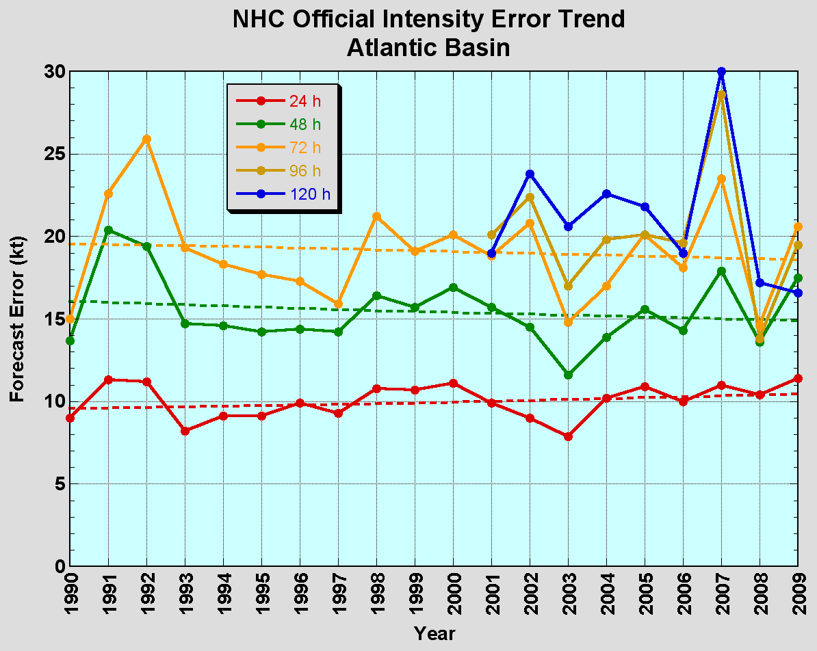
The Good – Track forecast improvements
The Bad - Intensity forecasts no real gains
No progress with intensity in last 15-20 years
Error cut in half over past 15 years
10-year improvement - As accurate at 48h as we were at 24h in 2000
24-48h intensity forecast off by 1 category
Off by 2 categories 5-10% of time

Slide 6
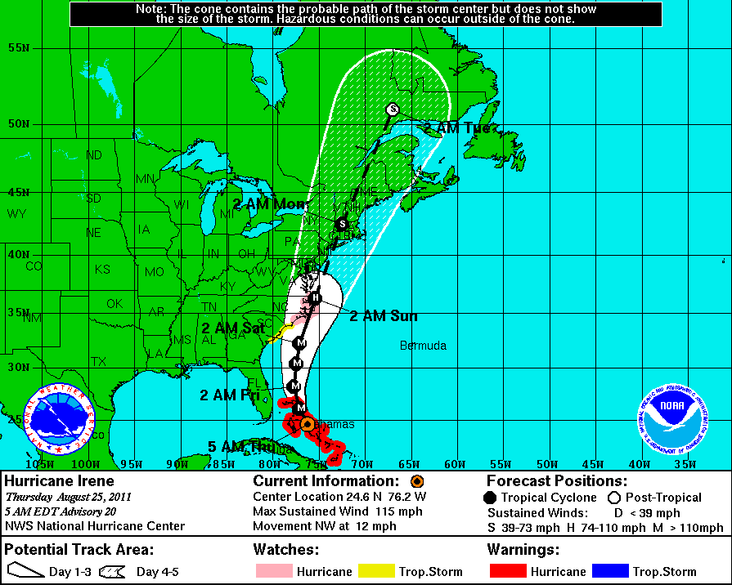
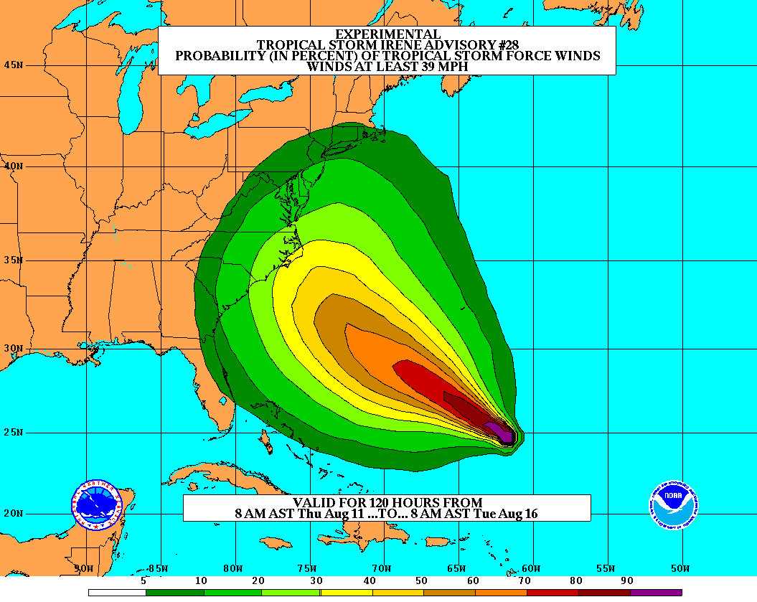
HFIP Objectives
Improving forecast accuracy
  Hurricane impact areas (track): 50% in 10 years
  Severity (intensity): 50% in 10 years
  Special focus: Rapid intensity change
    Increase probability of detecting rapid intensification at day 1 to 90% and 60% at day 5
Extend forecast reliability out to 7 days
Quantify, bound and reduce forecast uncertainty to enable risk management decisions
Improve storm surge forecast
More information on HFIP website: http://www.hfip.org
Notes:
With recent catastrophic events like Katrina (2005) and Wilma (2005), back- to-back Category 5 storms in the Caribbean Sea like Dean (2007) and Felix (2007), and rapid intensifying storms just prior to landfall like Charley (2004) and Humberto (2007)

Slide 7
HFIP Challenges
Limited operational high performance computing availability
Model initialization issues within the first 24-36 hrs
Better utilization of existing satellite data
Development of useful probabilistic forecast products and effectively communicate the information

Slide 8


Airborne Observation
NOAA Gulfstream-IV jet:
Flight altitude:
  ~45,000 ft (13700 m, 150 hPa)
Purpose
  synoptic
Instrument
    GPS dropsonde
Observation frequency
  Flight level: 1 Hz
  dropsonde: ~30 个
  interval: 150-200 km
NOAA P-3:
Flight altitude
  ~25,000 ft (7600m, 400 hPa)
Purpose
  Inner core
Instrument
  GPS dropsonde
  AXBT, AXCP, AXCTD, Bouy
  Doppler Radar
  SFMR, DWRL etc.
Observation frequency
  dropsonde: ~30 个
Notes:
AXBT: airborne expendable bathythermographs, measures ocean temperature as a function of depth
AXCP: airborne expendable current probes
AXCTD: Airborne eXpendable Conductivity Temperature and Depth probes
Drifting bouy

Slide 9
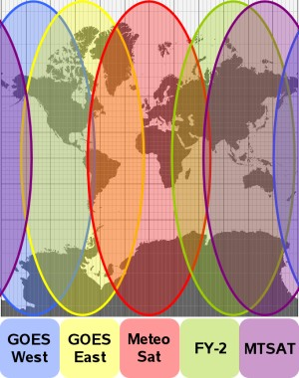
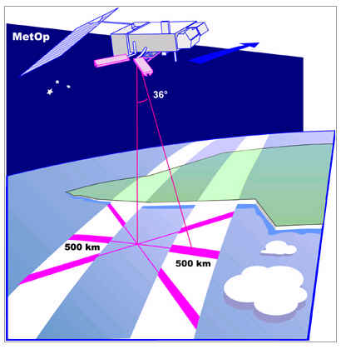
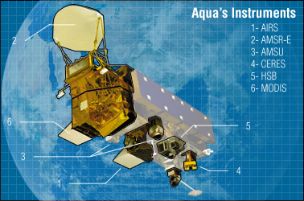
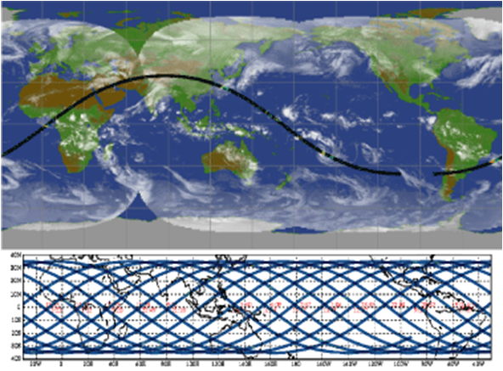
Satellite Observation
Geostationary
  visible, infrared, water vapor channels
  cloud structure, cloud-drift winds
Polar-orbiting
  active scatterometer
  surface wind speed and direction
Polar-orbiting
  passive microwave channels
  precipitation structure, ice scattering

Slide 10
Understandings from Observation
Synoptic environment
Vortex structure
Convective structure
Turbulence structure
Hurricane BL structure
Microphysics structure
Important parameters

Slide 11
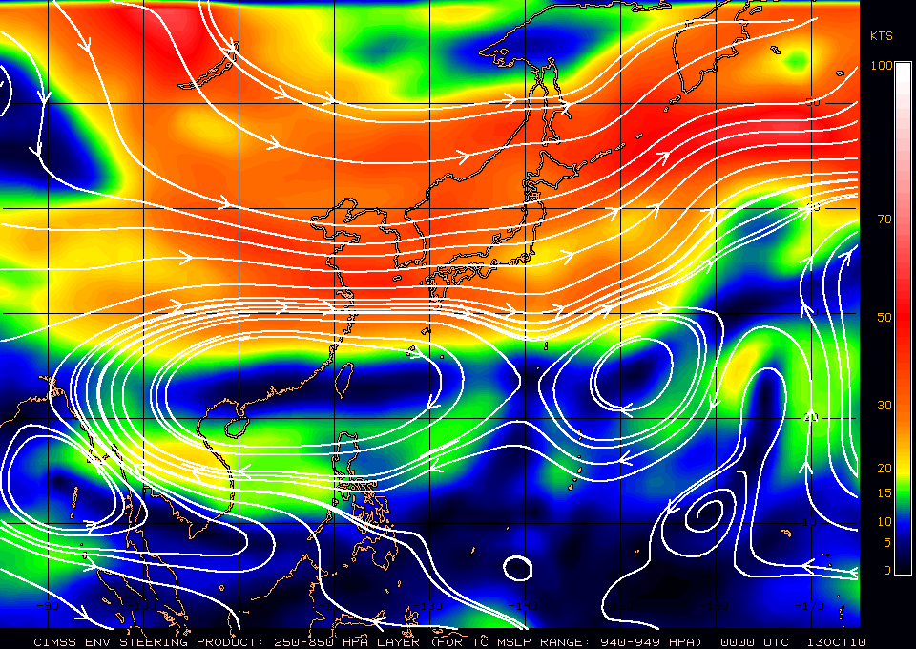
Synoptic Environment (Megi 2010)

Slide 12
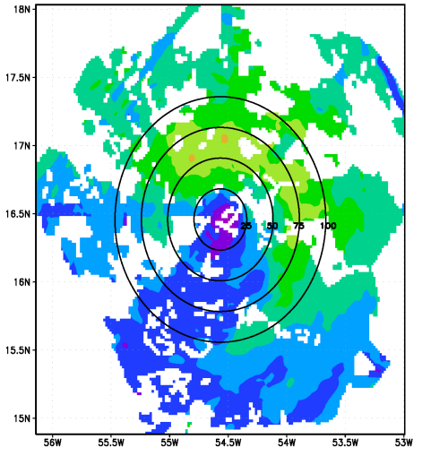
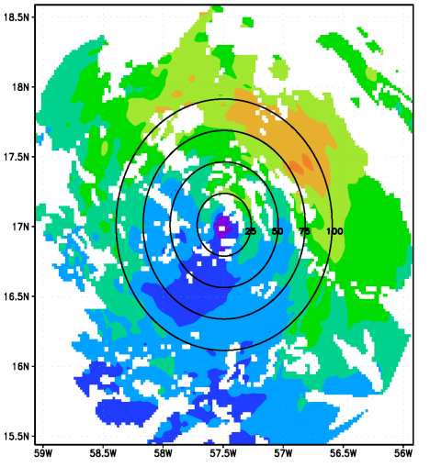
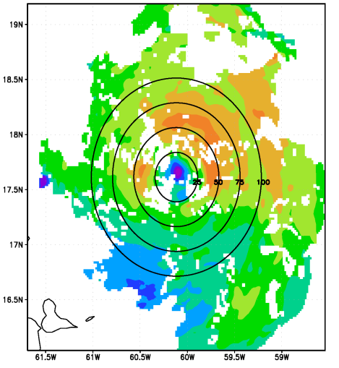
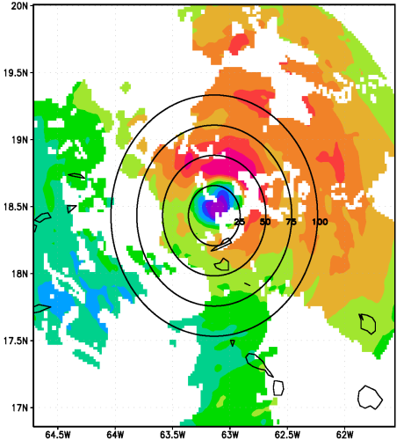
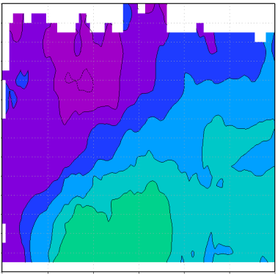
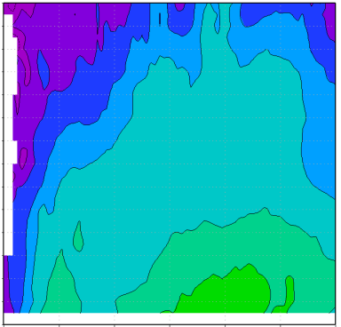
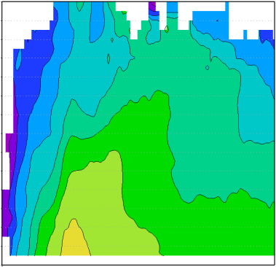
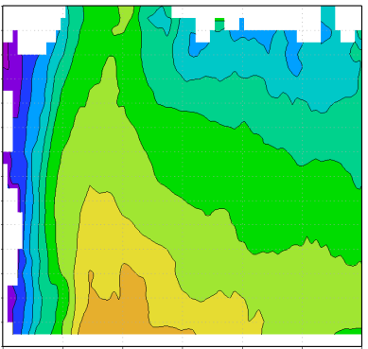
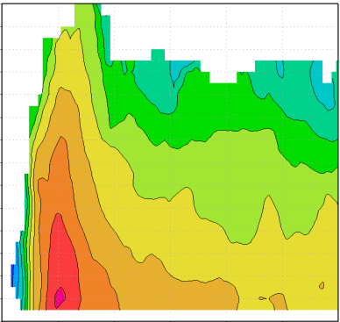
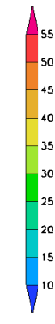
Earl (2010) Vortex Structure
Flight 1 – 00 UTC 29 Aug
Flight 2 – 12 UTC 29 Aug
Flight 3 – 00 UTC 30 Aug
Flight 4 – 12 UTC 30 Aug
DC-8
DC-8
C-130
C-130
C-130
C-130
G-IV
G-IV
G-IV
100828I
100829H
100829I
100830H
100830I
P-3
P-3
P-3
P-3
P-3
Earl intensity and flight observation
2-km altitude wind speed
14
Flight 1 – 00 UTC 29 Aug
Flight 2 – 12 UTC 29 Aug
Flight 3 – 00 UTC 30 Aug
Flight 4 – 12 UTC 30 Aug
Flight 5 – 00 UTC 31 Aug
12
10
height (km)
8
6
4
2
0
25
50
75
100
125
150
25
50
75
100
125
150
25
50
75
100
125
150
25
50
75
100
125
150
25
50
75
100
125
150
radius (km)
radius (km)
radius (km)
radius (km)
radius (km)
Axisymmetric tangential wind (shaded, m s⁻¹)
Rogers et al. 2012

Slide 13
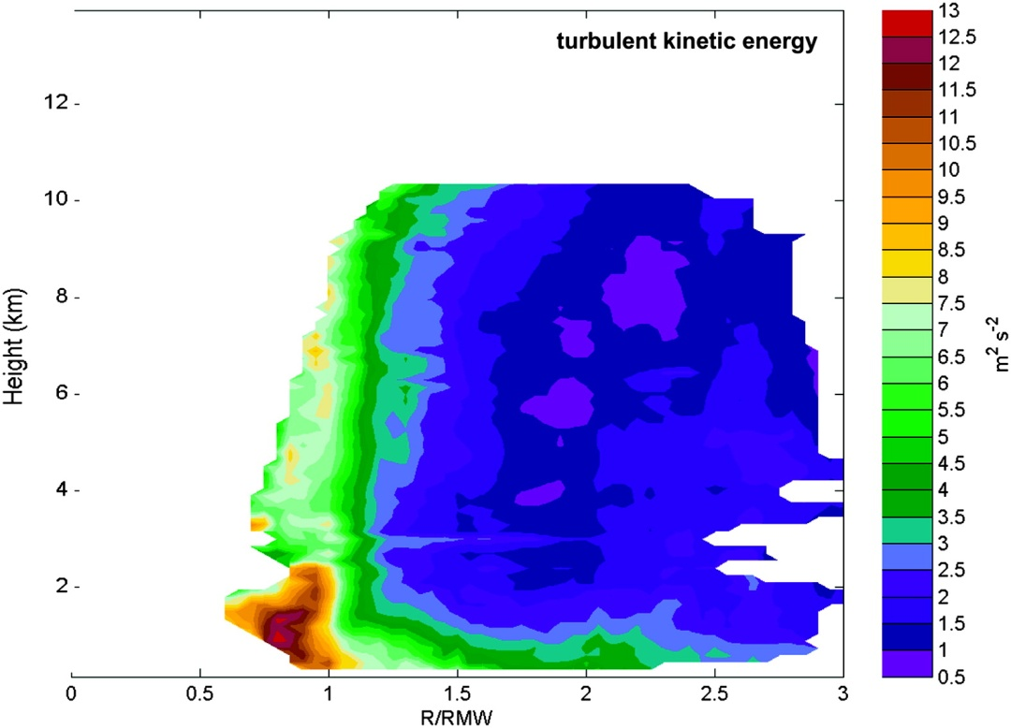
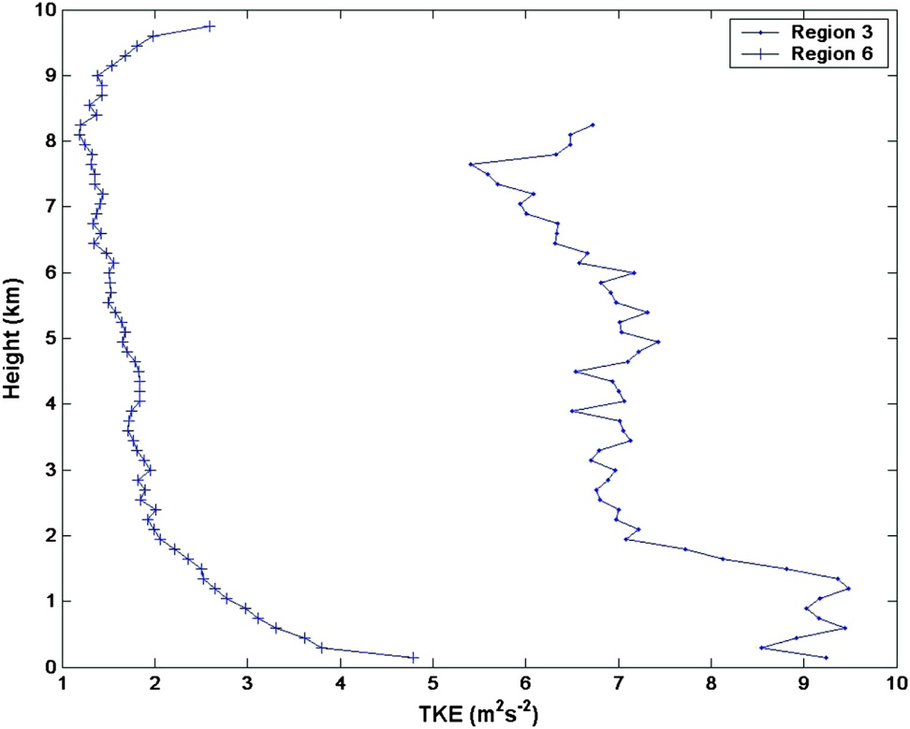
Turbulence Structure
Composite of turbulent kinetic energy (shaded, m² s⁻²) calculated from profile data.
Vertical profiles of composite mean turbulent kinetic energy for inner eyewall edge (dotted) and outer radii (crosses)
Lorsolo et al. 2010

Slide 14
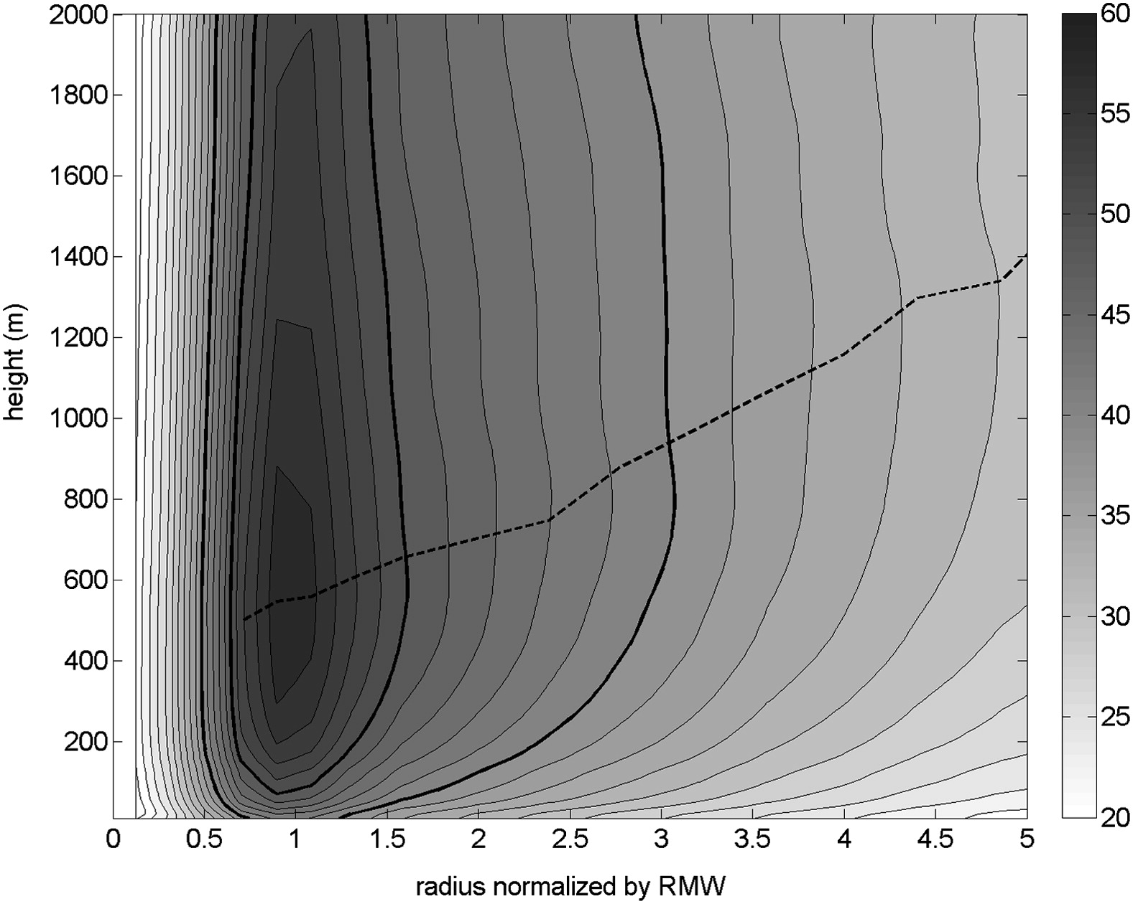
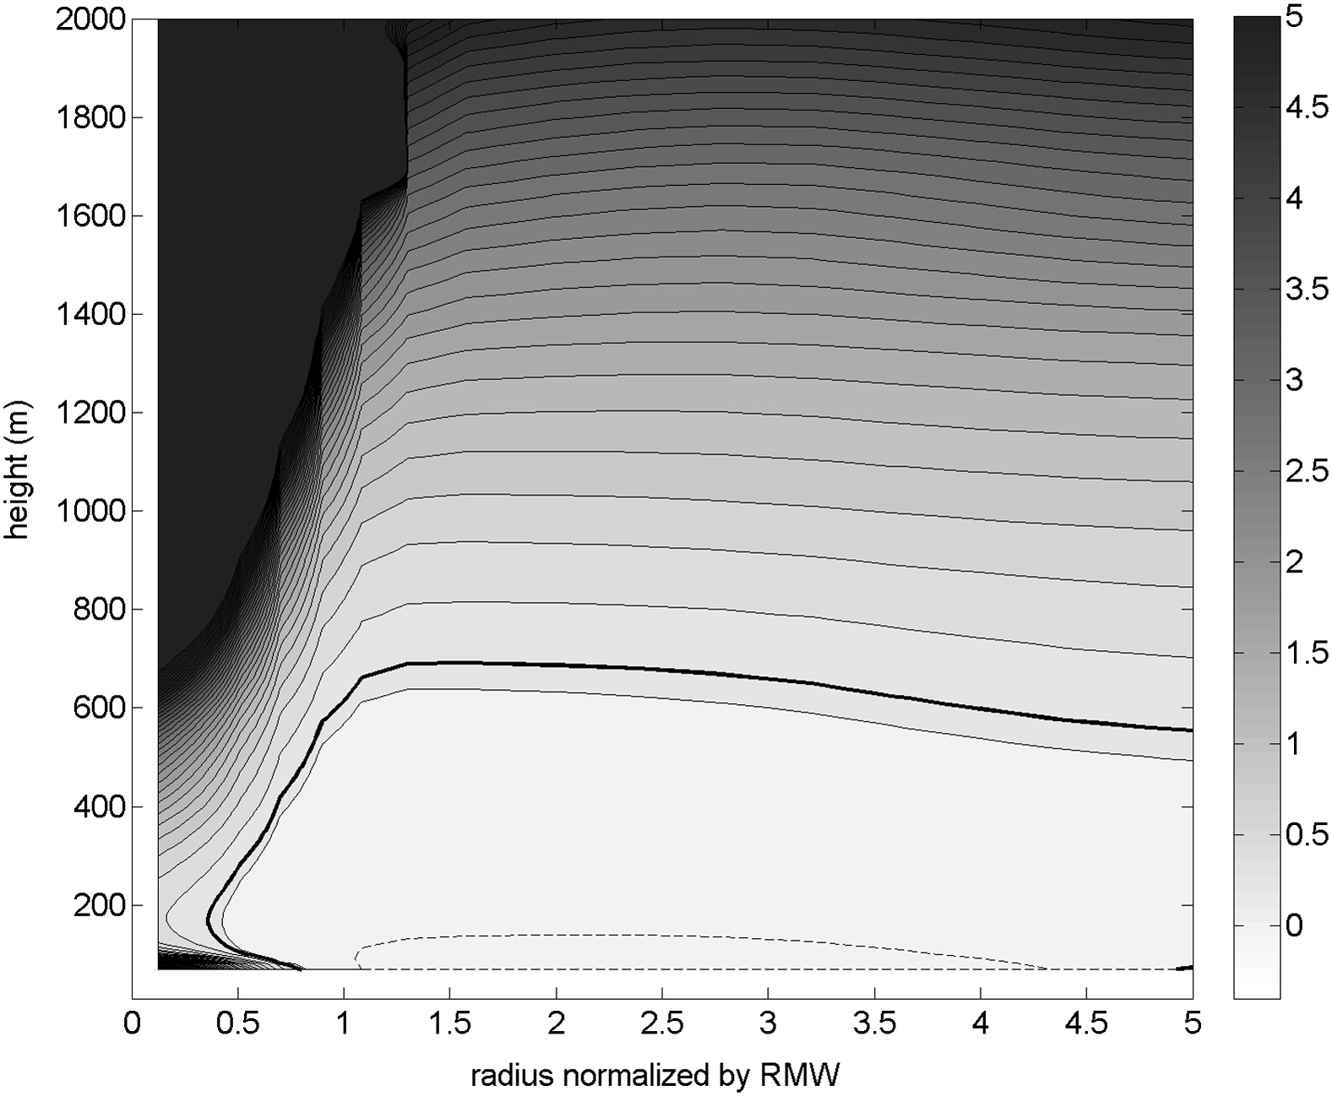
Hurricane BL Structure
Composite analysis result of the total wind speed (m s⁻¹) as a function of altitude and the normalized radius to the storm center. The black dashed line depicts the height of the maximum wind speed varying with radius. The contour interval is 2 m s⁻¹. The thick black lines are the 40 and 50 m s⁻¹ contours
Composite analysis result of the bulk Richardson number (Ri) as a function of altitude and the normalized radius to the storm center. The thick black line denotes the constant contour of Ri with a value of 0.25
Zhang, J.A. et al. 2011

Slide 15
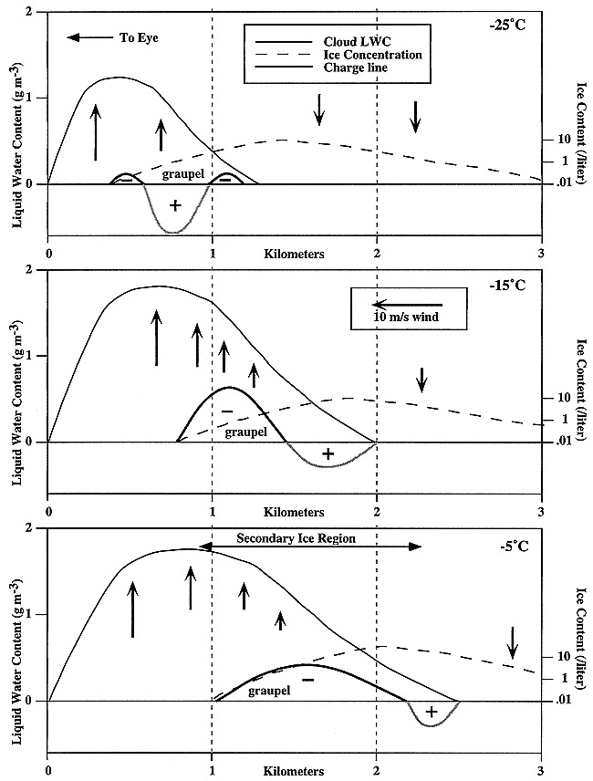
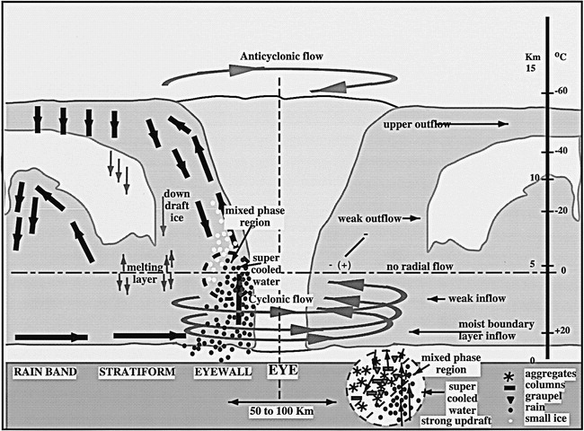
Microphysics Structure
Idealized cross section through the upshear side of an updraft containing supercooled liquid water and a downshear ice-containing downdraft as might occur in a hurricane eyewall (with circular symmetry) or locally in a deep convective cloud
Schematic depicting hurricane precipitation processes, cloud distribution, and preferred regions for charge separation
Black and Hallett 1999
Notes:
The charge separation protocol was taken from Saunders et al. (1991; Fig. 7); other scenarios are possible. Arrows indicate local vertical velocity, and the expected location of graupel particles is shown. Separation of charge resulting from ice–graupel collisions depends on the relative concentration of particles and the magnitude of the liquid water content; the sign and magnitude of the charge on the target (larger) particle is indicated, as inferred from laboratory data. The sign and magnitude of the separated charge varies with location both along the horizontal (as measured by aircraft penetrations perpendicular to the horizontal wind) and in the vertical (from aircraft penetrations at different temperatures). The relative concentration of vapor-grown ice results from splinter production by the Hallett–Mossop process under appropriate conditions. Subsequent vertical and downshear advection of the particles determines the LWC to ice transition. The charging processes are controlled by the rate at which splinters are captured by supercooled drops to form new rimers and produce yet more splinters under appropriate conditions and the rate of bounce of such particles from growing graupel.
Ocean surface temperatures are near 28°C giving cloud-base temperatures near 22°C. In mature hurricanes, typical vertical velocities near 0°C level are 5–8 m s−1, with convection extending to well beyond the −40°C isotherm, the temperature for homogeneous ice nucleation. The inset shows the region where charge separation occurs in the horizontal gradient of vertical shear, limited in altitude by the lack of supercooled water above −5°C. White dots indicate where small ice particles, frozen drops, and graupel exist, and black drops indicate rain. Air motion arrows show axial and radial flow leading to redistribution of hydrometeors. Tangential (primary) circulations are represented by fat arrows with elliptical tails; note the change from cyclonically curved flow to anticyclonic outflow near the top of the storm and ice redistribution at midlevels. Thinner, straight arrows show approximate radial and vertical air motions; lengths are not to scale. The observed distribution of electric field polarity is shown.

Slide 16
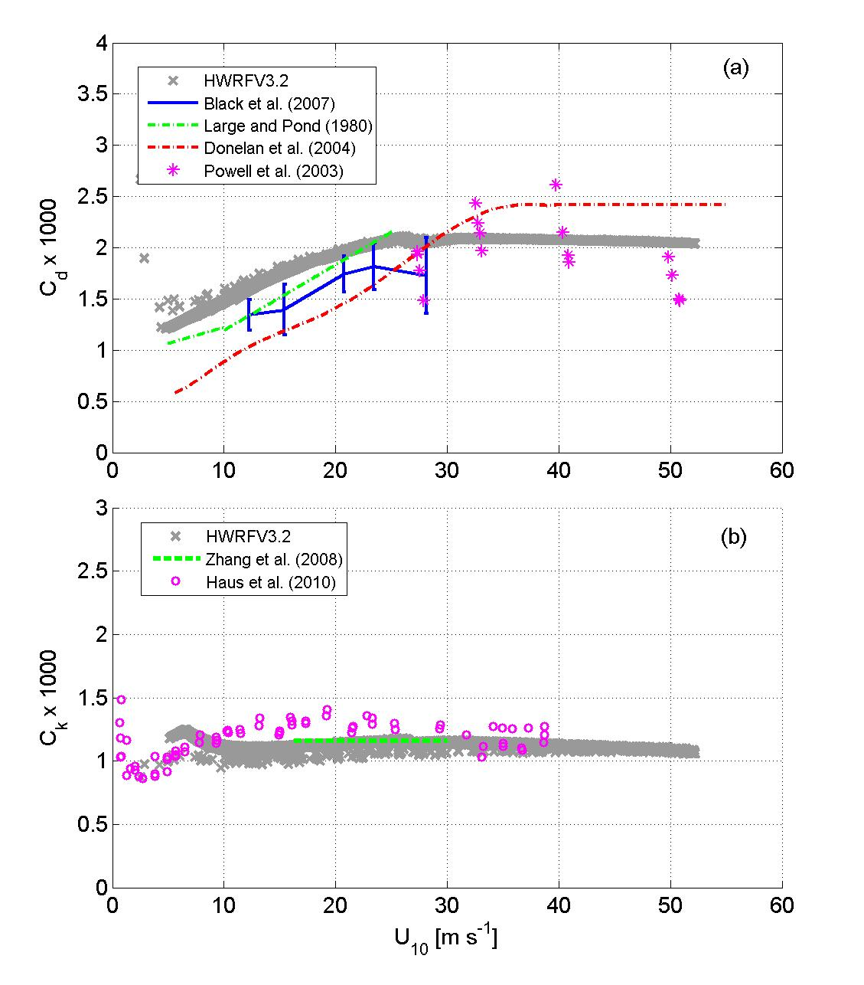
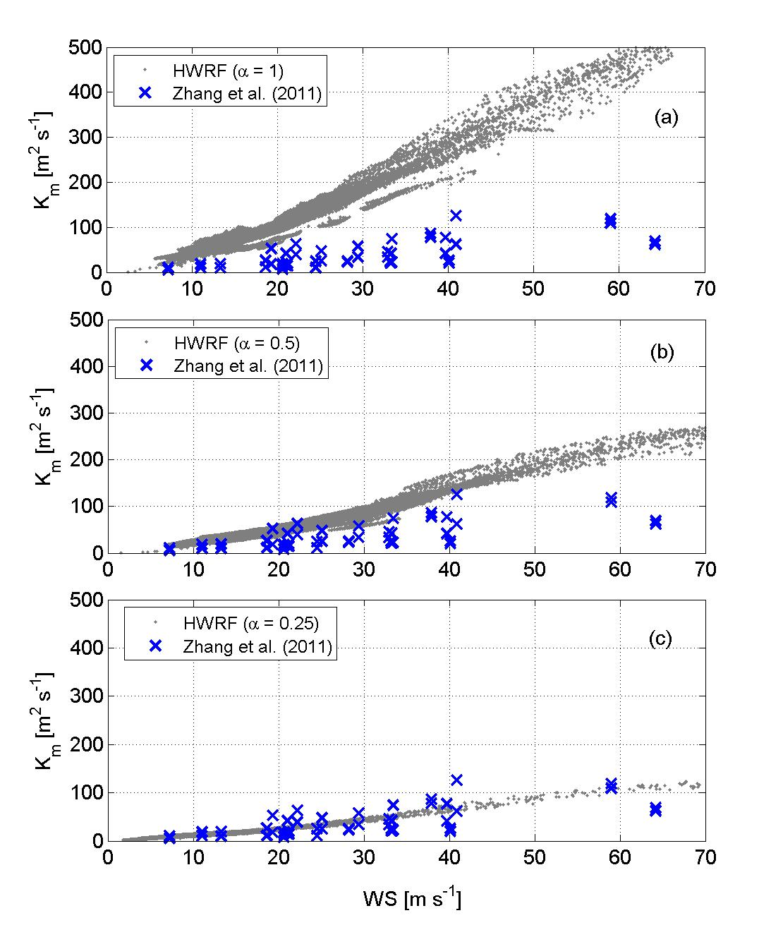
High Resolution PBL Physics Parameters
C_{d}: Surface exchange coefficient for momentum
K_{mc}: Eddy diffusivity for momentum
K_{m} =1/2 K_{mc}
C_{k}: Surface exchange coefficient for moisture & heat
K_{m} =1/4 K_{mc}
Gopalakrishnan et al. 2011

Slide 17
Major HWRF active developments
Model framework expansion
  New model internal storm track algorithm (HRD-EMC)
  Multiple nest framework (HRD-EMC)
  Idealized test (HRD-ESRL)
Physics improvement
  New GFS convection and shallow convection (EMC)
  Modified PBL (HRD-EMC)
  GFDL surface scheme (EMC-HRD)
  Modifications to treatment of eddy diffusivity (HRD-EMC)
Vortex initialization & Cycling (EMC-HRD)
  Improve vortex initialization for more realistic storm size and intensity corrections
  Cycle multiple-nest fields
Couple to HYCOM ocean model in the Atlantic (EMC)
Data assimilation
  GSI & Hybrid DA (EMC)
  HEDAS & Regional Hybrid DA (HRD-EMC)
Model compatibility (EMC)
  Add configuration flexibility
  Add multi-platform compatibility
Notes:
17

Slide 18
NCEP Operational HWRF (2.0) 2007
AOML/HRD HWRFX (V3.0.1) 2008 (HFIP Stream 2)
HWRF Vortex
Assimilation & GSI
WRF pre-processing system
Flexibility for testing initial
Conditions for research
NMM dynamics with
one moving nest
NMM dynamics with
multiple moving nests
Operating resolution 27:9
Operating resolution
27:9, 9:3 and 27:9:3
Hurricane EnKF Data
Assimilation System (HEDAS)
Ocean Coupled
GFDL/GFS Physics/
Slab LSM
GFDL/GFS Physics/
NOAH LSM
Consistent w/ 3 km res.
Framework also
Includes Idealized
Cases/ 1-D HYCOM
HWRF post-processor
& HPLOT
Diapost: High Res. Hurricane Post-Processing system
Release Version HWRF V3.2
2010
Tropical Prediction System
(HWRF-GEN)
Basin-Scale &
Multiple-Movable Nests
27:9:3 REAL-TIME HFIP STREAM 1.5 SYSTEM (2011)
HWRF V3.2/V3.4

Slide 19
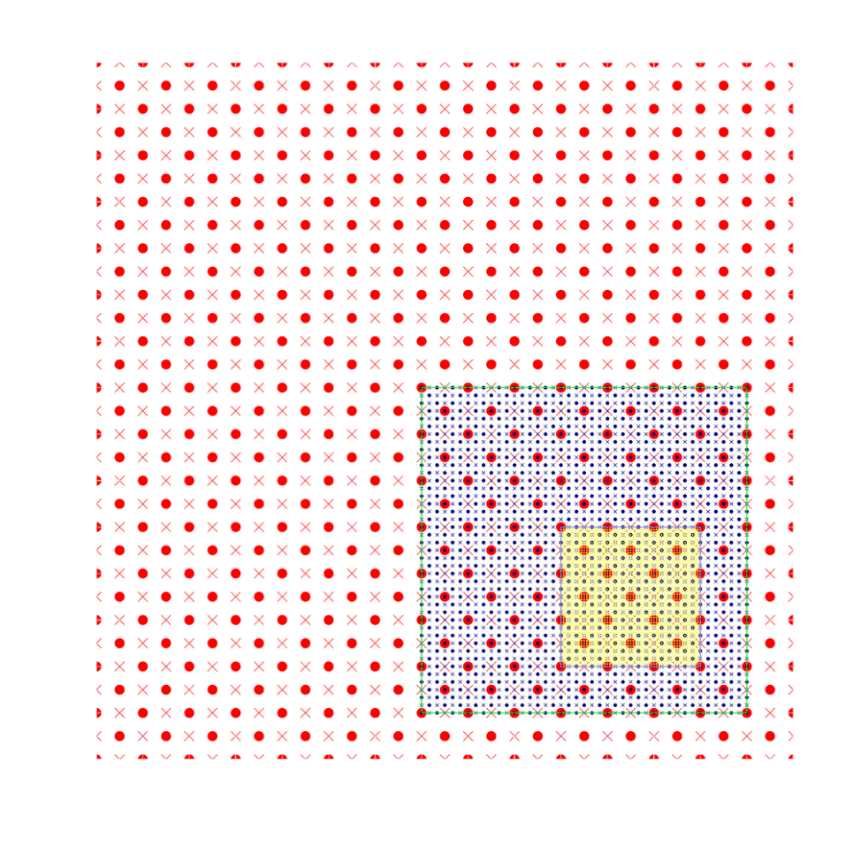
Main Development Activities
Moving Nest (HRD/EMC)
Starting point at mass points
Aligning at mass points
Mediate domain follows the inner most domain
Nest following centroid MSLP minima
Main Developments
Idealized framework (HRD/PSD)
Physics configuration (EMC/HRD/PSD)
3rd Nest Initialization (EMC/HRD)
Ongoing Developments
Hybrid DA (EMC/HRD/GSD)
Multiple moving nests (HRD/EMC)
3-Nest Oper. Implementation--2012 (EMC)
Repository Version (EMC/DTC)
• Mass points × Wind points
Successful O2R and R2O story under HFIP direction!

Slide 20
Coupling processes
Atmospheric Component
SST
Coupler
SST
Oceanic Component
Fluxes
Winds
Domain attributes
Fluxes
Winds
Domain attributes
Coupler functions
Interpolation
Data passing
Synchronize oceanic and atmospheric components
Initialize the moving nest leading edge

Slide 21
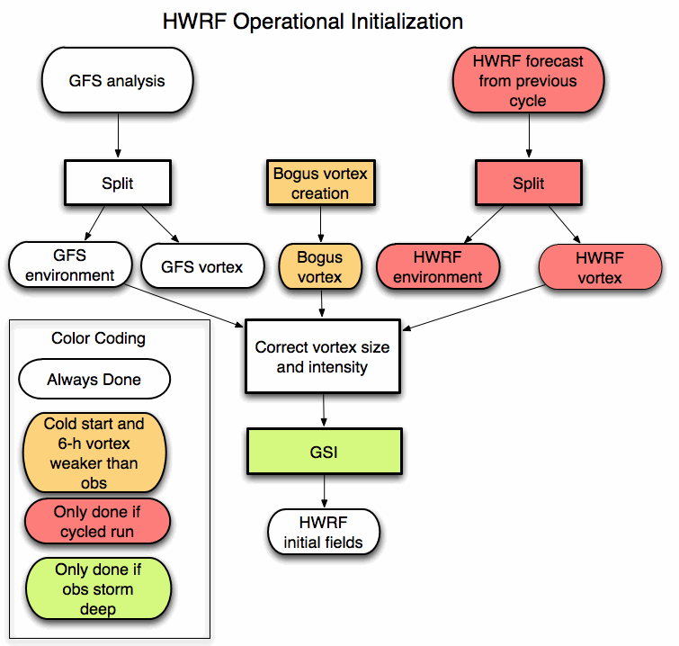
Vortex initialization and cycling processes

Slide 22

Data Assimilation
For Vortex scale
T – 6 h
T
T + 126 h
Ensemble
Spin-up
DA Cycling
with EnKF
Deterministic HWRF-X Forecast from Ens. Mean
1-hour Cycles
Ensemble
Initialization from T-6h GFS-EnKF
Real-Time
Observation
Pre-Processing
Mean of Final Analysis Assumed Valid for T
Credit: A. Aksoy

Slide 23
Current Model Configurations
 | 2011 Oper. HWRF | Stream 1.5 HWRF | Proposed 2012 HWRF
Domain | 27 KM: 77.76˚X 77.76˚ 9 KM: 7.2˚ X 6.0˚ | 27 KM: 77.76˚ X 77.76˚ 9 KM: 10.56˚ X 10.2˚ 3 KM: 7.6˚ X 6.4˚ | 27 KM: 77.76˚ X 77.76˚ 9 KM: 10.56˚ X 10.2˚ 3 KM: 6.12˚ X 5.42˚
Vortex Initialization | 27-9 KM: Yes, with GSI | 27-9 KM: Yes, GSI 3 KM: No, Downscaled | Modified Vortex Initialization at 3 KM, with 30x30º analysis domain and GSI
Cycling | Yes(Vortex only) | Yes (9 km vortex only) | Yes (3 km vortex only)
Ocean Coupling | 27-9 KM: Yes | 27-9 KM: Yes 3 KM: No, Downscaled | 27-9 KM: Yes 3 KM: No, Downscaled
Physics schemes
Microphysics | Ferrier | Ferrier | Modified Ferrier (High-Res)
Radiation | GFDL | GFDL | GFDL
Surface | GFDL (2011) | GFDL (High_res) | GFDL (High_res)
PBL Scheme | GFS | 2011 GFS (High-res) | 2012 GFS (High_res)
Convection | New SAS | New SAS (27-9 KM) no CP (3 KM) | SAS (High-Res), No CP (3 KM), Shallow Convection
Land Surface | GFDL Slab | GFDL Slab | GFDL Slab
GWD | Yes(27km); No(9km) | Yes(27km); No(9-3km) | Yes(27km); No(9-3km)
Notes:
23

Slide 24
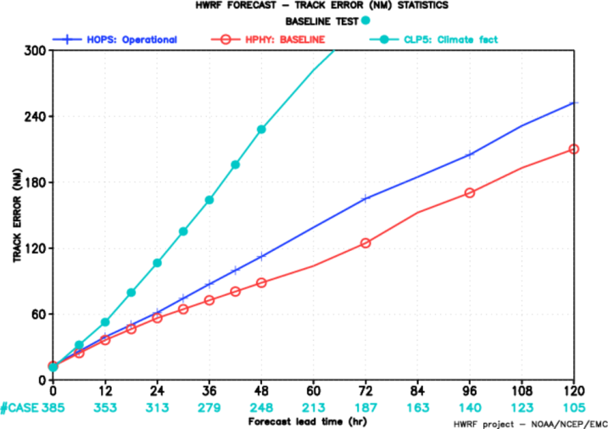
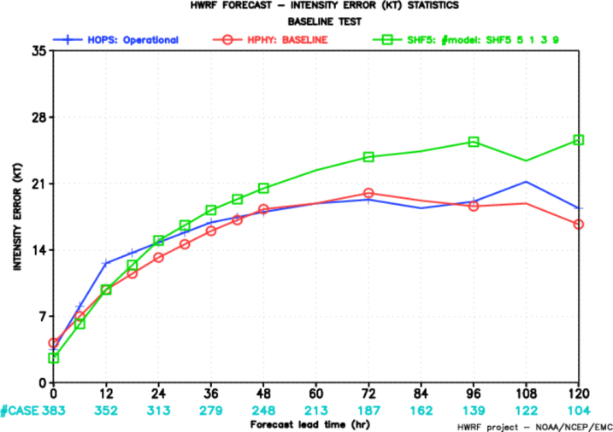
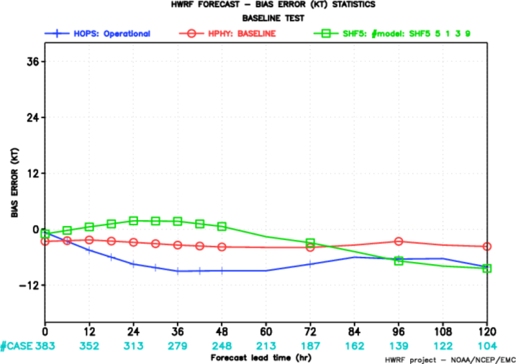
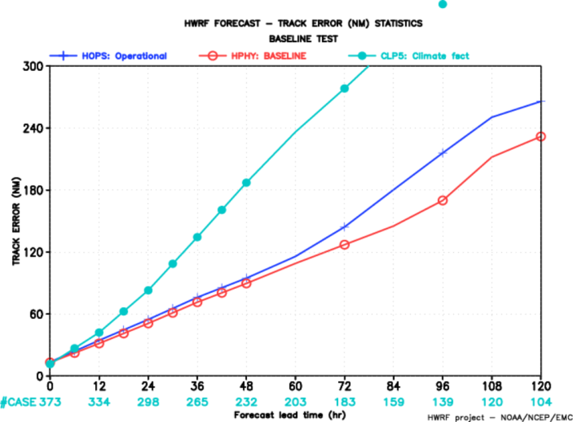
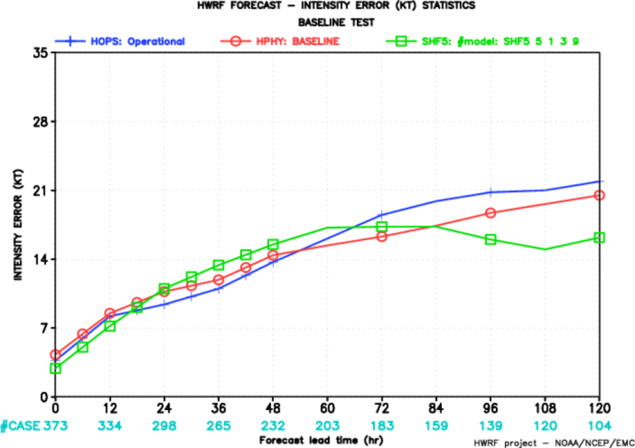
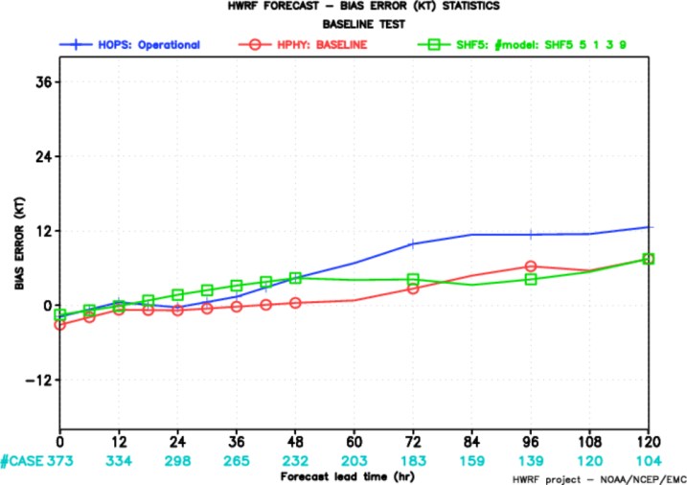
2010 AL
Track Error
Intensity Error
Bias Error
2011 AL
HOPS
HPHY
CLP5
SHF5

Slide 25
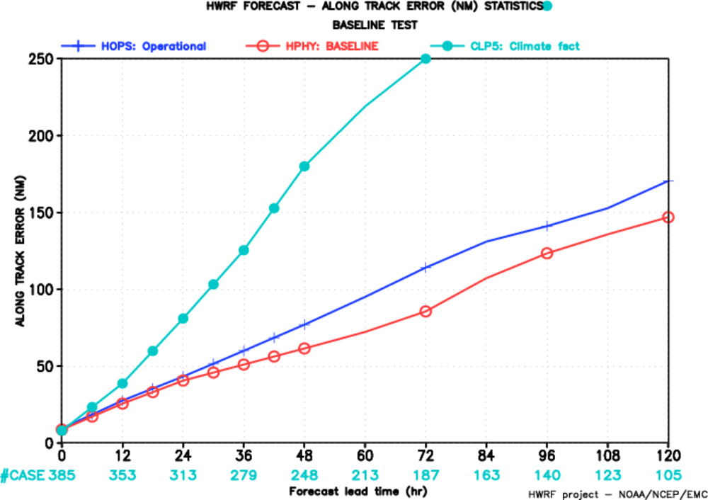
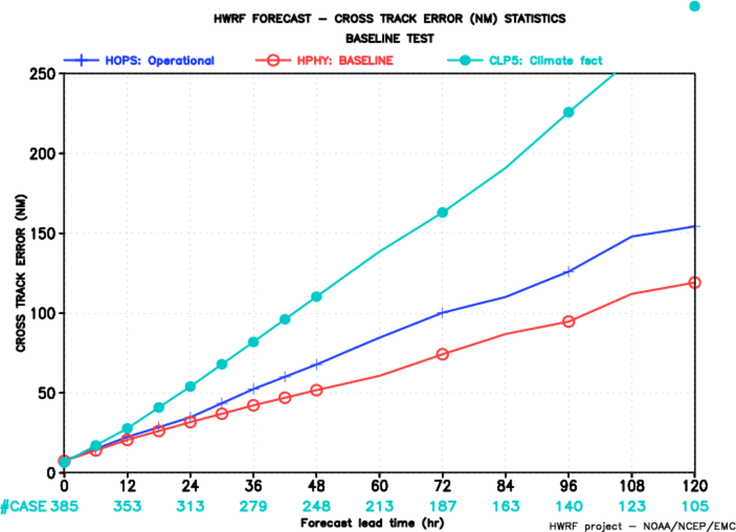
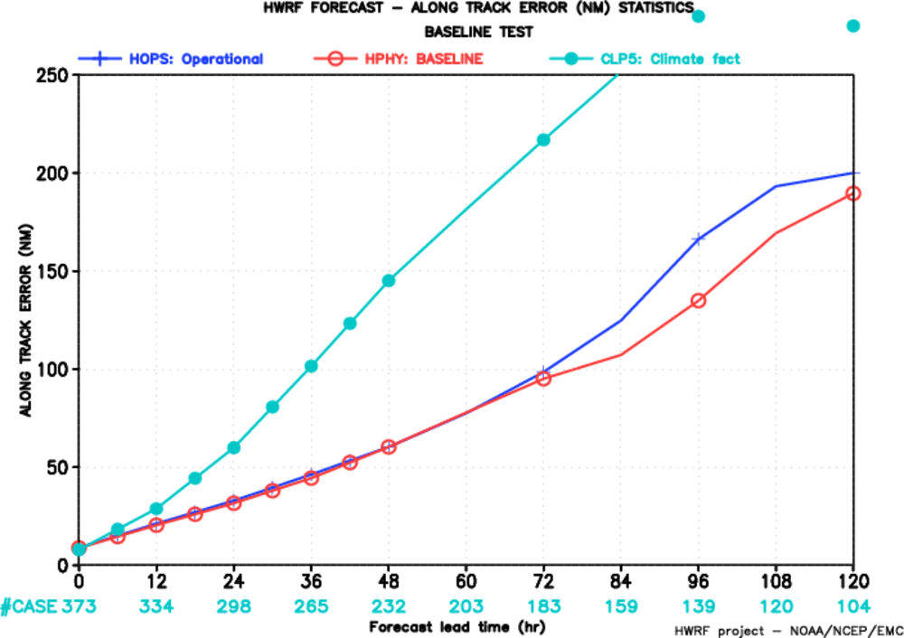
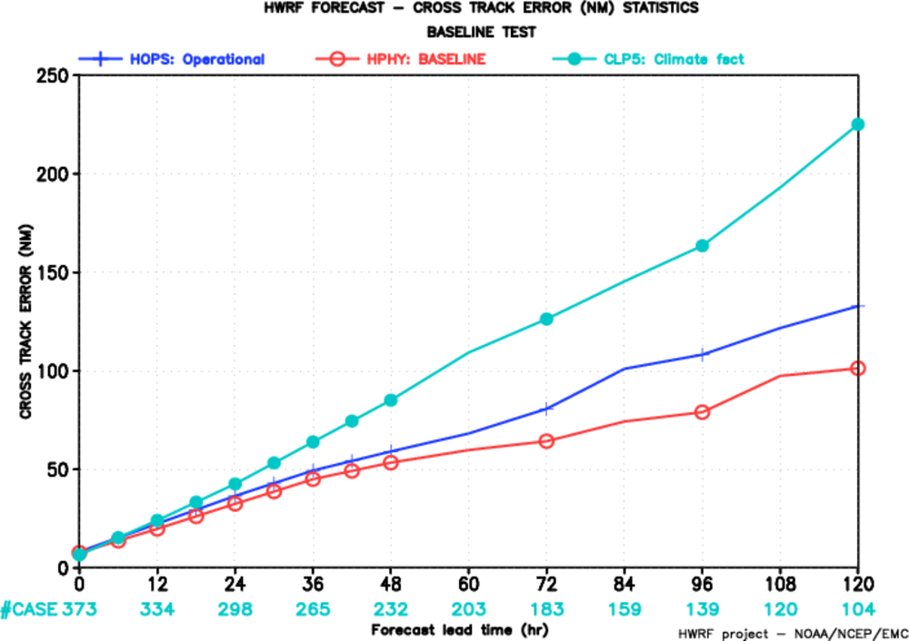
2010 AL
Along Track Error
Cross Track Error
2011 AL
HOPS
HPHY
CLP5

Slide 26
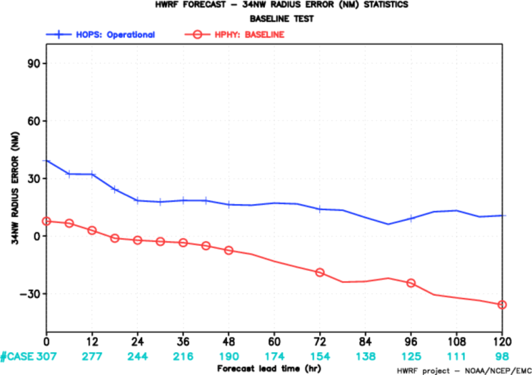
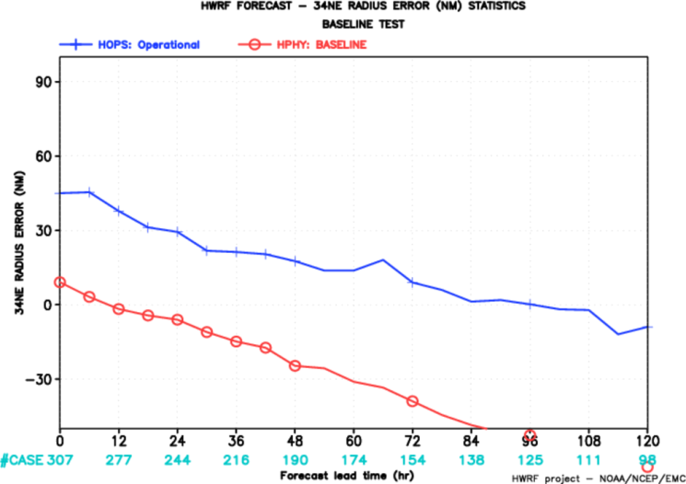
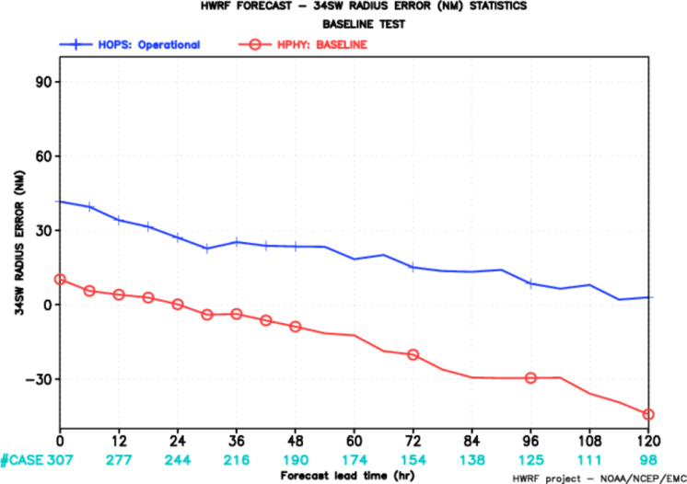
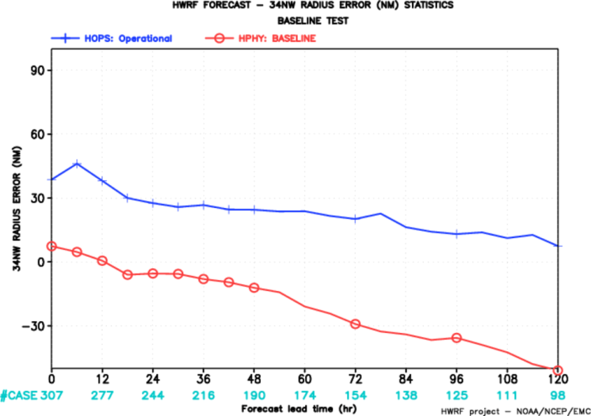
Radius 34kts
2010 AL
NW
NE
SW
SE
HOPS
HPHY

Slide 27
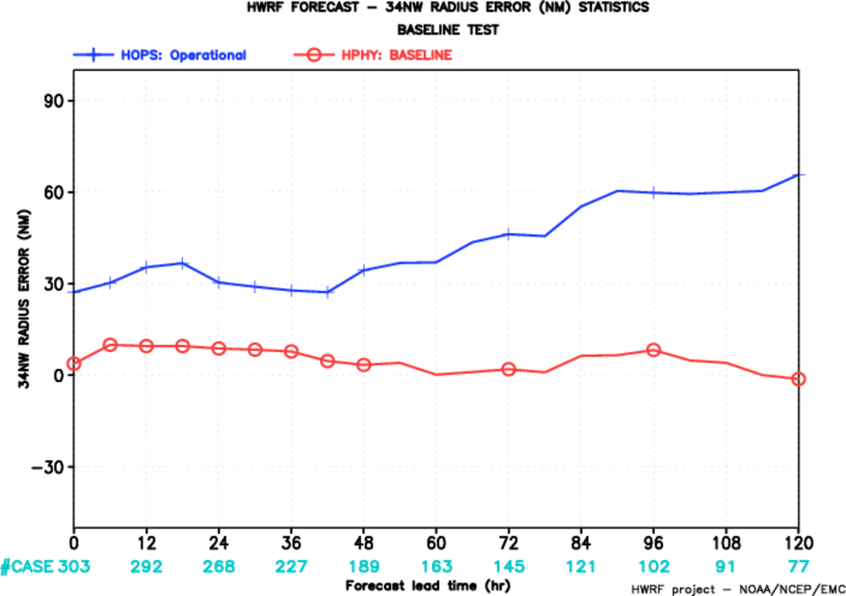
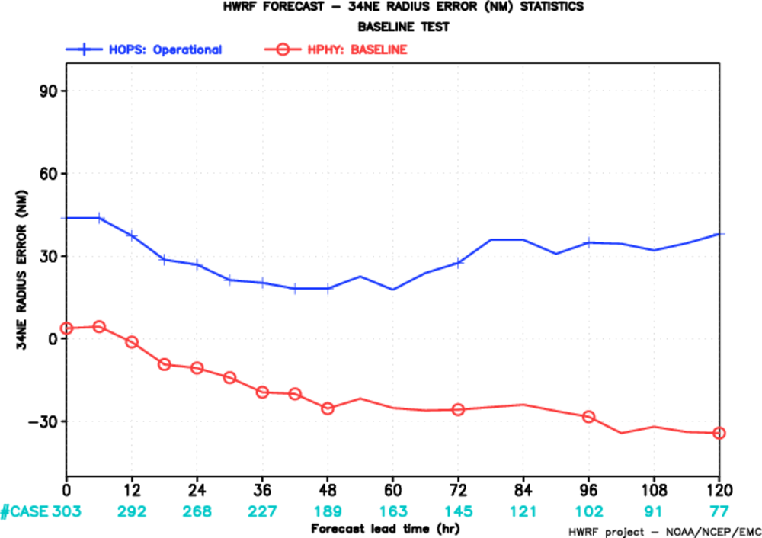
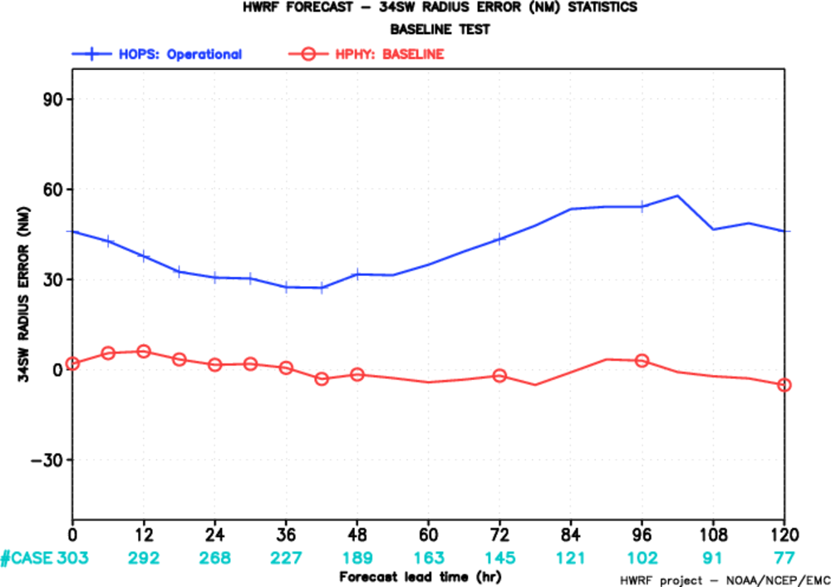
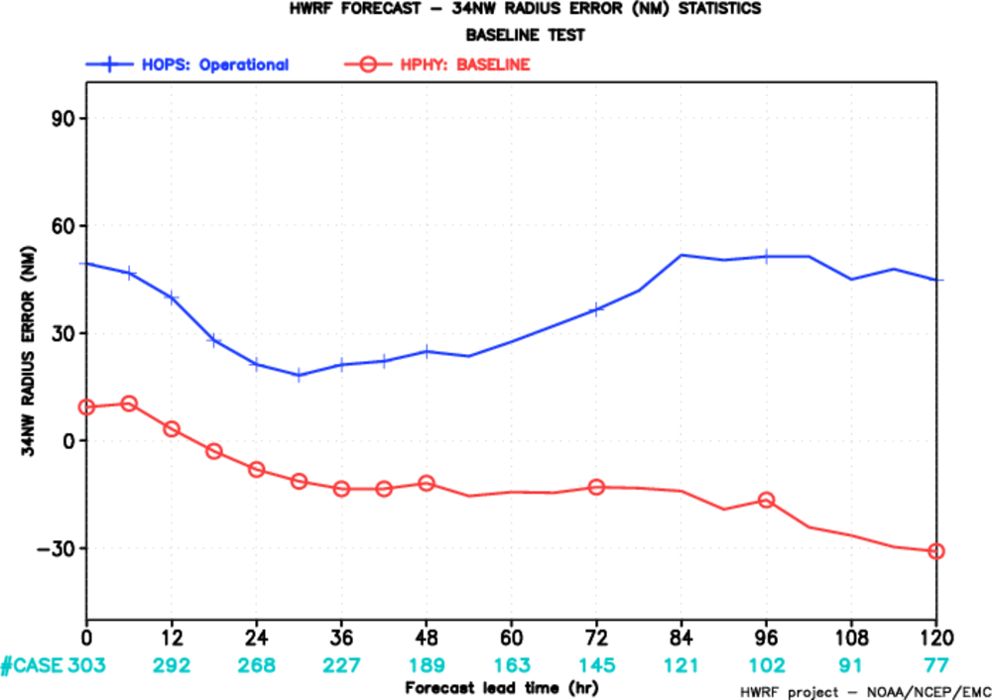
Radius 34kts
2011 AL
NW
NE
SW
SE
HOPS
HPHY

Slide 28
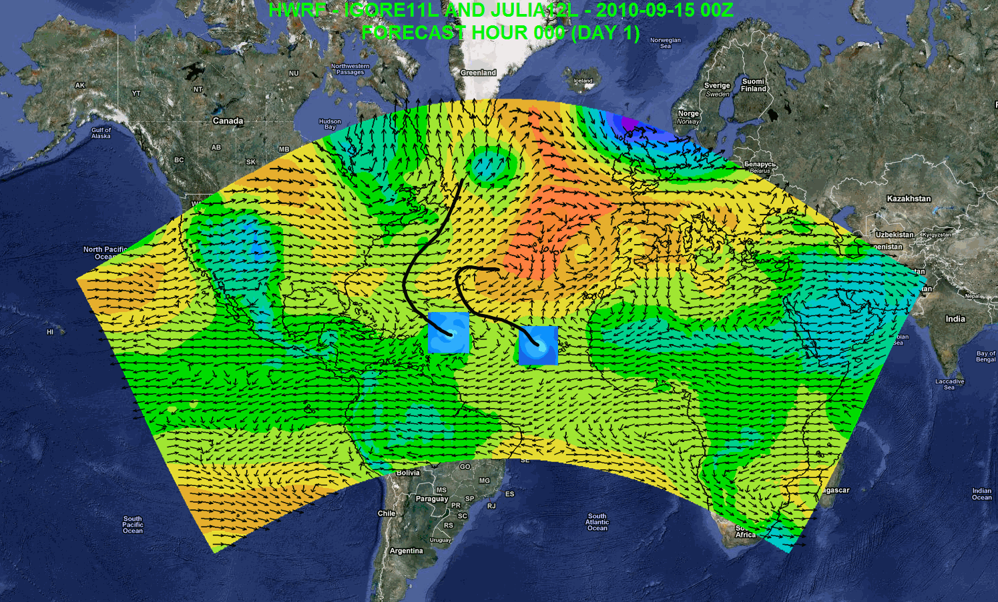
Possible Applications
Independent DA and cycling system
7-day forecast
Track forecast
Local applications
Regional ensembles/products
Daily Tropical Outlook/genesis
Website at AOML: https://storm.aoml.noaa.gov/realtime
Notes:
Independent DA system including vortex scale DA
Genesis
Track forecast
Local application
Drive local-scale model
Website at AOML: https://storm.aoml.noaa.gov/realtime

Slide 29
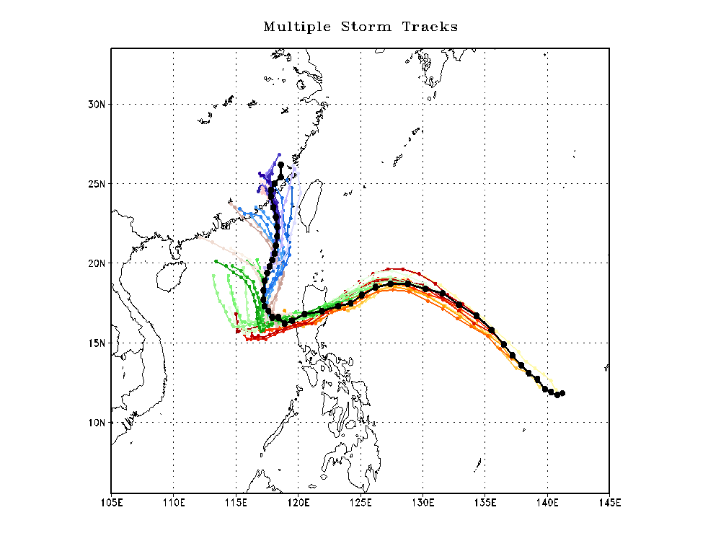
Megi路径预报

Slide 30
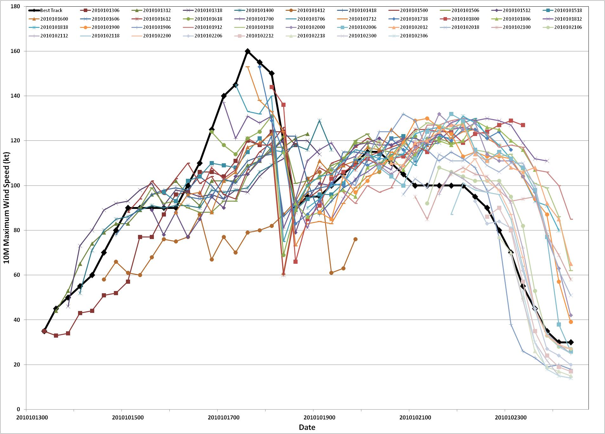
Megi强度预报
CAT-5
CAT-4
CAT-3
CAT-2
CAT-1
TS

Slide 31




Sidr, 2007 Moving Nest
Sidr, 2007 Intensity Forecast
Sidr, 2007 Initial vortex
Sidr, 2007 Track Forecast

Slide 32
Advancing the HWRF System FY2012 & Beyond
 | 2012 |  | 2013 | 2014* |  | 2015* | 2016*
Resolution/ Infrastructure | Triple nested HWRF (27/9/3 km) |  | Increased vertical resolution, higher model top | community R2O efforts (HFIP) |  | Upgrades to WRF infrastructure, Multiple moving domains, NEMS/ESMF/NMM-B, Other oceanic basins
Physics | PBL, Shallow Convection & Microphysics |  | Microphysics, Radiation, Surface Physics, Coupling to Waves and Land Surface, Physics for high-resolution
DA/ Vortex Initialization | Storm size correction, dynamic mass-wind consistency |  | Inner core DA (Doppler Radar, satellite) |  | Hybrid-EnKF DA, advanced vortex relocation procedure, improved GSI
Ocean | HYCOM Coupling |  | Improved ocean data assimilation, physics and resolution, unified coupled system for ATL & EPAC
Waves | One-way Wave Coupling |  |  | Two-way wave coupling, multi-grid surf zone physics, effects of sea spray
Diagnostics and Product Development |  | HWRF Ensembles, Coupling to Hydrological/ Surge/ Inundation models, diagnostics, product development
.
Ongoing Work
2012 upgrades
Planned developments
*Computer upgrade

