Slide 1

HWRF flux test
Ligia Bernardet & Shaowu Bao
Nov 06, 2012

Slide 2
Ocean in tropical cyclone models
Allows greater accuracy in
  SST field
  Latent/sensible heat fluxes
  Intensity
Crucial because SST can change rapidly in tropical cyclones
Can represent the following processes
  Turbulent mixing (one-dimensional)
  Upwelling (three-dimensional)
  Advection (three-dimensional)
  Note that in HWRF, POM is 3-D in Atlantic and 1-D in East Pac

Slide 3
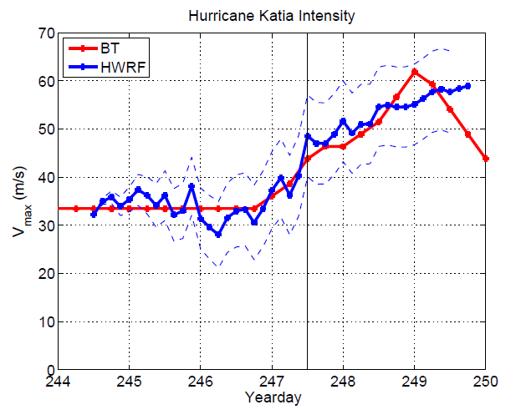
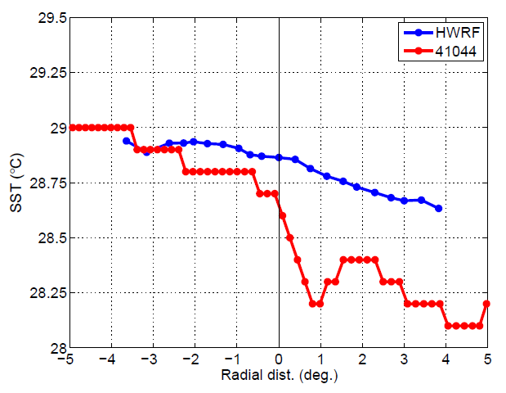
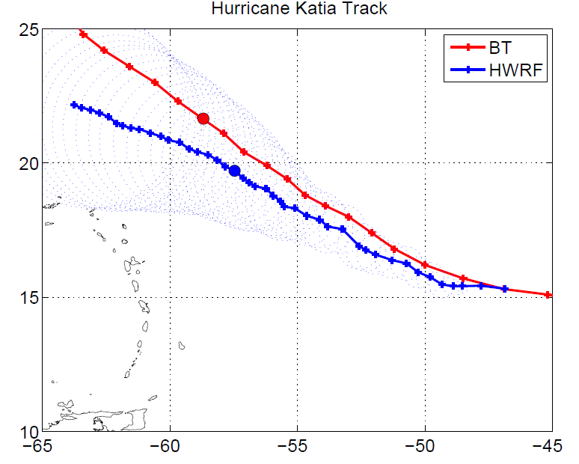
DTC Fluxes Test: Background
HRD (Ulhorn and Cione) compared HWRF retro forecasts for 2011 against buoys and showed that HWRF ocean does not respond (=does not cool as much as obs) when storm goes by.
Buoy passage 9/4 12Z
Katia 09/01/11 init12 Z

Slide 4
DTC Fluxes Test: Background
HRD (Ulhorn and Cione) compared HWRF retro forecasts for 2011 against buoys and showed that HWRF ocean does not respond (=does not cool as much as obs) when storm goes by.
URI recalled that momentum, sensible, latent fluxes from HWRF atmosphere to ocean are truncated in POM (75%) because in the past HWRF intensities were too low
Consulted EMC and they were interested in DTC testing
DTC ran 2012 season: control (75% fluxes) and modified (100%)
Further analysis by URI and HRD

Slide 5
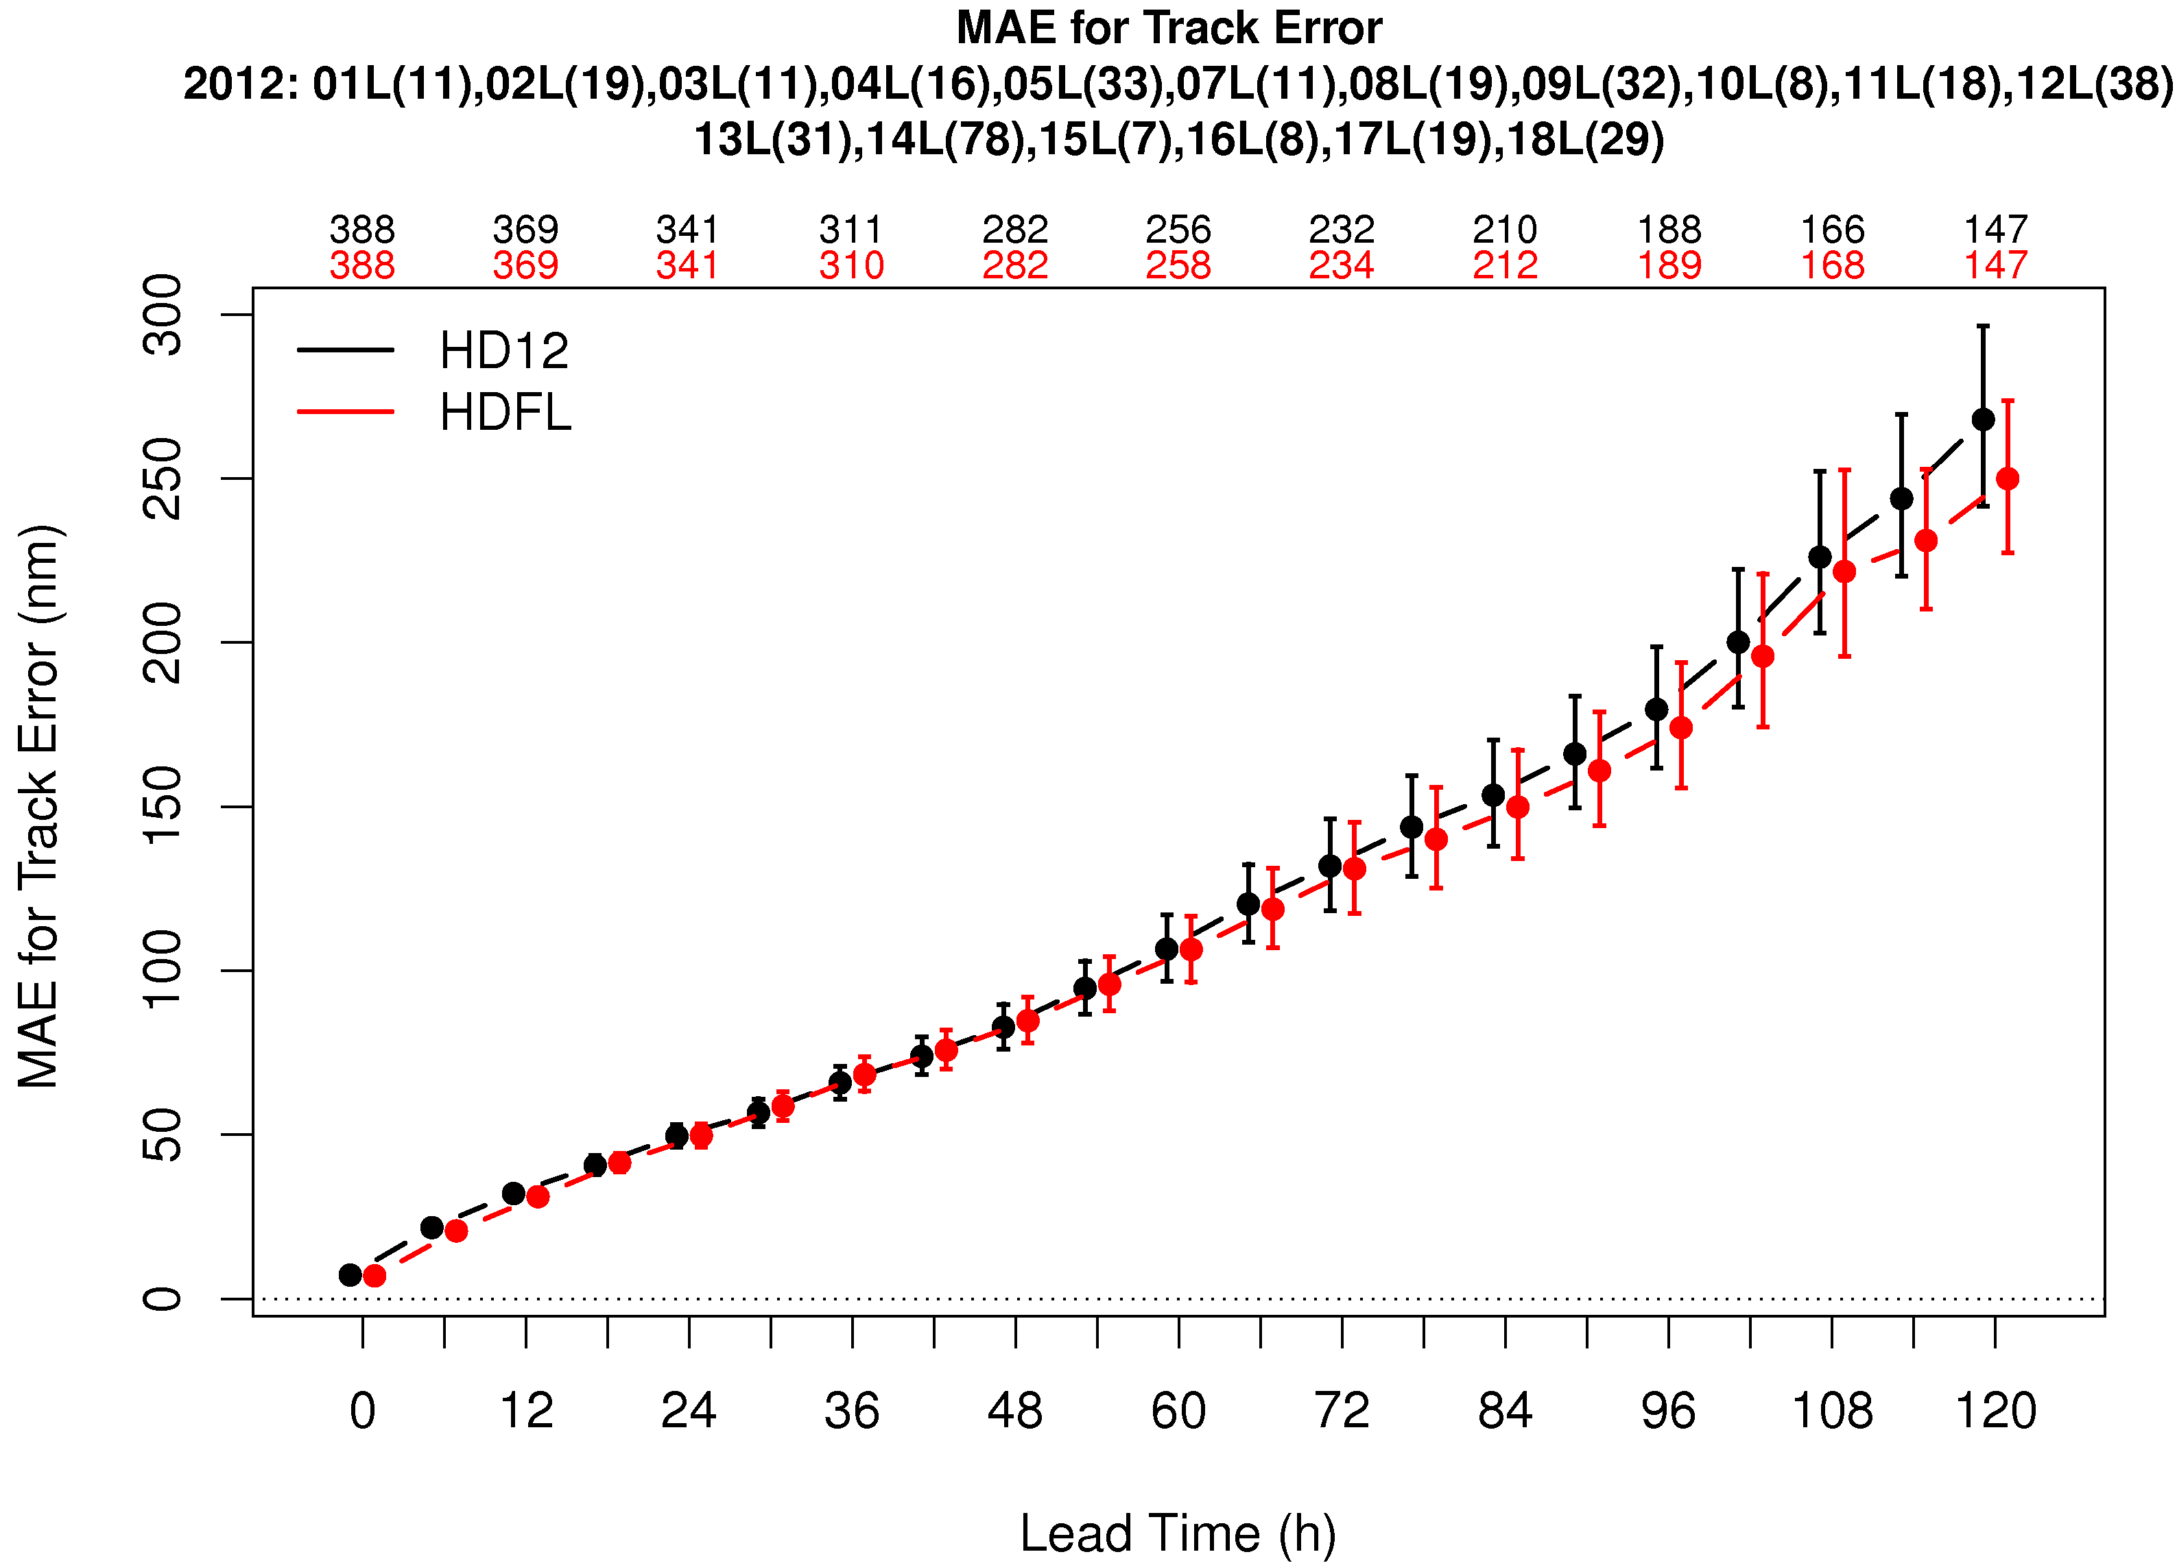
Atlantic track
Memorize these acronyms!!
HD12: Control
HDFL: Flux Experiment
No statistically significant (SS) differences
SS (95%) is determined doing pairwise differences

Slide 6
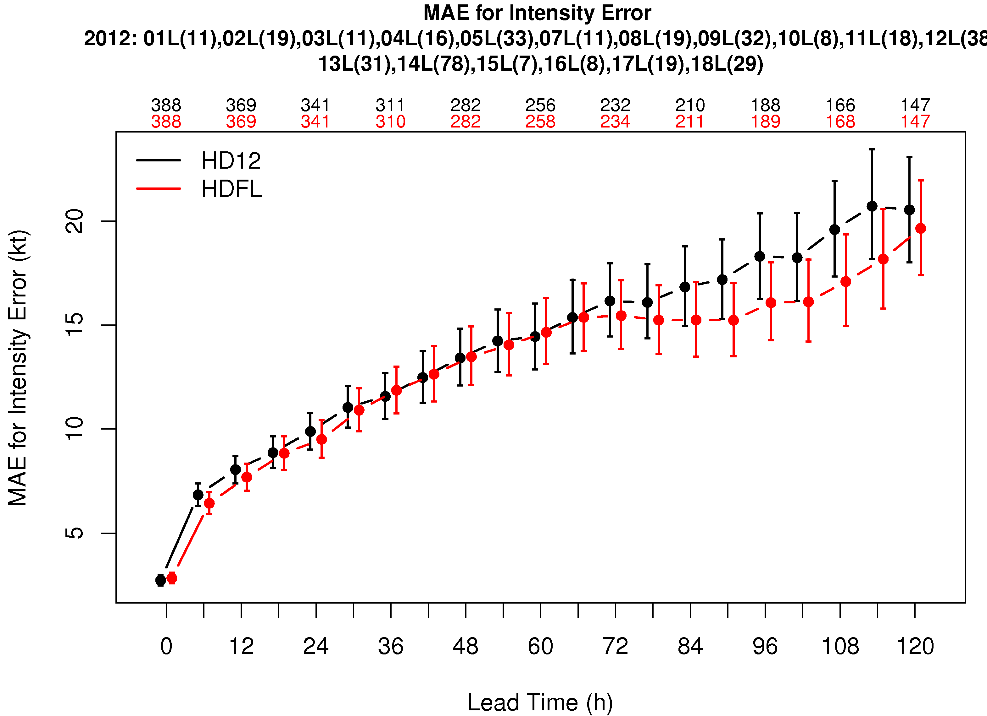
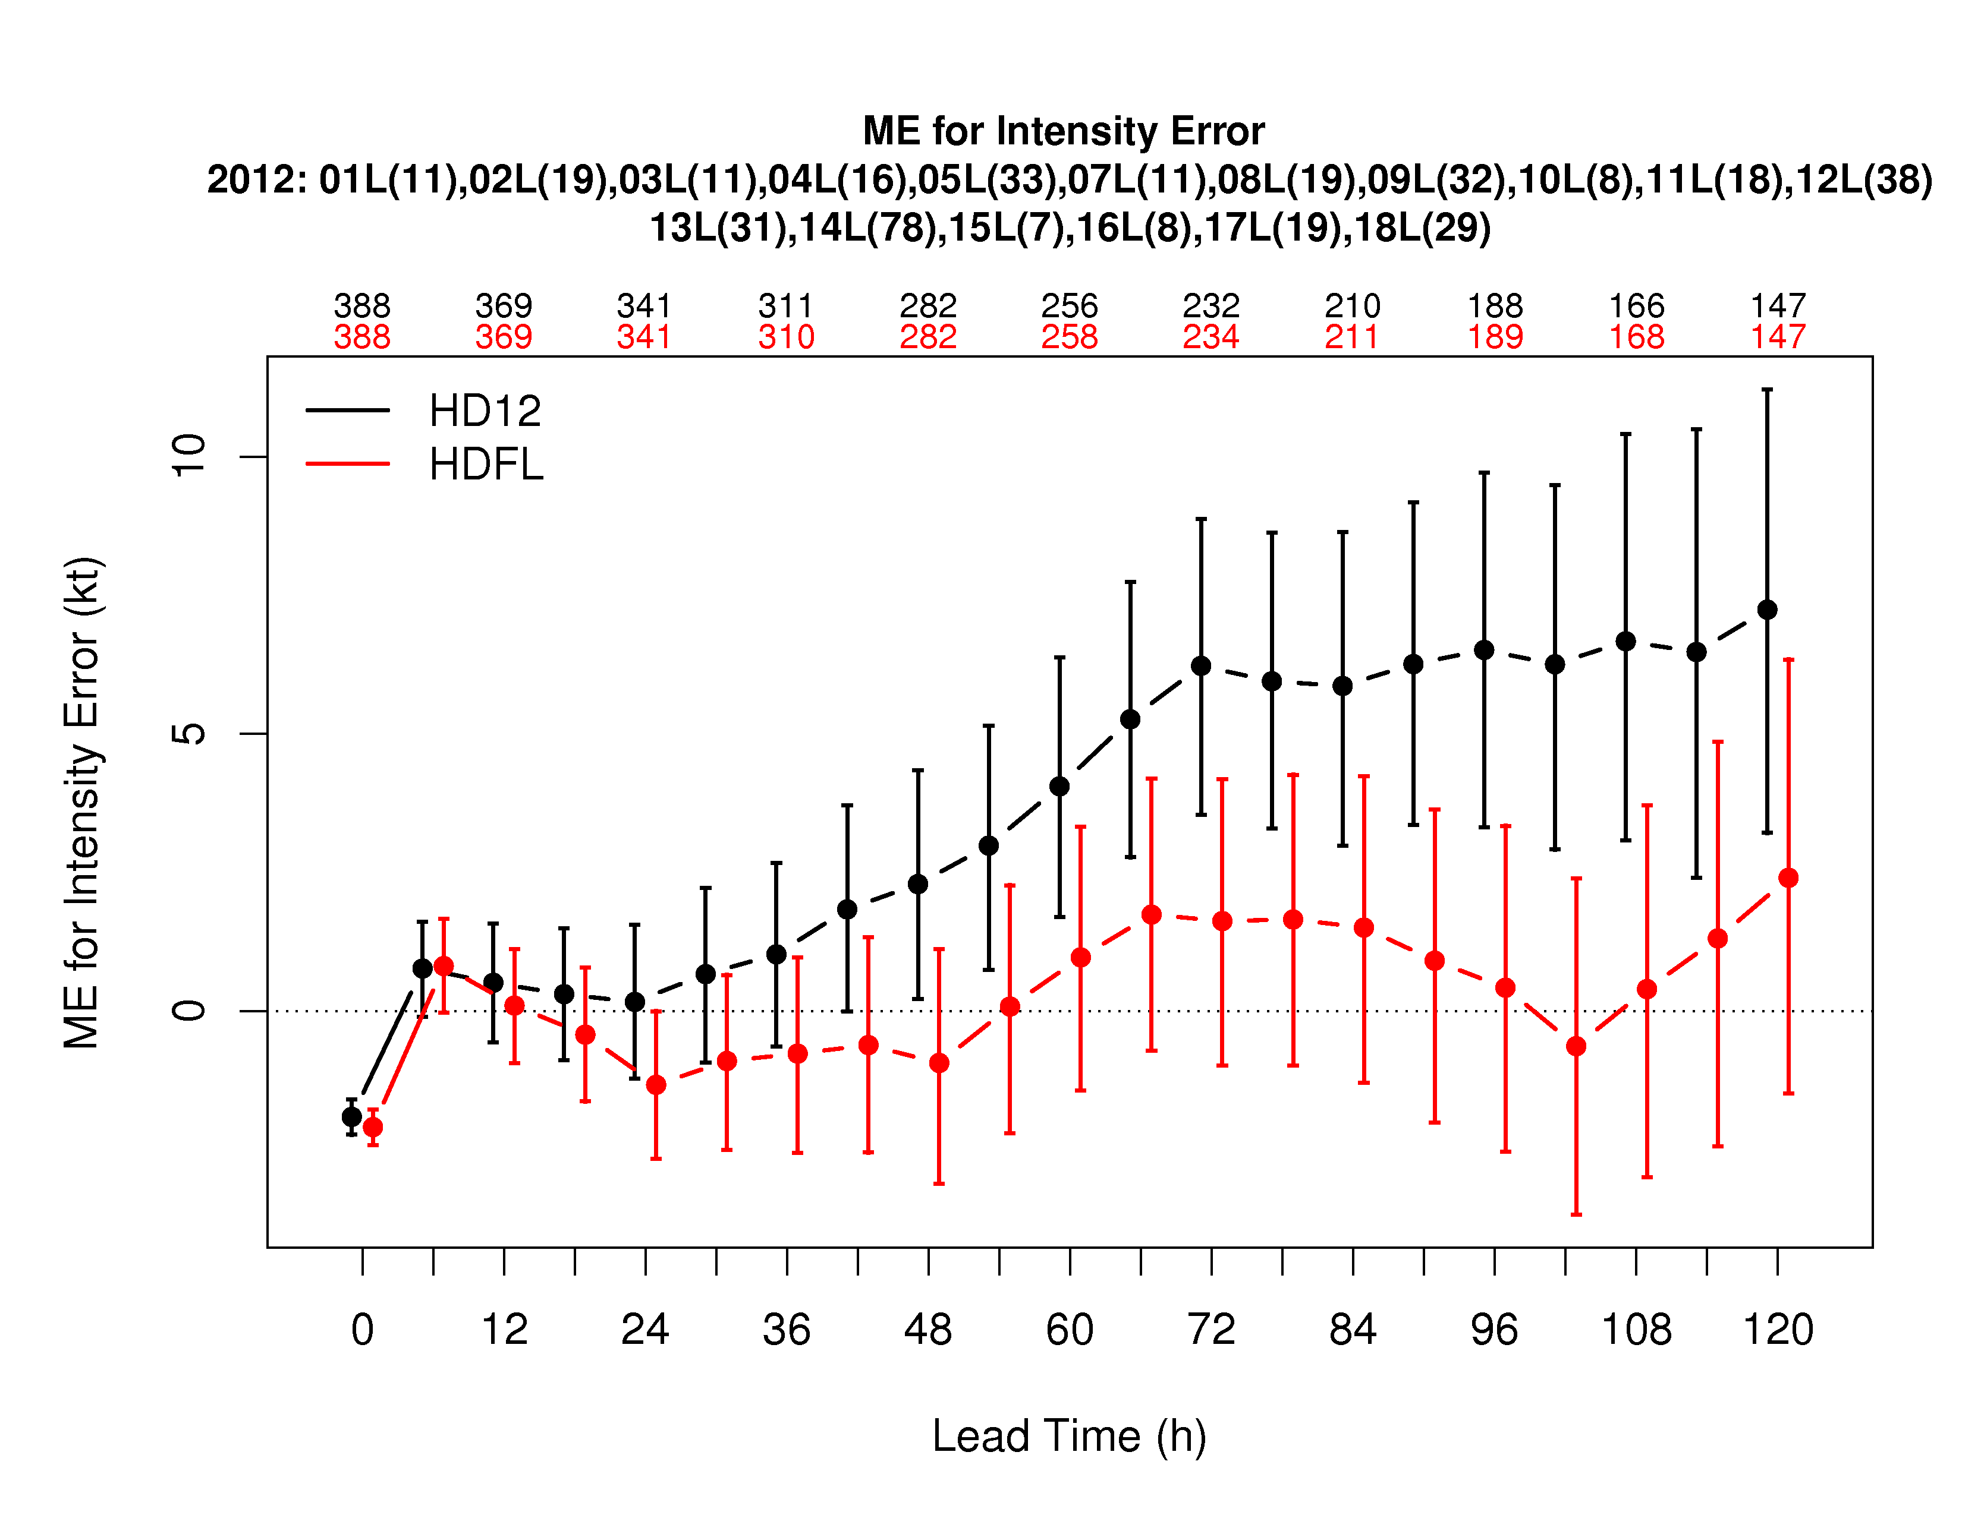
Atlantic Intensity
MAE: HDFL SS better at 3 lead times
ME (bias): HD12 lowers intensity and helps overintensification at long lead times

Slide 7
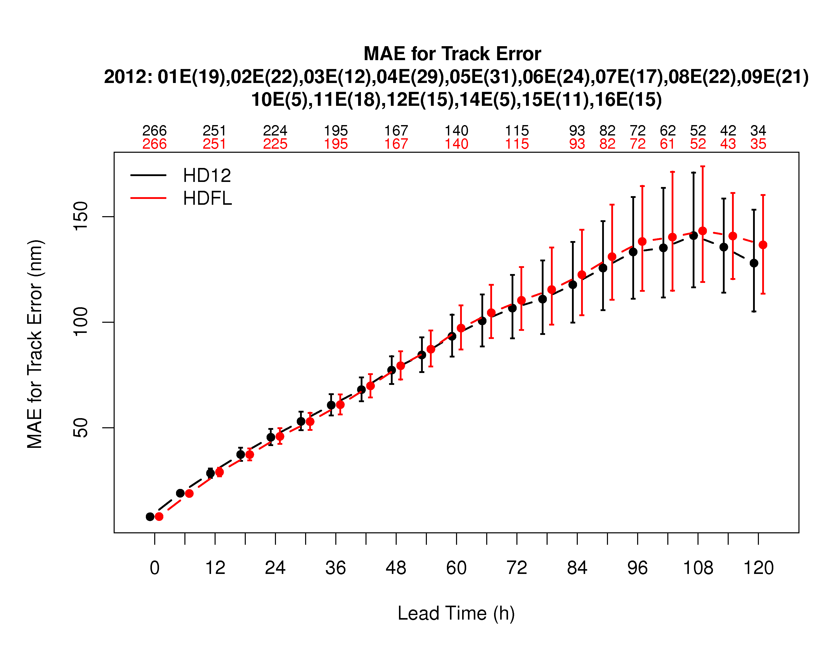
Pacific Track
HDFL is SS worse at 4 lead times but difference is small

Slide 8
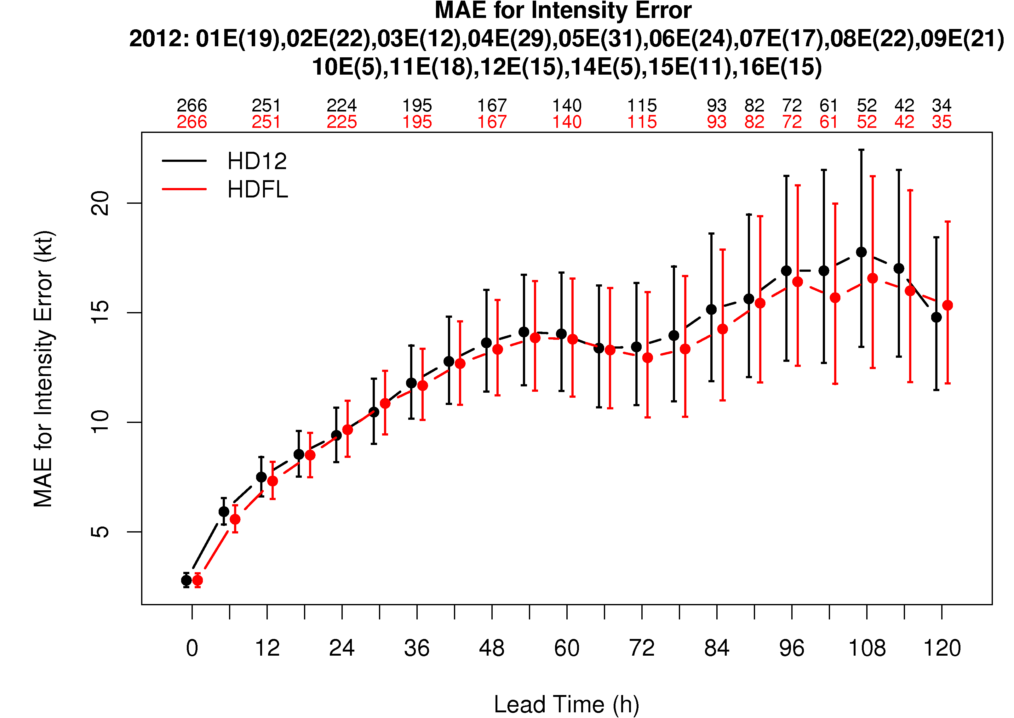
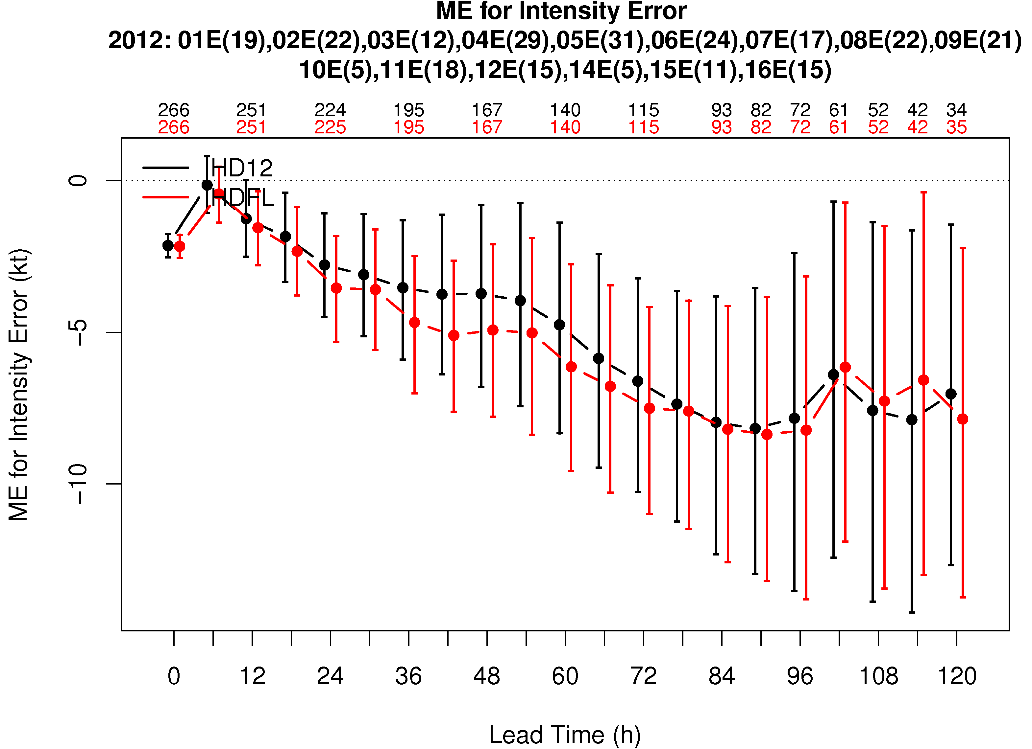
Pacific Intensity
HDFL worse at 1 lead time and better at 3
Smaller impact on EP, perhaps because
  POM is 1-dimensional
  Different vertical distribution of ocean temperature

Slide 9
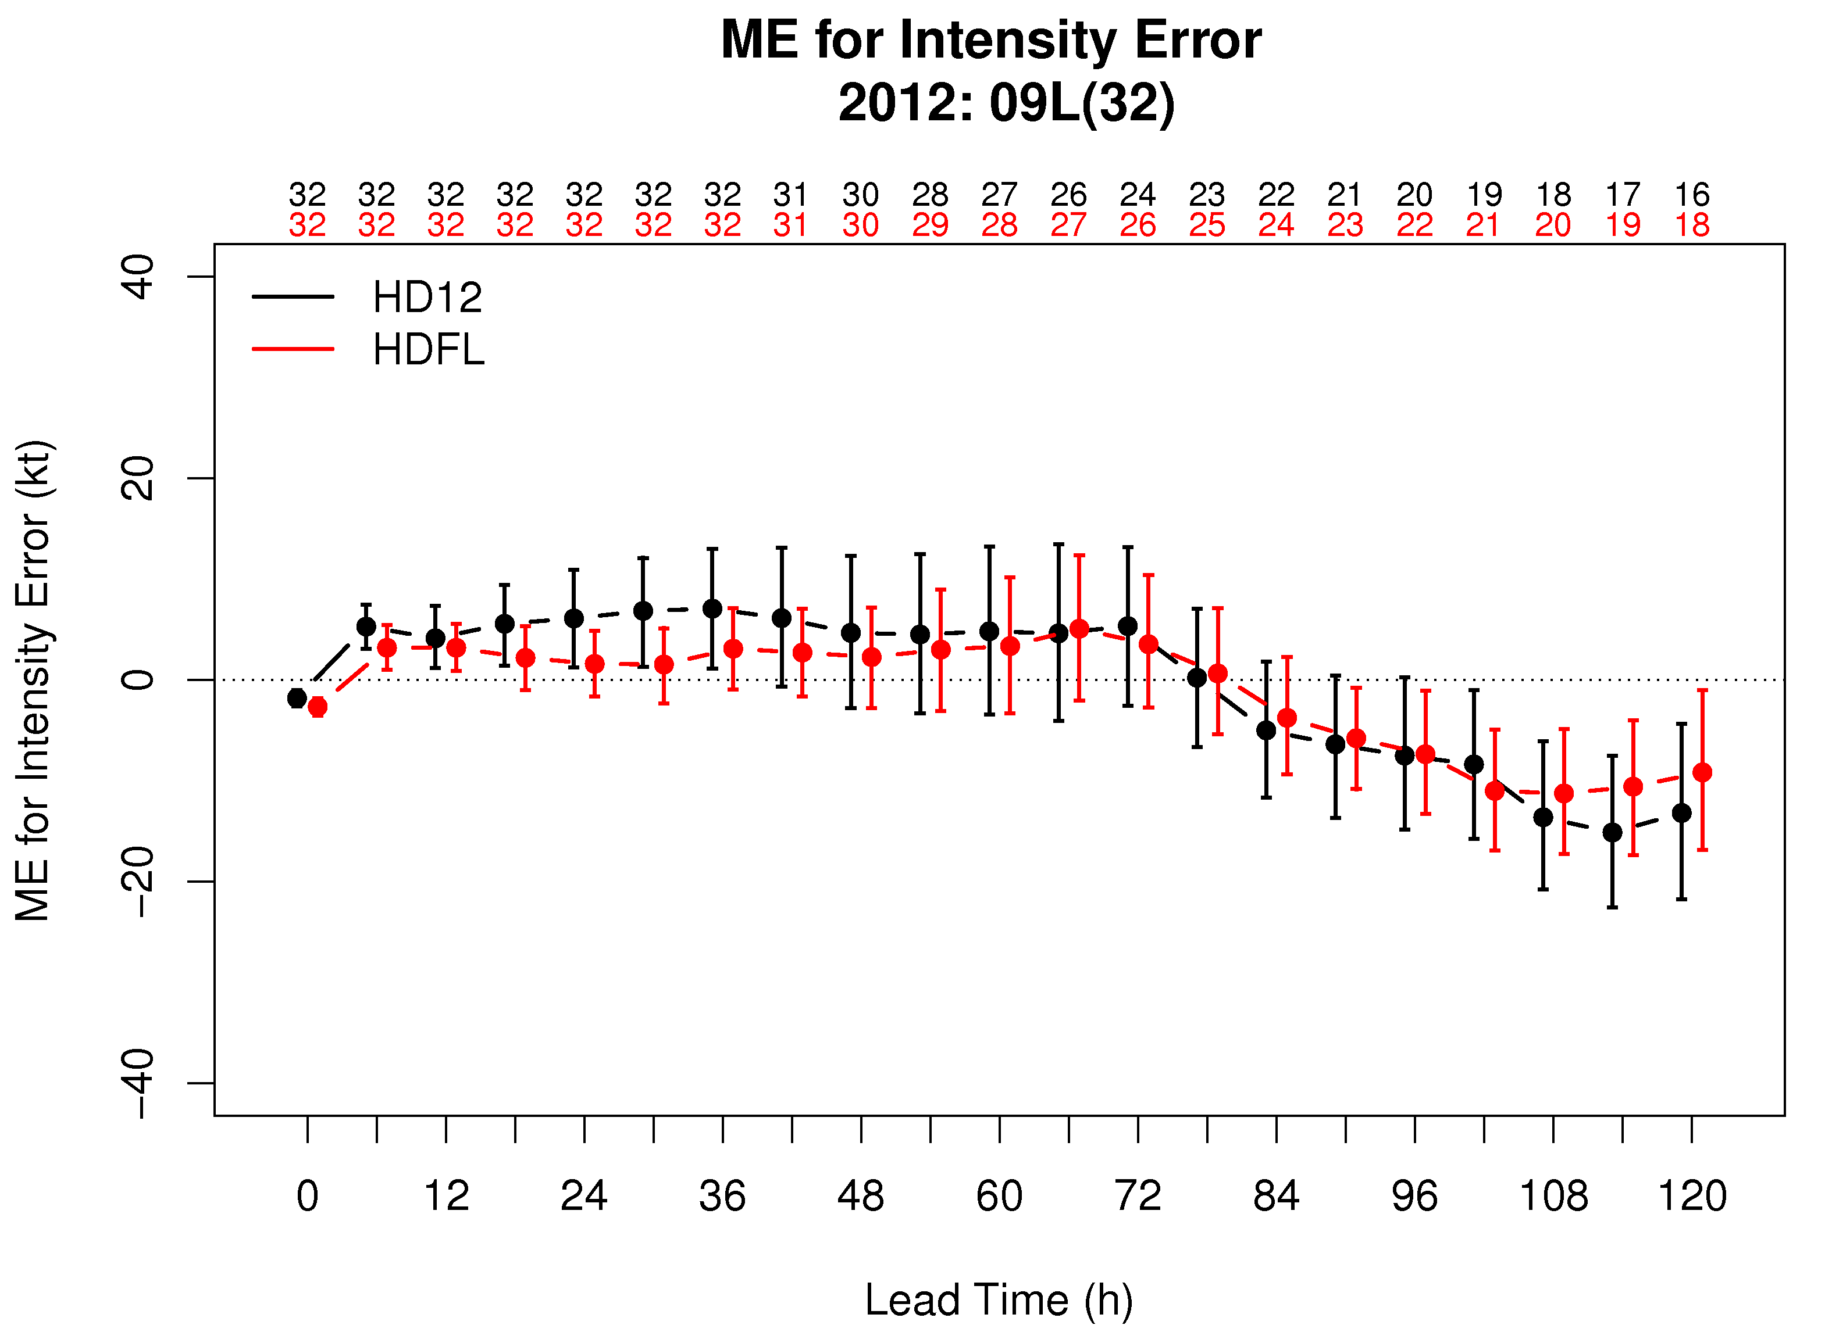
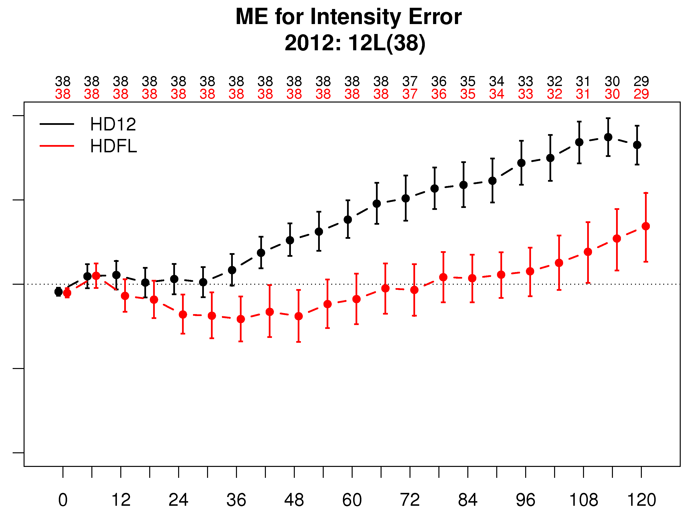
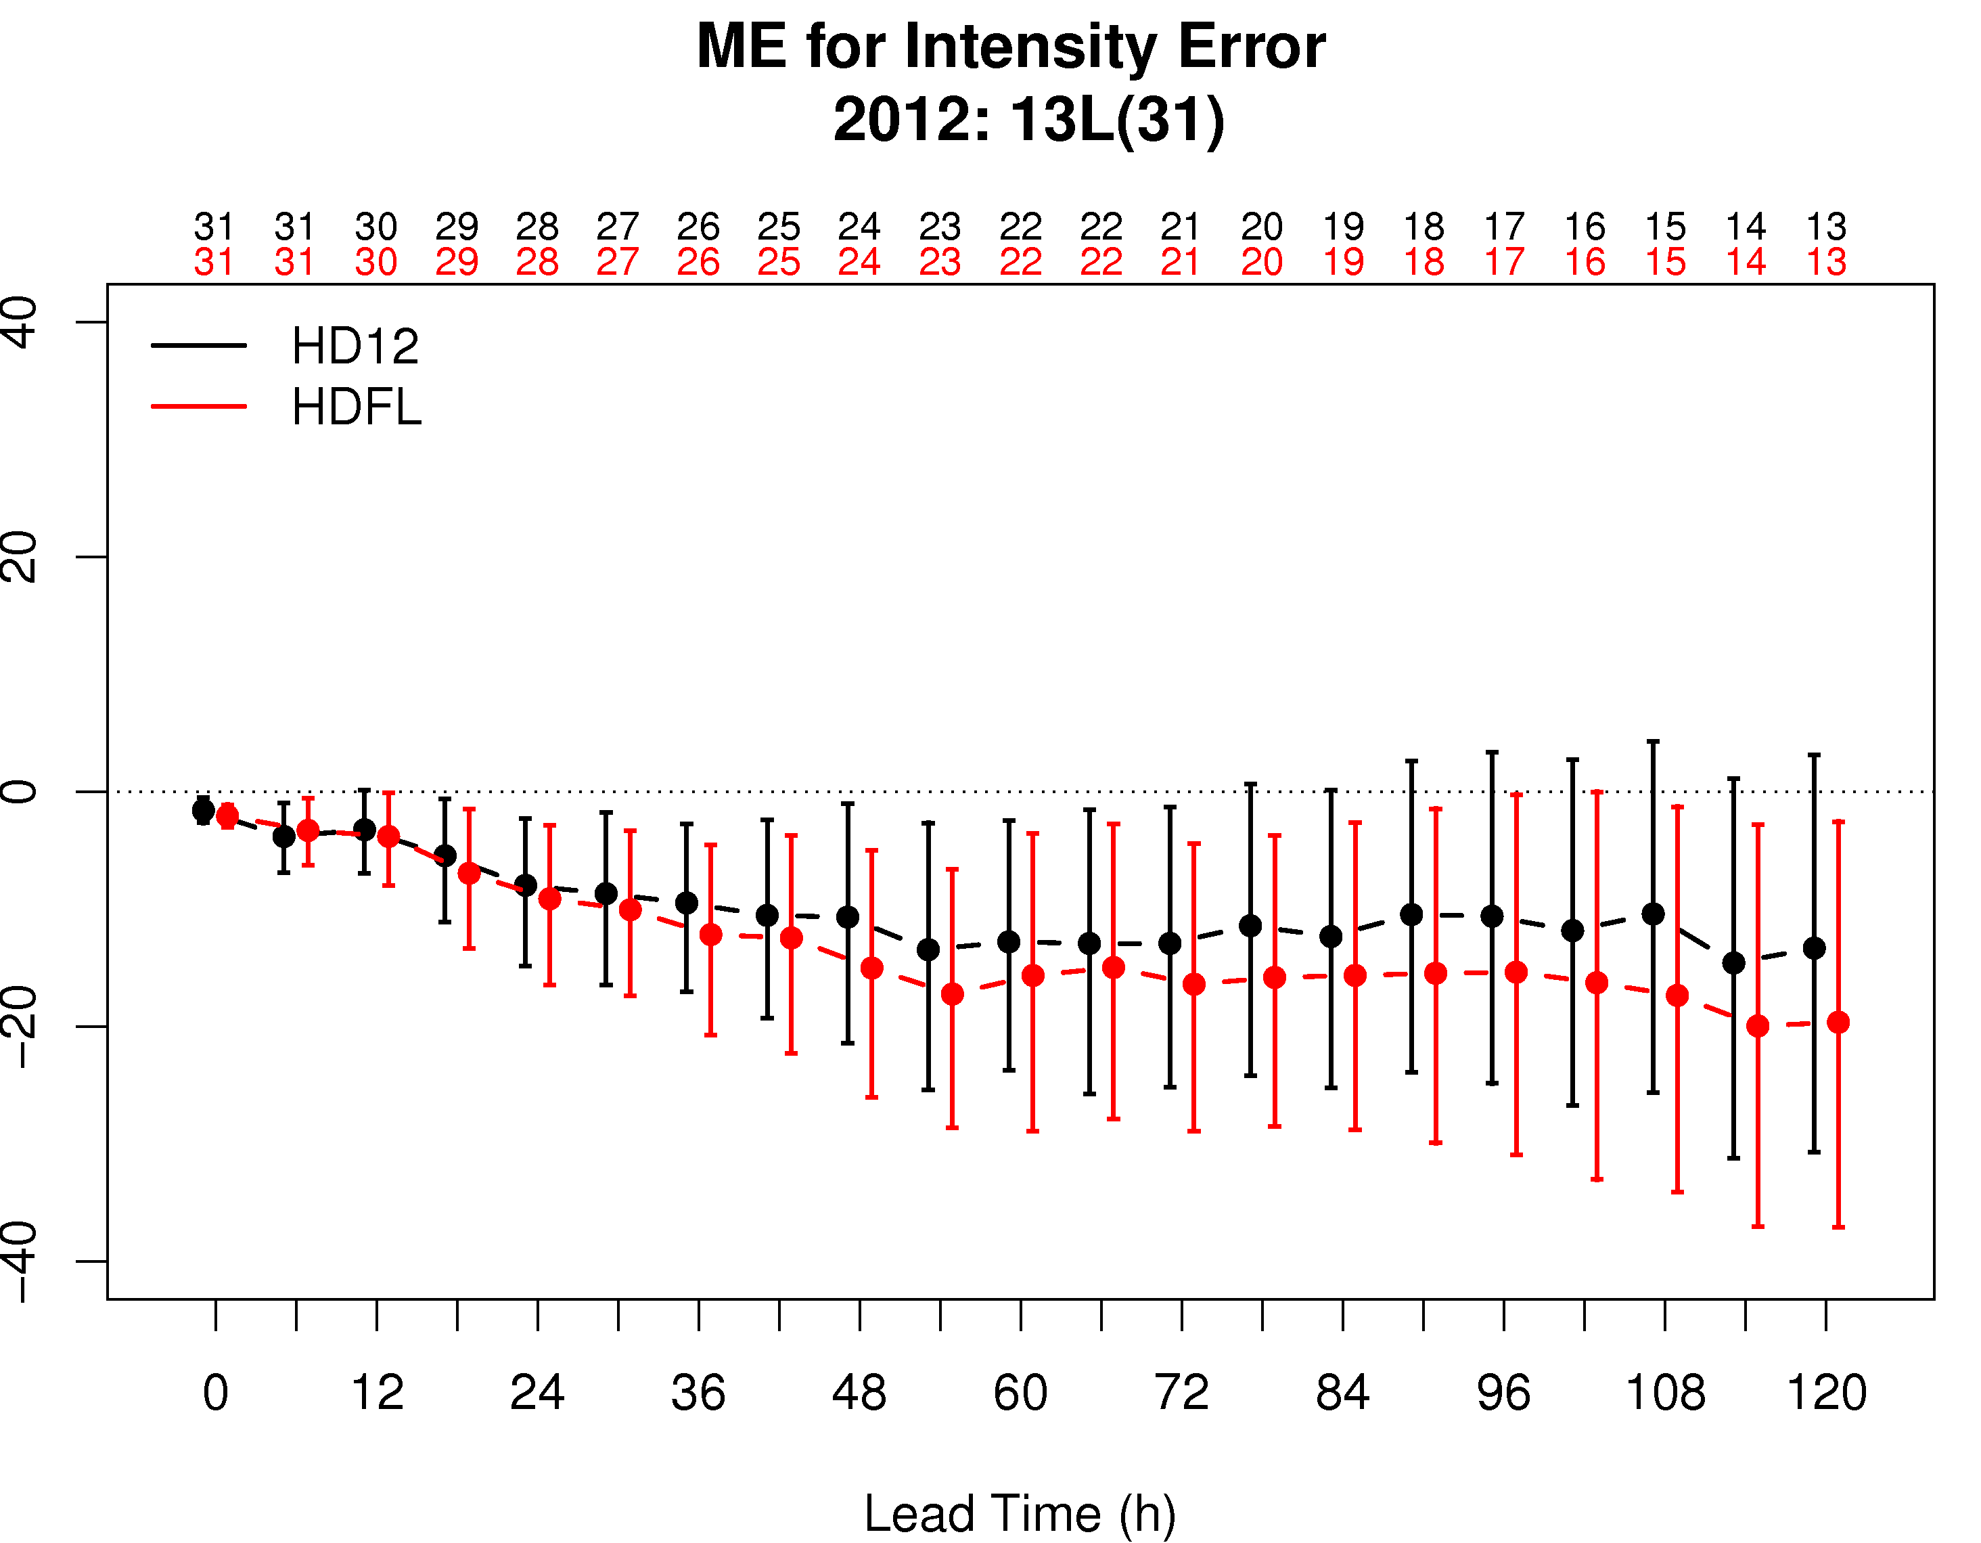
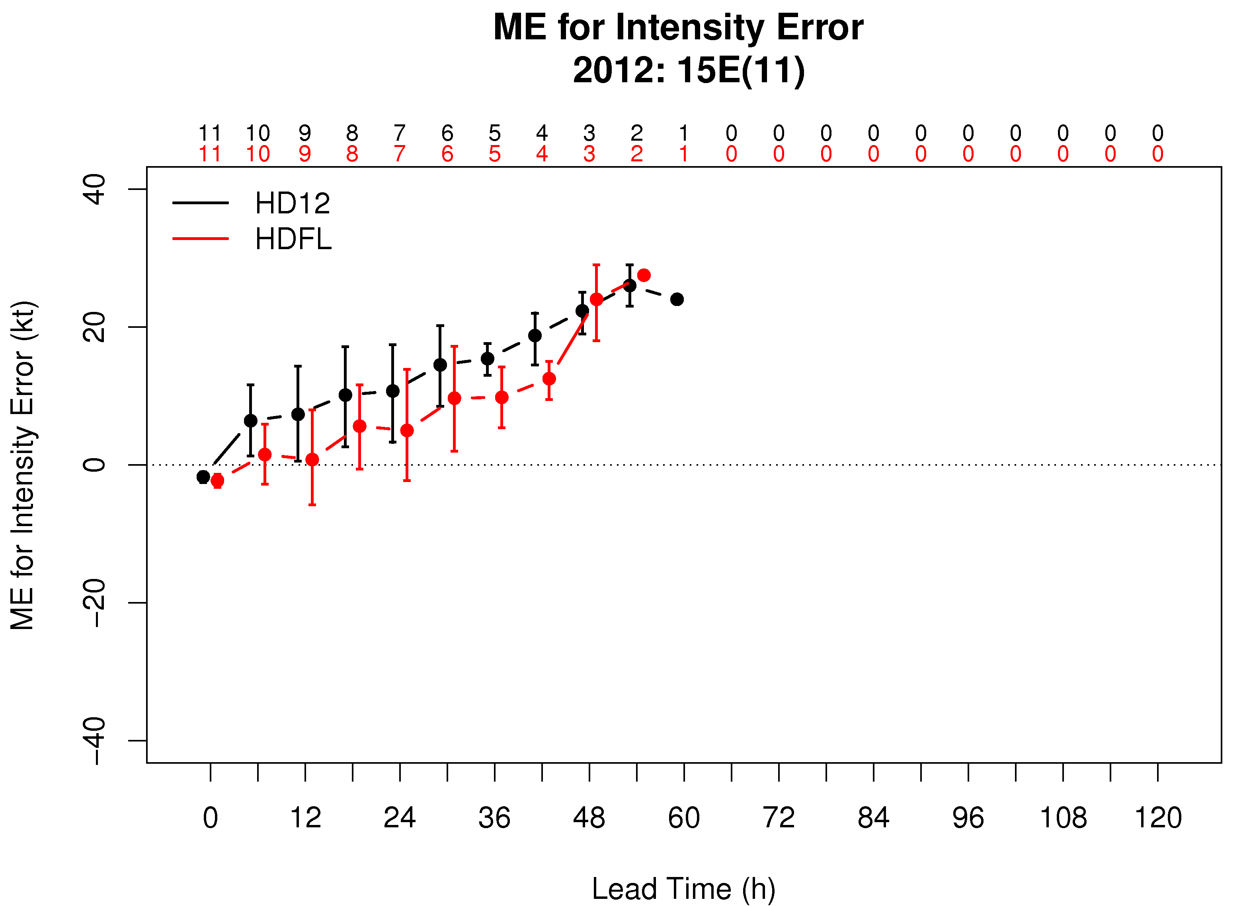
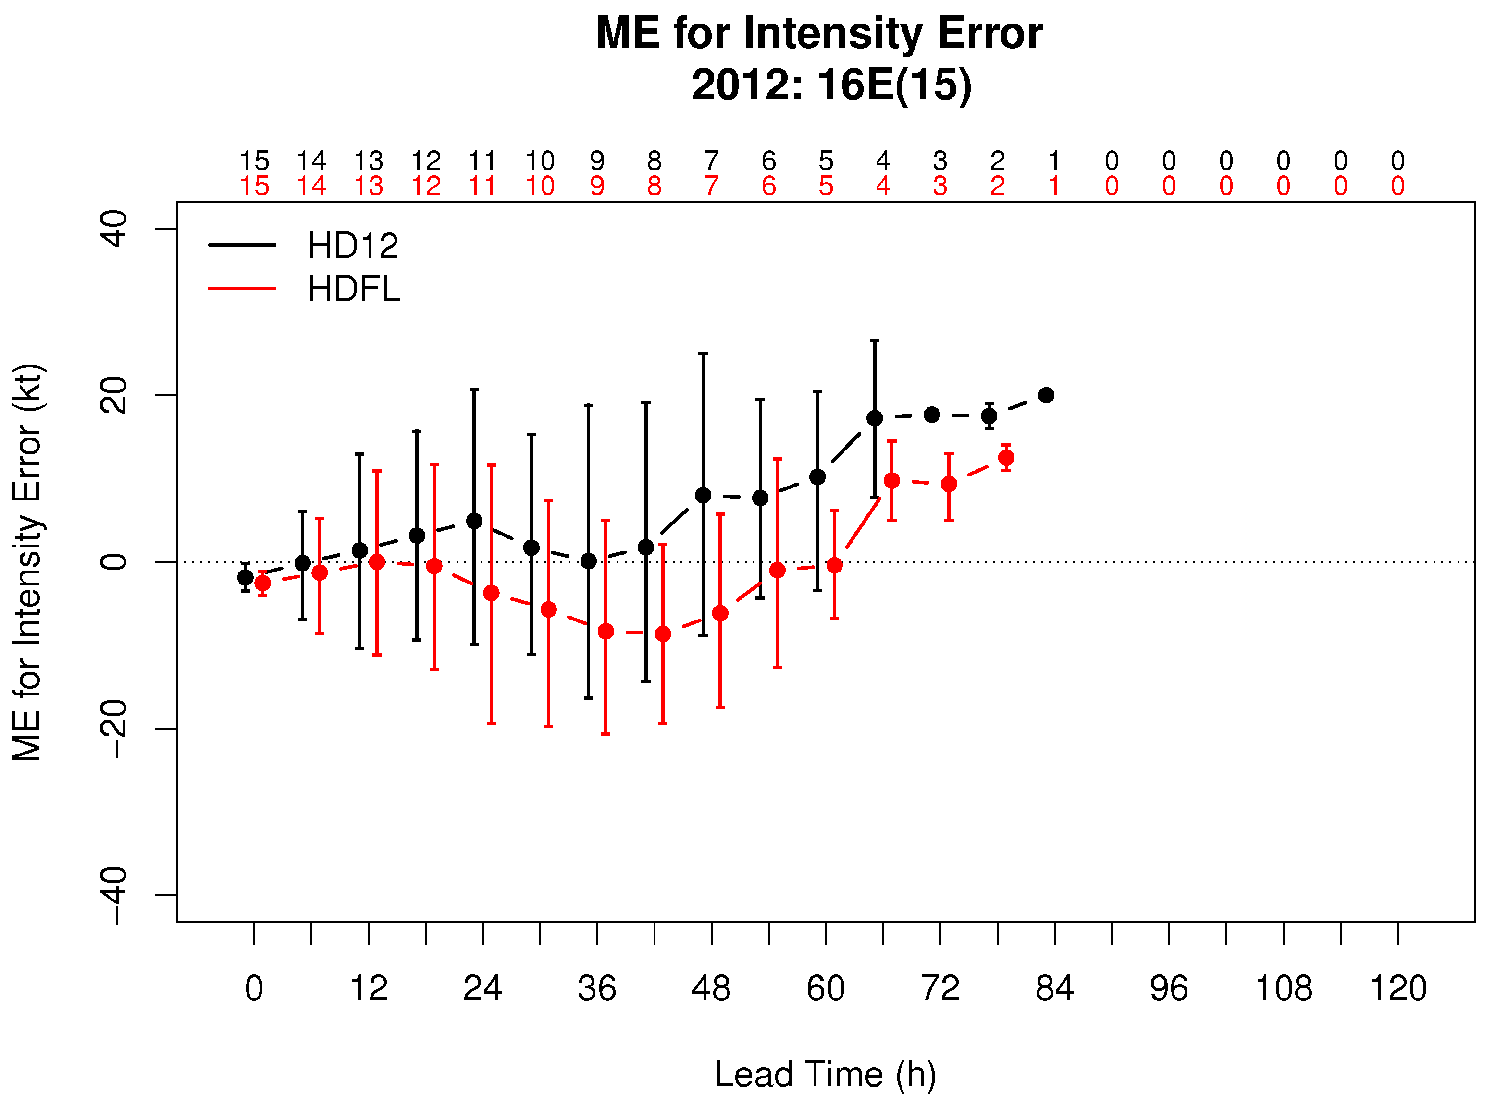
Storms with largest intensity differences
Isaac
Michael
Leslie
Olivia
Paul

Slide 10
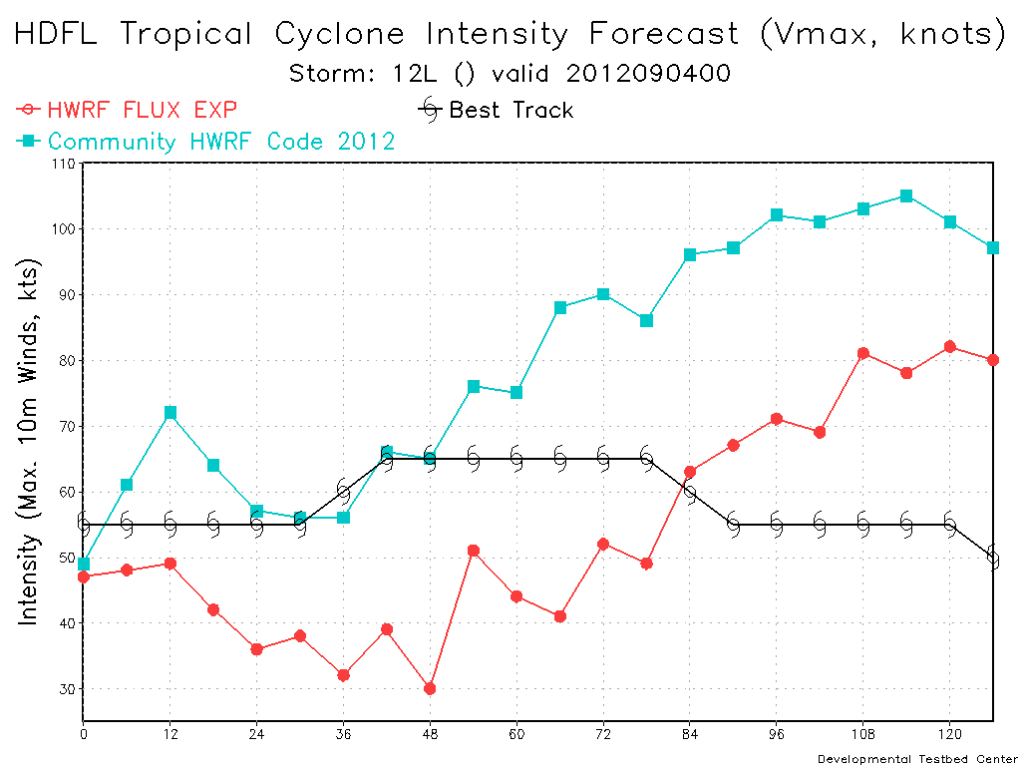
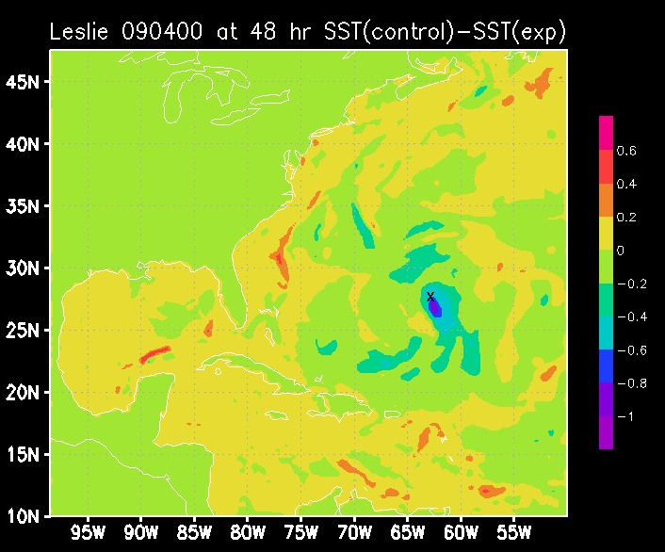
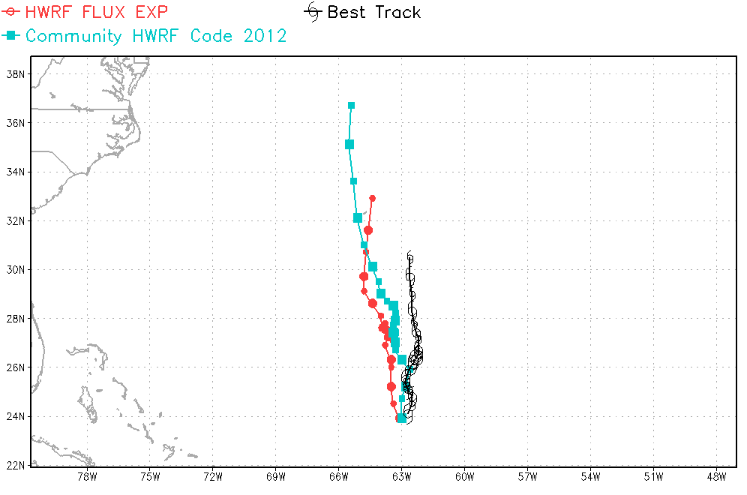
Leslie bias and 09/04 00Z case
HDFL reduces intensity (as expected). Is it because of low SST under storm?
At 48 h, control has cooler SST than flux exp (contrary to linear interpretation)
X
Non linearity:
more mixing
more cooling
less intensity
less mixing
X = storm center

Slide 11
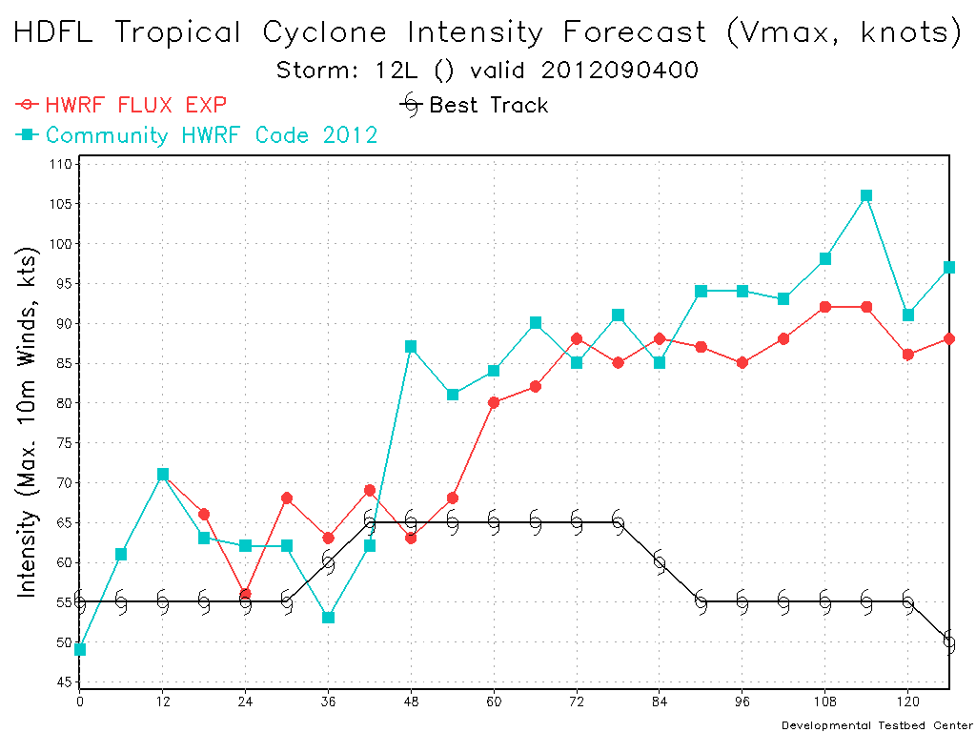
Leslie: rerun with same IC 09/04 00Z
Question: How much of the difference between HDFL and HD12 for a given case is due to fluxes change as opposed to sensitivity to IC?
Method: Ran with same IC
Answer: When same IC are used, differences between HD12 and HDFL are much smaller
Original run (cycled)
Rerun using same IC for control and flux experiment
Sensitivity to IC will lead to differences that are not just because of fluxes
In each run, different fluxes make a small difference, which gets compounded by cycling
Caution should be used when differences between a pair of runs is analyzed!!

Slide 12
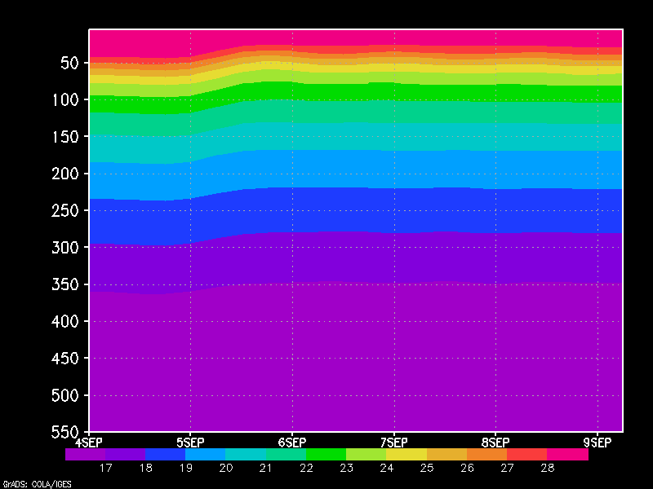
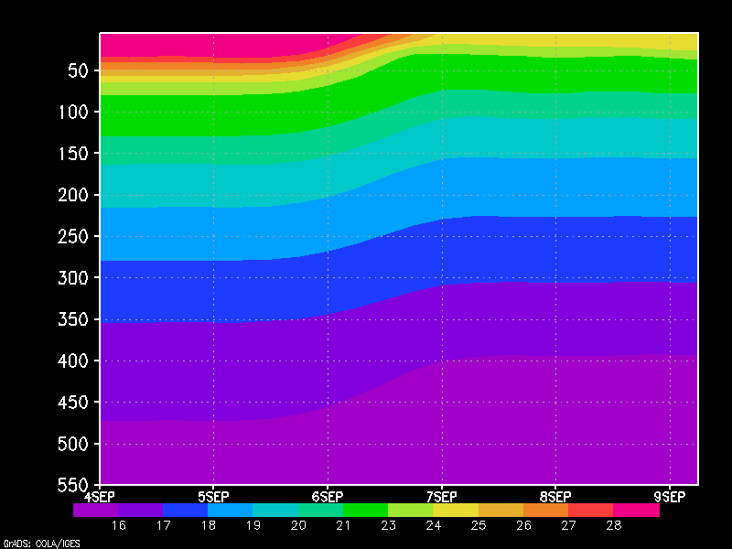
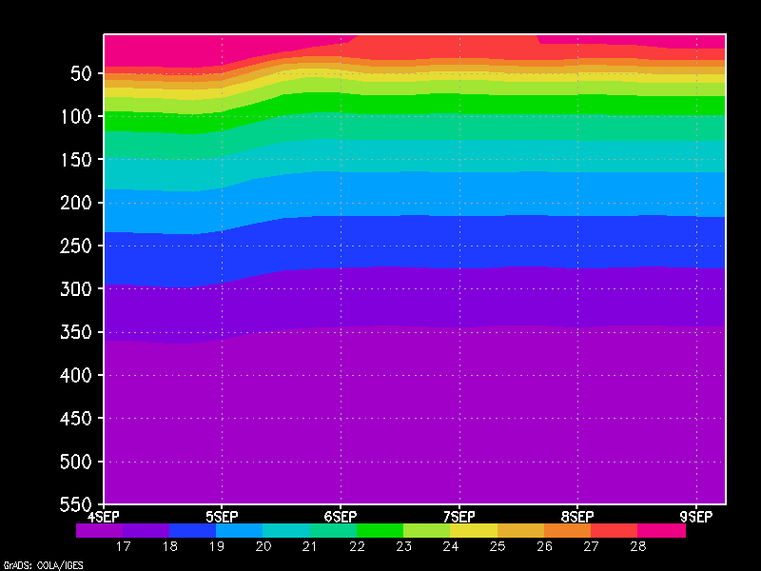

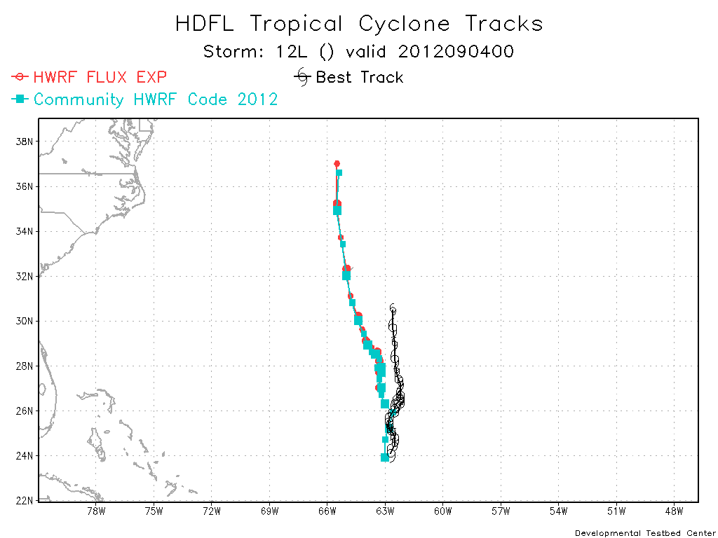
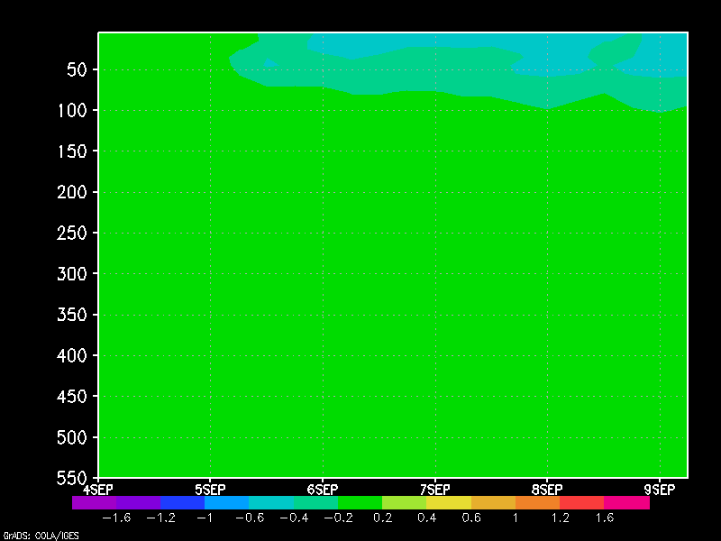
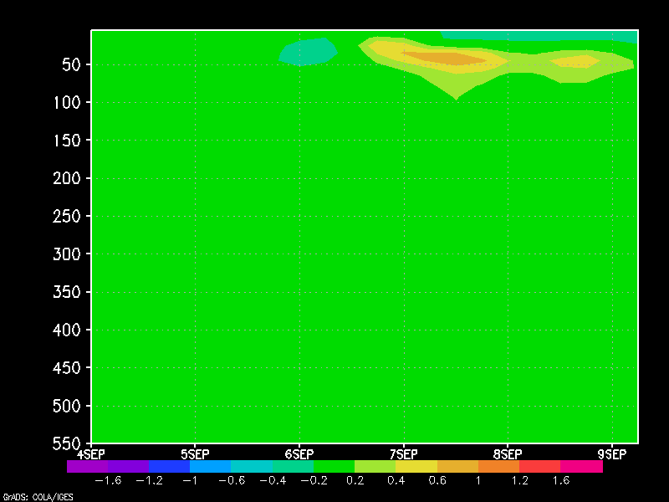
Nonlinearity in ocean response
Location X (24 h)
Location Y (48 h)
HD12
temp
Rerun using same IC for control and flux experiment
Depth 0 -500 m
HDFL
temp
At 48h, HDFL warmer. Even though HDFL more flux, weaker winds cause cooling
HDFL
-HD12
temp
48h location
Y
24-h location
X
HDFL cooler
HDFL warmer
0-120 h forecast

Slide 13
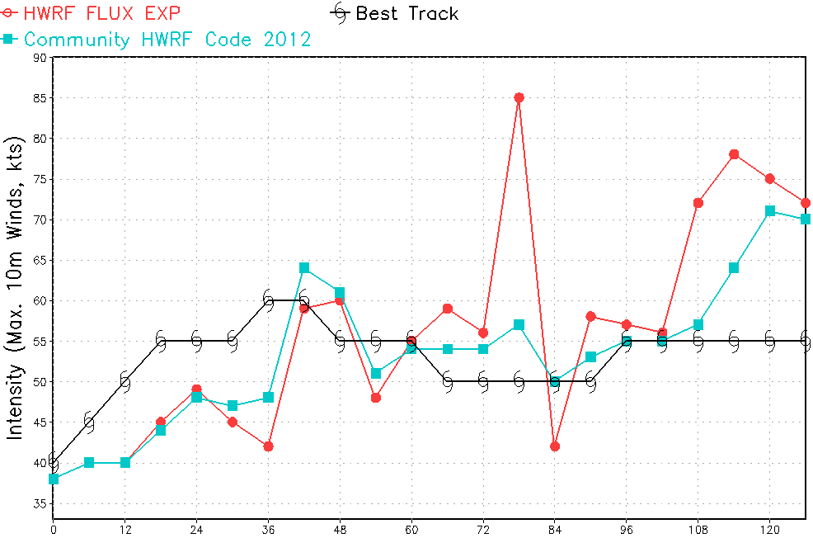
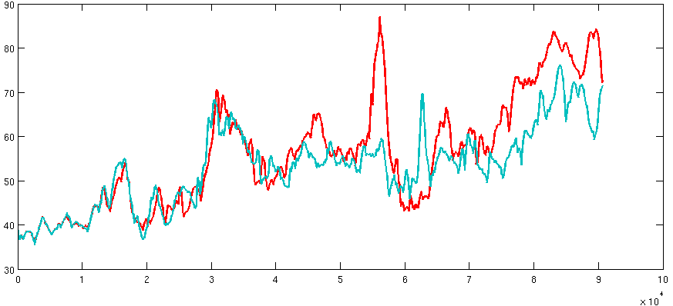
Leslie initialized 08/30 18 UTC
Second cycle of Leslie
ATCF
HDFL: RI starting at 72-h (30 kt in 6 h)
HD12 does not have RI
(verified in HTCF)
Source of difference is under investigation
HTCF

Slide 14
Final remarks
DTC has completed the runs of control and flux experiment for entire 2012 season
Overall the impact of the change in fluxes seem beneficial
Website for plots: http://www.dtcenter.org/HurrWRF/graphics/HDFL-HD12/
All runs have been archived and can be used for further
DTC is interested in staying involved in analysis of results

Slide 15
Backup slides
(From Hurricane Tutorial – Rich Yablonsky from URI)

Slide 16
1) Vertical mixing/entrainment
A
T
M
O
S
P
H
E
R
E
Wind stress → surface layer currents
Current shear → turbulence
Turbulent mixing → entrainment of cooler water
POM-TC uses the Mellor-Yamada 2.5 turbulence
closure submodel to parameterize vertical mixing
O
C
E
A
N
Warm sea surface temperature
Sea surface temperature decreases
Cool subsurface temperature
Subsurface temperature increases
This is a 1-D (vertical) process
Courtesy: R. Yablonsky (URI)

Slide 17
2) Upwelling
A
T
M
O
S
P
H
E
R
E
Cyclonic wind stress → divergent surface currents
Divergent currents → upwelling
Cyclonic
hurricane
vortex
Upwelling → cooler water brought to surface
O
C
E
A
N
Warm sea surface temperature
Cool subsurface temperature
This is a 3-D process
Courtesy: R. Yablonsky (URI)

Slide 18
3) Horizontal advection
A
T
M
O
S
P
H
E
R
E
Preexisting cold pool is located outside storm core
Preexisting current direction is towards storm core
Cyclonic
hurricane
vortex
Ocean currents advect cold pool under storm core
O
C
E
A
N
Warm sea surface temperature
Cool subsurface temperature
This is a horizontal process
Courtesy: R. Yablonsky (URI)

Slide 19
HWRF/POM-TC Coupling
Hurricane Model
Wind speed (U_{a})
Temperature (T_{a})
Humidity (q_{a})
Momentum flux (τ)
Temperature flux
Shortwave radiation
Momentum flux (τ)
Sensible heat flux (Q_{H})
Latent heat flux (Q_{E})
SST (T_{s})
Air-Sea Interface
Ocean Model
Courtesy: R. Yablonsky (URI)

