Slide 1
Basin-scale Multiple Movable Nest HWRF Modeling System --A pathway toward operational implementation
Xuejin Zhang & Thiago Quirino
UM/CIMAS & AOML/HRD
Collaborators:
AOML/HRD modeling group
NCEP/EMC HWRF Team
Acknowledgement:
This research funded by NOAA/HFIP (NOAA Award: NA12NWS4680007)

Slide 2
The Modeling System
Initialization
Static terrestrial initialization
Initialization & Cycling
Vortex initialization (Relocation & modification)
Data assimilation
Forecast System
Trigger mechanism
Resource allocation
Submission & monitor system (jobs & resources management)
Products
&
Dissemination
Post-processing
Diagnostic & forecast products
Web products
Product real-time dissemination
Tape archive
Grib file generation
UPP implementation

Slide 3
Initialization framework (Current)
WPS
Generate static terrestrial data for 27-km resolution domain
Prep-hybrid
Generate ICs & BCs for 27-km resolution domain from GFS
Filtering
Filter vortex in ICs from GFS
Bogus or Cycling
Create bogus vortex or modify vortex cycled from previous cycle based on tcvital
Trigger Mechanism
GFS environment
HWRF vortex
Relocation & Merging
Generate static terrestrial data for 27-km resolution domain
WPS
Generate static terrestrial data for all resolution domains
GSI DA
Forecast System

Slide 4
Initialization framework (Future)
WPS
Generate static terrestrial data for 27-km resolution domain
Prep-hybrid
Generate ICs & BCs for 27-km resolution domain from GFS Ensemble
Vortex Separation
Trigger Mechanism
GFS Ensemble environment
GFS Ensemble vortex
Relocation & Merging
Generate static terrestrial data for 27-km resolution domain
WPS
Generate static terrestrial data for all resolution domains
Hybrid DA
Forecast System

Slide 5
Initialization framework (Future final)
WPS
Generate static terrestrial data for 27-km resolution domain
Prep-hybrid
Generate ICs & BCs for 27-km resolution domain from GFS Ensemble
GFS/HWRF Ensemble ICs
WPS
Generate static terrestrial data for all resolution domains
Trigger Mechanism
Hybrid DA
Vortex DA
Forecast System

Slide 6
Trigger mechanism
Decide forecast configuration from tcvital
Number of storms
Priority storm if number of storms more than four
Forecast length (Need genesis forecast product)
Set up domain location
Prepare vortex initialization domains (until hybrid DA available)
Allocate resources (disk space, CPUs, running time, and post-processing resource)

Slide 7
Basin-scale Model Configurations
 | 2012 HWRF Operational | Basin-scale Model (Stream 2)
Domain | 27 KM: 77.76˚ X 77.76˚ 9 KM: 10.56˚ X 10.2˚ 3 KM: 6.12˚ X 5.42˚ | 27 KM: 178.20˚ X 77.58˚ 9 KM: 10.56˚ X 10.2˚ 3 KM: 6.12˚ X 5.42˚
Vortex Initialization | Modified Vortex Initialization at 3 KM, with 30x30º analysis domain and GSI | 27KM: GFS 9-3 KM: No, Downscaled
Cycling | Yes (3 km vortex only) | No
Ocean Coupling | 27-9 KM: Yes 3 KM: No, Downscaled | 27-9-3 KM: No
Physics schemes
Microphysics | Modified Ferrier (High-Res) | Modified Ferrier (High-Res)
Radiation | GFDL | GFDL
Surface | GFDL (High_res) | GFDL (High_res)
PBL Scheme | 2012 GFS (High_res) | 2012 GFS (High_res)
Convection | SAS (High-Res), No CP (3 KM), Shallow Convection | SAS (High-Res), No CP (3 KM), Shallow Convection
Land Surface | GFDL Slab | GFDL Slab
GWD | Yes(27km); No(9-3km) | No(27km); No(9-3km)
Notes:
7

Slide 8
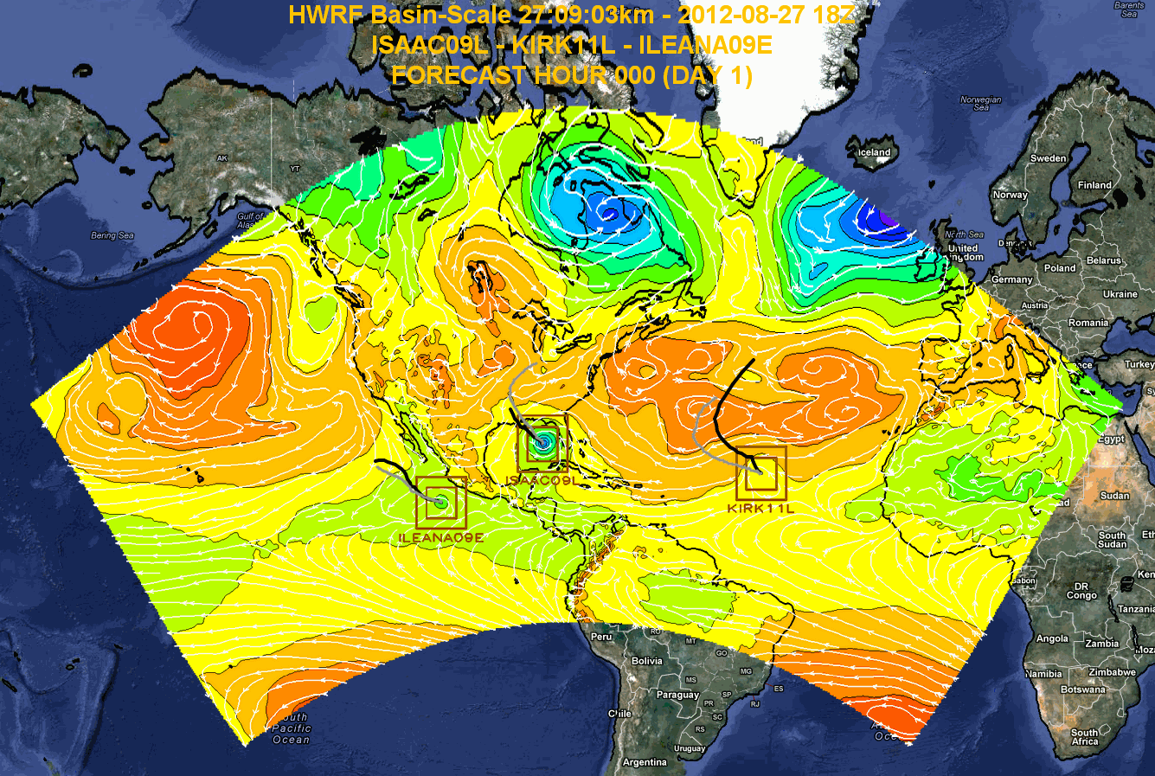
Isaac-Ileana-Kirk real-time forecast

Slide 9
Retrospective & Real-time Forecasts
Cycles start from 00Z 22 August 2012 by 11/14
Real-time test: Sandy (24 cycles)
Web products:
3 categories (27km environment; 3km moving nest; multi-model)
20 products
https://storm.aoml.noaa.gov/basin

Slide 10
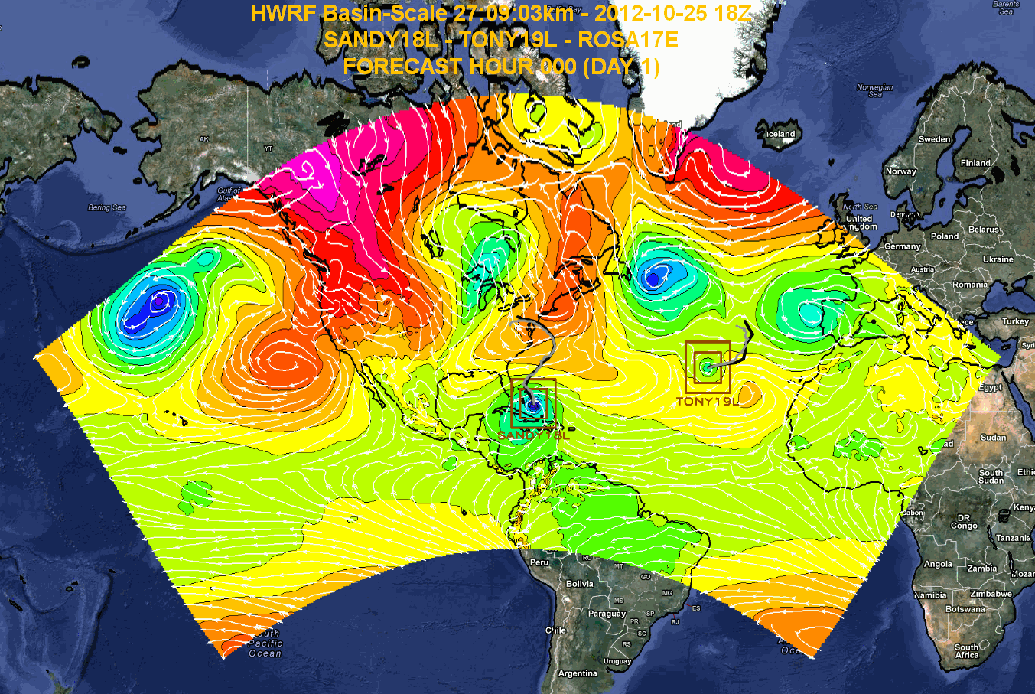
Model functionality and Sandy real-time forecast

Slide 11
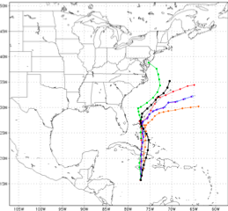
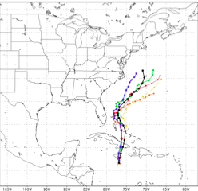
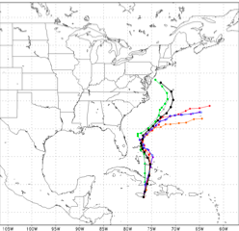
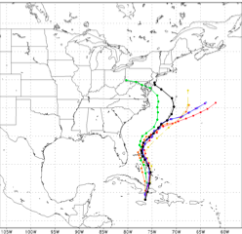
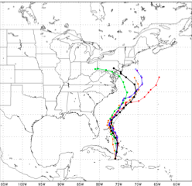
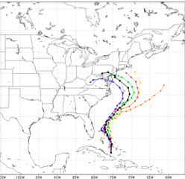
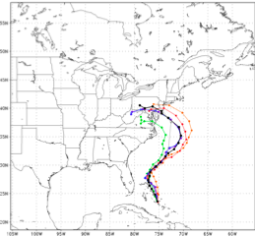
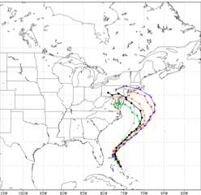
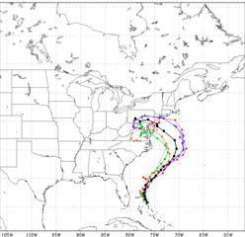
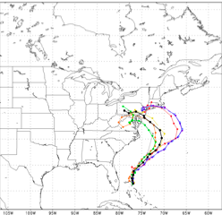
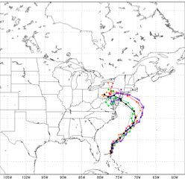
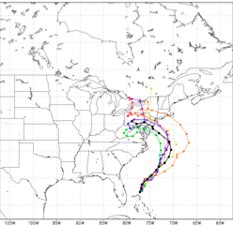
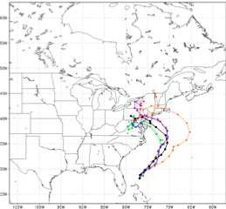
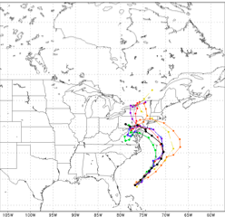
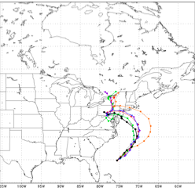
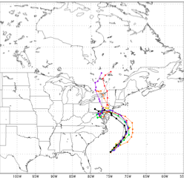
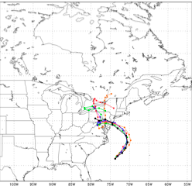
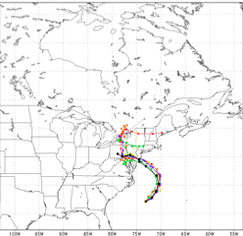
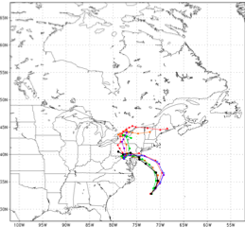
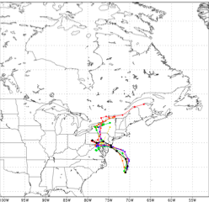
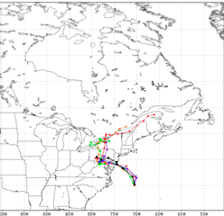
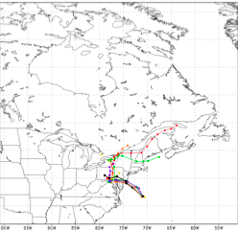
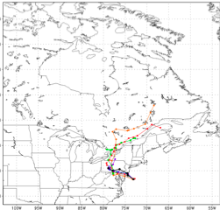
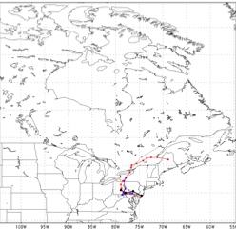







Hurricane Sandy Track Forecasts
2012102406
2012102412
2012102418
2012102500
2012102506
2012102512
2012102518
2012102600
2012102606
2012102612
2012102618
2012102700
2012102706
2012102712
2012102718
2012102800
2012102806
2012102812
2012102818
2012102900
2012102906
2012102912
2012102918
2012103000

Slide 12
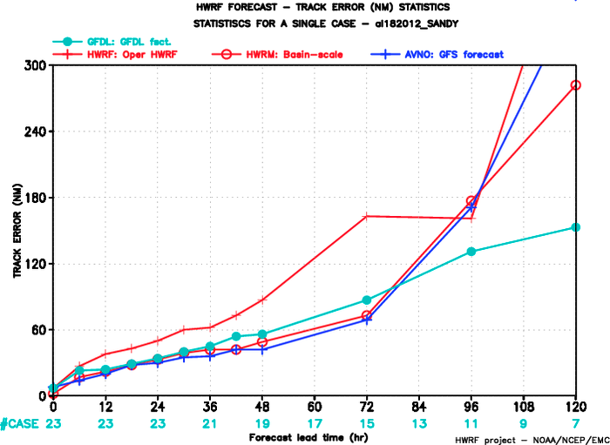

Slide 13
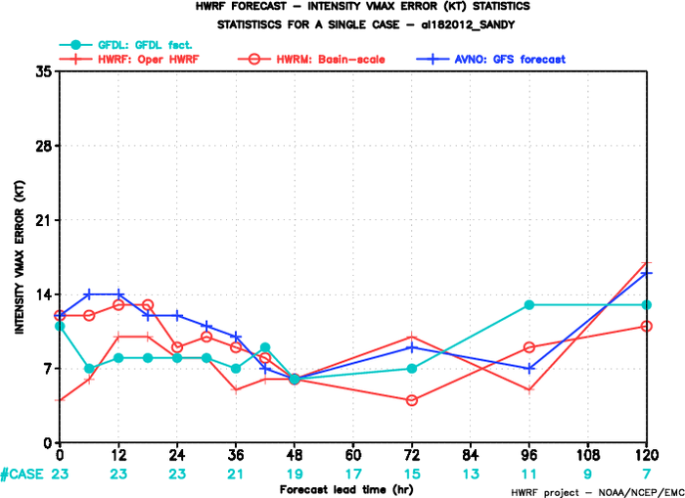

Slide 14
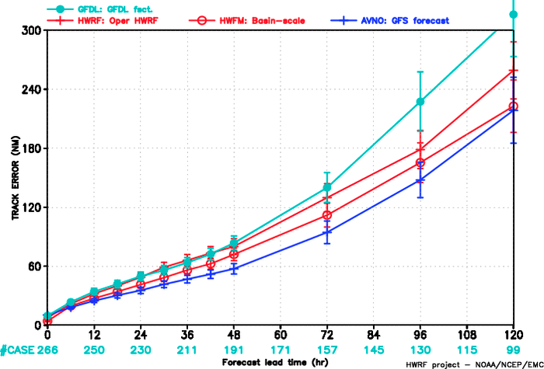
Track error (Atlantic 09-19)

Slide 15
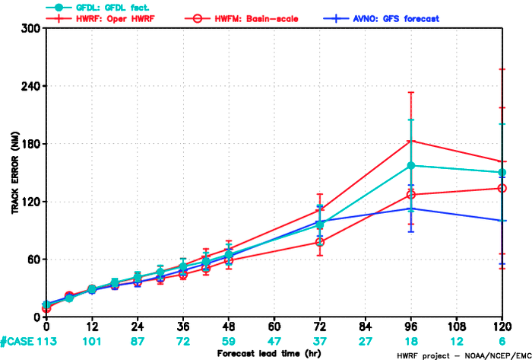
Track error (East Pacific 09-17)

Slide 16
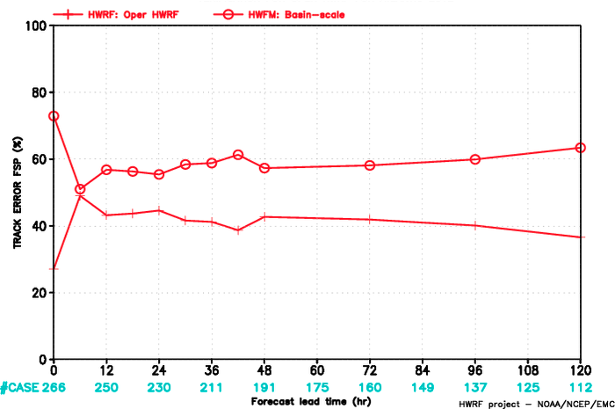
Track error FSP (Atlantic 09-19)

Slide 17
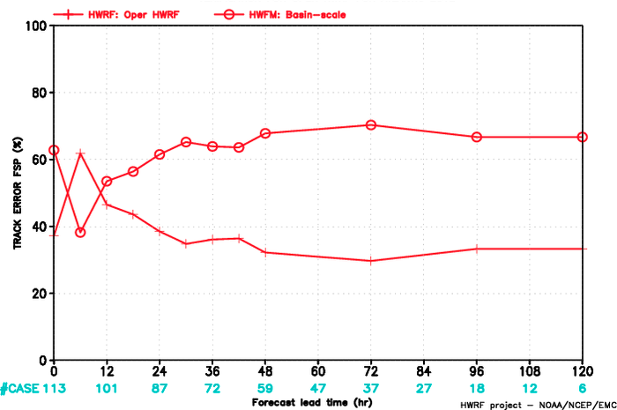
Track error FSP (East Pacific 09-17)

Slide 18
Future work
Complete the season retrospective forecasts
Diagnose differences among good and bad cases
Automate vortex initialization and create a benchmark
Test different initial conditions from different DA systems
Implement UPP for basin-scale modeling system

Slide 19
Challenges
Optimize the code to meet the operational time constraint
Initialize the forecast system
Ocean coupling
Post-processing
Forecast products

Slide 20
Basin-scale HWRF Configuration Test
 | Number of Nest Domains | Wall Clock Time | CPUs
27 km | No | 50 mins | 196
27-9-3 km | 2 (1 storm) | 137 mins | 196
27-9-3 km | 4 (2 storms) | 256 mins | 196
27-9-3 km | 6 (3 storms) | 363 mins | 196
27-9-3 km | 8 (4 storms) | 430 mins | 196
Note: Optimization ongoing

Slide 21
Conclusion
The modeling system is under development and shows significant improvement on track forecast
Vortex initialization through DA or cycling is an essential part to improve intensity forecasts
Forecast efficiency will be critical to the pathway toward operational implementation

