Slide 1
Advances in Basin Scale Modeling in HRD
Kevin Yeh & Xuejin Zhang
AOML/HRD & CIMAS
Sundararaman G. Gopalakrishnan
AOML/HRD

Slide 2
Basin-Scale Modeling Configuration
Fixed basin-scale domain (d01) at 27-km resolution with a fixed/movable inner domain (d02) at 9-km resolution
Previous HWRF 6h forecast for d01 & d02 are both cycled with GSI data assimilation always on for the genesis case (no vortex initialization, no ocean coupling)
A 5-day genesis forecast takes ~ 2 hr w/ 110 CPUs on Jet
Domain size: ~191.52˚ X ~77.76 ˚

Slide 3
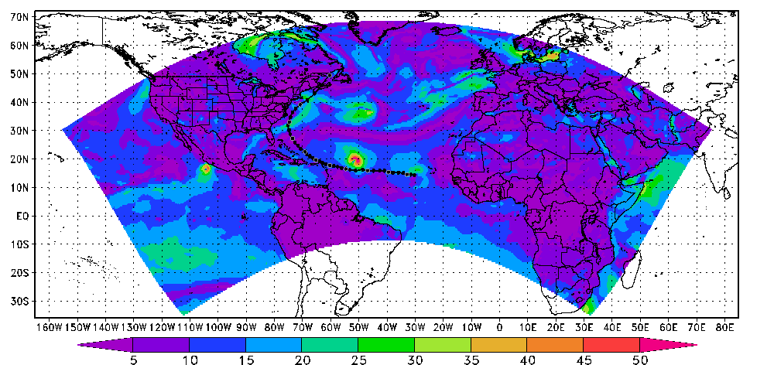
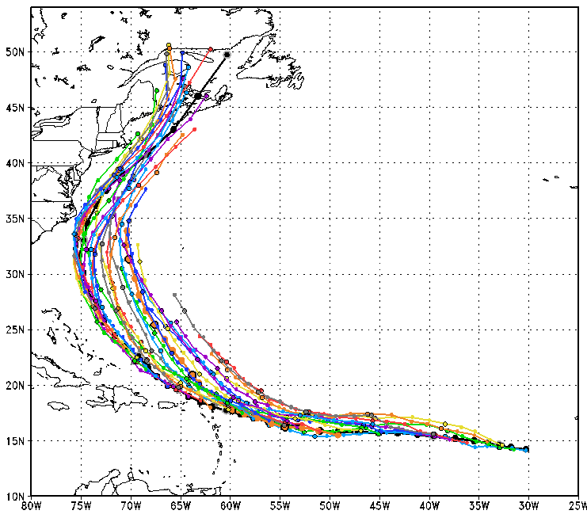
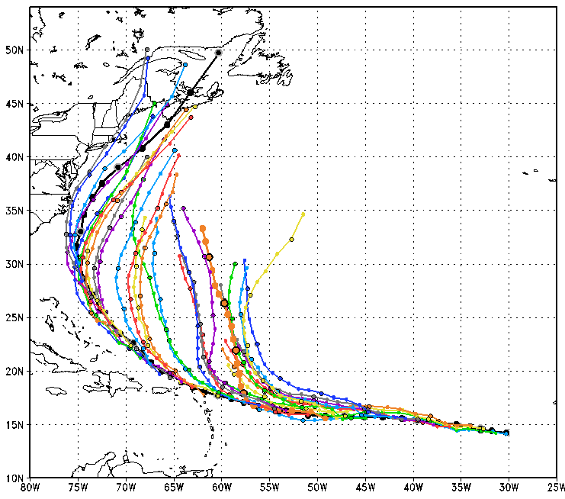
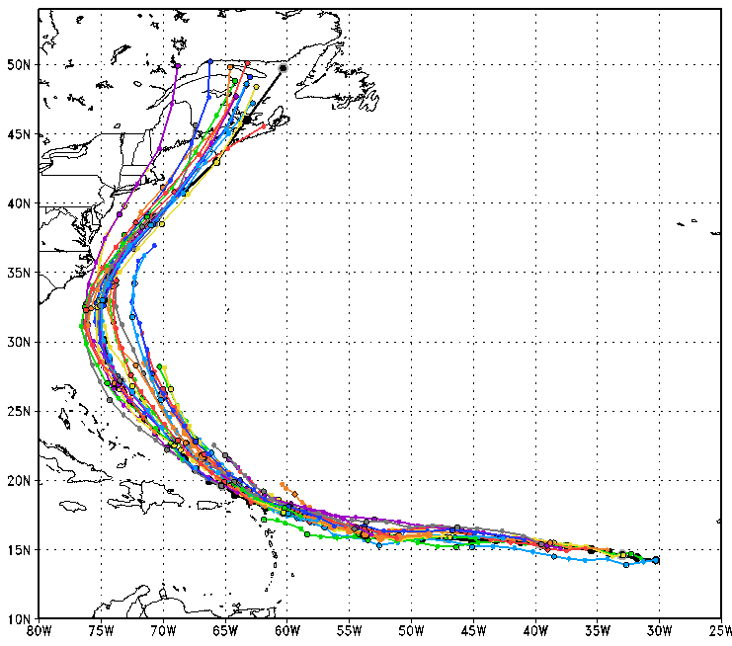
Operational forecast initialization
GFS environmental flows
Vortex init
GSI DA for deep cases
Experimental forecast initialization
HWRF environmental flows
Vortex init
GSI DA for deep cases
Genesis Model forecast initialization
HWRF-cycled environmental flows
GSI DA for all cases
Notes:
HWRF track forecast is improved by 30% for 3-day fcst, and 20% for 5-day fcst, based on 33 cases of Earl (2010)

Slide 4
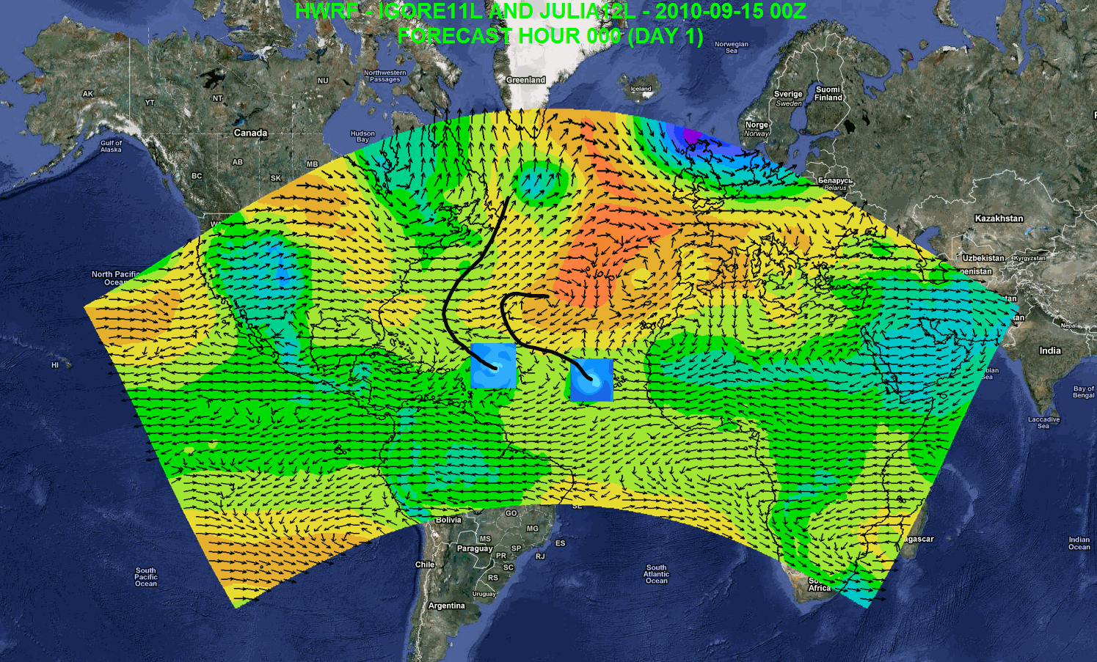
Possible Applications
Independent DA and cycling system
7-day forecast
Track forecast
Local applications
Regional ensembles/products
Daily Tropical Outlook/genesis
Website at AOML: https://storm.aoml.noaa.gov/realtime
Notes:
Independent DA system including vortex scale DA
Genesis
Track forecast
Local application
Drive local-scale model
Website at AOML: https://storm.aoml.noaa.gov/realtime

