Slide 1
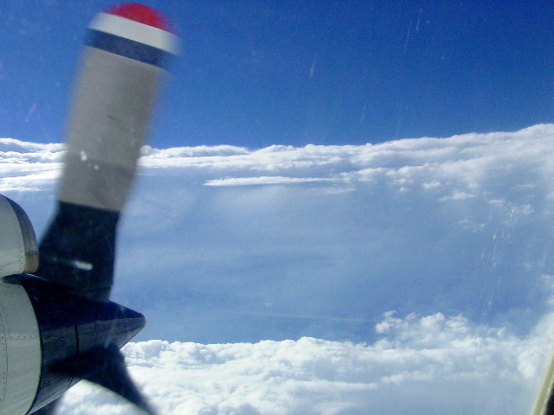
Aircraft Observations of Hurricanes
Robert Rogers
NOAA/AOML Hurricane Research Division
Miami, FL

Slide 2
Motivation
Why are observations important?
Many important physical processes within hurricanes span scales that cover many orders of magnitude, ranging from thousands of kilometers to millionths of meters
Observations key component of balanced approach toward advancing understanding and improving forecasts of hurricanes (observations, modeling, theory)
They can provide checks on theories and assess performance of models
Three primary platforms for observations – airborne, spaceborne, and land-based – focus here on airborne

Slide 3
Outline
Hurricane basics
Tools for observing hurricanes
Use of observations to improve hurricane forecasts
Views from the aircraft

Slide 4
Hurricane basics
Recipe for a Hurricane

Slide 5
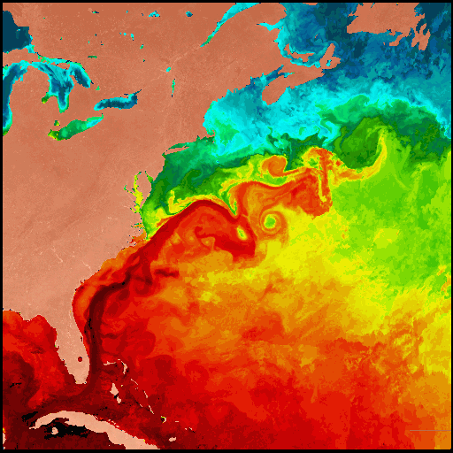
Warm Ocean
Sea surface temperature measured by satellites

Slide 6
Not too much "Wind Shear"

Slide 7
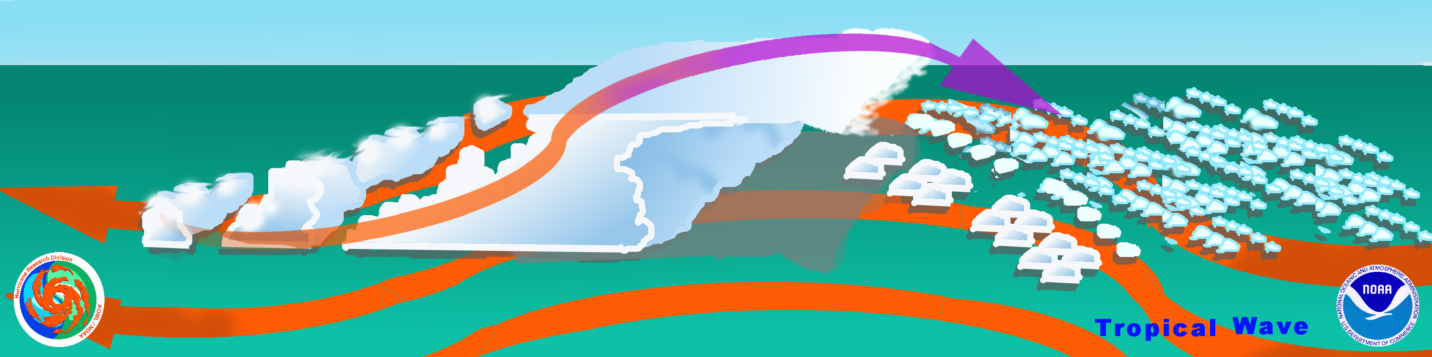
A pre-existing "Trigger"...
Tropical waves triggering convection

Slide 8
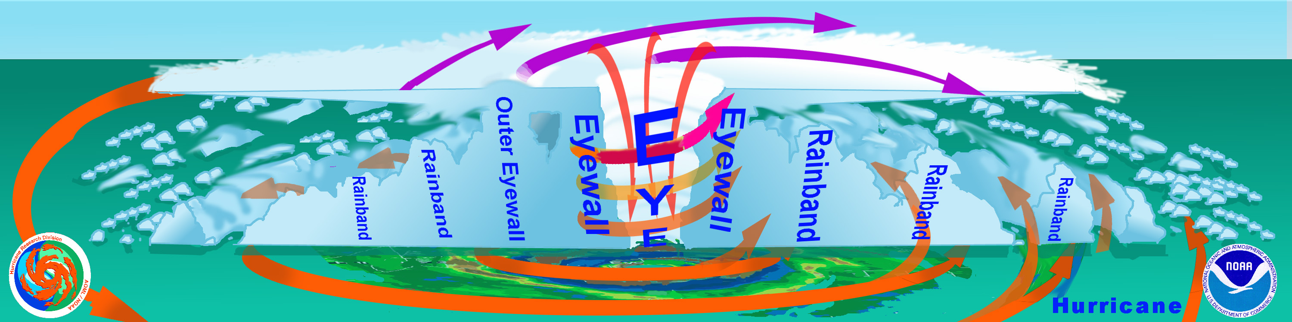
Nature's great heat engine...
The Hurricane
Outflow (“Exhaust”)
Energy Release
(“Cylinders”)
Ocean (“Fuel”)

Slide 9
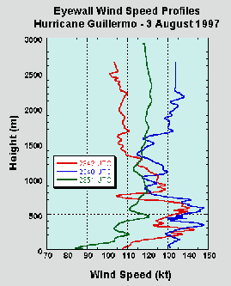

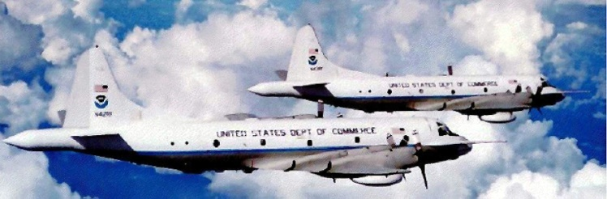
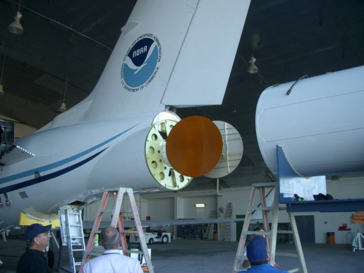
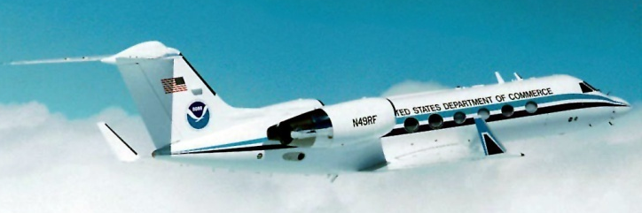
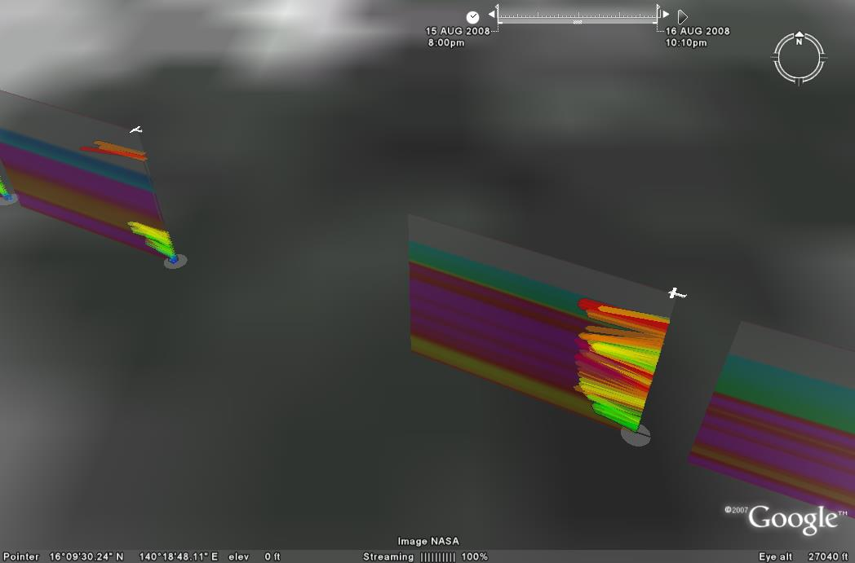
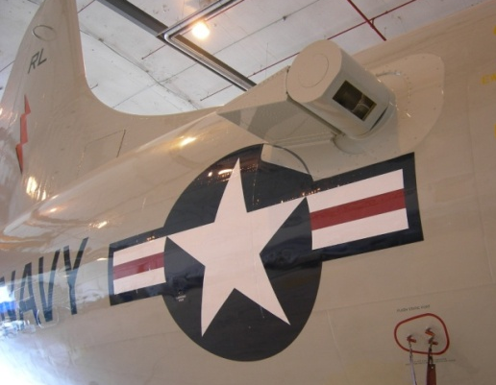
Tools for observing hurricanes
In-situ
  Wind, press., temp.
Expendables
  Dropsondes
  AXBT, AXCP, buoy
Remote Sensors
  Tail Doppler Radar (TDR)
  SFMR
  Doppler Wind Lidar (DWL)
  Scanning Radar Altimeter
  Scatterometer/ profiler
Platforms
  Unmanned Aerial Systems (UAS)
P-3
UAS
TDR
G-IV
dropsonde
DWL
DWL
Notes:
UR image depicts dropsonde profiles in eyewall of Hurricane Guillermo (1997)
LR image is Doppler Wind Lidar profiles from TCS-08

Slide 10
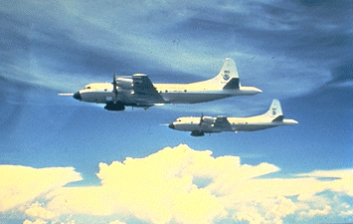

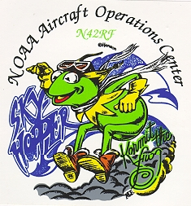
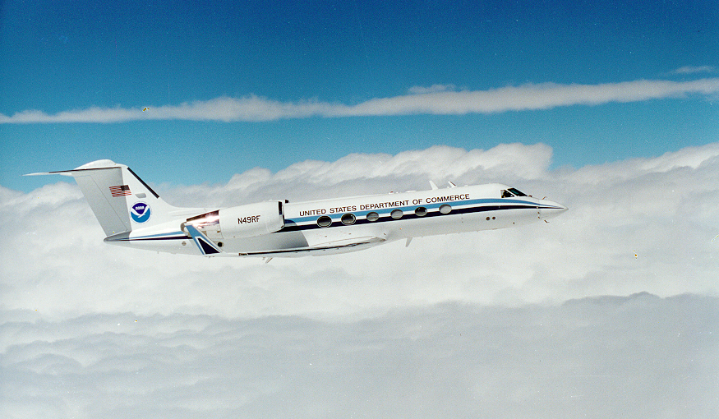

Tools for observing hurricanes
“Miss Piggy” Built in 1976 at Lockheed-Martin, Marietta, Georgia
“Kermit” Built in 1975 at Lockheed-Martin, Marietta, Georgia
“Gonzo” Built in 1994 at Gulfstream Aerospace Corporation in Savannah Georgia

Slide 11
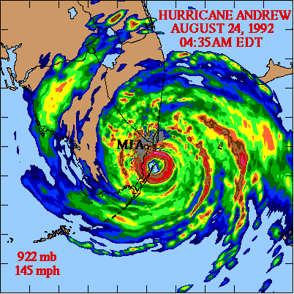
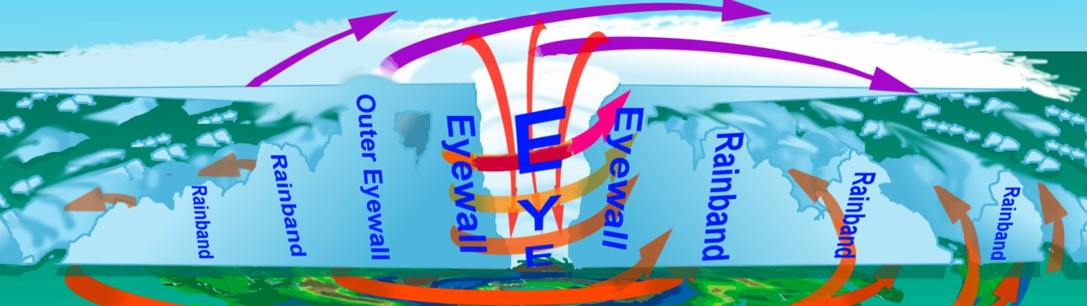




Hurricane Research
10 mi
Notes:
Aircraft provide the best way to observe hurricane wind and pressure.
Aircraft flights into hurricanes began near the end of WWII (1945) to provide location, movement, and intensity observations for forecasters. We fly through the storms near the bottom to enable estimates of surface winds using flight-level, radar, dropsondes and SFMR observations.
AF WC-130s and P-3s fly at or below 2 mi altitude (10,000 ft), G-IV flies at 9 mi altitude (45,000 ft)

Slide 12
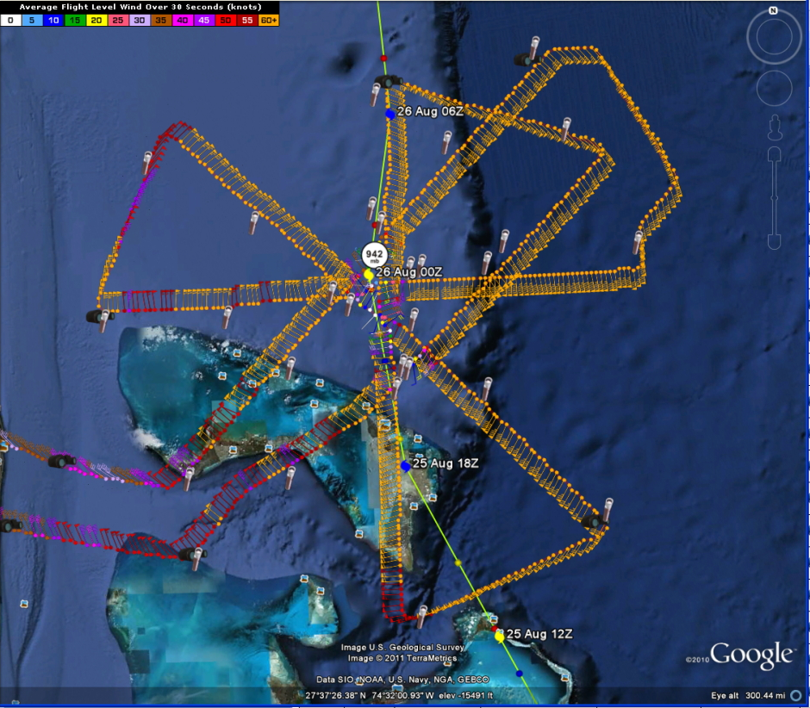
P-3 Flight track into Hurricane Irene
August 25, 2011

Slide 13
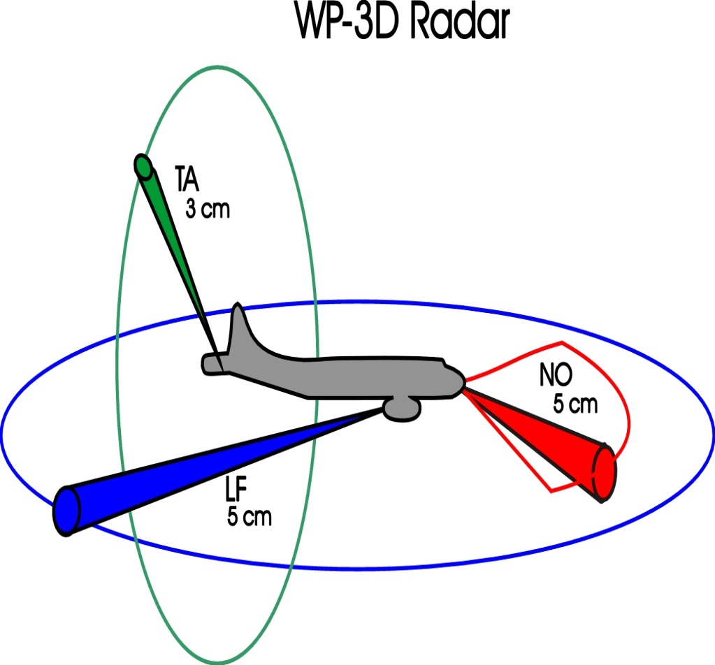
Airborne radar
Radars on WP-3D

Slide 14
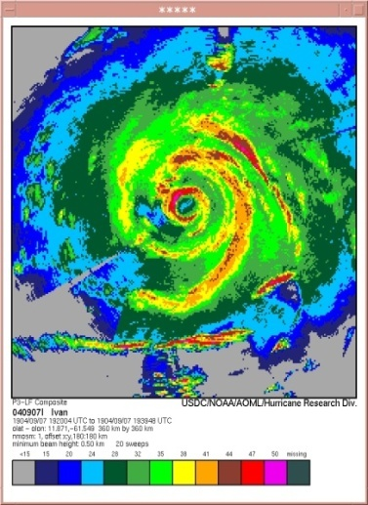
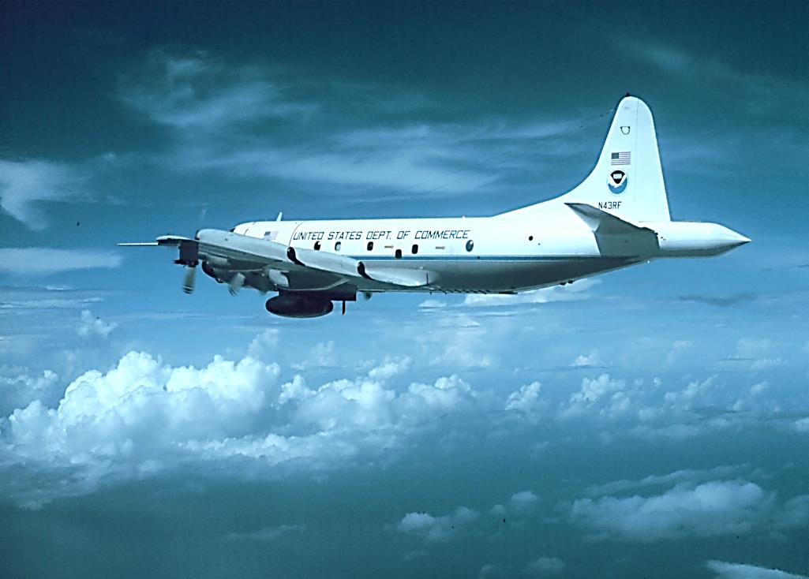
Lower Fuselage (LF) Radar
LF image of Hurricane Ivan (2004)
spiral rainbands
eyewall

Slide 15
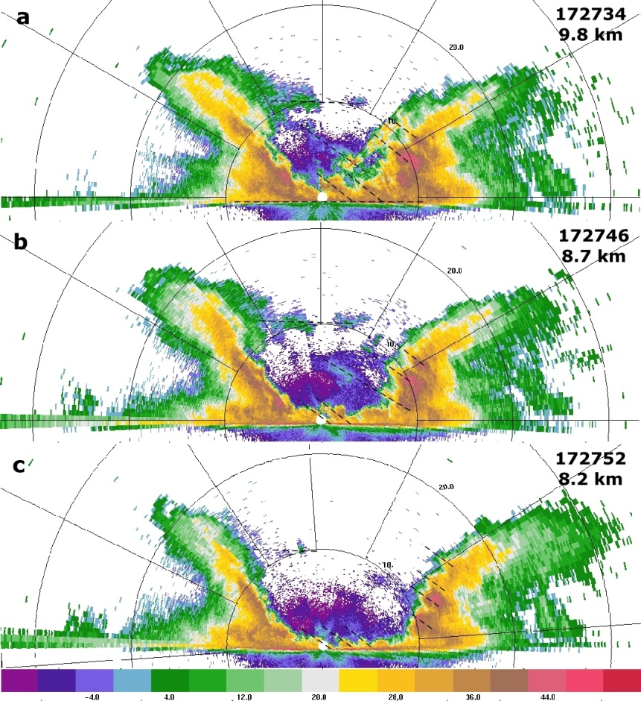

Tail Doppler Radar

Slide 16
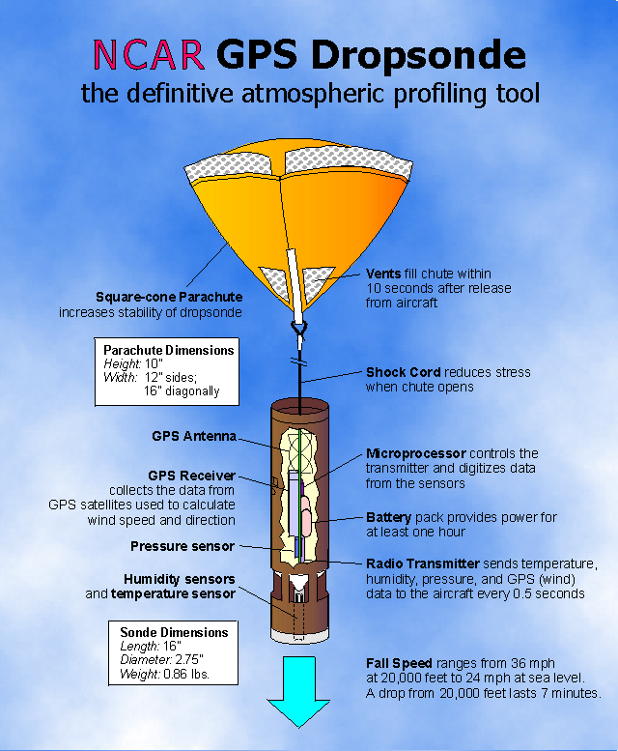
GPS dropsonde

Slide 17
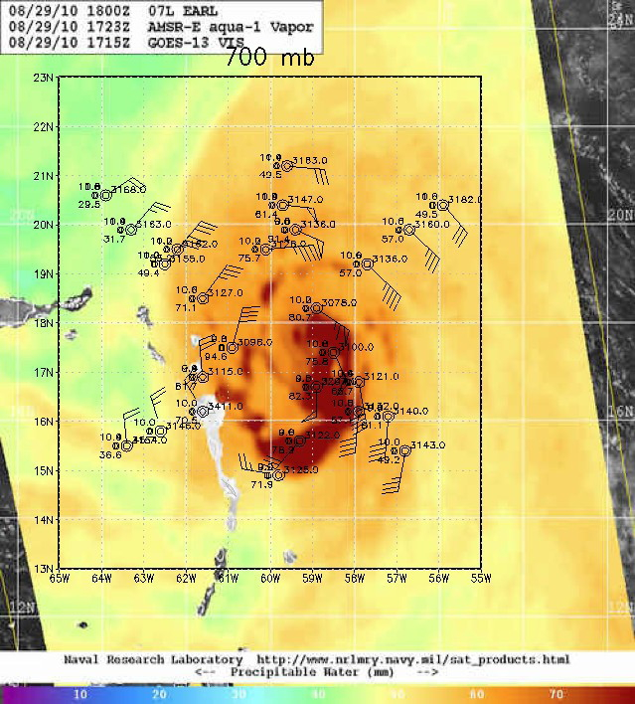

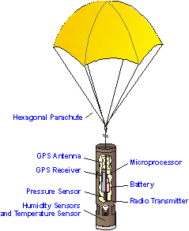
Types of Airborne Observations
Environmental structure
Synoptic-surveillance using dropsondes
Variation in moisture content of environment around hurricane

Slide 18
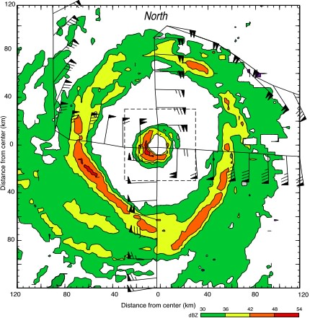
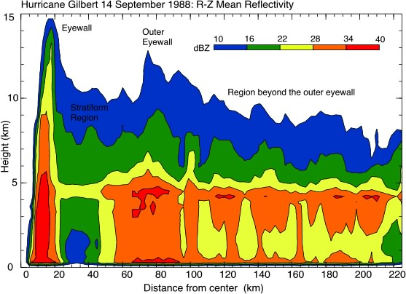
Types of Airborne Observations
Vortex Structure
Double eyewalls seen from airborne radar
eyewalls
inner
eyewall
outer
eyewall
stratiform
stratiform
Highest rain rates normally in eyewall, mostly convective, cover small area
Lighter rain rates in stratiform areas outside eyewall, cover larger area

Slide 19
Types of Airborne Observations
Convective Structure
Strong convection seen from radar
ER-2 EDOP
ER-2 EDOP
P-3 TA
P-3 TA
Vertical velocity (m/s)
Reflectivity (dBZ)

Slide 20
Types of Airborne Observations
Microphysical Structure
Flight track and LF image
Cloud physics particle images
Concentration of cloud physics (ice and water) particles

Slide 21
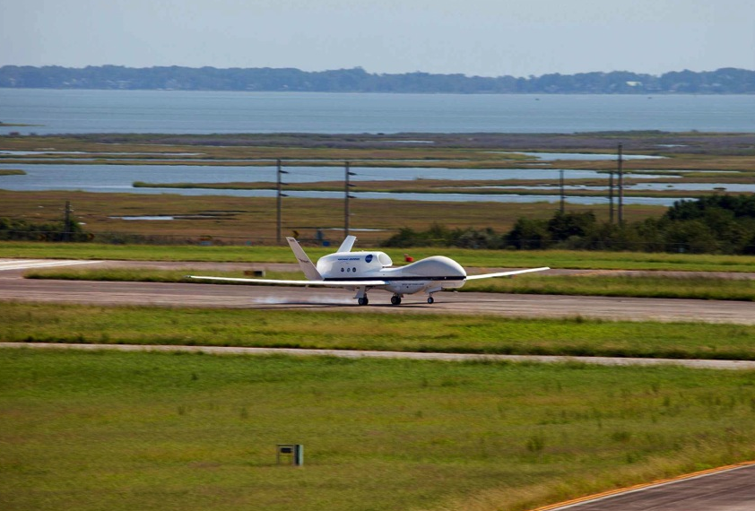
New Airborne Platforms
Global Hawk Aircraft (Unmanned Aerial System)
can stay airborne for >24 h, compared with 8 h for P-3 and G-IV
First Global Hawk landing at Wallops Flight Facility, Sept. 7, 2012.

Slide 22
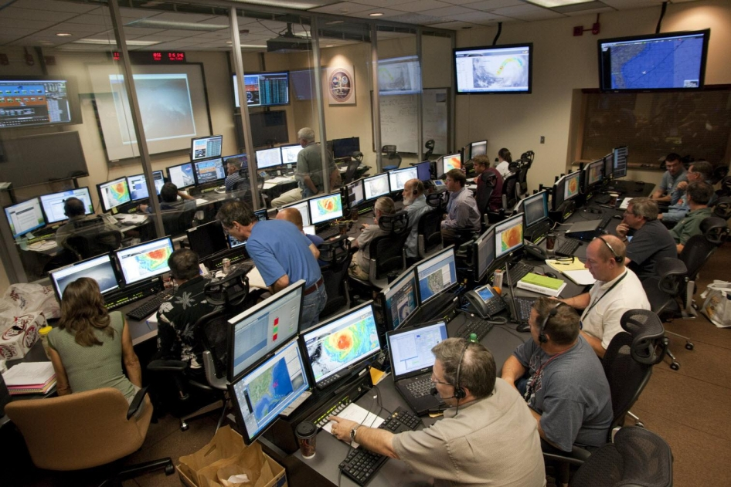
New Airborne Platforms
Global Hawk Operations Center (NASA Armstrong Base, CA)

Slide 23
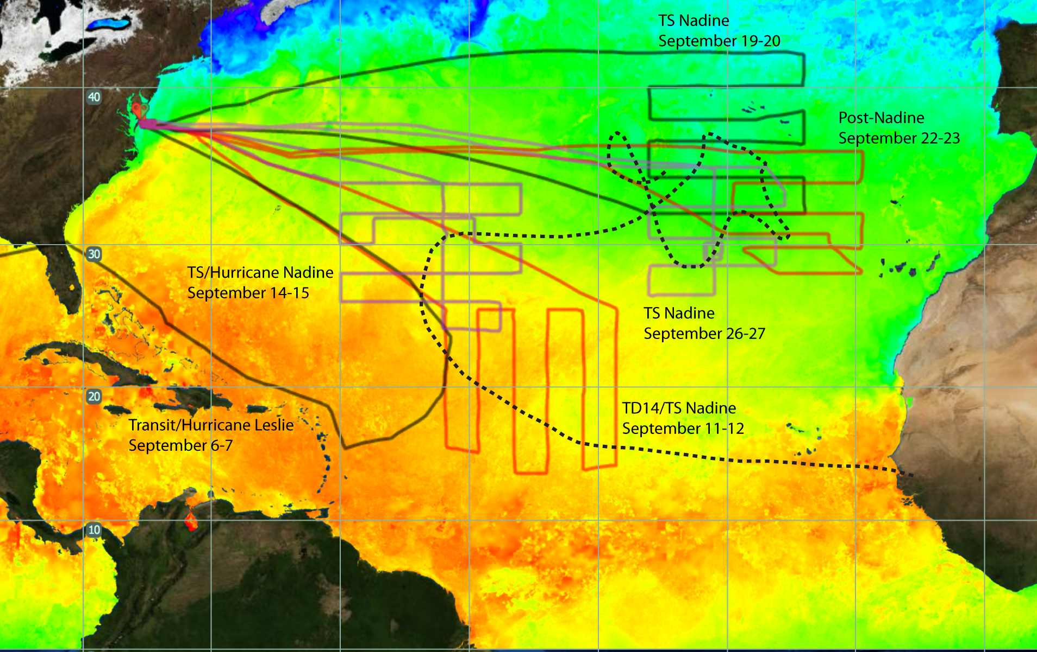

New Airborne Platforms
Long range of Global Hawk
Nadine’s track
21
26
28
30
32
(Hurricane and Severe Storm Sentinel, HS3, from 2012)

Slide 24

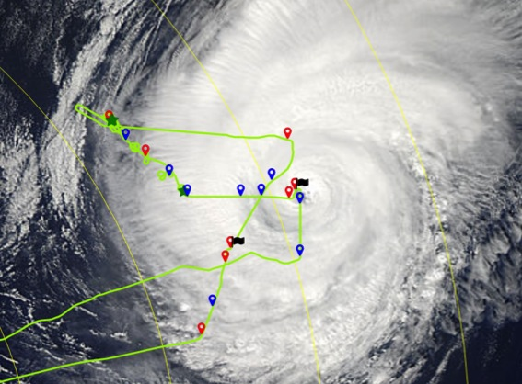
New Airborne Platforms
Coyote (Unmanned Aerial System)
released from P-3 like a dropsonde, can be controlled for ~2 h
can get measurements down to surface, where manned aircraft can not reach
Coyote measurements in Hurricane Edouard (2014)
MODIS
1640Z
1420Z
1341Z
1638Z
1316Z
1259Z

Slide 25
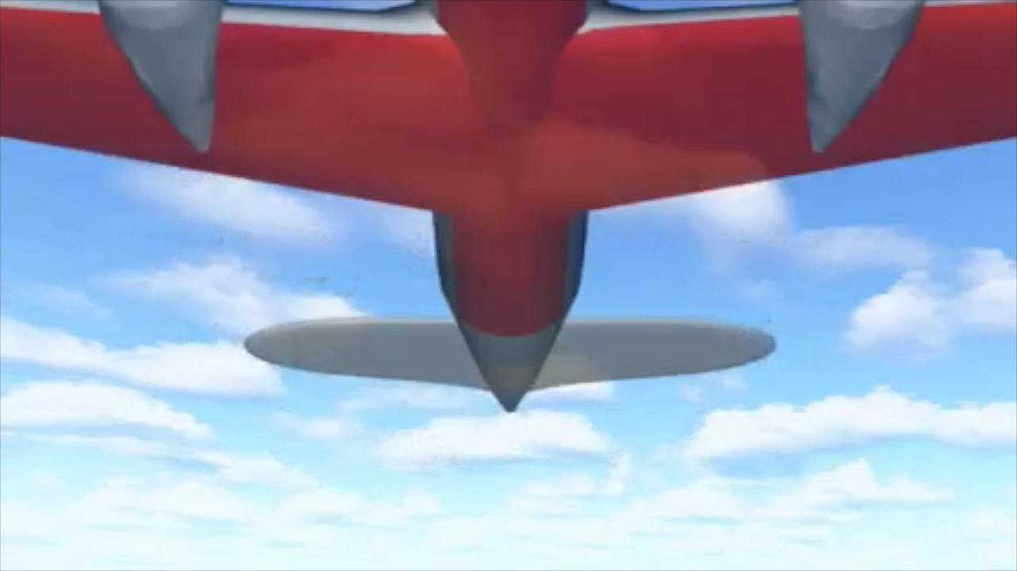
New Airborne Platforms
Depiction of Coyote launch

Slide 26
Use of observations to improve hurricane forecasts
Improving the specification of the initial state of the atmosphere (Data Assimilation)
Evaluating and improving the performance of numerical models (Model Evaluation)
Improving the understanding of tropical cyclone behavior (Hypothesis Testing)

Slide 27
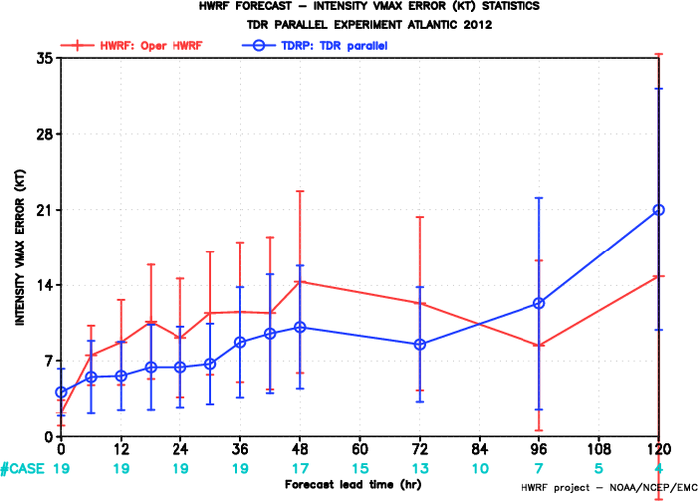
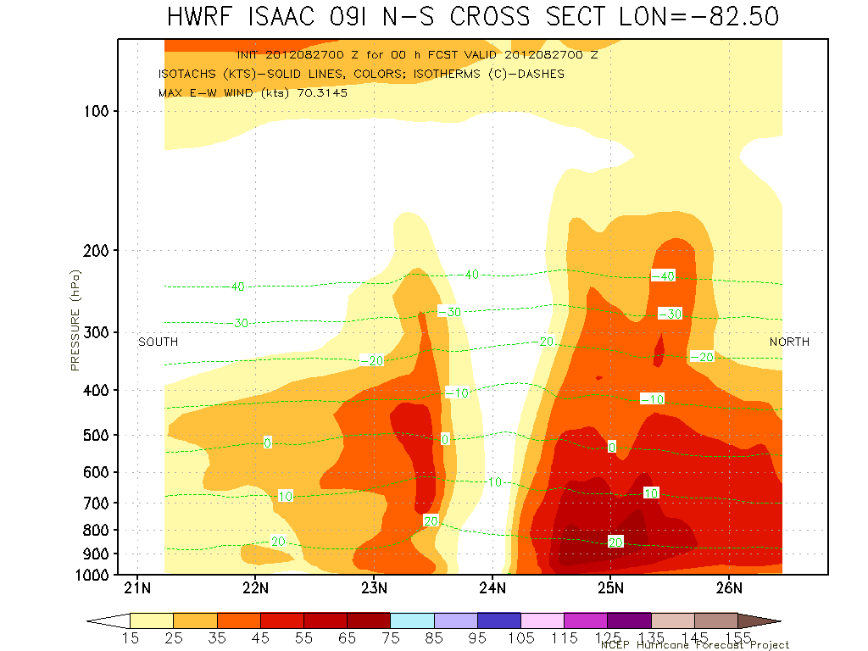
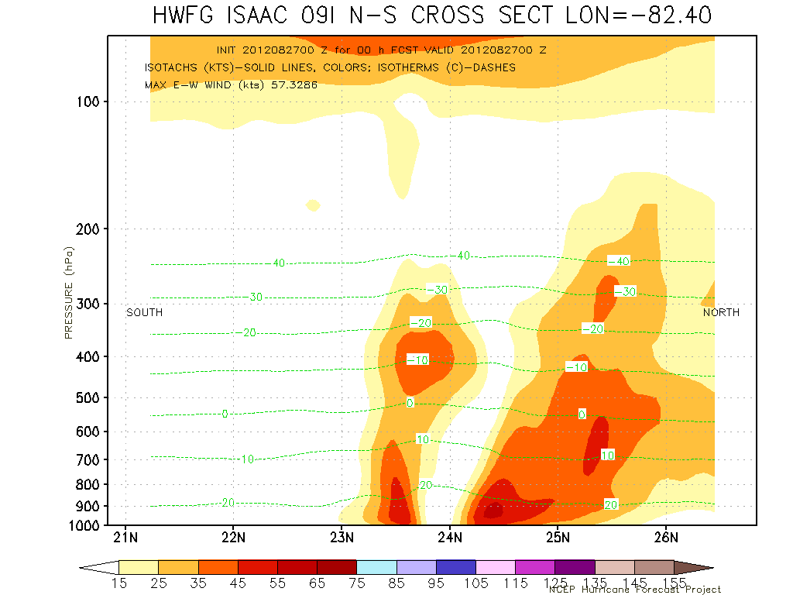
Use of Observations – Data assimilation
Impact of assimilating inner-core observations into forecast model
without radar
with radar
Intensity forecast error
Forecast hour
Vertical cross section of wind speed at start of model forecast
Without radar data
With radar data
Improved representation of vortex tilt

Slide 28
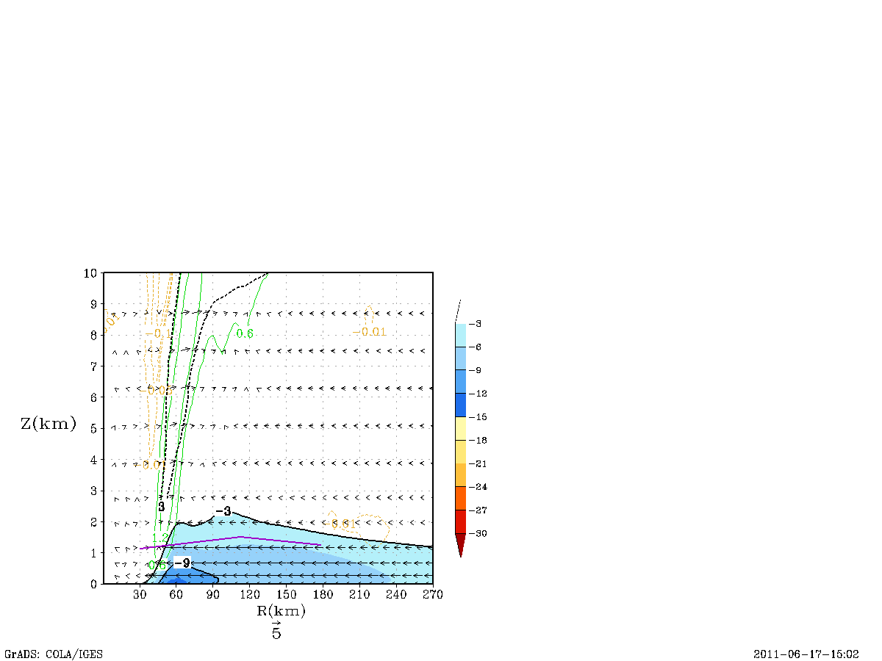
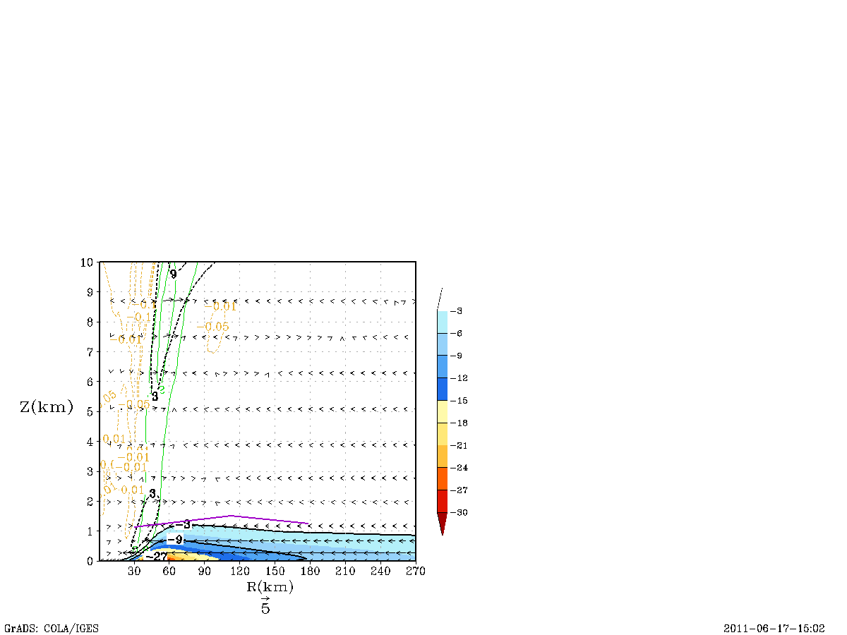
Use of Observations - Model evaluation
Sensitivity of radial wind to mixing processes in low levels
Radial inflow for different model runs
Old mixing version
New mixing version based on observations
2
Inflow depth based on observations
2
Inflow depth based on observations
height (km)
height (km)
1
1
inflow
inflow
0
0
30
90
150
210
270
30
90
150
210
270
radius (km)
radius (km)
Inflow layer too deep
Inflow strength too weak
peak radial inflow stronger with more accurate mixing
depth of inflow layer more consistent with dropsonde composites using more accurate mixing
28

Slide 29
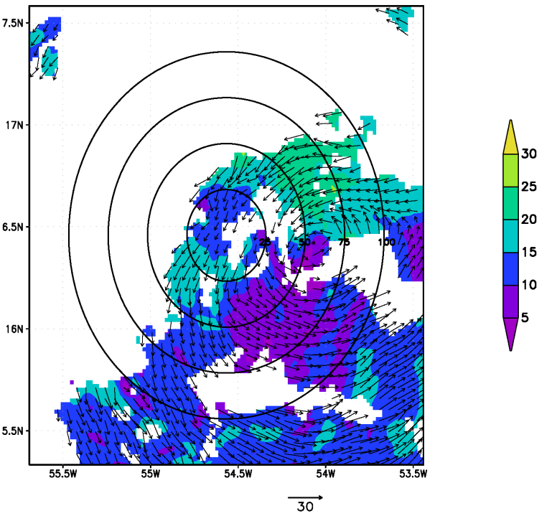
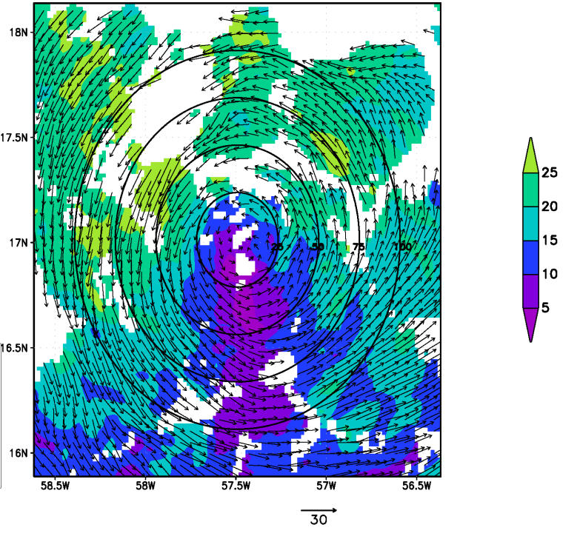
Use of Observations – Hypothesis testing
Is Vortex alignment necessary for Rapid Intensification (RI)?
Wind speed and direction at 8 km before and during RI for Hurricane Earl (2010)
Flight 1 – before intensification
Flight 2 – 12 h later, during intensification
8 km
8 km
center
center
Vortex tilted between 2 and 8 km during first flight
Vortex aligned between 2 and 8 km during second flight

Slide 30
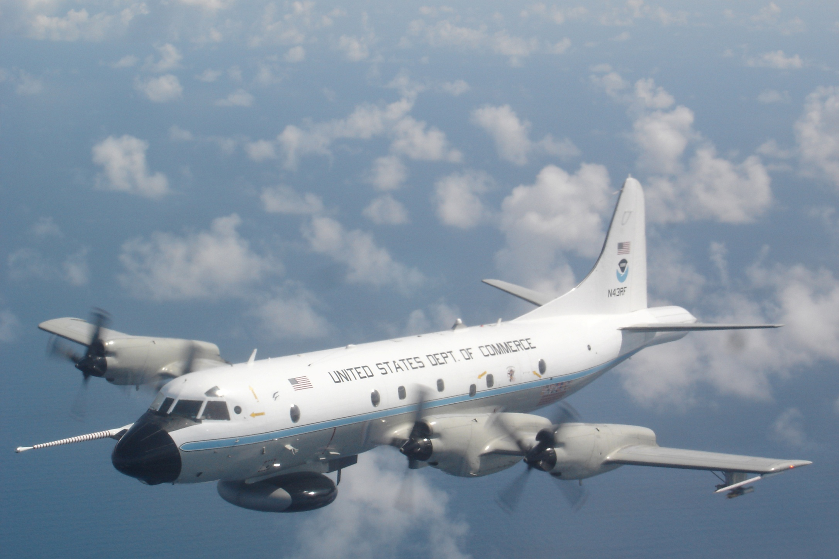
Views from the aircraft

Slide 31
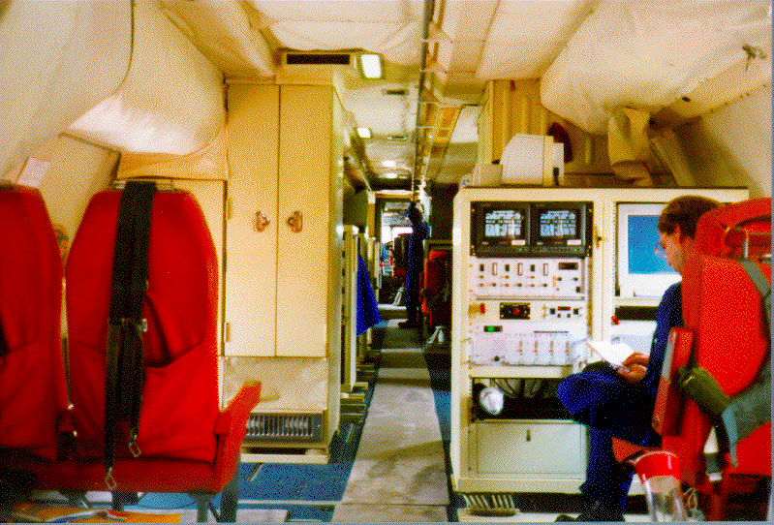
Inside the P-3 Aircraft

Slide 32
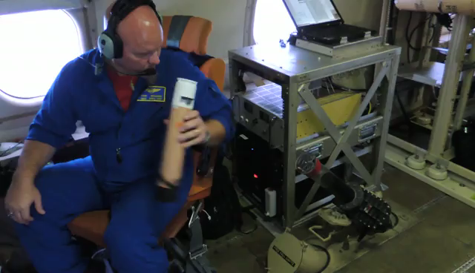
Dropsonde release on P-3

Slide 33
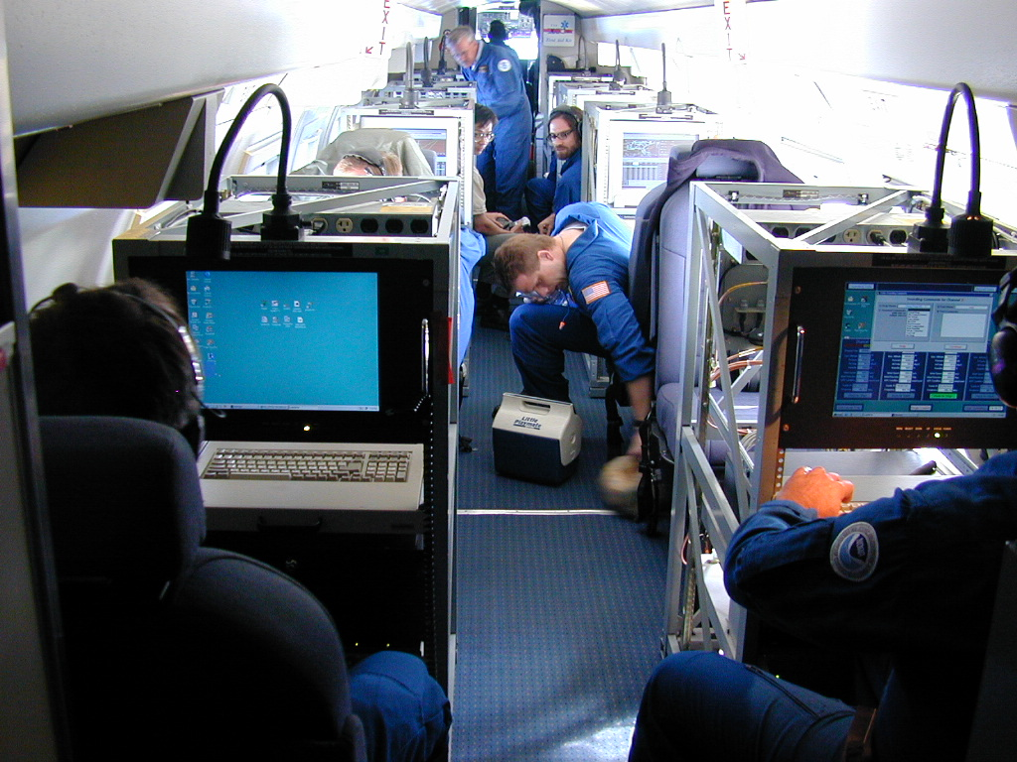
Inside the G-IV Aircraft

Slide 34
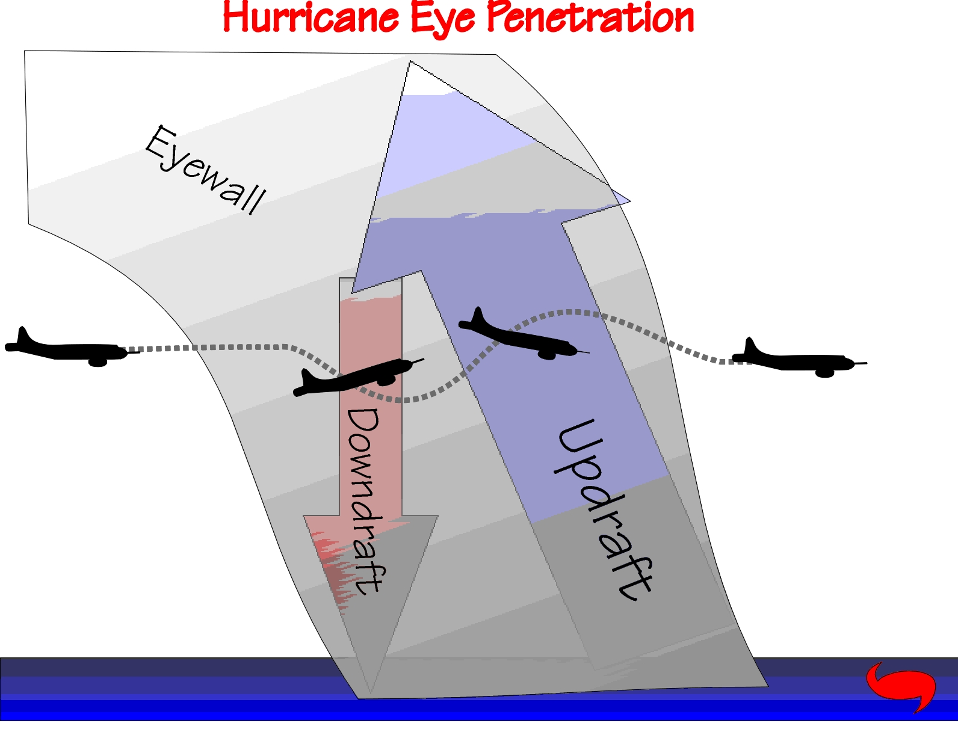

Slide 35
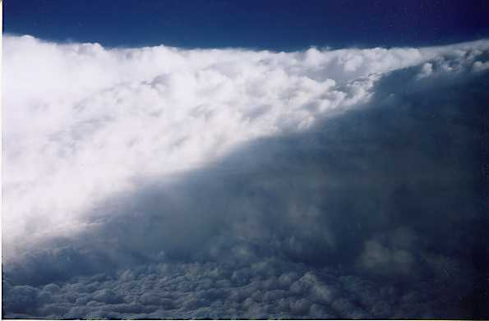
Within the Eye of Hurricane Georges (1998)
eyewall
low clouds above
sea-surface

Slide 36
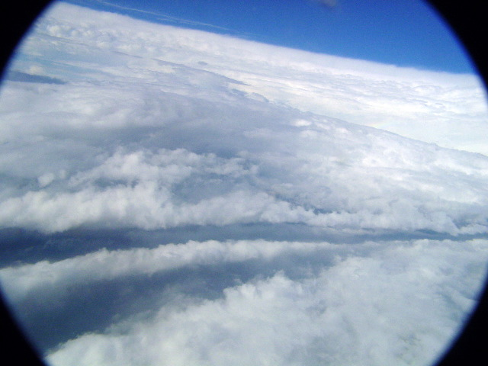
In the Eye of the Hurricane Isabel (2003)

Slide 37
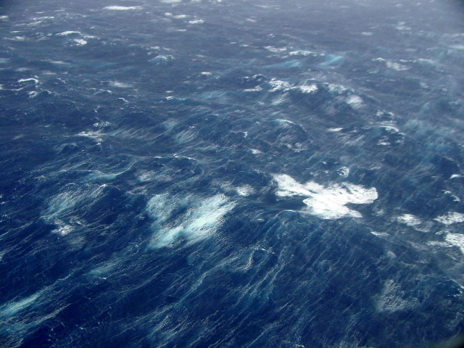
Sea state under Hurricane Isabel (2003)
Breaking waves
Wind-blown streaks

Slide 38
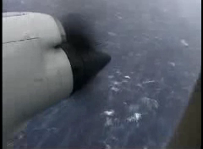
Low-level flight

Slide 39
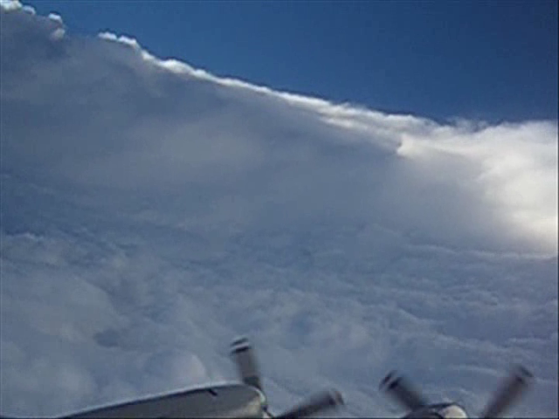
Stadium effect

Slide 40
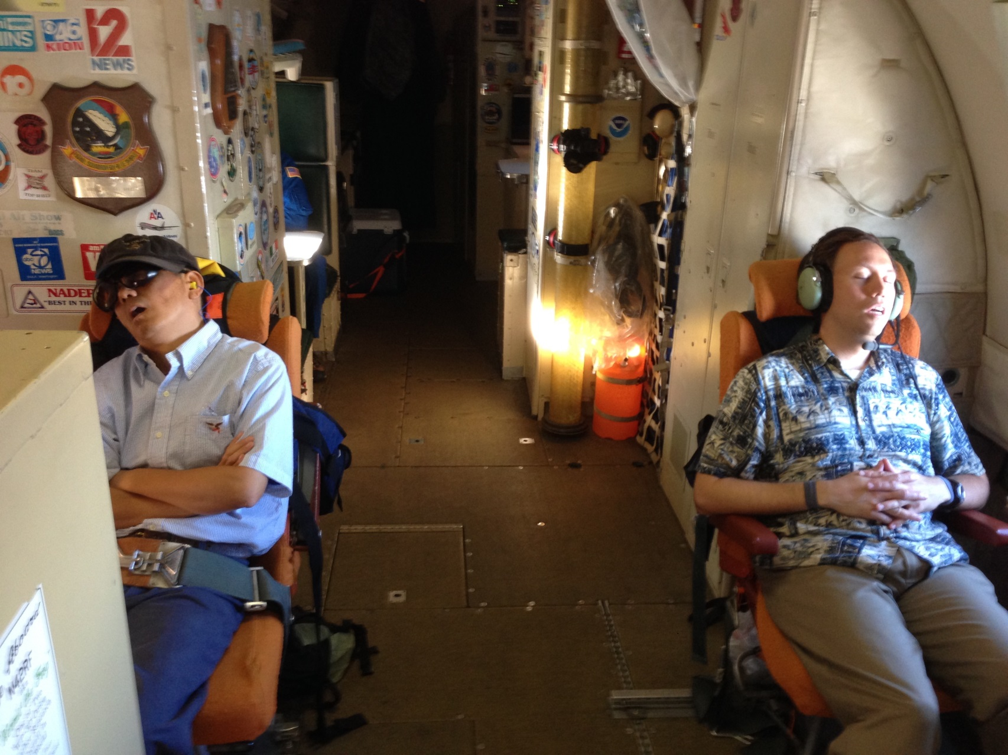
Impressed scientists

Slide 41
Summary
Observations are a critical component to a balanced approach to improving the understanding and prediction of hurricanes
Wealth of observations across multiple scales have been collected over many years, and they continue to be collected
New tools and platforms being developed to collect observations (e.g., Global Hawk, Coyote UAS)
These observations serve a variety of purposes to improve hurricane forecasts
  Model evaluation
  Data assimilation
  Hypothesis testing

Slide 42
Extra slides

Slide 43
Questions
What are key ingredients for hurricane formation?
What are some platforms and instruments important in observing hurricanes?
What considerations should be made when deciding what types of platforms and instruments to use in observing hurricanes?
How can observations be used to improve hurricane forecasts?

Slide 44
Questions
What are key ingredients for hurricane formation? Warm ocean, low vertical shear, preexisting forcing for convection
What are some airborne platforms and instruments important in observing hurricanes? P-3, G-IV, Global Hawk, Coyote, airborne radar, dropsondes, SFMR
What considerations should be made when deciding what types of platforms and instruments to use in observing hurricanes? Types of measurements needed, location in storm, spatial coverage, temporal frequency
How can observations be used to improve hurricane forecasts? Data assimilation, model evaluation, hypothesis testing

Slide 45
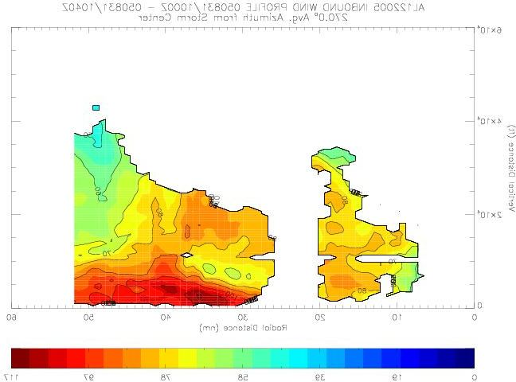
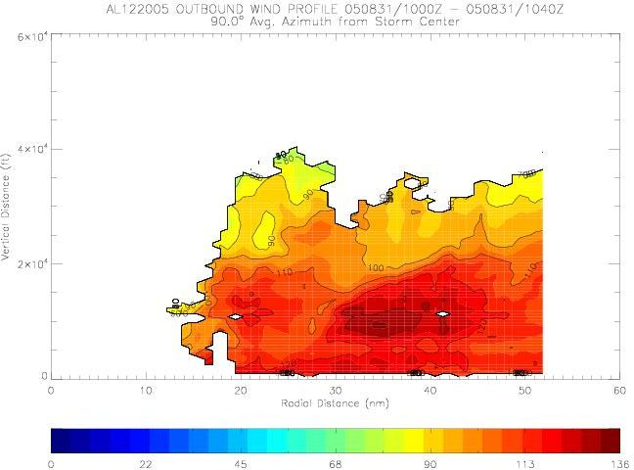


Real-time Doppler Radar analyses:
Hurricane Katrina (2005)
Vertical cross-section of Doppler winds
Lower-fuselage radar image for
Hurricane Katrina 1028 UTC 29 August
Airborne Doppler radar:
1st transmission of real-time quality controlled observations and analyses to NHC from aircraft in Hurricane Katrina (27 August, again on 28 August).
Can allow for the diagnosis of wind structure and intensity in real-time
1-km
kt
0
22
45
68
90
113
136
6
9
6
9
Doppler-derived winds at 1 km
1-km altitude

Slide 46


Slide 47




Types of Observations - Airborne
Environmental structure
Targeted upper ocean observations
TC impact on upper ocean effect of Hurricanes Gustav and Ike (2008)
CBLAST
Waves from 200’ in Isabel
Notes:
Drifter array in Gustav and Ike were placed by AFRC WC-130 ahead of storm. Gustav array still functioning when Ike was crossing Gulf. Also deployed AXBT grid post-Gustave which proved to be pre-Ike, followed by in storm Ike AXBT drops and post-Ike array. Revealed warm eddy and cold eddy left behind from Gustav interactions with Loop current.
Upper right picture shows sea-height anomaly (color) with superposition of Ike track and radii of hurricane (red circle) and storm force (yellow circle )winds. Black curly lines are tracks of Gustav drifters and circles are planned deployment locations for Ike drifters and floats. Thin black line shows P-3 track during pre-Ike AXBT pattern. Dropped over 300 AXBTs in Gustav and Ike.

Slide 48














Types of Observations - Airborne
Vortex Structure
Lower fuselage images from storms used in airborne Doppler composite
(a) Guillermo 8/2/97
(b) Fabian 9/3/03
(c) Isabel 9/12/03
(d) Isabel 9/13/03
(e) Isabel 9/14/03
(f) Frances 8/30/04
(g) Frances 8/31/04
(h) Frances 9/1/04
(i) Ivan 9/7/04
(j) Katrina 8/28/05
(j) Katrina 8/28/05
(k) Katrina 8/29/05
(l) Rita 9/21/05
(k) Katrina 8/29/05
(m) Rita 9/22/05
(n) Paloma 11/8/08

Slide 49


Types of Observations - Airborne
Vortex Structure
Composite asymmetric vortex structure of mature hurricanes in vertical shear
Composite mean 2-km reflectivity (shaded, dBZ) and vertical velocity (contour, m/s)
Composite mean 2-7 km vortex tilt

Slide 50




Types of Observations - Airborne
Vortex Structure
Vortex-scale measurements of Hurricane Katrina (2005) using Airborne Doppler radar
V_{q}
Tangential wind
150
100
distance (km)
Radial and vertical wind
V_{r}, w
50
0
0
50
100
150
distance (km)

Slide 51
Types of Observations - Airborne
Convective Structure
Partitioning into location relative to RMW
r / RMW
Inner eyewall
Outer radii

Slide 52


Types of Observations - Airborne
Convective Structure
Statistical characteristics (e.g.,mean profiles) of convective-scale features
Inner eyewall
Inner eyewall
Outer radii
Outer radii

Slide 53


Types of Airborne Observations
Turbulent Structure
Turbulent kinetic energy inferred from airborne Doppler
High turbulent kinetic energy in convection
Altitude (km)
High turbulent kinetic energy in PBL
Radial Distance (km)

Slide 54



Types of Observations - Airborne
Boundary Layer Structure
Radial variation of mean PBL structures from GPS dropsonde composites
tangential wind
radial wind
virtual potential temperature
%
%
%
r / RMW
r / RMW
r / RMW
794 dropsondes in 13 different storms
normalized by RMW and peak value within composite

Slide 55




Use of Observations – Data assimilation
Assimilation of inner core radar observations
20°
V_{r} SOs
22Z 29 August-01Z 30 August
Real-time superobs transmitted during P-3 mission and assimilated into forecast model
D2
Hurricane Earl (2010)
D1
Notes:
Top left image shows how airborne Doppler scans through storm with alternating fore/aft beams every 0.7 km resulting in herringbone patterns of beam intersections with 1.4 km resolution along track and 150 m resolution across track.
Bottom right image shows ARW domain used this summer by HEDAS to assimilate the Doppler superobs – in this case for Hurricane Earl when it was rapidly intensifying just NE of the Leeward Islands. The inset shows SOs used from 5 legs (represented by colors) across the storm. IFEX 2010 made 5 back to back P-3 flights every 12 h during the RI of Earl from 00Z 29 August to 12Z 31 August.
A superob (SO) is an average of several observations in proximity to each other. This averaging reduces the number of costly assimilations and avoids assimilating correlated data
Doppler SOs are averages of the observations of radial component of wind along pointing vector where all observations pointing in nearly same direction at nearly same distance from aircraft
Azimuthal grid resolution (around fuselage axis): 3-5 degrees depending upon radius
Radial grid resolution: 2 km
Along track resolution: 1 min = ~7-8 km
All radial velocity observations within a grid box are candidates for SOs, but only the 25 points closest to grid point used
Velocities >2 SD from bin average rejected
Bins with SD > 2XSD rejected
~5000 SOs per penetration of hurricane

Slide 56

Use of Observations – Data assimilation
Impact of assimilating inner-core observations into forecast model
Positive impact of Tail Doppler radar data on TS Karen intensity forecast
Intensity Forecast for Karen (2013)
Valid 12 UTC 4 October 2013
80
Best track
75
HWRF without Doppler
70
HWRF with Doppler
10-m peak wind (kt)
65
60
55
50
45
40
35
30
25
20
15
0
12
24
36
48
60
72
84
96
108
120
Forecast hour
NHC Forecast Discussion on October 4, 5 PM:
“…THE 12Z HWRF RUN SHOWED CONSIDERABLY LESS INTENSIFICATION WITH KAREN COMPARED TO PREVIOUS RUNS AFTER ASSIMILATING DATA FROM THE FROM THE NOAA P-3 TAIL DOPPLER RADAR. THIS MARKS THE FIRST TIME DOPPLER RADAR DATA HAVE BEEN ASSIMILATIED INTO AN OPERATIONAL HURRICANE MODEL IN REAL TIME. ..”

Slide 57







Use of Observations – Hypothesis testing
Vortex alignment and Earl’s Rapid Intensification
Geographic coverage of P-3 RI flights
Intensity coverage of P-3 RI flights
DC-8
DC-8
C-130
C-130
C-130
C-130
G-IV
G-IV
G-IV
100828I
100829H
100829I
100830H
100830I
P-3
P-3
P-3
P-3
P-3
Axisymmetric tangential wind (shaded, m s⁻¹)
14
Flight 1 – 00 UTC 29 Aug
Flight 2 – 12 UTC 29 Aug
Flight 3 – 00 UTC 30 Aug
Flight 4 – 12 UTC 30 Aug
Flight 5 – 00 UTC 31 Aug
12
10
height (km)
8
6
4
2
0
25
50
75
100
125
150
25
50
75
100
125
150
25
50
75
100
125
150
25
50
75
100
125
150
25
50
75
100
125
150
radius (km)
radius (km)
radius (km)
radius (km)
radius (km)

Slide 58




Use of Observations – Hypothesis testing
Vortex alignment and Earl’s Rapid Intensification
Wind speed (m/s) at 2-km altitude
Flight 1 – 00 UTC 29 Aug
Flight 2 – 12 UTC 29 Aug
Flight 3 – 00 UTC 30 Aug
Flight 4 – 12 UTC 30 Aug
RI begins during flight 2
time period of focus is between flight 1 and 2

Slide 59

NOAA Gulfstream-IV jet flies at high altitudes in the hurricane environment

Slide 60
Hurricane Isabel 2003

