Slide 1
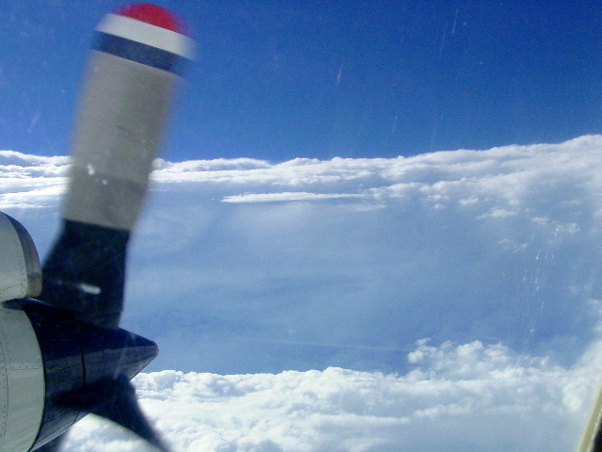


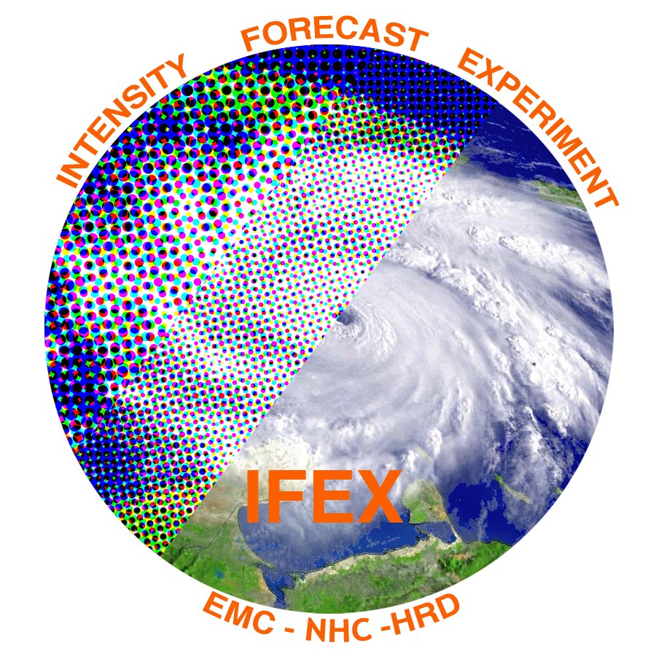

Observations of the structure and evolution of Hurricane Edouard (2014) during intensity change. Part II: Kinematic structure and the distribution of deep convection
Robert Rogers¹, Jun Zhang^{1,2}, Jon Zawislak³, Haiyan Jiang³,
Trey Alvey⁴, Ed Zipser⁴, Stephanie Stevenson⁵
¹NOAA/AOML Hurricane Research Division
²Cooperative Institute for Marine and Atmospheric Studies, University of Miami
³Florida International University
⁴University of Utah
⁵University at Albany, State University of New York

Slide 2
Deep convection and tropical cyclone intensification

Slide 3
Motivation
Recent aircraft and satellite composite studies of intensifying TC’s have focused on radial and azimuthal distribution of deep convection
  Preferred radial location inside RMW
  Preferred azimuthal location downshear, upshear left
Part I discussed evolution of thermodynamic parameters, precipitation during Edouard’s lifecycle
  Noted evolution of precipitation, humidity on upshear side
  Symmetry increased as intensification occurred
Questions to address here
  Do we see a similar distribution for deep convection in Edouard?
    Compare 14 September (RI) with 16 September (PEAK)
  What governs azimuthal, radial, temporal distributions of deep convection?
  What are consequences for intensity change?

Slide 4
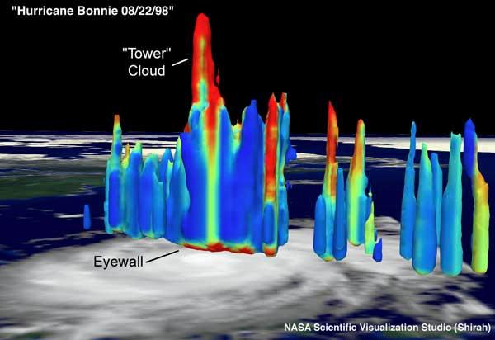
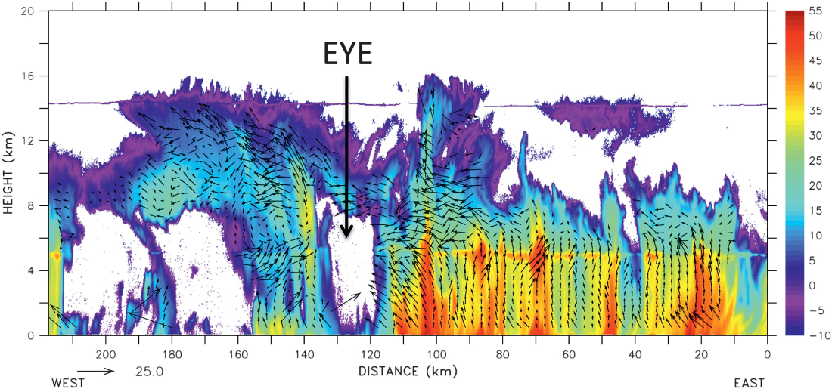
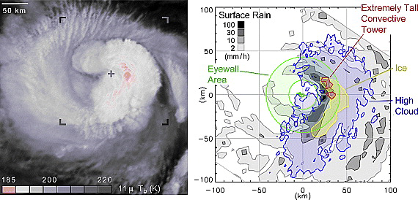

Slide 5
What is the importance of deep convection?

Slide 6
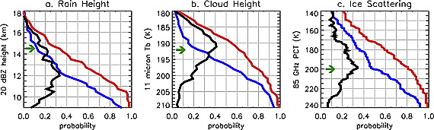
What is the importance of deep convection?

Slide 7
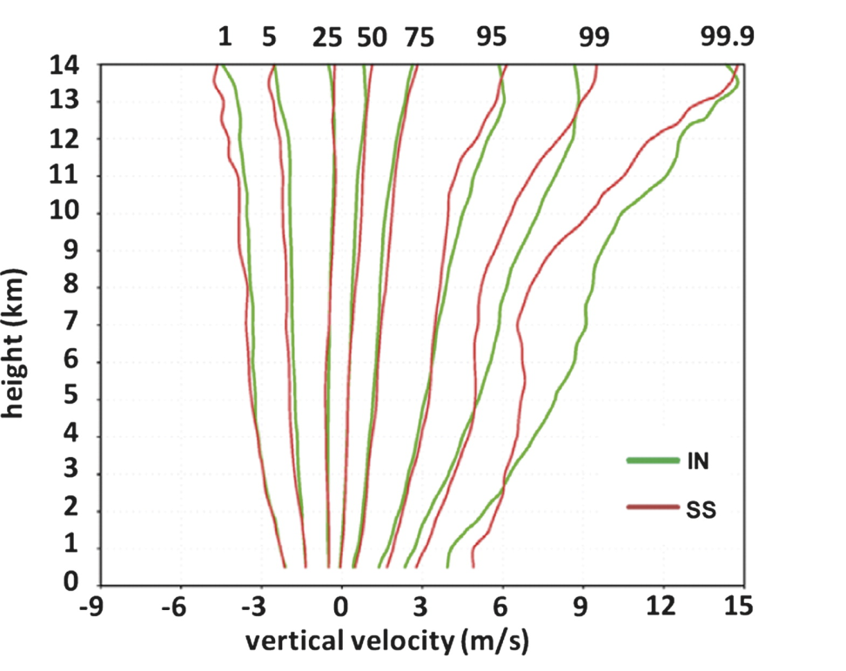
What is the importance of deep convection?

Slide 8
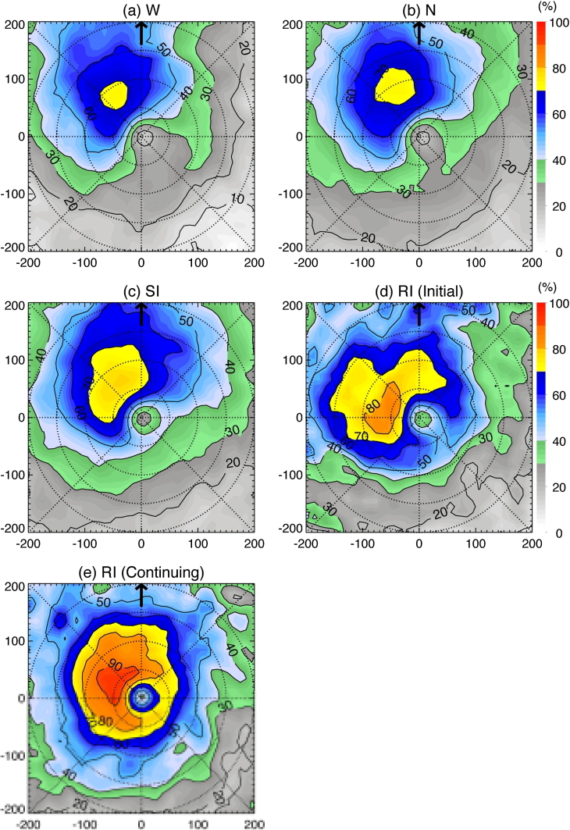
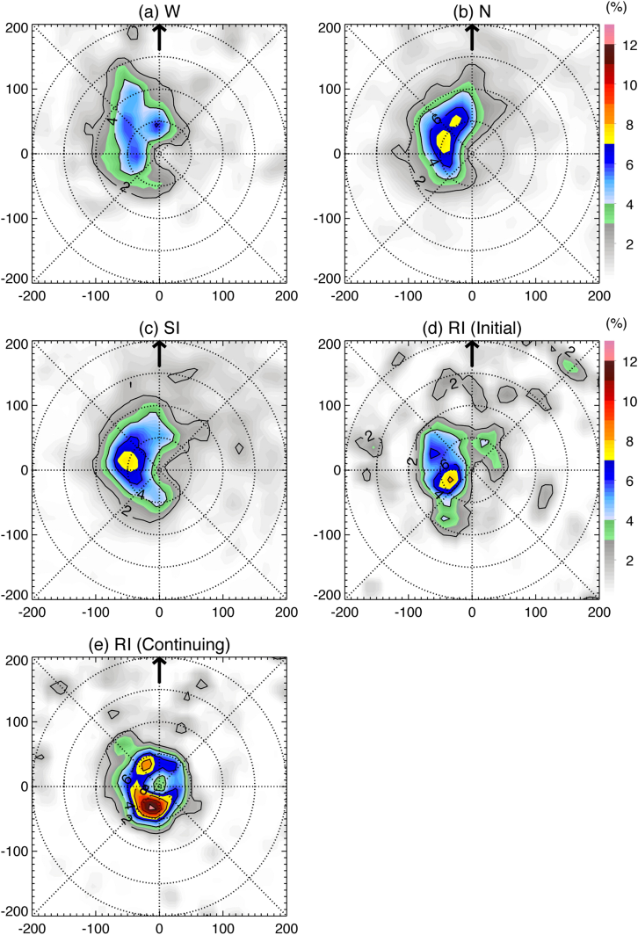
What is the importance of deep convection?
Surface ref > 20 dBZ
ref > 20 dBZ above 10 km
Zagrodnik and Jiang 2014

Slide 9
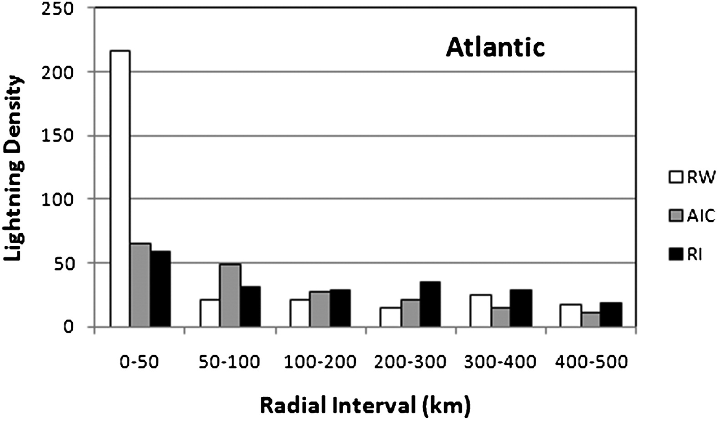
What is the importance of deep convection?
DeMaria et al. 2012

Slide 10
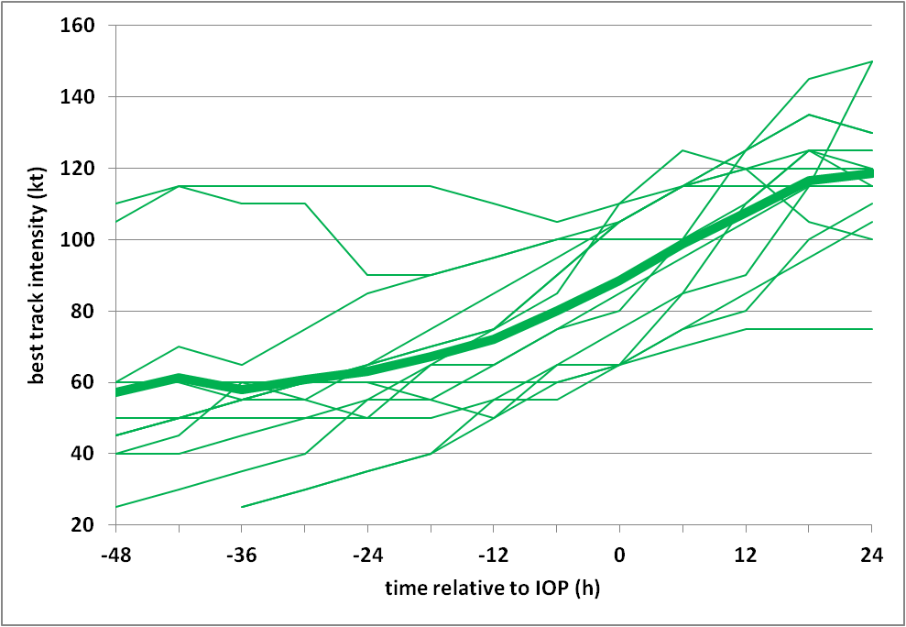
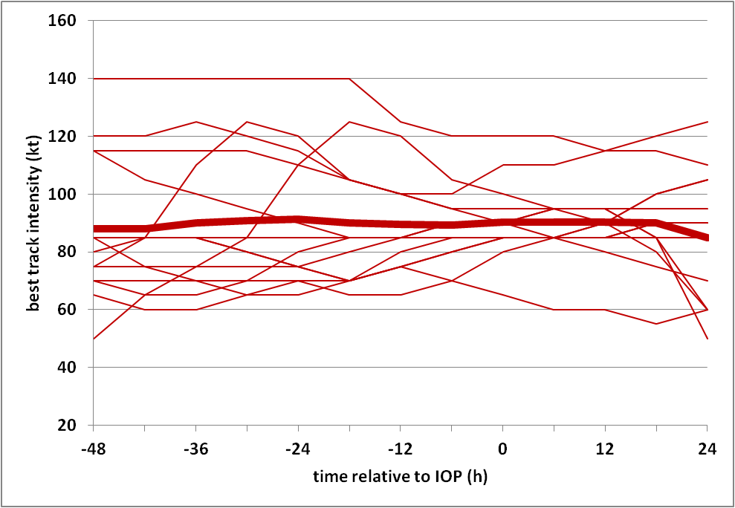
What is the importance of deep convection?
Composite study of airborne Doppler radar observations of vortex- and convective-scale structure and TC intensification
Best track intensity history for each IOP (thick line is mean)
Intensifying (IN)
Steady-state (SS)
IOP
IOP
(Rogers et al. 2013)
  40 eyewall passes from 14 IOP’s in 8 IN TC’s
53 eyewall passes from 14 IOP’s in 6 SS TC’s
Many IOP’s in IN dataset occur in middle of intensification period

Slide 11
What is the preferred (radial, azimuthal) location?

Slide 12
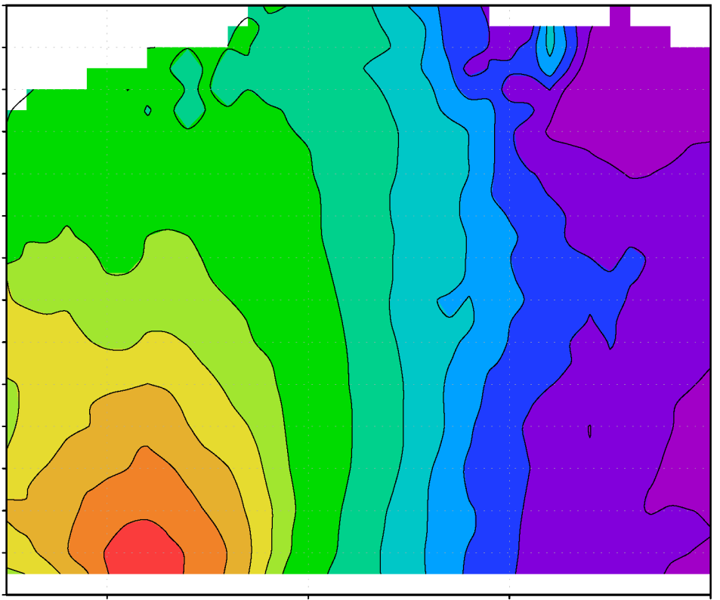
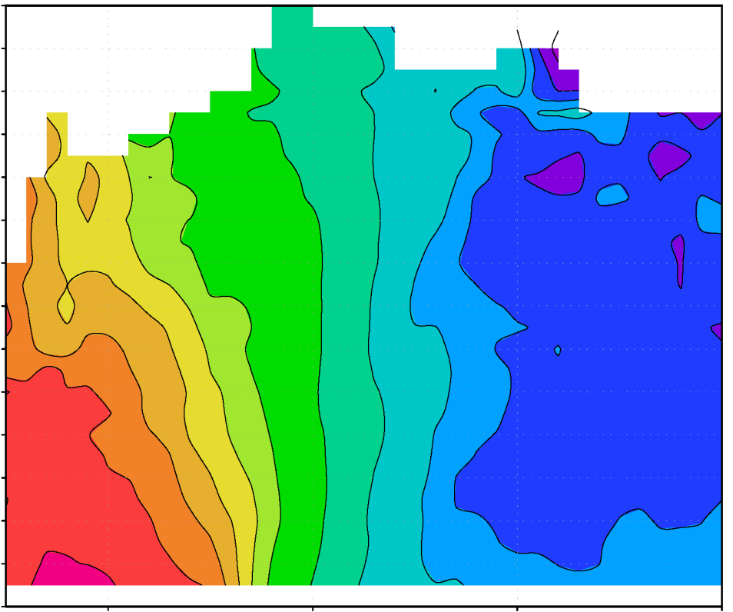
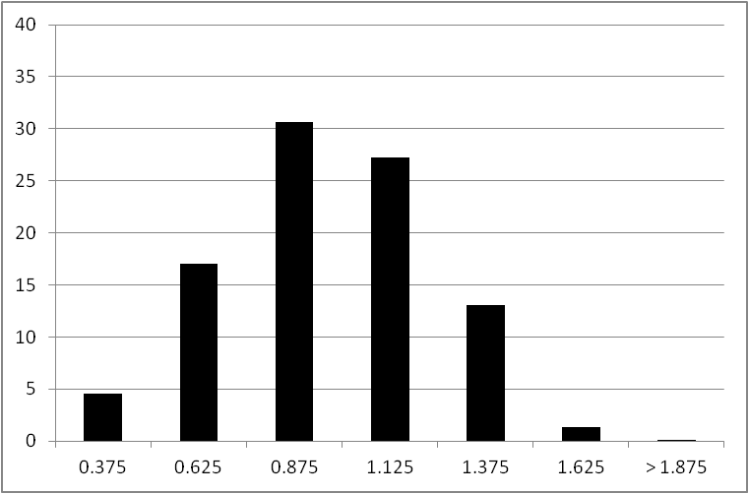
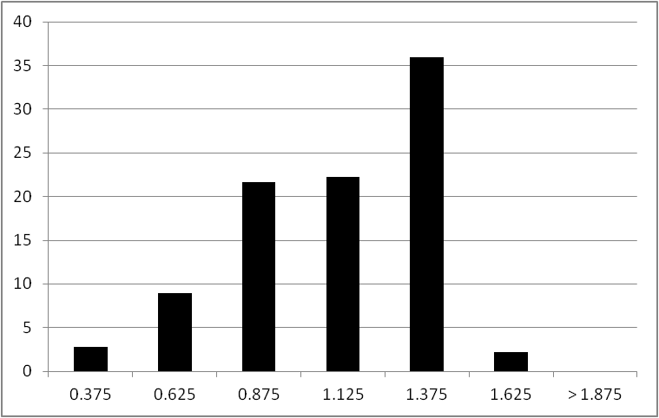
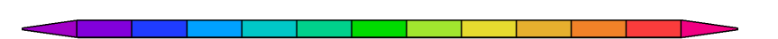
What is the preferred radial location?
Comparison of airborne Doppler composites of IN and SS cases
Radial distribution of convective bursts
(Rogers et al. 2013)
vorticity (x 10⁻⁴ s⁻¹)
vorticity (x 10⁻⁴ s⁻¹)
40
IN
40
SS
35
35
30
30
percentage
25
percentage
25
20
20
15
15
10
10
5
5
0
0
0.25
0.5
1
1.25
1.5
2
0.25
0.5
1
1.25
1.5
2
0.25
0.5
0.75
1
1.25
1.5
1.75
2
0.25
0.5
0.75
1
1.25
1.5
1.75
2
0.75
1.75
0.75
1.75
r/RMW
r/RMW
r/RMW
r/RMW
3
4
5
6
8
12
18
21
24
27
30
33
3
4
5
6
8
12
18
21
24
27
30
33
IN cases: distribution of convective bursts peaks inside RMW compared with outside RMW for SS cases
relationship between radial location of diabatic heating and intensification consistent with balance model studies

Slide 13

What is the preferred radial location?
WWLLN bursts relative to FLIGHT+ RMW and 24-h intensity change
(courtesy Stephanie Stevenson, SUNY Albany)
Intensifying TCs have lightning bursts at or inside RMW
Inside RMW
Outside RMW
Centers reformed

Slide 14
What is the preferred radial location?
WWLLN bursts relative to FLIGHT+ RMW and 24-h intensity change
(courtesy Stephanie Stevenson, SUNY Albany)
Intensifying TCs have lightning bursts at or inside RMW

Slide 15
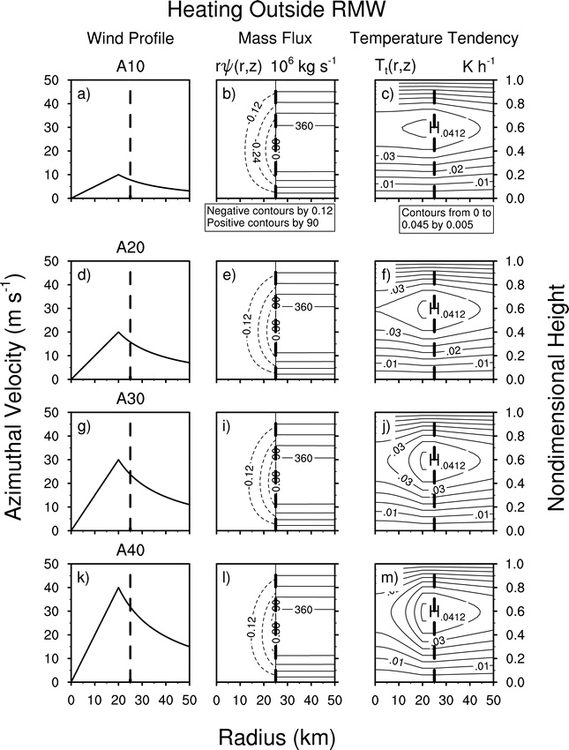
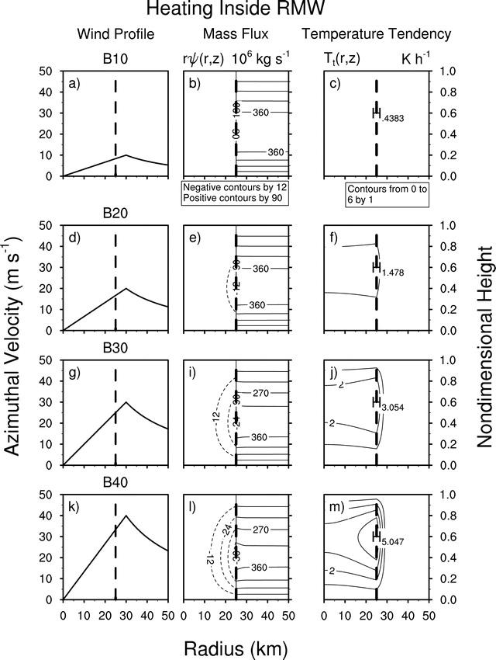
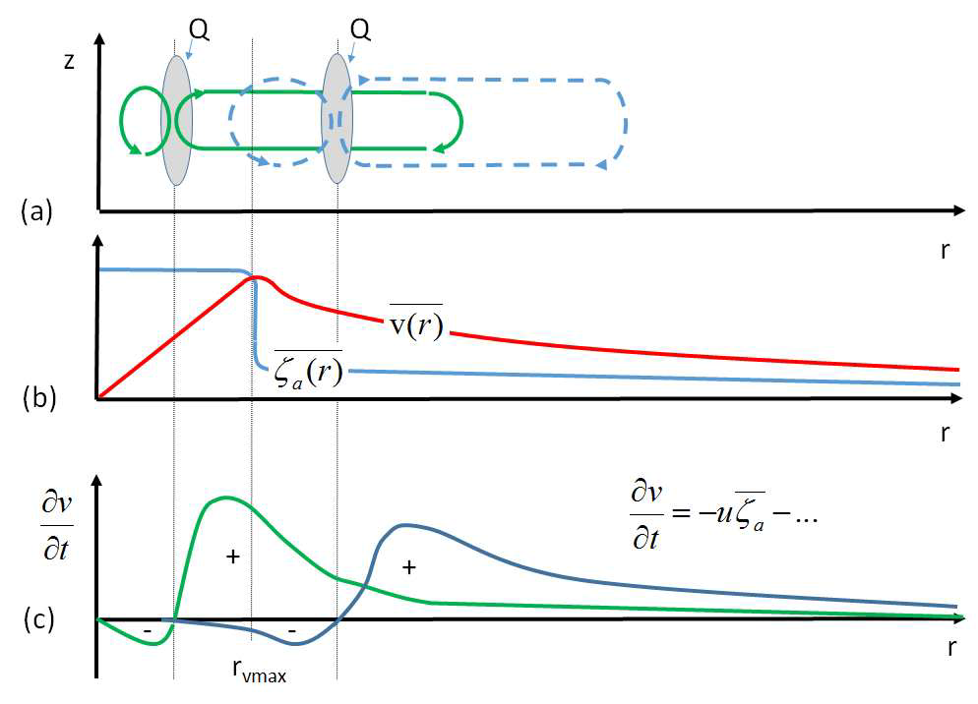
What is the preferred radial location?
Two proposed mechanisms
diabatic heating
heating outside RMW
Diabatic heating efficiency
heating inside RMW
diabatic heating
(Vigh and Schubert 2009)
RMW
Angular momentum increase in PBL
Either mechanism requires diabatic heating inside RMW
(Montgomery and Smith 2016, in review)

Slide 16
What is the preferred azimuthal location?

Slide 17
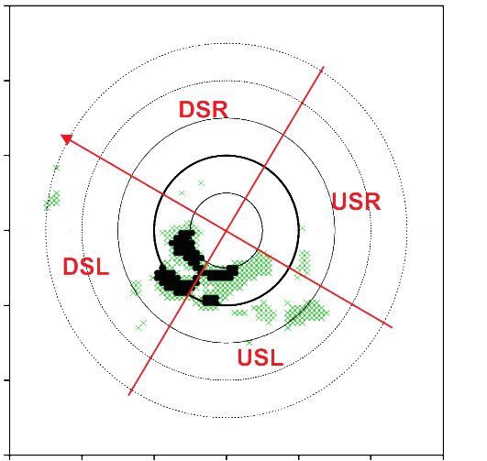
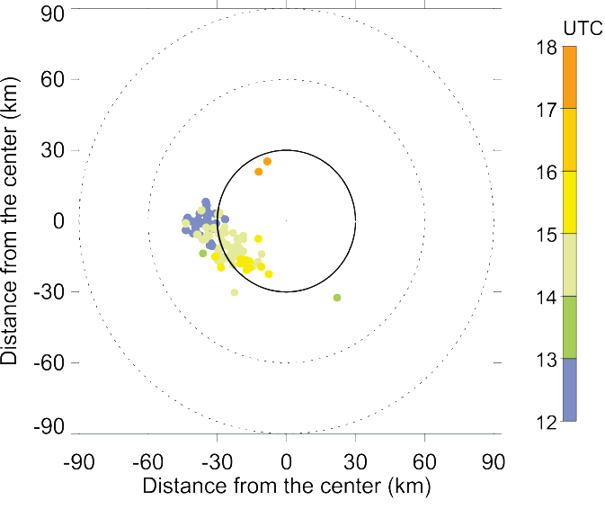

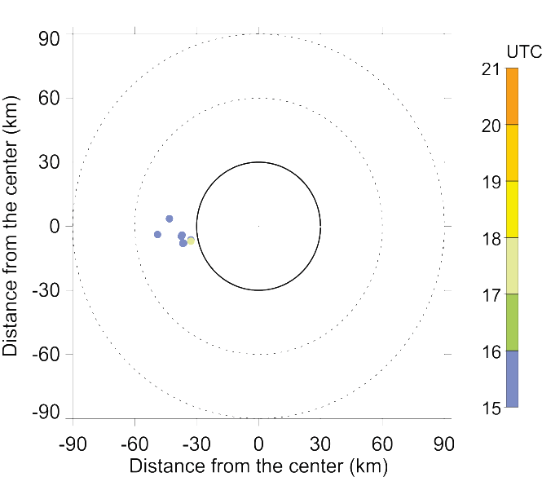
What is the preferred azimuthal location?
Locations of strong updrafts and lightning for Edouard
Strong 8-16 km updrafts
Lightning flashes from WWLLN
90
> 3 m/s
> 5 m/s
60
DSR
Distance from the center (km)
shear
shear
30
USR
14 September
(RI)
0
RMW
DSL
-30
-60
USL
-90
-90
-60
-30
0
30
60
90
Distance from the center (km)
90
> 3 m/s
> 5 m/s
60
DSR
Distance from the center (km)
30
shear
shear
USR
16 September
(SS)
0
RMW
-30
DSL
-60
USL
-90
-90
-60
-30
0
30
60
90
Distance from the center (km)
14 Sept: Lightning flashes begin DSL, rotate toward USL and inside RMW
16 Sept: Limited strong updrafts and lightning mostly DSL
(Rogers et al. 2016,
In review)

Slide 18
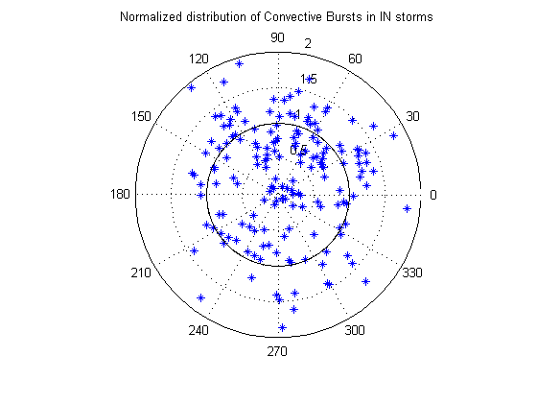
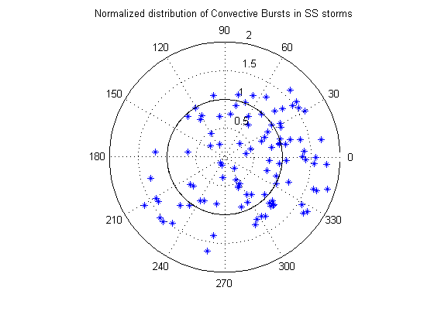
What is the preferred azimuthal location?
Doppler composite convective burst (CB) distribution and structure and Intensity Change
IN
Shear
SS
Shear
(courtesy Josh Wadler, Univ. Oklahoma)

Slide 19
PRECIPITATION CHARACTERISTICS
Symmetry Index (Alvey et al. 2015)
PMW
Mean 85-91 GHz (pixels ≤ 250 K) PCT
Mean IR T_{B}
(1)
In each quadrant
(2)
Subtract the means for each quadrant pair and sum the differences
(DSR-DSL)+(DSR-USL)+(DSR-USR)….
Departure from Symmetry [K]
Day
IR
Although still asymmetric during RI, increase in precipitation symmetry during intensification
Deep convection predominantly asymmetric (left of shear) throughout

Slide 20
3. What controls the (radial, azimuthal) location?
Radial location
  PBL convergence
  updraft slope
  outer-core inertial stability
Azimuthal location
  storm motion
  vertical shear
  thermodynamic environment
  helicity

Slide 21
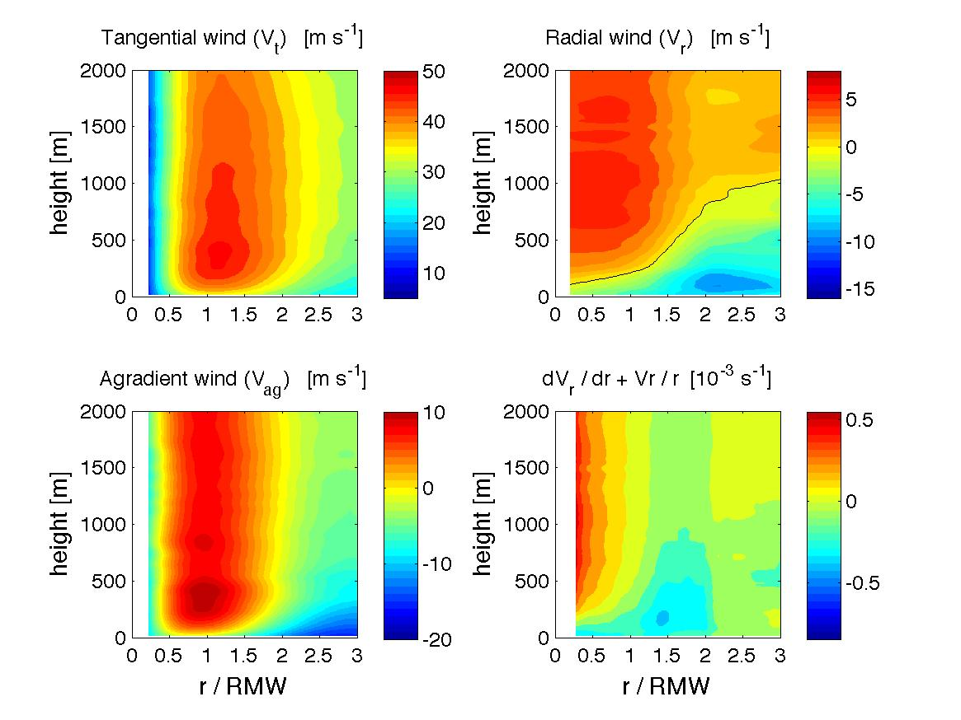
3. What controls the radial location?
PBL convergence
PBL kinematic structures for Earl (2010) and Edouard (2014)
Earl
(RI)
r/RMW
r/RMW
r/RMW
Rogers et al. (2015)
Edouard
(SS)
r/RMW
r/RMW
r/RMW
Rogers et al. (2016, in review)
Edouard (SS) had a shallower, weaker inflow than Earl (RI)
Radial location of peak convergence for Edouard closer to center than Earl

Slide 22
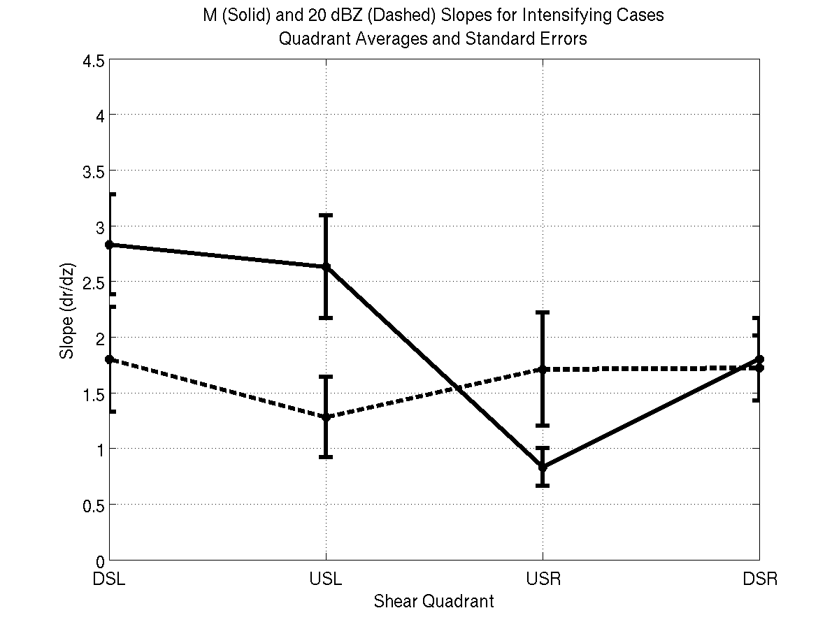
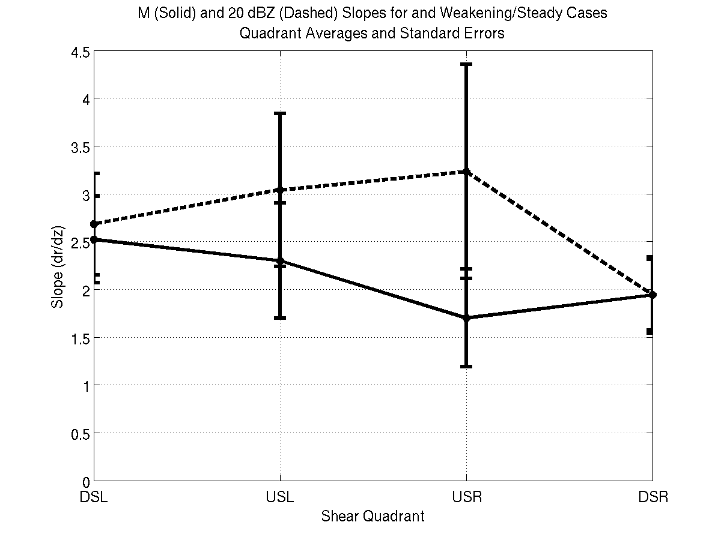
3. What controls the radial location?
Updraft slope
Slopes of reflectivity (dashed) and M (solid) radar composites as a function of shear-relative quadrant
4.5
Intensifying
4.5
Steady-state
4
4
3.5
3.5
dBZ
slope (dr/dz)
3
M
slope (dr/dz)
3
2.5
2.5
M
2
2
1.5
dBZ
1.5
1
1
0.5
0.5
DSL
USL
USR
DSR
DSL
USL
USR
DSR
Shear-relative quadrant
Shear-relative quadrant
Schematic of slope differences left of shear
(Hazelton et al. 2014)
Intensifying
Steady-state
M
M
20 dBZ
20 dBZ
RMW_{2km}
RMW_{2km}

Slide 23
3. What controls the radial location?
Outer core inertial stability

Slide 24
3. What controls the azimuthal location?
Storm motion

Slide 25
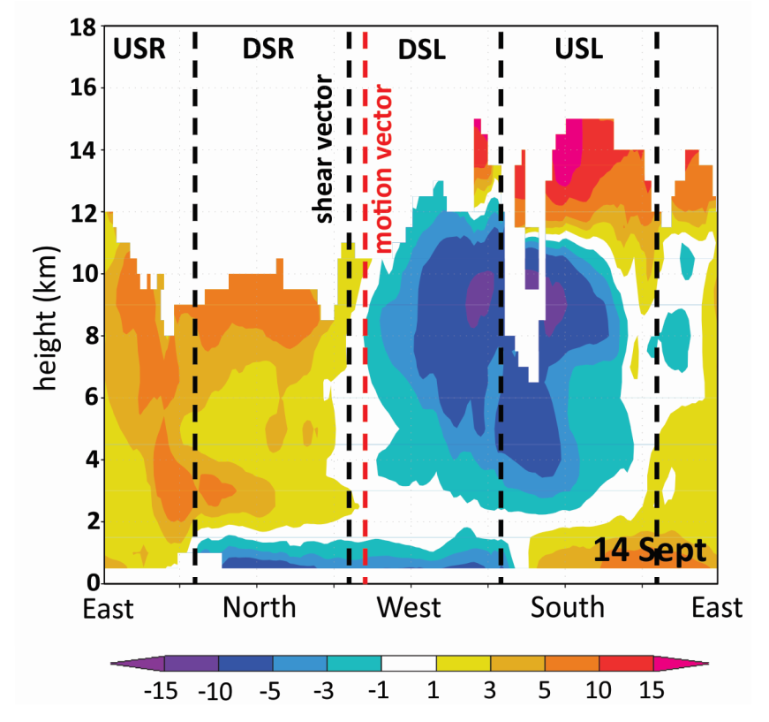
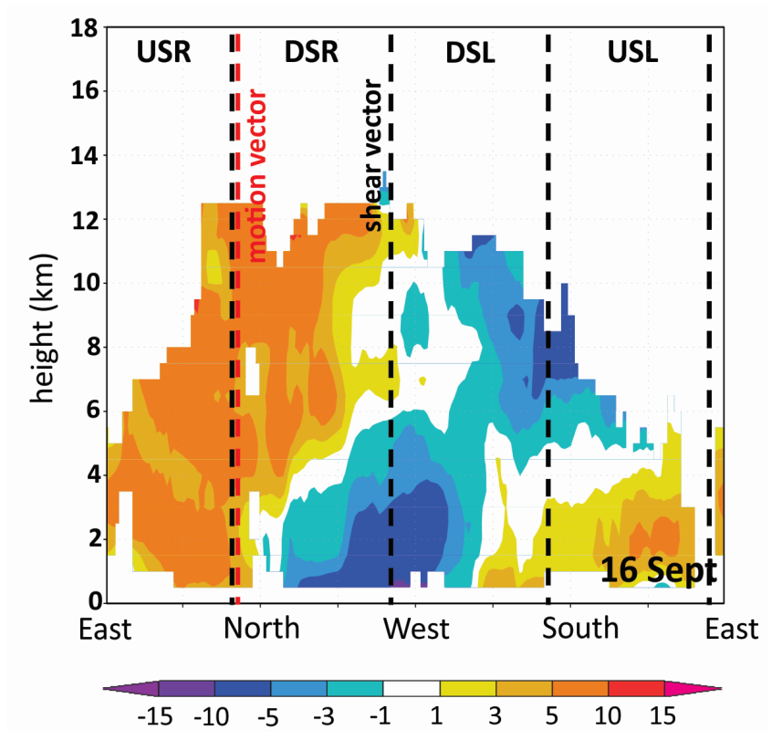
3. What controls the azimuthal location?
Vertical shear
Variation of radial flow around Edouard outside RMW
Azimuth-height plots of storm-relative radial flow (shaded, m/s) in 40-60 km radial band
outflow
inflow
outflow
inflow
inflow
(Rogers et al. 2016, In review)
Clear wavenumber-1 pattern consistent with shear-modulated secondary circulation
Low-level inflow from NE around to W sides (DSR, DSL)

Slide 26
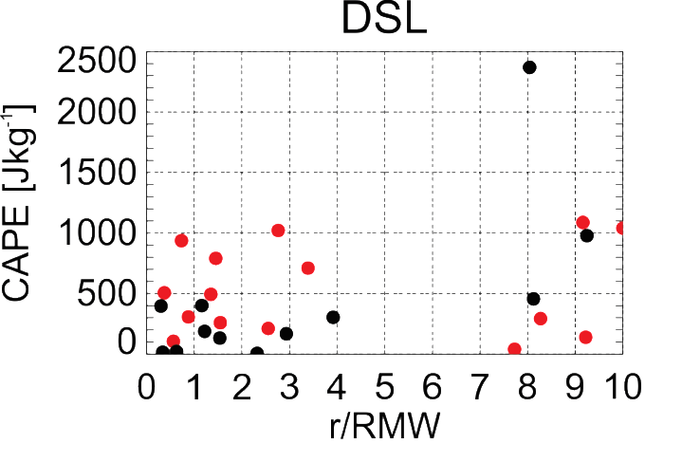
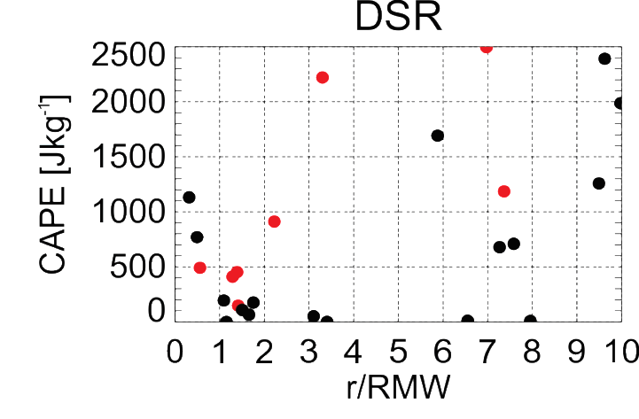
3. What controls the azimuthal location?
Thermodynamic environment of Edouard
SST (shaded, C) and SST anomaly (contour, C)
CAPE from GH sondes outside RMW
DSR
Sept 14-15 (RI)
Sept 16-17 (PEAK)
DSL
14 September
(RI)
USR
USL
DSR
USR
16 September
(SS)
DSL
USL
(Zawislak et al. 2016, In review)
14 Sept: High SST downshear, around storm
  Some points with CAPE downshear of 1000-2500 J/kg
16 Sept: Pronounced cooling USL, USR
Most CAPE values downshear < 500 J/kg

Slide 27
3. What controls the azimuthal location?
Helicity

Slide 28
Can this process be predicted?

Slide 32
Key findings
Increased coverage of deep convection upshear left associated with RI
Radial location of deep convection determined by radial flow, convergence downshear
Forcing and local environment of deep convection key in determining its role in RI – determining whether convection is symmetrically distributed and primarily inside RMW
  SST, recovery of PBL from downdraft cooling, and CAPE
  Relative humidity
  Shear
  Helicity
  Inertial stability
Questions and future work
What determines distance inflow and convergence penetrate inside RMW?
Efficiency arguments vs. alternate interpretations, e.g., angular momentum advection in frictional boundary layer?
Alternate modes of precipitation (shallow, moderate convection, stratiform)?
Combined aircraft, satellite, lightning networks
  Higher temporal resolution than considered here
Modeling studies
  High temporal resolution
  Thermodynamic and kinematic fields
  Trajectory calculations

Slide 33
Extra slides

Slide 34
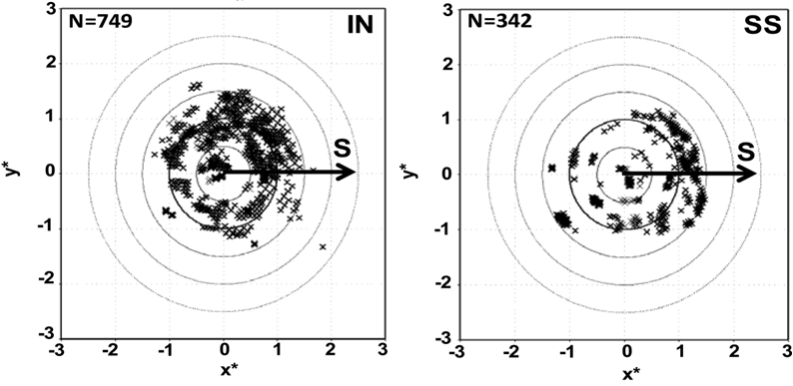
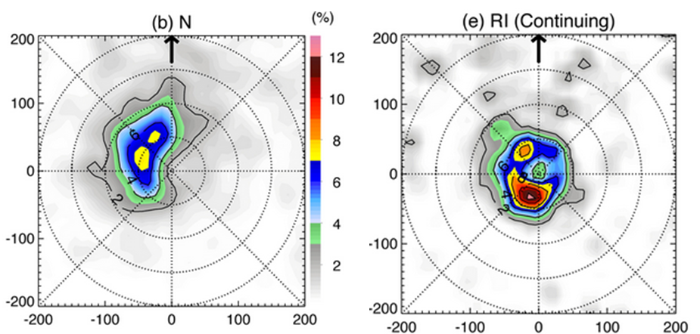
Motivation
Recent aircraft and satellite composite studies of intensifying TC’s have focused on radial and azimuthal distribution of deep convection
  Preferred radial location inside RMW
Location of convective bursts from P-3 airborne Doppler
RMW
RMW
Rogers et al. 2013
  Preferred azimuthal location downshear, upshear left
Location of percent occurrence of 10-km reflectivity > 20 dBZ from TRMM PR
RI (contin)
N
DSL
shear
DSR
shear
USL
USR
Zagrodnik and Jiang 2014

Slide 35
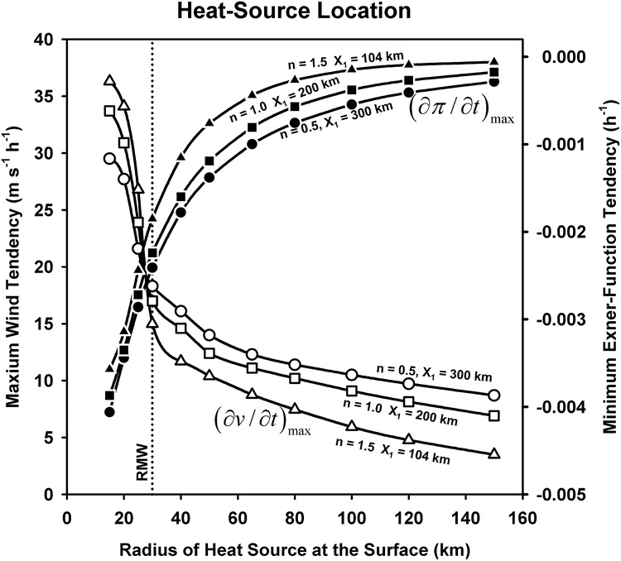
Motivation and background
Analytic studies of diabatic heating and its role in TC intensification
heating outside RMW
diabatic heating
heating inside RMW
diabatic heating
Vigh and Schubert 2009
Pendergrass and Willoughby 2009
Radial location of heating key determinant of subsequent intensity change

Slide 36
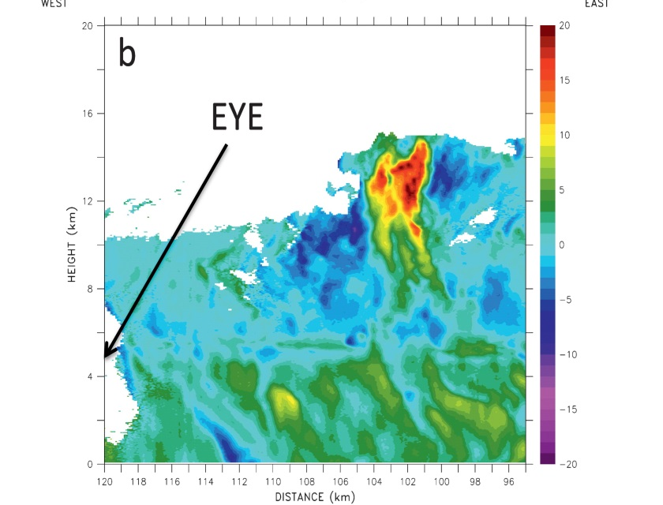

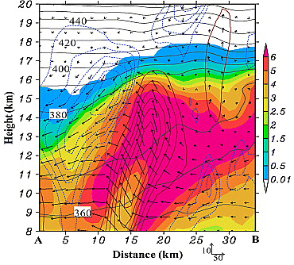

Slide 37
VHT slide here

Slide 38
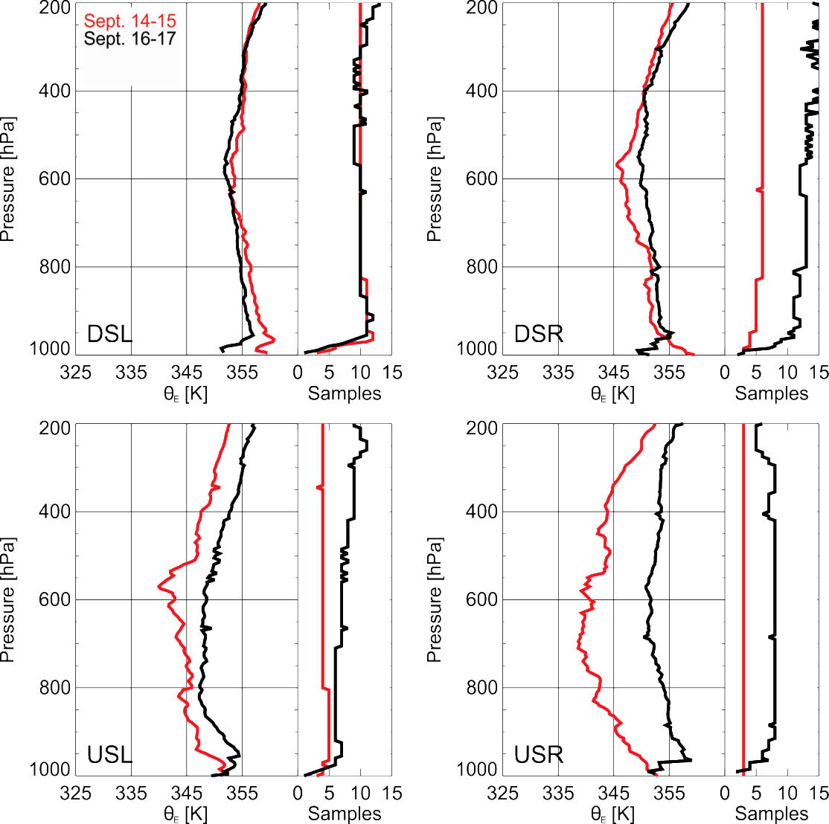
2. What governs distributions?
Shear-relative vertical profiles of θ_{e} from Global Hawk drops from 0-200 km radius
14 Sept: Low stability in lower troposphere in all quadrants
  Stabilization in PBL DSL, recovered by USR, DSR
16 Sept: Stabilization aloft, especially USL, USR
    Stabilization of PBL in all quadrants

Slide 39
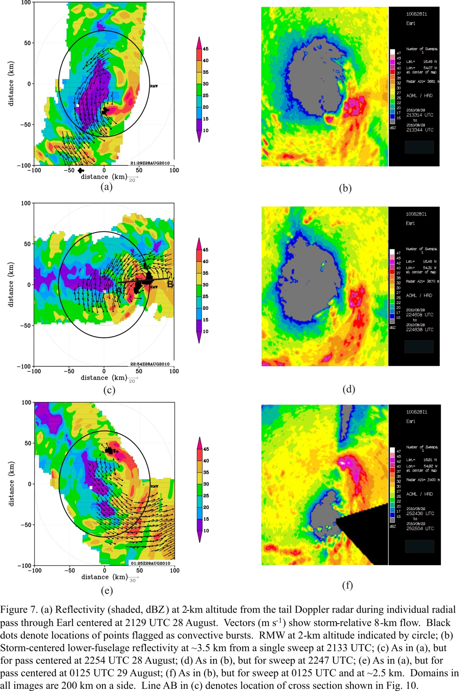

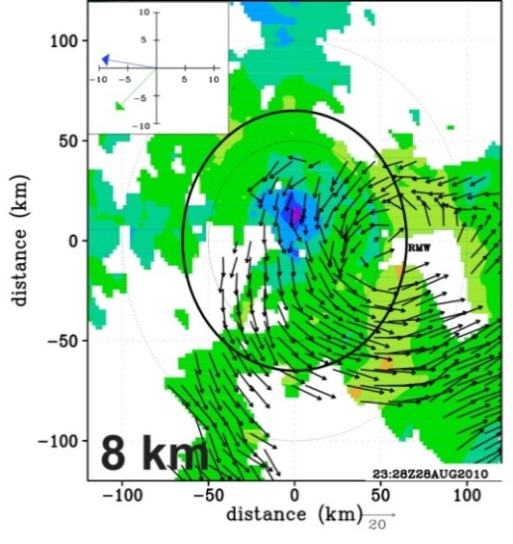


RI onset: Convective bursts and vortex alignment
Reflectivity (shaded, dBZ) from lower fuselage radar at ~ 3 km
100
47
45
50
42
40
shear
shear
shear
37
distance (km)
35
32
0
30
27
25
22
20
-50
17
15
dBZ
-100
-50
21:29 UTC Aug 28
-50
22:54 UTC Aug 28
01:25 UTC Aug 29
0
50
-100
0
50
100
-50
-100
100
distance (km)
-100
0
50
100
distance (km)
distance (km)
2-km wind speed (shaded, m s⁻¹) and 8-km wind vectors from airborne Doppler (m s⁻¹)
motion
motion
shear
shear
00 UTC Aug 29
12 UTC Aug 29
Rogers et al. 2014
Displaced circulation center during first flight
Convective bursts tracked around storm left of shear vector during first flight, inside RMW; evolution supported by lightning data (not shown)
RI began ~ 6 h after end of first flight
Vortex had aligned by time of second flight
Notes:
Circulation center at 8 km ~50 km displaced southeast of 2-km center during first mission, left of shear
Convective bursts evident inside RMW, tracks around left of shear side of storm during first mission

Slide 40
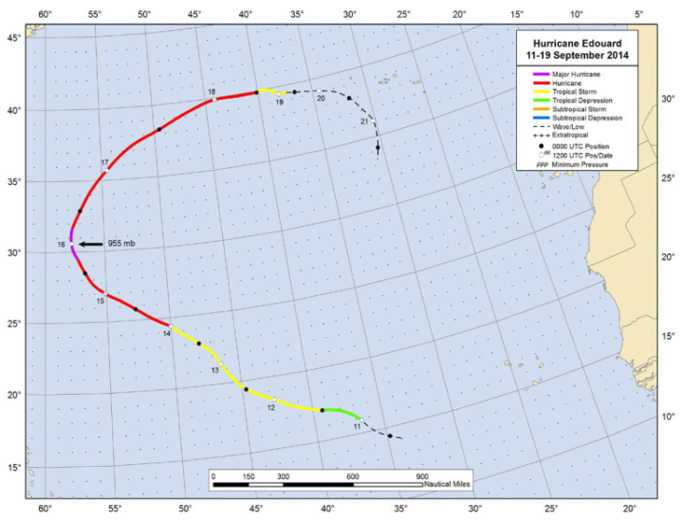
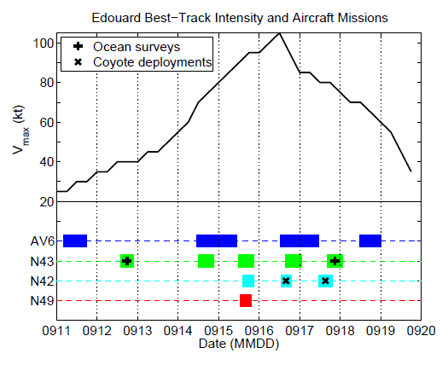
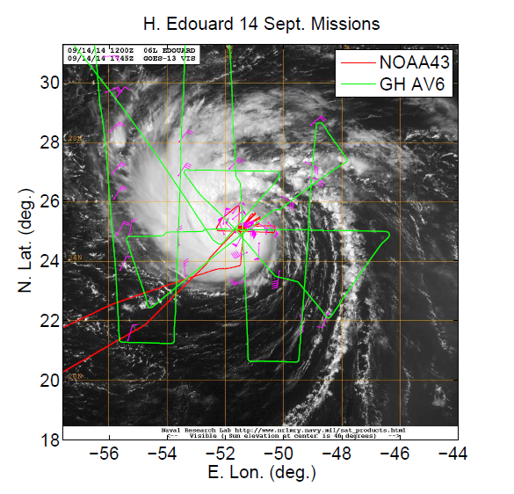
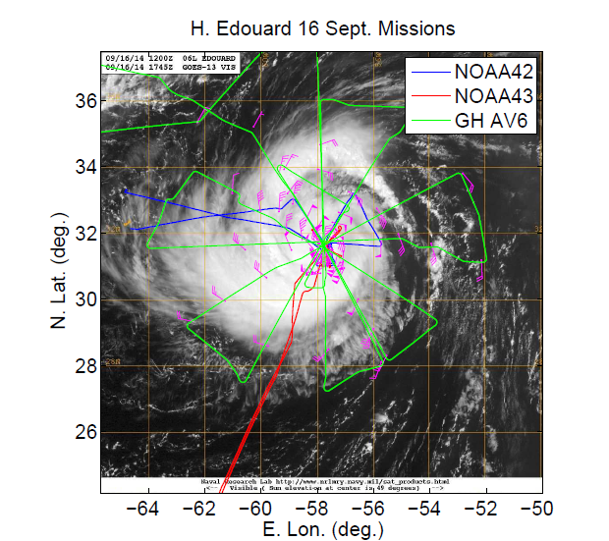
Overview of dataset
Flight tracks and times vs. intensity
16 Sept
14 Sept
Focus will be during joint N43/AV6 missions on 14 Sept and 16 Sept
Storm was intensifying during 14 Sept mission, slowly weakening during 16 Sept mission

Slide 41
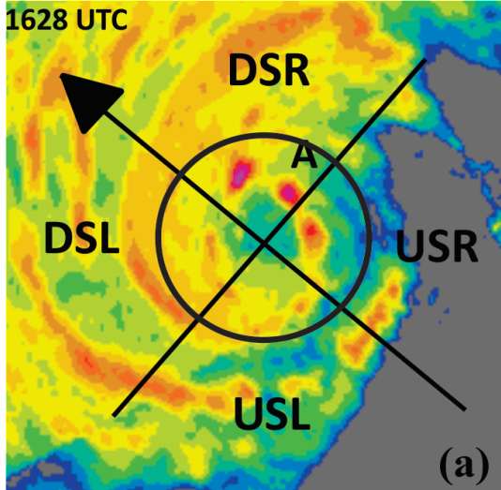


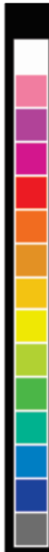



distance (km)
Distribution of precipitation
72
72
72
36
36
36
distance (km)
distance (km)
distance (km)
0
0
0
47
-36
RMW
-36
-36
45
42
40
-72
37
-72
-36
0
36
72
-72
-72
35
distance (km)
-72
-36
0
36
72
-72
-36
0
36
72
32
distance (km)
distance (km)
30
72
72
72
27
25
36
22
36
36
20
17
distance (km)
distance (km)
distance (km)
15
0
0
0
dBZ
-36
-36
-36
-72
-72
-72
-72
-36
0
36
72
-72
-36
0
36
72
-72
-36
0
36
72
distance (km)
distance (km)
distance (km)
Most of highest reflectivity concentrated on SW, S sides of storm (ranging from DSL to USL)
Individual cells seen developing on N side, translating around toward SW on 14 Sept
High reflectivity also seen on SW side during 16 Sept mission

Slide 42
Vortex structure
Wind speed (shaded, m/s) and vectors (m/s)
14 Sept
16 Sept
55
55
50
50
45
45
40
40
35
35
30
30
25
25
20
20
15
15
10
10
8 km
5
5
8 km
55
55
50
50
45
45
40
40
35
35
30
30
25
25
20
20
15
15
10
10
2 km
5
5
2 km
Very little tilt during both days
2-km RMW ~30 km for both days
Broader circulation at 2 km on 16 Sept

Slide 43
Radial distribution: PBL kinematic structures for Earl (2010) and Edouard (2014)
Earl
Edouard
Green – N42
Magenta – C130
Red – DC8
Black – GIV
Blue – N43
Green – N42
Red – GH
RMW
RMW
RMW
RMW
Similar coverage of dropsondes, especially outside the RMW, for Earl and Edouard
This was by design for the GH mission on 9/16

Slide 44
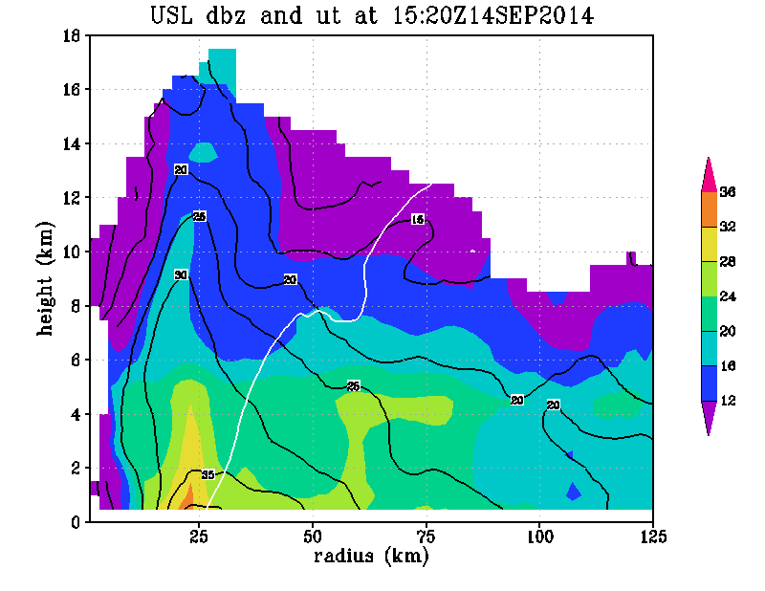
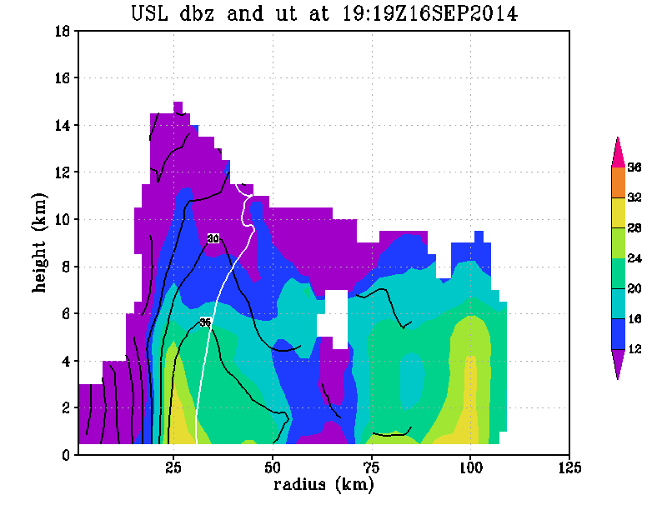
Convective structure within context of vortex structure
Radius-height quadrant averages of reflectivity (shaded, dBZ), tangential wind (contour, m/s) and M surface passing through 2-km RMW (solid) and axis of peak reflectivity (dashed) for upshear-left quadrant
14 Sept
16 Sept
dBZ
36
36
32
dBZ
32
28
28
24
M
24
M
20
20
16
16
12
12
Deep layer of high reflectivity in USL quadrant on 9/14
Inward-sloping RMW below 10 km, coincident with reflectivity axis
Significant difference in slope of dBZ and M surfaces during intensifying phase
For 16 Sept, shallower reflectivity in USL quadrant, dBZ and M surface slopes closer to each other
Similar to Doppler composite results of Hazelton et al. (2015), Earl case study of Rogers et al. (2015)

Slide 45
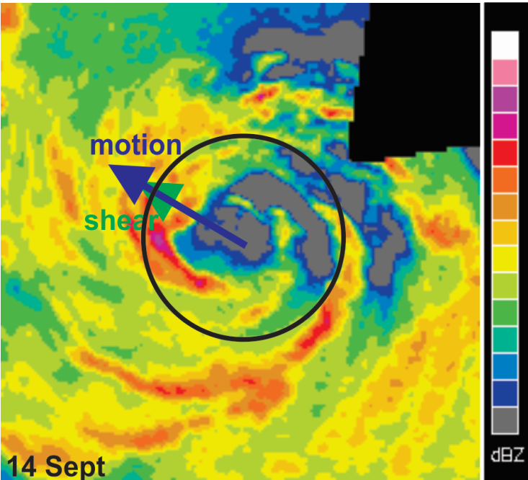

1. Do we see a similar distribution for deep convection?
P-3 lower fuselage (LF) images at ~2.5 km altitude
72
72
47
47
45
45
36
42
36
42
40
40
distance (km)
37
distance (km)
37
35
35
0
RMW
32
0
32
30
RMW
30
27
27
25
25
22
22
-36
20
-36
20
17
17
15
15
dBZ
dBZ
-72
72
-72
-72
-36
0
36
-72
-36
0
36
72
distance (km)
distance (km)
1746 UTC 14 September (RI)
2124 UTC 16 September (PEAK)
Precipitation generally DSL at and inside RMW on both days
More azimuthal coverage of precipitation on 14 September
More precipitation inside RMW on 14 September

Slide 46
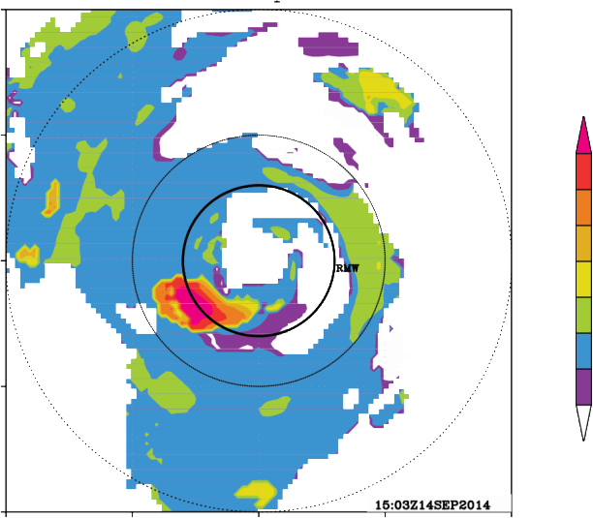



1. Do we see a similar distribution for deep convection?
Echo tops and updraft strength from airborne Doppler
Height (km) of 20-dBZ echo tops
Peak vertical velocity (m/s) in 8-16 km layer
100
100
DSR
DSR
8
50
16
50
5
14
3
distance (km)
DSL
12
distance (km)
DSL
2
1503 UTC
14 September
(RI)
0
10
0
1
USR
USR
0.5
8
-0.5
6
-1
-50
USL
4
-50
USL
-2
2
-3
-5
-100
-8
-100
-50
0
50
100
-100
-50
0
50
100
-100
distance (km)
distance (km)
100
100
DSR
DSR
8
50
16
50
5
distance (km)
14
3
1946 UTC
16 September
(PEAK)
USR
12
distance (km)
USR
2
0
10
0
1
8
0.5
DSL
6
DSL
-0.5
4
-1
-50
USL
2
-50
USL
-2
-3
-5
-100
-100
-8
-100
-50
0
50
100
-100
-50
0
50
100
distance (km)
distance (km)
14 Sept: Deep convection (echo tops > 16 km, updrafts > 7 m/s) on SW side (DSL, USL)
Strong updrafts and high echo tops generally at and inside 2-km RMW
16 Sept: Very small area of echo tops > 10 km, nothing reaching 12 km

Slide 47
Azimuthal Variation in Burst Structure and Intensity Change
97% 95% 98% 97% 95%
One-sided t-test significance level
Error bars are standard error
Intensifying storms have stronger updrafts, at a higher altitude, with higher echo tops in the upshear left quadrant compared with steady-state storms

Slide 48


3. What controls the location? PBL convergence
Low-level kinematic fields in DSR quadrant for Edouard
Tangential (contour, m/s) and radial flow (shaded, m/s)
Vertical velocity (contour, m/s) and divergence (shaded, x10⁻³ s⁻¹)
4
4
3
4
5
3
3
3
height (km)
2
height (km)
2
14 September
(RI)
1
1
2
0.5
2
0.5
0
-0.5
-0.5
-1
1
-1
-2
-2
1
-3
-3
-5
-4
0
10
20
30
40
50
60
70
80
90
0
10
20
30
40
50
60
70
80
90
radius (km)
radius (km)
4
4
3
4
3
5
height (km)
3
height (km)
3
2
2
1
1
16 September
(SS)
2
0.5
2
0.5
0
-0.5
-0.5
-1
1
-1
1
-2
-2
-3
-3
-5
-4
0
10
20
30
40
50
60
70
80
90
0
10
20
30
40
50
60
70
80
90
radius (km)
radius (km)
14 Sept: Inflow penetrates further inward, inside RMW
PBL convergence, updrafts maximized inside RMW
16 Sept: Inflow, convergence, updrafts further outward at and outside RMW

Slide 49


3. Consequences for Intensity Change?
Vertical velocity and inertial stability in DSL, USL quadrants
Vertical velocity (shaded, m/s) and inertial stability (contour, x 10⁻⁷ s⁻²)
18
16
14
12
2.5
height (km)
2
14 September
(RI)
10
1.5
8
1
0.5
6
0
4
-0.5
-1
2
90
80
70
60
50
40
30
20
10
10
20
30
40
50
60
70
80
90
radius (km)
radius (km)
18
16
14
2.5
height (km)
12
2
16 September
(PEAK)
10
1.5
8
1
0.5
6
0
4
-0.5
-1
2
90
80
70
60
50
40
30
20
10
10
20
30
40
50
60
70
80
90
radius (km)
radius (km)
14 Sept: Strong upper-level updrafts in both quadrants, coincident with high I
16 Sept: Strong upper-level updrafts DSL, weak USL, in weaker-I environment

Slide 50


3. What controls the location? PBL convergence
Comparison of HWRF composites using strong and weak PBL vertical mixing
Low-level divergence
strong mixing
Vertical velocity (weak - strong)
weak mixing
Weak mixing (closer to observations):
  better HWRF RI forecasts
  stronger PBL convergence, closer to center
  stronger updrafts inside RMW

Slide 51

3. What controls the location? Updraft slope
Downshear vertical velocity (shaded, m s⁻¹) and tangential wind (contour, m s⁻¹)
12
12
11
peak w
(RI)
11
(SS)
10
10
peak w
9
M surface
2.4
9
M surface
2.4
8
2
8
2
7
1.6
7
1.6
height (km)
1.2
height (km)
1.2
6
0.8
6
0.8
5
0.4
5
0.4
4
0
4
0
3
-0.4
3
-0.4
2
-0.8
2
-0.8
1
12 UTC Aug 30 2010
1
00 UTC Sep 1 2008
0
25
50
75
100
125
0
25
50
75
100
125
radius (km)
radius (km)
Updraft core originates inside RMW for both cases
Slope of updraft core departs from M surface for Earl, parallels M surface for Gustav
Peak heating inside local RMW for Earl, outside for Gustav
Notes:
Updraft core originates from PBL inside RMW for both cases
Slope of updraft core departs signficantly from M surface for Earl, closer to M surface for Gustav
Updraft core inside local RMW, in high inertial stability regime for Earl, outside local RMW for Gustav
Relationship consistent with composite slope results from Hazelton et al. (17C.7, Fri. 3:00 pm talk)

Slide 52

USL eyewall w CFAD from Earl (2010)

