Slide 1
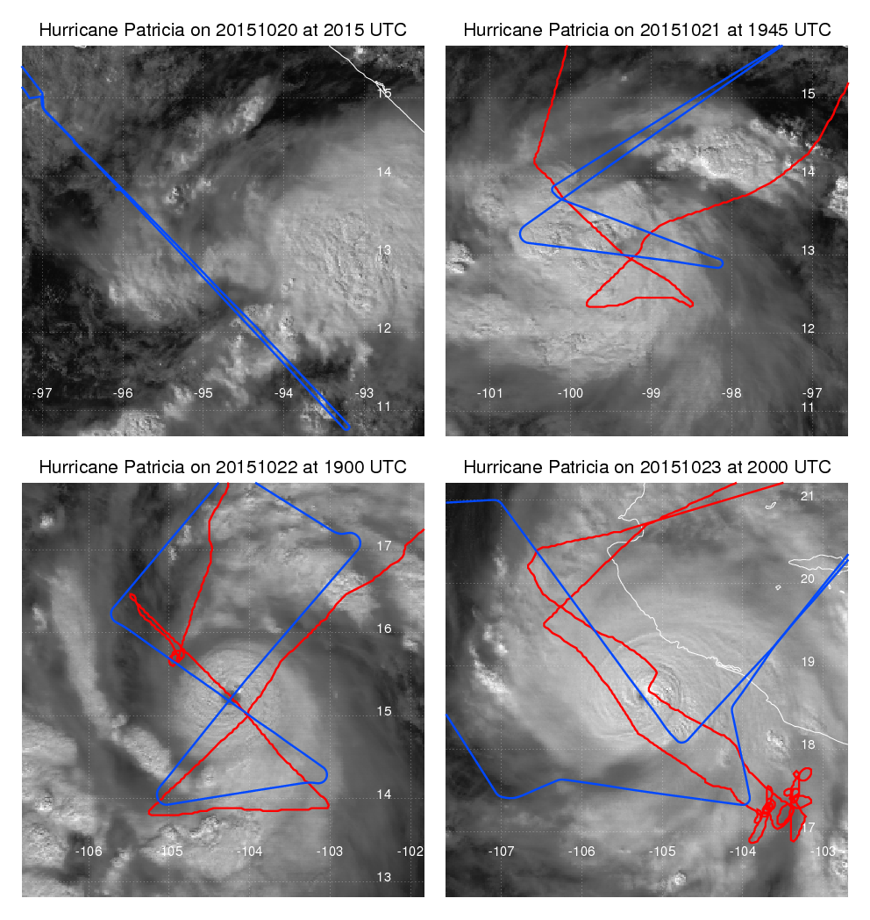
Flight tracks and visible satellite imagery. Blue is WB-57, red is P-3.

Slide 2
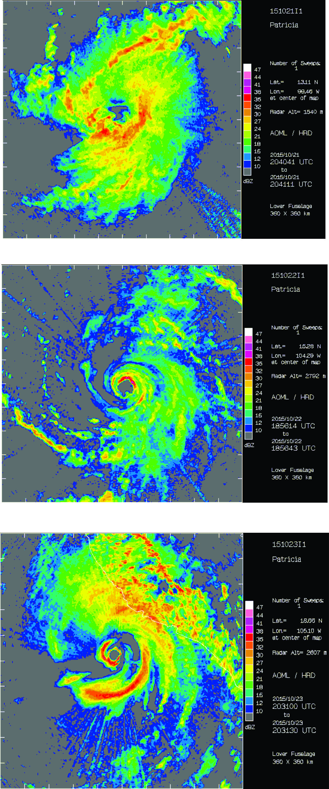
P-3 lower fuselage reflectivity at ~1.5 km altitude (Oct. 21) and ~2.8 km (Oct. 22-23). Domains are 360 km on a side.

Slide 3
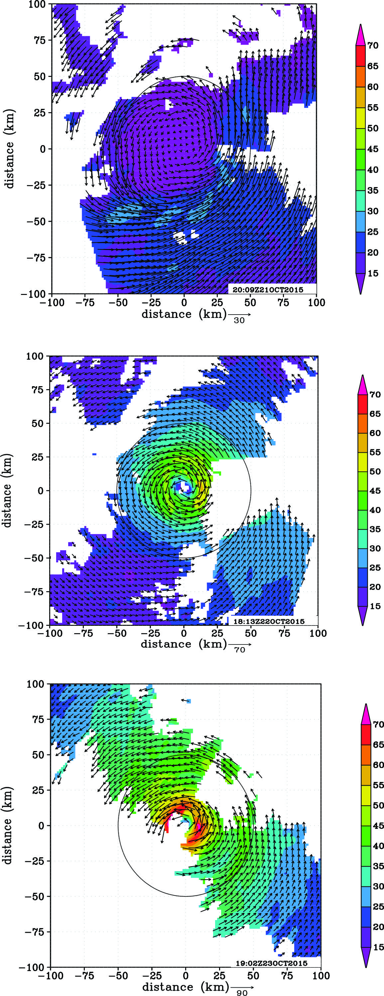
Storm-relative wind speed (shaded, m/s) and wind vectors at 2-km altitude for Oct. 21-23.

Slide 4
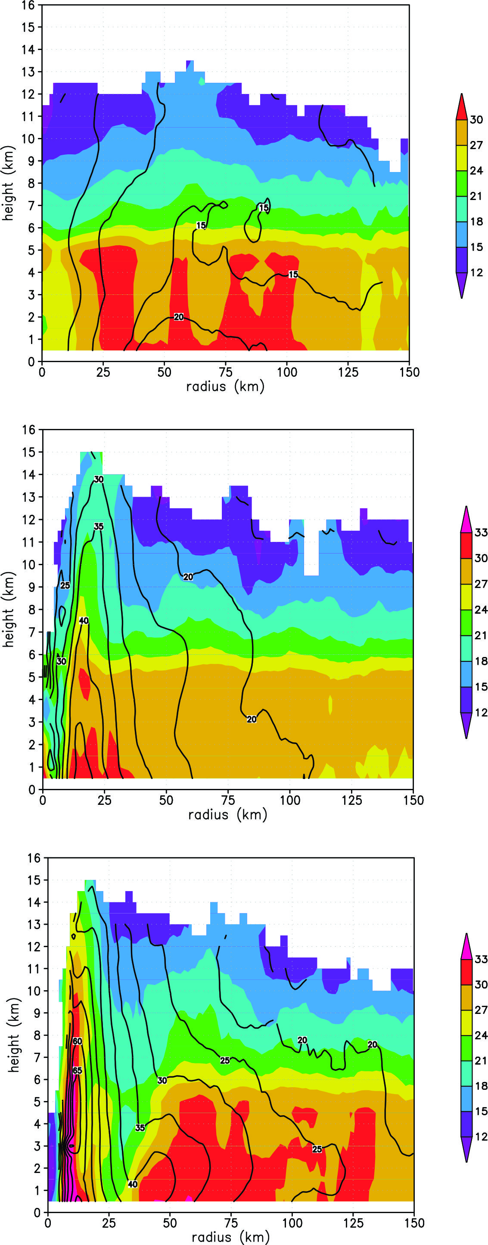
Azimuthally-averaged reflectivity (shaded, dBZ) and tangential wind (contour, m/s) for Oct. 21 (top) to Oct. 23 (bottom).

Slide 5
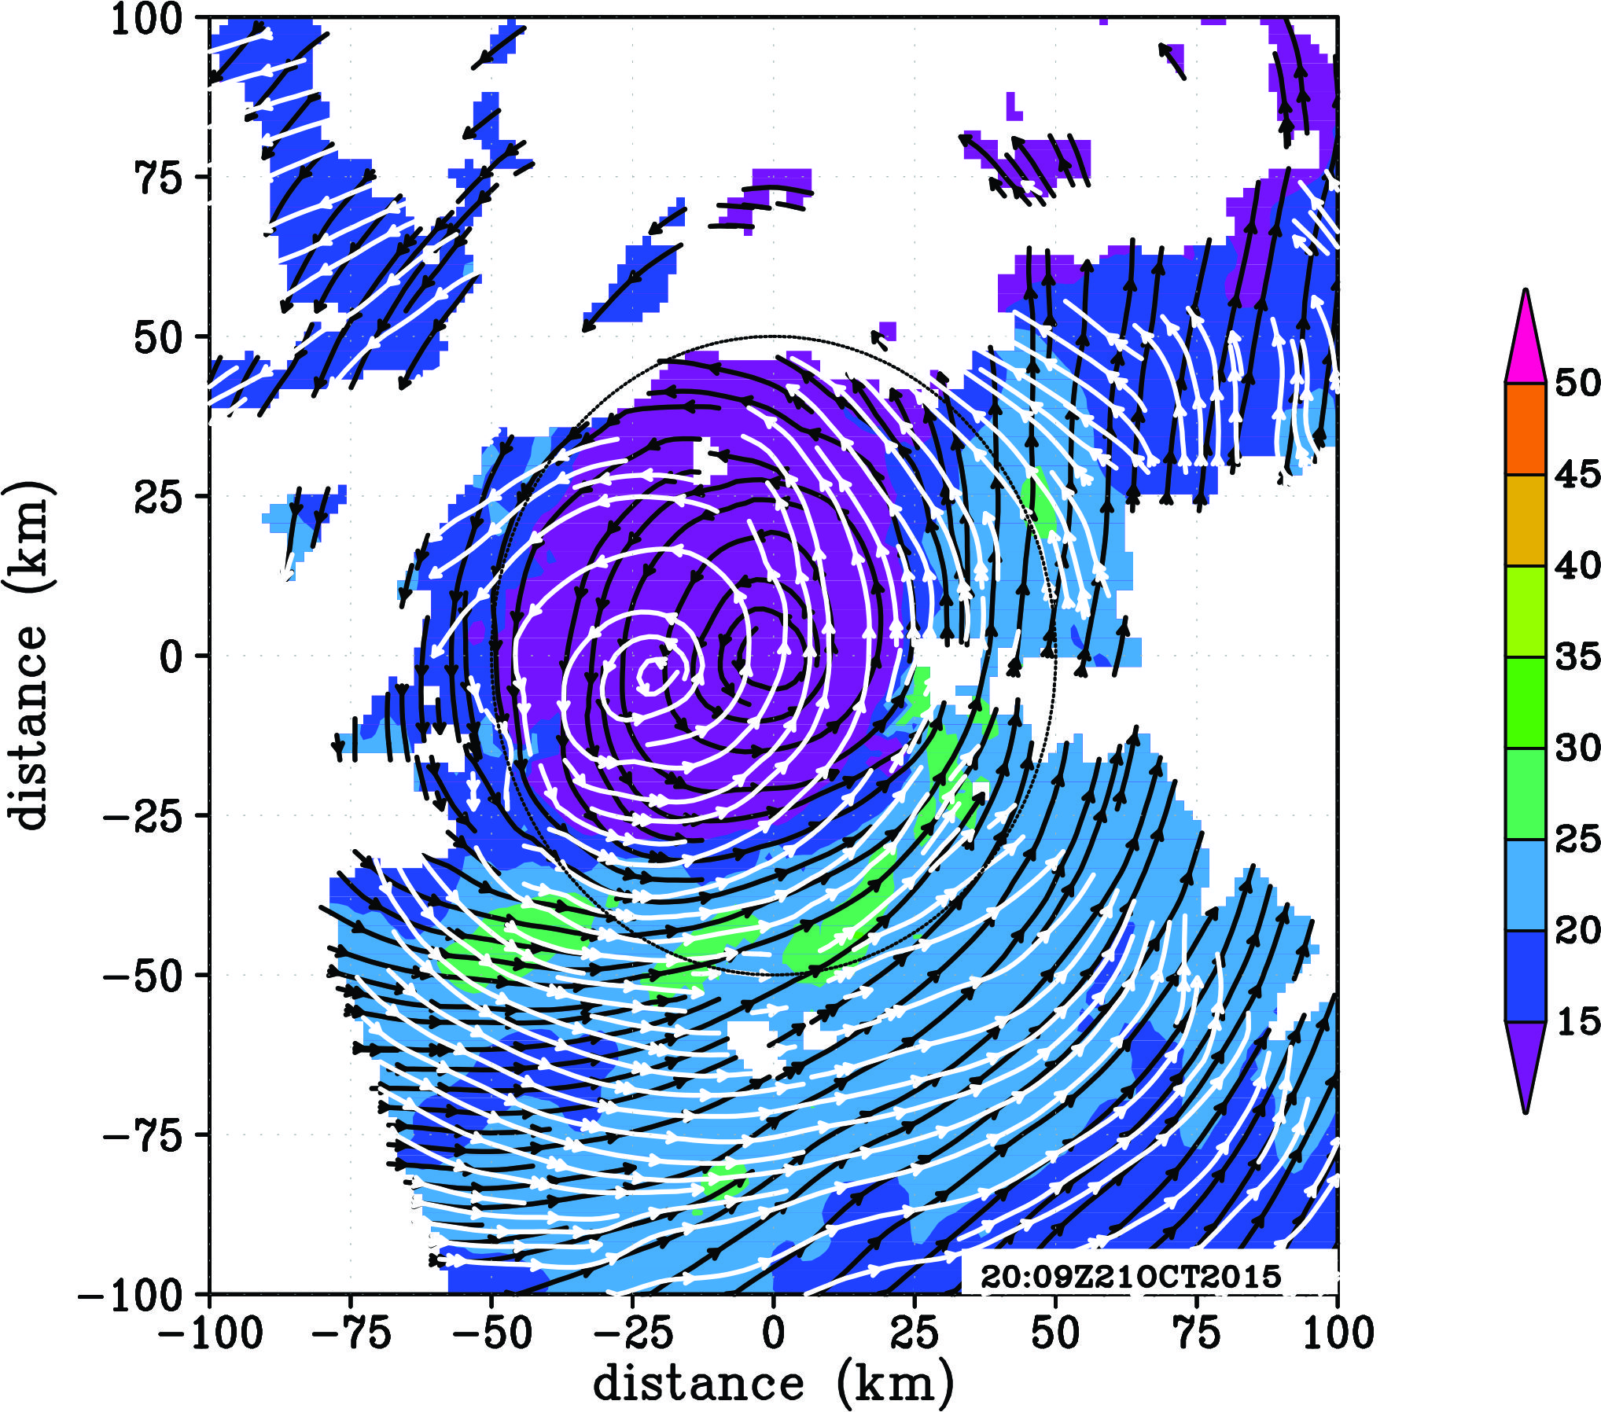
Storm-relative wind speed at 2-km altitude (shaded, m/s) and streamlines of storm-relative flow at 2 km (black lines) and 8 km (white lines) on Oct. 21.

Slide 6
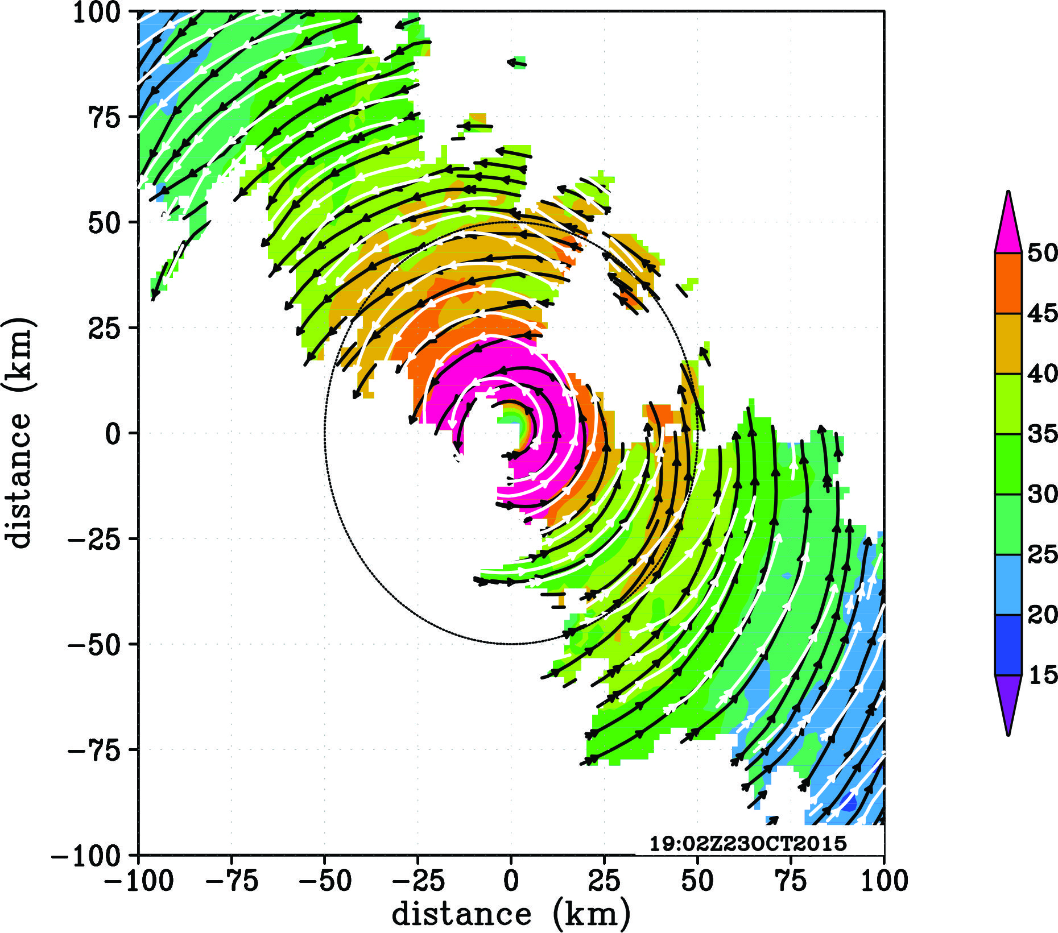
Storm-relative wind speed at 2-km altitude (shaded, m/s) and streamlines of storm-relative flow at 2 km (black lines) and 8 km (white lines) on Oct. 23.

