Slide 1
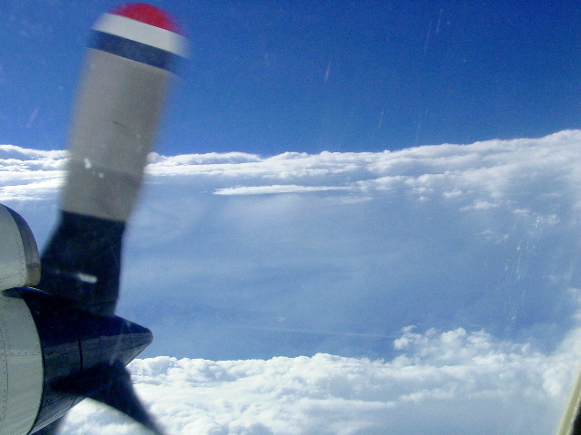
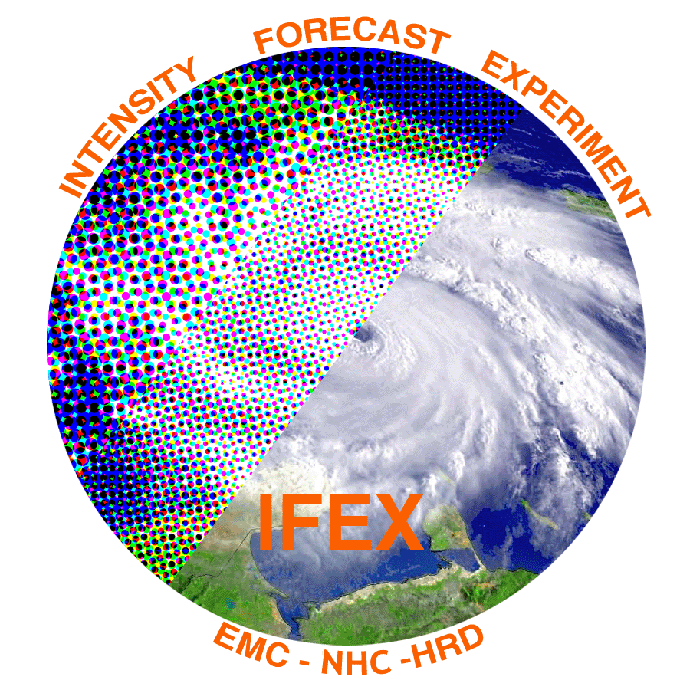
Multiscale kinematic structure and evolution of Hurricane Edouard from 14-­16 September using Global Hawk dropsondes and P-­3 airborne Doppler radar
Robert Rogers¹, Jun Zhang^{1,2}, Jon Zawislak³, Eric Uhlhorn¹
¹NOAA/AOML Hurricane Research Division
²Cooperative Institute for Marine and Atmospheric Studies, University of Miami
³Florida International University
(thanks to Paul Reasor for performing the Doppler re-analyses)

Slide 2
Motivation
Work continues on investigating the inner-core vortex, convective, and boundary layer structure of TC’s and how they relate to intensity change
Recent aircraft studies have focused on radial distribution of deep convection
PBL structure may play a role in governing this distribution
Satellite studies emphasize azimuthal coverage of shallow, moderate convection
Azimuthal location of deep convection also identified as being important
These studies have suffered from a lack of deep-layer thermodynamic information
HS3 provided this information for Edouard (2014), which was sampled by the GH and P-3’s during intensifying and slowly-weakening phases
How did the structures in Edouard during these periods compare with previous studies?

Slide 3
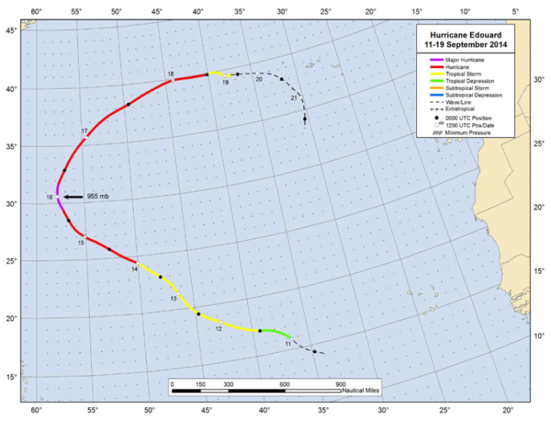
Overview of dataset
Flight tracks and times vs. intensity
16 Sept
14 Sept
Focus will be during joint N43/AV6 missions on 14 Sept and 16 Sept
Storm was intensifying during 14 Sept mission, slowly weakening during 16 Sept mission

Slide 4
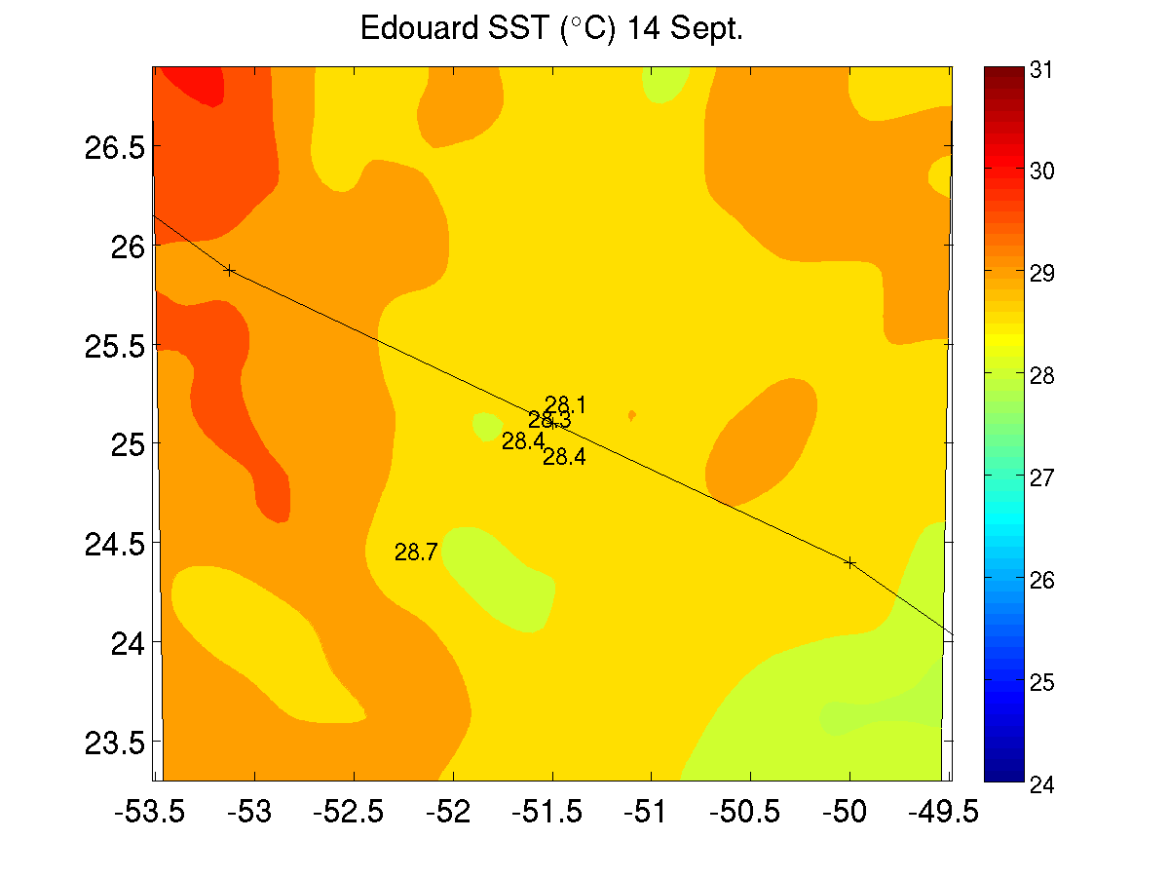
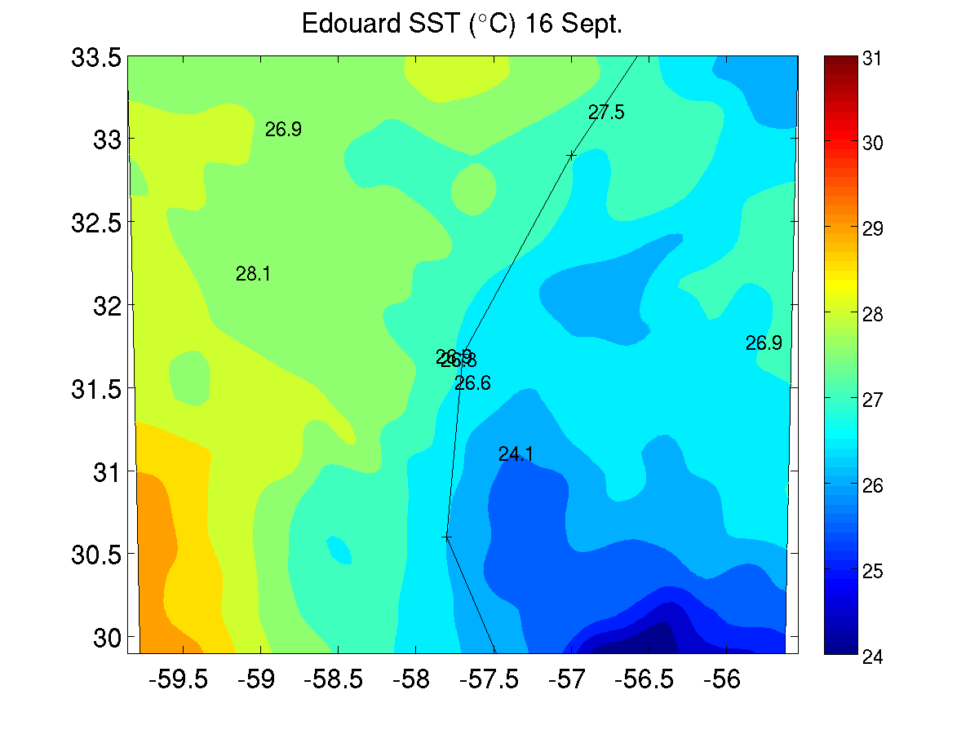
Environmental conditions
14 Sept
16 Sept
m/s
m/s
shear
motion
Storm motion and SHIPS shear vectors (m/s)
m/s
m/s
SST (⁰C) from MW and AXBT’s
Moderate SE shear during 14 Sept, weak E shear during 16 Sept
Motion nearly parallel during 14 Sept, perpendicular toward NNE during 16 Sept
SST > 28 C in front of storm on 14 Sept, cold wake effects on 16 Sept right of track

Slide 5
Vortex structure
Wind speed (shaded, m/s) and vectors (m/s)
14 Sept
16 Sept
8 km
8 km
2 km
2 km
Very little tilt during both days
Broader circulation at 2 km on 16 Sept

Slide 6
Reflectivity structure and evolution
Storm-centered lower-fuselage radar animations during 14 Sept and 16 Sept missions
*On-station altitude for aircraft is ~2.5 – 3 km
14 Sept
16 Sept
DSR
DSR
shear schematic
DSL
USR
USR
DSL
USL
USL
Most of highest reflectivity concentrated on SW, S sides of storm (ranging from DSL to USL)
Individual cells seen developing on N side, translating around toward SW on 14 Sept
High reflectivity also seen on SW side during 16 Sept mission

Slide 7
Reflectivity structure and evolution
Lower-fuselage radar images during 14 Sept and 16 Sept missions
14 Sept
16 Sept
1455 UTC
1852 UTC
1632 UTC
2057 UTC
1745 UTC
2123 UTC
DSR
DSR
DSL
USR
USR
DSL
USL
USL
Most of highest reflectivity concentrated on SW, S sides of storm (ranging from DSL to USL)
Individual cells seen developing on N side, translating around toward SW on 14 Sept
High reflectivity also seen on SW side during 16 Sept mission

Slide 8
Convective structure
Echo tops (shaded, km) and peak 8-14 km updrafts (contour, 3, 5, 7 m/s)
14 Sept
16 Sept
14 Sept
16 Sept
DSR
DSR
DSL
USR
USR
DSL
USL
USL
Deep convection, with echo tops > 16 km, seen during 14 Sept flight on SW side (DSL, USL)
Lower echo tops, but still > 10-12 km, seen 2.5 h later in similar location
Strong updrafts and high tops seen generally inside 2-km RMW on 14 Sept
By 16 Sept very small area of echo tops > 10 km, nothing reaching 12 km
Tallest echoes on SW side, some occurring outside 2-km RMW

Slide 9
Radial flow at the eyewall
Azimuth-height plots of storm-relative radial flow surrounding eyewall (20-40 km annular average)
14 Sept
16 Sept
18
DSR
DSL
USL
USR
18
USR
DSR
DSL
USL
16
shear vector
motion vector
16
motion vector
shear vector
14
14
12
12
height (km)
10
height (km)
10
8
8
6
6
4
4
2
2
0
0
North
West
South
East
East
North
West
South
East
East
Clear wavenumber-1 pattern seen in lower-tropospheric radial flow
Inflow from NE around to W sides (DSR, DSL); maximized on N side during both flights
Consistent with Doppler composites of Reasor et al. (2013) and SFMR/FL composites of Zhang and Uhlhorn (2012)

Slide 10
Shear-relative thermodynamic context for precipitation
Shear-relative vertical profiles of theta-e for GH drops from 0-200 km radius
DSR
DSL
USR
USL
DSR
USR
DSL
USL
High low-level theta-e DSR, DSL, decrease in thetae with height below 600 hPa in all quadrants on 14 Sept
Increase in theta-e and stabilization aloft, especially USL, USR, on 16 Sept
Stabilization of PBL on 16 Sept, strongest in USL, USR, weakest in DSL, DSR (consistent with Molinari et al. 2013, Zhang et al. 2013)

Slide 11
Comparison of PBL kinematic structures for Earl (2010) and Edouard (2014)
Earl
Edouard
Green – N42
Magenta – C130
Red – DC8
Black – GIV
Blue – N43
Green – N42
Red – GH
RMW
RMW
RMW
RMW
Similar coverage of dropsondes, especially outside the RMW, for Earl and Edouard
This was by design for the GH mission on 9/16

Slide 12
Comparison of PBL kinematic structures for Earl (2010) and Edouard (2014)
Earl
r/RMW
r/RMW
r/RMW
Edouard
r/RMW
r/RMW
r/RMW
Both storms showed supergradient flow, Edouard had a shallower, weaker inflow than Earl
Radial location of peak convergence for Edouard at ~1.5 x RMW, for Earl peak was at ~0.75 x RMW – could that explain difference in radial location of tallest echoes for Edouard and Earl?

Slide 13
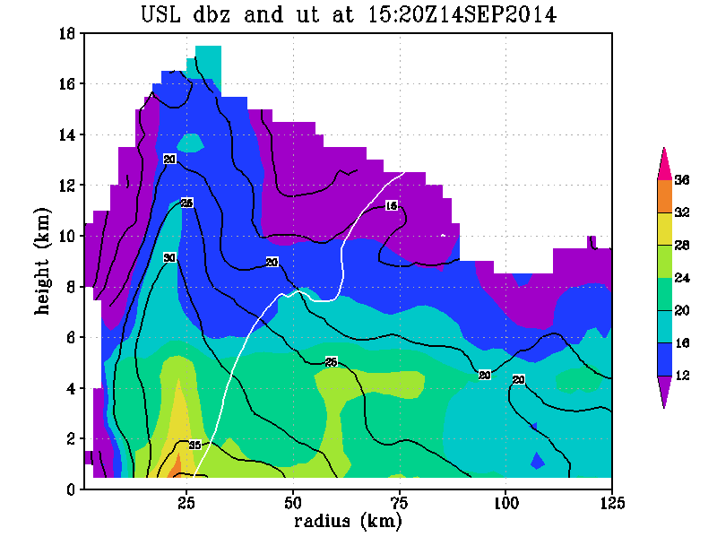
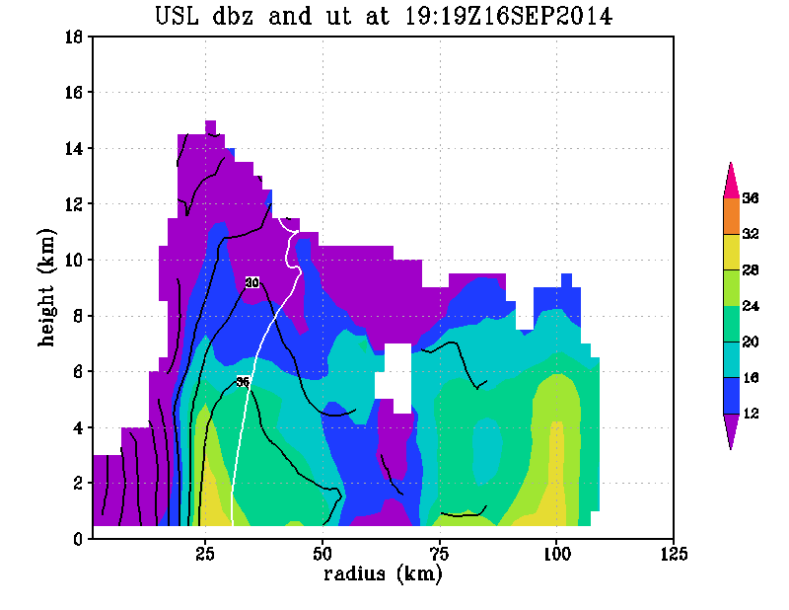
Convective structure within context of vortex structure
Radius-height quadrant averages of reflectivity (shaded, dBZ), tangential wind (contour, m/s) and M surface passing through 2-km RMW (solid) and axis of peak reflectivity (dashed) for upshear-left quadrant
14 Sept
16 Sept
Deep layer of high reflectivity in USL quadrant on 9/14
Inward-sloping RMW below 10 km, coincident with reflectivity axis
Significant difference in slope of dBZ and M surfaces during intensifying phase
For 16 Sept, shallower reflectivity in USL quadrant
dBZ and M surface slopes closer to each other
Similar to Doppler composite results of Hazelton et al. (2015), Earl case study of Rogers et al. (2015)

Slide 14
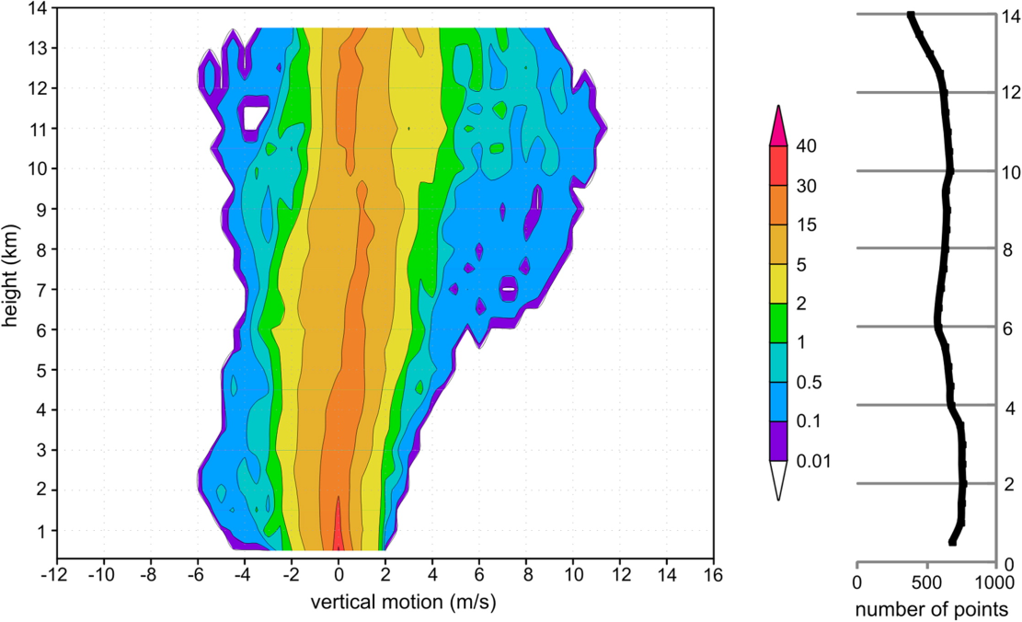

Slide 15
Extra slides

Slide 16
Shear-relative radial profiles of near-surface theta-e

Slide 17
Azimuth-height plots of storm-relative radial flow surrounding eyewall (20-40 km annular average)
DSR
DSL
USL
USR
USR
DSR
DSL
USL
shear vector
motion vector
motion vector
shear vector
height (km)
height (km)
E
N
W
S
E
E
N
W
S
E
Shear heading
Math angle – 123
Nav angle – 327
Mag – 13 kt
Motion heading
Math angle – 147
Nav angle – 303
Speed – 13 kt
Shear heading
Math angle – 161
Nav angle – 289
Mag – 5 kt
Motion heading
Math angle – 74
Nav angle – 16
Speed – 12 kt

