Slide 1
The Tropospheric Wind Lidar Technology Experiment (TWiLiTE):
Status and plans for HS3
Bruce Gentry, Matt McGill, Ryan Cargo, Bill Hart, Roman Machan, Dan Reed, Stan Scott, Shane Wake, David Wilkens, John Yorks
HS3 Science Team Meeting
October 19-20, 2010
Greenbelt, MD

Slide 2
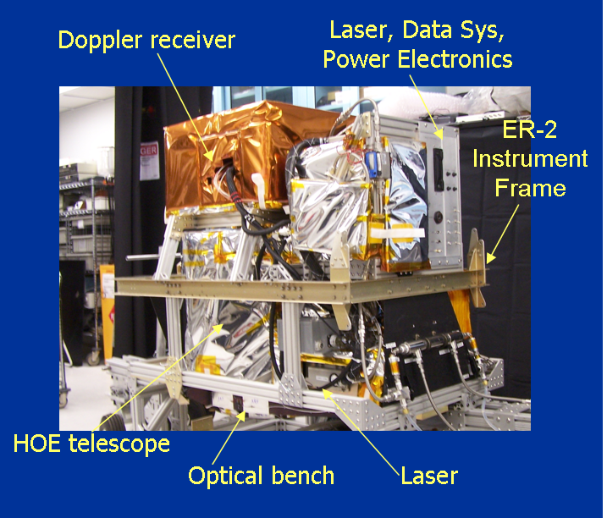
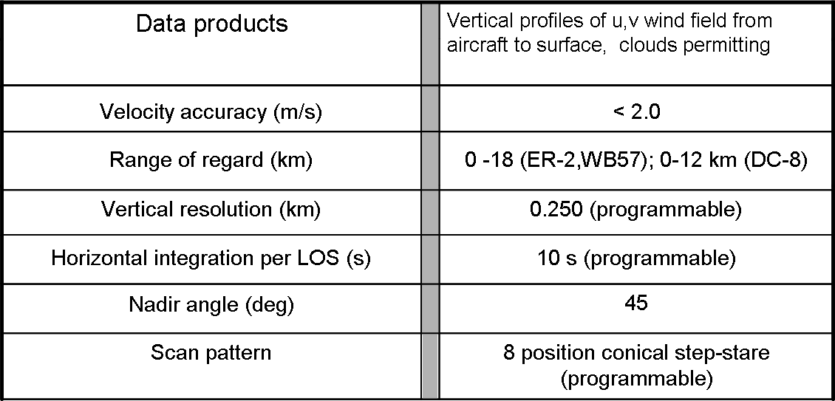
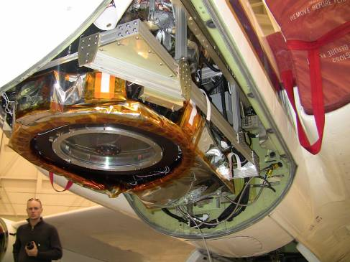
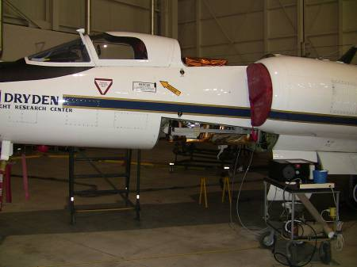
Tropospheric Wind Lidar Technology Experiment
(TWiLiTE) Instrument Incubator Program
The TWiLiTE instrument is a compact, rugged direct detection scanning Doppler lidar designed to measure wind profiles in clear air from 20 km to the surface.
TWiLiTE operates autonomously on NASA research aircraft (ER-2, DC-8, WB-57, Global Hawk).
Initial engineering flight tests on the NASA ER-2 in 2009 demonstrated autonomous operation of all major systems.
TWiLiTE will be reconfigured to fly on the NASA Global Hawk as part of the Hurricane and Severe Storm Sentinel Venture Class Mission.
TWiLiTE system configured for ER-2 QBay
TWiLiTE ER-2 Integration
September, 2009
Notes:
TWiLiTE is a 3 year technology development program funded by ESTO under the IIP.
TWiLiTE Supports the 3DWinds NRC Decadal Survey Mission. It represents the direct detection molecular or ‘clear air’ portion of the recommended ‘Hybrid Doppler lidar concept’. The coherent Doppler utilizes aerosol backscatter ahs complementery measurement capabilities and is the other half of the Hybrid concept.
The TWiLiTE Doppler lidar measures wind profiles by measuring the Doppler shift of the laser backscattered return from molecules in the atmosphere.
Designed to measure full profiles of horizontal winds from the flight altitude of the NASA ER2 (20 km) to the surface with 250 m vertical resolution and <2 m/s accuracy
Advances TRL of key technologies identified for future space missions e.g the single frequency uv NdYAG laser; the molecular Doppler receiver; Tunable fabry Perot etalon filter and the rotating conically scanned telescope.
These technologies were demonstrated at the system level in initial engineering flights of TWiLiTE on the NASA ER-2 high altitude aircraft in September, 2009. Exit TRL from the IIP is 5.
Additional flight tests of TWiLiTE on the ER-2 are planned for Fall, 2010.
TWiLiTE will be reconfigured to fly in the NASA Global Hawk as part of the Hurricane and Severe Storm Sentinel (HS3) Venture Class Mission.

Slide 3
Double Edge Measurement Principle
Molecular Channel at 355 nm
Δν_{DOP}
Aerosol
Edge Filter 1
Edge Filter 2
Molecular
Frequency

Slide 4
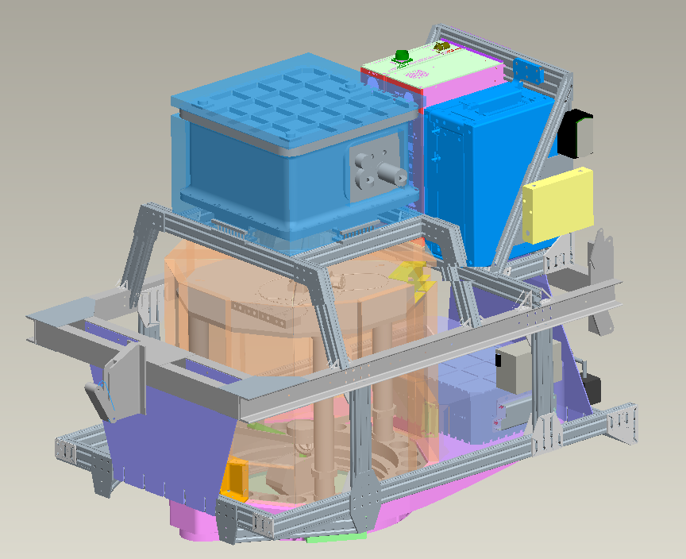
TWiLiTE Modular Assembly
2A
2B
1
2C
5
3
6
4
7
Doppler receiver (Notes: insulated pressurized box; vibration isolated from frame; on liquid cooling loop; weighs about 100 lbs)
A) Data system electronic box; B) power distribution box; C) laser electronics module (LEM)
Laser Optical Module (LOM) (Notes: insulated pressurized box; on liquid cooling loop; 3 pt titanium flex mounts to opt bench)
Optical Bench
HOE telescope
ER-2 Qbay instrument pallet (mechanical interface defined by aircraft.)
80-20 structure (modular framework can be easily redesigned for different aircraft)

Slide 5
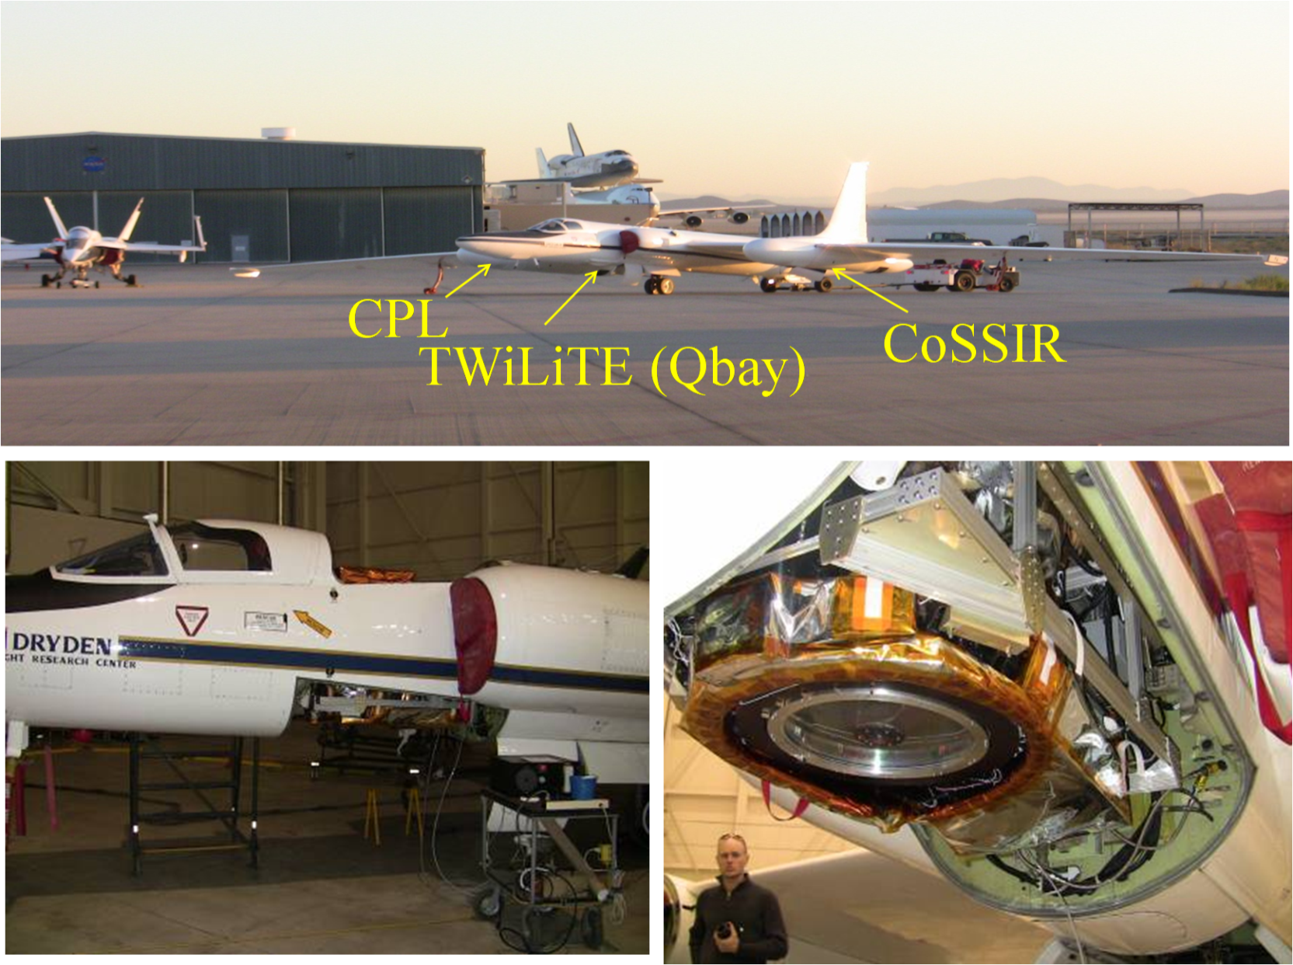
ER-2 Engineering Flights
September, 2009

Slide 6
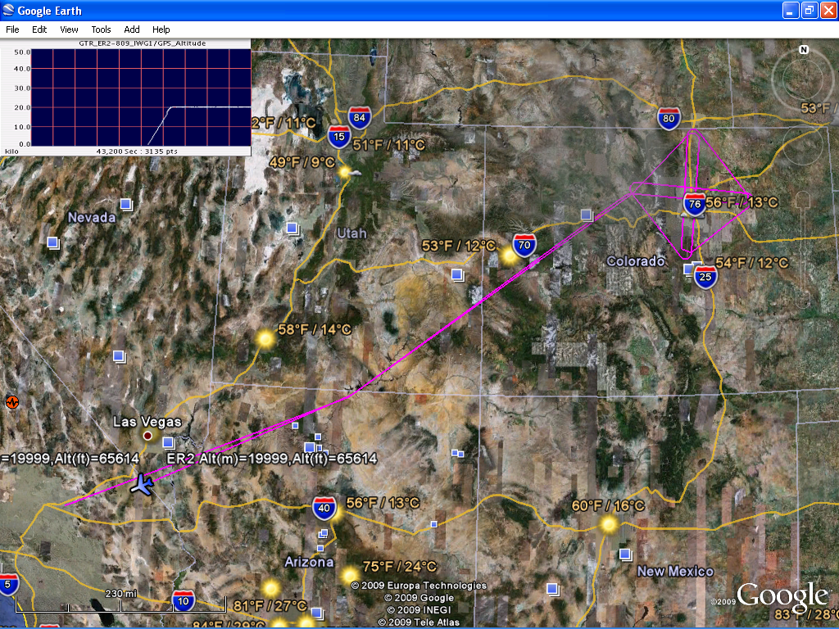
October 1, 2009 flight track – DFRC to Boulder
9:25 PDT launch; 5.4 hours
x -18:52
S1
x -19:02
S3
x -20:12
x -20:23

Slide 7
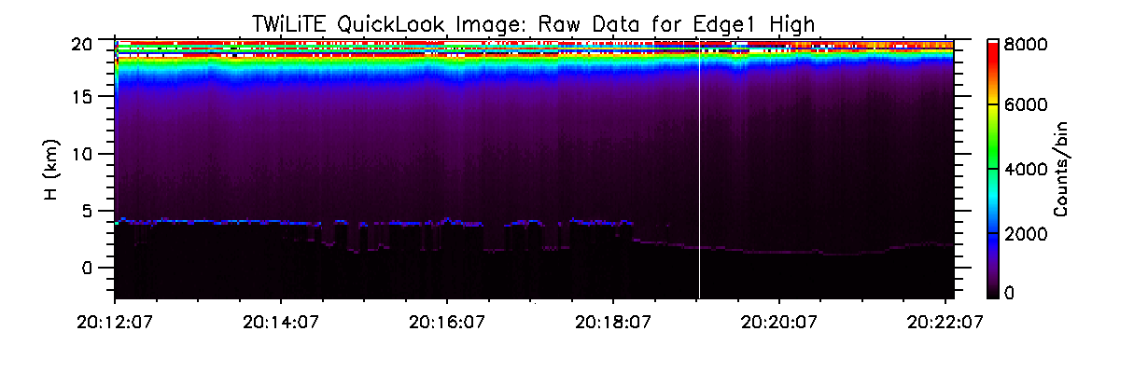
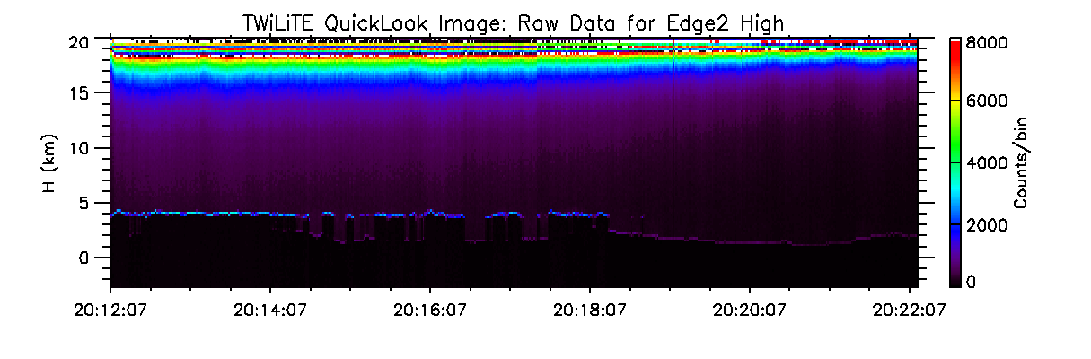
Edge Channel Signals
Data Collection Period S3 - 20:12 to 20:22 UT
1 second average; Δz=70 m
Cloud tops
Ground returns
Aerosol signals

Slide 8
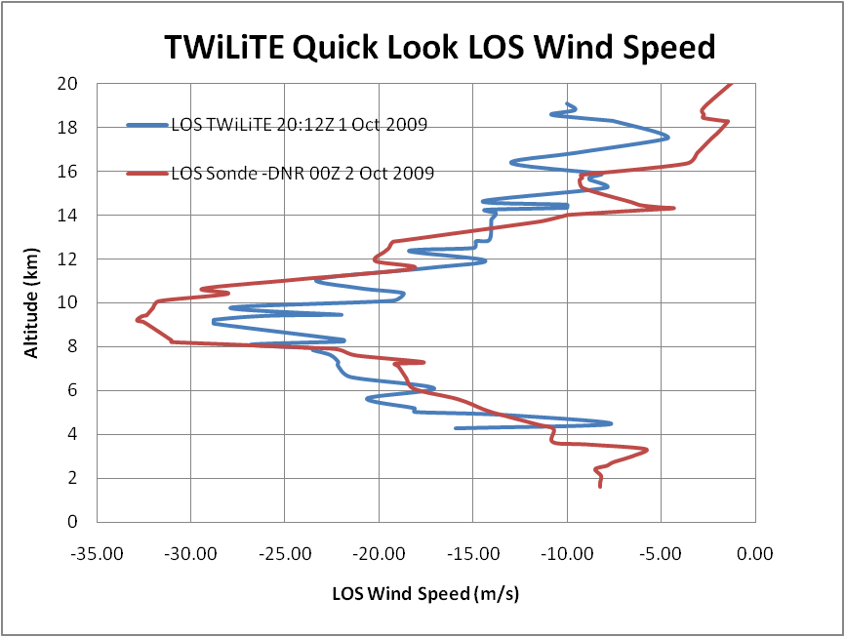
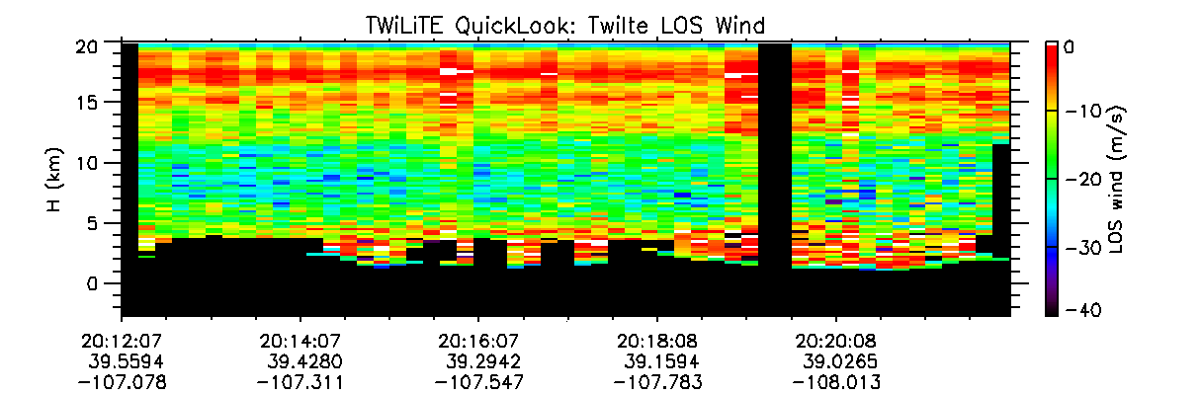
TWiLiTE Quick Look LOS Winds
October 1, 2009 – Period S3, 20:12 to 20:22 UT
10 second average; ; Δz=210

Slide 9
TWiLiTE ER-2 2009 Flight Test Summary
  Demonstrated fully autonomous operation of TWiLiTE including in flight calibration, bore sight alignment and data acquisition
    Established liquid cooling system operational parameters
    Tested auto alignment system in flight
    Demonstrated etalon calibration and alignment holds for >6 hours continuous operation in aircraft
    Photon counting data acquisition of clear air molecular backscatter returns, as well as low level aerosols, clouds and surface returns
  Last flight included ground validation in Boulder, CO area
    NOAA Doppler lidar, sondes, Vaisala and NOAA profilers
  Additional test flights on the ER-2 are planned early in FY11 to complete engineering testing.

Slide 10


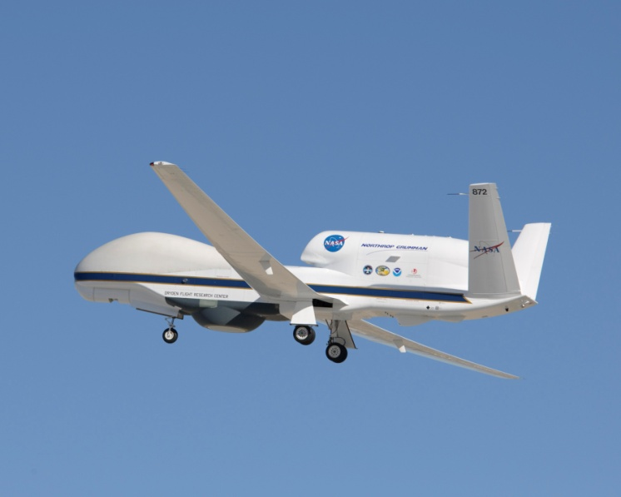
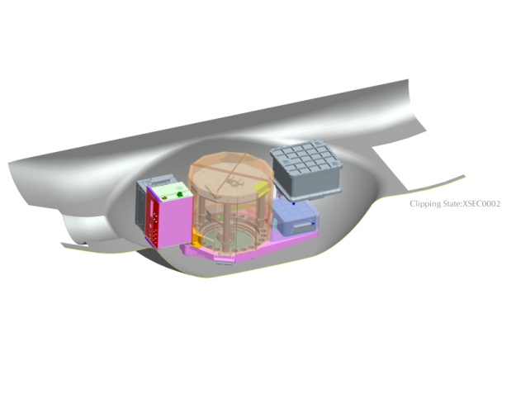
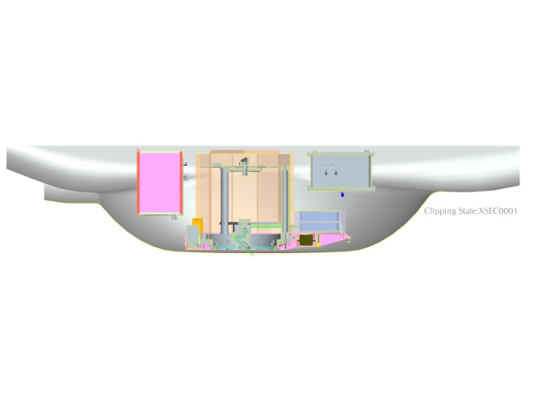
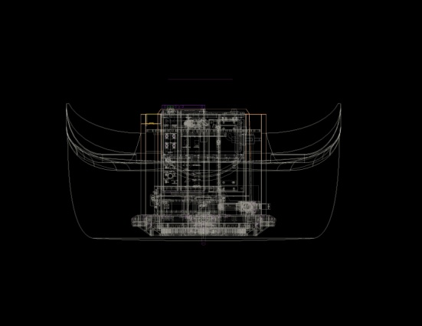
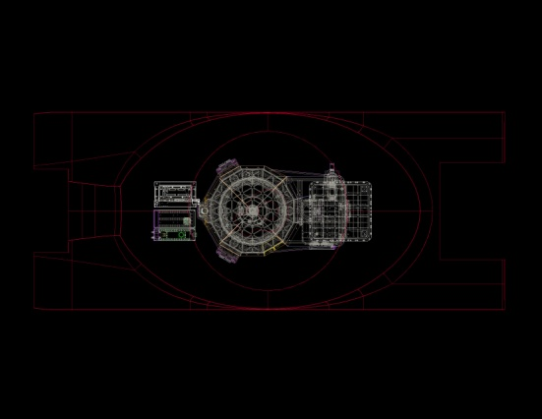
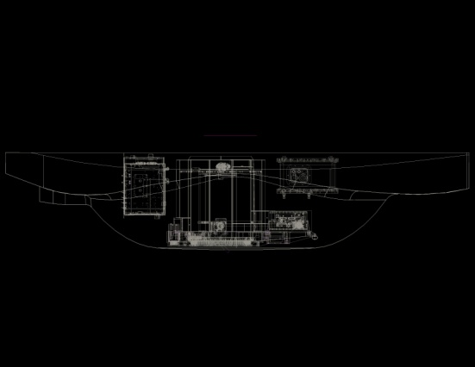
Hurricane and Severe Storm Sentinel (HS3)
TWiLiTE on the Global Hawk: Option 1
Use TWiLiTE instrument modules including HOE telescope
Modified AESA deep fairing in Zone 25
Use Northrup LCS (Liquid Cooling System) for thermal control
~540 lbs

Slide 11

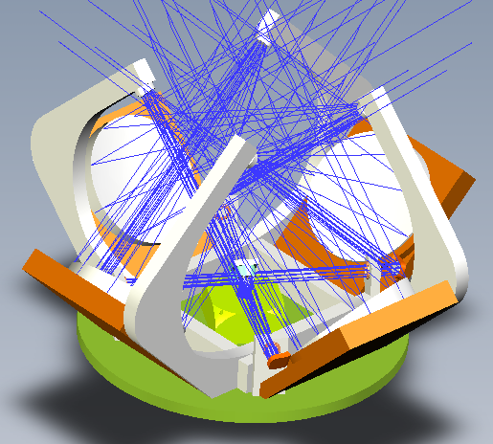
Hybrid Doppler Lidar Transceiver
Funded by ESTO 2008 ACT
GSFC IRAD support for modifications
to integrate with TWiLiTE
4 identical fixed pointing telescopes
Small rotating mirror assemby selects
which FOV is active
20 cm Diameter primary mirrors
Carbon composite structure :
  Lightweight, stiff, low CTE
High reflectivity coatings → same
effective collecting area as larger HOE
Designed to operate at 355 nm and
2054 nm
Latest layout of Structural Design

Slide 12
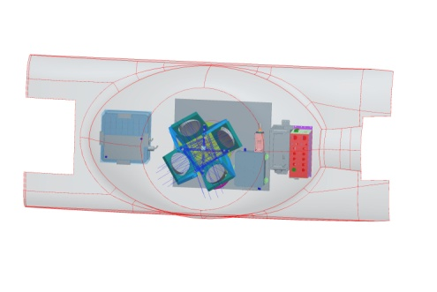
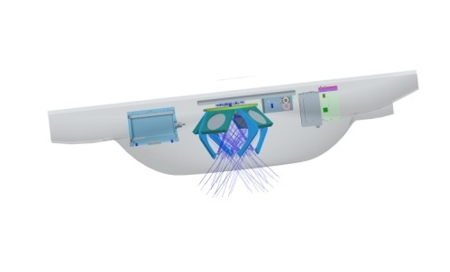
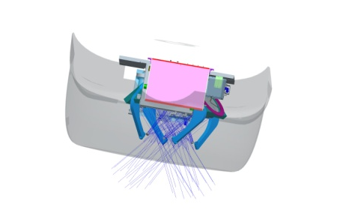
HS3 TWiLiTE on Global Hawk -
Option 2
Hurricane and Severe Storm Sentinel (HS3)
TWiLiTE on the Global Hawk: Option 2
Use TWiLiTE instrument modules except HOE telescope/optical bench
Replace HOE telescope with new design based on ESTO ACT funded project – smaller, lighter, more robust design using conventional optics
Use modified AESA deep fairing in Zone 25
Use Northrup LCS (Liquid Cooling System) for thermal control
Bottom view
Side view
Rear view

Slide 13
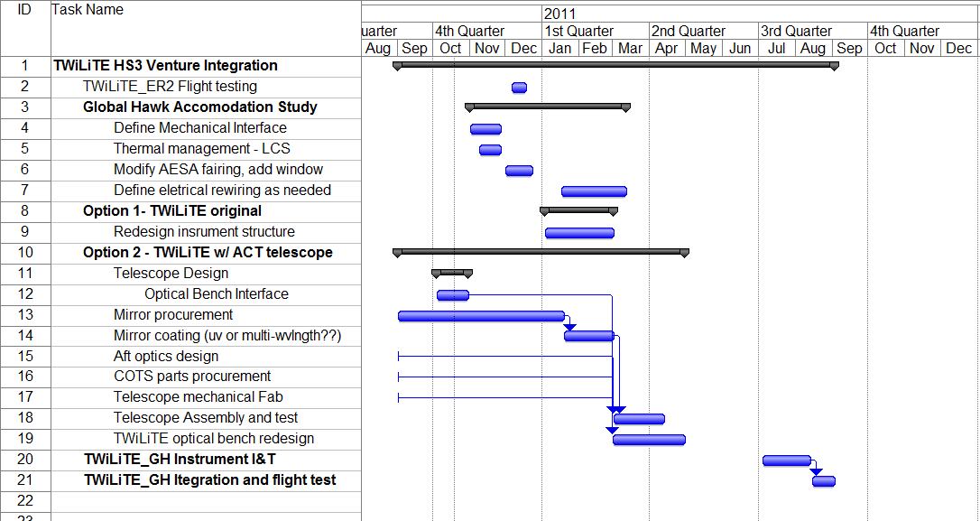
TWiLiTE I&T Schedule

Slide 14
Summary
The TWiLiTE IIP program concluded in 2009 with two deployments to integrate the instrument in the ER-2 aircraft and fly 26 hours of engineering test flights
During these flights TWiLiTE demonstrated fully autonomous operation of the major lidar functions including etalon calibration, telescope/laser bore sight alignment and science data acquisition.
We will continue flight testing TWiLiTE on the ER-2 in the fall of 2010 and will then begin reconfiguring the instrument to fly on the NASA Global Hawk in preparation for HS3.
Two options are being considered. Both options will be persued in parallel during the accommodation study. Selection will be made based on performance and schedule.

Slide 15
Backups

Slide 16
Doppler Lidar Measurement Concept
DOPPLER RECEIVER - Multiple flavors dependent on scattering target -
Aerosol return gives high accuracy and high spatial and temporal resolution when aerosols present
Molecular return gives lower accuracy and resolution but signal is always there
Backscattered Spectrum
Δν_{DOP}
Aerosol (λ⁻²)
Molecular (λ⁻⁴)
Frequency

Slide 17
Outline
TWiLiTE IIP Recap and Instrument Status
2009 ER-2 Engineering Flights
HS3 Integration Plans
Summary

Slide 18
Double Edge Measurement Principle
Molecular Channel at 355 nm
Δν_{DOP}
Aerosol
Edge Filter 1
Edge Filter 2
Molecular
Frequency

Slide 19
Outline
TWiLiTE IIP Recap and Instrument Status
2009 ER-2 Engineering Flights
HS3 Integration Plans
Summary

Slide 20
Double Edge Measurement Principle
Molecular Channel at 355 nm
Δν_{DOP}
Aerosol
Edge Filter 1
Edge Filter 2
Molecular
Frequency

Slide 21
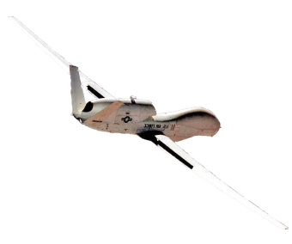
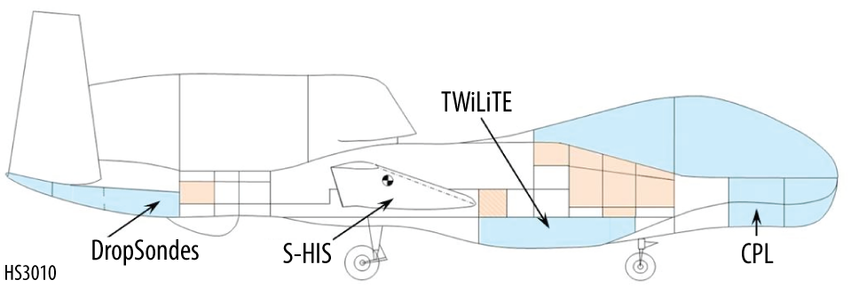
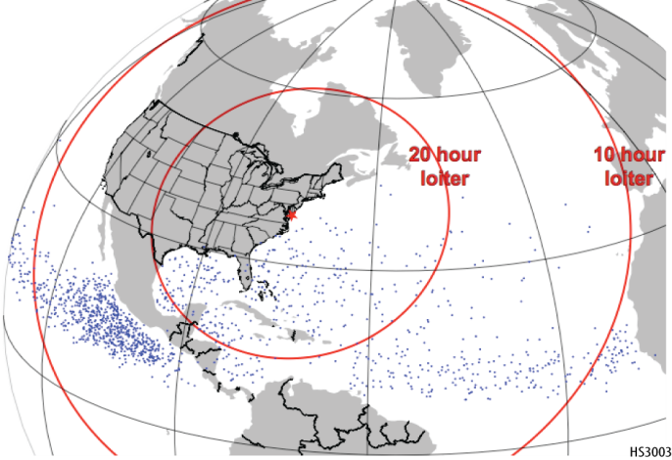
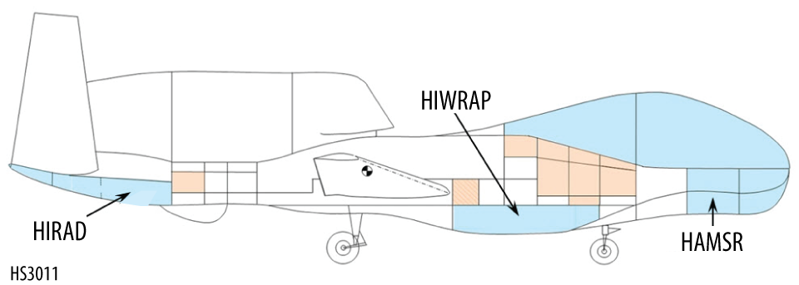
Hurricane and Severe Storm Sentinel (HS3)
Hurricane and Severe Storm Sentinel
HS³
Application of the Global Hawk for Hurricane Studies
PI: Scott A. Braun (GSFC)
Science Goal:
To understand hurricane genesis and intensification.
Key Science Questions:
How do hurricanes form?
What causes rapid intensity changes?
How are intensity changes after formation related to upper-tropospheric flow features?
What’s the role of the Saharan Air Layer?
Two Global Hawk (GH) aircraft
Environment GH instrumentation
TWiLiTE (direct detection wind lidar)
CPL (cloud & aerosol lidar)
Scanning HIS (T, RH)
Dropsondes (wind, T, RH)
Over-storm GH instrumentation
HIWRAP (3-D winds plus sfc winds)
HIRAD (sfc winds and rain)
HAMSR (T, RH)
Science Objectives:
Observing the genesis of tropical cyclones and the intensification from a tropical storm to a hurricane over an extended period - surveillance rather than reconnaissance
Providing 3-D observations of the wind field both within tropical cyclones and in the environment
Measuring moisture fields, clouds, aerosols, and precipitation
Environment GH
Genesis Locations and Loiter Times
Over-storm GH

Slide 22
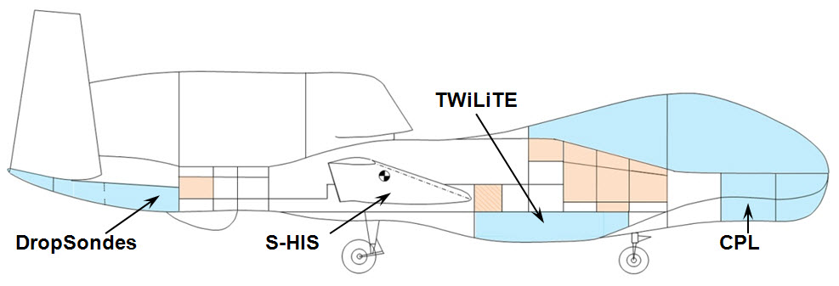
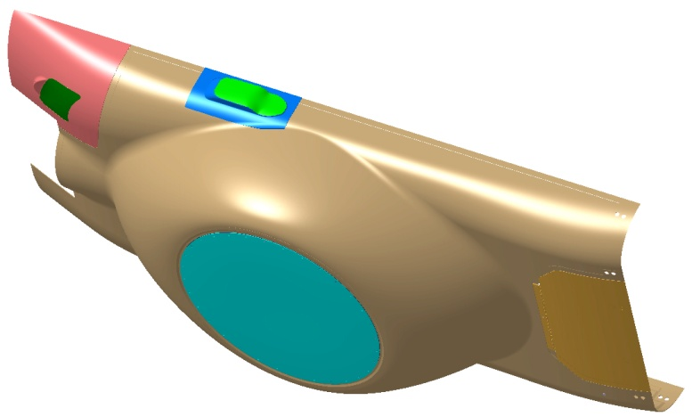

Hurricane and Severe Storm Sentinel (HS3)
Environmental Aircraft Payload
Global Hawk w/ AESA deep fairing in flight testing for GRIP - 8/15/2010 (courtesy Gerry Heymsfield)
MODIFIED AESA RADOME FAIRING ASSY

Slide 23
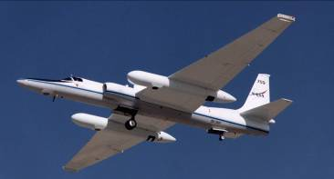
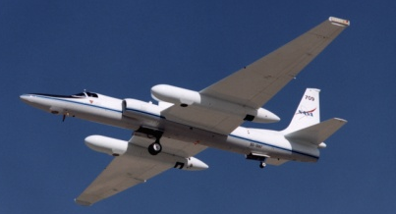
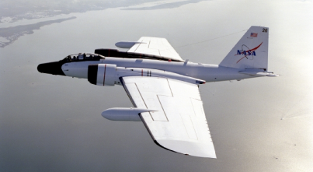
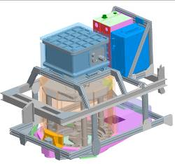
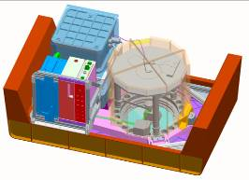
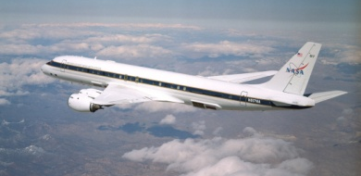
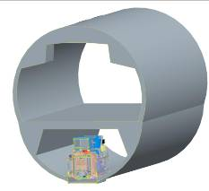
TWiLiTE Compatible
NASA Airborne Science Platforms
36 hrs duration
Unmanned vehicle
6-8 hrs duration
Unattended operation
Global Hawk
25
20
15
10
5
ER2
WB57
TWiLiTE configured for DC8 Nadir Port 7
(ROSES07-AITT)
Max Altitude (km)
DC8
TWiLiTE configured for Global Hawk Zone 25
(HS3)
TWiLiTE configured for WB57 3’ Pallet
(ESTO IIP04)
TWiLiTE configured for ER-2 Q-Bay
(ESTO IIP04)

Slide 24
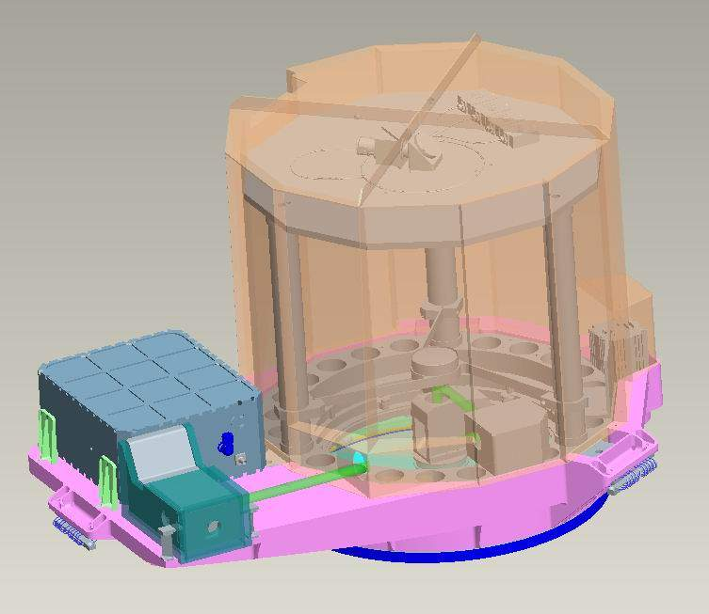
Optical Bench Detail
5
3
1- Laser Optical Module
2- Beam expander
3- Telescope
4- Window
5- Telescope Cover
6- IMU integrated in bench
1
6
4
2
Mass: 237lbs

Slide 25
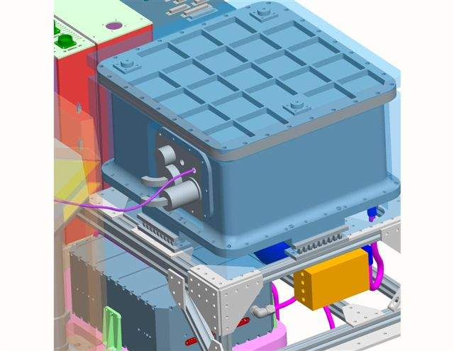
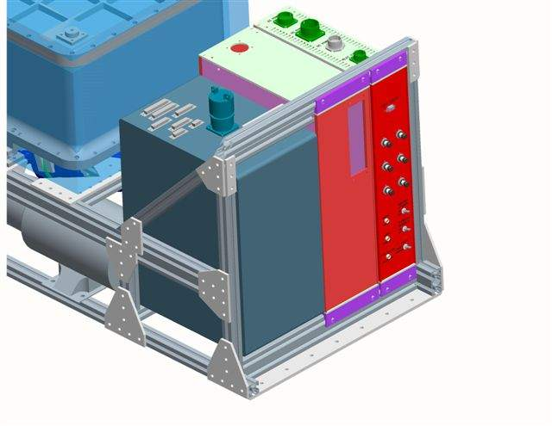
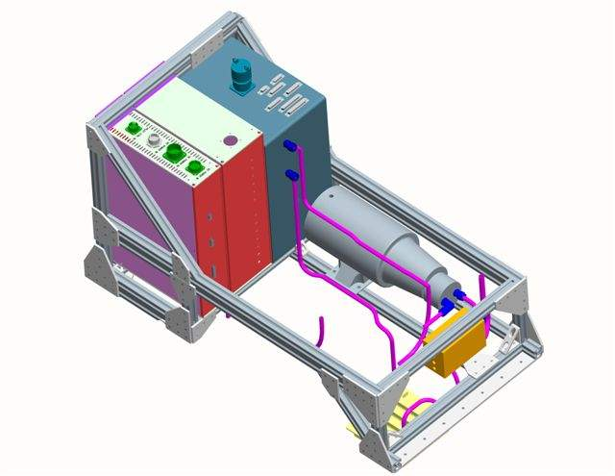
Electronics Detail
*Receiver mounted on wirerope isolators
*All cooling connections w/ flex tubing
*LEU, Power, & Data boxes rack mounted w/ extra rear support
*Connections top & rear. UI on front
*Pump mounted on 8020 frame
*Most interconnections made before install in pallet

Slide 26
Example: October 1, 2009 Flight
Edwards AFB to Boulder CO
6 hour flight with ER-2 flying at 20 km
  1.5 hour flight to Boulder and 1.5 hour return
  ~3 hours flying diamond pattern with North, South crossing legs
  Pattern centered on sounding site just North of Denver
  Ground validation NOAA lidar, multiple sonde launches, Vaisala and NOAA profilers
TWiLiTE running fully autonomously
  Multiple data streams: Housekeeping data sampled every 1 sec starting at instrument power on; Etalon calibration scans run every 10 minutes starting at laser power on (> 55000 ft altitude); 10 minute science data acquisition periods following calibration sequence; Auto-alignment system runs every 30 minutes or on fault detect); Instrument GPS/IMU data stored at 100Hz.
  Telescope fixed pointing in at 90 deg relative to flight track. No scanning.

Slide 27
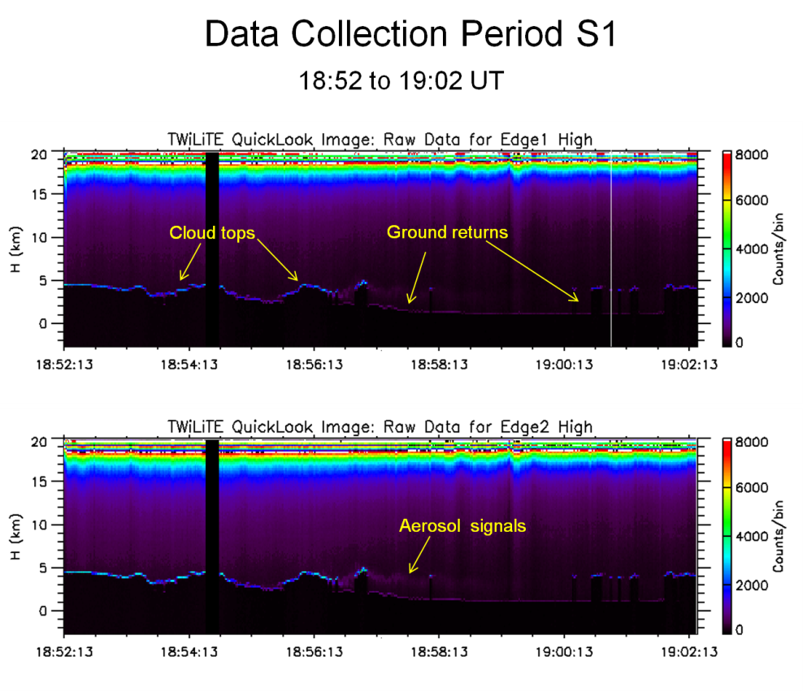
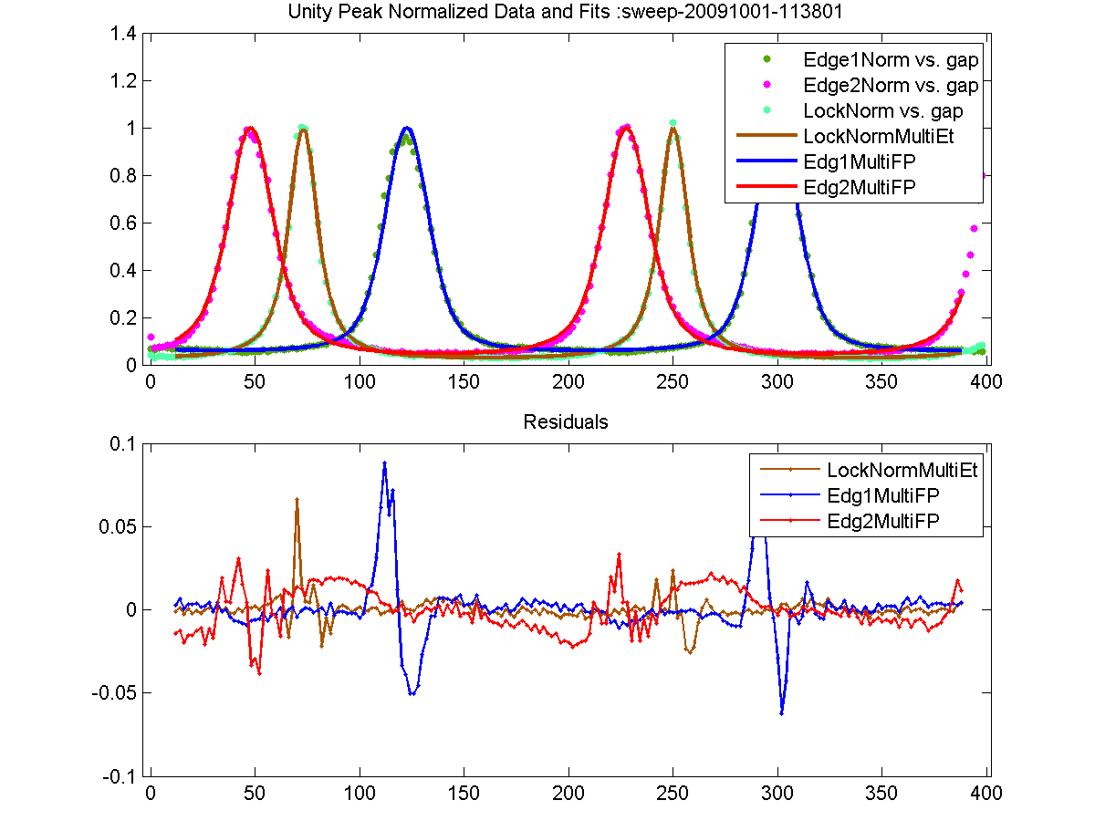
September, 2009 Engineering Flights
Objectives: Collect engineering data and science data to validate performance of TWiLiTE new technologies (laser, etalon filter, holographic telescope, Doppler receiver) and sub-systems (thermal control system, auto alignment system, data acquisition electronics, autonomous flight software) by flying TWiLiTE on ER-2 high altitude research aircraft.

Slide 28
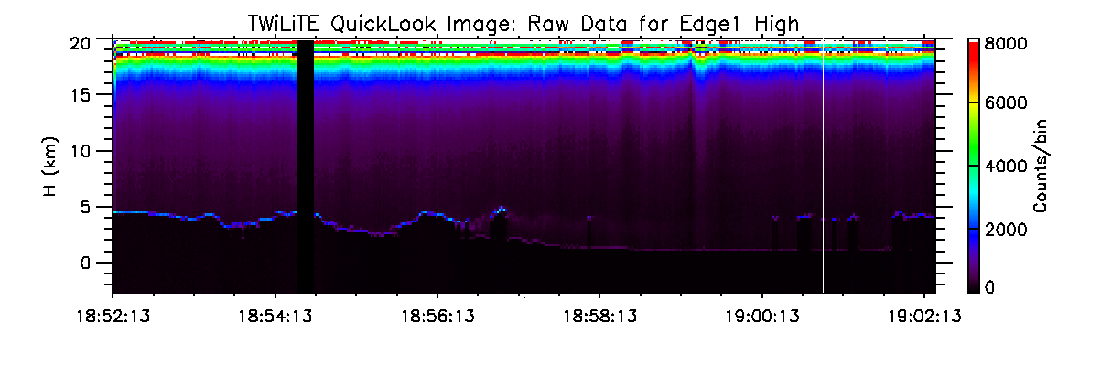
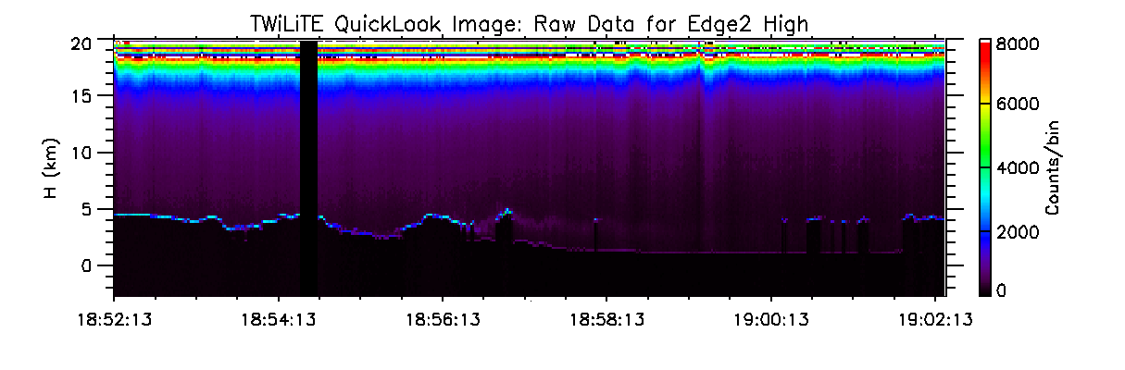
Data Collection Period S1
18:52 to 19:02 UT
Cloud tops
Ground returns
Aerosol signals

Slide 29
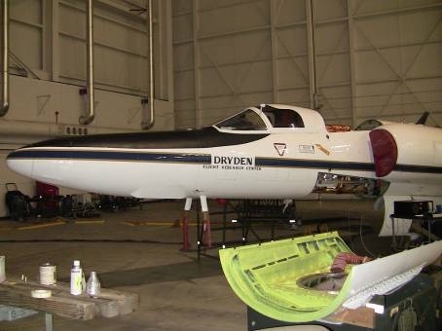
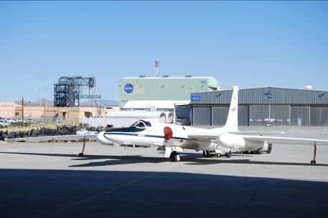
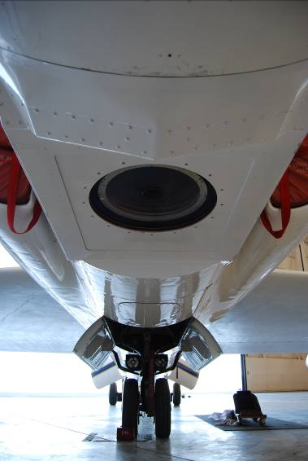
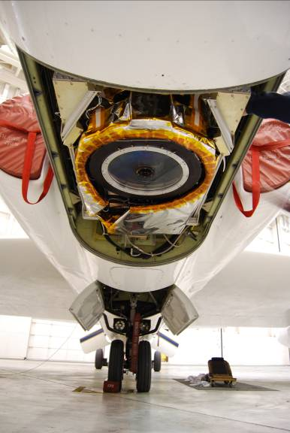
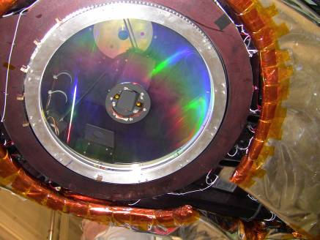
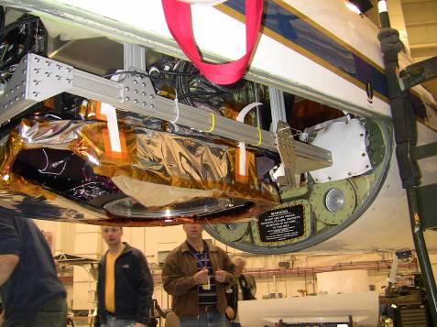
ER-2 Engineering Flights
February, 2009 and September, 2009

Slide 30
October 1, 2010 Ground Validation

Slide 32
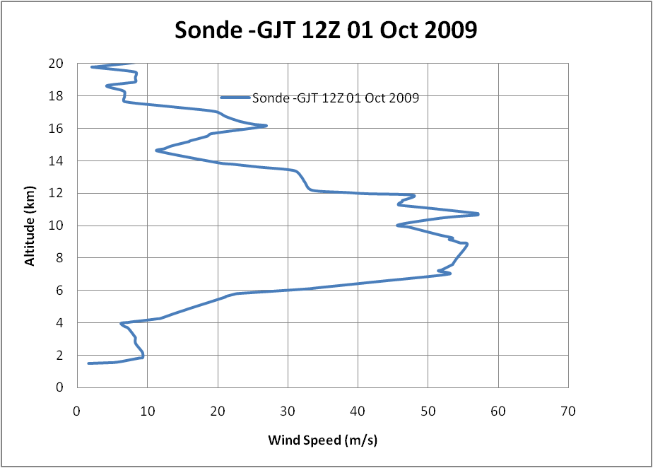




Slide 33


Slide 34

NOAA Boulder Validation
60min – Lidar wind profiles from staring Lidar data*
(W. A. Brewer and R. M. Hardesty)
*disregard lowest gate

Slide 35

NOAA Boulder Validation
30 min Lidar wind profiles (from azimuthal scans)
(W. A. Brewer and R. M. Hardesty)

Slide 36



Direct Detection Doppler lidar profiling at Howard Beltsville Research Facility
Goddard Lidar Observatory for Winds (GLOW) mobile Doppler lidar
Direct detection Doppler Lidar system
Measures clear air wind profiles using molecular backscatter
Serves as testbed for air and space based lidar technologies
Multiple field campaigns since 2000
Measurement summary
Vertical resolution=250 m
Δt=3 min
Altitude range= 2 to 20 km
Elevation angle= 45 deg
Scan pattern = 4 directions: (N,S,E,W)+vertical
Dwell per LOS = 30 sec
Line of sight wind profiles are sequentially measured at 4 azimuth angles (N,S,E,W)+vertical. The multiple direction LOS profiles are combined to produce vertical profiles of horizontal wind speed and direction (right)
GLOW Lidar Parameters
Wavelength = 355 nm
Laser energy = 25 mJ @ 50 pps
Telescope diam. = 45 cm
Azimuth/Elevation scanner
Double Edge molecular receiver
Photon Counting PMTs
QE=0.25

Slide 37

2007 NRC Decadal Survey Recommendations for Tropospheric Winds
3D Tropospheric Winds mission called “transformational” and ranked #1 by Weather panel. with concurrence by Water panel. Overall prioritized in 3rd tier of 15 NASA recommended missions.
“The Panel strongly recommends an aggressive program early on to address the high-risk components of the instrument package, and then design, build, aircraft-test, and ultimately conduct space-based flights of a prototype Hybrid Doppler Wind Lidar (HDWL).”
“The Panel recommends a phased development of the HDWL mission with
the following approach:
  Stage 1: Design, develop and demonstrate a prototype HDWL system capable of global wind measurements.
  Stage II: Launch of a HDWL system that would meet fully-operational threshold tropospheric wind measurement requirements

Slide 38




TWiLiTE Direct Detection Wind Lidar
Key Technologies
 | Entrance TRL | Exit TRL
High spectral resolution all solid state laser transmitter | 4 | 5
High spectral resolution optical filters | 4 | 5
Efficient 355 nm photon counting molecular Doppler receiver technologies | 4 | 5
Novel UV Holographic Optical Element telescopes and scanning optics | 3 | 5

Slide 39
Unfinished Business – Need for additional ER-2 test flights
At least one more round of test flights on the ER-2 is planned to complete engineering testing.
  Fine tune thermal system control to achieve +/- 2 deg for critical elements (etalon, laser optical module, HOE)
  Increase precision of auto-alignment algorithm to optimize and maintain boresight
  Collect and store all onboard GPS/IMU data for post-processing
  Test HOE scanning
  Test all systems in presence of high clouds

