Slide 1
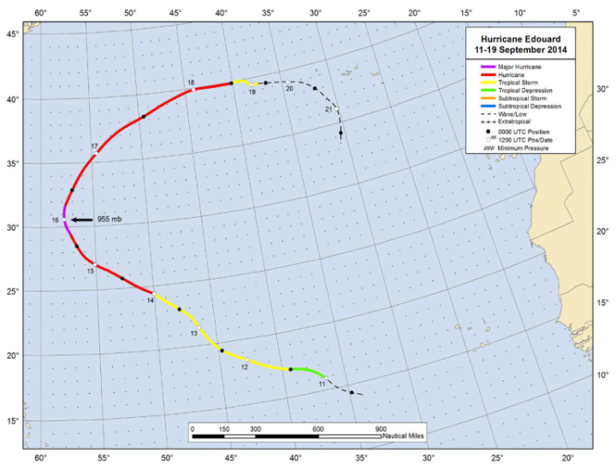
16 Sept
14 Sept

Slide 3
Synoptic environment

Slide 4
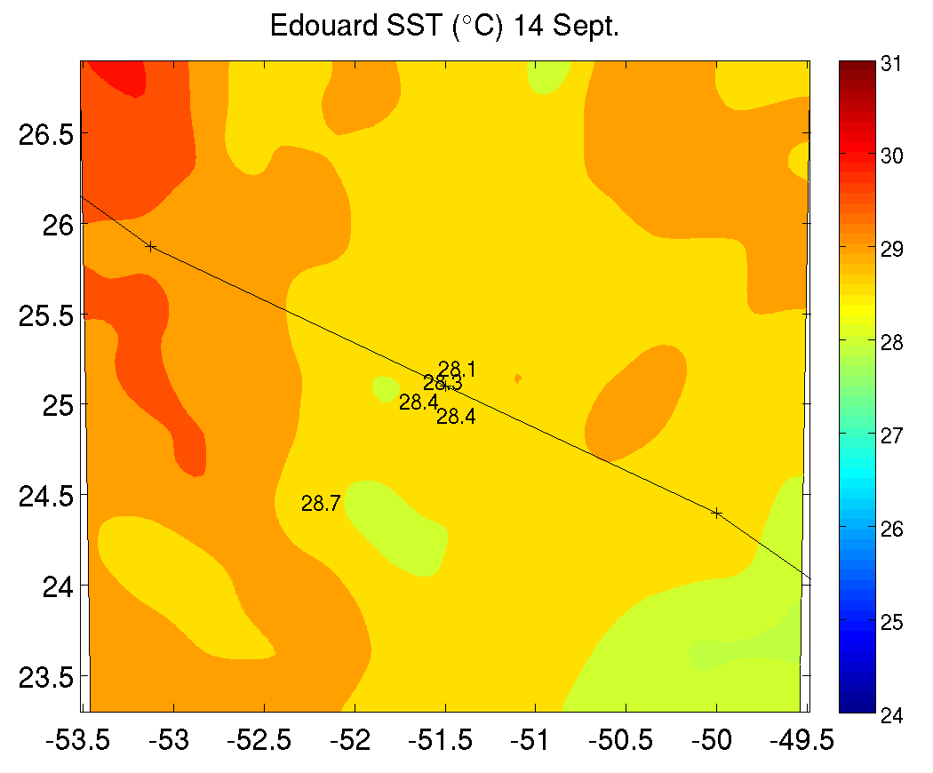
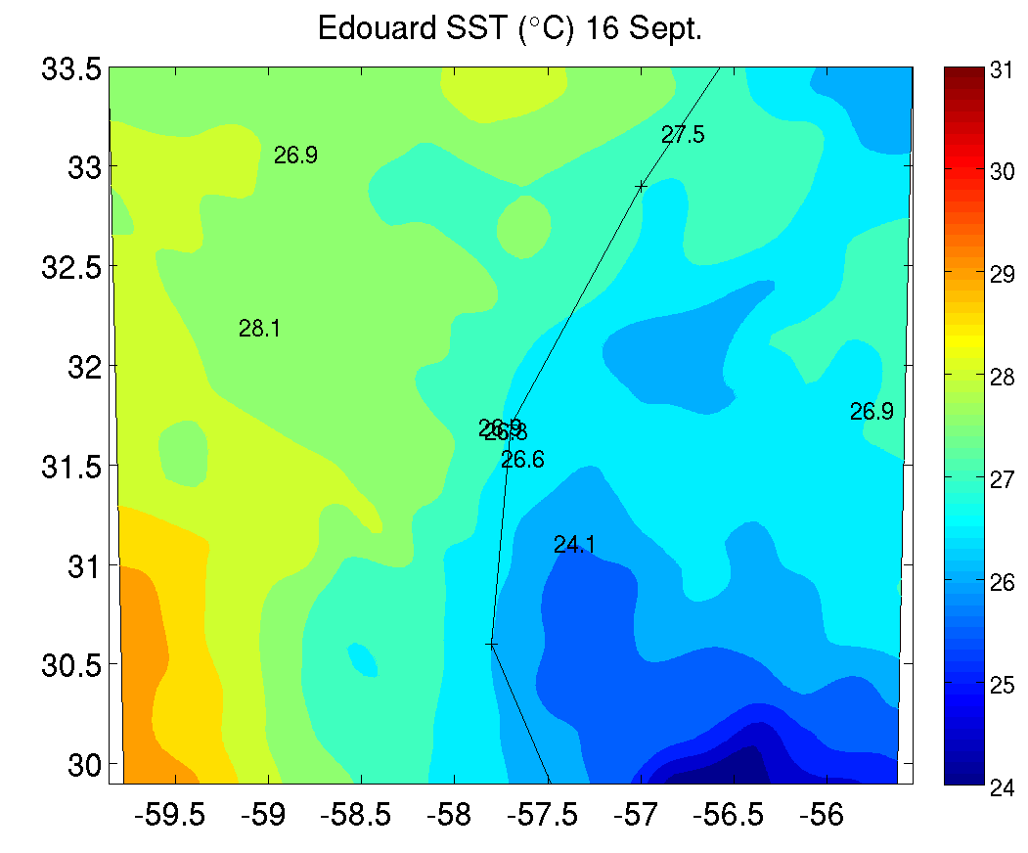
14 Sept
16 Sept
m/s
m/s
shear
motion
m/s
m/s

Slide 5
14 Sept
16 Sept
55
55
50
50
45
45
40
40
35
35
30
30
25
25
20
20
15
15
10
10
8 km
5
8 km
5
55
55
50
50
45
45
40
40
35
35
30
30
25
25
20
20
15
15
10
10
2 km
5
2 km
5

Slide 6
DSR
DSL
USR
USL
DSR
USR
DSL
USL

Slide 7
DSR
DSL
USR
USL
DSR
USR
DSL
USL

Slide 8
DSR
DSL
USR
USL
DSR
USR
DSL
USL

Slide 9
18
DSR
DSL
USL
USR
16
shear vector
motion vector
14
12
height (km)
10
8
6
4
2
0
North
West
South
East
East
-15
-10
-5
-3
-1
1
3
5
10
15
18
USR
DSR
DSL
USL
16
motion vector
shear vector
14
12
height (km)
10
8
6
4
2
0
North
West
South
East
East
-15
-10
-5
-3
-1
1
3
5
10
15

Slide 10
1628 UTC
1700 UTC
1637 UTC
1722 UTC
1647 UTC
1745 UTC
DSR
DSL
USR
USL

Slide 11
Blue – N43
Green – N42
Red – GH
RMW
RMW

Slide 12
r/RMW
r/RMW
r/RMW

