Slide 1
Use of G-IV (and C-130) for Synoptic Surveillance Missions
Chris Landsea – NOAA/NWS/NHC
Chris.Landsea@noaa.gov
The basic idea is to have data from the G-IV (and C-130, if necessary) in time to impact the watch and warning process for hurricane landfalls along the U.S. coast or Puerto Rico/Virgin Islands, i.e., 48 hours prior to the forecast arrival of tropical-storm-force winds at the coastline.

Slide 2
Event | Day/Time | Time prior to forecast landfall (h)
Decision to task a deployment | d-3 / 12Z | 90-126
Decision to deploy; Decision to task a mission | d-2 / 12Z | 66-102
Decision to fly mission | d-1 / 12Z | 42-78
Mission takeoff | d-1 / 18Z | 36-72
Drop data in guidance | d / 06Z | 24-60
Missions can end once the take-off time is within about 30 h of landfall.

Slide 3
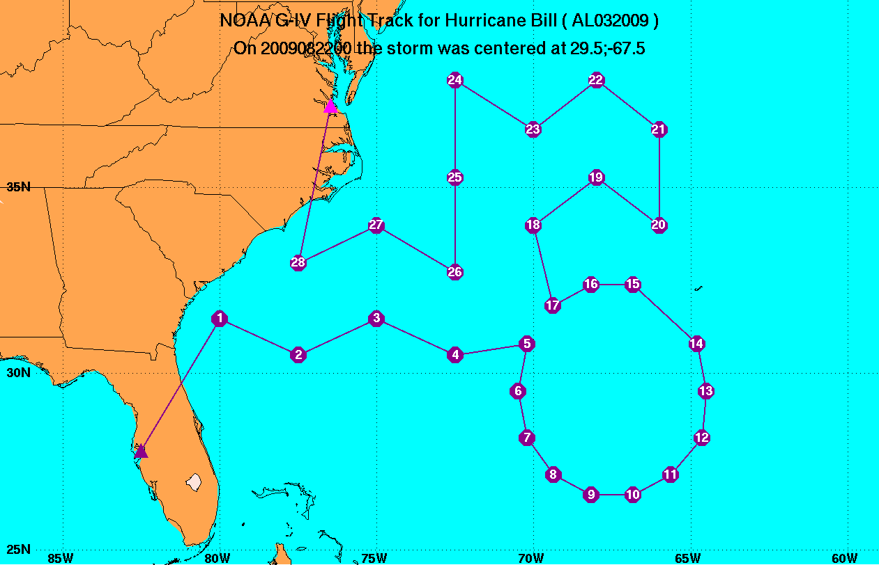

Slide 4
Can deploy G-IV away from Tampa, if needed.
Decision to also task a C-130 usually is due to hurricane being in the Atlantic north of Caribbean Islands
Can have twice a day G-IV missions, if hurricane is accessible via Tampa.
Flight tracks designed ~24 hr in advance
Flight tracks can be updated day of the mission (~6 hr before takeoff)
Typically 25-30 dropwindsondes launched – all in synoptic environment
Have email notification of flights & plans

