Slide 1
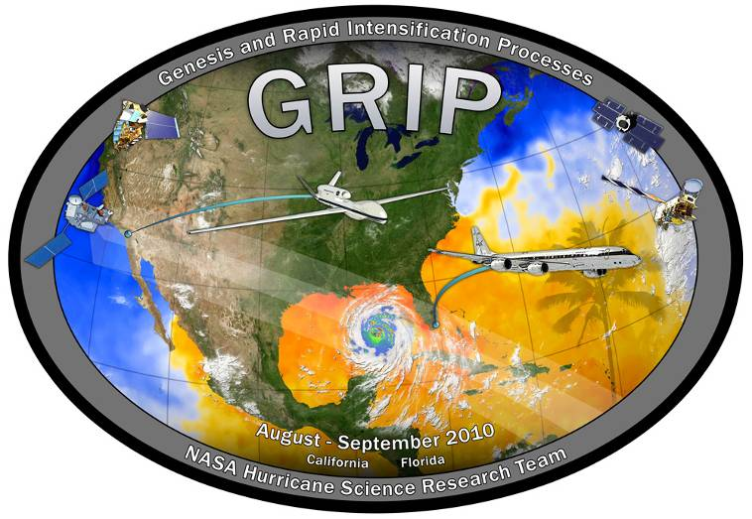
Genesis and Rapid Intensification Processes: Aircraft Planning
Scott Braun
NASA/GSFC

Slide 2
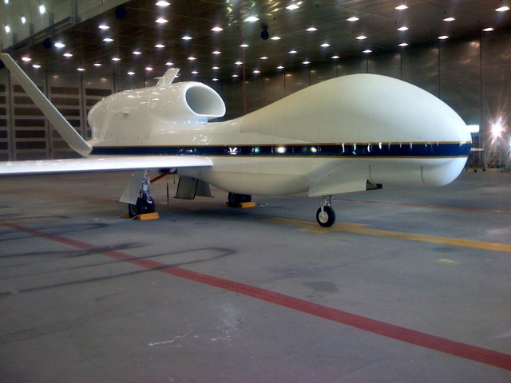
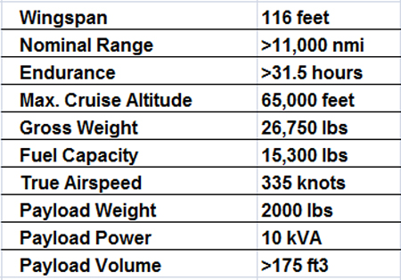
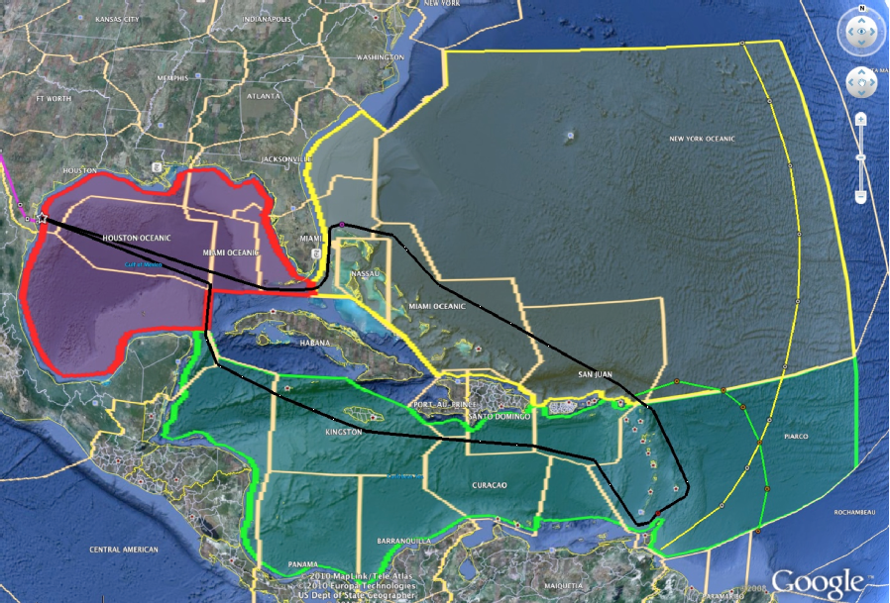
The Global Hawk
GH quickly reaches flight altitude of 55 kft. Reaches 65 kft after ~20 h as it burns fuel.
GRIP flights based from Dryden
In-storm operations:
• Will be extremely cautious operating near convection, performance in hurricanes not tested yet
Flight Operations Region

Slide 3
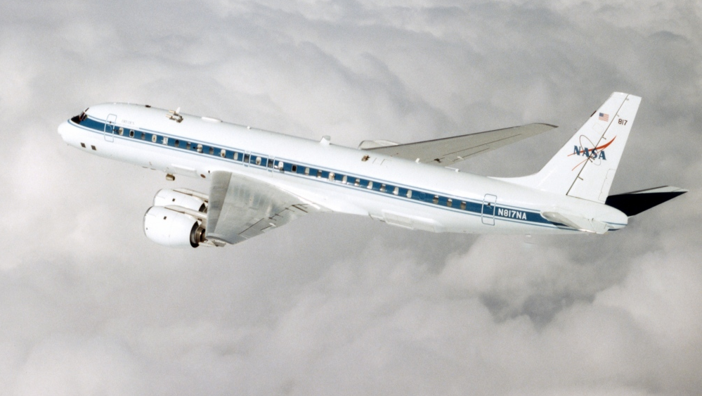
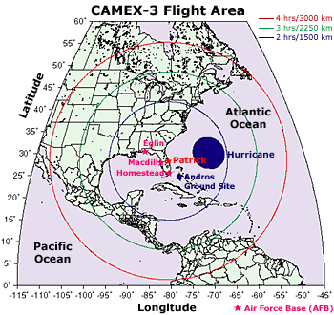
The NASA DC-8
• Range 5,400 nmi
• Up to 42,000 ft
• Endurance up to 12 h
(but usually 6-10 h)
• Payload weight: up to 30,000 lbs
Operations:
• Fort Lauderdale
In-storm operations:
• Will fly into hurricanes, convective cloud systems, although avoids strong convection

Slide 4
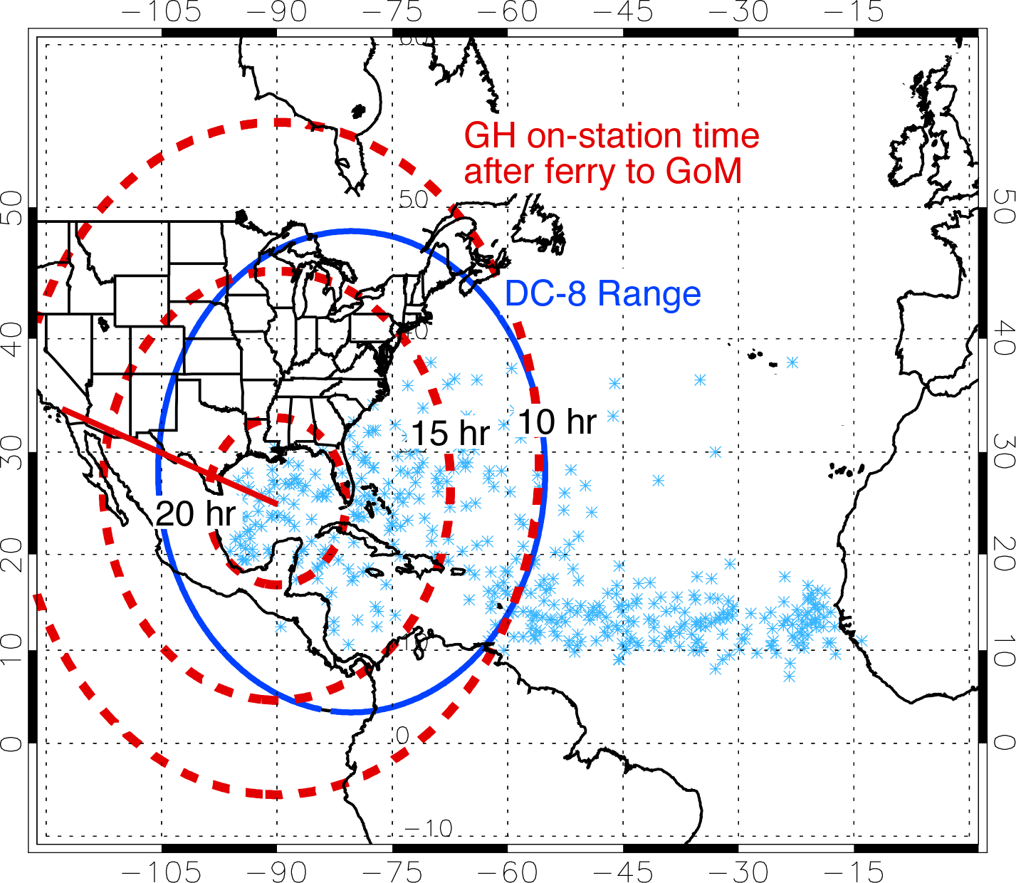
Atlantic Flight Ranges and Duration

Slide 5
Phenomena of Interest
Disturbances with potential for genesis
Tropical storms with potential for rapid intensification (RI)
Intense hurricanes with potential for rapid weakening
• Deep, rotating convective cores (radar measurements of precipitation regions and localized rotating convection)
• Broad vortices providing the favorable mesoscale environment for development
• Environmental influences (e.g., dry air, vertical shear)
• Environmental and inner-core structures when nascent eye wall forms prior to RI (organization of winds, formation of warm core, role of deep convection)
• Environmental structure and inner-core response prior to and during rapid weakening

Slide 6
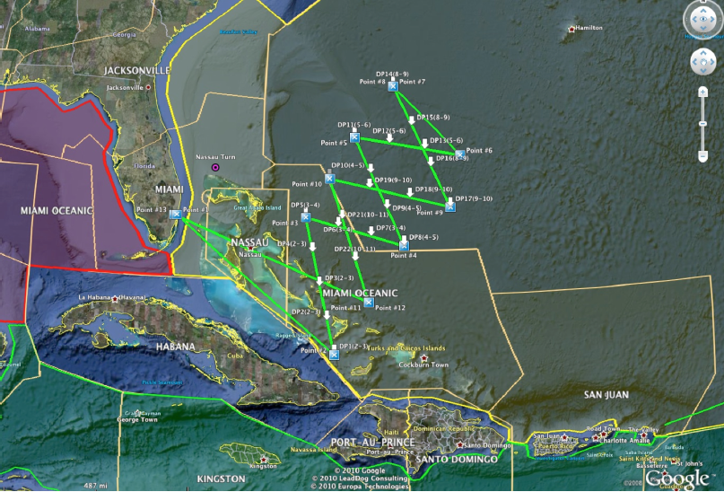
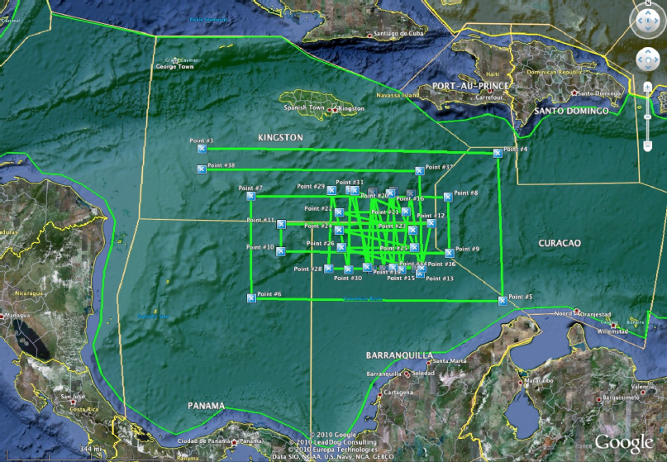
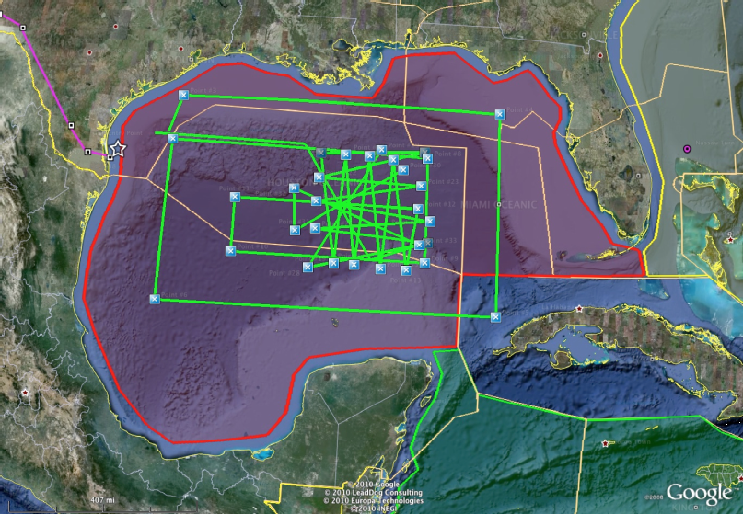
Flight Patterns
Flight Modules

Slide 7
Operations
Flights can be any time of day with goals of either maximizing coverage/sampling (simultaneous flights of GH and DC-8) or maintaining temporal continuity
Dropsondes from GH: As frequently as every 5 min (30 nmi), descent time ~17 min, 8 channels
Dropsondes from DC-8: As frequently as every 5 min (35 nmi), descent time 12 min, 4 channels
Dropsonde data can be downlinked to GTS

Slide 9
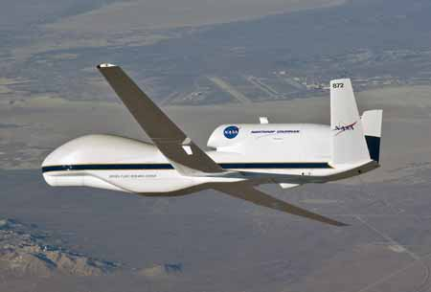
Instrument Implementation & Platform
Global Hawk Payload
HIWRAP, Heymsfield/GSFC
Surface winds in rain-free areas
3D winds, reflectivity in rain
HAMSR, Lambrigtsen/JPL
Soundings in rain-free regions
LWP, retrieved precip. profiles in rain
Dropsondes, Wick/NOAA
LIP, Blakeslee/MSFC
Operations:
PRE-GRIP out of Dryden in late Spring or early Summer 2010
GRIP flights based from Dryden
In-storm operations:
• Will be extremely cautious operating near convection, performance in hurricanes not tested yet
LIP

Slide 10
GRIP DC-8 Payload
Dropsondes
(Vertical Profiles of Temp, Press, Humidity and Winds)
DAWN
Doppler Aerosol Wind Lidar
(Vertical Profiles of Vectored Horizontal Winds)
MMS
Meteorological Measurement System
(Insitu Press, Temp, 3D Winds and Turbulence)
CAPS, CVI, PIP
(Cloud Particle Size distributions, Precip Rate, Rain & Ice water content)
LASE
Lidar Atmospheric Sensing Experiment
(H2Ov, Aerosol profiles and Cloud distributions)
APR-2
Airborne Precipitation Radar Dual Frequency
(Vertical Structure Rain Reflectivity and Cross Winds)

