Slide 1
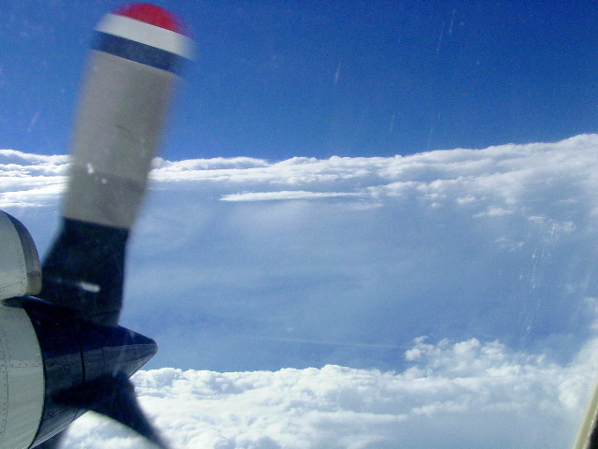
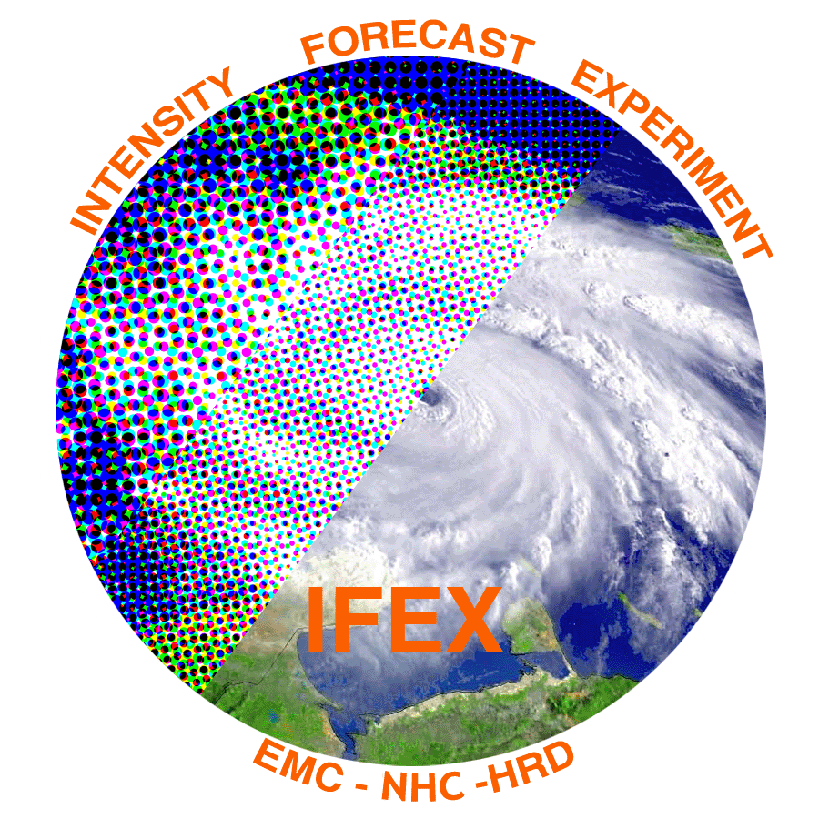
Observations of the asymmetric structure and intensity evolution of Hurricane Edouard (2014).
Part I: Kinematic structure and distribution of deep convection
Robert Rogers¹, Jun Zhang^{1,2}, Jon Zawislak³, Eric Uhlhorn¹
¹NOAA/AOML Hurricane Research Division
²Cooperative Institute for Marine and Atmospheric Studies, University of Miami
³Florida International University
(Acknowledgements: Paul Reasor, Ed Zipser, Trey Alvey)

Slide 2
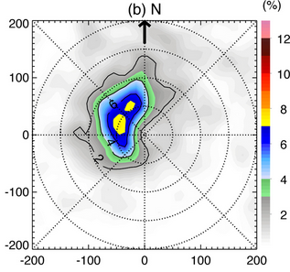
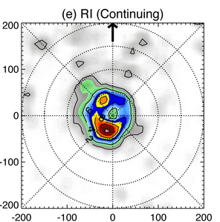
Motivation
Recent aircraft and satellite composite studies of intensifying vs. steady-state TC’s have focused on radial and azimuthal distribution of deep convection
Preferred radial location inside RMW
Preferred azimuthal location downshear, upshear left
Axisymmetric vorticity and distribution of convective bursts from composites of airborne Doppler
(Rogers et al. 2013)
Shear-relative distribution of 20 dBZ echo tops (km) from composites of TRMM PR overpasses
(Zagrodnik and Jiang 2014)

Slide 3
Motivation (cont.)
Possible mechanisms for these radial and azimuthal distributions
Radial profiles of PBL convergence
Outer core lower-tropospheric inertial stability profiles
Buoyancy distributions (both radial and azimuthal)
Slope differences between diabatic heating, M surfaces
HS3 provided this information for Edouard (2014), which was sampled by the GH and P-3’s during intensifying and slowly-weakening phases
What can the observations in Edouard tell us about these mechanisms?

Slide 4
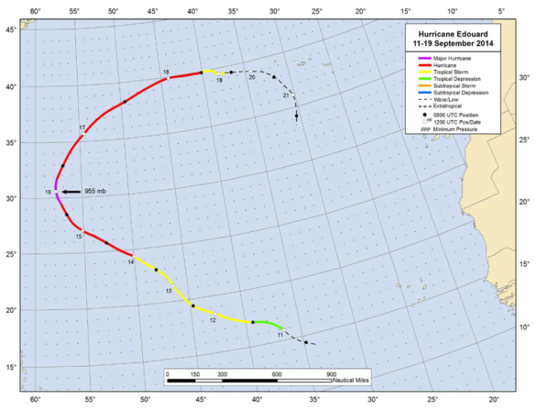
Overview of dataset
Flight tracks and times vs. intensity
16 Sept
14 Sept
Focus will be during joint N43/AV6 missions on 14 Sept and 16 Sept
Storm was intensifying during 14 Sept mission, slowly weakening during 16 Sept mission

Slide 5
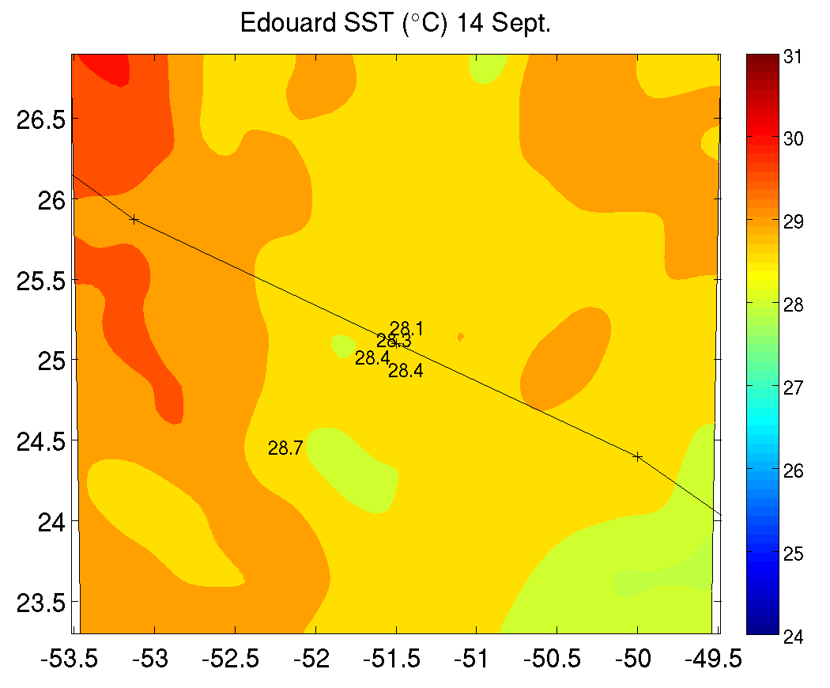
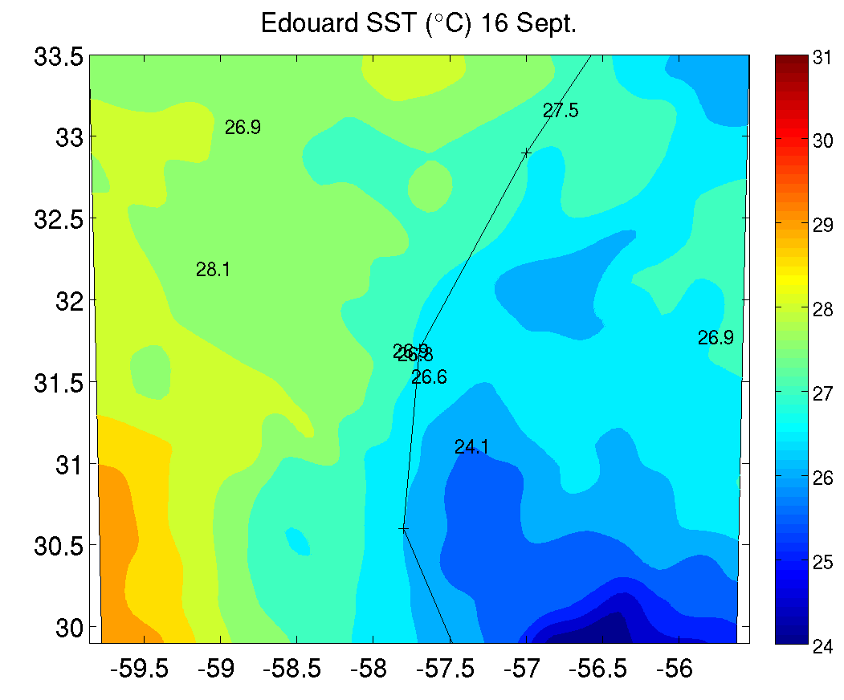
Environmental conditions
14 Sept
16 Sept
m/s
m/s
shear
motion
Storm motion and SHIPS shear vectors (m/s)
m/s
m/s
Storm-centered SST (⁰C) from MW and AXBT’s
Moderate SE shear during 14 Sept, weak E shear during 16 Sept
Motion nearly parallel during 14 Sept, perpendicular toward NNE during 16 Sept
SST > 28 C in front of storm on 14 Sept, cold wake effects on 16 Sept right of track

Slide 6
Distribution of deep convection
14 Sept
16 Sept

Slide 7
Distribution of deep convection
Locations of points with 8-16 km peak w > 3 m/s (green) and 5 m/s (black)
14 Sept
16 Sept
DSR
DSR
USR
DSL
USR
DSL
USL
USL

Slide 8
Forcing mechanism for deep convection?
14 Sept
16 Sept
DSR
DSR
Radial (shaded), tangential (contour) wind DSR
Divergence (shaded), vertical velocity (contour) DSR
DSR
DSR
Radial flow penetrates further inward DSR, convergence peaked inside RMW on 14 Sept
Updraft originates closer to center, stronger magnitude on 14 Sept

Slide 9
Impact of convective heating on vortex
Inertial stability (shaded, x 10⁻⁷ s⁻²) and vertical velocity (contour, m/s) in downwind quadrants
USL
DSL
14 Sept
Stronger updrafts DSL, closer to center on 14 Sept
Persistent strong updrafts aloft USL on 14 Sept, co-located with high inertial stability in that quadrant. Little to no updrafts USL on 16 Sept.
USL
DSL
16 Sept

