Slide 1
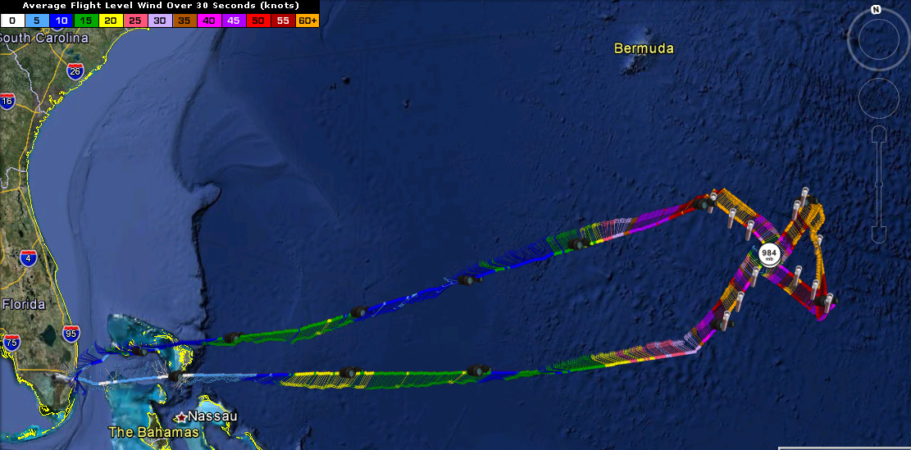
TROPICAL STORM LESLIE $$ NNNN
20120907H3
E. Uhlhorn

Slide 2
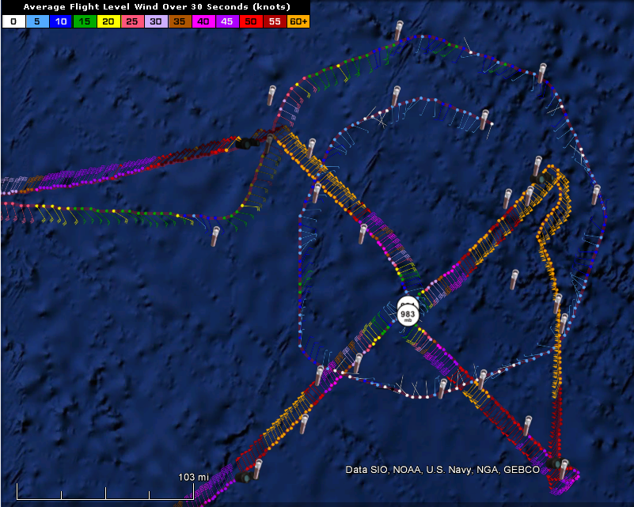
Stuffs
Mission
Single figure-4 TDR
8 kft
Coordinated with G-IV
15 Sondes, 10 AXBTs
Issues
Power cycled (twice) -- didn’t impact Doppler processing
Poor data display – chokes at 00 UTC

Slide 3
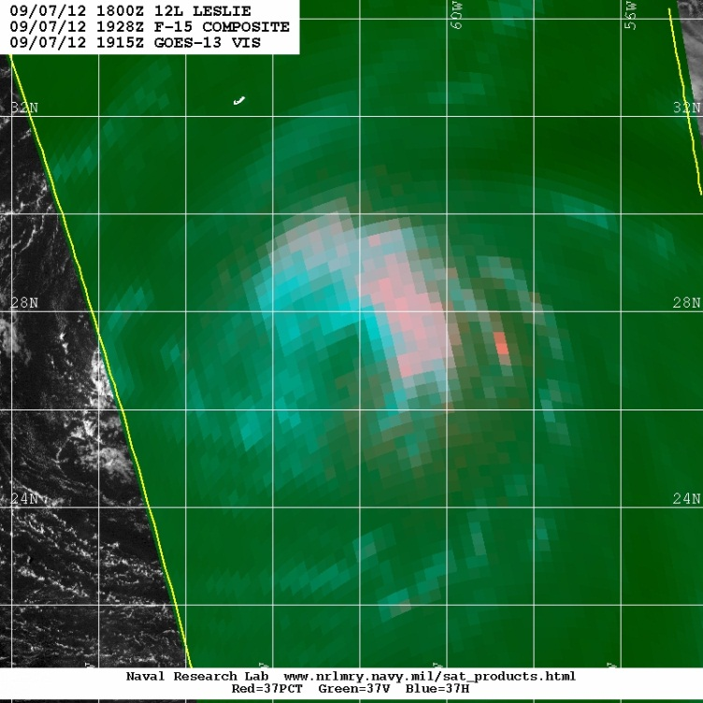
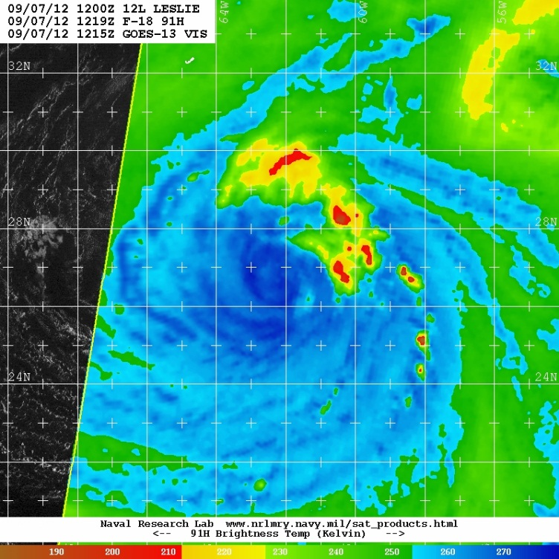
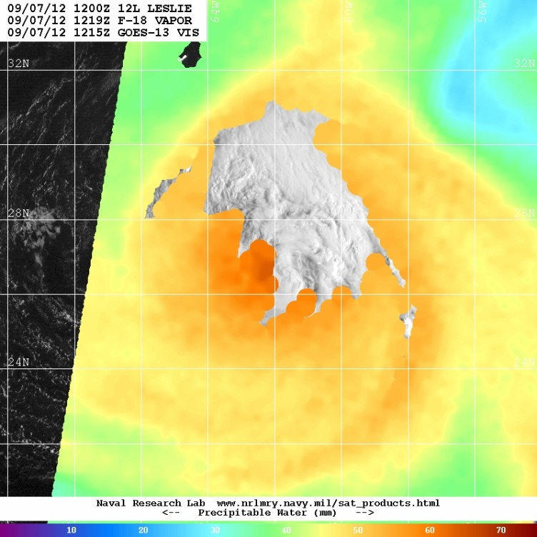

Slide 4
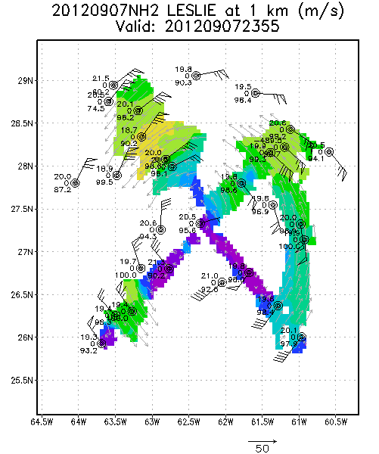
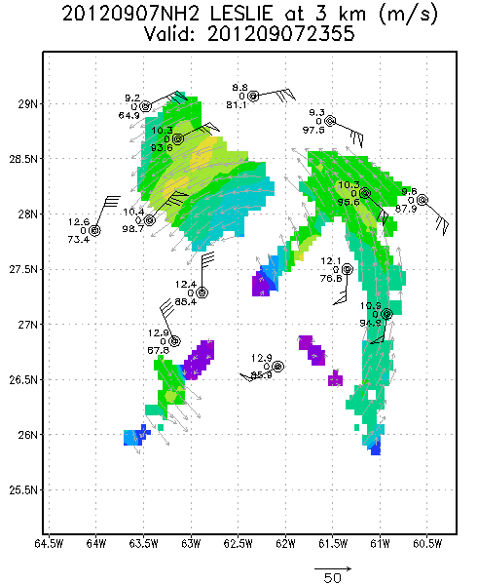
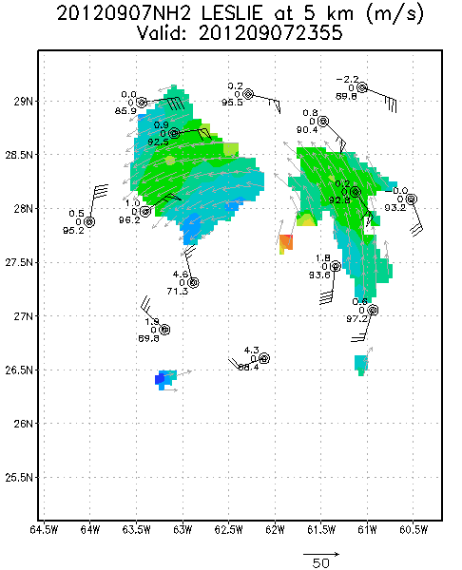

Slide 5
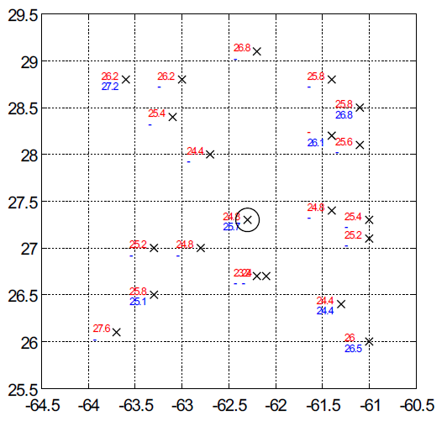
Sea Surface and Air Temps

