Slide 1
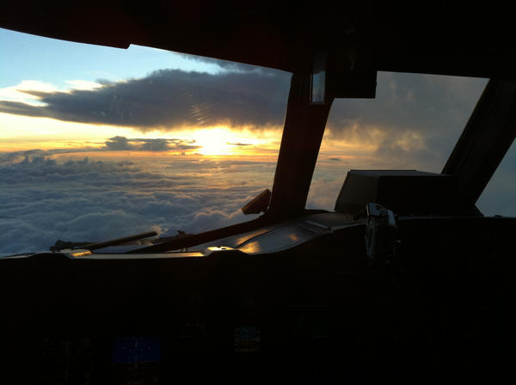
Hurricane Leslie Debrief
14 Sept. 2012
Sunrise looking east of Leslie on 7 Sept. 2012
Image taken onboard NOAA42, courtesy of AOC

Slide 2
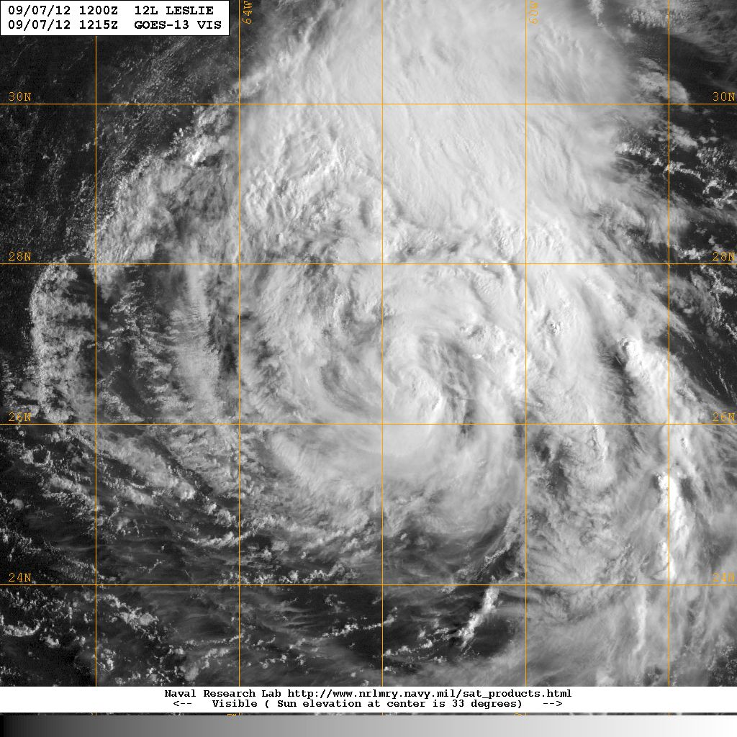
Debrief outline
Overview
P-3 TDR and G-IV missions
Science discussions (LPS will lead)
ASPEN from the ground - a plan
HEDAS presentation
NASA HS3 coordination so far
Other issues

Slide 3
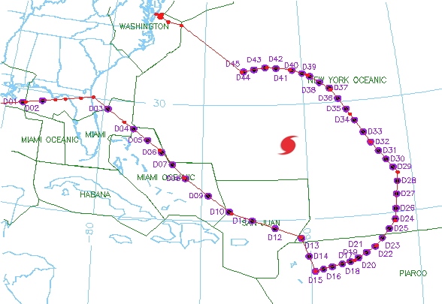
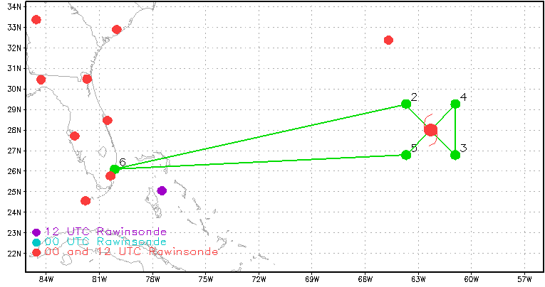
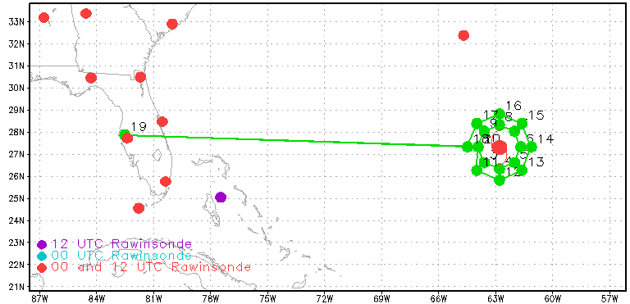
Missions into Leslie
Sept. 6, 2012
Global Hawk
Sept. 7, 2012
NOAA 42 - Ferry (KMCF to FLL)
NOAA42 - 8Z take-off
NOAA42 - 20Z take-off
NOAA49 - 21Z take-off
Sept. 8, 2012
NOAA42 - 8Z take-off
NOAA42 - 20Z take-off; Cancelled
NOAA49 - 21Z take-off; Cancelled
NOAA42 - Ferry (FLL to FLL)
Global Hawk track
NOAA42 track
NOAA49 track

