Slide 1
Track error (NM)
Intensity error (Kt)
(30)
(28)
(26)
(24)
(21)
(17)
(13)
Forecast time (hr)

Slide 2
Bias (NM)
Track relative error (%)
Intensity relative error (%)

Slide 3
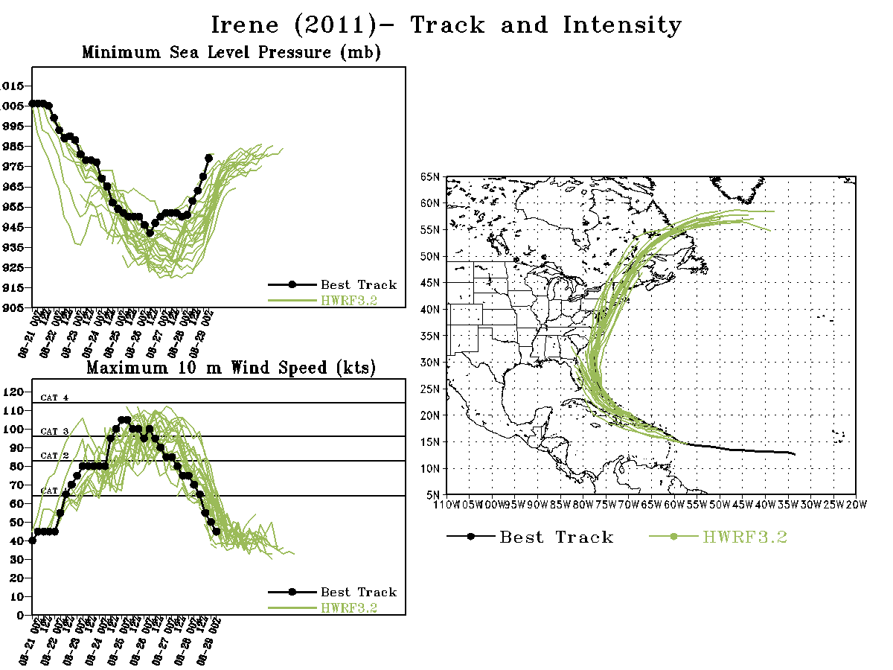

Slide 4
