Slide 1
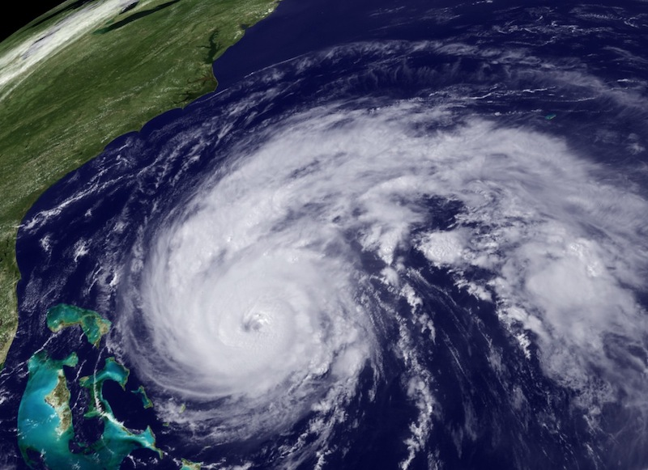


NOAA Hurricane Forecast Improvement Project
Frank Marks
HFIP Research Lead
10 November 2010
Notes:
Hurricane Earl 2 September 2010

Slide 2
HFIP Organization Structure
HFIP Leadership: Frank Marks (Research Lead), Ed Rappaport (Operations Lead), Fred Toepfer (Project Manager), Bob Gall (Development Manager)
FY2010 Teams | Team Leads and Member’s Organization
1. Global Model/Physics Development Team | Benjamin (ESRL), Brown (ESRL), HRD, NRL, GFDL, EMC, NRL
2. Regional Model/Physics Development Team | Bender (GFDL), Kwon (EMC), HRD, NRL, ESRL URI, Old Dominion Univ, NESL
3. Ensemble Development Team | Toth (ESRL), Reynolds (NRL), HRD, PSU, EMC, NHC, FSU
4. Data Assimilation/Vortex Initialization Team | Lapenta (EMC), Whitaker (ESRL), NRL, HRD, CIRA, PSU
Verification Team | Marchok (GFDL), Brown (RAL), NRL, NESDIS/STAR, HRD, NHC, EMC, ESRL
6. Applications Development and Diagnostics Team | Rappaport (NHC), DeMaria (NESDIS/STAR), EMC, NRL, HRD, RAL, ESRL, OU, FSU
7. Hurricane Observations Team | Aberson (HRD), Shay (RSMAS), NHC, HRD, EMC, NESDIS/STAR, ESRL, URI, NRL, AOC, RAL
Ocean/Wave Model Team | Tolman (EMC), Halliwell ( AOML), URI, ESRL, NRL, RSMAS, HRD

Slide 3
FY10 Project Summary
Item | Responsibility | Status
Complete Full-Scale HFIP Development Plan | HFIP PM | Complete.
2010 Funds distributed to all participating organizations | HFIP PM | Complete.
Complete and Submit Draft of National R&D Agenda for Improved Global Atmospheric Prediction for Community Wide Review. | HFIP PM | Complete.
R&D report on CY09 Technical Accomplishments | HFIP PM | Complete
CY10 Computer Resources | HFIP PM | Boulder system (tJet) was increased from ~2,300 cores to ~10,600 cores; Have ~ 10MH DOE resources left. Received 1.4MH for NRL resources at Stennis. Completed new proposal for additional computing at Oakridge (40M).
HFIP Scientific Steering Committee | HFIP Science Lead | Draft Charter Prepared – need HEOB approval.
Weekly Team Telecons and Team Status Reporting | HFIP TM | Ongoing
Organization Status Reporting | HFIP PM | Ongoing

Slide 4
FY10 Milestone Summary
Status | # | Notes
Completed | 26
Ongoing | 7 | (3) Ongoing; NCAR Status not provided for (4) milestones
Late | 2 | Release Plan for Improving Physics and Initialization in Regional Models. (Naomi) Will be completed by end of 3rd quarter. Implement NAEFS upgrade to include FNMOC ensembles. Date slipped to Jan 2011 due to system maintenance at NCEP.
Not Accomplished as Planned. | 2 | 1. “Run 15km Global Ensemble for 2008, 20 members” will be accomplished at 30km rather than 15km due to computer resource constraints. - Will be completed at 30km by 4th quarter. 2. “Obtain and Install AXBT Receivers and additional Ocean Probes”. AOC has a contract ready to award for the AXBT receivers, but the manufacturer encountered some problems with their performance. AOC is working with them and Dr. Nick Shay of the University of Miami to resolve the issue. AOC expects to have them in place next season. Many of the ocean probes have been delivered and are being used this season.
Total | 35

Slide 5
Operational System
(Stream 1) Upgrades
Global Forecast System (GFS) upgrades (Dec 2009)
  Added tropical storm pseudo sea-level pressure observations
  Additional observations (NOAA19 HIRS/4, AMSU-A, & MHS brightness temperature, EUMETSAT-9 atmospheric motion vectors)
GFS upgrades (May 2010)
  Resolution increase (27 km from 38 km)
  Improved Physics (radiation, gravity wave drag, mountain blocking, shallow convection, PBL, deep convection with overshooting cloud tops)
  Removal of computational artifacts e.g.: negative water vapor
HWRF upgrades (May 2010)
  Upgrade surface exchange coefficients
  Coupling with HyCOM ocean model

Slide 6
HPC Augmentations
2008
  15M Hours – NSF-supported Texas Area Computing Center (TACC)
2009
  NJET Boulder ~2MHours/month starting 9/2009
  TACC – HFIP 20M Hours 7/1 – 12/31
  TACC PSU 13M Hours for High Resolution ARW Ensembles and DA
  115K Hours/month on NOAA R&D Computer in Gaithersburg
  NCEP backup computer (Cirrus) for HWRF testing
2010
  NJET ~2M Hours/month until 9/2010
  DOE ORNL Jaguar - 20M hours
  TACC – 2.5M hours 1/1 – 6/30
  Add ~3000 processors to njet 8/2010 through purchase of tjet
Notes:
FY10 Demo System:
Improved EnKF and 4DVAR DA systems for global models.
Improved DA systems for regional models.
High resolution global ensembles (resolution 15-25 km) .
Multi model global ensembles (possible candidates—FIM, Cubed Sphere, GFS).
Regional single model ensemble.

Slide 7
HFIP HPCC Configuration
 | Install Date | Cores | Performance (Tflops) | Storage (Tbytes)
Phase 1 | Aug 2009 | 3184 | 35.6 | 350
Phase 2 | Sep 2010 | 10600 | 113.0 | 416
Combining HFIP with additional 3112 cores from other projects. Measured Linpack result is 126.5 Tflops
  35th on June 2010 Top 500 list
Current system is 10128 cores on tJet and 472 cores on nJet
Sharing of infrastructure and resources allowed for a bigger single system (tjet)

Slide 8
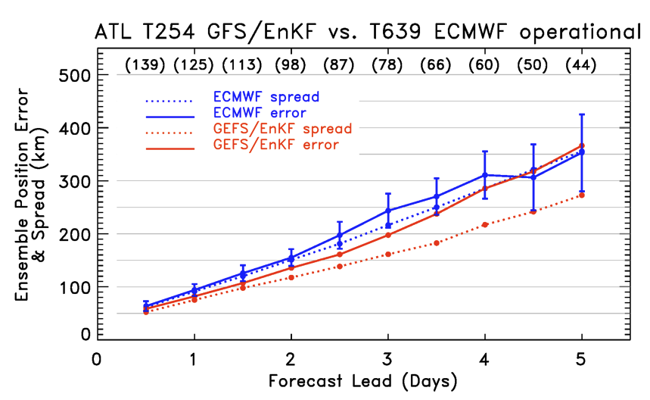
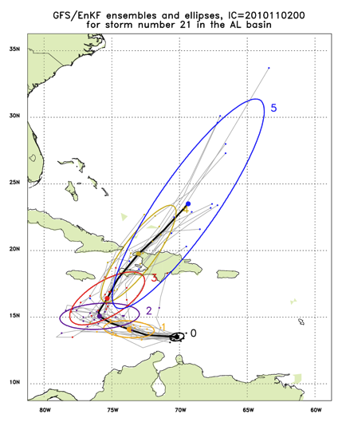
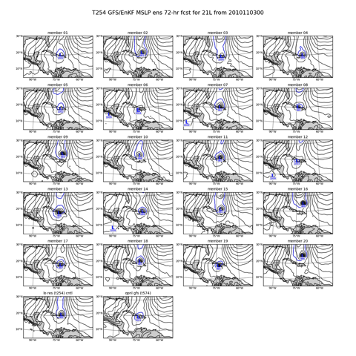
Global Model Development – GFS/EnKF
Tomas (21L) – init 00Z 2 November
http://ruc.noaa.gov/hfip/gfsenkf
GFS
Courtesy of Tom Hamill & Jeff Whitaker (ESRL)
Notes:
Global Ensembles:
80-member T254 GFS ensembles cycled every 6-h continuously from 1 August to current time
Look at 20 members of the 80 member ensemble
Left panels shows ellipse plot of 20 members at each forecast time – ellipse shape shows the spread along/across track
Right panel show surface pressure post stamp images of 20 members

Slide 9
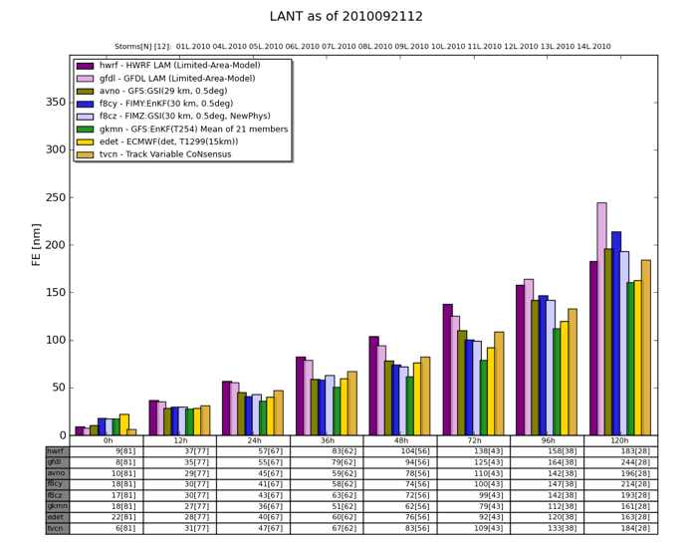
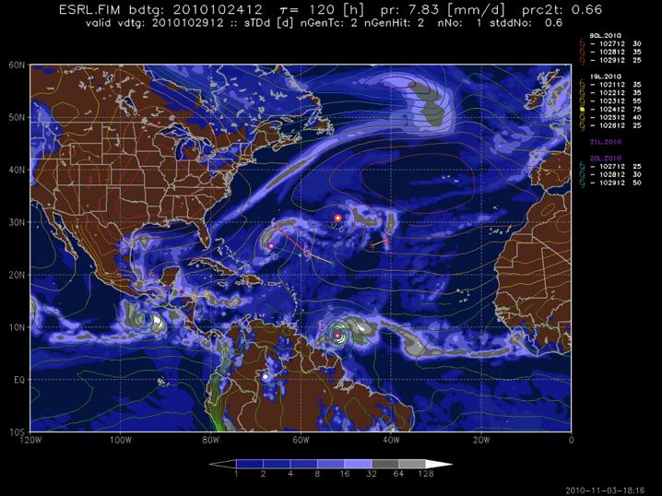
Global Model Development - FIM
Shary
Tomas
FIM
Courtesy of Stan Benjamin & Mike Fiorino (ESRL)
Notes:
FIM Deterministic models run each day during Aug-Sep 2009:
30 km (Initialized with GSI-3DVAR and EnKF).
15 km (Initialized with EnKF).
10 km (Initialized with EnKF).
Global Ensembles:
30 km FIM (initialized with EnKF) 20 members.

Slide 10
HWRF code management:
facilitate research & operations collaboration
WRF Repository
Extensive Testing
Stream 1
Stream 2
02/2011
WRF V3.2+
HWRF operational configuration (2011)
04/2010
WRF V3.2
WRF V3.2
HWRFx
2010
07/2009
WRF V3.1.1
upgrades
2011
WRF V3.1
HWRFx
2009
04/2009
WRF V3.1
04/2008
WRF V3.0
WRF V3.0
add moving nest
HWRFx
2008
12/2006
WRF V2.2
08/2005
WRF V2.1
05/2004
WRF V2
oper HWRF
2007
oper HWRF
2008
oper HWRF
2009
oper HWRF
2010
Ligia Bernardet (DTC), Vijay Tallapragada (EMC), & Gopal (HRD)

Slide 11

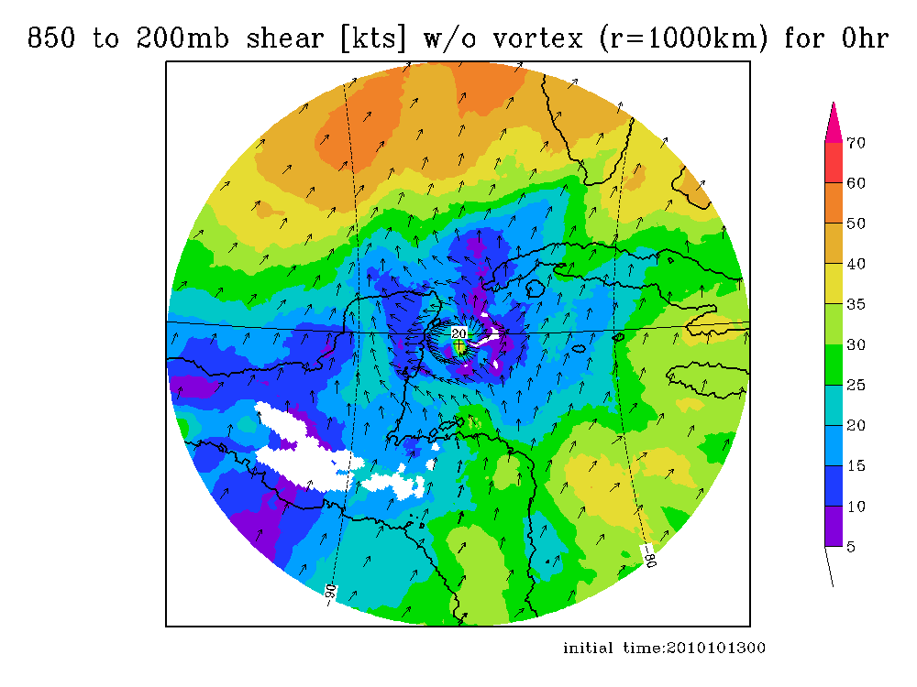
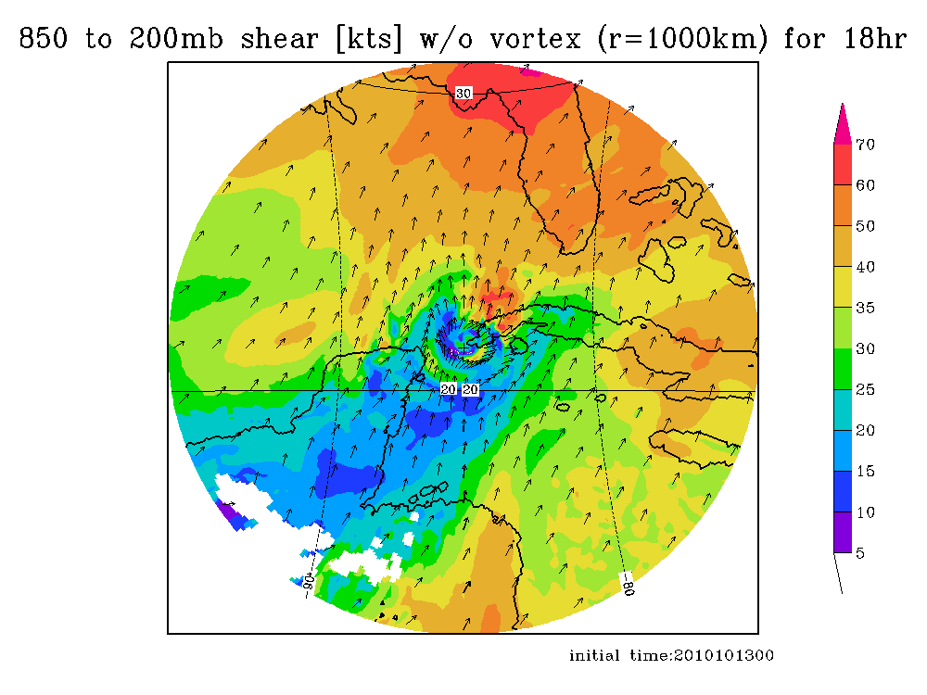
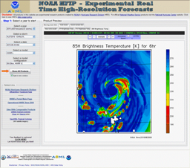
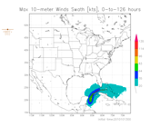
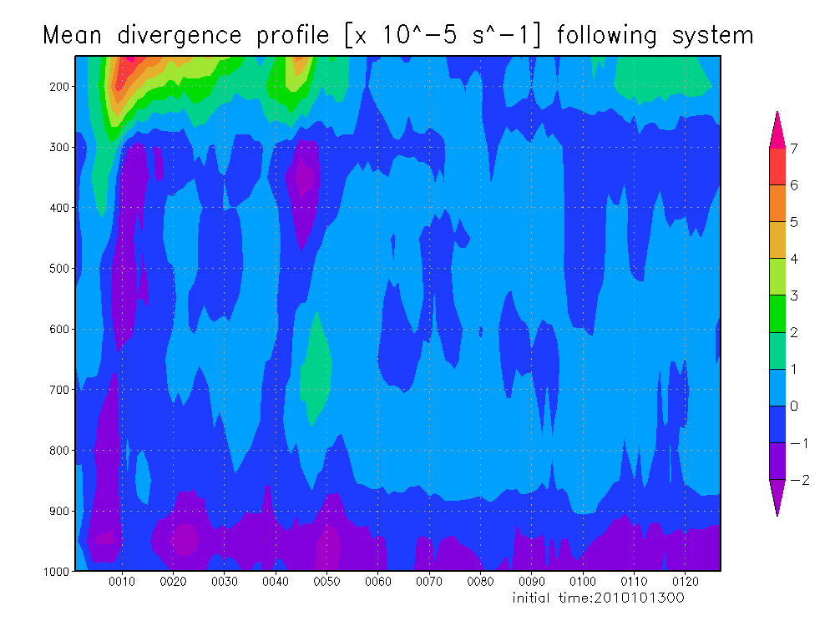
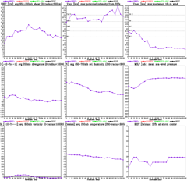
https://storm.aoml.noaa.gov/realtime
HFIP stream 2 (9/3 km resolution)
  HWRFX with HWRF IC
  HWRFX with HEDAS IC
  HWRFV3.2-HRD
All Storms of 2010
  4 cycles per day
  431 cases in 24 storms
19 main products; e.g.,
  Synthetic microwave imagery
  SHIPS predictors
  Shear and Steering
  Time-height cross-sections
  Swaths (wind and rainfall)
Courtesy of Gopal & Thiago Quirino (HRD)
Notes:
Demo 2011 season; Not only we have improved the products but also added a suite of NOAA HWRF systems at different configurations.
Example of Hurricane Paula

Slide 12
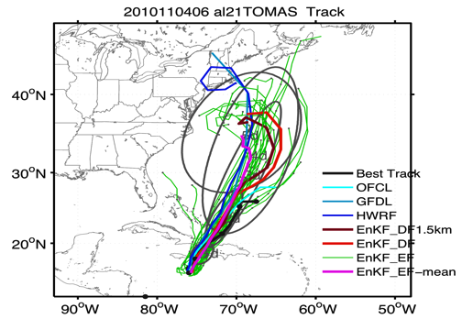
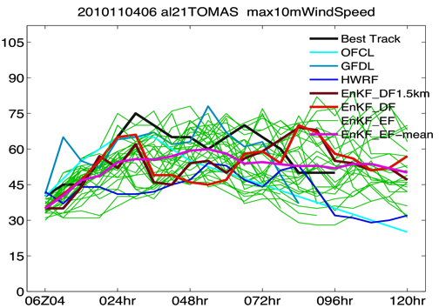
Single Model Ensembles: Earl
ICs: GFS-EnKF analysis
BCs: GFS forecast
ARW
Courtesy Fuqing Zhang (PSU)

Slide 13
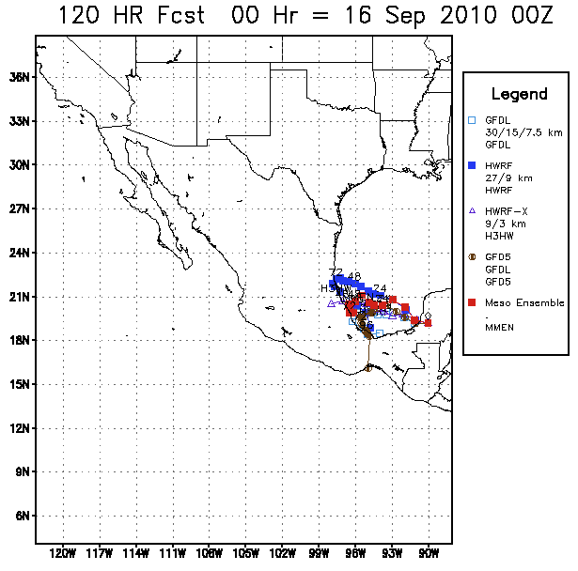
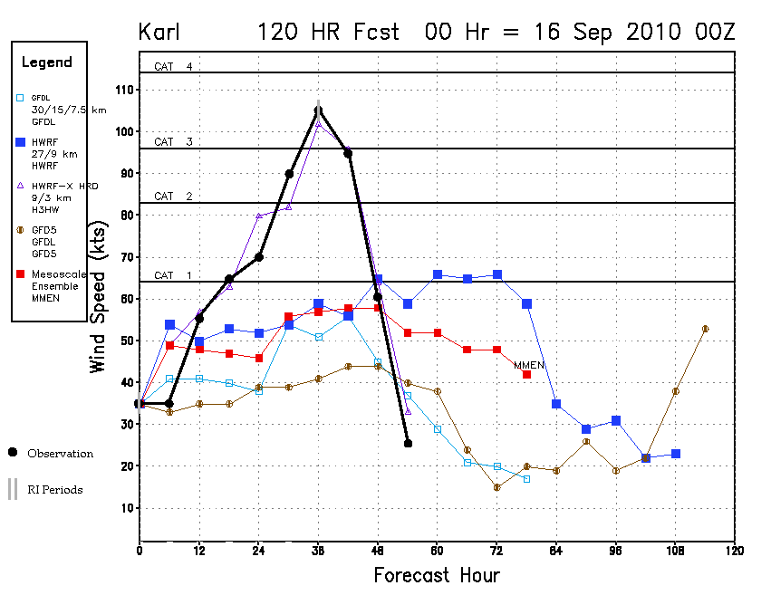
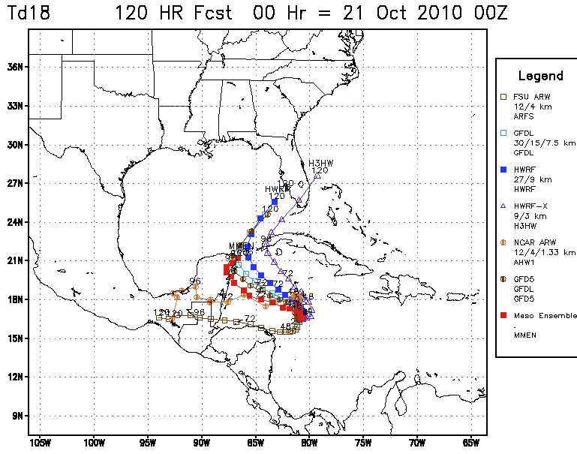
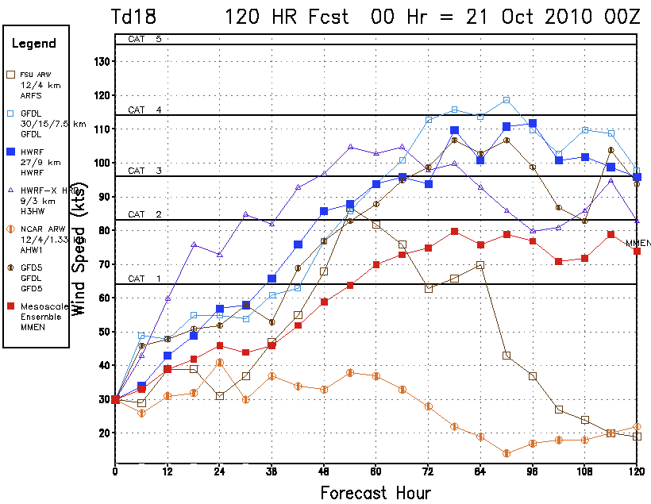
Multi-model Ensembles
Hurricane Karl
Hurricane Karl
2010 season:
Multi-model regional ensemble
Regional models do better on intensity for strong hurricanes (Karl), but worse for weak systems (TD18/ Richard)
TD 18 (Richard)
TD 18 (Richard)
Courtesy of DTC & FSU

Slide 14
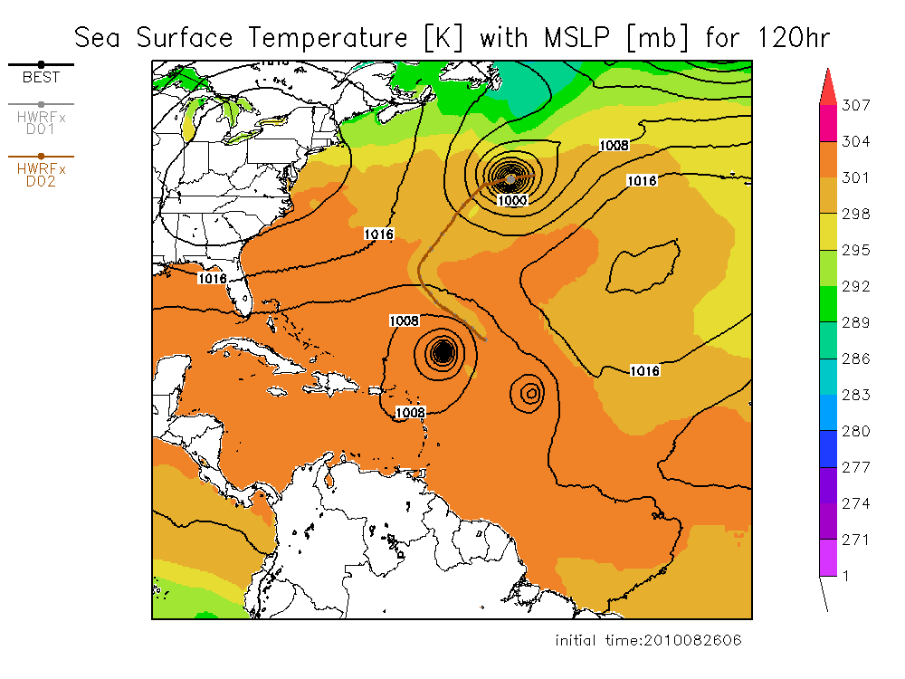
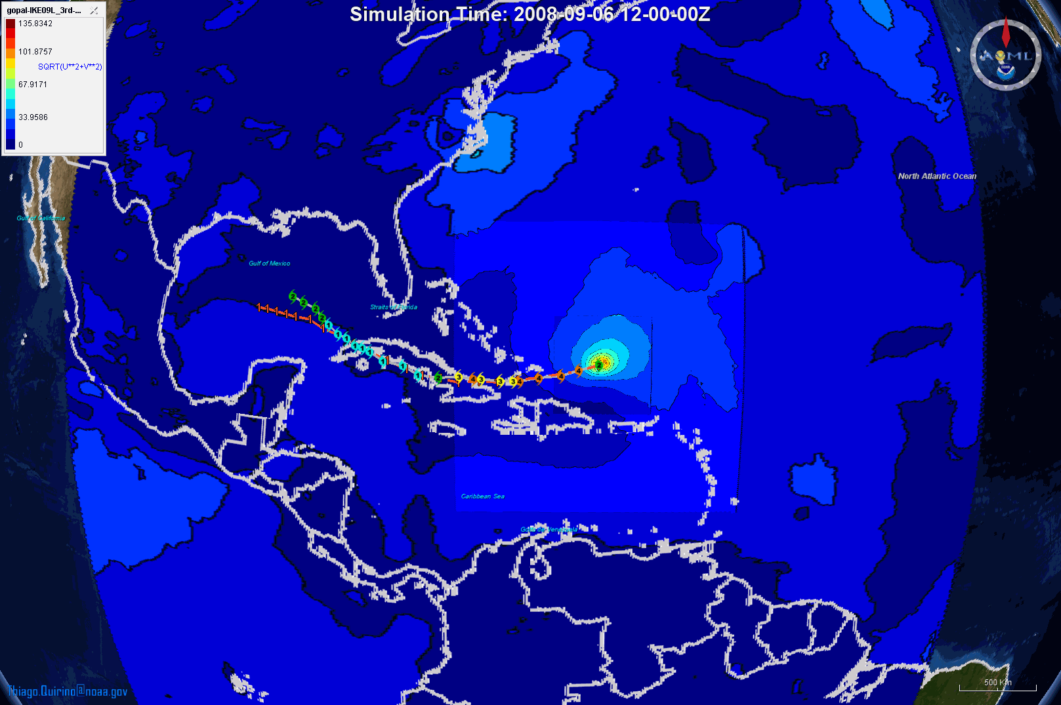
HWRFx-HWRFV3.2 Transition
HWRFV3.2
HWRFV3.2
Ike Simulation at 27:9:3
Forecast at 9:3
Evaluation of the system at 9:3 (Stream 2)
Evaluation of the operational configuration (27:9:3) (Stream 1 & 1.5)
Improved initialization at 3 km resolution (HEDAS & HWRF)
Advancing physics at 3 km resolution
Vijay Tallapragada (EMC), & Gopal (HRD)
Notes:
Danielle, Earl and Fiona
3-km from 9:3 will be used as the base line for operations at 27:9:3
14

Slide 15
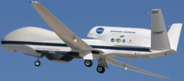
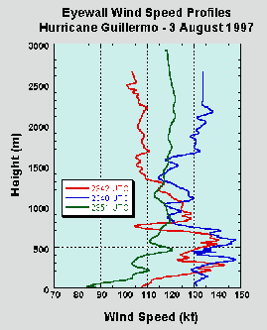

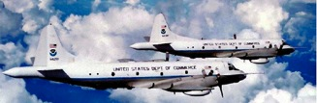
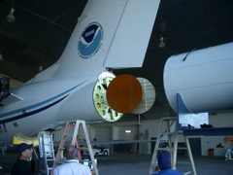

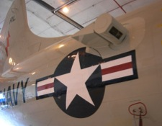
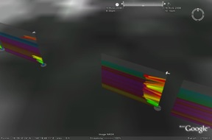
Improved Use of Observations:
Intensity Forecast experiment (IFEX 2010)
In-situ
  Wind, press., temp.
Expendables
  Dropsondes
  AXBT, AXCP, buoy
Remote Sensors
  Doppler Radar
  SFMR/HIRAD
  WSRA
  Scatterometer/profiler
  UAS
Global Hawk UAS
G-IV Tail Doppler Radar
ONR DWL
Rob Rogers, AOML/HRD
Notes:
UR image depicts dropsonde profiles in eyewall of Hurricane Guillermo (1997)
LR image is Doppler Wind Lidar profiles from TCS-08

Slide 16
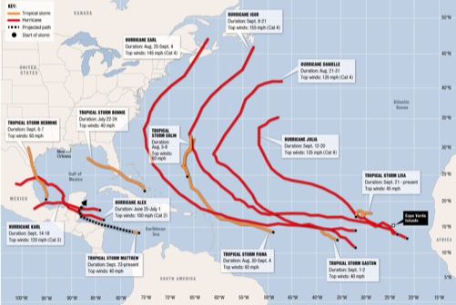
Improved Use of Observations:
Intensity Forecast experiment (IFEX 2010)
To date:
  NOAA aircraft flew ~375 h (28 P-3 and 22 G-IV missions) in 8 tropical systems, and 3 Gulf ocean survey missions
  Deployed ~1000 GPS dropsondes; ~250 ocean probes (AXBT/CP/CTD)
  Performed 75 Doppler analyses & SO data sets, 130 H*Wind analyses
  Performed 560 HWRFx simulations in 19 storms and 10 invests
  19 HEDAS analyses & HWRFx runs for Hurricanes Earl, Karl, & Tomas
  2 coordinated P-3/Global Hawk missions – 1 each in Earl & Karl
  ONR DWL installation delayed
  G-IV TDR acceptance tests delayed
TD 2 & 5, TS Alex, Bonnie & Matthew, Hurricanes Earl, Karl, Richard, Tomas plus 3 Gulf ocean survey missions (+10 ocean survey missions in support of DWH spill - unprecedented upper ocean data set for coupled modeling)
For details see:
http://noaahrd.wordpress.com/category/ifex-discussion/
Tropical Depression 5
Duration: August 10-11
Top winds: 35 mph
Tropical Depression 2
Duration: July 7-8
Top winds: 35 mph
HURRICANE RICHARD
Duration: October 21-26
Top winds: 92 mph
Rob Rogers, AOML/HRD

Slide 17
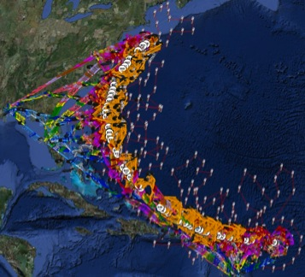
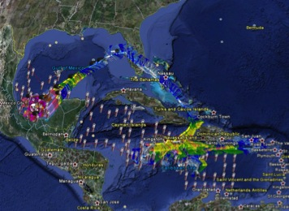
Improved Use of Observations:
Intensity Forecast experiment (IFEX 2010)
Earl data set:
  nearly complete lifecycle, sampled by P-3’s at 12-h intervals for inner core, 24-h intervals for environment by G-IV
  significant RI event sampled by Doppler radar prior to, during, and after
  steady-state period as a major hurricane sampled, including vortex interaction with increasing upper-level SW shear
  weakening stages sampled, including period leading up to ET
  First Global Hawk mission in hurricane
Karl data set:
  good coverage during pre-genesis stage with combined IFEX, PREDICT & GRIP dropsonde data
  disorganized circulation gradually became better organized during 36 h system was sampled by P-3
  significant RI episode sampled by P-3 Doppler radar, DC-8 & Global Hawk in Bay of Campeche
Hurricane Earl
Hurricane Karl
Rob Rogers, AOML/HRD

Slide 18


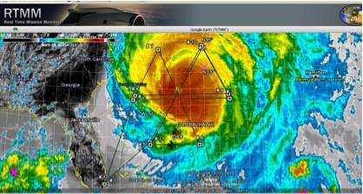
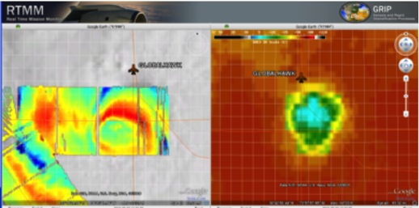
Successes from Earl Flight
Global Hawk UAS flight into Hurricane Earl
RTMM GH-DC8 Coordination (top) and HAMSR imagery overlaid on satellite images (bottom)
24 h mission (8 h on station)
Ability to overfly a major hurricane (7 overpasses of eye)
Mission scientists able to work with GH pilots on real time track changes
Coordination with other aircraft possible and effective (3 passes with DC-8)
All instruments worked well* and most provided real-time data and/or imagery
*GPS dropsonde system not installed
Mike Black, AOML/HRD
Notes:
Images on Right: RTMM GH-DC8 Coordination (top) and HAMSR imagery overlaid on satellite images (bottom)
7 eye passes attempted, 5 directly over, 1 near miss, 1 detoured around eyewall due to lightning
3 passes were coordinated with NASA DC8 beneath the GH
Very little turbulence encountered at 60 kft
Many real time flight changes were made

Slide 19
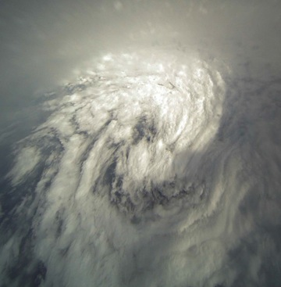
Pros & Cons of Global Hawk as TC research platform
Pros
Long (+24 hr) duration flight time
Continuous monitoring of storm for 15-20 h if deployed closer to targets
Large payload for remote-sensing instruments
Ability to profile entire depth of troposphere
Cons
Long (days) turnaround time between flights
Complicated & expensive support needed to fly
Very little in-situ measurements
Earls eye/eyewall from 60,000 feet
Mike Black, AOML/HRD

Slide 20
Improved Models & Data:
Model evaluation
Critical to HFIP success: Massive amounts of simulation output:
  High-resolution hurricane (HRH) test: 69 cases (2005 & 2007) for 6 model teams - >50 Tb
  2008 & 2009 HFIP Real-time test – >70 cases plus multi-model regional ensembles - >70 Tb
  2010 Demonstration -> 30 storms & invests plus multi model ensembles -> ~400 Tb
Need diagnostic tools to evaluate more than track and peak wind (e.g., large-scale, vortex-scale, convective scale, probability)
Application Development & Diagnostics Team

Slide 21
FY 11 Funding
Funding for FY11 is continuing resolution
HFIP Funding for FY10:
Dedicated for HPC $3.000M
OAR Base $6.020M
NWS Base $14.040M
Total $23.060M
Anticipated Funding for FY11:
Dedicated for HPC $3.000M
OAR Base ~$6.101M
NWS Base $13.040M
Total ~$23.141M
No anticipated internal reprogramming anticipated

Slide 22
FY11 Priorities
Upgrade TJet, currently NOAA’s largest HPC System (126 tflops)
  Increase computing power by 50% to 15K cores
  Increase storage and capacity by 50%
Work with NWS, NOAA CIO and CFO to develop strategy to address need for addition operational HPC
  Capitalize on significant science improvements that translate into better forecasts
Science Plan and Science Review Committee
Support effort for quantifying economic impact of improved hurricane forecasts
Development of probabilistic products for forecasters
Observing strategies

Slide 23
Challenges for HFIP
Improved intensity prediction at higher resolutions requires better understanding of model dynamical behavior in response to assimilated observations and physics.
  Current observations assimilated are not projecting onto the model to produce expected intensity changes.
  Current physics packages for global/regional hurricane models at higher resolution are not appropriate to capture hurricane intensity change.
High resolution global and regional ensemble systems are showing promise, but require further testing and evaluation.
Develop better products to convey ensemble information.
Need to ensure future operational computer power is available for transfer to operations.

Slide 24
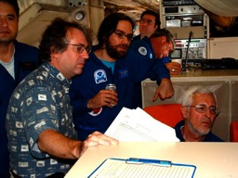
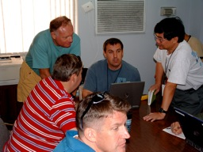
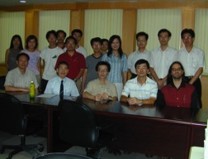
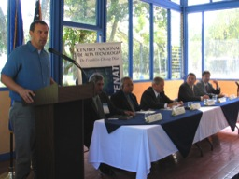
Keys to Success
  Partnership: AOML, ESRL, GFDL, DTC, USWRP, NESDIS/STAR working closely with Operations (EMC, NHC, AOC) and Federal & Academic Partners (NASA, NSF, ONR, NRL, NCAR, MMS)
  More integrated use & support of Testbeds: JHT, DTC, JCSDA
  Blend Traditional hurricane research activities and HFIP research activities
  Manpower (diversity) to evaluate model performance with hurricane data sets is a critical need
CBLAST
IFEX/RAINEX
DOTSTAR
IFEX/TCSP

Slide 25
Discussion Points
  Will be updating Dr. Alexander MacDonald, co-chair of HFIP Executive Oversight Board (HEOB), on Wednesday, November 24.
  Next HEOB Meeting scheduled for Thursday, December 9, 2010 from 1-3pm in SSMC3, Rm. 11836
    Topics will include:
      Review of FY10
      Plans for FY11
  How will OAR Reorganization and new SEE budget process affect HFIP, if any? -- Thoughts?

Slide 26
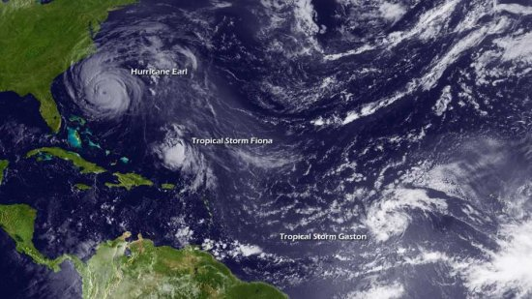
Questions?

