Slide 1
Observations and Modeling of Land-Falling Tropical Cyclones
Frank Marks
NOAA/AOML, Hurricane Research Division
24 January 2012

Slide 2
USWRP PDT-5
PDT-5 focused on landfall TC impacts (e.g., damage from wind, coastal inundation, freshwater flood, severe weather), not on traditional metrics, e.g., track and intensity
PDT-5 noted that to meet objectives required synergism between observations and modeling to isolate physical processes and evaluate models

Slide 3
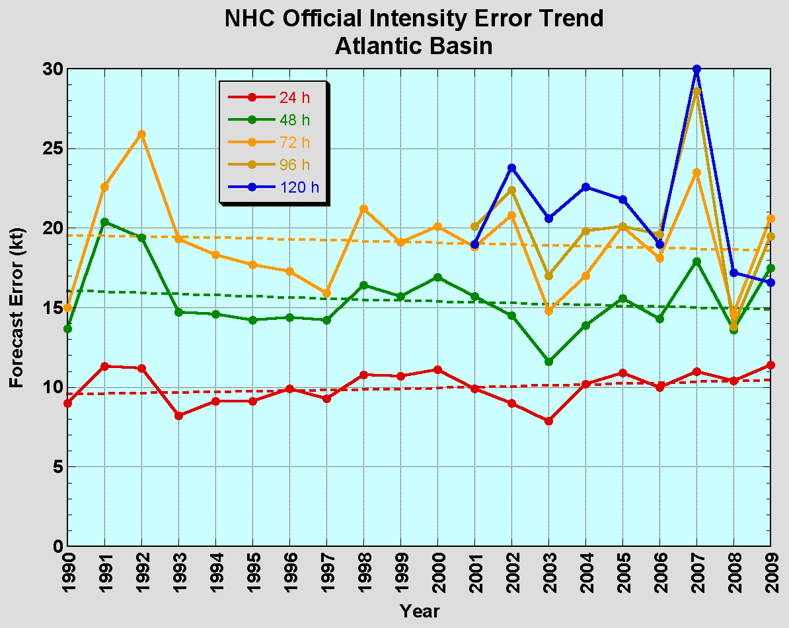
The Good – Track forecasts
Current Capabilities
The Bad - Intensity forecasts
No progress with intensity in last 15-20 years
10-year improvement - As accurate at 48h as we were at 24 h in 2000
24-48 h intensity forecast off by 1 category
Off by 2 categories 5-10% of time

Slide 4
Current Capabilities
Storm Size: Progress is difficult to measure due to inadequate observations
Storm Surge: Accurate within ±20% when track, intensity, and size known
Lead Time: Lead time was extended from 3 to 5 days in 2001
Precipitation: Modest annual improvements; forecast patterns match observations when track error is low
New/Improved Products: Refined cone graphic, wind speed probabilities, graphical tropical weather outlook, and probabilistic storm surge
Social/Behavioral Science: In its infancy

Slide 5
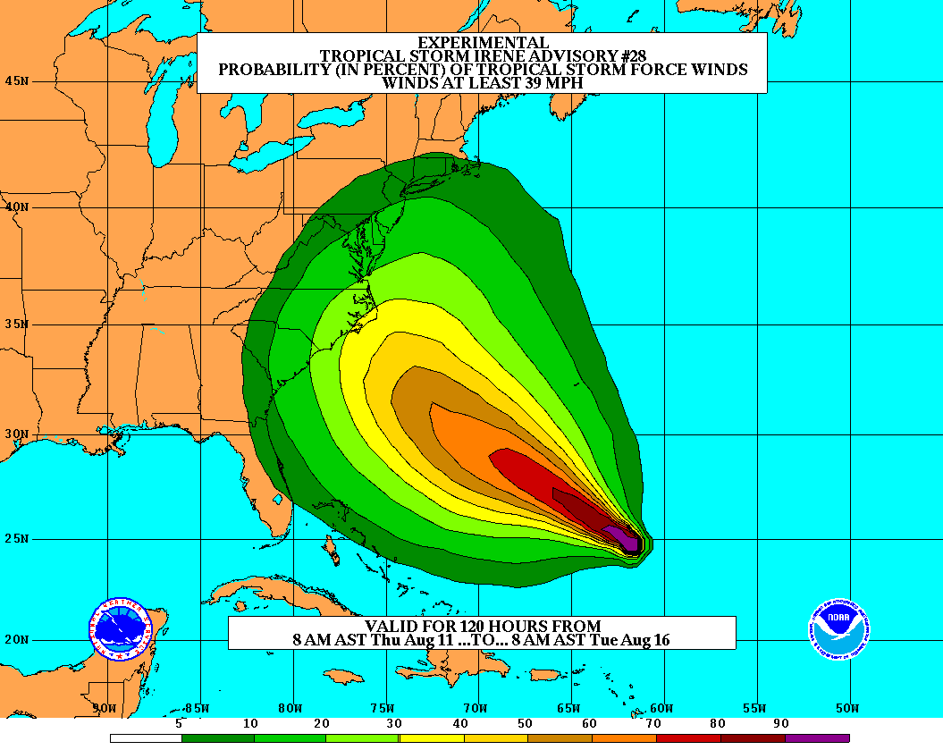
Improve Forecast Accuracy
Hurricane impact areas (track) – 50% in 10 years
Severity (intensity) – 50% in 10 years
Special Focus on Rapid Intensity Change (RI)
Extend forecast reliability out to 7 days
Quantify, bound & reduce forecast uncertainty to enable risk management decisions
http://www.hfip.org/
Notes:
http://www.nrc.noaa.gov/HFIPDraftPlan.html
HFIP Team
Frank Marks, research lead
Ed Rappaport, operations lead
Fred Toepfer, project manager
Robert Gall, development manager
Mark DeMaria
Chris Fairall
Jim McFadden
Scott Kiser
Daniel Melendez
Roger Pierce
HFIP executieve oversight board:
OAR DAA/Sandy MacDonald, co-chair
NWS AA/Jack Hayes, co-chair
NCEP/Louis Uccellini,
TPC/Bill Read,
NESDIS/Mark DeMaria,
NOS/Jesse Feyen,
AOML/Bob Atlas
PPI/Paul Doremus
NMFS/Bonnie Ponwith,
NOS/Liz Scheffler,
NMAO-PM Aircraft/Phil Kenul,
OFCM/Sam Williamson
Executive Secretariat: OAR/Joseph Bartosik and NWS/John Iacabucci

Slide 6
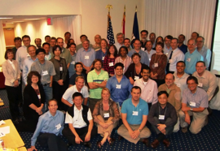
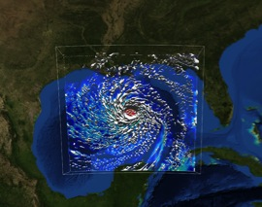
How to get there?
Science (9 Teams)
Improve understanding from combination of observations & models
Higher resolution coupled models – critical to storm evolution forecasts – especially intensity changes
Forecast techniques to understand, reduce & communicate uncertainty
Information Technology
Increased computing power- run advanced hurricane/global models and reduce uncertainty
IT infrastructure for inter-agency data exchange
Observing Strategy
Improved use of existing and planned systems
Improved Products for Forecasters
D1
Partnership: NCEP, AOC, AOML, ESRL, GFDL, DTC, USWRP, NESDIS
Notes:
Two Stream Approach to HFIP developments:
Stream 1– Operational Transition and Implementation
Stream 2 – Advanced Technology Demonstration
Unconstrained by near-term availability of operational computing
Uses both NOAA’s and computing resources from major supercomputing centers for testing and evaluation.
Emphasis is on high resolution global and regional models run as ensembles
Real-time or near real time runs during hurricane season
Stream 1.5 (JHT-like)
NHC Forecaster Defined.
Subset of Stream 2 that forecasters see as particularly promising or provides demonstrated capability
Will be configured to run in real-time and products made available to NHC.

Slide 7
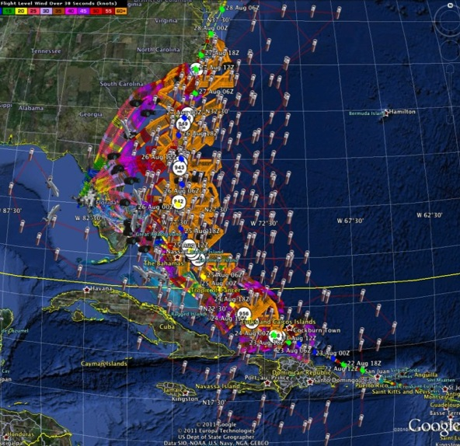
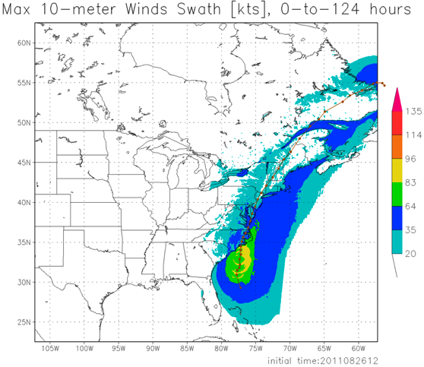
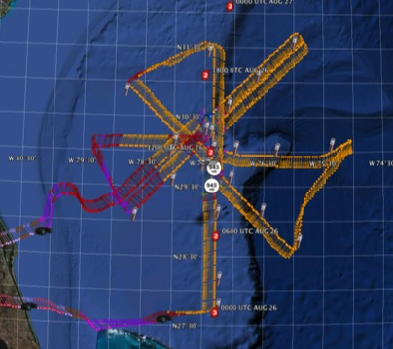
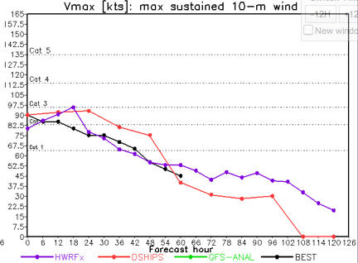
Improved Models & Data: IFEX 2011: Irene
HWRF/HEDAS
20110826 12UTC
Doppler SO (EnKF) transmitted in real-time for assimilation into HWRF
20110826I1
0926-1416 UTC
7 P-3 Flights
23 August – 27 August 2011
HWRF/HEDAS
20110826 12UTC
7 missions from 23-27 Aug 2011 at ~12 h sampling of Doppler SO (HEDAS) & 8 G-IV missions
Sampled Irene as a major hurricane through landfall
Aberson, Aksoy, Gamache, Gopal (AOML/HRD)
Notes:
Map shows flight tracks for all of the NOAA missions (color coded are the flight level winds for the P-3 missions, dropsonde symbols denote G-IV patterns)

Slide 8
Improved Models & Data: EnKF DA of inner core Doppler data
% Improvement over HFIP baseline
79 82 82 81 76 65 46 cases
All cases with Doppler data 2008-2011
Need help of Research community to address
F. Zhang (PSU) & Aberson (HRD)
Notes:
2004-2010 for Intensity improvement

Slide 9
USWRP PDT-5
PDT-5 noted that modest gains in prediction of impacts will lead to vast improvement over present state because cost-benefit is high.
Leading people to expend necessary resources to prepare property requires strong leadership from government, and a demonstrated track record of accurate, timely forecasts.

Slide 10
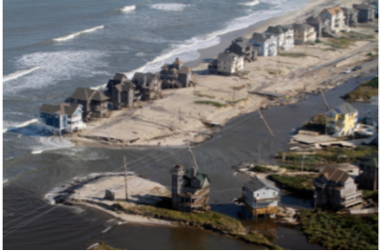
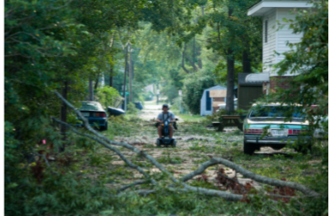
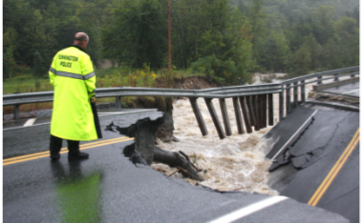
Where do we need to be?
NOAA’s National Weather Service (NWS) mission is to fulfill this commitment through building a Weather Ready Nation.
NWS must contribute to hazard resiliency by continually assessing and improving its services to the Nation.
Hurricane Irene (2011):
41 deaths
$7 to $10 Billion damage
Major infrastructure losses
Power lost to 8 million
Virginia Beach, Va
Hatteras Island, N.C.
Woodford, Vt.
Jim R. Bounds/AP
Austen Danforth/Bennington Banner/AP
Brendan Hoffman/Getty Images

