Slide 1
Can We Hope to Improve Prediction of Tropical Cyclone Intensity?
Frank Marks and Tomislava Vukicevic
NOAA/AOML, Hurricane Research Division
11 July 2012
Notes:
Hurricane Irene 27 August 2011

Slide 2
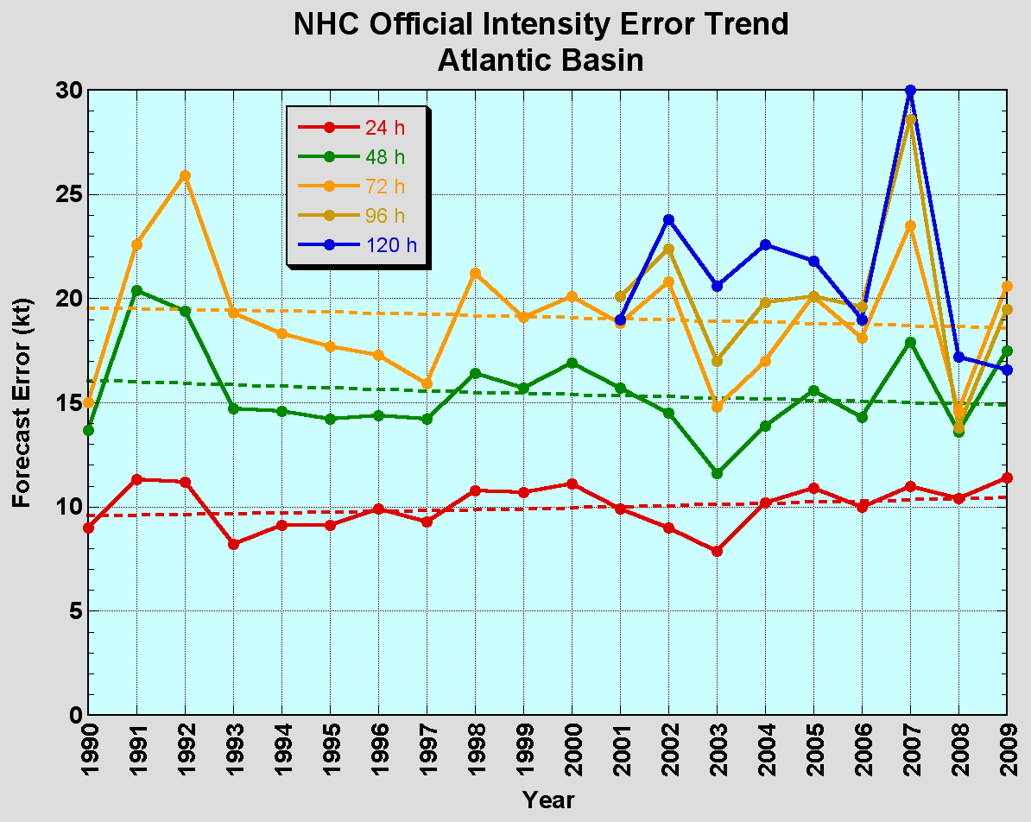
Forecast Reality
No progress with intensity in last 15-20 years
Notes:
NWS Directive (NWSI 10-604)
Hurricane. A tropical cyclone in which the maximum 1-minute sustained surface wind is 64 knots (74 mph) or greater.
Maximum sustained surface wind. When applied to a particular weather system, refers to the highest one-minute average wind (at elevation of 10 meters with an unobstructed exposure) associated with that weather system at a particular point in time.

Slide 3
Observation Reality

Slide 4
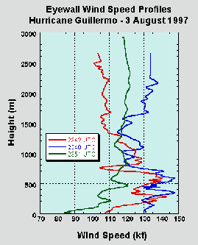
Observation Reality
Courtesy FCMP webpage

Slide 5
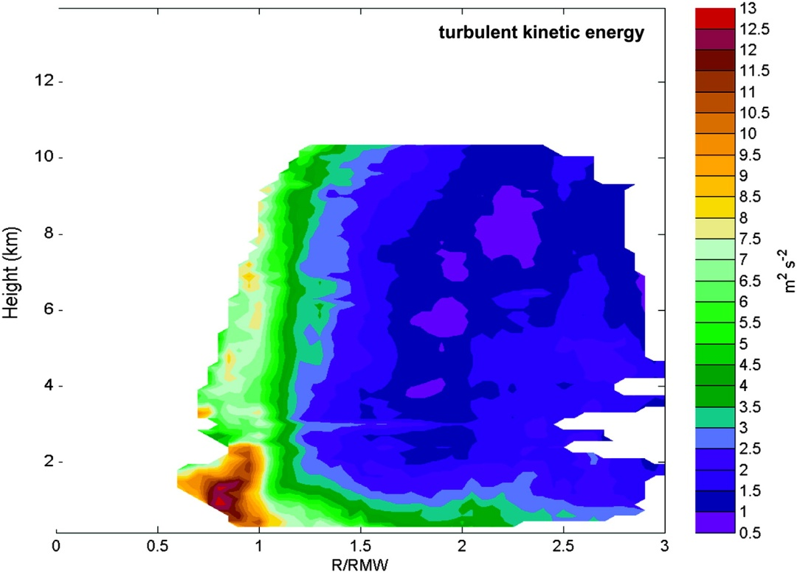
Observation Reality
TKE
Mean TKE
Mean Tangential Wind
Mean Radial Wind
Height (km)
Height (km)
Height (km)
R*
R*
Rogers et al (2012)

Slide 6
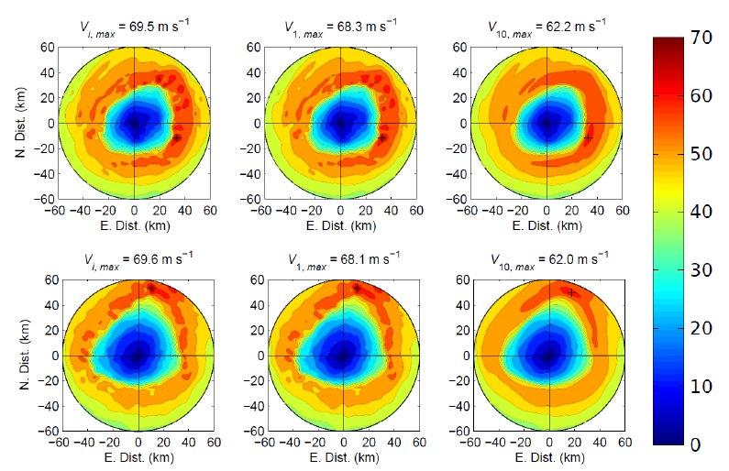
Model Reality
Instantaneous Vmax
1-min Vmax
10-min Vmax
T1
T2
Uhlhorn & Nolan (2011)
Notes:
FIG. 1. Instantaneous (left column), 1-min averaged (middle column), and 10-min averaged (right
column) 10-m winds for two periods of model simulation in which high-frequency model output
was obtained. Peak values for each field are indicated and locations are marked by plus signs.
32

Slide 7
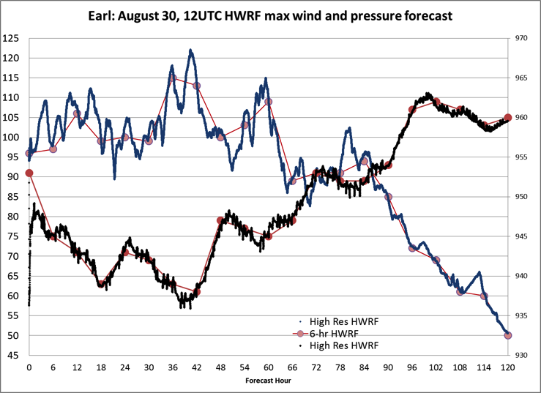
Model Reality
Minimum pressure
Peak wind
Courtesy D. Zelinsky (NHC)

Slide 8
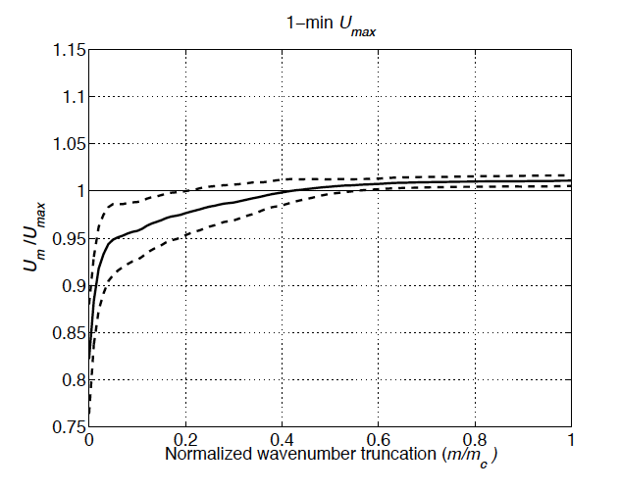
Sampling Conundrum
Wavenumber 34 or 3.1 km
Uhlhorn & Nolan (2011)

Slide 9
Model Reality
Uhlhorn & Nolan (2011)
Notes:
FIG. 4. Instantaneous to 1-min gust factor (Gi;1), defined as ratio of peak instantaneous wind
speed to maximum 1-minute average wind speed for the same simulated anemometer. Data is
within eyewall from both high-frequency model output periods.

Slide 10
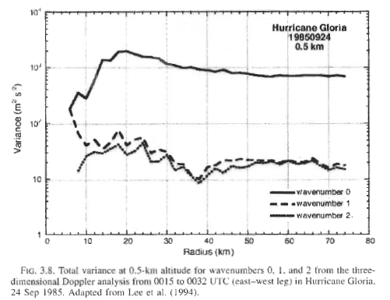
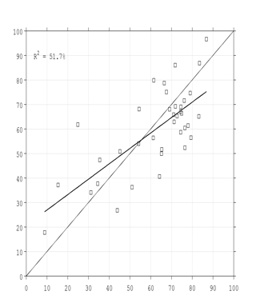
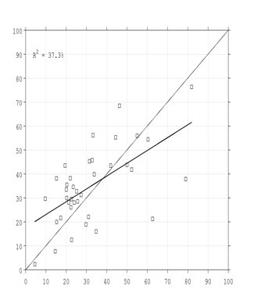
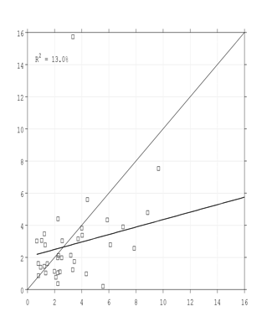
Potential Solution
Variance Explained (%) by Wavenumber Components of 1-km Tangential Wind Speed
Wavenumber 0
Wavenumber 1
Wavenumber 2
100
100
16
70-80%
Radar Observed (%)
20-30%
2-3%
100
100
16
HEDAS Analysis (%)
HEDAS Analysis (%)
HEDAS Analysis (%)
(courtesy A. Aksoy)

Slide 11
Simple Model
In storm centered polar coordinates maximum wind intensity (Vmax) at any (r, z) is defined as follows
Hypothesis: ε is a stochastic quantity with variance within observation uncertainty

Slide 12
Uncertainty (ε)
BT-Doppler
reduced to surface
BT-SFMR
BT-HEDAS
Courtesy P. Reasor, E. Uhlhorn and B.Klotz

Slide 13
Conclusions
PDFs suggest ε is stochastic and Vmax can be treated statistically consisting of low-wavenumber plus residual
Residual standard deviation <Vmax observation error
Residual can be interpreted as maximum Vmax error
PDF suggests Vmax is represented in analyses, and is accurate to within observation error of ~4.6 m s⁻¹
Results suggest that if low-wavenumber amplitudes and RMW are predictable with negligible errors, Vmax should be predictable within observation uncertainty
ε is likely predictability limit for 1-min sustained wind

Slide 14
Questions?

Slide 15
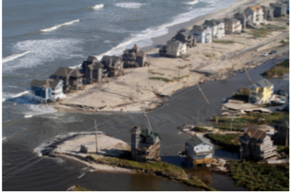
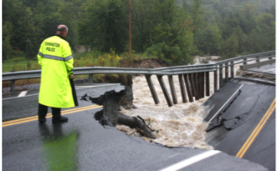
Improvements still needed!
NOAA’s National Weather Service (NWS) mission is to fulfill this commitment through building a Weather Ready Nation.
NWS must contribute to hazard resiliency by continually assessing and improving its services to the Nation.
Hurricane Irene (2011):
41 deaths
$7 to $10 Billion damage
Major infrastructure losses
Power lost to 8 million
Virginia Beach, Va
Hatteras Island, N.C.
Woodford, Vt.
Jim R. Bounds/AP
Austen Danforth/Bennington Banner/AP
Brendan Hoffman/Getty Images

