Slide 1
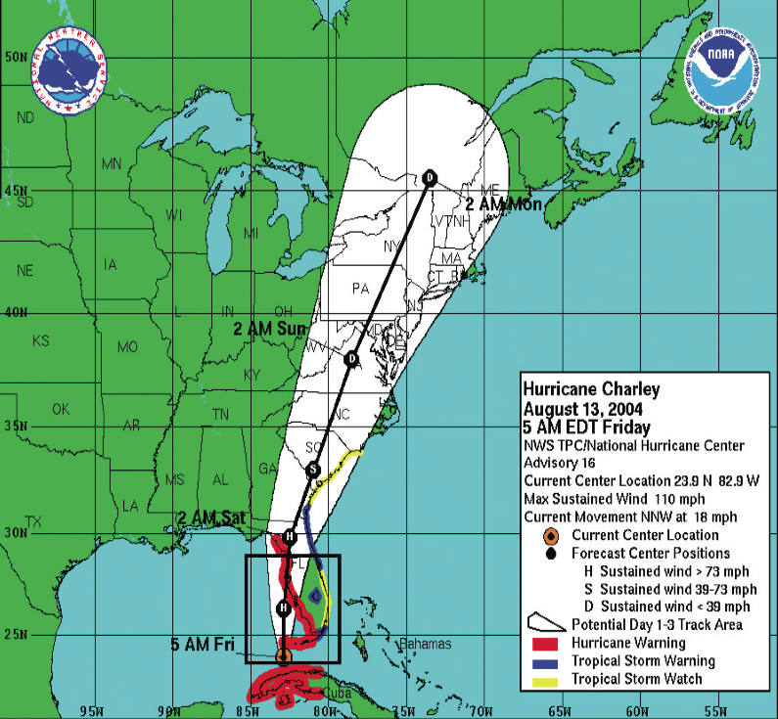
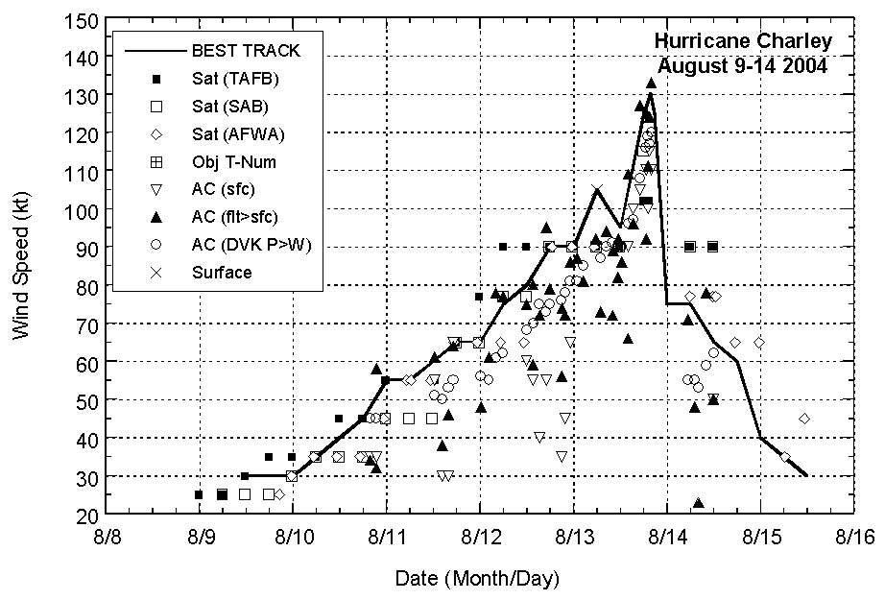
Winning! What Charlie taught us about hurricanes
Good track forecasts are not enough
Peak wind is not enough to determine impact
Rapid intensity change (RI) is most serious forecast issue
Forecast uncertainty needs to be better described

Slide 2
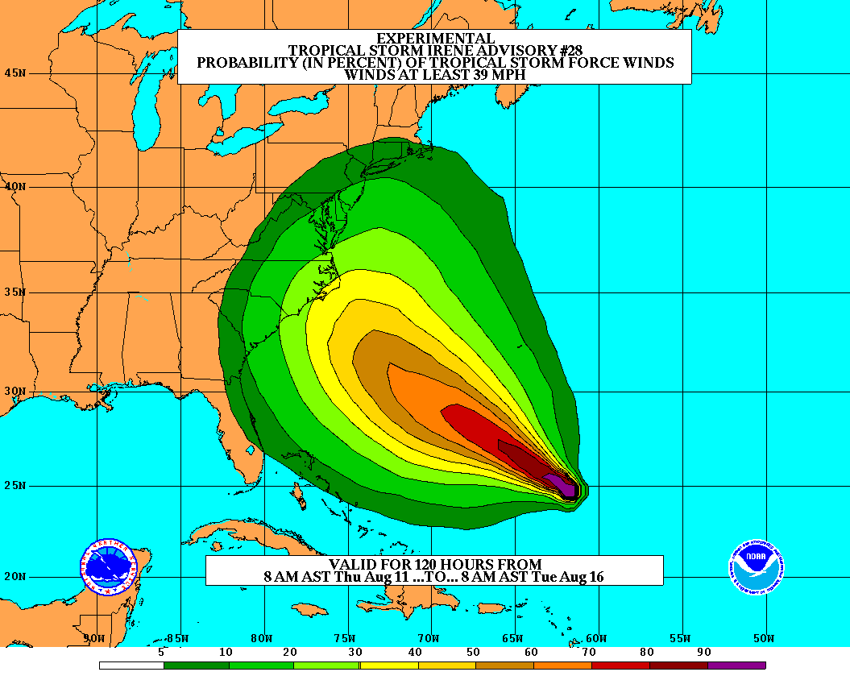
Goals
Improve Forecast Accuracy
Hurricane impact areas (track) – 50% in 10 years
Severity (intensity) – 50% in 10 years
Special Focus on Rapid Intensity Change (RI)
Extend forecast reliability out to 7 days
Quantify, bound and reduce forecast uncertainty to enable risk management decisions
http://www.hfip.org/
Notes:
http://www.nrc.noaa.gov/HFIPDraftPlan.html
HFIP Team
Frank Marks, research lead
Ed Rappaport, operations lead
Fred Toepfer, project manager
Robert Gall, development manager
Mark DeMaria
Chris Fairall
Jim McFadden
Scott Kiser
Daniel Melendez
Roger Pierce
HFIP executieve oversight board:
OAR DAA/Sandy MacDonald, co-chair
NWS AA/Jack Hayes, co-chair
NCEP/Louis Uccellini,
TPC/Bill Read,
NESDIS/Mark DeMaria,
NOS/Jesse Feyen,
AOML/Bob Atlas
PPI/Paul Doremus
NMFS/Bonnie Ponwith,
NOS/Liz Scheffler,
NMAO-PM Aircraft/Phil Kenul,
OFCM/Sam Williamson
Executive Secretariat: OAR/Joseph Bartosik and NWS/John Iacabucci

