Slide 1
Were Sandy’s Track and Intensity Changes Unusual?
Frank Marks, Hua Chen, & Gopal NOAA/AOML Hurricane Research Division
9 January 2014
Notes:
Hurricane Sandy 28 October 2012

Slide 2
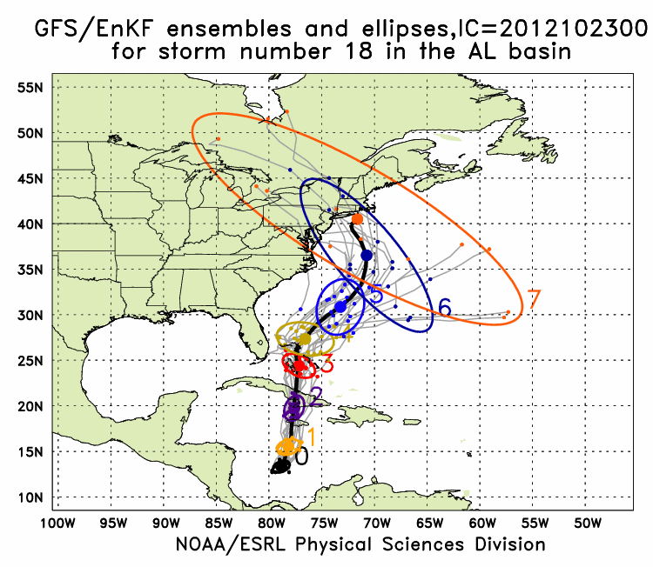
Sandy Track: GFS/EnKF & Basin HWRF
GFS/EnKF T382 20 member ensemble
Observed
http://www.esrl.noaa.gov/psd/forecasts/gfsenkf/ens/
Notes:
Model data available at: http://www.esrl.noaa.gov/psd/forecasts/gfsenkf/ens/
Global Ensembles:
80-member T254 GFS ensembles cycled every 6-h continuously from 1 August to current time
Look at 20 members of the 80 member ensemble
Left panels shows ellipse plot of 20 members at each forecast time – ellipse shape shows the spread along/across track
Right panel show surface pressure post stamp images of 20 members

Slide 3
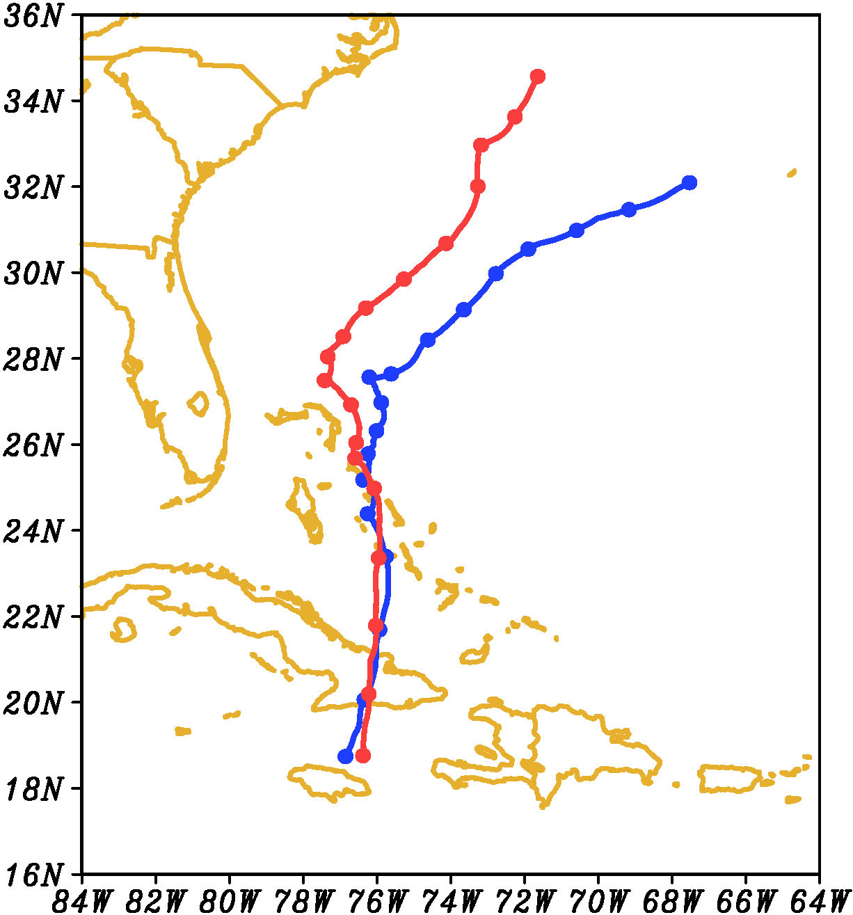
Sandy Track Start 00Z 25 October
96 h
00Z 24 October
(blue)
00Z 25 October
(red)
Tracks very similar to 36 h
(12Z 26 October)
96 h
72 h
72 h
48 h
48 h
24 h
24 h
00:00OCT25
Notes:
Images from: http://www.nhc.noaa.gov/verification/verify5.shtml

Slide 4
Basin HWRF 500 hPa
Init: 00Z 24 October

Slide 5
Basin HWRF 500 hPa
Init: 00Z 25 October

Slide 6
Basin HWRF 500 hPa
00Z 24-00Z 25

Slide 7
Sandy Track Start 00Z 25 October
96 h
00Z 24 October
(blue)
00Z 25 October
(red)
Tracks very similar to 36 h
(12Z 26 October)
96 h
72 h
72 h
48 h
48 h
24 h
24 h
00:00OCT25
Notes:
Images from: http://www.nhc.noaa.gov/verification/verify5.shtml

Slide 8
Basin HWRF 200 hPa PV

Slide 9
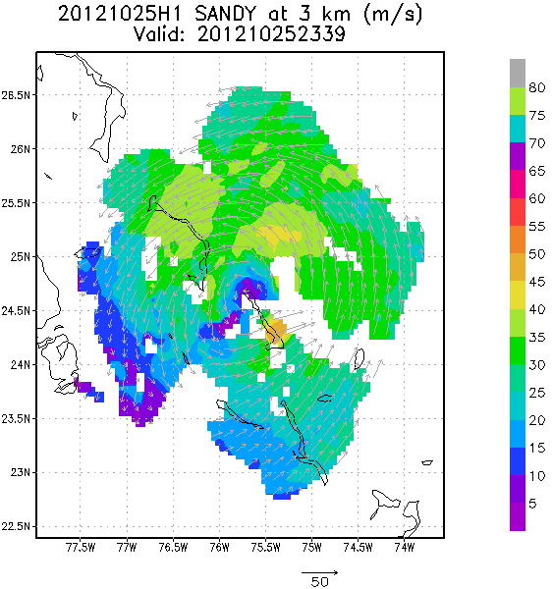
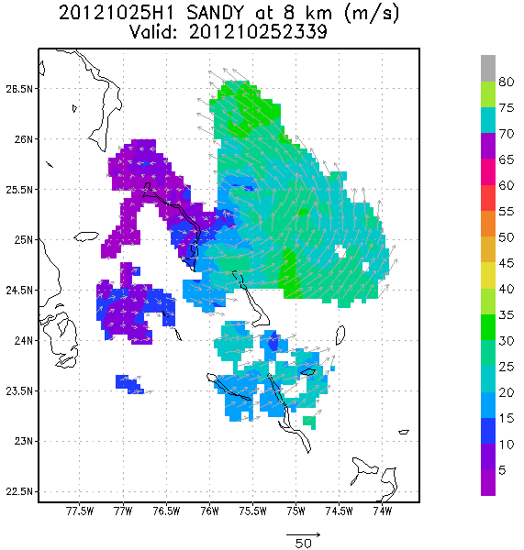
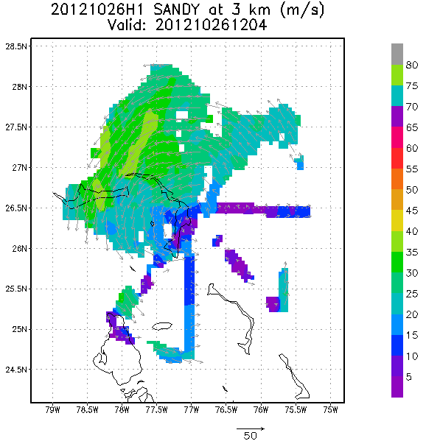
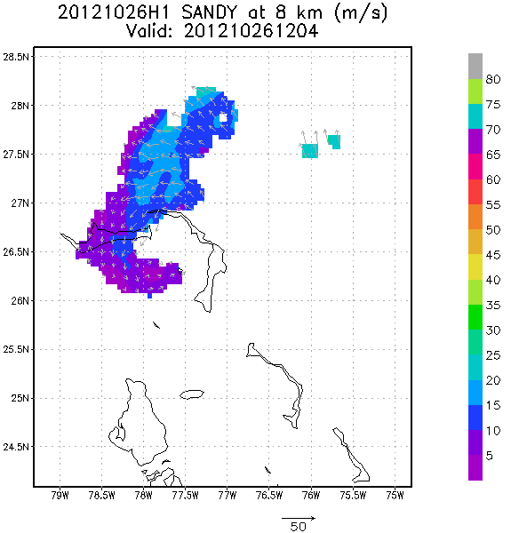
TDR Analyses
00Z 26 October
12Z 26 October
Notes:
http://www.nws.noaa.gov/om/assessments/pdfs/Irene2012.pdf
http://www.nhc.noaa.gov/data/tcr/AL182012_Sandy.pdf

Slide 10
VIS satellite loop 26 October

