Slide 1
NOAA HFIP/IFEX
Hurricane Sandy
21-29 October 2012
Frank Marks
NOAA/AOML Hurricane Research Division
2 November 2012
Notes:
Hurricane Earl 2 September 2010

Slide 2

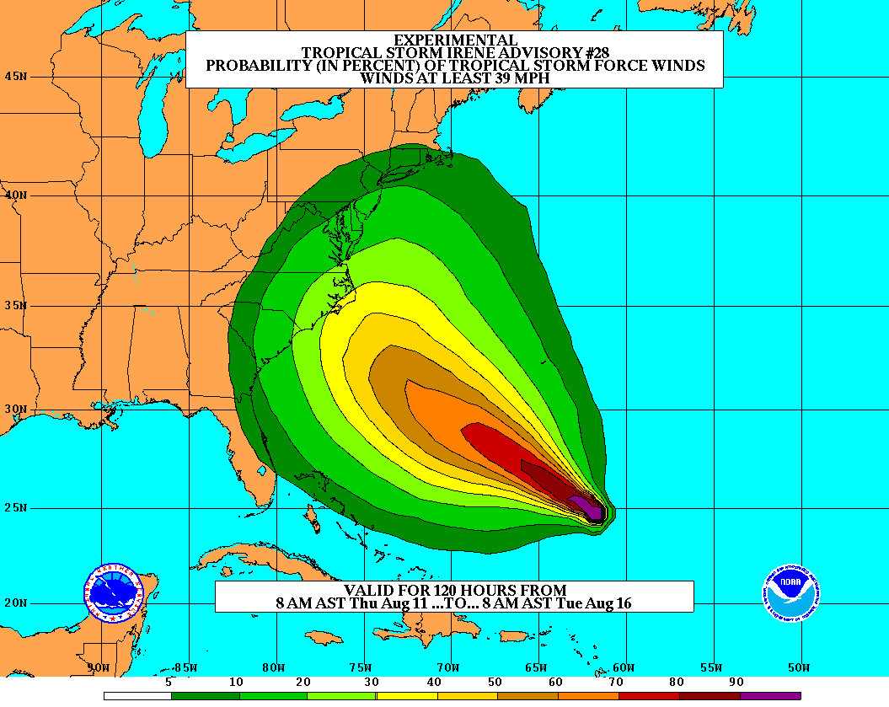
Goals
Improve Forecast Accuracy
  Hurricane impact areas (track) – 50%
  in 10 years
  Severity (intensity) – 50% in 10 years
  Rapid intensity change detection
Extend forecast reliability out to 7 days
Quantify, bound and reduce forecast uncertainty to enable risk management decisions
http://www.hfip.org/
Notes:
http://www.nrc.noaa.gov/HFIPDraftPlan.html
HFIP Team
Frank Marks, research lead
Ed Rappaport, operations lead
Fred Toepfer, project manager
Robert Gall, development manager
Mark DeMaria
Chris Fairall
Jim McFadden
Daniel Melendez
HFIP executieve oversight board:
OAR AA/Robert Detrick, co-chair
NWS AA (acting)/Laura Furgione, co-chair
NCEP/Louis Uccellini,
NHC/Rick Knabb,
NESDIS/Mark DeMaria,
NOS/Jesse Feyen,
AOML/Bob Atlas
PPI/Paul Doremus
NMFS/Bonnie Ponwith,
NOS/Liz Scheffler,
NMAO-PM Aircraft/Mike Devany
OFCM/Sam Williamson
Executive Secretariat: OAR/Brian Orndorff and NWS/Nasheema Lett
http://www.hfip.org/

Slide 3
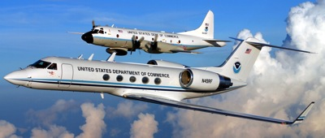
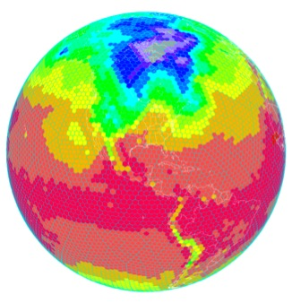
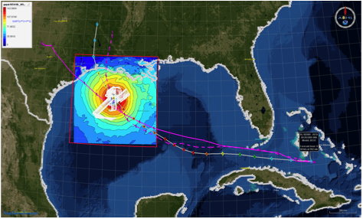
HFIP Activities
Traditional Hurricane Research Activities:
Observations, analysis, database, & instrument R&D (IFEX)
Statistical-dynamical model development
Advances in operational models (Stream 1)
New HFIP Research Thrusts:
Experimental global and regional hurricane model development (Stream 2)
Data assimilation techniques and observing system strategy analysis development (Stream 1 & 2)
Model evaluation tool development (Stream 1.5)
Application and tool development for forecasters
D1
D2
Partnership: NCEP, AOC, AOML, ESRL, GFDL, DTC, USWRP, NESDIS/STAR
http://www.hfip.org/documents/
Notes:
http://www.hfip.org/documents/
Two Stream Approach to HFIP developments:
Stream 1– Operational Transition and Implementation
Stream 2 – Advanced Technology Demonstration
Unconstrained by near-term availability of operational computing
Uses both NOAA’s and computing resources from major supercomputing centers for testing and evaluation.
Emphasis is on high resolution global and regional models run as ensembles
Real-time or near real time runs during hurricane season
Stream 1.5 (JHT-like)
NHC Forecaster Defined.
Subset of Stream 2 that forecasters see as particularly promising or provides demonstrated capability
Will be configured to run in real-time and products made available to NHC.

Slide 4
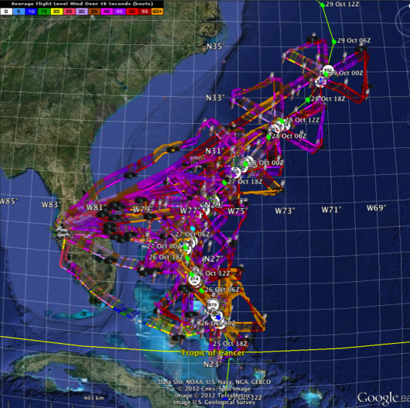
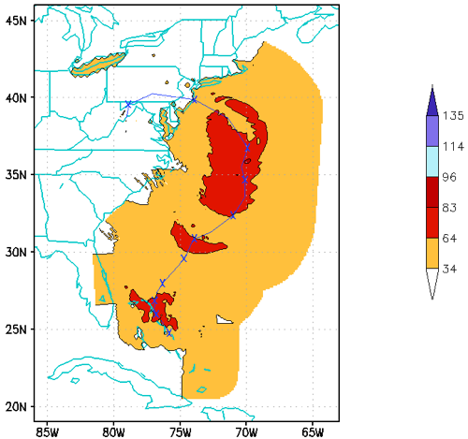
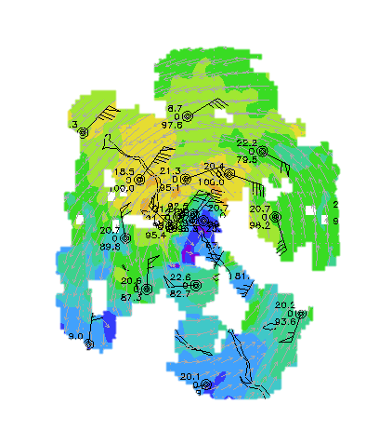
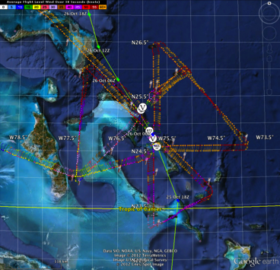
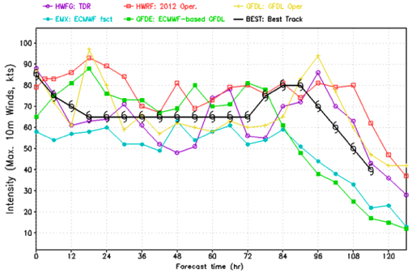
Improved Models & Data:
IFEX 2012: Sandy
4 P-3 Flights
22 August – 24 August 2011
TDR-Experiment: Doppler data transmitted in real-time for assimilation into HWRF
HWRF/GSI
20121026 00UTC
7 WP-3D TDR missions from 00 UTC 26 – 12 UTC 29 September 2012 at 12 h Doppler sampling (HEDAS/GSI)
3 G-IV missions (1 G-IV TDR mission)
Sampled Hurricane Sandy from passage N of Cuba to landfall
HWRF/GSI
20121026 00UTC
Aberson, Aksoy, Gamache, Gopal (AOML/HRD), Tong (EMC)
Notes:
Map shows flight tracks for all of the NOAA missions (color coded are the flight level winds for the P-3 missions, dropsonde symbols denote G-IV patterns)
Flight track plots courtesy of Tropical Atlantic - http://tropicalatlantic.com/recon/
Model data available at: http://storm.aoml.noaa.gov/realtime

Slide 5
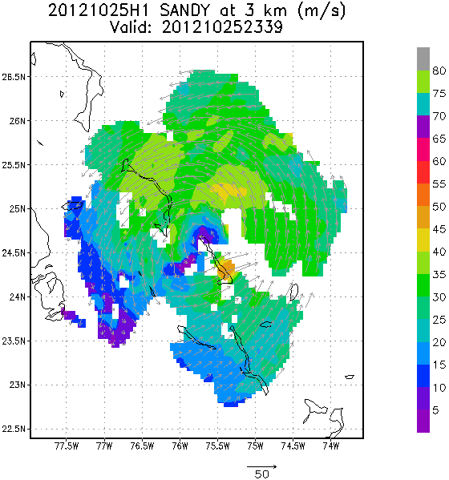
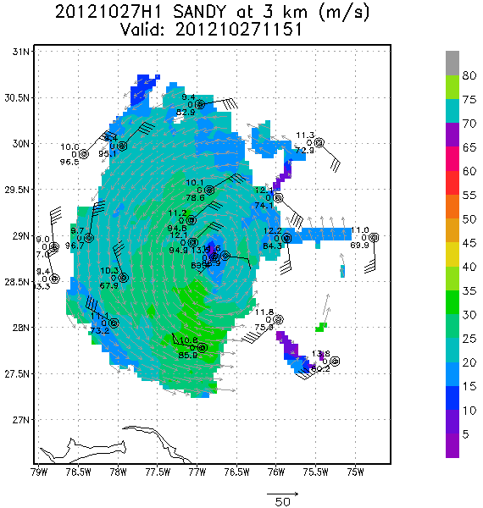
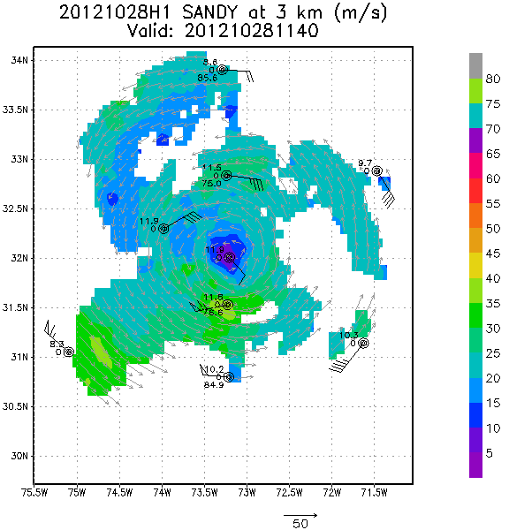
Improved Models & Data:
IFEX 2012: Sandy
Real-time P-3 Tail Doppler Composite at 3 km altitude
m/s
Flight 121025H1
Flight 121027H1
Flight 121028H1
S. Murillo, P. Reasor (AOML/HRD)
Notes:
Colors denote Doppler winds and station codes denote dropsondes
West-east vertical cross section of wind speed (shaded, m/s).

Slide 6
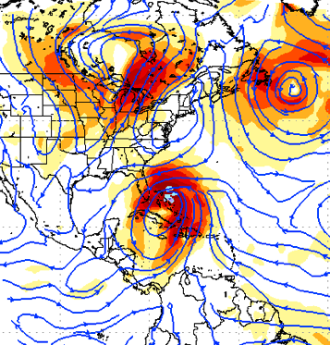
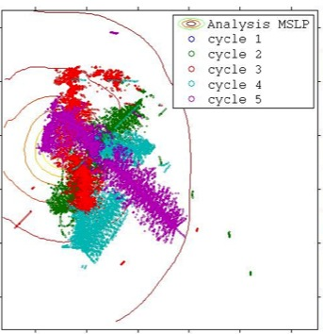
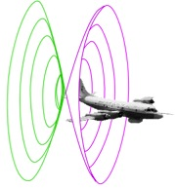
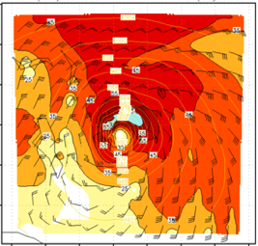
Improved Models & Data:
Assimilation of data into models
Synergy of high resolution forecast and airborne observations
P-3 and G-IV QC Doppler observations
Data assimilation
Improving initial condition in storm core region
Improving high resolution regional forecast
Wind intensity at 10 m
Hurricane Sandy (2012)
F. Zhang (PSU), Tong (EMC), Aberson, Aksoy, Gamache (AOML/HRD)
Notes:
See papers: Zhang et al (2011) - http://www.agu.org/pubs/crossref/2011/2011GL048469.shtml
Aksoy et al (2012) - http://dx.doi.org/10.1175/MWR-D-11-00212.1

Slide 7
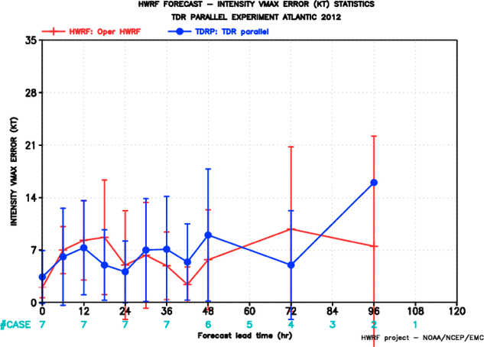
Improved Models & Data:
Impact of airborne Doppler radar
HRD HWRF/EnKF
EMC HWRF/1-Way Hybrid/GSI
All cases with Doppler data Hurricane Sandy
PSU WRF/EnKF
3 HFIP teams assimilated TDR data in real-time
EMC (Tong)
HRD (Aberson)
PSU (F. Zhang)
With TDR
F. Zhang (PSU), Tong (EMC), Aberson, Aksoy, Gamache (AOML/HRD)
Notes:
Intensity Error of Models for all cases (2009-2011) with airborne Doppler data available from NOAA P-3s (% Improvement over HFIP baseline – average intensity error for three years of operational model guidance errors for 2006-2008 when HFIP began)
Black lines are the baseline intensity skill (solid), 20%improvement threshold (large dash), and 50% improvement threshold (small dash)
Green lines represent the average intensity errors for two different regional models: small dash - Advanced Research WRF or ARW used by the bulk of the research community; and solid - high-resolution research version of HWRF developed at HRD and transitioned to EMC for operational implementation this summer
Red line is the average intensity error for the high-resolution research HWRF without the Doppler data
Note that from 36-96 h the average error is very close to or exceeding the 20% improvement threshold for HFIP at 5 years
We are busily investigating the reason for lack of improved skill from 0-24 h when the data should have the most impact. We identified some model biases due to physical parameterizations which we are working with EMC to correct thanks to the ability to use observations to improve the initial conditions.
See papers: Zhang et al (2011) - http://www.agu.org/pubs/crossref/2011/2011GL048469.shtml
Aksoy et al (2012) - http://dx.doi.org/10.1175/MWR-D-11-00212.1

Slide 8
Improved Models & Data:
Impact of airborne Doppler radar
% Improvement over HFIP baseline
cases
All cases with Doppler data 2008-2011
Aircraft data impact
Need help of Research community to address
F. Zhang (PSU), Aberson, Aksoy, Gamache (AOML/HRD)
Notes:
Intensity Error of Models for all cases (2009-2011) with airborne Doppler data available from NOAA P-3s (% Improvement over HFIP baseline – average intensity error for three years of operational model guidance errors for 2006-2008 when HFIP began)
Black lines are the baseline intensity skill (solid), 20%improvement threshold (large dash), and 50% improvement threshold (small dash)
Green lines represent the average intensity errors for two different regional models: small dash - Advanced Research WRF or ARW used by the bulk of the research community; and solid - high-resolution research version of HWRF developed at HRD and transitioned to EMC for operational implementation this summer
Red line is the average intensity error for the high-resolution research HWRF without the Doppler data
Note that from 36-96 h the average error is very close to or exceeding the 20% improvement threshold for HFIP at 5 years
We are busily investigating the reason for lack of improved skill from 0-24 h when the data should have the most impact. We identified some model biases due to physical parameterizations which we are working with EMC to correct thanks to the ability to use observations to improve the initial conditions.
See papers: Zhang et al (2011) - http://www.agu.org/pubs/crossref/2011/2011GL048469.shtml
Aksoy et al (2012) - http://dx.doi.org/10.1175/MWR-D-11-00212.1

Slide 9
HFIP Success to Date
HFIP focused research efforts within NOAA & interagency partners
HFIP defined solution to transition research into operations with Stream 1.5 products available to NHC forecasters in real-time
  Transitioned global hybrid DA system and 3-km HWRF into operations this season
HFIP making significant progress – 5-year goals within reach
  Global ensembles providing 20% improvement in track guidance
  Improved model initialization and higher resolution models, along with inner core data shows significant (20-40%) improvement in intensity
  3-5 day lead-time hurricane genesis product
http://www.hfip.org/documents/reports2.php
Notes:
http://www.hfip.org/documents/reports2.php

Slide 10
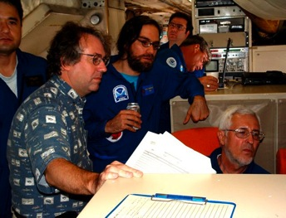
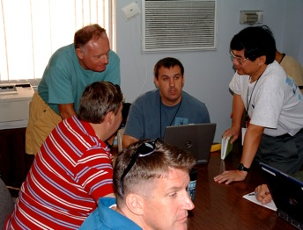
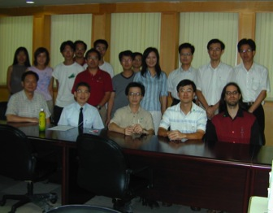
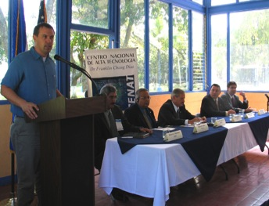
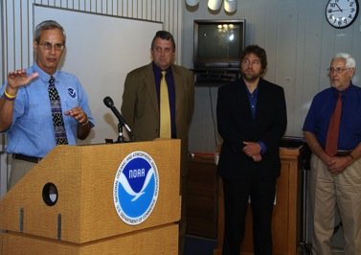
Keys to Success
  Partnership: NOAA Research working closely with NOAA Operations, and Federal & Academic Partners (NASA, NSF, ONR, NRL, NCAR)
  More integrated use & support of Testbeds (JHT, DTC, JCSDA)
  Blend traditional hurricane and HFIP research activities
  Manpower (diversity) to evaluate model performance with hurricane data sets is a critical need
CBLAST
IFEX/RAINEX
DOTSTAR
IFEX/TCSP
IFEX/PREDICT/GRIP

Slide 11
Questions?

