Slide 1
Latest Developments in NOAA’s Hurricane Forecast Improvement Project
Frank Marks
NOAA/AOML Hurricane Research Division
HFIP Research Lead
17 September 2013
Notes:
Hurricane Sandy 28 October 2012

Slide 2
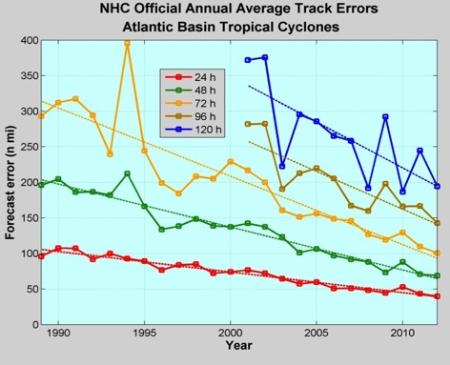
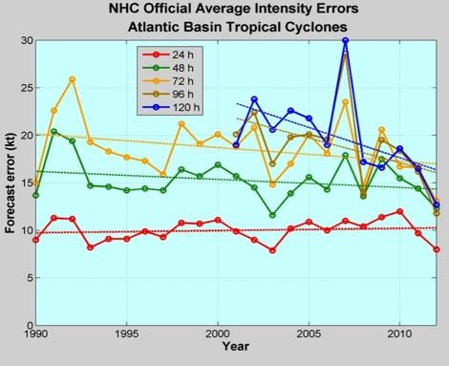
Good – track forecast improvements
Current Capabilities
Not so Good – Modest intensity gains
Some intensity gains since 2008, especially at >48 h
Errors cut in half over past 15 years
10-yr improvement – current 48 h as accurate as 24 h in 2000
24-48 h intensity forecast off by 1 category
Off by 2 categories perhaps 5-10% of time
http://www.nhc.noaa.gov/verification/verify5.shtml
Notes:
Images from: http://www.nhc.noaa.gov/verification/verify5.shtml

Slide 3
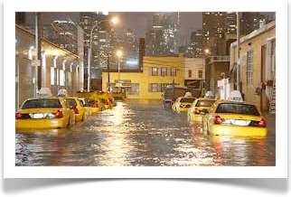
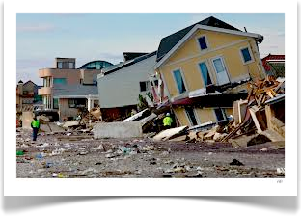
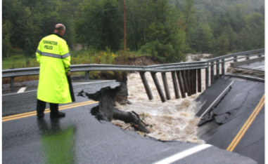
Improvements still needed!
NWS mission is to fulfill this commitment through building a Weather Ready Nation.
NWS contributes to hazard resiliency by continually assessing and improving its services to Nation.
Hurricane Irene (2011):
  41 deaths
  $7 to $10 Billion damage
  Major infrastructure losses
  Power lost to 8 million
Hurricane Sandy (2012):
    159 deaths (72 along US East Coast)
    ~$50 Billion damage
    Major infrastructure losses
    Power lost to 8.5 million
Woodford, Vt.
Austen Danforth/Bennington Banner/AP
http://www.nhc.noaa.gov/data/tcr/AL182012_Sandy.pdf
Notes:
http://www.nws.noaa.gov/om/assessments/pdfs/Irene2012.pdf
http://www.nhc.noaa.gov/data/tcr/AL182012_Sandy.pdf

Slide 4

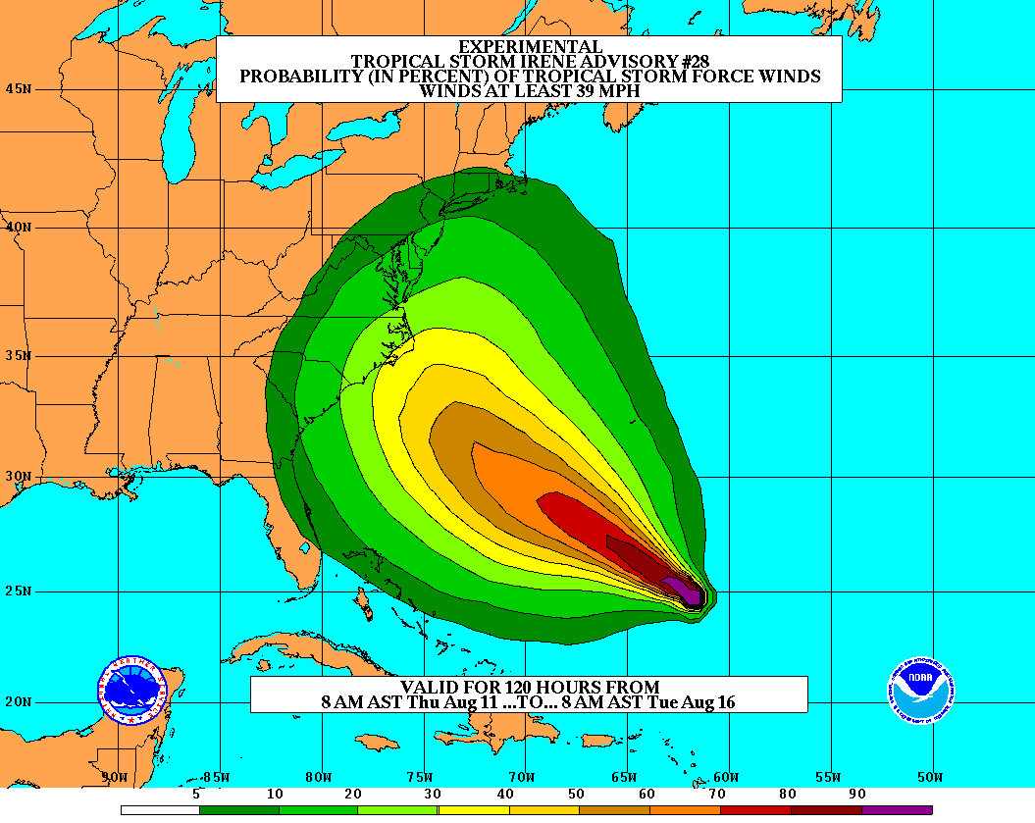
Vision
  Organize hurricane community to dramatically improve numerical forecast guidance to NHC in 5-10 years
Goals
Improve Forecast Accuracy
  Hurricane impact areas (track) – 50%
  in 10 years
  Severity (intensity) – 50% in 10 years
  Rapid intensity change detection
Extend forecast reliability out to 7 days
Quantify, bound and reduce forecast uncertainty to enable risk management decisions
http://www.hfip.org/
Notes:
http://www.nrc.noaa.gov/HFIPDraftPlan.html
HFIP Team
Frank Marks, research lead
Ed Rappaport, operations lead
Fred Toepfer, project manager
Robert Gall, development manager
Mark DeMaria
Chris Fairall
Jim McFadden
Daniel Melendez
HFIP executieve oversight board:
OAR AA/Robert Detrick, co-chair
NWS AA (acting)/Laura Furgione, co-chair
NCEP/Louis Uccellini,
NHC/Rick Knabb,
NESDIS/Mark DeMaria,
NOS/Jesse Feyen,
AOML/Bob Atlas
PPI/Paul Doremus
NMFS/Bonnie Ponwith,
NOS/Liz Scheffler,
NMAO-PM Aircraft/Mike Devany
OFCM/Sam Williamson
Executive Secretariat: OAR/Brian Orndorff and NWS/Nasheema Lett
http://www.hfip.org/

Slide 5
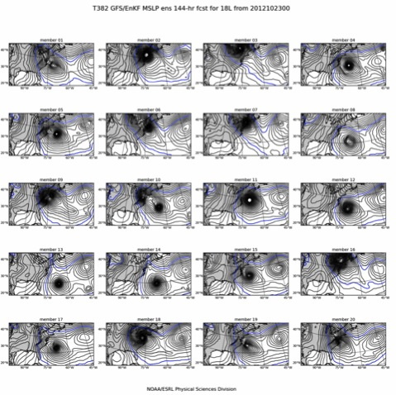
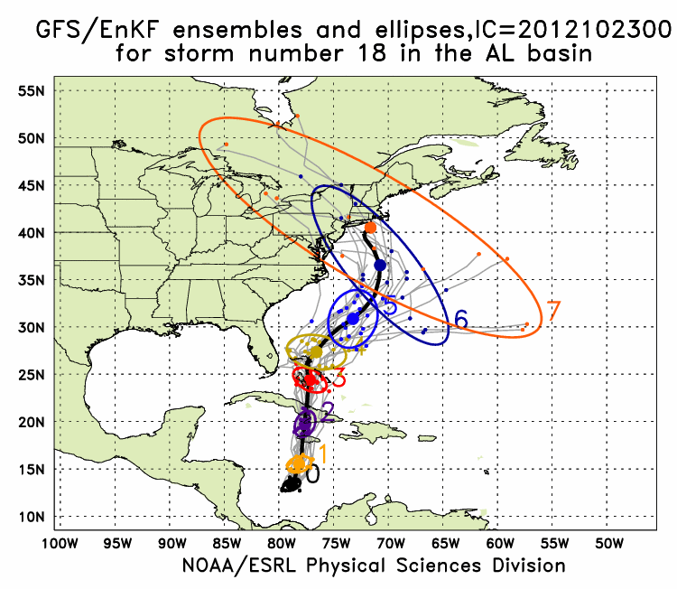
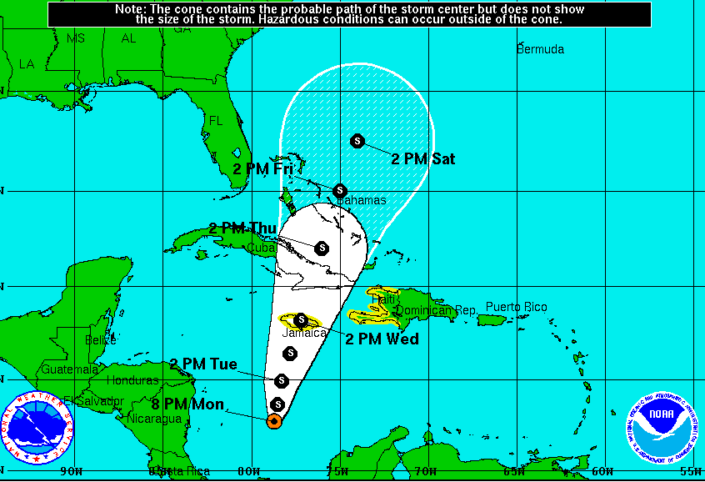
Global Model Development – GFS/EnKF
Sandy (18L) – init 00Z 23 October
GFS/EnKF T382 20 member ensemble
7-Day forecast – 20 member ensemble
Observed
http://www.esrl.noaa.gov/psd/forecasts/gfsenkf/ens/
Global Model Team - Tom Hamill & Jeff Whitaker (ESRL)
Notes:
Model data available at: http://www.esrl.noaa.gov/psd/forecasts/gfsenkf/ens/
Global Ensembles:
80-member T254 GFS ensembles cycled every 6-h continuously from 1 August to current time
Look at 20 members of the 80 member ensemble
Left panels shows ellipse plot of 20 members at each forecast time – ellipse shape shows the spread along/across track
Right panel show surface pressure post stamp images of 20 members

Slide 6
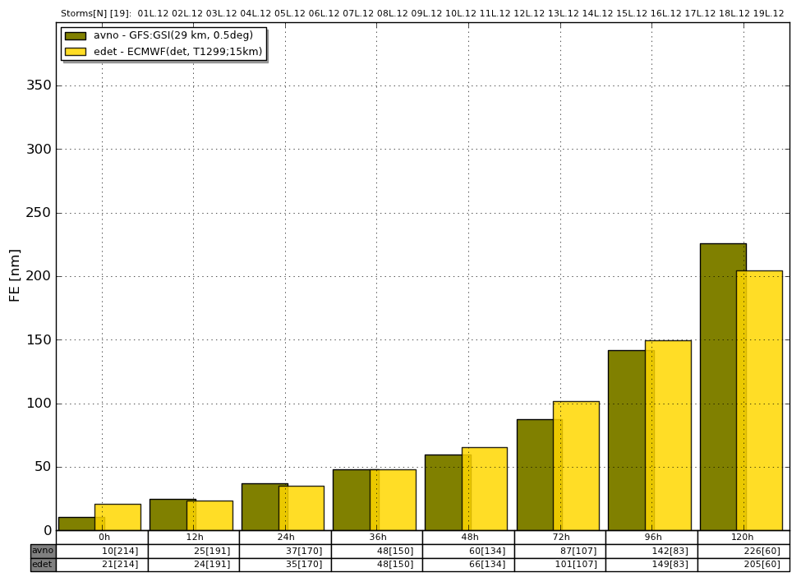
HFIP Successes to date:
Operational GFS Track Forecasts
2012 Track Error
(% Improvement over HFIP baseline)

Slide 7
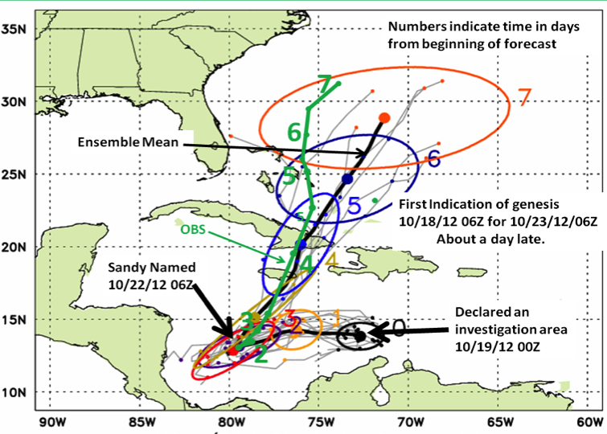
Global Model Development – Ensemble – Genesis
Global Model Team - Tom Hamill & Jeff Whitaker (ESRL)
Notes:
In the case of Irene new tools to forecast genesis developed by HFIP using the HFIP global model ensembles from GFS/EnKF (30 members) and FIM (10 members) were able to detect and track the system that formed into Irene 5 days before it was named by NHC and 2 days before NHC declared it an INVEST area
Thin black lines are the disturbance tracks from each of the ensemble members, the small black dots the location of each of the ensemble members at 24 h intervals after the initial time, and the colored ellipses enclose 75% of the ensemble positions. Note that the ellipses elongate along track (reflecting speed uncertainty) in the early forecasts, and elongate perpendicular to the track (reflecting uncertainty in the storm turn to the N at the later forecast times. At day 3 & 4 when the storm was named the uncertainty is the least.
The solid green line is the observed Best Track from NHC starting when the storm was named.
Model data available at: http://www.esrl.noaa.gov/psd/forecasts/gfsenkf/ens/

Slide 8
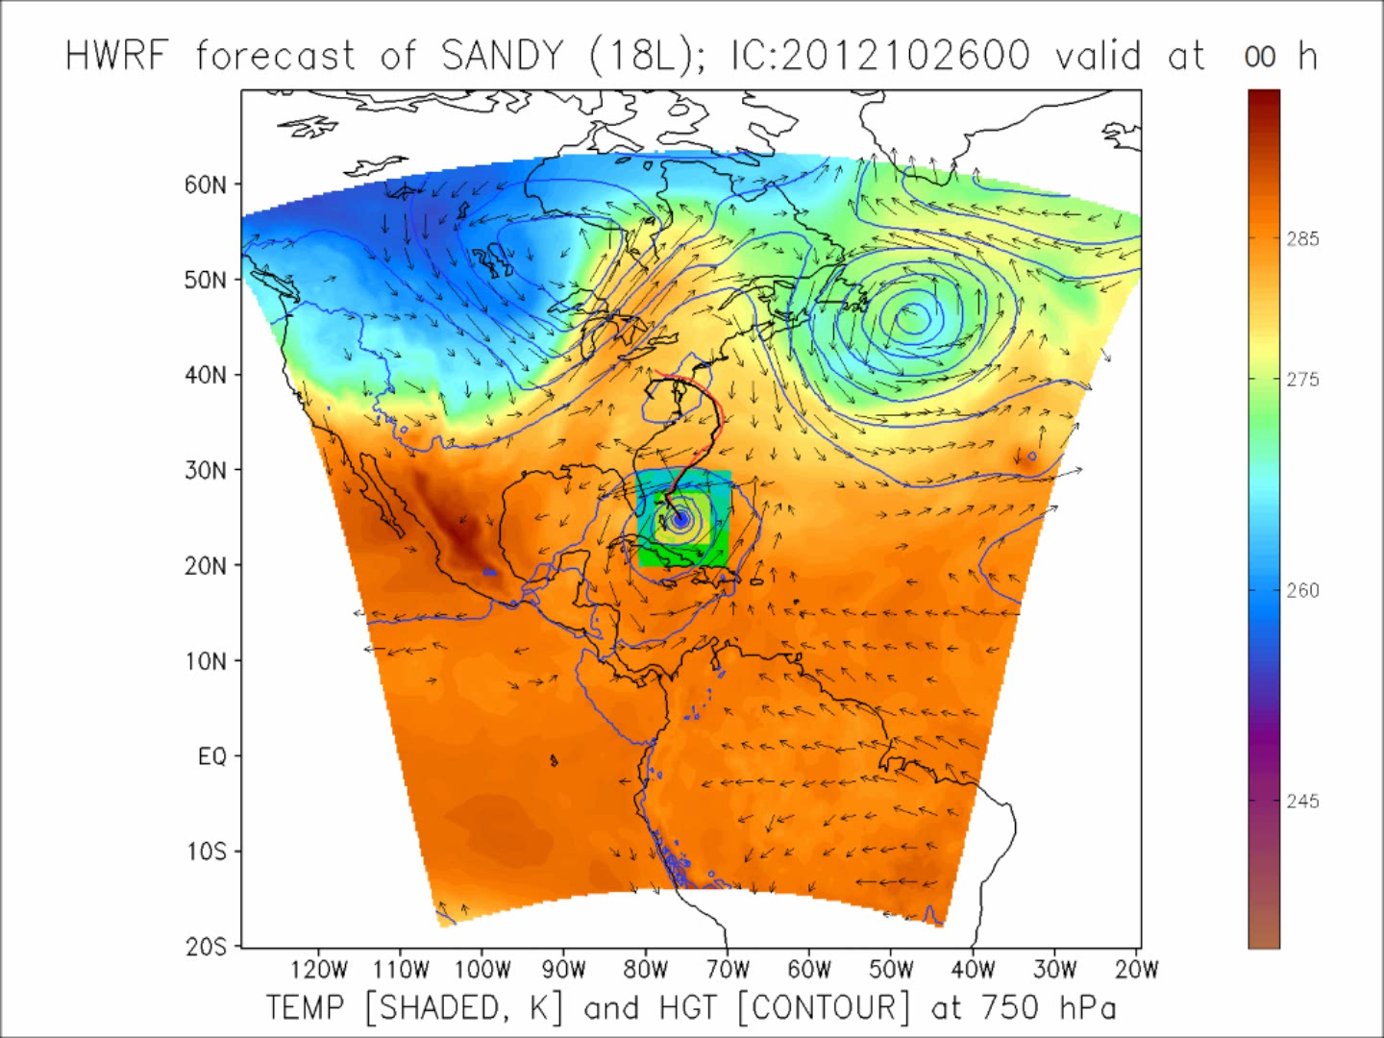
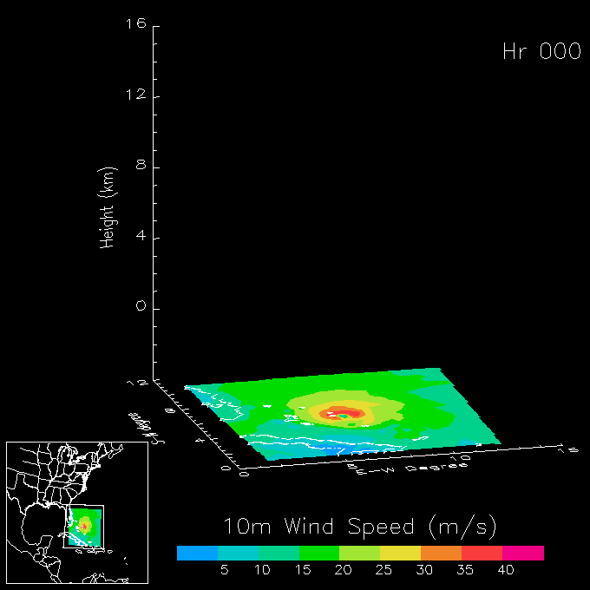
Regional Model Development:
HWRF
HWRF operational (27/9/3 km)
  Advanced nesting algorithm with resolution to 3 km
  Viable operational pathway with transition to operations
  Pathway to improved structure and intensity predictions
  Initialization algorithm at 3 km resolution
http://www.emc.ncep.noaa.gov/gc_wmb/vxt/
HWRF Model Team - Gopal, X. Zhang (HRD), V. Tallapragada, S. Trahan (EMC)
Notes:
Demo 2011 season; Not only we have improved the products but also added a suite of NOAA HWRF systems at different configurations.
Example of Hurricane Dora 2004 (initialized at 18Z on 18 July 2011)
Top left: 10-m wind swath for 126 h forecast
Bottom left: time-height cross section of mean wind over 3 km nest centered on storm
Top right: storm-relative vertical wind shear on 3-km nest for 24 h and 30 h forecast – note decreasing NE shear over center
Bottom right: SHIPS type predictors for regional model
Overlay: moving 3-km inner nest showing 10-m wind evolution
Model products available at: http://storm.aoml.noaa.gov/realtime

Slide 9
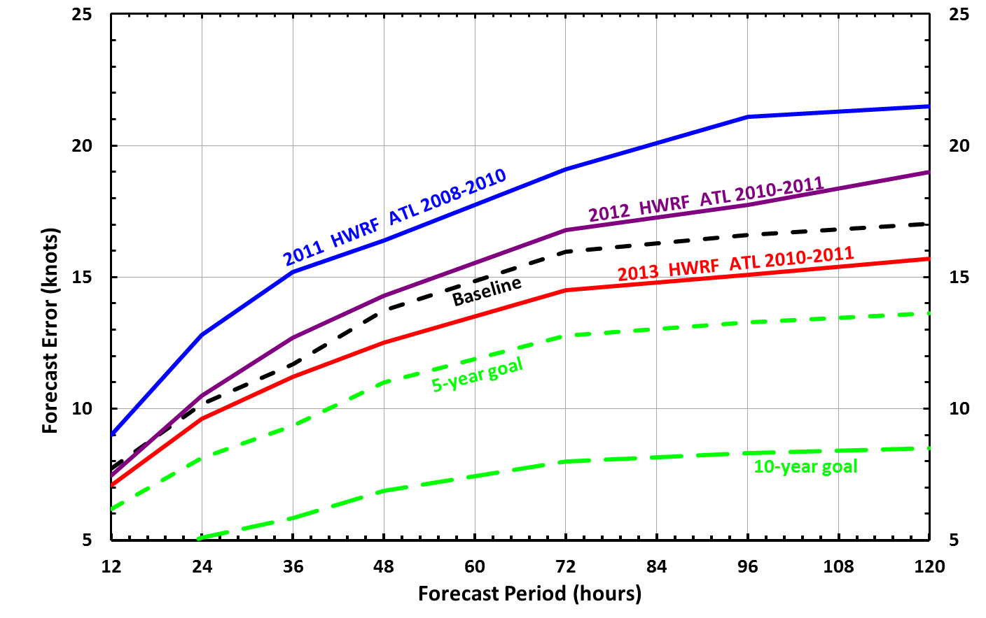
HFIP Successes to date:
HWRF Intensity Forecast Improvements

Slide 10
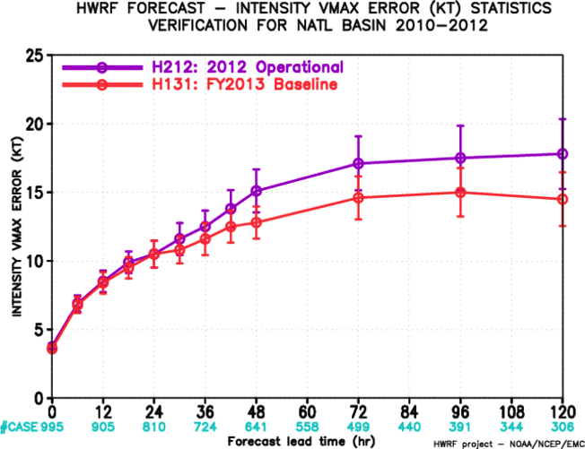
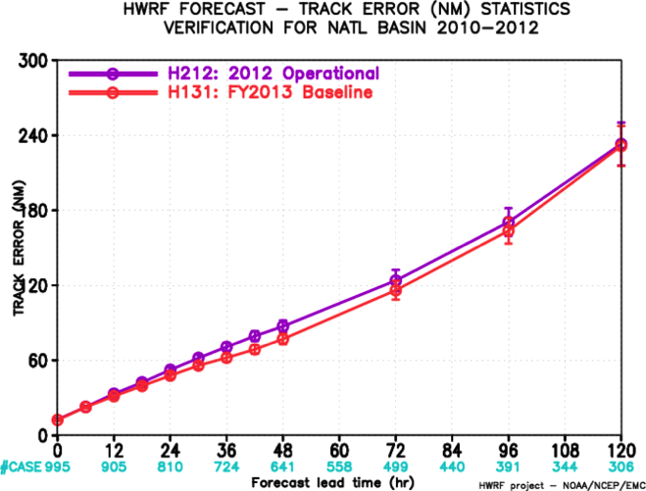
Improved Models & Data:
HWRF 2013
http://www.emc.ncep.noaa.gov/gc_wmb/vxt/
2010-2012 Atlantic Track Verification
>20% improvement
~10% improvement
Intensity errors
Track errors
HWRF Model Team - V. Tallapragada, S. Trahan, Y. Kwon (EMC)

Slide 11
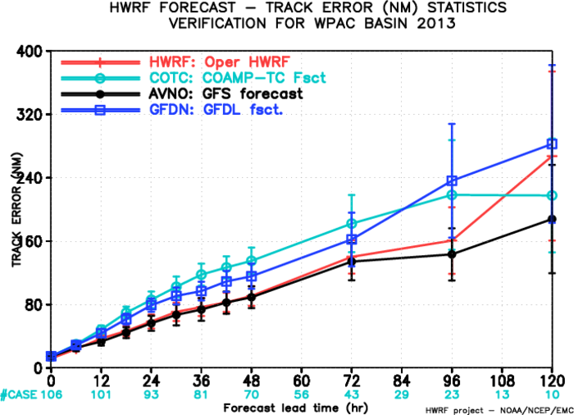
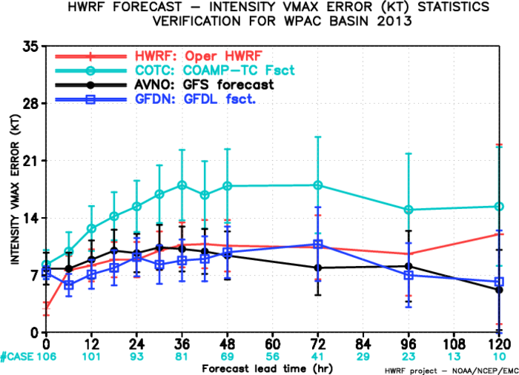
Improved Models & Data:
HWRF WPAC 2013
http://www.emc.ncep.noaa.gov/HWRF/WestPacific/index.html
HWRF Model Team - V. Tallapragada, S. Trahan, Y. Kwon (EMC)

Slide 12

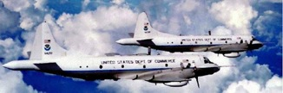
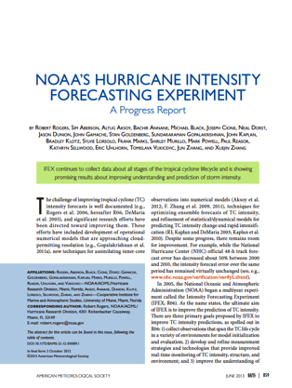
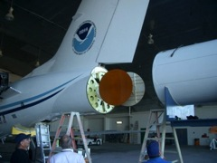

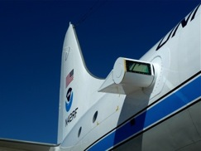
Improved Use of Observations:
Intensity Forecast Experiment (IFEX)
In-situ
  Wind, press., temp.
Expendables
  Dropsondes
  AXBT, AXCP, buoy
Remote Sensors
  Doppler Radar
  SFMR/HIRAD
  WSRA
  Scatterometer/profiler
  UAS - LALE
Improve prediction of TC intensity change by:
  collecting observations through the TC life cycle
  developing and refining measurement technologies
  improving understanding of physical processes important in TC intensity change
NASA Global Hawk
G-IV Tail Doppler Radar
ONR DWL
R. Rogers, S. Murillo, P. Reasor (AOML/HRD)
Notes:
UR image depicts dropsonde profiles in eyewall of Hurricane Guillermo (1997)
LR image is Doppler Wind Lidar profiles from TCS-08
See IFEX paper (Rogers et al 2006): http://dx.doi.org/10.1175/BAMS-87-11-1523
HRD IFEX website: http://www.aoml.noaa.gov/hrd/HFP2011/index.html

Slide 13
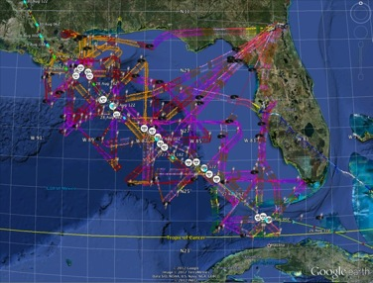
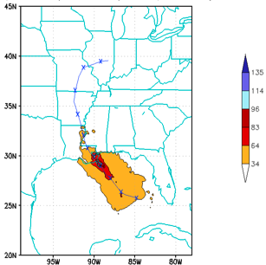
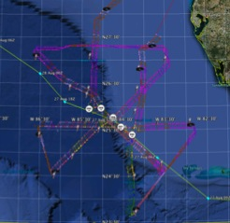
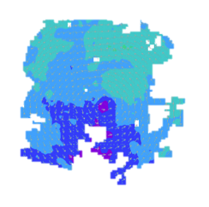
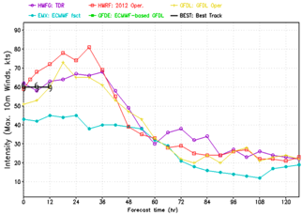
Collect observations over life-cycle: Isaac 2012
HWRF/GSI
20120827 12UTC
Doppler data transmitted in real-time for assimilation into HWRF
5 P-3 Flights
26 August – 28 August 2011
4 missions from 22-24 Aug 2012 and 5 missions from 26-28 Aug 2012 at 12 h Doppler sampling (HEDAS/GSI) & 6 G-IV missions
Sampled Isaac as a tropical storm to hurricane at landfall
HWRF/GSI
20120827 12UTC
Aberson, Aksoy, Gamache, Gopal (AOML/HRD), Tong (EMC)
Notes:
Map shows flight tracks for all of the NOAA missions (color coded are the flight level winds for the P-3 missions, dropsonde symbols denote G-IV patterns)
Flight track plots courtesy of Tropical Atlantic - http://tropicalatlantic.com/recon/
Model data available at: http://storm.aoml.noaa.gov/realtime

Slide 14
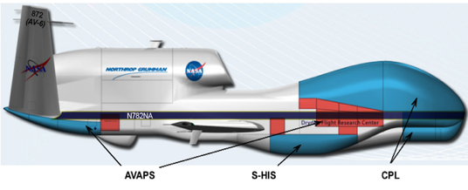
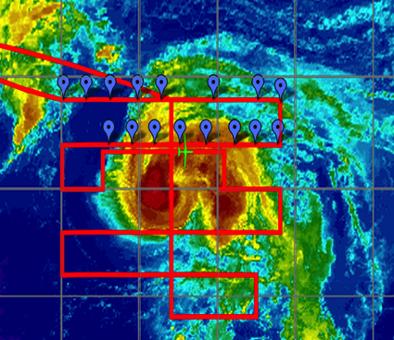
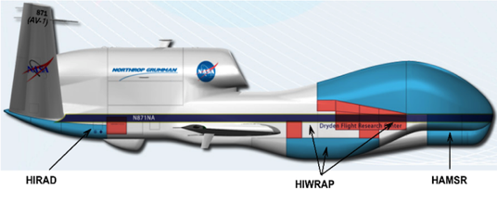

Develop & refine measurement technology: HS3 (2012-2014)
“Environmental” G-H
Hurricane Nadine
“Over-Storm” G-H
HS3 Teams – S. Braun (NASA/GSFC)

Slide 15
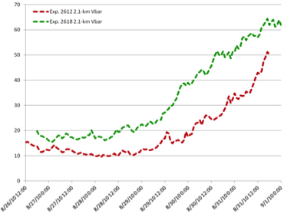
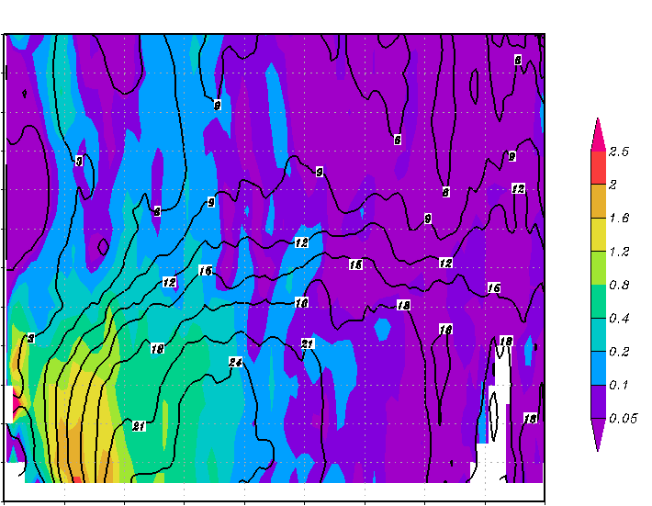
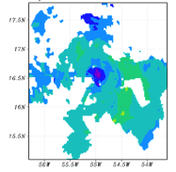
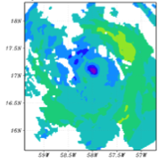
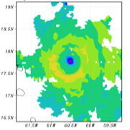
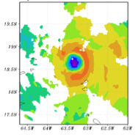
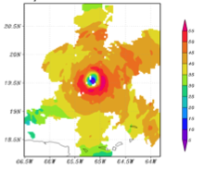
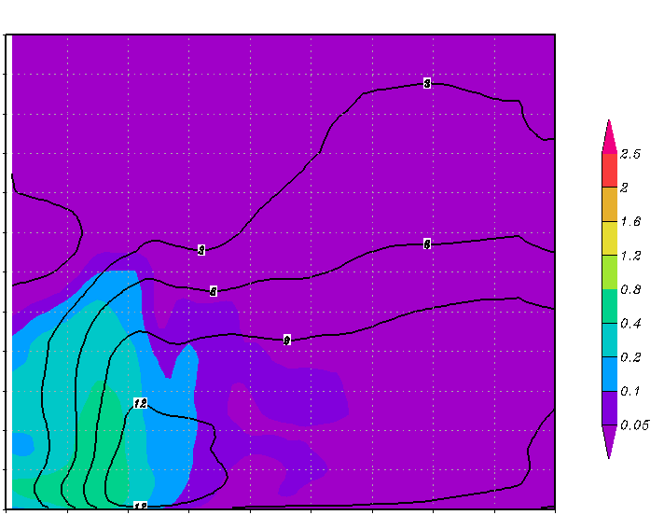
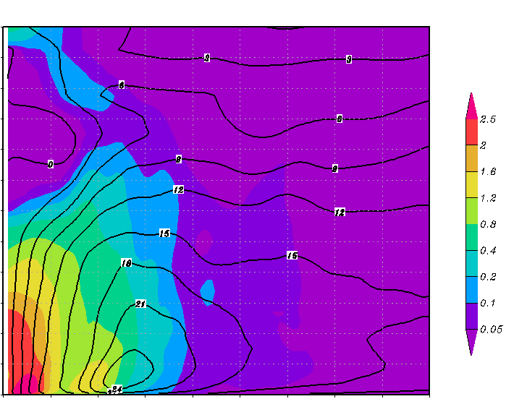
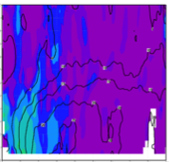
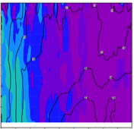
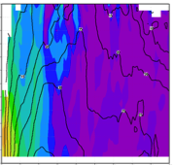
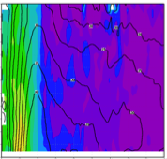
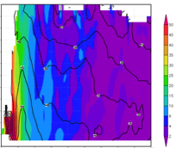
Improve understanding of TC structure & intensity: RI
HWRF runs
Observations
12
Doppler
RMW: 65
IS_{av} : 3.5
11
Doppler-derived wind speed (shaded, m s⁻¹) at 2 km altitude
10
wind speed (m s⁻¹)
9
(a)
00 UTC 29 Aug
(b)
12 UTC 29 Aug
(c)
00 UTC 30 Aug
8
(d)
12 UTC 30 Aug
(e)
00 UTC 31 Aug
height (km)
7
6
5
4
I
II
III
3
2
1
0
0
20
40
60
80
100
120
140
160
180
12
12
radius (km)
11
Exp.2612
RMW: 44
IS_{av} : 1.8
11
Exp.2618
RMW: 56
IS_{av} : 3.9
Axisymmetric relative vorticity (shaded, x 10⁻⁴ s⁻¹) and tangential wind (contour, m s⁻¹)
10
10
12
(f)
9
9
(i)
(j)
11
height (km)
8
(g)
(h)
height (km)
8
10
7
7
9
6
6
8
height (km)
5
5
7
6
4
4
5
3
3
4
2
2
3
2
1
1
1
0
0
0
0
20
40
60
80
100
120
140
160
180
0
20
40
60
80
100
120
140
160
180
0
20
40
60
80
100
120
140
160
180
0
20
40
60
80
100
120
140
160
0
20
40
60
80
100
120
140
160
180
0
20
40
60
80
100
120
140
160
180
180
radius (km)
radius (km)
radius (km)
0
20
40
60
80
100
120
140
160
180
radius (km)
radius (km)
(b)

Slide 16
HFIP Lesson Learned
Make better use of inner core observations to evaluate more than track and intensity:
  Structure – drives damage and coastal inundation (surge)
  Rainfall – drives inland inundation (floods)
Make better use of inner core observations (in-situ & satellite) to initialize models
Develop strategies to use ensembles to address uncertainty in intensity, structure, and rain
Future model architecture must include environmental changes on times scales out to 10 days (best represented in global model), and high-resolution to resolve rapidly changing inner core structure (best handled by moving nests in regional model)
Notes:
http://www.hfip.org/documents/reports2.php

Slide 17
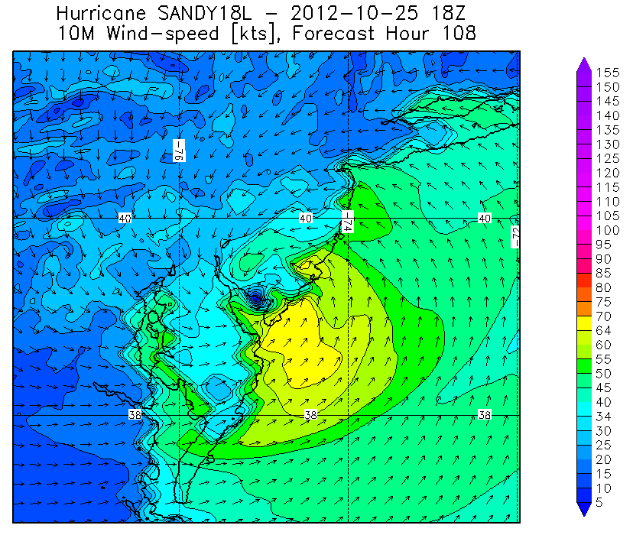
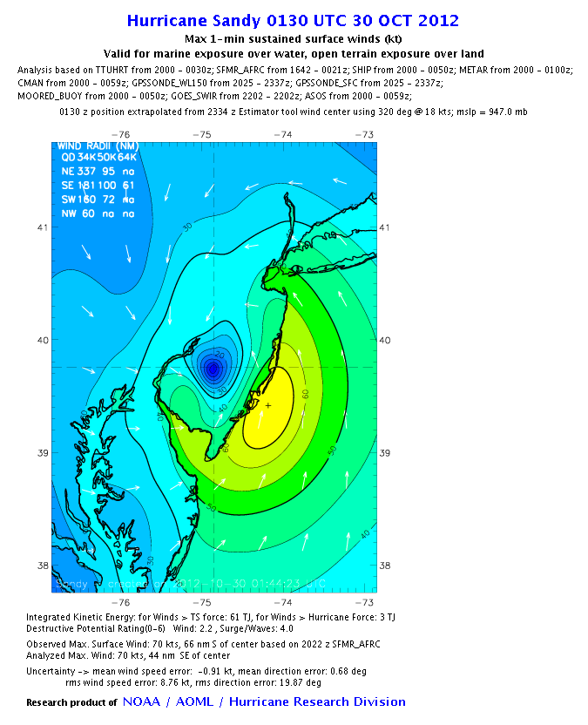
Model evaluation:
Wind Structure
H*Wind 10m winds
HWRF 10m winds
HWIND analysis
HWRF Forecast (108 h)
Post-hurricane Sandy (2012)
HWRF Model Team - Gopal, X. Zhang (HRD), V. Tallapragada, S. Trahan (EMC)
Notes:
• Surface wind field work is mainly supported through a NOPP that Hans Graber controls (collaboration between UM, USACE, HRD, and Vince Cardone’s Ocean Weather). HRD receives support to provide them near real-time surface winds to drive their surge and wave models. HRD also receives support for these wind fields from the USACE, particularly for the production of wind fields for past storms to use for model testing. Finally, some of the support comes from the development of a wind model for the State of Florida CAT model effort in collaboration with FSU, FIU, and UF.

Slide 18
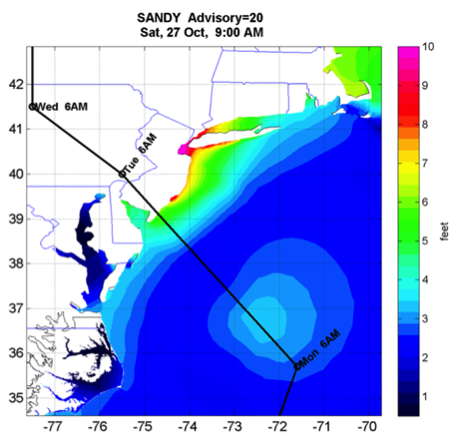
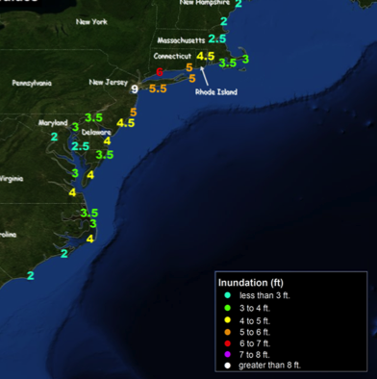
Model evaluation:
Surge
Storm Surge Observations
ADCIRC maximum surge (36 h)
Post-hurricane Sandy (2012)
HWRF Model Team - Gopal, X. Zhang (HRD), V. Tallapragada, S. Trahan (EMC)

Slide 19
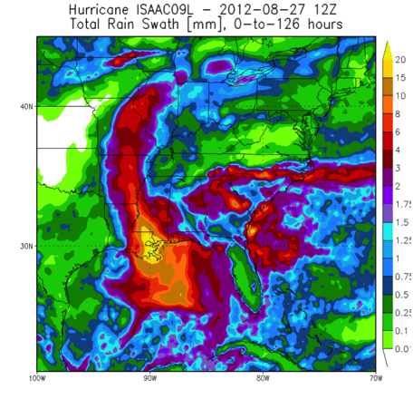
Model evaluation:
Rainfall
Stage IV rain accumulation (144 h)
HWRF rain accumulation (120 h)
Hurricane Isaac (2012)
HWRF Model Team - Gopal, X. Zhang (HRD), V. Tallapragada, S. Trahan (EMC)

Slide 20
HFIP Lesson Learned
Make better use of inner core observations to evaluate more than track and intensity:
  Structure – drives damage and coastal inundation (surge)
  Rainfall – drives inland inundation (floods)
Make better use of inner core observations (in-situ & satellite) to initialize models
Develop strategies to use ensembles to address uncertainty in intensity, structure, and rain
Future model architecture must include environmental changes on times scales out to 10 days (best represented in global model), and high-resolution to resolve rapidly changing inner core structure (best handled by moving nests in regional model)
Notes:
http://www.hfip.org/documents/reports2.php

Slide 21
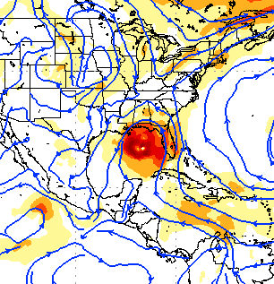



Improved Models & Data:
Assimilation of data into models
Synergy of high resolution forecast and airborne observations
P-3 and G-IV QC Doppler observations
Data assimilation
Improving initial condition in storm core region
Improving high resolution regional forecast
Wind intensity at 10 m
Hurricane Isaac (2012)
F. Zhang (PSU), Aberson, Aksoy, Gamache, Gopal (AOML/HRD)
Notes:
See papers: Zhang et al (2011) - http://www.agu.org/pubs/crossref/2011/2011GL048469.shtml
Aksoy et al (2012) - http://dx.doi.org/10.1175/MWR-D-11-00212.1

Slide 22




Improved Models & Data:
TDR data impact
Intensity Errors
Isaac (2013)
OPER HWRF
OPER HWRF
HWRG TDR
HWRG TDR
Vertical cross section at initial time
S
No Doppler
N
S
With Doppler
N
Isaac (2013)
HWRF Model Team - V. Tallapragada, M. Tong, S. Trahan (EMC)

Slide 23


Improved Models & Data:
TDR data impact
Results from TDR DA Experiments (2010-2012)
Intensity errors
Track errors
-4% 18% 14% 9% 9% 21% 6%
Assimilation of TDR positively improved intensity forecasts by about 10-20%
HWRF Model Team - V. Tallapragada, S. Trahan, Y. Kwon (EMC)

Slide 24
HFIP Lesson Learned
Make better use of inner core observations to evaluate more than track and intensity:
  Structure – drives damage and coastal inundation (surge)
  Rainfall – drives inland inundation (floods)
Make better use of inner core observations (in-situ & satellite) to initialize models
Develop strategies to use ensembles to address uncertainty in intensity, structure, and rain
Future model architecture must include environmental changes on times scales out to 10 days (best represented in global model), and high-resolution to resolve rapidly changing inner core structure (best handled by moving nests in regional model)
Notes:
http://www.hfip.org/documents/reports2.php

Slide 25




Regional Model Development: HWRF Ensembles
HWRF EPS uses Stochastic Convective Trigger (nest) & GEFS (large-scale) perturbations
Uses 2013 HWRF operational configuration
48-h 10-m Wind Speed (Isaac, 2012)
ATL-Intensity
12% 10% 14% 12% 13% 13% 8%
~13% improvement
HWRF Model Team – Z. Zhang & V. Tallapragada (EMC)

Slide 26
HFIP Lesson Learned
Make better use of inner core observations to evaluate more than track and intensity:
  Structure – drives damage and coastal inundation (surge)
  Rainfall – drives inland inundation (floods)
Make better use of inner core observations (in-situ & satellite) to initialize models
Develop strategies to use ensembles to address uncertainty in intensity, structure, and rain
Future model architecture must include environmental changes on times scales out to 10 days (best represented in global model), and high-resolution to resolve rapidly changing inner core structure (best handled by moving nests in regional model)
Notes:
http://www.hfip.org/documents/reports2.php

Slide 27


Regional Model Development:
HWRF Basin-Scale
(http://storm.aoml.noaa.gov/hwrfxprojects/?projectName=BASIN)
HWRF Model Team - Gopal, X. Zhang, T. Quirino (HRD), V. Tallapragada (EMC)
Notes:
Earl and Danielle forecast initialized at 0000Z 27 August 2011
Large “basin-scale” domain is at 27 km resolution with inner nest at 9-km using operational HWRF as the basis. Outer domain covers the EPAC and ATL TC development regions with one domain which remains fixed from cycle to cycle.
27

Slide 28





HFIP Keys to Success
  Partnership: NOAA Research working closely with:
    NOAA Operations (EMC, NHC, AOC)
    Federal & Academic Partners (NASA, NCAR, NRL, NSF, ONR)
  More integrated use & support of Testbeds (e.g., JHT, DTC, JCSDA)
  Blend traditional approach and HFIP (applied) research activities
  Manpower (diversity) to evaluate model performance with hurricane data sets is a critical need
CBLAST
IFEX/RAINEX
IFEX/TCSP
IFEX/PREDICT/GRIP
Hybrid-DA Workshop

Slide 29









Outreach
Our blog
http://noaahrd.wordpress.com
HRD Web page
http://www.aoml.noaa.gov/hrd
Facebook
http://www.facebook.com/noaahrd
Twitter
http://twitter.com/#!/HRD_AOML_NOAA
Tweets from the eye
Tweets from the eye
Visiting scientist program
Visiting scientist program

Slide 30
Questions?

