Slide 1
NOAA’s Hurricane Forecast Improvement Project - HFIP
Frank Marks
HFIP Research Lead
AOML/Hurricane Research Division
11 August 2015
Notes:
Hurricane Edouard 16 September 2014

Slide 2

Vision
  Organize hurricane community to dramatically improve numerical forecast guidance to NHC in 5-10 years
Goals
Improve forecast accuracy for track & intensity by 20% in 5 years, 50% in 10 years
Extend forecast reliability to 7 days
Increase rapid intensity change detection
http://www.hfip.org/
Notes:
http://www.nrc.noaa.gov/HFIPDraftPlan.html
HFIP Team
Frank Marks, research lead
Ed Rappaport, operations lead
Fred Toepfer, project manager
Robert Gall, development manager
Mark DeMaria
Chris Fairall
Jim McFadden
Daniel Melendez
HFIP executieve oversight board:
OAR AA/Robert Detrick, co-chair
NWS AA (acting)/Laura Furgione, co-chair
NCEP/Louis Uccellini,
NHC/Rick Knabb,
NESDIS/Mark DeMaria,
NOS/Jesse Feyen,
AOML/Bob Atlas
PPI/Paul Doremus
NMFS/Bonnie Ponwith,
NOS/Liz Scheffler,
NMAO-PM Aircraft/Mike Devany
OFCM/Sam Williamson
Executive Secretariat: OAR/Brian Orndorff and NWS/Nasheema Lett
http://www.hfip.org/

Slide 3
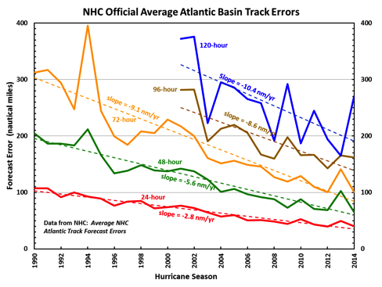
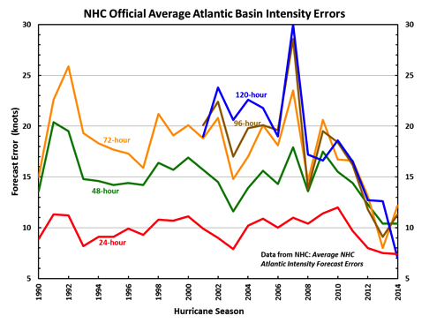
Current State of the Art
Errors cut in half over past 15 yr
10-yr improvement - As accurate at 48 h as we were at 24 h in 2000
24-48 h intensity forecast off by ~1 category
Some intensity gains since 2008, especially >48 h
Notes:
Images from: http://www.nhc.noaa.gov/verification/verify5.shtml

Slide 4
HFIP Successes to date:
HWRF Forecast Improvements
Improvements of the order of 10-15% each year since 2012
Dramatic improvement in first 5 years of HFIP
http://www.emc.ncep.noaa.gov/gc_wmb/vxt/
Notes:
Added 3rd nest in 2012

Slide 5
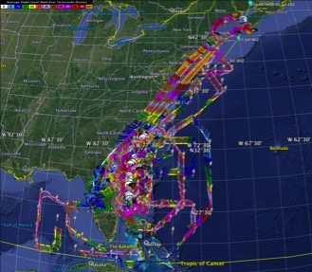

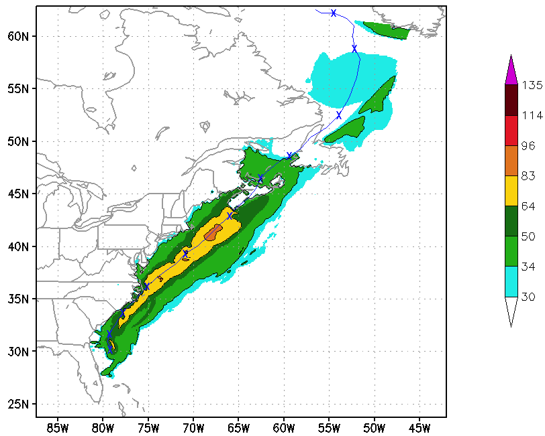
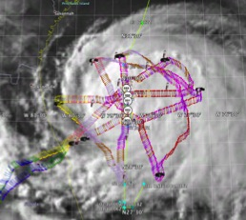
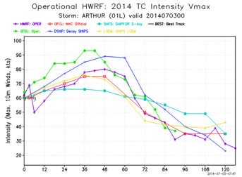
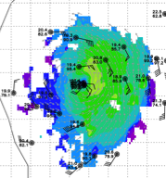
HFIP Successes to date:
Impact of aircraft observations: TDR
5 P-3 Flights
2 July – 5 July 2014
Doppler data transmitted in real-time for assimilation into HWRF
5 P-3 missions from 2-5 July 2014 at 12 h Doppler sampling (HEDAS/GSI) & 3 G-IV missions
Sampled Arthur as a tropical storm to hurricane at landfall in NC, to extra-tropical transition in Nova Scotia
5
Notes:
Map shows flight tracks for all of the NOAA missions (color coded are the flight level winds for the P-3 missions, dropsonde symbols denote G-IV patterns)
Flight track plots courtesy of Tropical Atlantic - http://tropicalatlantic.com/recon/
Model data available at: http://www.emc.ncep.noaa.gov/gc_wmb/vxt/RT_ATLANTIC/ARTHUR01L/

Slide 6
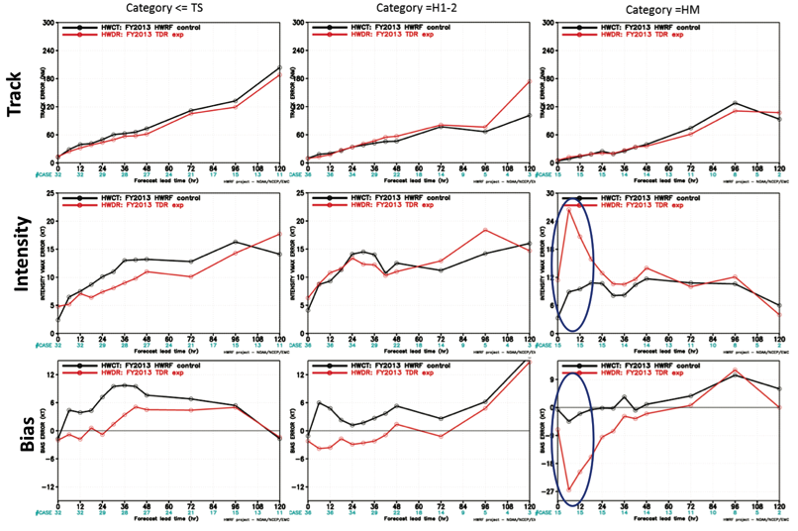
HFIP Successes to date:
Impact of aircraft observations: TDR
32 cases
34 cases
15 cases
Notes:
84 cases in 39 storms over 5 years (2008-2012)
Major issue is with initializing strong storms.

Slide 7
HFIP Priorities 2015-2016
Operational Impact
Demonstrate Basin-HWRF during hurricane season
Demonstrate impact of aircraft data & Doppler Radar (TDR)
Demonstrate multi- & single-model ensembles for Track & Intensity
Research & Development
Develop HWRF GSI hybrid DA - Focus on high resolution inner domains
Improve use of satellite data in TC DA (QOSAP)
Improve use of inner core observations operationally, G-IV TDR, UAS, etc.
Improve HWRF physics using aircraft observations (IFEX, SHOUT)
Develop global physics for high resolution (HIWPP, R2O)
Technical Advancements
Transition HWRF to Basin-NMMB (HIWPP, R2O)

Slide 8
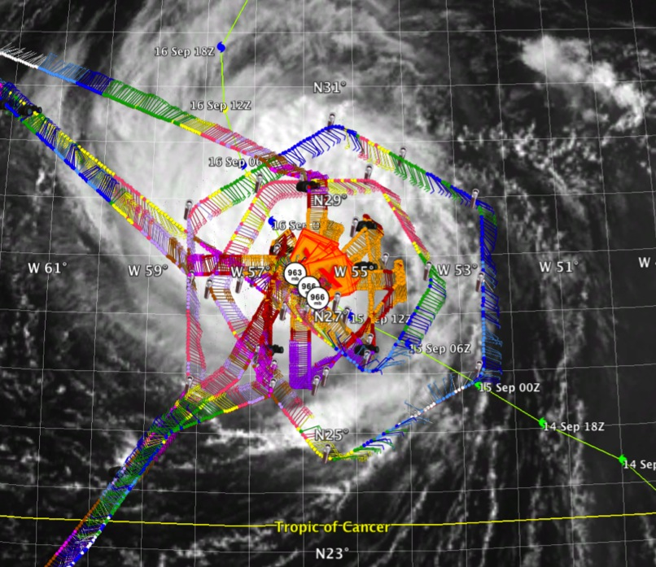
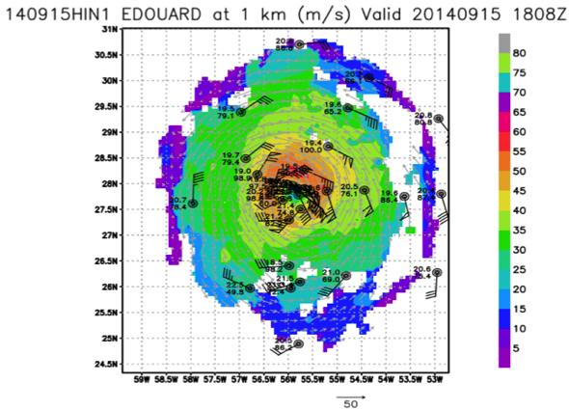
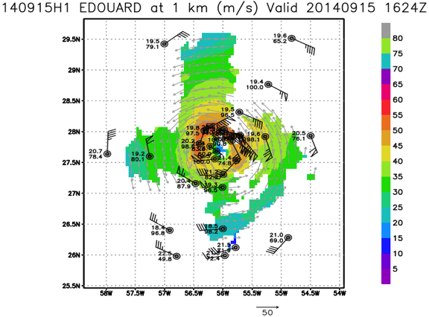
  Develop & refine observing technologies: G-IV TDR
P-3 & G-IV Doppler analysis at 1 km altitude
P-3 Doppler analysis at 1 km altitude
2 P-3 and G-IV flight track in Hurricane Edouard 15 September 2014
8

Slide 9
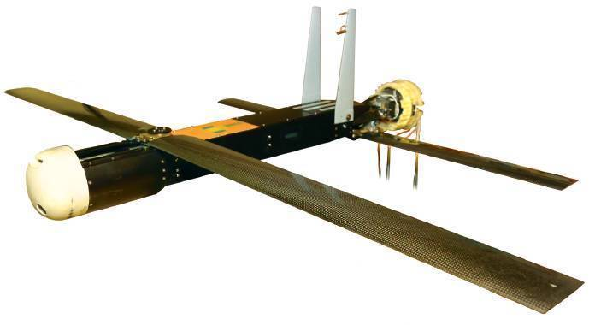
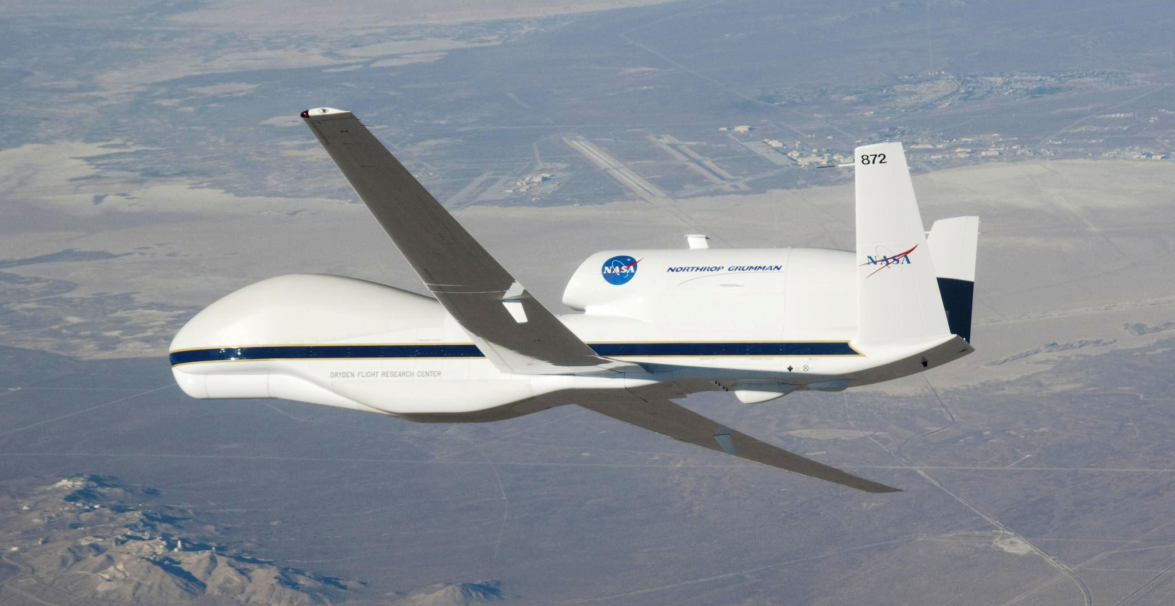
  Develop & refine observing technologies: UAS
2 successful flights of Coyote UAS in Hurricane Edouard in 2014. Plan to fly more storms in 2015 and send data to the National Hurricane Center
4 Global Hawk flights sampled life cycle of Edouard from tropical storm to extra-tropical transition (282 dropsondes deployed during ~58 h over and near storm). SHOUT for 2015 (25 August - 27 September & ~10 missions)
Notes:
NOAA successfully deployed an unmanned aircraft, the Coyote, from a hurricane hunter into the eye of Hurricane Edouard last season, and is expanding the use of this small unmanned aircraft.
Planned flights will measure the regions of strongest winds at low altitudes in hurricanes and send that data in real-time to forecasters at the National Hurricane Center.
NOAA is adding a Doppler wind Lidar on the P-3 aircraft used to collect, process and transmit atmospheric data from within a hurricane .
The Lidar will complement the P-3 tail Doppler radar allowing NOAA to sample the winds inside the hurricane, even within the clear eye, that may be driving hurricane intensity changes.

Slide 10




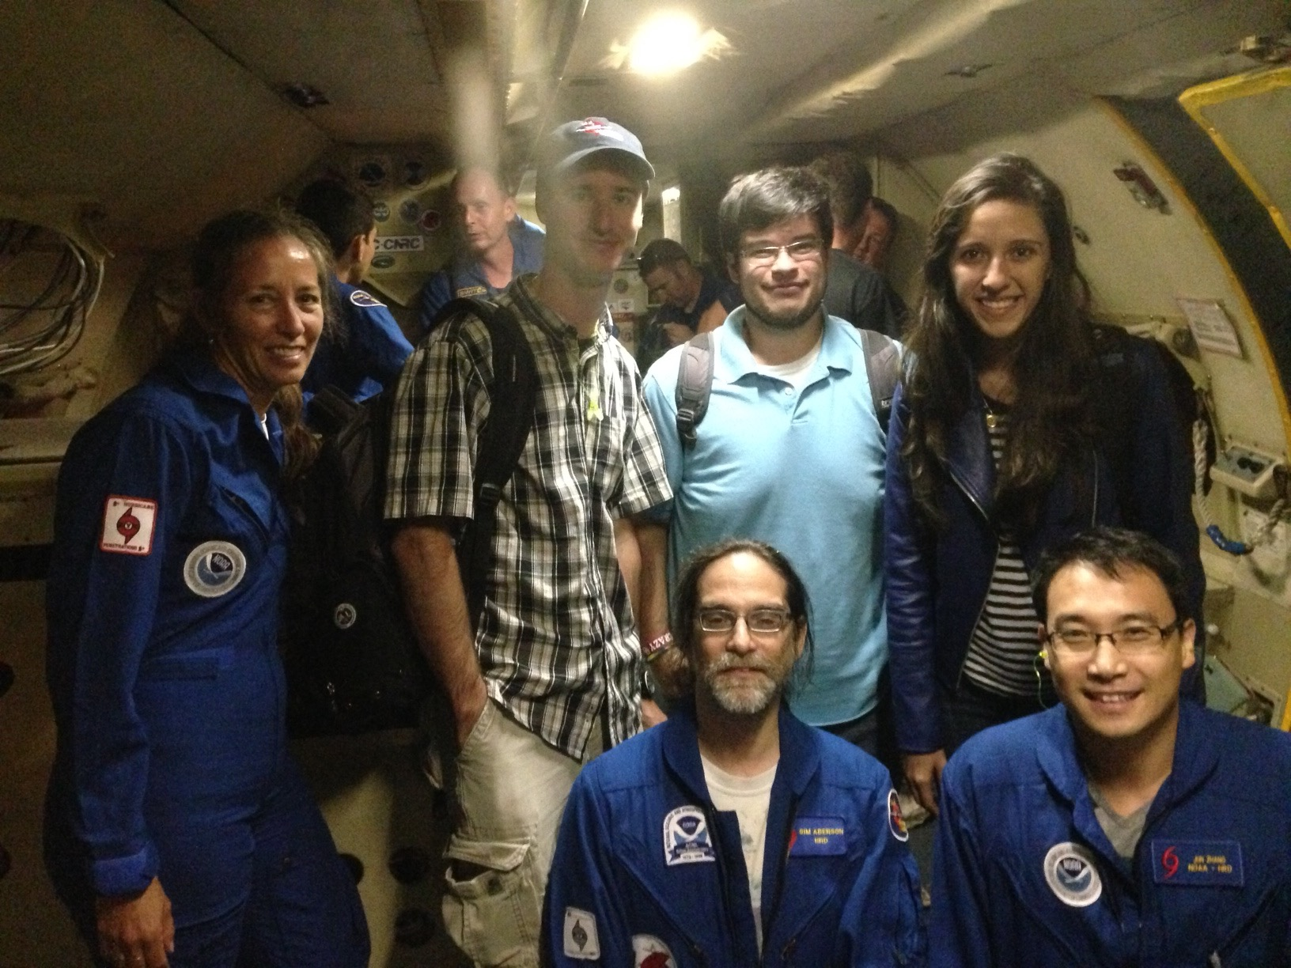
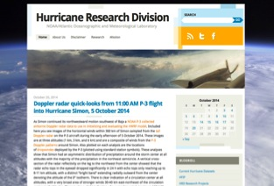
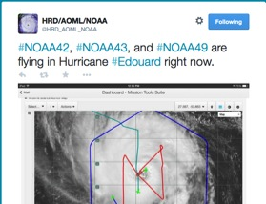
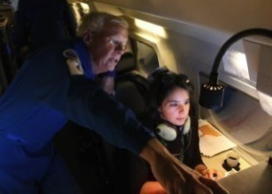
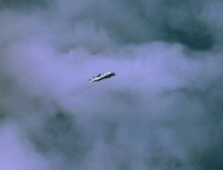
Outreach
Our blog
http://noaahrd.wordpress.com
HRD Web page
http://www.aoml.noaa.gov/hrd
Facebook (3,583 likes)
http://www.facebook.com/noaahrd
Twitter (13,400 followers)
http://twitter.com/#!/HRD_AOML_NOAA
Tweets from the eye
Visiting scientist program
10
Notes:
10
Since 15 May 2010 HRD has maintained our Blog on Wordpress which supports a RSS feed, Twitter, and Facebook accounts.
Wordpress Stats: 1,201 posts (18-19 posts per month), 255 comments. Most posts are during the hurricane season where we post our updates on field activities whenever we are operating.
Wordpress Blog Views by Month and Year
Months and Years
Jan Feb Mar Apr May Jun Jul Aug Sep Oct Nov Dec Total
2010 152 753 1,790 3,463 5,521 2,047 1,479 1,019 16,224
2011 1,028 927 1,152 1,143 1,417 1,495 1,959 7,195 2,588 1,885 1,659 1,231 23,679
2012 1,139 1,179 1,305 1,456 1,754 1,855 1,929 14,433 4,537 5,302 3,179 2,770 40,838
2013 3,702 1,880 1,687 1,323 2,264 1,736 2,622 4,619 7,276 1,369 1,167 1,292 30,937
2014 1,591 1,493 1,456 1,607 1,739 2,389 3,768 4,748 4,591 3,315 2,268 2,428 31,393
2015 1,913 1,880 1,863 2,284 2,403 2,732 3,230 825 ` 17,130
Since late September 2013 HRD has tracked web pages using Google Analytics:
HRD Web site Stats: Since late September 2013 a total of 188,460 visits or 47,000 visits per month with 383,873 page views
Twitter Stats: 1,743 tweets of which 1,201 are directly from the Wordpress Blog and the rest from “Tweets from the Eye” which we do directly to Twitter from the NOAA aircraft during missions. “Tweets from the Eye” are a very effective and popular outreach tool helping educate the Public to what NOAA does.

Slide 11
Questions?

