Slide 1
Latest Developments in NOAA’s Hurricane Forecast Improvement Project
Frank Marks NOAA/AOML Hurricane Research Division
17 July 2013
Notes:
Hurricane Earl 2 September 2010

Slide 2
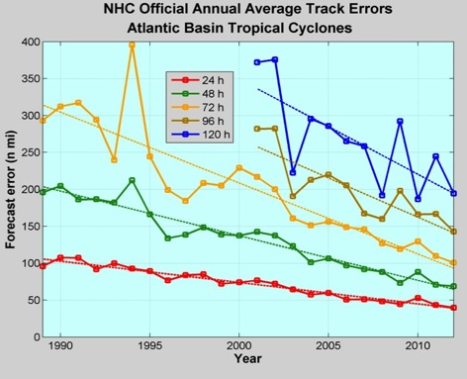
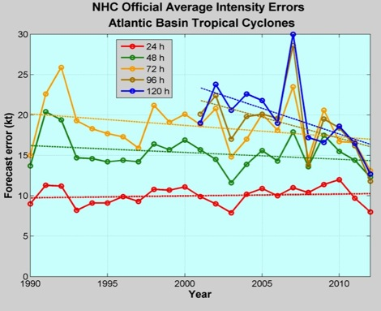
Good – track forecast improvements
Current Capabilities
Not so Good – Modest intensity gains
Some intensity gains since 2008, especially at >48 h
Errors cut in half over past 15 years
10-year improvement - As accurate at 48 hours as we were at 24 hours in 2000
24-48h intensity forecast off by 1 category
Off by 2 categories perhaps 5-10% of time
http://www.nhc.noaa.gov/verification/verify5.shtml
Notes:
Images from: http://www.nhc.noaa.gov/verification/verify5.shtml

Slide 3
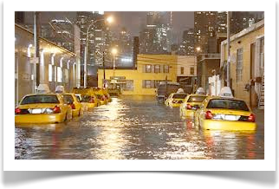
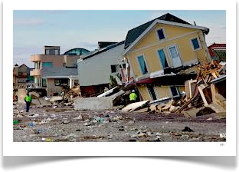
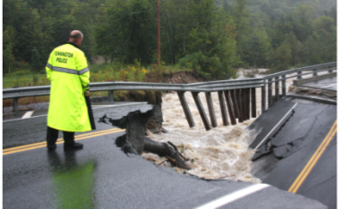
Improvements still needed!
NWS mission is to fulfill this commitment through building a Weather Ready Nation.
NWS contributes to hazard resiliency by continually assessing and improving its services to Nation.
Hurricane Irene (2011):
41 deaths
$7 to $10 Billion damage
Major infrastructure losses
Power lost to 8 million
Hurricane Sandy (2012):
159 (72 along US East Coast) deaths
~$50 Billion damage
Major infrastructure losses
Power lost to 8.5 million
Woodford, Vt.
Austen Danforth/Bennington Banner/AP
http://www.nhc.noaa.gov/data/tcr/AL182012_Sandy.pdf
Notes:
http://www.nws.noaa.gov/om/assessments/pdfs/Irene2012.pdf
http://www.nhc.noaa.gov/data/tcr/AL182012_Sandy.pdf

Slide 4
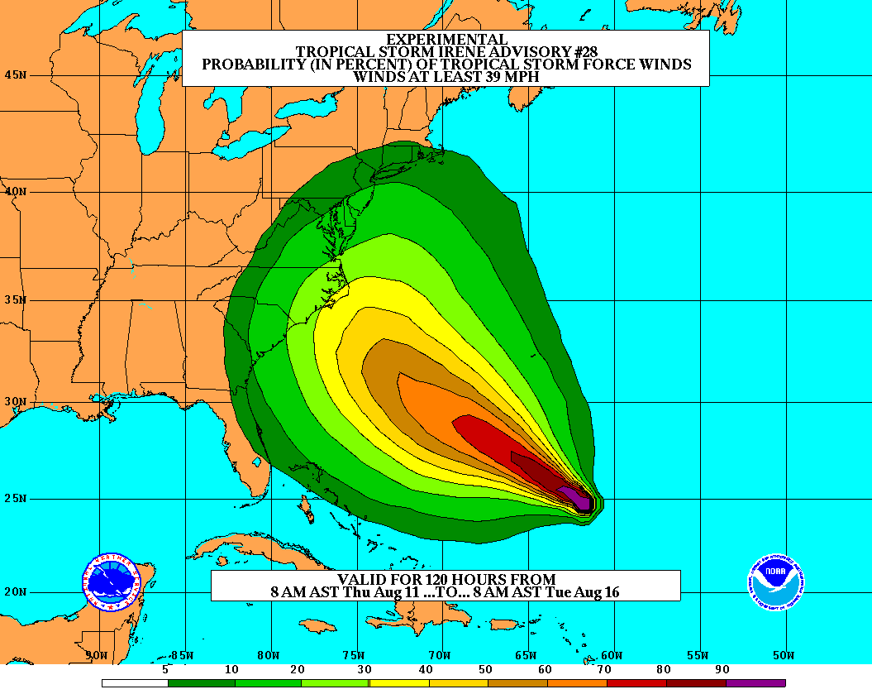
Vision
Organize hurricane community to dramatically improve numerical forecast guidance to NHC in 5-10 years
Goals
Improve Forecast Accuracy
Hurricane impact areas (track) – 50% in 10 years
Severity (intensity) – 50% in 10 years
Rapid intensity change detection
Extend forecast reliability out to 7 days
Quantify, bound and reduce forecast uncertainty to enable risk management decisions
http://www.hfip.org/
Notes:
http://www.nrc.noaa.gov/HFIPDraftPlan.html
HFIP Team
Frank Marks, research lead
Ed Rappaport, operations lead
Fred Toepfer, project manager
Robert Gall, development manager
Mark DeMaria
Chris Fairall
Jim McFadden
Daniel Melendez
HFIP executieve oversight board:
OAR AA/Robert Detrick, co-chair
NWS AA (acting)/Laura Furgione, co-chair
NCEP/Louis Uccellini,
NHC/Rick Knabb,
NESDIS/Mark DeMaria,
NOS/Jesse Feyen,
AOML/Bob Atlas
PPI/Paul Doremus
NMFS/Bonnie Ponwith,
NOS/Liz Scheffler,
NMAO-PM Aircraft/Mike Devany
OFCM/Sam Williamson
Executive Secretariat: OAR/Brian Orndorff and NWS/Nasheema Lett
http://www.hfip.org/

Slide 5
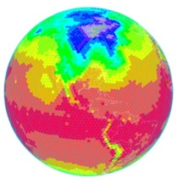
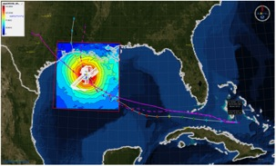
HFIP Activities
Traditional Hurricane Research Activities:
Observations, analysis, database, & instrument R&D (IFEX)
Statistical-dynamical model development
Advances in operational models (Stream 1)
New HFIP Research Thrusts:
Experimental global and regional hurricane model development (Stream 2)
Data assimilation techniques and observing system strategy analysis development (Stream 1 & 2)
Model evaluation tool development (Stream 1.5)
Application and tool development for forecasters
D1
D2
Partnership: NCEP, AOC, AOML, ESRL, GFDL, DTC, USWRP, NESDIS/STAR
http://www.hfip.org/documents/
Notes:
http://www.hfip.org/documents/
Two Stream Approach to HFIP developments:
Stream 1– Operational Transition and Implementation
Stream 2 – Advanced Technology Demonstration
Unconstrained by near-term availability of operational computing
Uses both NOAA’s and computing resources from major supercomputing centers for testing and evaluation.
Emphasis is on high resolution global and regional models run as ensembles
Real-time or near real time runs during hurricane season
Stream 1.5 (JHT-like)
NHC Forecaster Defined.
Subset of Stream 2 that forecasters see as particularly promising or provides demonstrated capability
Will be configured to run in real-time and products made available to NHC.

Slide 6
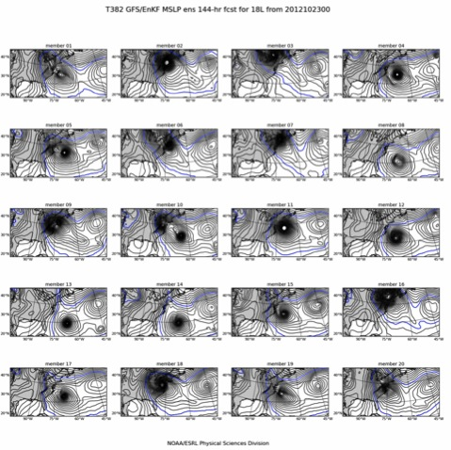
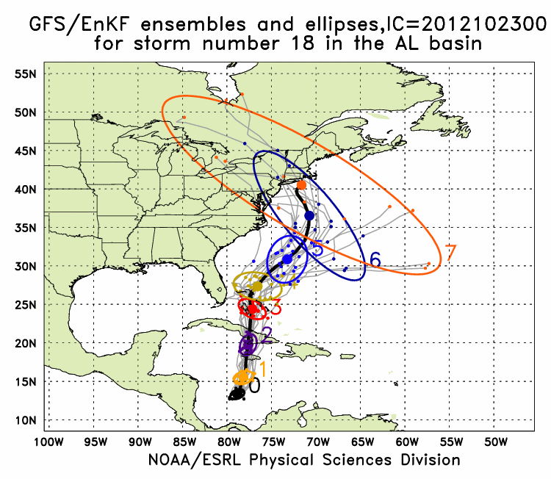
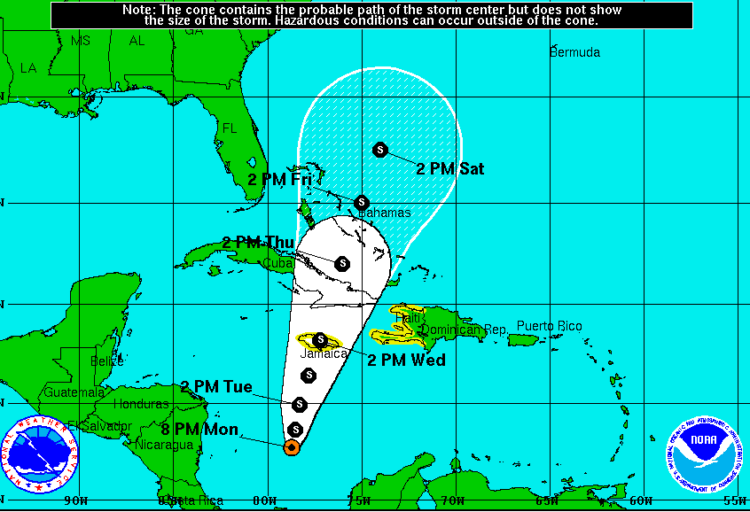
Global Model Development – GFS/EnKF
Sandy (18L) – init 00Z 23 October
GFS/EnKF T382 20 member ensemble
7-Day forecast – 20 member ensemble
Observed
http://www.esrl.noaa.gov/psd/forecasts/gfsenkf/ens/
Global Model Team - Tom Hamill & Jeff Whitaker (ESRL)
Notes:
Model data available at: http://www.esrl.noaa.gov/psd/forecasts/gfsenkf/ens/
Global Ensembles:
80-member T254 GFS ensembles cycled every 6-h continuously from 1 August to current time
Look at 20 members of the 80 member ensemble
Left panels shows ellipse plot of 20 members at each forecast time – ellipse shape shows the spread along/across track
Right panel show surface pressure post stamp images of 20 members

Slide 7
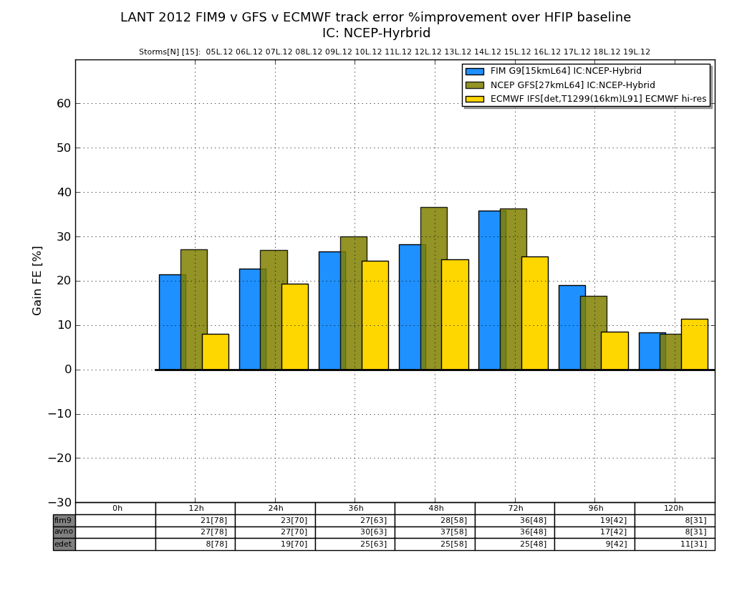
HFIP Successes to date:
Operational GFS Track Forecasts
2012 Track Error (% Improvement over HFIP baseline)

Slide 8
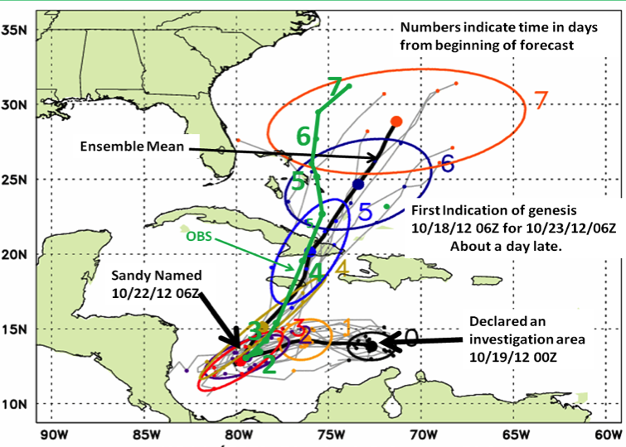
Global Model Development – Ensemble – Genesis
Global Model Team - Tom Hamill & Jeff Whitaker (ESRL)
Notes:
In the case of Irene new tools to forecast genesis developed by HFIP using the HFIP global model ensembles from GFS/EnKF (30 members) and FIM (10 members) were able to detect and track the system that formed into Irene 5 days before it was named by NHC and 2 days before NHC declared it an INVEST area
Thin black lines are the disturbance tracks from each of the ensemble members, the small black dots the location of each of the ensemble members at 24 h intervals after the initial time, and the colored ellipses enclose 75% of the ensemble positions. Note that the ellipses elongate along track (reflecting speed uncertainty) in the early forecasts, and elongate perpendicular to the track (reflecting uncertainty in the storm turn to the N at the later forecast times. At day 3 & 4 when the storm was named the uncertainty is the least.
The solid green line is the observed Best Track from NHC starting when the storm was named.
Model data available at: http://www.esrl.noaa.gov/psd/forecasts/gfsenkf/ens/

Slide 9
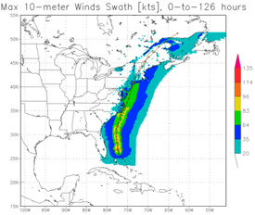
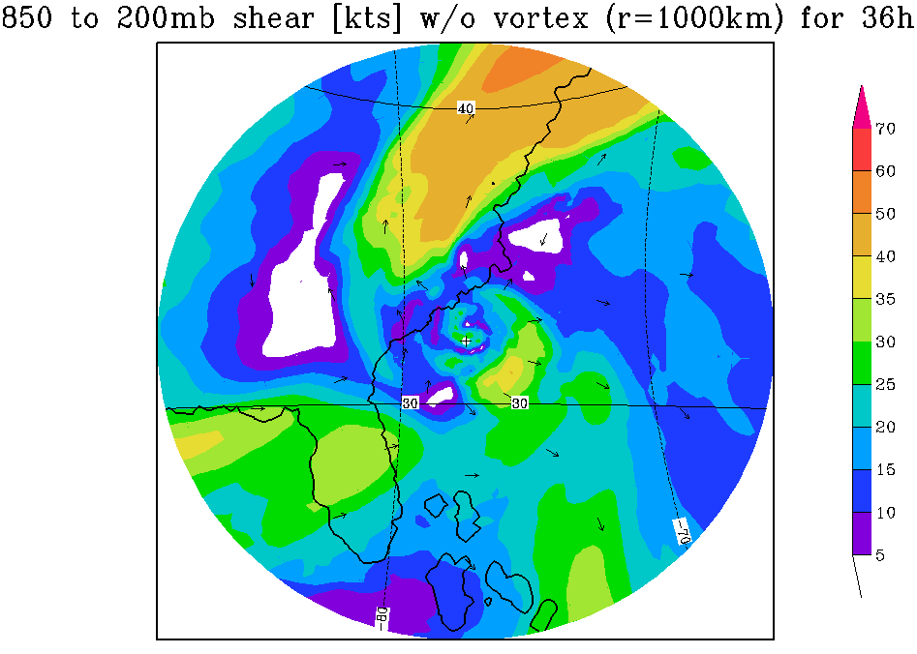
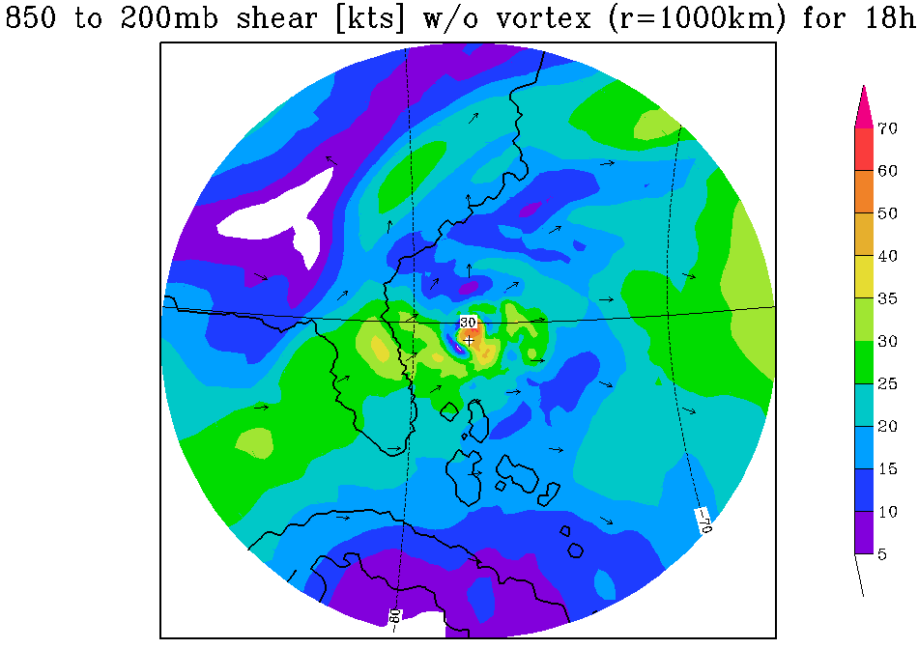
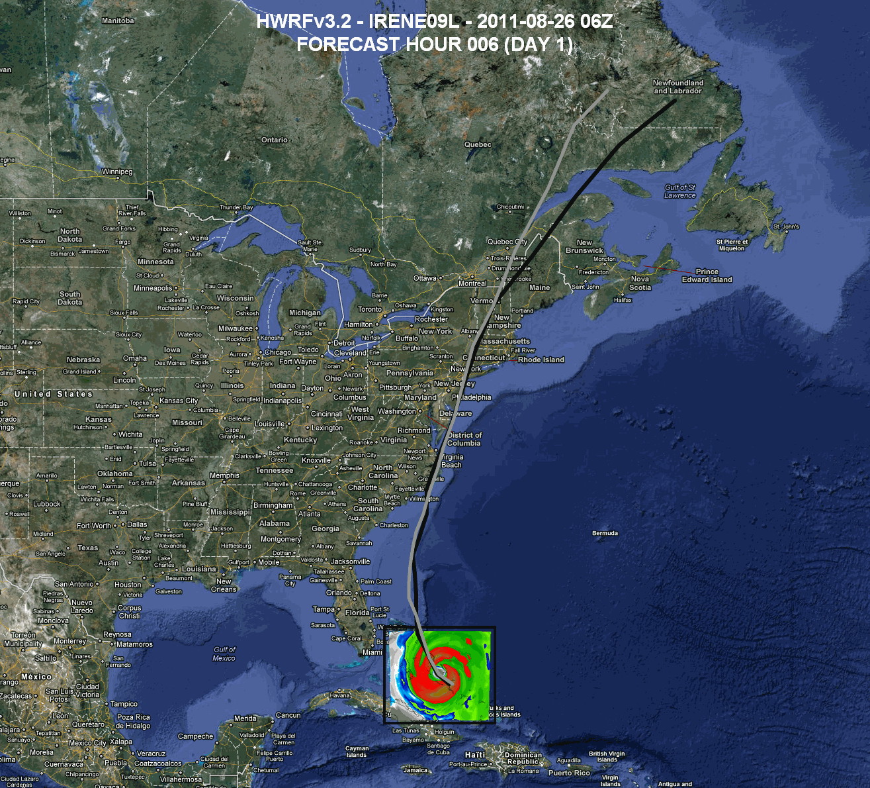
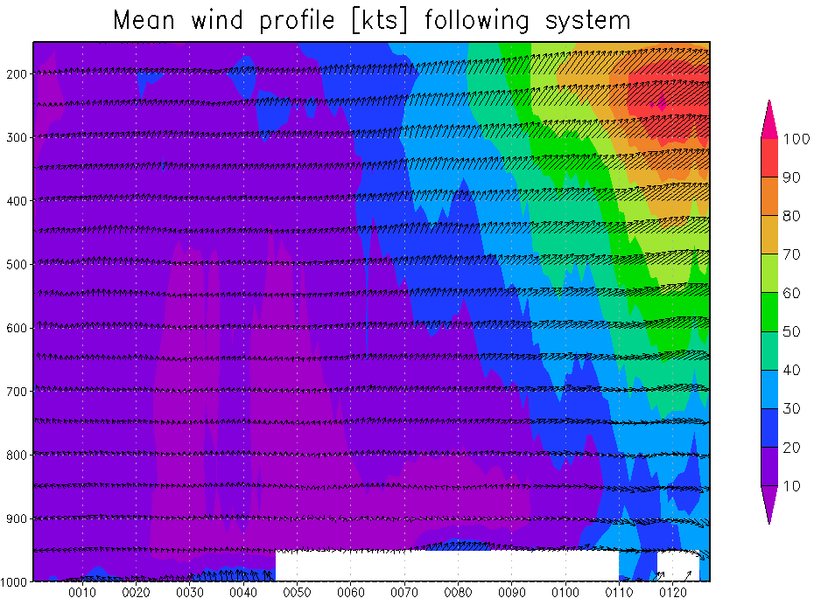
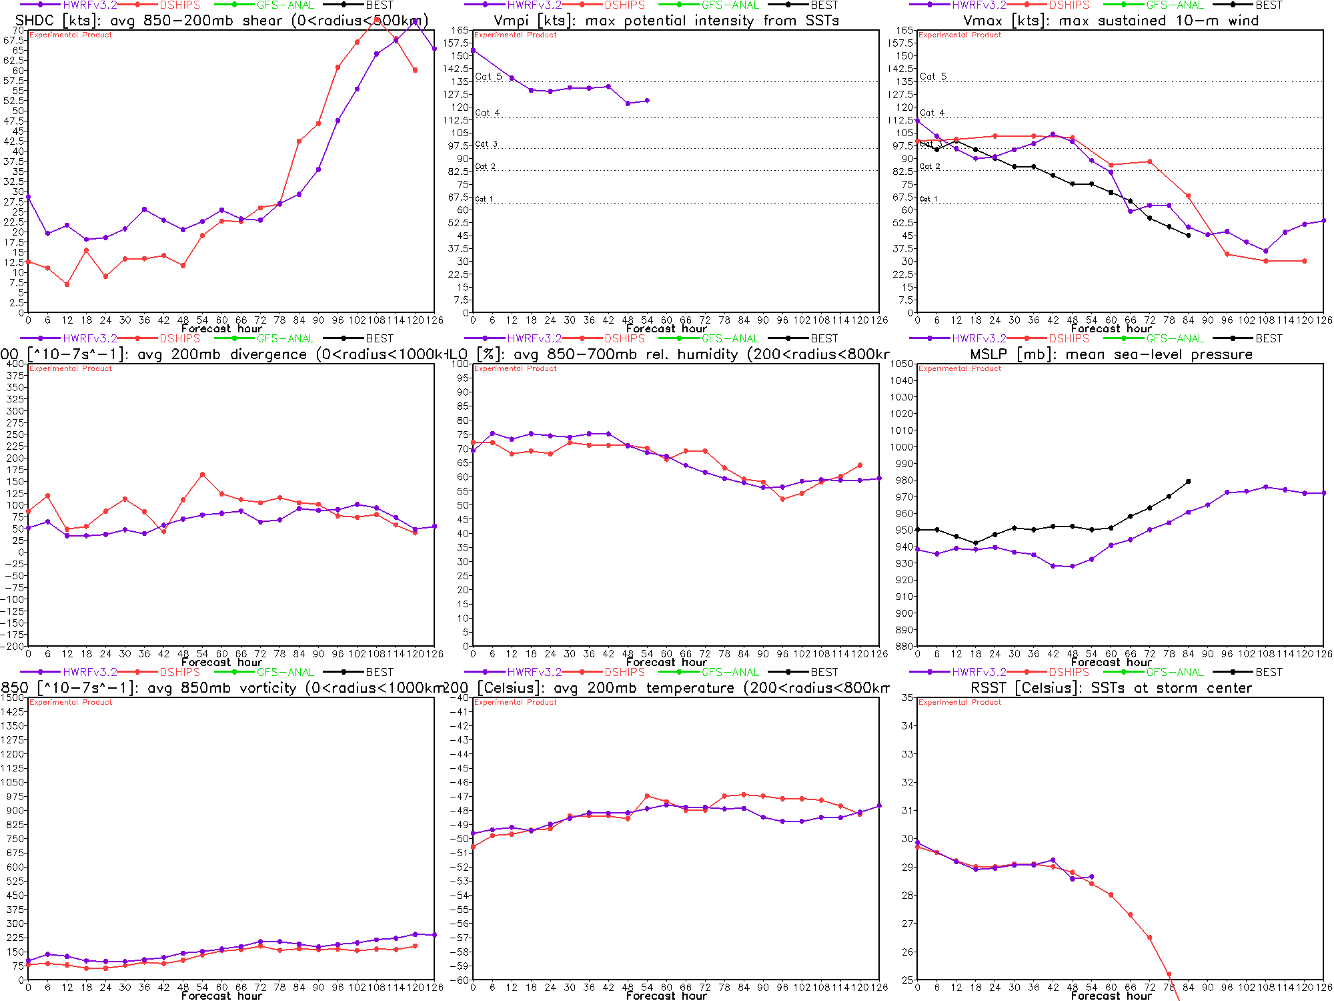
Regional Model Development: HWRF
http://www.emc.ncep.noaa.gov/gc_wmb/vxt/
HFIP operational (27/9/3 km)
Advanced nesting algorithm providing resolutions to 3 km
Viable operational pathway & potential transition to operations
Pathway to Improved structure and intensity predictions*
Extension of initialization algorithm down to 3 km resolution
19 main products; e.g.,
Synthetic microwave imagery
SHIPS predictors
Shear and Steering
Time-height cross-sections
Swaths (wind and rainfall)
https://storm.aoml.noaa.gov/realtime
HWRF Model Team - Gopal, X. Zhang (HRD), V. Tallapragada, S. Trahan (EMC)
Notes:
Demo 2011 season; Not only we have improved the products but also added a suite of NOAA HWRF systems at different configurations.
Example of Hurricane Dora 2004 (initialized at 18Z on 18 July 2011)
Top left: 10-m wind swath for 126 h forecast
Bottom left: time-height cross section of mean wind over 3 km nest centered on storm
Top right: storm-relative vertical wind shear on 3-km nest for 24 h and 30 h forecast – note decreasing NE shear over center
Bottom right: SHIPS type predictors for regional model
Overlay: moving 3-km inner nest showing 10-m wind evolution
Model products available at: http://storm.aoml.noaa.gov/realtime

Slide 10
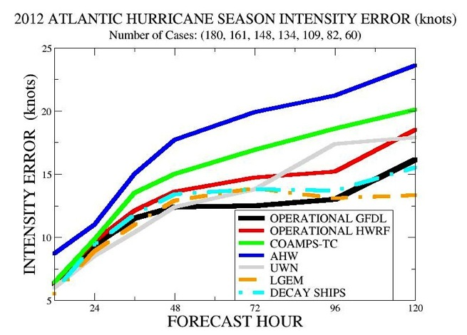
Regional Model Development: HWRF
2012 HWRF
HWRF Model Team - Gopal, X. Zhang (HRD), V. Tallapragada, S. Trahan (EMC)
Notes:
• As the new models are developed to deal with intensity and structure we need to develop new metrics for model and forecast evaluation beyond the traditional minimum central pressure and peak surface wind. The NWS metric of the peak 1-min sustained surface wind anywhere is not as meaningful anymore. A model or forecast could be correct on those parameters for the wrong reason. Customers want to know more about the impacts to expect and that means structure and size matter. Proposed new metrics are structure (radii of 35, 50, 65 kt, and radius of maximum wind in different quadrants) and rapid intensification (FAR vs POD). They need to be tested and improved with data as well as model output.

Slide 11
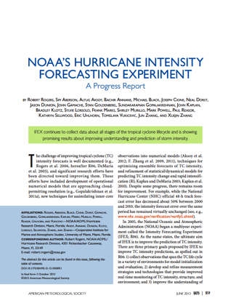
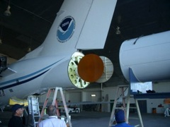
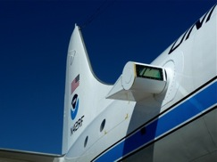
Improved Use of Observations: Intensity Forecast Experiment (IFEX)
In-situ
Wind, press., temp.
Expendables
Dropsondes
AXBT, AXCP, buoy
Remote Sensors
Doppler Radar
SFMR/HIRAD
WSRA
Scatterometer/profiler
UAS - LALE
Improve prediction of TC intensity change by:
collecting observations through the TC life cycle
developing and refining measurement technologies
improving understanding of physical processes important in TC intensity change
NASA Global Hawk
G-IV Tail Doppler Radar
ONR DWL
R. Rogers, S. Murillo, P. Reasor (AOML/HRD)
Notes:
UR image depicts dropsonde profiles in eyewall of Hurricane Guillermo (1997)
LR image is Doppler Wind Lidar profiles from TCS-08
See IFEX paper (Rogers et al 2006): http://dx.doi.org/10.1175/BAMS-87-11-1523
HRD IFEX website: http://www.aoml.noaa.gov/hrd/HFP2011/index.html

Slide 12
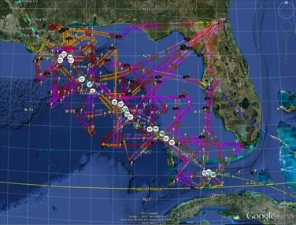
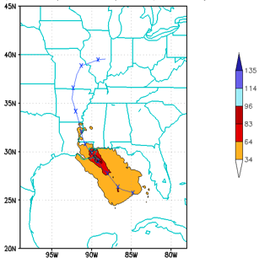
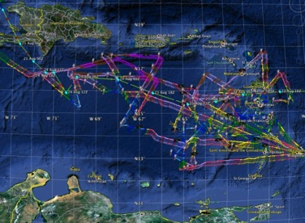
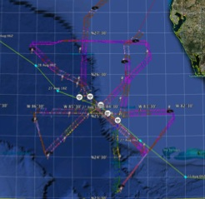
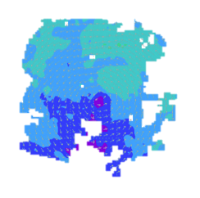
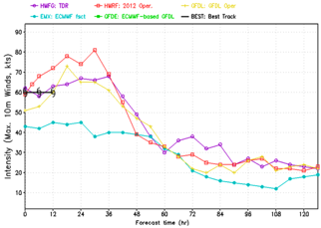
Improved Models & Data: IFEX 2012: Isaac
4 P-3 Flights
22 August – 24 August 2011
HWRF/GSI
20120827 12UTC
Doppler data transmitted in real-time for assimilation into HWRF
5 P-3 Flights
26 August – 28 August 2011
4 missions from 22-24 Aug 2012 and 5 missions from 26-28 Aug 2012 at 12 h Doppler sampling (HEDAS/GSI) & 6 G-IV missions
Sampled Isaac as a tropical storm to hurricane at landfall
HWRF/GSI
20120827 12UTC
Aberson, Aksoy, Gamache, Gopal (AOML/HRD), Tong (EMC)
Notes:
Map shows flight tracks for all of the NOAA missions (color coded are the flight level winds for the P-3 missions, dropsonde symbols denote G-IV patterns)
Flight track plots courtesy of Tropical Atlantic - http://tropicalatlantic.com/recon/
Model data available at: http://storm.aoml.noaa.gov/realtime

Slide 13
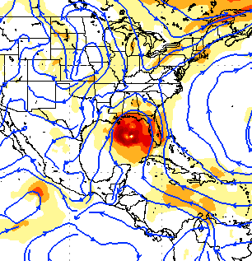
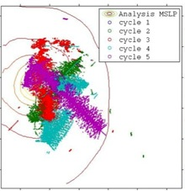
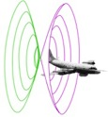
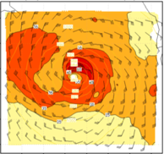
Improved Models & Data: Assimilation of data into models
Synergy of high resolution forecast and airborne observations
P-3 and G-IV QC Doppler observations
Data assimilation
Improving initial condition in storm core region
Improving high resolution regional forecast
Wind intensity at 10 m
Hurricane Isaac (2012)
F. Zhang (PSU), Aberson, Aksoy, Gamache, Gopal (AOML/HRD)
Notes:
See papers: Zhang et al (2011) - http://www.agu.org/pubs/crossref/2011/2011GL048469.shtml
Aksoy et al (2012) - http://dx.doi.org/10.1175/MWR-D-11-00212.1

Slide 14
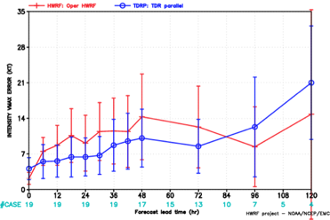
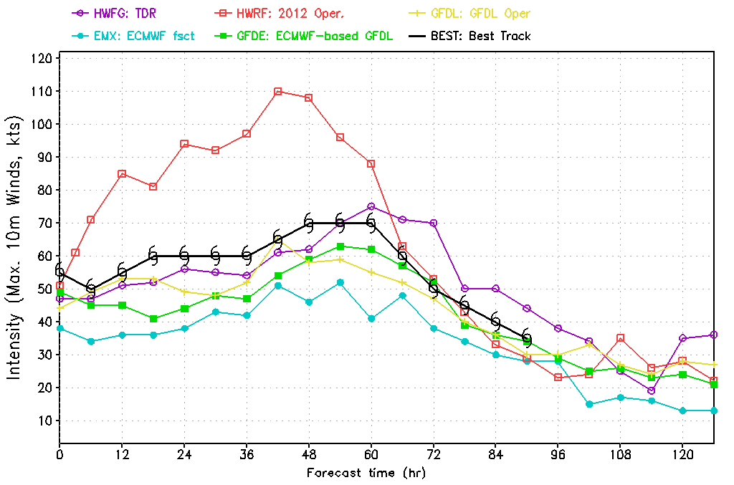
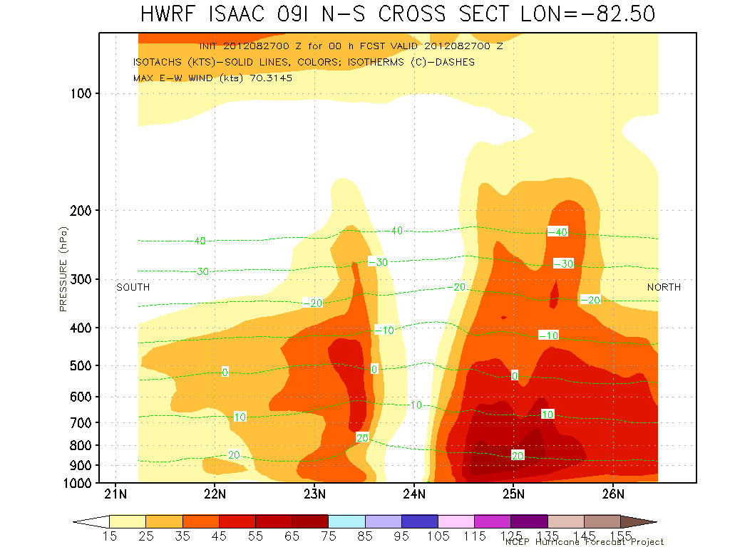
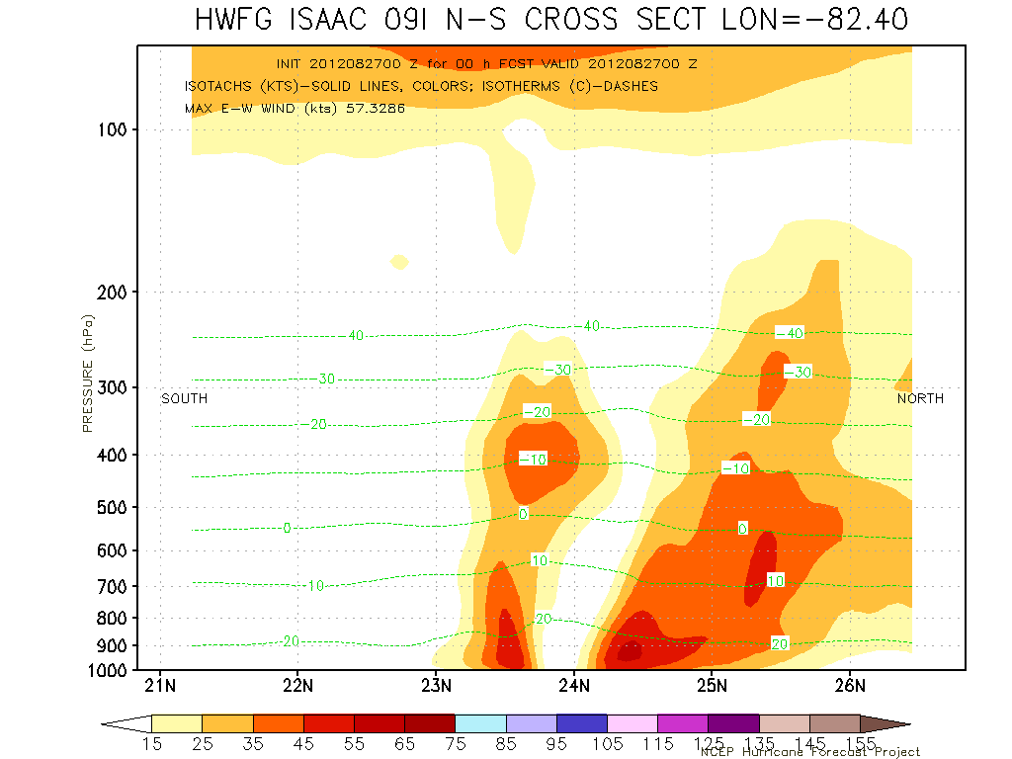
Improved Models & Data: Impact of airborne Doppler radar
Intensity Errors
Isaac (2013)
OPER HWRF
OPER HWRF
HWRG TDR
HWRG TDR
Vertical cross section at initial time
S
No Doppler
N
S
With Doppler
N
Isaac (2013)
HWRF Model Team - V. Tallapragada, M. Tong, S. Trahan (EMC)

Slide 15
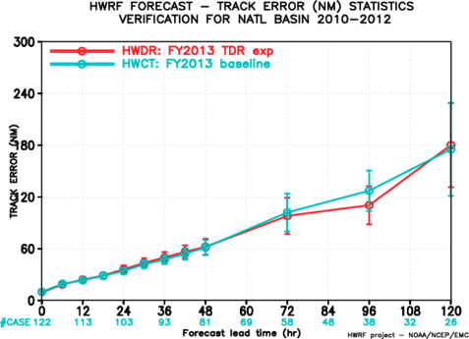
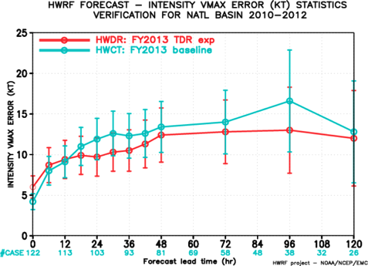
Improved Models & Data: What’s New? – TDR data impact
Results from TDR DA Experiments (2010-2012)
Intensity errors
Track errors
-4% 18% 14% 9% 9% 21% 6%
Assimilation of TDR positively improved intensity forecasts by about 10-20%
HWRF Model Team - V. Tallapragada, S. Trahan, Y. Kwon (EMC)

Slide 16
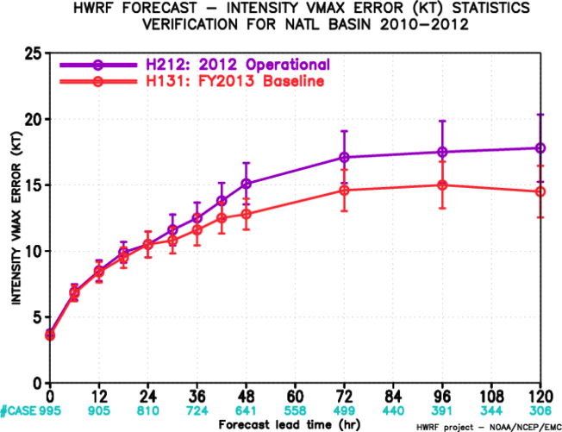
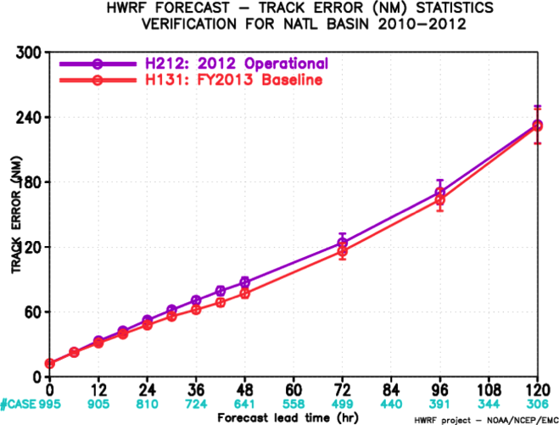
Improved Models & Data: What’s New - HWRF 2013
2010-2012 Atlantic Track Verification
>20% improvement
~10% improvement
Intensity errors
Track errors
HWRF Model Team - V. Tallapragada, S. Trahan, Y. Kwon (EMC)

Slide 17
Regional Model Development: What’s Next? - HWRF Basin-Scale
(http://storm.aoml.noaa.gov/hwrfxprojects/?projectName=BASIN)
HWRF Model Team - Gopal, X. Zhang, T. Quirino (HRD), V. Tallapragada (EMC)
Notes:
Earl and Danielle forecast initialized at 0000Z 27 August 2011
Large “basin-scale” domain is at 27 km resolution with inner nest at 9-km using operational HWRF as the basis. Outer domain covers the EPAC and ATL TC development regions with one domain which remains fixed from cycle to cycle.
17

Slide 18
HFIP Success to Date
HFIP focused research efforts within NOAA & interagency partners
HFIP defined solution to transition research into operations with Stream 1.5 products available to NHC forecasters in real-time
Transitioned global hybrid DA system and 3-km HWRF into operations this season
HFIP making significant progress – 5-year goals within reach
Global ensembles providing 20% improvement in track guidance
Improved model initialization and higher resolution models, along with inner core data shows significant (20-40%) improvement in intensity
3-5 day lead-time hurricane genesis product
http://www.hfip.org/documents/reports2.php
Notes:
http://www.hfip.org/documents/reports2.php

Slide 19
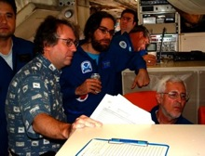
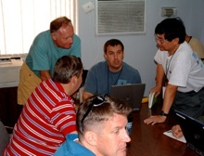
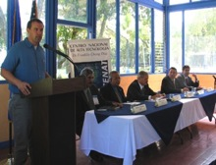
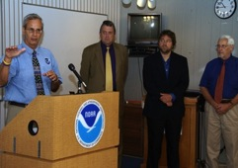
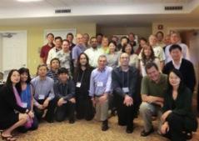
HFIP Keys to Success
Partnership: NOAA Research working closely with:
NOAA Operations (EMC, NHC, AOC)
Federal & Academic Partners (NASA, NCAR, NRL, NSF, ONR)
More integrated use & support of Testbeds (e.g., JHT, DTC, JCSDA)
Blend traditional approach and HFIP (applied) research activities
Manpower (diversity) to evaluate model performance with hurricane data sets is a critical need
CBLAST
IFEX/RAINEX
IFEX/TCSP
IFEX/PREDICT/GRIP
Hybrid-DA Workshop

Slide 20
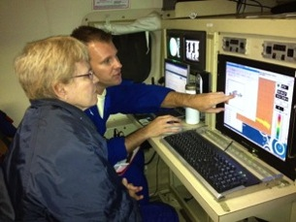
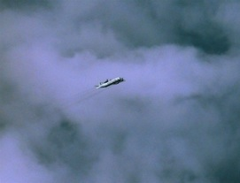
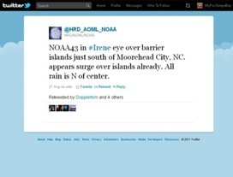
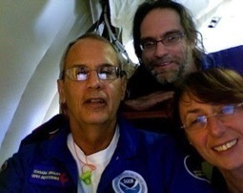
Outreach
Our blog
http://noaahrd.wordpress.com
HRD Web page
http://www.aoml.noaa.gov/hrd
Facebook
http://www.facebook.com/noaahrd
Twitter
http://twitter.com/#!/HRD_AOML_NOAA
Tweets from the eye
Tweets from the eye
Visiting scientist program
Visiting scientist program

Slide 21
Questions?

